Slide 1
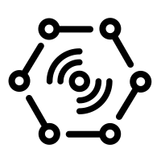

Business Integration
(Time Series Insights)
Wind Farm (Wind Farm Dashboard App )
Send data from devices to cloud (JSON telemetry data)
Wind Farm (Wind Farm Dashboard App )
Stream Processing (Stream Analytics)
Cloud Gateway
(IoT Hub)
CWF-001 to CWF-010
Warm Path Storage
(Cosmos DB)
Business Integration
(Power BI)
Things
Insights

Slide 2
Why was the subsystem chosen?
Wind Farm Simulator: To simulate 10 devices which send the needed data very fast.
IoT Hub: Gather all Data at one point for futher processing.
Azure Time Series Hub Event Source: Connect Times Series Insights with the IoT Hub
Azure Time Series Insights: Analysis & presentation of near real-time data
Azure Stream Analytics: Process and redirect incoming data from the Wind Farm.
Azure Cosmos DB: Device telemetry data -> long-term storage for analysis.
Power BI: Analysis & presentation of warm-stored data (Cosmos DB)

