Slide 1
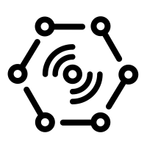

Business Integration
(Time Series Insights)
Wind Farm (Wind Farm Dashboard App )
Send data from devices to cloud (JSON telemetry data)
Wind Farm (Wind Farm Dashboard App )
Stream Processing (Stream Analytics)
Cloud Gateway
(IoT Hub)
Warm Path Storage
(Cosmos DB)
Business Integration
(Power BI)
Things
Insights

