Slide 1
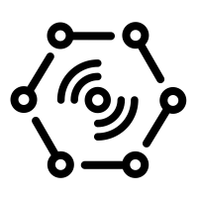


Send device twin to gateway
Send data from device to cloud (JSON telemetry data)
Stream Processing (Stream Analytics)
Weather
Station
(IoT Device)
Cloud Gateway
(IoT Hub)
Send Wind Speed
Device Twin
Update
(Function App)
Send Data from cloud to device (JSON Device Twin)
Store Data
Cold Path
Storage
(Data Lake Store)
Calculate Averange
(Data Lake Analytics)
Things
Insights
Actions

