Slide 1
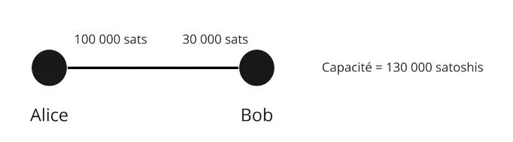
Capacity

Slide 2
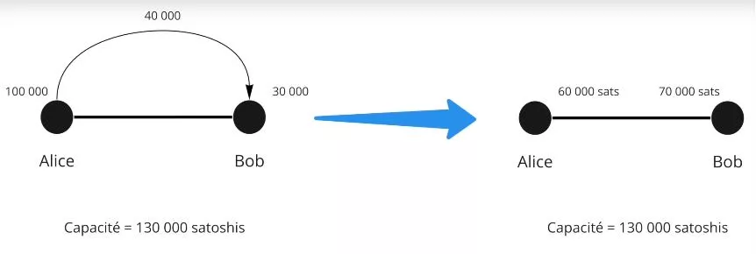
Capacity
Capacity

Slide 3
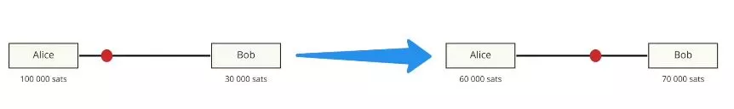

Slide 4
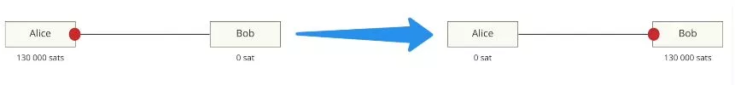

Slide 5
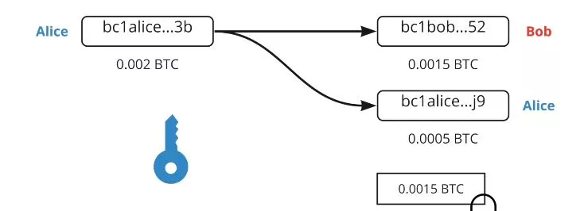

Slide 6
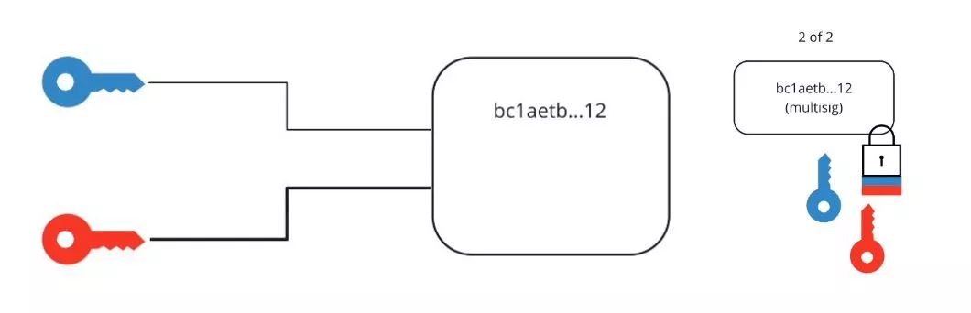

Slide 7
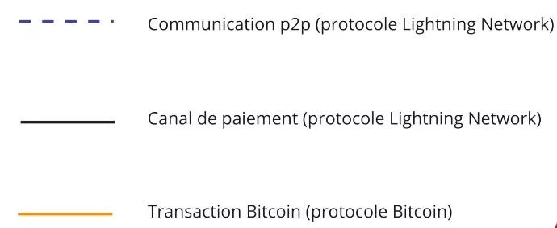
P2P communication (Lightning Network Protocol)
Payment channel (Lightning Network Protocol)
Bitcoin transaction (Bitcoin protocol)

Slide 8
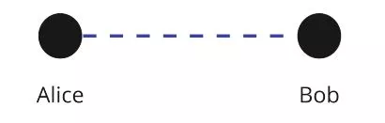

Slide 9
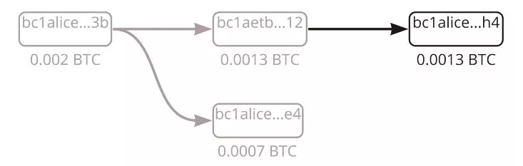

Slide 10
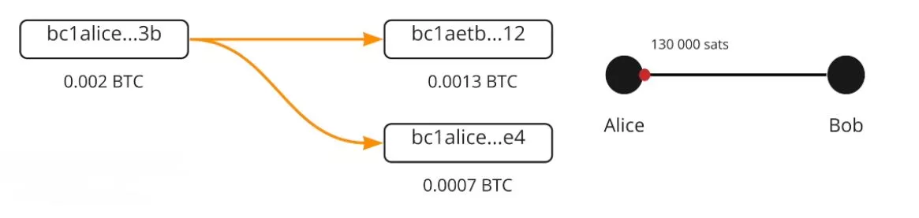

Slide 11
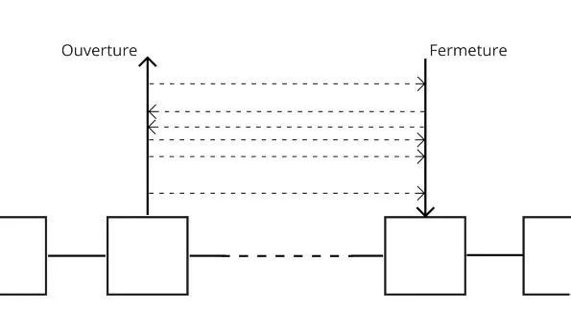
Opening
Closing

Slide 12
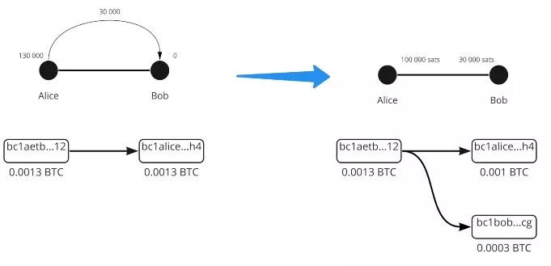

Slide 13
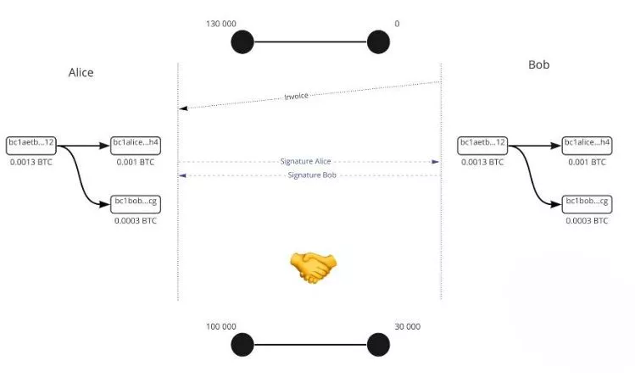
invoice
Alice’s signature
Bob’s signature

Slide 14
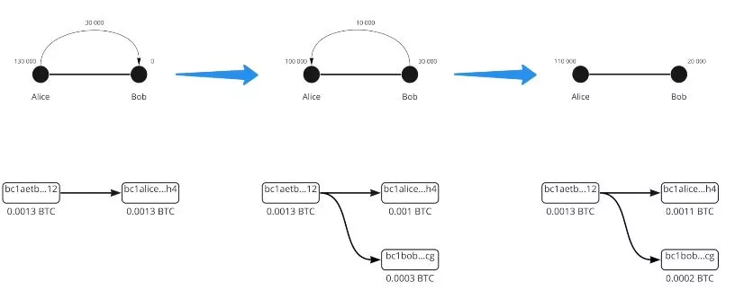

Slide 15
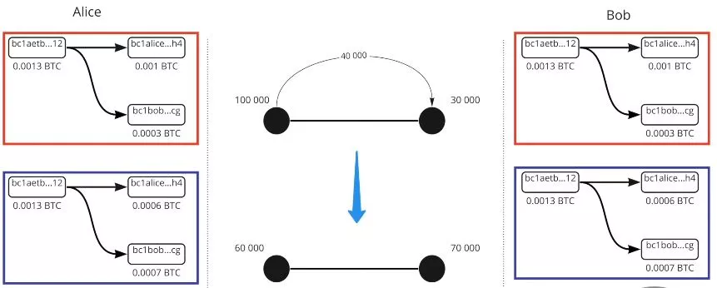

Slide 16
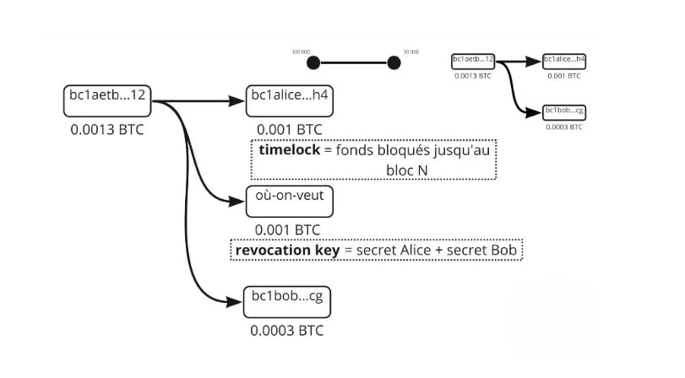
Timelock
Funds blocked until
Block N
Where we want
revocation key
Alice’s secret + Bob’s secret

Slide 17
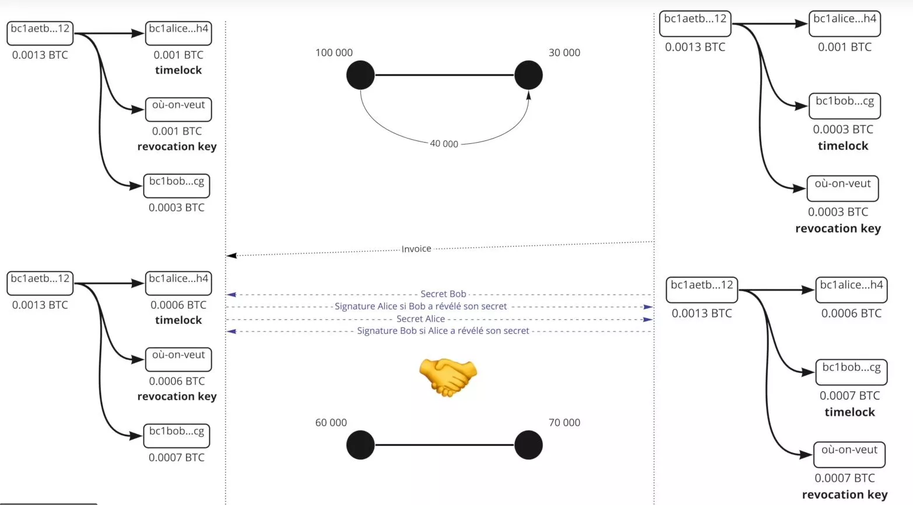
Timelock
Where we want
revocation key
Timelock
revocation key
invoice
Bob’s secret
Alice’s signature if Bob revealed his secret
Timelock
Alice’s secret
Bob’s signature if Alice revealed his secret
revocation key
Timelock
Where we want
revocation key

Slide 18
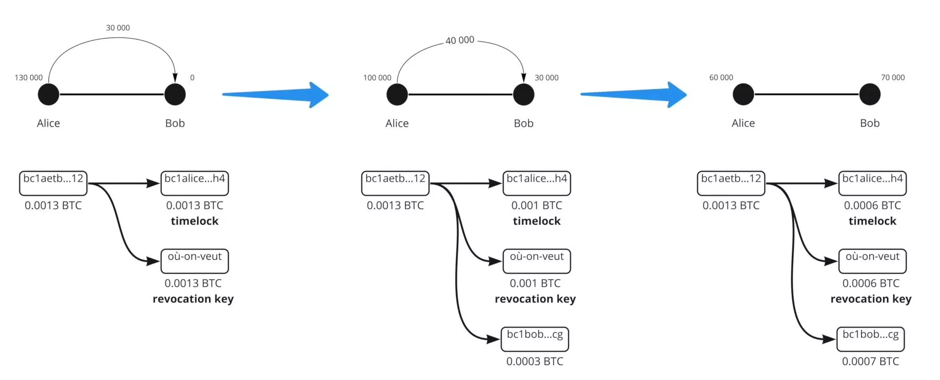
Where we want
Timelock
Timelock
Timelock
Where we want
Where we want
revocation key
revocation key
revocation key

Slide 19
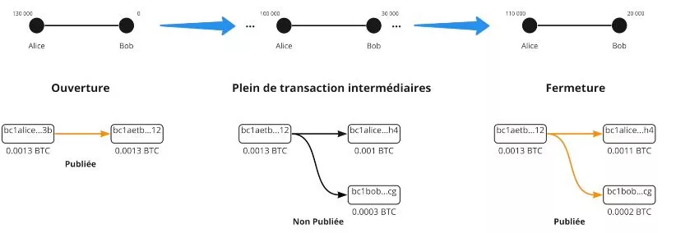
Opening
Lots of intermediary transactions
Closing
Published
Unpublished
Published

Slide 20
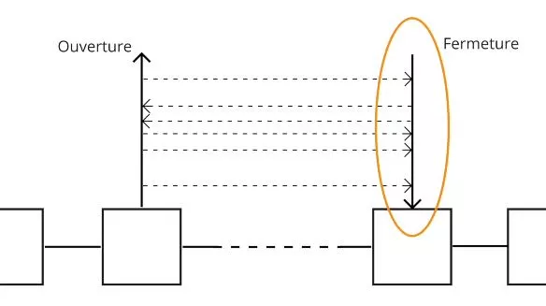
Opening
Closing

Slide 21
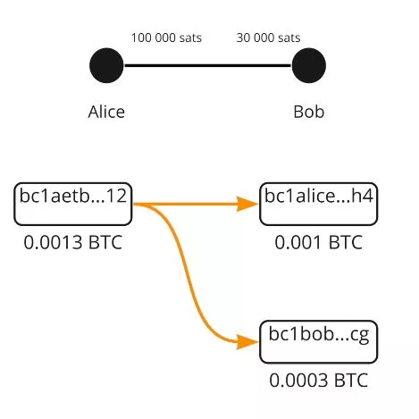

Slide 22
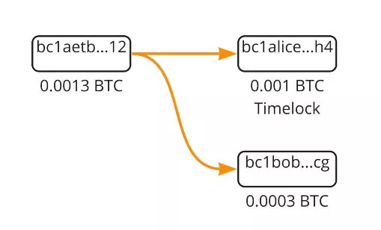
Timelock

Slide 23
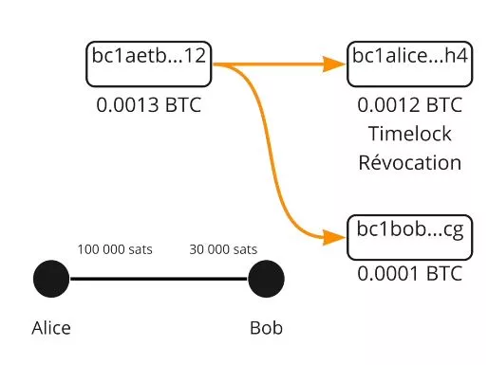
Timelock revocation

Slide 24
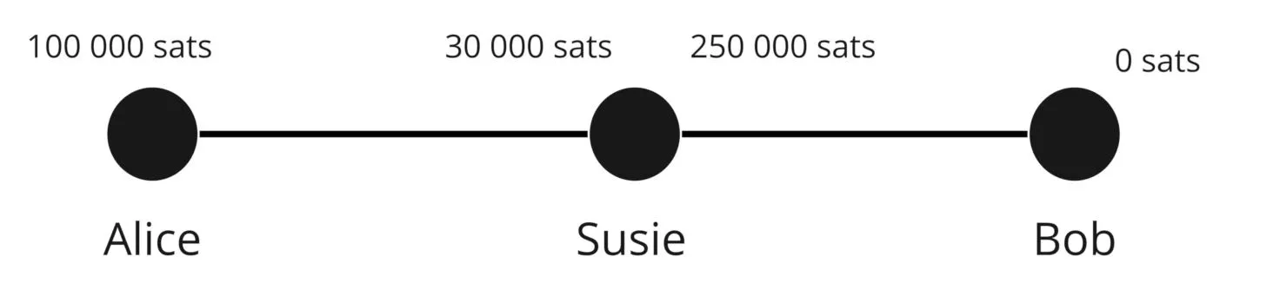

Slide 25
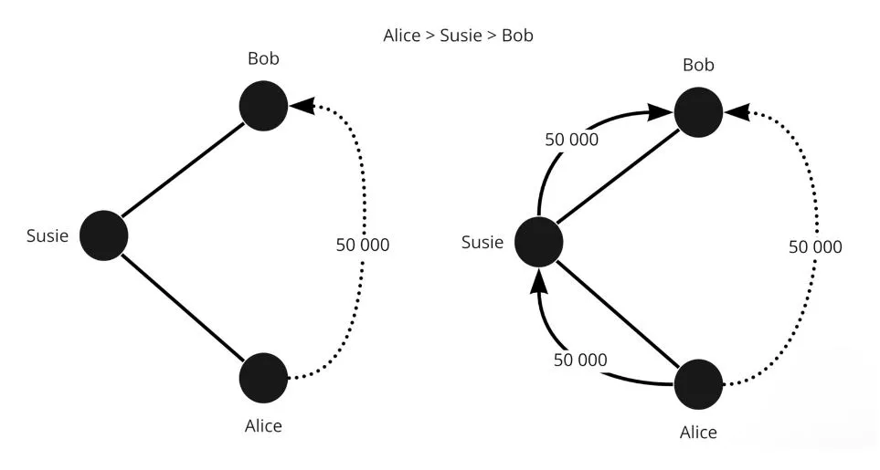

Slide 26
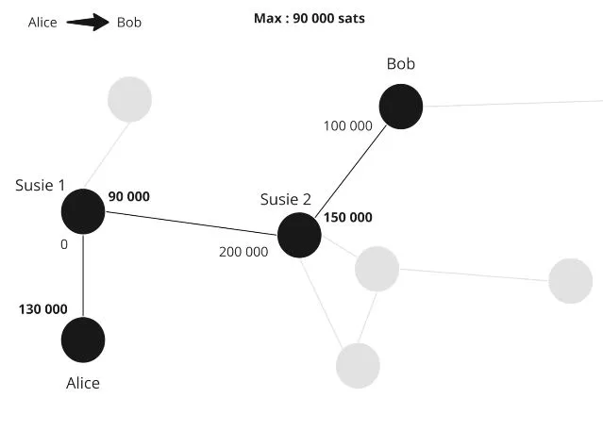

Slide 27
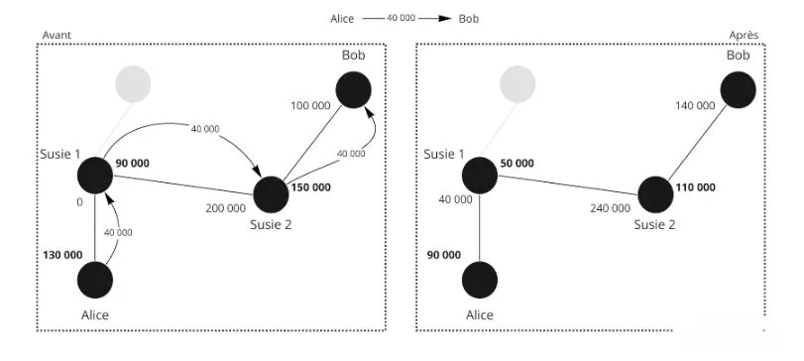
Before
After

Slide 28
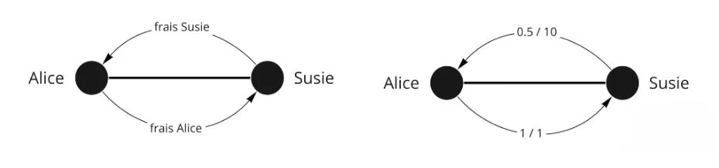
Susie’s fee
Alice’s fee

Slide 29
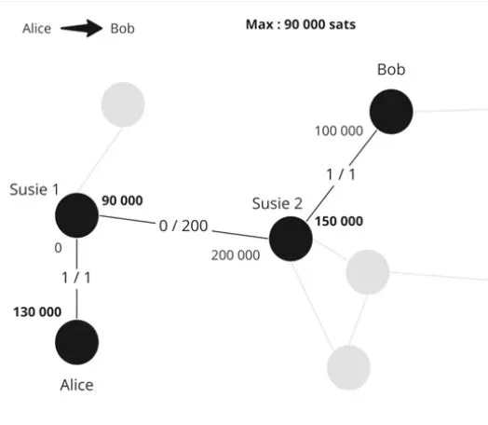

Slide 30
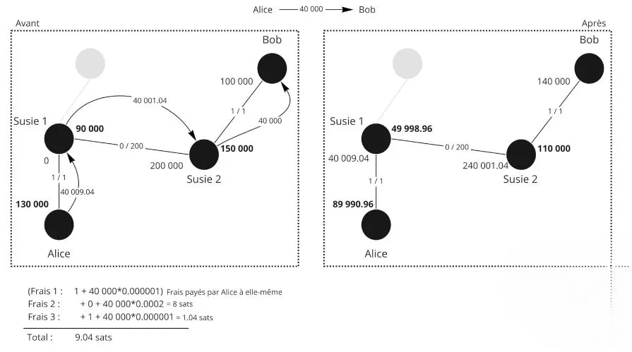
Before
After
Fee 1
(Fee paid by Alice to herself)
Fee 2
Fee 3

Slide 31
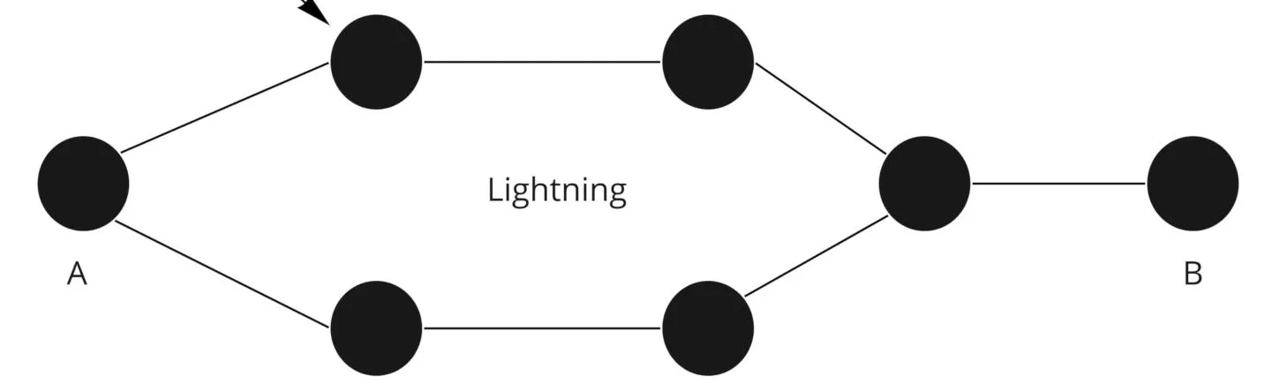

Slide 32
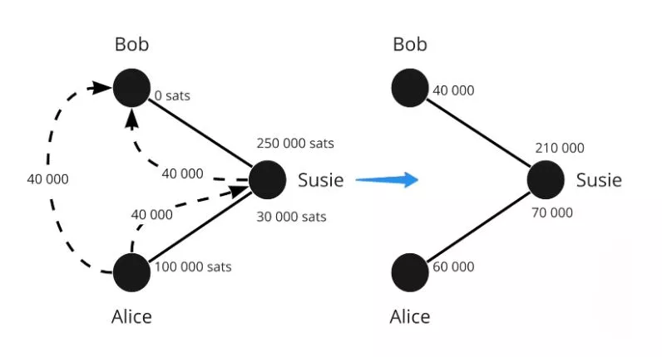

Slide 33
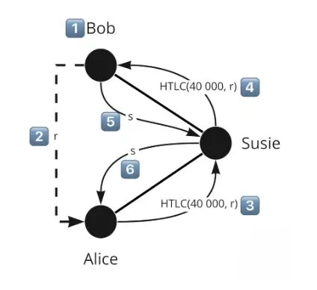

Slide 34
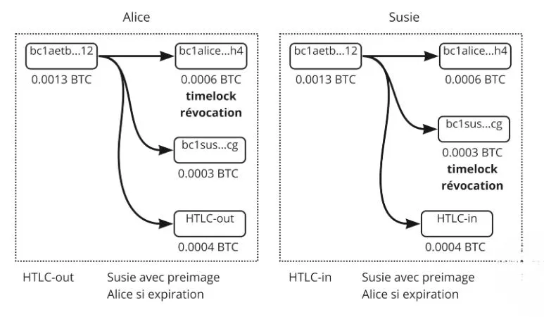
Timelock revocation
Timelock revocation
Susie with Alice preimage in case of expiration
Susie with Alice preimage in case of expiration

Slide 35
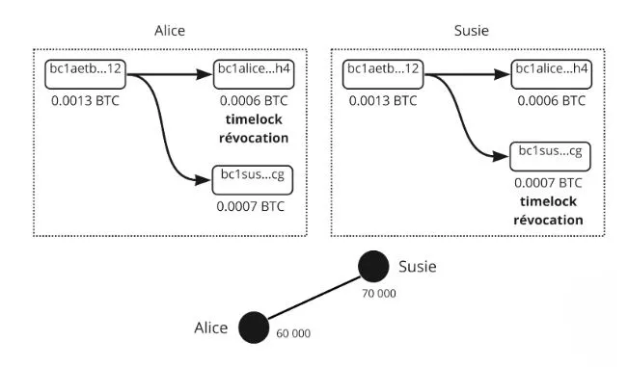
Timelock revocation
Timelock revocation

Slide 36
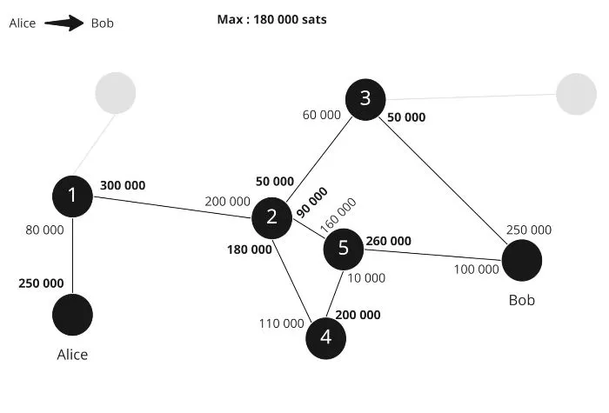

Slide 37
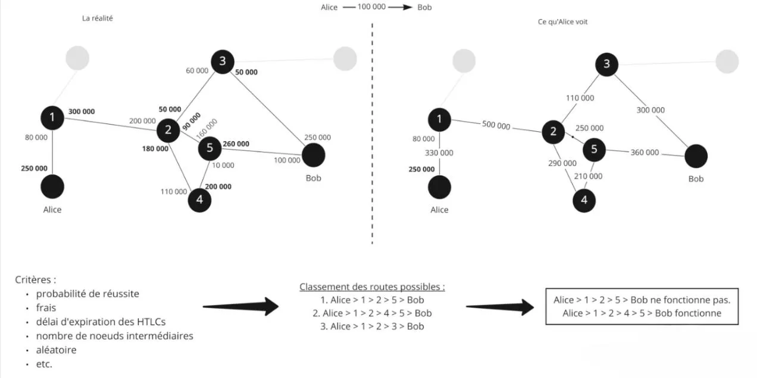
Criteria
Classification of possible routes
probability of success
Bob route doesn’t work
costs
Bob route works
HTLCs expiration time
number of intermediate nodes
random

Slide 38
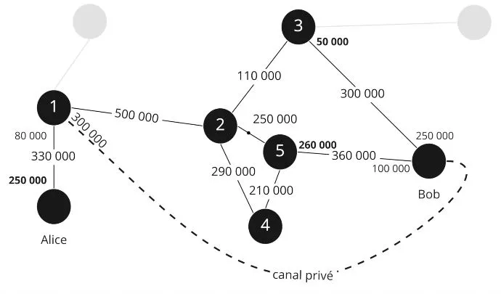
Private channel

Slide 39
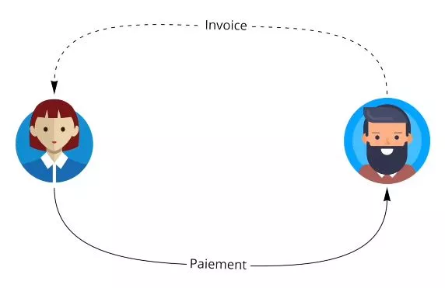
<
<
Invoice
Payment

Slide 40
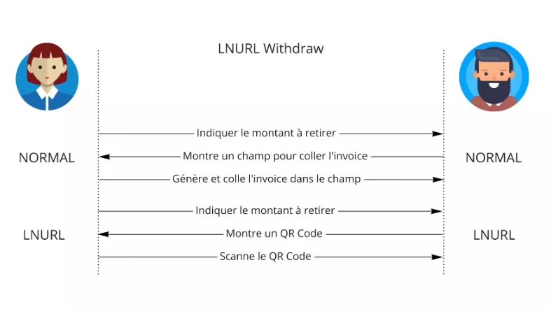
Indicate the amount to withdraw
NORMAL
Show the field where to past the invoice
NORMAL
Generate and paste the invoice into the field
Indicate the amount to withdraw
Show a QR code
Scan the QR code

Slide 41
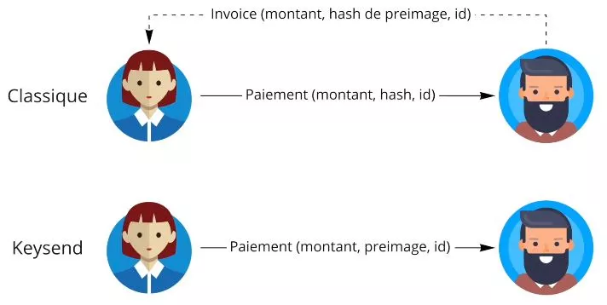
Invoice (amount, preimage, hash, id)
Classic
Payment (amount, hash, id)
Payment (amount, preimage, id)

Slide 42
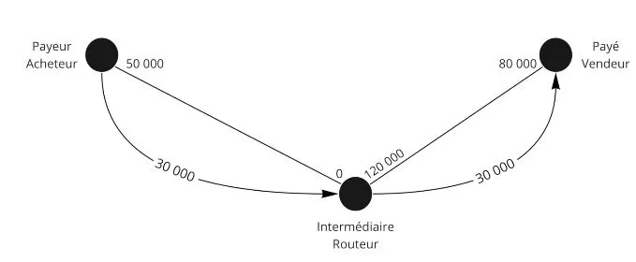
Payer - Buyer
Paid seller
Intermediate router

Slide 43
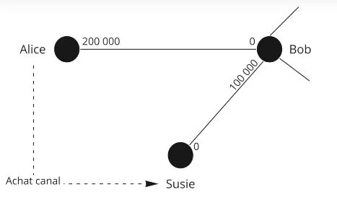
Channel purchase

Slide 44
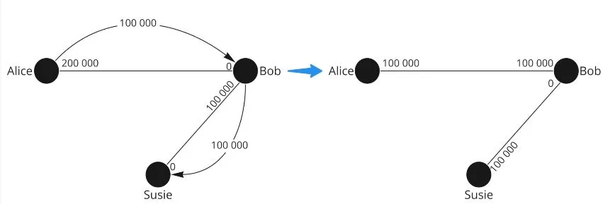

Slide 45
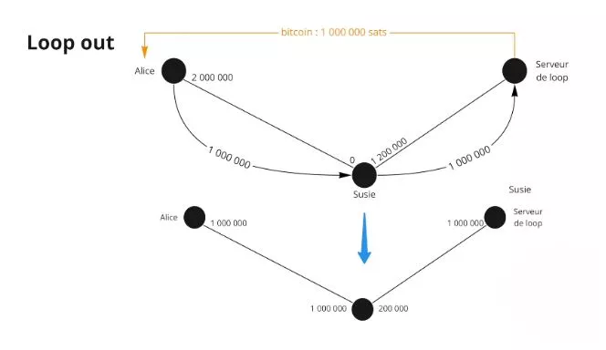
Loop out
Loop Server
Loop Server

Slide 46
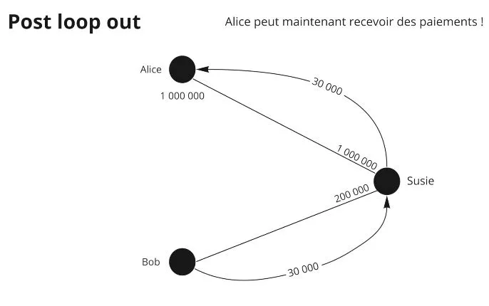
Post loop out
Alice can now receive payments!

Slide 47
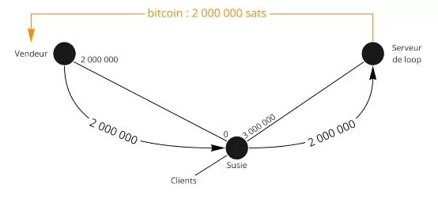
Seller
Loop Server

Slide 48
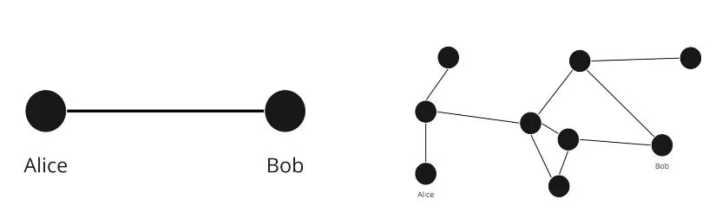

Slide 49
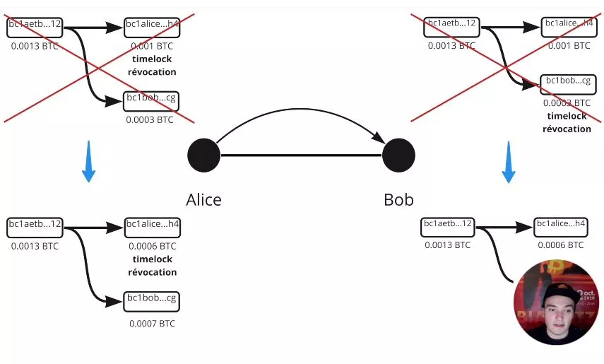
Timelock revocation
Timelock revocation
Timelock revocation

Slide 50
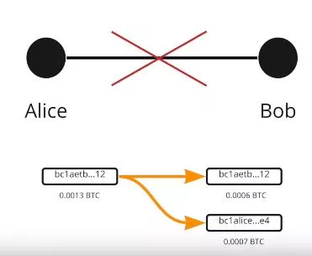

Slide 51

Invoice (amount, r)

Slide 52


