Slide 1

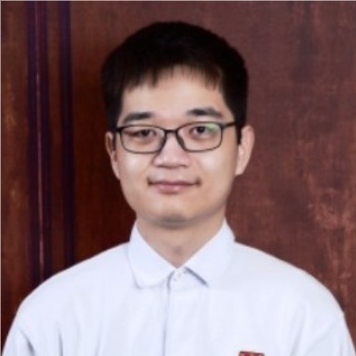



SpassMed Fatal Shocks Detection
David Shan
Master of Data Science & AI, University of Waterloo
Peiyi Zheng
Master of Data Science & AI, University of Waterloo
November 23, 2022

Slide 2
Agenda
Item
Use Case Restatement
Timeline - Milestones
Value to the Company

Slide 3
Use Case Restatement/Context/Motivation
Business Problem
Objective
Motivation
What we will do
Describe in your own words the business problem you are trying to address to make sure you are aligned with the company

Slide 4
Timeline - Milestones
Time | Milestone | Tasks
Week 1 | Use case understanding | Use case understanding, literature review
Week 2-3 | Data exploration | EDA (Missing Value), literature review
Week 4-10 | Design proof of concepts | Create pipeline from scratch, experimental design
Week 11-13 | Model optimization | Change parameters and generate additional prototypes, A/B testing, Optimization (GPU, Parallelization, source code, optimize packages efficiency)
Week 14-17 | Add value | Real-time Execution, Prepare documentation and report, Github repo
How would you distribute your tasks during the execution of the project? Include timelines with expected deliverables
This example is not completed. Try to include between 3-8 milestones at most.

Slide 5
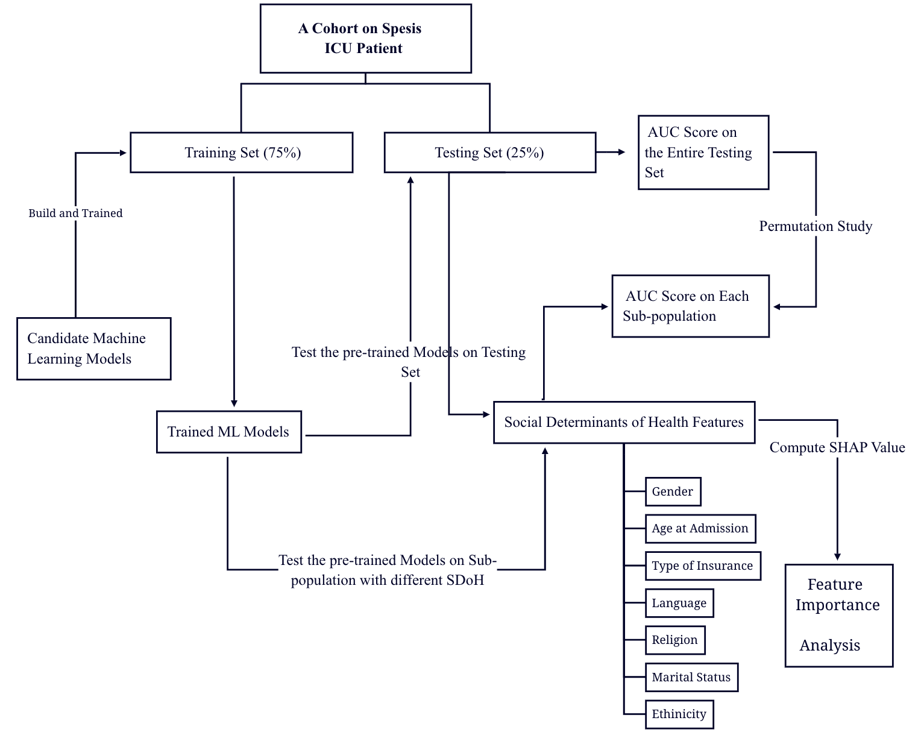
A Simple Workflow

Slide 6
Value to the Company
Expected Outcome
Marketable - How we make sure the success:
Accuracy
Execution Time - within a hour or even better until real-time
Ethics - no bias
What deliverables are you expecting to have at the end of the project? What metrics do you consider relevant to measure success? In what way your proposal is adding value to the company?

Slide 7
Thanks for watching

