Slide 1
UNeXt: MLP-based Rapid Medical Image Segmentation Network
Valanarasu & Patel, Johns Hopkins University — MICCAI 2022 (arXiv:2203.04967, March 2022)
Group members | ID
Ido Leibowitz | ---
Ze'ev Gastevert | ---
David Sheinenzon | ---
Code: https://github.com/DavidShenzi/unext-project
Video: https://youtu.be/1VO1uWPQsVE

Slide 2
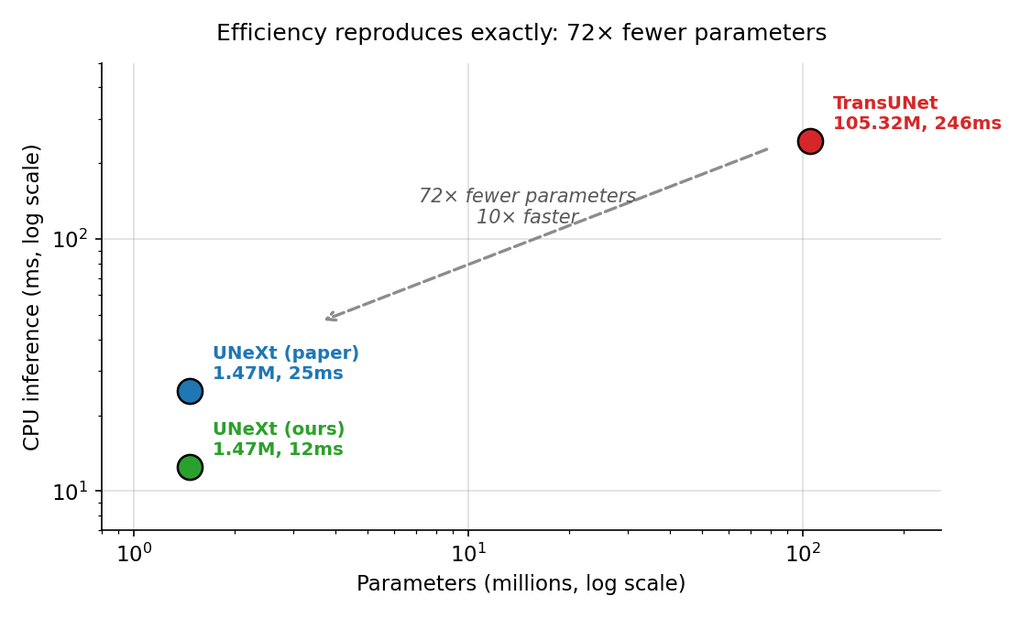
Motivation: segmentation at the point of care
Medical image segmentation guides diagnosis — outlining a lesion in an ultrasound scan
U-Net and its successors are accurate, but parameter-heavy and slow
Point-of-care use — a handheld probe, a clinic laptop, a field device — needs inference on CPU, in seconds, not a datacenter GPU
TransUNet: 105.32 M parameters, 38.52 GFLOPs, 246 ms per image on CPU
The question: can we keep the accuracy at a fraction of the cost?

Slide 3
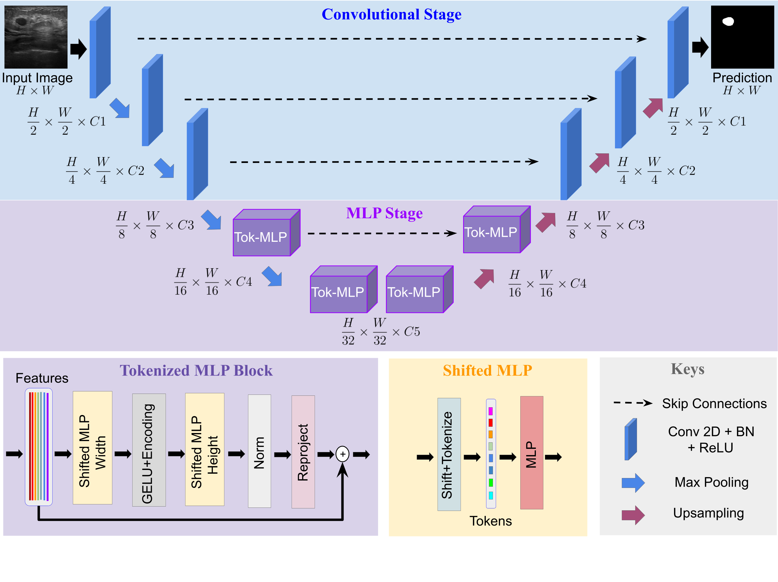
The solution: UNeXt
U-Net shape — but the deep layers use MLPs, not convolution or attention
Conv stage (3 shallow levels) — Conv3×3 → BN → ReLU, narrow channels (16/32/128)
Tokenized MLP stage (2 deep levels) — features are tokenized, then passed through shifted MLPs
Skip connections join matching encoder and decoder levels
Why MLPs? Self-attention costs O(n²) in the number of tokens. MLPs are plain matrix multiplies — far cheaper.
The catch: an MLP is spatially blind. It has no notion of "adjacent pixel".

Slide 4
The key trick: shifted MLPs
How UNeXt gives an MLP a sense of locality — for free
Before each Linear layer, feature-map chunks are cyclically shifted (torch.roll, ±2 px) along height, then width
A depthwise convolution sits between the two Linear layers as positional encoding
Each token now mixes with its actual spatial neighbours before projection
Cost: zero extra parameters, zero extra FLOPs — it is pure indexing
Paper's reported results (BUSI) | UNeXt | TransUNet | Factor
Parameters | 1.47 M | 105.32 M | 72× fewer
GFLOPs | 0.57 | 38.52 | 68× less
CPU inference | 25 ms | 246 ms | 10× faster
IoU / F1 | 0.6695 / 0.7937 | 0.6692/0.7930 | ~1

Slide 5
Our setup
BUSI · RTX 5060 Laptop · 11 training runs · ~10 h GPU
Dataset: BUSI breast ultrasound — 647 images (437 benign + 210 malignant), 80/20 split
Protocol: the authors' exact README command, then controlled variations
Getting a 2022 repo to run in 2026: removed an unused mmcv import, updated timm and albumentations APIs, and wrote the dataset preprocessing ourselves — the repo ships none
Sanity check — does our implementation match? | Ours | Paper
Parameters | 1,471,921 | 1.47 M ✓
GFLOPs @ 256×256 | 0.577 | 0.57 ✓
CPU inference | 12.5 ms | 25 ms ✓

Slide 6
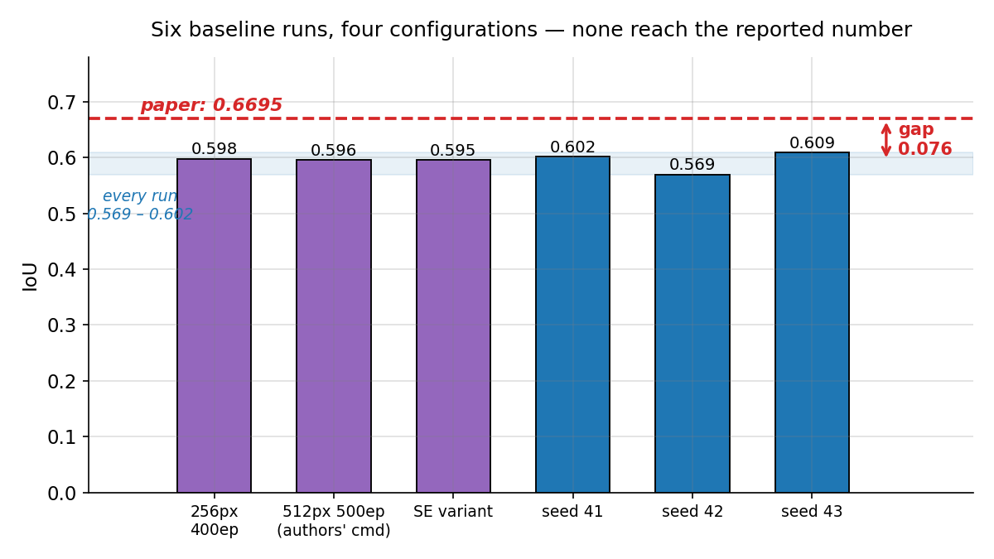
We could not reproduce the reported accuracy
Running the authors' exact command (512×512, 500 epochs, lr 1e-4, batch 8): IoU 0.5956 vs the paper's 0.6695
Six runs across four configurations all land in 0.569 – 0.602
3-split mean (the paper's own protocol): 0.5931 ± 0.0210 — short by 0.076 IoU
No official weights to check against: the repo ships none, and GitHub issues #11 (Apr 2022) and #21 (Jul 2022) requesting them are still open and unanswered.

Slide 7
Five hypotheses, systematically eliminated
# | Hypothesis | How we tested it | Verdict
1 | Wrong resolution (256 vs 512) | ran both | 512 was worse (0.5956 vs 0.5975)
2 | Mixed precision hurt accuracy | AMP vs FP32 | tied at every 50-epoch window
3 | Wrong decision threshold | swept 0.3 – 0.7 | flat; 0.5 already optimal
4 | Unlucky split composition | checked 3 seeds | balanced on class + lesion area
5 | Split averaging (paper = mean of 3) | ran 3 splits | spread 0.039, gap 0.076 — too big
Hypothesis 5 is decisive: split-to-split variation is ~3.6× too small to explain the gap. Even our best single split (0.6085) falls well short of 0.6695.
Conclusion: the gap is real and systematic — not a configuration mistake on our side.

Slide 8
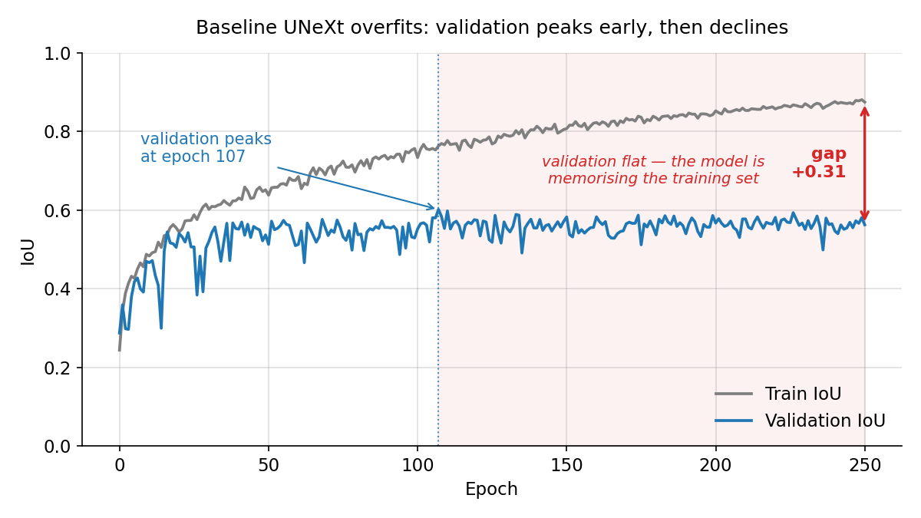
Diagnosis: the model overfits badly
Validation IoU peaks at epoch ~95–107, then declines for 300+ epochs
Final train IoU 0.87–0.91 vs validation 0.56–0.58 → +0.31 generalization gap
Root cause: the paper augments with rotate90 + flips only — not enough for 518 training images

Slide 9
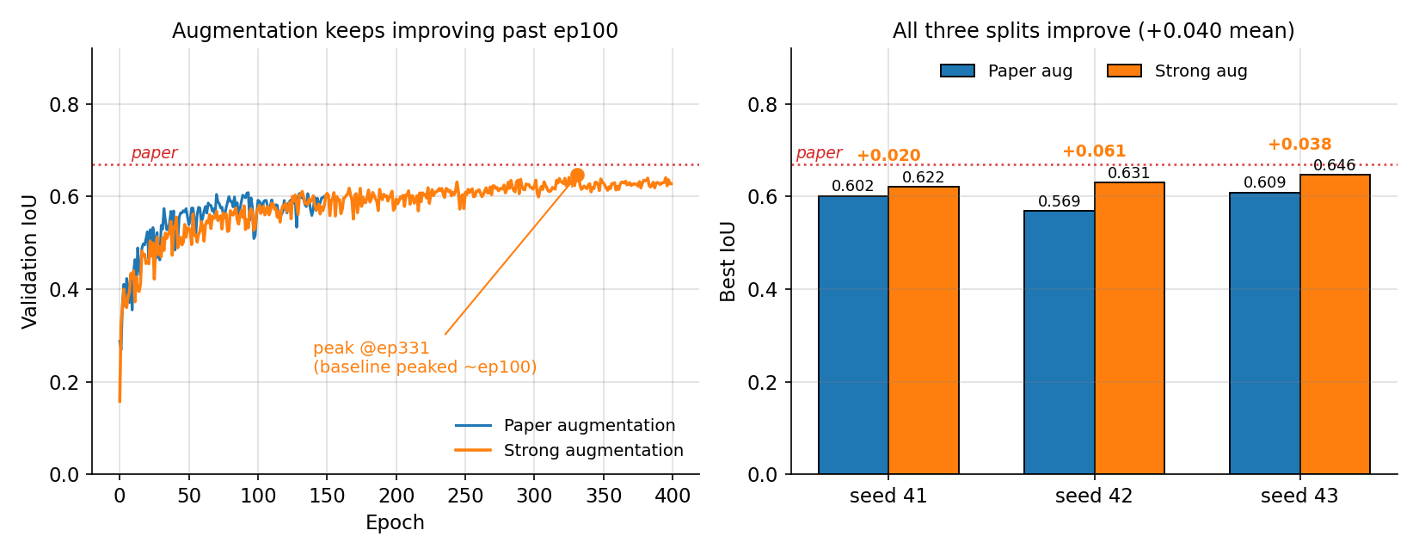
Our fix: stronger augmentation
Added affine, brightness/contrast, gamma and elastic deformation
Mean IoU 0.5931 → 0.6328 (+0.040). All three splits improved. Gap to paper halved: 0.076 → 0.037
Overfitting gap cut 60%; split-to-split Dice spread cut 4.4× (±0.0242 → ±0.0054)
Honest caveat: compared at the *same* number of epochs the gain shrinks to +0.023. Augmentation does not converge faster — it removes the ceiling, letting training run to ep282–390 instead of stalling near 100.

Slide 10
Four modifications, measured against the right yardstick
Two grafted onto our best model, two trained from scratch — all on strong augmentation
 | SE attention | Skip-Fusion | Focal Tversky | Boundary gate | Wavelet mixer
What it changes | channel gating | gate on skips | the loss | gate on skips, edge-aware | the token mixer
Parameters | +0.55% | +5.90% | none | +8.8% | +1.43%
GFLOPs | none | +11% | none | +16% | -9%
Change in IoU | 0.000 | +0.002 | +0.005 | +0.004 | -0.001
Paired runs | 1 | 1 | 6 | 3 | 3
Not one of them clears 0.011 IoU — and 0.011 is what we get by changing the random seed alone. We reran six configurations changing nothing but the random seed: they disagree by 0.011 on average, and by as much as 0.019.
So the honest verdict is: none of these architectural changes does anything we can measure. Two of them cost 11–16% more compute to achieve it.
The exception is the wavelet mixer — it is the only one that makes the network cheaper. Same accuracy, 9% fewer FLOPs. That is where the next two slides go.

Slide 11
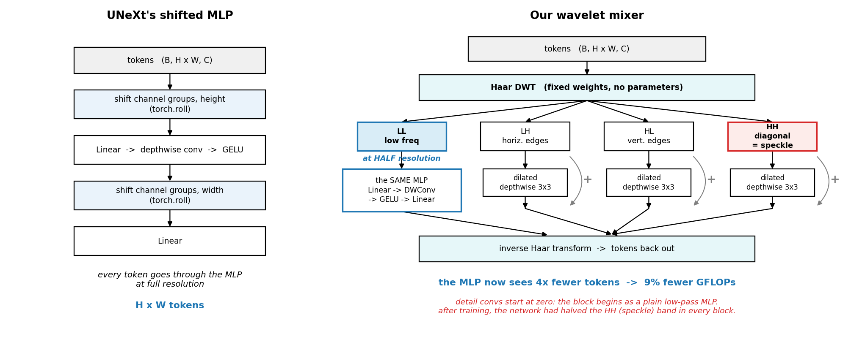
What we changed: the token mixer
A fixed Haar wavelet transform in place of the shifted MLP
The low band keeps the paper's MLP — but runs it on a quarter of the tokens. That is where the 9% FLOP saving comes from. The three detail bands get a small convolution each, added back on top.

Slide 12
Same accuracy, 9% less compute
Three splits, paper-matched seeds, strong augmentation on both sides
 | Baseline (shifted MLP) | Wavelet mixer
Mean change in IoU | — | -0.0014
GFLOPs | 0.577 | 0.525 (-9.0%)
Parameters | 1,471,921 | 1,493,041 (+1.4%)
Boundary F1 | 0.4740 | 0.4570 (-0.017)
-0.0014 IoU is an eighth of our seed noise. This is "identical", not "slightly worse" — and it is the only change we tried that made the network cheaper rather than more expensive.
The honest cost: contours are slightly softer (boundary F1 −0.017, worse on 3 of 3 splits). Smoothing away speckle also smooths the lesion edge.

Slide 13
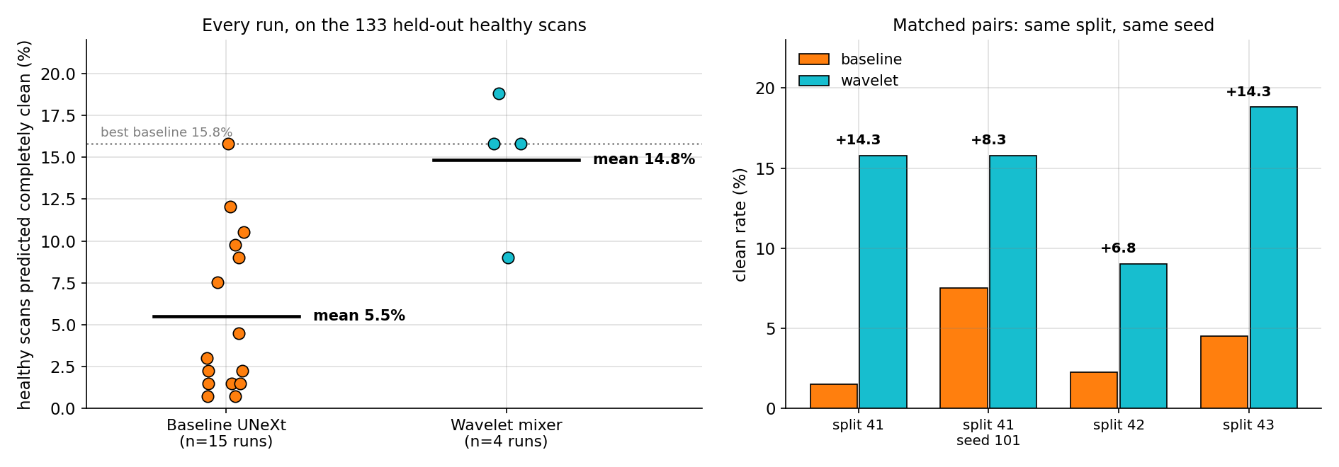
The metric the paper never measures
BUSI ships 133 scans with no lesion — no model here was trained on any of them
IoU cannot score a healthy scan — the mask is empty, so predicting nothing scores perfectly. That degeneracy is what makes these 133 a clean held-out test of a different question: when there is no tumour, how much does the model invent?

Slide 14
Challenges
1. A real bug in the upstream code — inputs were being squashed from ±2.5 into ±0.01, discarding most of the signal.
2. Frozen BatchNorm is not frozen — our "frozen" backbone would have drifted silently, invalidating the whole comparison.
3. Grafting a new layer without disturbing the model took several attempts.
4. A 2022 repo on a 2026 stack — dead dependencies, no released weights to check against.

Slide 15
Conclusions
The efficiency claims reproduce exactly — 1.47 M parameters, 0.577 GFLOPs, 72x smaller than TransUNet.
The accuracy does not — 0.593 against the published 0.669, across six runs.
The cause is overfitting — stronger augmentation recovers +0.040, without touching the architecture.
No architectural change beat the random seed — a different seed moves IoU by 0.011; every modification moved it less.
Except one — the wavelet mixer: same accuracy, 9% fewer FLOPs, and 3x more healthy scans left completely clean.
Takeaway: the training recipe mattered more than the architecture — and most reported gains this size are indistinguishable from the random seed.

Slide 16
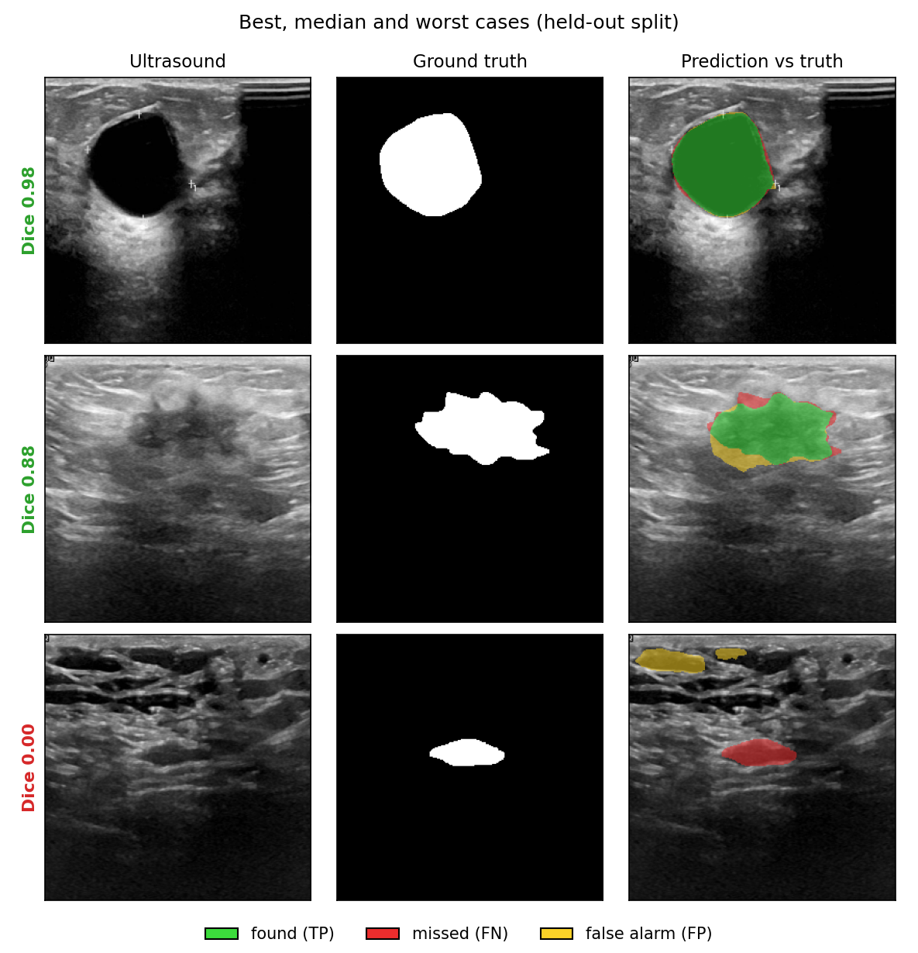
Appendix: qualitative results
Best, median and worst cases from the held-out split
The failure case (bottom): the model responds to hypoechoic regions at the top of the image while missing the small true lesion — small lesions on noisy scans remain hard.

Slide 17
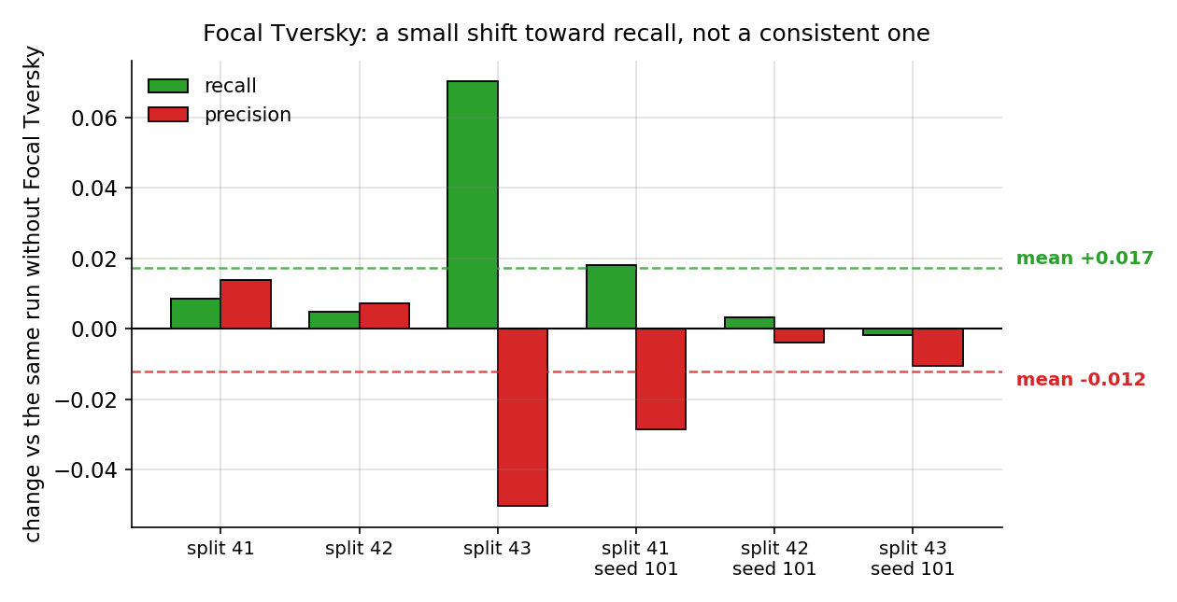
Appendix: what Focal Tversky actually changed
A small shift toward recall — but only one split shows it clearly
Averaged over six paired runs: recall +0.017, precision −0.012. The direction matches what the loss was designed to do, but the size is small and one split (43) accounts for most of it.

