Slide 1
Part 2: Measuring Performance

Slide 2
Always measure!
Number One Advice
Notes:
But let’s start with the number one advice: always measure! It’s very important that when we talk about performance we always need numbers and predefined tests that we can repeat.
Don’t simply relay on what you think or what someone else tells you about performance. Simply measure it!
Additionally for performance optimization projects you always need a baseline. You need tests that tell you the performance of the code before you start to optimize it so you can then compare the numbers before and after the optimization. So the first step of every performance related work is to collect numbers.
In this and the next section we will learn how you can collect numbers for .NET Core applications.
But before we dive into the tools I would like to talk about what we want to measure and what typical metrics we have in the performance field.

Slide 3
Measure CPU
CPU Utilization: The % of time when the CPU does work
Wall clock time: simply the time that an operation takes on one specific hardware
Typical question: in which method do we spend a long time?
Notes:
One very important group of performance metrics are CPU related metrics.
For example the CPU utilization is the percentage of time when the CPU does work.
Another metrics is wall clock time, which is what many people actually mean when they say performance: it is basically the time span between the start and the end of an operation.
When we want to measure the CPU utilization of our .NET code then the typical question is: In which method does the CPU spend significant time?

Slide 4
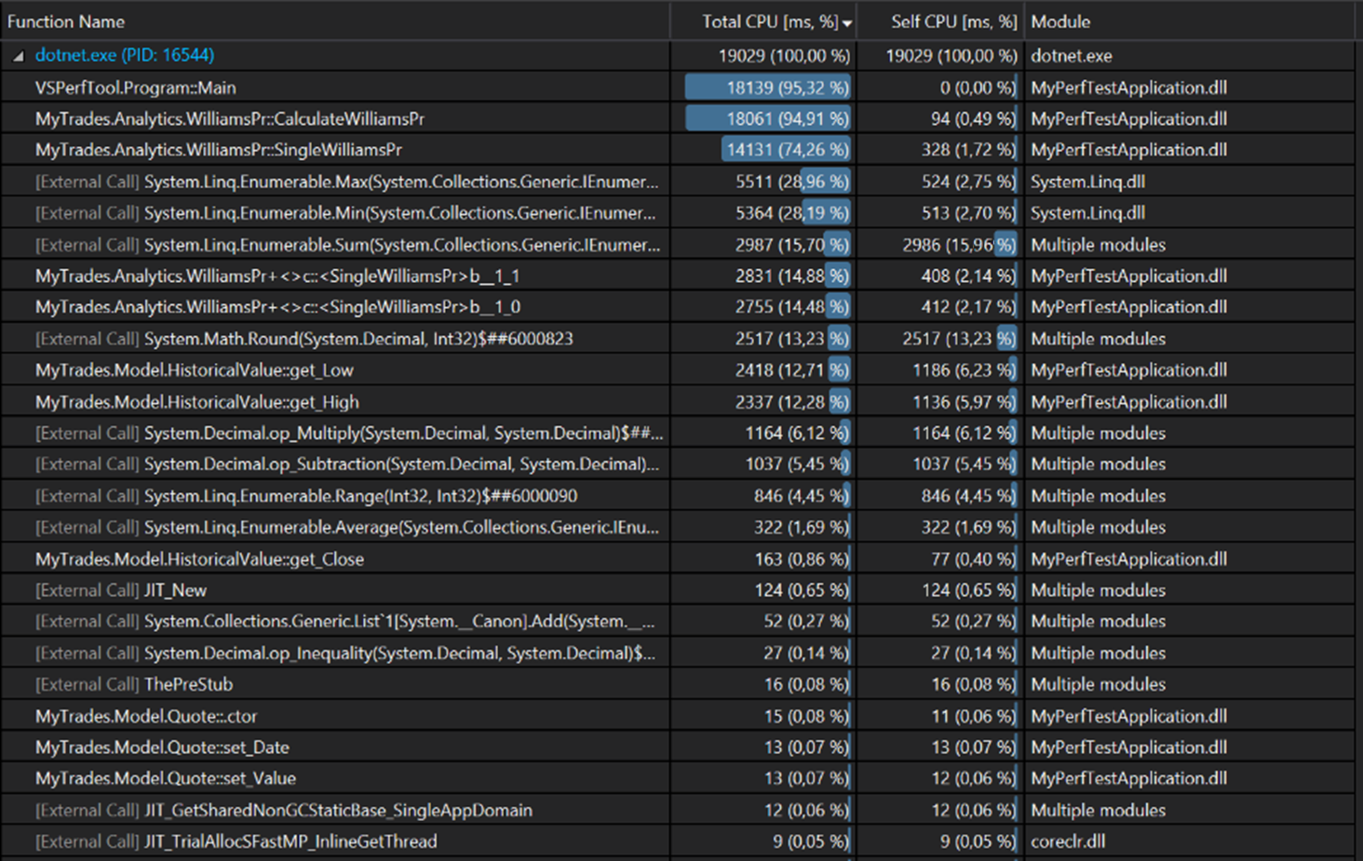
Typical output when we measure CPU related metrics
Notes:
And the answer to this is basically a callstack where you see all your methods that were executed with some meaningful numbers (typically either percentage or time).
Now such a report is typically generated by a profiler, which measures the execution of your code during a so called profiling session.
With such a report you can immediately see which methods consume most of the CPU and with that you can quickly figure out which part of your code you should optimize.
In this case you can see that the SingleWilliamsPr is definitely worth to look at, furthermore you also see that the Linq Min and Max methods are also big contributors.
But before we dive into this, let’s discuss how such a report is generated. After that we will look at this example again.

Slide 5
Types of CPU Profilers
Sampling
Instrumentation
Notes:
So let’s discuss how a profiler works and how these reports are generated.
So in general there are two ways of collecting this data: a profiler does either sampling or instrumentation.

Slide 6
Sampling Profiler
Huge number of snapshots with callstacks -> aggregates this data
Can be done on a running process without restart
Minimal overhead
Non CPU work is not visible! (e.g.: Thread.Sleep(…), I/O Operation)
Notes:
Let’s start with sampling!
A sampling profiler takes a huge number of snapshots of the application with callstacks and then aggregates this data.
The nice thing about this is that it has minimal overhead, and a sampling profiler can be attached to a running process. So for example in production you can simply attach a sampling profiler to a process, and then let it create sampling for let’s say 30 seconds. In this case the production system has a small overhead for that 30 seconds, but after that the profiling is done, and the application can run as it did before.
The overhead mostly depends on the number of snapshots that the profiler takes, but in general with default settings the overhead of such a profiler is around 2-3%. Some of them allow you to change the snapshot frequency, which of course affects the overhead.
Now one downside of a sampling profiler is that if something does not run on the CPU then it won’t be shown. So only those threads are visible that execute something on the CPU. For example if a thread waits on for an IO operation then it won’t be in the sample.

Slide 7
Sampling Profiler – Inclusive and Exclusive
Inclusive: Main(), A(), B() – 100%
Exclusive: C() – 50% D() – 25% E() – 25 %
 | Inc. | Excl.
Main | 100% | 0%
A | 100% | 0%
B | 100% | 0%
C | 50% | 50%
D | 25% | 25%
E | 25% | 25%
C()
C()
D()
E()
public void B()
{
C();
//Do other work
D();
//Do other word
E();
}
B()
B()
B()
B()
A()
A()
A()
A()
Main()
Main()
Main()
Main()
Notes:
Now let’s talk about how this aggregation works.
So as already discussed a sampling profiler creates samples from every running thread with callstacks on a very high frequency.
Let’s say we have 4 such samples that we want to aggregate. As you see in all of these stacks the main method Called method A which called method B. In the first two cases method B called method C, but in the third case method B called method D and then in the last case method B called method E.
NEXT:
On the right side you can see the code of method B which can lead to such samples. So we have a Main method that calls Method A, which calls only method B that looks something like this small code snippet.
NEXT:
So Main, A and B were included in all of the samples, so for these 3 methods all 4 samples are so called inclusive samples. This means we have these methods on the callstack in all samples.
But in many cases the really interesting part is the top of the callstack, and these are the so called exclusive samples. We had two samples with method C on the top of the stack and 1 sample for each D and E. So 50% of the samples had C on the top and 25% of those had D on the top and another 25% had E on the top.
NEXT:
And this is how a typical sampling profiler reports this. From the first column we see for each method which percent of the samples contained that method. The second column show how much samples shows the percentage of the samples that contained the method on the top of the callstack.
In a real world scenario of course we have much more samples.
So when you look at the report from a sampling profiler most of the time you will see two columns, one showing the weight of the method in the inclusive and another one showing the weight of the method in the exclusive samples.
Now profilers can have different names for this. PerfView, which we will take a look at later calls these Inclusive and exclusive samples, but for example Visual Studio calls them Total and Self CPU. But the point is the same: one columns shows how much samples had the method on the stack and the other one shows how much of those had the method on the top of the stack.

Slide 8
Sampling Profiler – Inclusive and Exclusive
Our previous example
Main(): ~95% excl.
SingleWilliamsPr(): ~74% excl.
LINQ Min() and Max(): ~57% excl.
LINQ Sum(): 15.96%
Math.Round(): 13.23%
Notes:
Now lets look at our example again that we saw a few slides earlier. This is a report from the sampling profiler of Visual Studio. So Total CPU times is just another name for inclusive samples. That shows the percentage of samples that contain that given method somewhere on the callstack.
NEXT
It is not surprising that almost more than 95% of the samples contained the main method on the stack.
NEXT
It’s more interesting that more than 74% of the samples contain the SingleWilliamsPr method
NEXT
and the Linq Min and Max methods are together in around 57% of the samples.
The Self CPU column shows the exclusive samples, so that is the percentage of samples that have the given method in the top of the callstack.
NEXT
We immediately see that 15,69% of the samples had the Sum LINQ method on the top of the stack
NEXT
and another 13.23% of the samples had the Math.Round also on the top of the stack.
So with this report you know that the SingleWilliamsPr method is almost always on the callstack and we spend almost 30% of the time either in the LINQ Sum() or in the Math.Round() method. So just based on this report if you want to optimize this code then it’s clear that you should look into the SingleWilliamsPr method and then search for lines that call either a LINQ method or the Math function.
Now you could go further with this analysis since Visual Studio also offers many great ways to visualize this data, but we stop here since there will be a whole video on Visual Studio profiling.

Slide 9
Instrumentation Profiler
Injects code to measure methods
Measures also non CPU work
Can potentially have more overhead
No attach/detach
public void MyMethod()
{
MethodStart(nameof(MyMethod)); //*
//Further instructions
MethodCallStart(nameof(CallAnotherMethod)); //*
CallAnotherMethod();
MethodCallFinished(nameof(CallAnotherMethod)); //*
//Further instructions
MethodEnd(nameof(MyMethod)); //*
}
//* Injected Profiler Code
Notes:
Now let’s move on to the second profiler type which is instrumentation.
An instrumentation profiler injects code into methods to measure how long a given method runs and to track method calls.
NEXT:
On the right side you see some pseudo code that shows how this works.
As you see the profiler injects a line before the first line of the method, in this case this is the MethodStart() call and also after the last line of the method, which is the MethodEnd() call. Theese calls typically measure the execution time of the method. Furthermore the profiler also inject code to track method calls. These are the MethodCallStart and MethodCallFinished methods.
Now in case of .NET this typically works on the Intermediate language level.
A big advantage compared to a sampling profiler is that in this case we really measure every method call and that also includes non CPU related work like waiting on IO or a System.Sleep call. So if the execution of a method is paused due to IO operations for let’s say 2 seconds then an instrumentation profiler will still properly measure the execution time of that method. A sampling profiler would not capture anything for that method in this 2 second timeframe since there is no thread that would do work on the CPU.
On the other hand typically an instrumentation profiler has more overhead than a sampling profiler. Although you can control this overhead to instrument only certain methods. For example instrumenting library code in some cases is not necessary, so one approach to reduce overhead is to only instrument code that is in your own assemblies.
Furthermore an instrumentation profiler typically needs a restart, so you cannot attach it to a running process on a production system. Now I say typically, because technically with the so called REJIT in newer .NET verions it would be possible to change the IL code during runtime and then revert it once you are done with the profiling, but I don’t know any product that would do this.

Slide 10
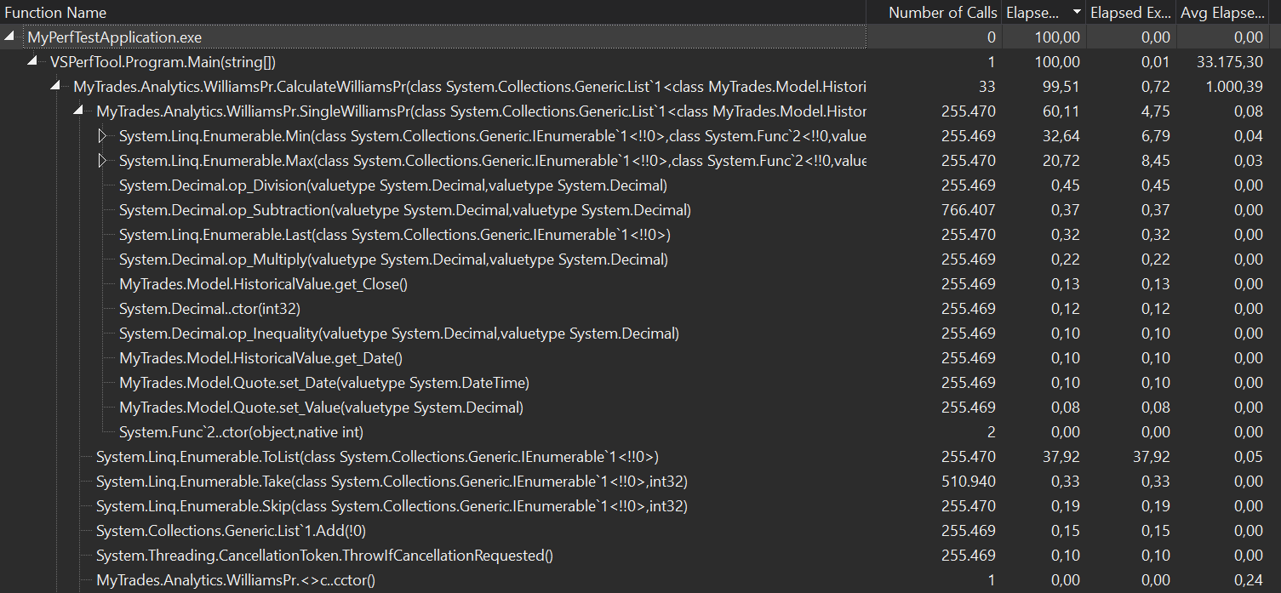
Instrumentation Profiler - Example
More than 255.000 Min(), Max() calls
More than 50% of the time spent in Min(), Max()
Also more than 255.00 ToList() calls
Notes:
Here is the output from an instrumentation profiler.
The first column shows the method name, the second column shows the number of calls to each methods and the third show the time spend in each method including their children during the profiling session. So this is different from the output of the sampling profiler. We don’t have samples here, we really measured each and every call.
NEXT
What we see is that for example the Min and the Max LINQ methods were called more than 255 thousand times
NEXT
and more than 50% of the time we were in one if these two methods.
NEXT
Another interesting finding is that the ToList method was also called more than 255 thousand times and that operation also took a significant time.
So in this case the instrumentation profiler delivers the same result: we should look into the SingleWilliamsPr method and take a look at the LINQ operations.
But keep in mind that if we would have an IO operation in the code causing the overhead then we would also see that with the instrumentation profiler, but it would be invisible to a sampling profiler.

Slide 11
Demo
Profiling CPU work with Visual Studio
Notes:
SLIDE: So let’s quickly check this out!
SCREENCAST:
Before we dive into this I would like to add that this feature is intended to help you during development. This is not meant to generate perfect data, and as you will see this is not the way to get automated tests. So the goal with this isn’t to exactly measure how long a method takes, this is rather for give you a first idea about the performance of your code without writing specific code for that with StopWatch or DateTime as many developers do.
Now I always say that you should measure release build, but this feature is actually meant to be used in debug mode, because it is based on breakpoints. And as you probably know in release mode some instructions can be optimized away which affects the mapping between your C# code and the executed machine code and that again affect breakpoints, and that makes this feature in release mode almost impossible to use.
So the point here to get a first impression. In many scenarios to me it doesn’t really matter when one method takes 5 and another 6 milliseconds, with this feature I typically just try to identify the big contributors, so I look for 5x or even 10x differences and with that information I know already in a debugging session where to look for potential optimization.
So in this exceptional case we remain in Debug mode. Btw. you can try to use this in Release mode, but in some cases this may not work and your breakpoints won’t be triggered. In those cases the only option is to either use debuig build or rely on other tools. One option is the Performance Profiler that we will see in the next demo.
So we have a simple .NET Core application here with two methods: the first one reads historical stock exchange data from the disk and the second method calculates a financial indicator called Relative Strength Index. So the first one is IO intensive, the second one is CPU intensive.
It’s not important to understand what RSI is, the point is that it is an algorithm that is CPU bound.
Let’s do line by line debugging.
As you see we hit the first breakpoint,
Let’s execute this line with F10! As you see reading the historical data took 5 ms let’s jump to the next line with F10, so now we calculated the financial indicator which took around 2500 ms.
Now as you see this is a very simple feature but it already gives us an overview. It doesn’t do any magic, but we already know that reading the data takes significantly les time then calculating the financial indicator. Of course this is dependent on the CPU, but we have a 500x difference here, so it’s clear which method is worth to optimize. And by the way the release build would have shown us exactly the same. So what I like about this feature is that I already have useful performance data during development which gives me an idea about the runtime of my methods.
There are also some other nice features here, like you can do the same between two breakpoints, so let’s measure the whole method.
And you can also move the instruction pointer back and measure it again.
And the PerfTips feature is available pretty much everywhere: you can do this in your .NET Core C# code, but also on Full Framework and even on native C++ code.
Now one thing I would like to point out is that in this case we saw that the CPU bound operation takes significantly more time than our IO operation, but this isn’t always the case! In many scenarios I saw the applications spending such more time doing IO then calculating things.
So the takeaway is that you can already see these kind of things with PerfTips, but of course you have to check your release build –which we we learn how to do in a later video.

Slide 12
Summary
Sampling profiler: high frequency sampling, only shows CPU work
Inclusive samples: samples that contain the method
Exclusive samples: samples with the given function on the top of the stack
Instrumenting Profiler: Injects code to measure every method, also shows non CPU related work
Notes:
All right, let’s summarize what we learned in this video.
First we discussed that a sampling takes samples on a very high frequency and it only shows CPU related work, so things like thread.sleep or a data base call won’t be visible in a report generated by a sampling profiler.
Then we discussed that for each method we have inclusive and exclusive samples. Inclive samples are samples that contain the given method somewhere on the stack and exclusive samples are samples that have the given method on the top of the callstack.
We also discussed that an instrumentation profiler injects code into the application to measure every method. The advantage here is that with this approach we can measure non CPU related work.

Slide 13
Measuring memory related metrics
Notes:
SLIDE: So let’s quickly check this out!
SCREENCAST:
Before we dive into this I would like to add that this feature is intended to help you during development. This is not meant to generate perfect data, and as you will see this is not the way to get automated tests. So the goal with this isn’t to exactly measure how long a method takes, this is rather for give you a first idea about the performance of your code without writing specific code for that with StopWatch or DateTime as many developers do.
Now I always say that you should measure release build, but this feature is actually meant to be used in debug mode, because it is based on breakpoints. And as you probably know in release mode some instructions can be optimized away which affects the mapping between your C# code and the executed machine code and that again affect breakpoints, and that makes this feature in release mode almost impossible to use.
So the point here to get a first impression. In many scenarios to me it doesn’t really matter when one method takes 5 and another 6 milliseconds, with this feature I typically just try to identify the big contributors, so I look for 5x or even 10x differences and with that information I know already in a debugging session where to look for potential optimization.
So in this exceptional case we remain in Debug mode. Btw. you can try to use this in Release mode, but in some cases this may not work and your breakpoints won’t be triggered. In those cases the only option is to either use debuig build or rely on other tools. One option is the Performance Profiler that we will see in the next demo.
So we have a simple .NET Core application here with two methods: the first one reads historical stock exchange data from the disk and the second method calculates a financial indicator called Relative Strength Index. So the first one is IO intensive, the second one is CPU intensive.
It’s not important to understand what RSI is, the point is that it is an algorithm that is CPU bound.
Let’s do line by line debugging.
As you see we hit the first breakpoint,
Let’s execute this line with F10! As you see reading the historical data took 5 ms let’s jump to the next line with F10, so now we calculated the financial indicator which took around 2500 ms.
Now as you see this is a very simple feature but it already gives us an overview. It doesn’t do any magic, but we already know that reading the data takes significantly les time then calculating the financial indicator. Of course this is dependent on the CPU, but we have a 500x difference here, so it’s clear which method is worth to optimize. And by the way the release build would have shown us exactly the same. So what I like about this feature is that I already have useful performance data during development which gives me an idea about the runtime of my methods.
There are also some other nice features here, like you can do the same between two breakpoints, so let’s measure the whole method.
And you can also move the instruction pointer back and measure it again.
And the PerfTips feature is available pretty much everywhere: you can do this in your .NET Core C# code, but also on Full Framework and even on native C++ code.
Now one thing I would like to point out is that in this case we saw that the CPU bound operation takes significantly more time than our IO operation, but this isn’t always the case! In many scenarios I saw the applications spending such more time doing IO then calculating things.
So the takeaway is that you can already see these kind of things with PerfTips, but of course you have to check your release build –which we we learn how to do in a later video.

Slide 14
In this Part
Garbage Collector (GC) basics
Track allocations
Find GC root preventing objects from being collected
.NET Core and GC
Notes:
First we will discuss how a Garbage collector works.
Then we will discuss the two typical memory related problems: we will see how to find methods that allocate too much then we will discuss how you can find so called GC roots that prevent objects from being collected, which is a typical problem that causes high memory usage.
And then will close the video by discussing a few things about the GC on .NET Core.

Slide 15
Measuring Memory
Utilization: Heap size, Physical memory size
Number of objects
.NET has automatic memory management with GC.
Typical problems:
1: too much work by the GC (hurts CPU)
2: not enough work by the GC (eventually out of memory).
Notes:
All right, let’s jump into this topic!
There are multiple interesting metrics in this area. One is for example the heap size, or the physical memory size. We could be also interested in the number of allocated objects on the heap.
Now one very important fact about .NET and also about .NET Core is that it has automatic memory management which is done by the GC. So the obvious question would be: well, if it is automatic then why should we care? The answer is that it still matters how much work the GC has to do.
So when we have a memory problem in .NET then it typically can go into two directions: either we allocate too much and we give too much work for the GC –and with that we burn CPU, since the GC needs CPU to do its job-, or we hold the objects forever and the GC cannot collect it, so it actually doesn’t do enough work and the result of this is typically an out of memory exception.

Slide 16
Garbage Collector
Local variable
Static Field
Finalizer
GC Roots
Managed Heap
List<T>
Item1
Item2
Item3
Notes:
Before we talk about how to measure memory related problems let’s talk about the GC a little bit.
So the GC helps us to manage the heap. That is why we call the heap in .NET “the managed heap”. In native C++ every time we allocate something on the heap with the new operator we also have to call delete to give back the memory once we don’t want to use that. Now this can be a source of errors, since if we don’t give back the memory to the operating system then our application can consume too much memory. This is what we call a memory leak in native applications. In order to avoid this .NET has a garbage collection which basically does automatically what we do with the delete operator in C++: it looks for objects that are not needed anymore and it collects them.
Now when is an object not needed anymore? Well, when there is no GC root referencing it. And this is exactly the job of the GC: one in a while it runs and checks if there is a GC root for every object on the heap and if there isn’t one then it will simple delete the object.
So what we have here on the slides are three GC roots that reference objects from the managed heap. As long as you can reach an object from a GC root the GC won’t collect it. You can either reach an object directly or indirectly. For example on the left side we have a local variable that references a List and that list holds three items.
Similarly a GC root can also be a static field and there are some other special GC roots like finalizers.

Slide 17
The Managed Heap – Large Object Heap (LOH)
Small Object Heap (SOH): objects smaller than 85000 bytes
Large Object Heap (LOH): objects bigger than 85000 bytes
Notes:
Now you can get many useful memory and GC related information with ETW which you can see in PerfView. But Before we go further I would like tell you a few things about the GC in .NET. Everything I will tell applies both for Full Framework and for the CoreCLR.
So we already discussed what the managed heap. Now in .NET the heap is has multiple segments. On .NET there is a so called Small Object heap and a Large Object heap.
Everything object that is 85,000 bytes or larger will be allocated on the large object heap. Everything that is smaller than 85 thousend bytes will be allocated on the small object heap. But don‘t rely on this number, this is just an implementation detail and this can be changed in future versions.

Slide 18
The Managed Heap – GC Generations
Gen0: every new object goes into this part, typically temporary variables. In a typical application most objects will only be in Gen0 and collected during first GC
Gen1: Buffer between Gen0 and Gen2
Gen2: Long living objects, e.g.: Static fields
LOH: Collected with Gen2
Notes:
Now the small object heap has a generational structure. The Gen0 is the part of the heap that contains every new objects. So objects that are less than 85thousend bytes are alocated here.
Now if an object from Gen0 survive a GC round then it will be promoted to Gen1, which is basically a buffer between Gen0 and Gen2.
And Gen2 is where the long lived objects are stored, these are objects that survived multiple GC rounds. If an object reached Gen2 then it will be either collected at some point or it remain in Gen2 until the process terminates.
The large object heap doesn’t have this generational structure, so once you allocate a large object it will be created on the large object heap and remains there until it is collected.
Currently the large object heap is collected together with Gen2.

Slide 19
The Managed Heap – GC Generations
Advantage: Performance
Gen0 collected very frequently - fast collection
Gen1 collected less frequently
Gen2 collected rarely – slow
Notes:
Now the point of this is to make the GC more efficient. It turns out that most of the objects don‘t survive the first GC round and they can be collected very quickly. And objects that already survived 2 or 3 GC rounds typically will be around much much longer.
Therefore Gen0 collection happens very frequently, Gen1 collection is less common, and Gen2 colectuin happens even more rarely.
Furthermore when a Gen1 collection happens then it also runs a Gen0 collection; and a Gen2 collection also starts Gen1 collection, therefore it’s called full GC.
Now why is this important when you care about performance? Well, because information about the generations tell us a lot about the allocations and the lifecycles of the objects in our application.
If you for example see that the Gen0 is always big, and the number of GC rounds in gen 0 increases, but gen1 and gen2 remain small then you know that your application allocates a lot and those objects have a very short life.
Also if you see that your Gen2 grows quickly then it means that potentially you have a memory leak.
An other option is that you allocate too much large objects, since the Large Object Heap is collected together with Gen2.
So the point is: the generational structure of the small object heap and the additional large object heap is optimized for performance, but sometimes it makes sense to take a look at the numbers.

Slide 20
Measuring Memory – Typical Questions
In what method do we allocate memory?
Which GC root holds the reference to the objects?
Notes:
So as you see when we talk about memory then in .NET the first thing that we have to deal with is the managed heap.
We have two typical questions we want to investigate during performance investigations.
If we see that the GC does too much work then the question is “in what method do we allocate memory”? In such cases typically there are too much allocations and the GC has a lot to do, since it has to collect what we allocated.
So the key point here is that the less work the GC has to do the faster your code will run. And the way you can optimize for this is that you only allocate the necessary amount of objects on the heap and not more than that. This is of course easy to say but hard to do. In further videos we will look into possible techniques that can help you to achieve this.
There is also a second option when memory management can go wrong:
In such a case we have a root object from which continuously more and more objects can be reached, so the GC won’t collect them. In this case the question is “Which GC root holds the reference to the objects?”

Slide 21
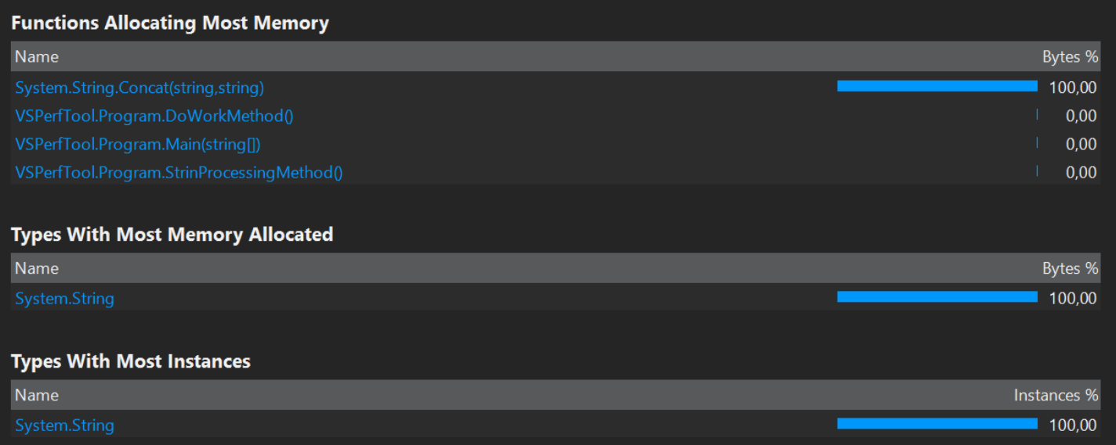
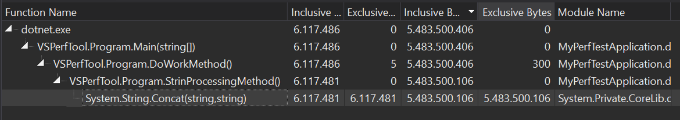
In what method do we allocate the most memory?
String.Concat allocates 100% in our code
System.Strings have the biggest size
System.String has the most instances
Our Program.StringProcessingMethod() calls String.Concat where the allocations happen
Notes:
Now let’s see a typical output from a memory profiler!
This is the report from the Visual Studio memory profiler.
NEXT:
The first list shows which method allocates the most memory. We immediately see that basically only String.Concat allocates.
NEXT:
The second list tells us that System.String takes up 100% of the heap
NEXT:
and the third list tells is the System.String has the most instances in our application. So with the first three lists together tell us that String.Concat() allocates an awful lot of strings.
Now the question is: where do we call String.Concat? At the bottom we have a callstack which tells us exactly this.
NEXT:
We call String.Concat in our StringProcessingMethod, which causes all the allocations.
This is of course a very small example but it already shows the workflow of a memory investigation very well: first we identified which type causes the problem then we searched for the method that allocates too much instances from this specific type.

Slide 22
Look at the method that causes the bottleneck
The ‘+’ operator creates a string every time
Strings are immutable
public static void StrinProcessingMethod()
{
String str = "";
for (int i = 0; i < 10; i++)
{
str += “SampleString1";
str += “SampleString2";
str += “SampleString3";
str += “SampleString4";
str += “SampleString5";
}
//Do something with str
}
Solution: use StringBuilder
Notes:
So this is the point when we look at the method and try to figure out if there is a way to rewrite it to make the code better.
I created this sample to show you a problem, and of course there is a way to make this better: you probably know that Strings in .NET are immutable, so when you add two strings together you actually create a third string regardless of the fact that we reuse the str local variable here.
And the effect of this was clearly visible on the performance report from the previous slide.
NEXT
Now .NET has a solution for this problem, and that is the StringBuilder type. So first performance lesson: if you concatenate lots of strings then use the StringBuilder type because that avoids string allocations.
This was the case on the classic .NET Framework and this of course doesn’t change with .NET Core.

Slide 23
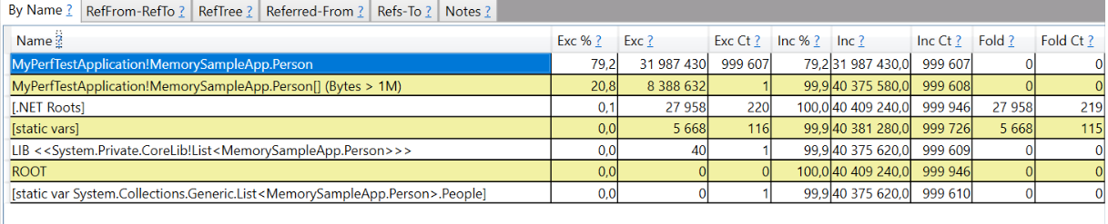
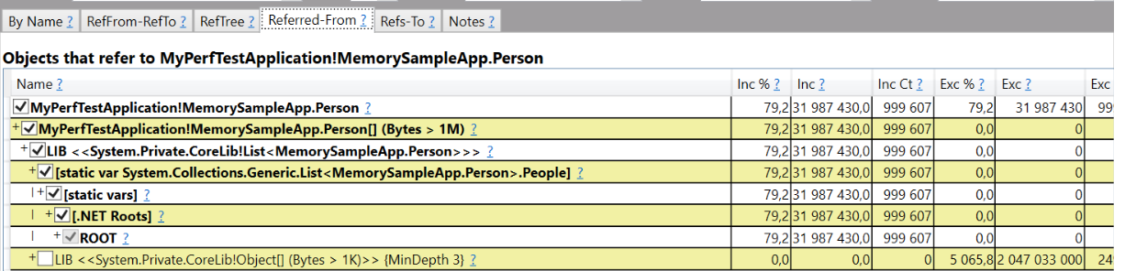
Which GC root holds the reference to the objects?
We have to search for GC roots. Allocation stack does not help
List all objects sorted – ones taking up the most memory are on the top
Track references to GC Roots
Notes:
Now let’s move on to the other question.
Until this point we wanted to see where allocation happens in order to find methods that put pressure to the GC.
Another case is when there aren’t too much allocations, but the allocated objects are never collected.
Now this itself isn’t necessary a problem. If these objects are used then it’s fine that they are not collected. But in some cases this isn’t intentional.
Now basically the only reason an object can’t get collected is that there is a GC root from which you can reach that object. In some cases this is intentional and absolutely fine, but in other cases it’s simply a mistake. In those cases we call this a memory leak.
Now to find the root cause of such a problem it’s not relevant where the allocation happens, so the callstack from our previous sample won’t help. What helps is the path from the object (or objects) that are not collected to the GC root that holds a reference to them and prevents them from being collected.
NEXT:
Such a report can be seen on this slide, which in this case was generated with PerfView.
As you see this list shows all types that had instances on the managed heap and it is sorted based on the number of instances. We see the Person type on the top of the list.
NEXT:
Many tools, like PerfView can show us the path from those instances to the GC root that holds a reference to them. This is what we have in this ScreenShot. It clearly shows that there is a List of Persons that holds the reference to those instances and it even tells us that this is a static field and the name f this field is People.

Slide 24
Source code of the sample app
class Program
{
public static List<Person> People = new List<Person>();
static void Main(string[] args)
{
for (int i = 0; i < 1000000; i++)
{
CreatePerson();
}
Console.ReadKey();
}
public static void CreatePerson()
{
People.Add(new Person { Name = "Test Person", Age = 34 });
}
}
Notes:
And here is the source code of the application that I sampled to create the report from the previous slide.
As you see we really have a static field called People – In our case that was the GC root. So in this example we were not interested in the method that allocated those instances, but we wanted to know what holds a reference to our objects.
Of course this isn’t a real world example, but don’t worry, we will come back to PerfView in a next video.

Slide 25
Demo
Visual Studio Performance Tools - Memory
Notes:
SLIDE: So let’s quickly check this out!
SCREENCAST:
Before we dive into this I would like to add that this feature is intended to help you during development. This is not meant to generate perfect data, and as you will see this is not the way to get automated tests. So the goal with this isn’t to exactly measure how long a method takes, this is rather for give you a first idea about the performance of your code without writing specific code for that with StopWatch or DateTime as many developers do.
Now I always say that you should measure release build, but this feature is actually meant to be used in debug mode, because it is based on breakpoints. And as you probably know in release mode some instructions can be optimized away which affects the mapping between your C# code and the executed machine code and that again affect breakpoints, and that makes this feature in release mode almost impossible to use.
So the point here to get a first impression. In many scenarios to me it doesn’t really matter when one method takes 5 and another 6 milliseconds, with this feature I typically just try to identify the big contributors, so I look for 5x or even 10x differences and with that information I know already in a debugging session where to look for potential optimization.
So in this exceptional case we remain in Debug mode. Btw. you can try to use this in Release mode, but in some cases this may not work and your breakpoints won’t be triggered. In those cases the only option is to either use debuig build or rely on other tools. One option is the Performance Profiler that we will see in the next demo.
So we have a simple .NET Core application here with two methods: the first one reads historical stock exchange data from the disk and the second method calculates a financial indicator called Relative Strength Index. So the first one is IO intensive, the second one is CPU intensive.
It’s not important to understand what RSI is, the point is that it is an algorithm that is CPU bound.
Let’s do line by line debugging.
As you see we hit the first breakpoint,
Let’s execute this line with F10! As you see reading the historical data took 5 ms let’s jump to the next line with F10, so now we calculated the financial indicator which took around 2500 ms.
Now as you see this is a very simple feature but it already gives us an overview. It doesn’t do any magic, but we already know that reading the data takes significantly les time then calculating the financial indicator. Of course this is dependent on the CPU, but we have a 500x difference here, so it’s clear which method is worth to optimize. And by the way the release build would have shown us exactly the same. So what I like about this feature is that I already have useful performance data during development which gives me an idea about the runtime of my methods.
There are also some other nice features here, like you can do the same between two breakpoints, so let’s measure the whole method.
And you can also move the instruction pointer back and measure it again.
And the PerfTips feature is available pretty much everywhere: you can do this in your .NET Core C# code, but also on Full Framework and even on native C++ code.
Now one thing I would like to point out is that in this case we saw that the CPU bound operation takes significantly more time than our IO operation, but this isn’t always the case! In many scenarios I saw the applications spending such more time doing IO then calculating things.
So the takeaway is that you can already see these kind of things with PerfTips, but of course you have to check your release build –which we we learn how to do in a later video.

Slide 26
Summary
.NET has automatic memory management
GC Root
Two things to measure: 1: which method(s) allocate(s) a significant amount of memory? 2: which GC roots prevent large number of objects from being GCed?
Notes:
All right, that’s about measuring memory related things.
Let’s quickly summarize what we learned in this section.
NEXT:
First we discussed that .NET has automatic memory management and how this is done by the GC
NEXT: Then we discussed that GC Roots reference objects from the managed heap and as long as an object is referenced by a GC root then it won’t be callected. It can be either referenced directly or indirectly
NEXT:
Then we discussed that we typically want to measure two things when it comes to GC. First it’s interesting to know which methods allocate significant amount of memory, because these method are good candidates for optimizations, since they put pressure on the GC, and more work for the GC means more work for the CPU.
The second point was to figure out what GC roots prevent a large number of objects from being collected.
NEXT:
Then we discussed that by turning on concurrent GC the GC can run most of the time in parallel with your application code and that server GC has dedicated GC threads.
NEXT: And finally we discussed that unlike with Full Framework you cannot plot GC performance counters with a .NET Core application, since the CoreCLR doesn’t emit performance counters.

Slide 27
Micro Benchmarking with BenchmarkDotNet
Notes:
Welcome to video 3.2 “Micro benchmarking with BenchmarkDotNet”.
In a previous video when I introduced the PerfTips tool in Visual Studio I told you that PerfTips is very nice if you want to have a quick overview about the performance of your methods, but it isn’t an accurate benchmarking framework.

Slide 28
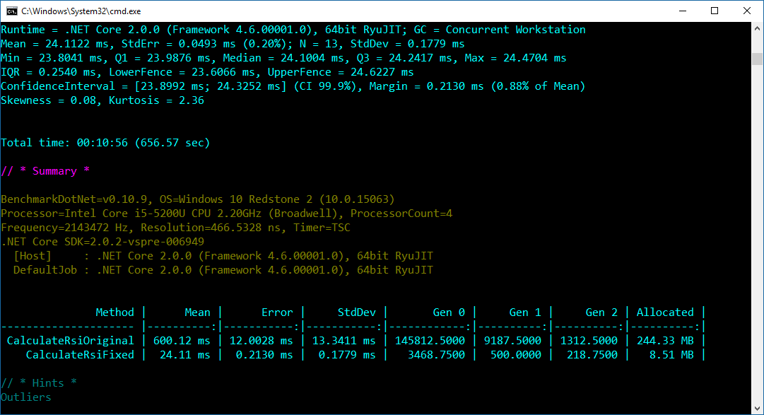
In this Part
BenchmarkDotNet for accurate measurements
Why benchmarking is hard
How BenchmarkDotNet helps
Notes:
It this video we will talk about Benchmark.NET, which is a very powerful benchmarking library that is designed to measure the execution of your code. So unlike with PerfTips the goal in this video is to really get accurate timing information of our code.
We will discuss why benchmarking is hard and we will see how Benchmark.NET solve many of the problems in this area.

Slide 29
Free, Open Source micro benchmarking library for .NET
What is BenchmarkDotNet?
Distributed by NuGet
Hosted on GitHub: https://github.com/dotnet/BenchmarkDotNet
Runs on CoreCLR, Full Framework, and Mono
Notes:
All right, so let’s quickly discuss what Benchmark.NET is!
So Benchmark.NET is a free, open source microbenchmarking library for .NET.
It is distributed with a single nuget package and its source code is hosted on github: https://github.com/dotnet/BenchmarkDotNet
It supports CoreCLR, FullFramework, and even mono.

Slide 30
Why should you use a benchmarking framework?
IL code is JITed when the method is executed the first time
Other applications (e.g. Virus Scanner) can affect your benchmark
Different .NET Flavors, RyuJIT vs. classic JIT, Server vs Workstation GC, etc.
Notes:
Before we dive into the details let’s discuss why you should use a benchmarking framework! At first glance measuring the performance of your method seems to be very easy, you just need to start a stopwatch in the first line of the method and then stop it at the end and print the result.
Now there are many problems with this approach:
NEXT:
First of all, if you have IL code then it will be JITTed before the first run and that can heavily effect your numbers. In fact, as a home work you can try this out: call the method twice and compare the two numbers you get! I bet the second time the method will run significantly faster.
NEXT:
Now running the method twice is still not a solution, because your machine may does something in the background. You can of course run the method multiple times and get an average, but what if your virus scanner decides to run half way through. And how much iterations do you need? 10? 100? Or should this depend on your CPU usage?
NEXT
Another problem is that different .NET runtimes (like Full Framework, Mono, and CoreCLR) behave differently. We have ryuJIT and the classic JIT, we have Server GC and Workstation GC. So if you want accurate numbers then you have to do a lot of work.

Slide 31
BenchmarkDotNet solves these problems!
Several launches with warm-up phase
Smart heuristic to figure out the number of iterations needed
With almost zero work it tests: CoreCLR, Full Framework, Mono
Can test for x86, x64; LegacyJIT, RyuJIT; Server, Workstation GC, etc.
Nice reporting
Supports Windows, Linux, macOS
Notes:
And Benchmark.NET solves exactly these problems.
NEXT
-It does several launches for your methods with a warm-up phase
NEXT
-Is has a heuristic to figure out the number of necessary iterations
NEXT
-With a few attributes it can automatically test your methods nor only on coreclr bur also on mono and FullFramework. The necessary projects are automatically generated for you.
NEXT
-The same applies for bitness (x86,x64), JIT (LegacyJIT/RyuJUT) and different GC Settings (Server/Workstation).
NEXT
-Plus, it has very nice reports with very useful numbers.
NEXT:
-And the good news: benchmarkdotnet is just a NuGet library, so you only have to add a single NuGet package, no installation is needed, and it supports Windows, Linux, and macOS

Slide 32
BenchmarkDotNet Intro
Add NuGet package: BenchmarkDotNet
Mark methods for benchmarking
[Benchmark]
public static void MyMethodToBenchmark()
{
//...hardcore perf. critical algorithm
}
Call BenchmarkRunner.Run<T> in your main method, where T: class containing methods with [Benchmark]
static void Main(string[] args)
{
var summary = BenchmarkRunner.Run<Program>();
}
Notes:
So let’s quickly see how you can use Benchmark.NET.
NEXT
The first step is to add the Benchmark.NET Nuget package to the project where you want to use it. This would be typically a project specifically intended for benchmarking.
NEXT
Once you have the NuGet package there are only two steps to already have the first results: you have to mark methods that you want to measure with the [Benchmark] attribute.
NEXT
Then you have to call the BenchmarkRunner.Run method in the main method of your program and pass the class that you want to benchmark as a generic parameter.
That’s it, after that you can start your program and Benchmark.NET will do it’s job

Slide 33
Demo
BenchmarkDotNet
Notes:
SLIDE: So let’s quickly take a look at this.
SCREENCAST:
I have our program here that we used in an earlier video when we learned about the diagnostic tools in Visual Studio. You may remember that we fixed the allocation problem with the Skip LINQ method. In that video, I measured the difference with PerfTips, which wasn’t actually a very precise measurement. In this code I have both versions, one prefixed with fix, that contains my fix to the allocation problem and the original one.
But let’s quickly take a look at the difference. So the original implementation always iterates through the items and with the skip operation it removes the first item in every iteration. This creates a new list in every iteration.
And then here we have the second implementation with the fix that we discussed in the Video 2.4. Instead of creating a new list in each iteration we keep track of the progress with an integer.
Now you may wonder who writes code like this original version. So let me quickly tell the story of this code. I wrote a small library to calculate different financial indicators in F# and that library also included this RSI calculator. I wanted to use that library in a Universal Windows Platform application, but unfortunately currently UWP doesn’t support F#. So I simply opened the compiled F# library in ILSpy, I switched the programming language to C# and copied that decompiled C# code. I had to adapt a few types, but basically this code is the C# equivalent of the code that the F# compiler generated. This was a recursive function with arrays. So this example isn’t really made up, that is actual code that ended up in my application.
All right, let’s move on and measure the difference between the original and the fixed version!
So this code is in a Netstandard 2.0 library. So, imagine you have your source code repository with a library.
First let’s create a project to host benchmark.NET, so I simply add a new console application. I also added methods to this new console application that call the original and the fixed method. So these are the methods that we will measure.
The first thing what we need in the new project is a reference to our .NET Standard library.
Then we add the Benchmark.net Nuget package to our benchmarking application.
And then the next step is to mark our calculation methods with the Benchmark attribute.
And then finally let’s call the BenchmarkRunner.Run method from the benchmarking programs main method.
I always say that you should benchmark Release build, this is especially important with micro benchmarking, BenchMark.NET will even warn you with a red text if you do that, so let’s switch to Release mode first, and then let’s start the project.
Now such a test can take longer, since Benchmark.net does a warm-up phase and as discussed runs the methods multiple times based on some smart algorithms.
And here we have the results. As you see we have a very nice report, although the result in this case isn’t surprising, the fixed version is significantly faster! Benchmark.NET not only prints those into the console, but also stores them in different format on the disk. So, pushing the data into some reporting service is very easy!
Now think about what we reached with this a little setup, because this is a very important step. I always say that you should measure everything and you should have baselines and repeatable test before you start working on performance. Now here we have a setup that is an optimal starting point for a performance improvement project. We just crated a project that measures the performance of our library so we have repeatable test here that we can start automatically. So, no more guessing, and no more gut feelings, we have accurate and repeatable test here!
So, if performance is important to you, and if you have performance critical parts in your code I would highly suggest that you create a similar setup and write some performance tests that you integrate into your CI. These can serve as baseline and can be executed periodically. This way you can immediately discover performance degradations in your performance critical methods.

Slide 34
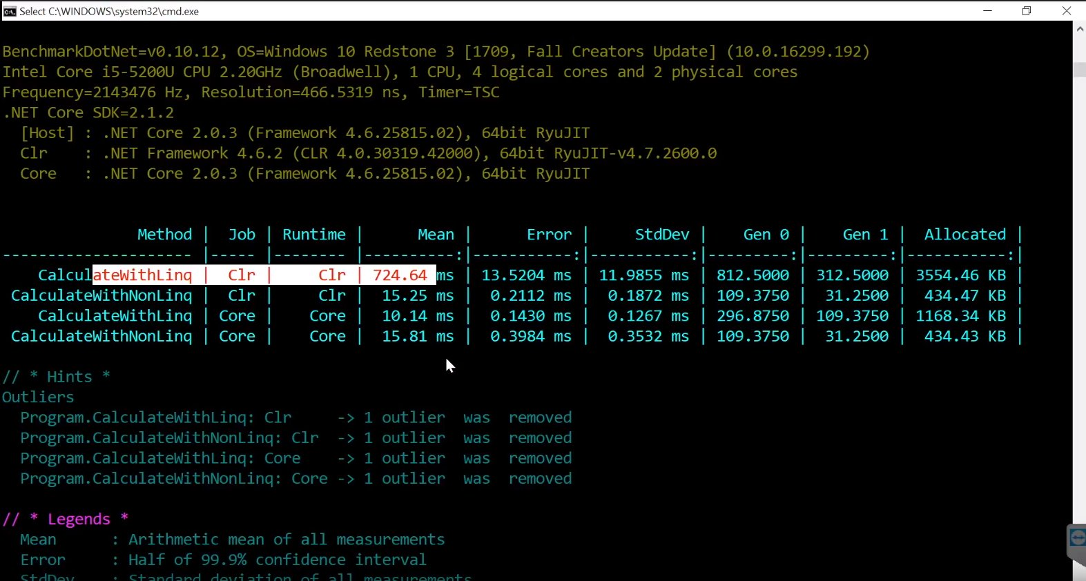
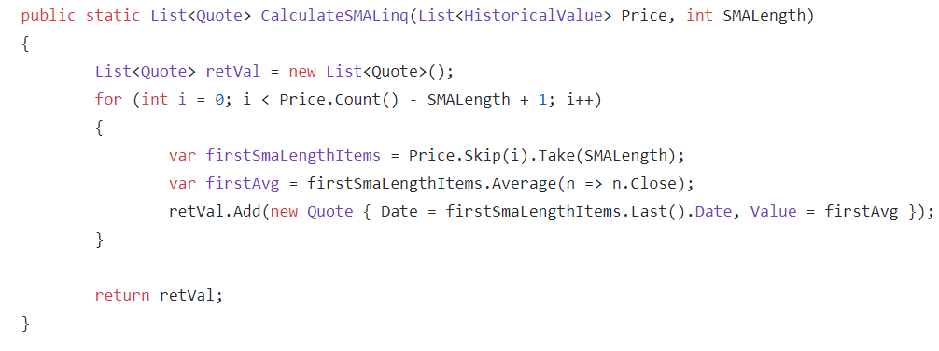
Benchmarkdotnet Full Framework vs. .NET Core

