Slide 1
Part 4: Data Access Layer Performance

Slide 2
In this Part
Differences between micro and macro benchmarking
When should you do macro benchmarking?
Data Access Layer performance
Demo!
Always!
Notes:
Until this point we talked about low level micro benchmarking, for example we saw how to properly measure the execution of a method with BenchmarkDotNet and we also discussed things like GC statistics. This time we go to the macro level.
We will discuss the differences between micro and macro benchmarking and we will also discuss when you should do macro benchmarking.
NEXT
NO …Well, I tell you that already now: do it always!
Anyway, we will discuss more about this later in the video
This time we move on from a simple console application, we will benchmark an asp.net core application with additional dependencies. We will use Prefix from Stackify to get the big picture about the performance of this application.
And then we will also talk about the Profiling API of the CLR.

Slide 3
Micro vs. Macro benchmarking
Micro benchmarking:
Mostly we did this in the previous videos
Measuring methods, GC, tracking allocations, etc.
In many cases it is very hard (Code has to be isolated, no dependencies)
Macro benchmarking:
Taking dependencies into account
ASP.NET Core – Response time, Database calls, External HTTP calls, etc.
Most of the .NET Applications out there spend significant time waiting on dependencies
Notes:
As the first step I would like to define what I mean by micro and macro benchmarking.
NEXT
So what we did in previous videos was actually micro benchmarking. We measured low level things like the execution of our methods, we tracked allocations, and we monitored the allocation count on the different heap generations.
Now all that is very important but there are cases when those metrics are not useful and investigating CPU and memory isn’t the way to go.
In fact for example if you have a typical .NET business application then measuring these kinds of things is really hard because those applications typically have external dependencies and the code is not architecture in a way that you can substitute those dependencies then those microbenchmarks won’t deliver meaningful data.
NEXT:
And this is exactly where Macrobenchmarking comes into the game. What I mean by macro benchmarking is that we take a step back and look at the big picture. We don’t really care about low level metrics, instead we focus on high level data which also takes dependencies into account.
So let’s take an example: let’s say we have an ASP.NET Core application. It absolutely makes sense to for example measure each HTTP call and see how long those take. Or another macro benchmark would be to monitor the outgoing HTTP calls or the database calls within the application. Furthermore it’s even better if this data is correlated. So for example imagine that for every ASP.NET Core action method you see how long those requests take and you also see every external dependency with timing information. In many cases it makes more sense to first get such an overview and if it’s needed dive deeper into the application with tools like the Visual Studio Performance Profiler, PerfView, or even BenchmarkDotNet.

Slide 4
MiniProfiler
Open-Source, Developed by StackExchange (StackOverflow)
https://github.com/miniprofiler
Relies on data that frameworks (e.g. EFCore) provide and on manual instrumentation
Distributed through multiple NuGet packages (package names later)
Works also on non Windows Systems (Mac, Linux, etc.)
Notes:
So MiniProfiler is an open source profiler tool that also supports .NET Core. It was created by the StackExhange team and they use that to profile sites like StackOverflow. Now if you didn’t know stackoverflow.com is based on .NET and that website has huge traffic.
StackExchange has a very open engineering culture, they blog a lot about their performance work and they also opensourced many of their tools and MiniProfiler is one of their great tool that everyone can use.
Unlike PreFix it does’t rely on the profiler API. In fact it does exactly what we discussed in on the previous slide. It relies on API offered by libraries and on additional manual instrumentation.
MiniProfiler can be added to your application through NuGet packages. We will come back to the package names in a moment.
Now one big advantage of miniprofiler is that it works on non windows systems. For example my own website, which is an ASP.NET Core application runs on a linux server and for development I mostly use macOS.
Now with that setup I cannot use for example PreFix, because it only works on Windows. And this is the reason why I want to introduce you MiniProfiler. MiniProfiler is basically a set of plain managed libraries, so it works everywhere. The downside is that you have to change your code manually, but the good thing is that no matter what kind of OS you use it will work.

Slide 5
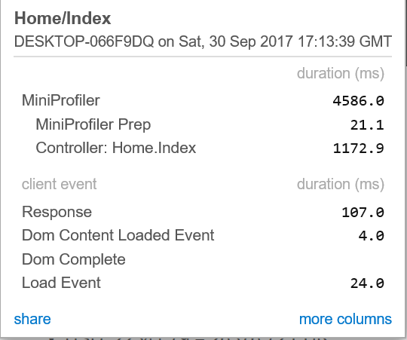
Add MiniProfiler to your ASP.NET Core app – First steps
Add “MiniProfiler.AspNetCore.Mvc“ package to track ASP.NET Core requests
Add „services.AddMiniProfiler()” to the „ConfigureServices” method in “Startup.cs”
Add “app.UseMiniProfiler();” to the Configure method
In _ViewImports.cshtml add “@addTagHelper *, MiniProfiler.AspNetCore.Mvc”
Add <mini-profiler /> to your master layout
Notes:
Let’s quickly go through the process of adding miniprofiler to an asp.net core application.
So the first step is to add the MiniProfiler.AspNetCore.MVC package to your project, and then in the startup.cs file you have to make two changes.
In the ConfigureServices method you need to add MiniProfiler to your services and in the Configure method you have to call UseMiniProfiler on your IApplicationBuilder.
With that miniprofiler will already measure the incoming requests, in order to see the data you have to make two additional changes:
NEXT:
In your ViewImports you have to add the Miniprofiler taghelper and you have to use this taghelper on a page to show the data. Typically this is done in the master layout page.
Once you did that you will see profiler information on your website. Of course you can check if you are in a non production environment and only use the taghelper to show the data in non production system. ASP.NET Core has many concepts for that.
On the bottom right part of the slide you can see what MiniProfiler shows us with this setup.

Slide 6
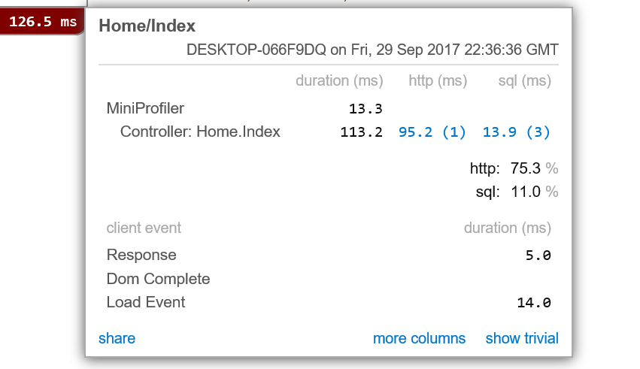
Add MiniProfiler to your ASP.NET Core app – Database and HTTP Calls
Measure Entity Framework Core calls: Add “MiniProfiler.EntityFrameworkCore” NuGet package In ConfigureServices:
public void ConfigureServices(IServiceCollection services)
{
services.AddDbContext<MyTestDbContext>();
services.AddMiniProfiler().AddEntityFramework();
//…rest of the method
}
Measure outgoing Web Request calls
var url = //…target URL
using (MiniProfiler.Current.CustomTiming("http", "GET " + url))
{
HttpClient httpClient = new HttpClient();
var response = await httpClient.GetAsync(url);
result = await response.Content.ReadAsStringAsync();
}
Measure a piece of code:
using (MiniProfiler.Current.Step("Convert currencies"))
{
//any code you want to measure
}
Notes:
Now with the changes from the previous slide you will automatically get timing information about the incoming requests, but that’s it. So unlike with PreFix you won’t see your database and HTTP calls.
In order to also track those you need a little bit of additional work. So let’s discuss how you san see a little bit more for example database and http calls similar to the screenshot on the bottom right part.
So to add database tracing you have to add the MiniProfiler.EntityFrameworkCore NuGet package and when you add MiniProfiler to your serveices in the ConfigureServices method you have to call the AddEntityFramework method. After that you will see your database calls with timing information and you will even be able to see the executed SQL queries. This applies to any database call through Entity Framework core, so on the code level there is not much to do.
NEXT
Unfortunately for outgoing HTTP request there isn’t a one liner that would turn on tracking for every HTTP call. For those you have to write code for every outgoing request. As you can see here on the code snippet you have to call the CustomTiming method on the MiniProfiler type and pass the HTTP method and the url as parameters in a using block. MiniProfiler will then automatically measure everything that is inside the using block.
NEXT
Additionally you can also define custom steps with the Step method. These steps measure everything within the using block and MiniProfiler also shows you this data on the UI.

Slide 7
Demo
Optimization of Entity Framework code with MiniProfiler
Notes:
SLIDE: So let’s quickly take a look at this.
SCREENCAST:
I have our program here that we used in an earlier video when we learned about the diagnostic tools in Visual Studio. You may remember that we fixed the allocation problem with the Skip LINQ method. In that video, I measured the difference with PerfTips, which wasn’t actually a very precise measurement. In this code I have both versions, one prefixed with fix, that contains my fix to the allocation problem and the original one.
But let’s quickly take a look at the difference. So the original implementation always iterates through the items and with the skip operation it removes the first item in every iteration. This creates a new list in every iteration.
And then here we have the second implementation with the fix that we discussed in the Video 2.4. Instead of creating a new list in each iteration we keep track of the progress with an integer.
Now you may wonder who writes code like this original version. So let me quickly tell the story of this code. I wrote a small library to calculate different financial indicators in F# and that library also included this RSI calculator. I wanted to use that library in a Universal Windows Platform application, but unfortunately currently UWP doesn’t support F#. So I simply opened the compiled F# library in ILSpy, I switched the programming language to C# and copied that decompiled C# code. I had to adapt a few types, but basically this code is the C# equivalent of the code that the F# compiler generated. This was a recursive function with arrays. So this example isn’t really made up, that is actual code that ended up in my application.
All right, let’s move on and measure the difference between the original and the fixed version!
So this code is in a Netstandard 2.0 library. So, imagine you have your source code repository with a library.
First let’s create a project to host benchmark.NET, so I simply add a new console application. I also added methods to this new console application that call the original and the fixed method. So these are the methods that we will measure.
The first thing what we need in the new project is a reference to our .NET Standard library.
Then we add the Benchmark.net Nuget package to our benchmarking application.
And then the next step is to mark our calculation methods with the Benchmark attribute.
And then finally let’s call the BenchmarkRunner.Run method from the benchmarking programs main method.
I always say that you should benchmark Release build, this is especially important with micro benchmarking, BenchMark.NET will even warn you with a red text if you do that, so let’s switch to Release mode first, and then let’s start the project.
Now such a test can take longer, since Benchmark.net does a warm-up phase and as discussed runs the methods multiple times based on some smart algorithms.
And here we have the results. As you see we have a very nice report, although the result in this case isn’t surprising, the fixed version is significantly faster! Benchmark.NET not only prints those into the console, but also stores them in different format on the disk. So, pushing the data into some reporting service is very easy!
Now think about what we reached with this a little setup, because this is a very important step. I always say that you should measure everything and you should have baselines and repeatable test before you start working on performance. Now here we have a setup that is an optimal starting point for a performance improvement project. We just crated a project that measures the performance of our library so we have repeatable test here that we can start automatically. So, no more guessing, and no more gut feelings, we have accurate and repeatable test here!
So, if performance is important to you, and if you have performance critical parts in your code I would highly suggest that you create a similar setup and write some performance tests that you integrate into your CI. These can serve as baseline and can be executed periodically. This way you can immediately discover performance degradations in your performance critical methods.

