Slide 1

ASP.NET Core 2.0 New Project to CI/CD
Erik Dahl
@dahlsailrunner
knowyourtoolset.com
https://app.pluralsight.com/profile/author/erik-dahl

Slide 2
Discussion Flow
Look at the running application
Benefits of ASP.NET Core and when *not* to use it
Creating a new ASP.NET Core project
Preparing the project for development, git, and builds
Front-end review
Back-end review
Build setup
Release setup

Slide 3
Benefits of ASP.NET Core
Run in IIS, nginx, Apache, Docker
Lightweight and high performance
Tooling that makes modern dev easier
https://docs.microsoft.com/en-us/aspnet/core/
When to use full .NET Framework
Existing apps – no need to quickly port them
Dependencies or functionality not (yet) available in .NET Core
https://docs.microsoft.com/en-us/dotnet/standard/choosing-core-framework-server
Recommendation: Extend applications with .NET Core when applicable – i.e. new API or similar; port class libraries to .NET Standard

Slide 4
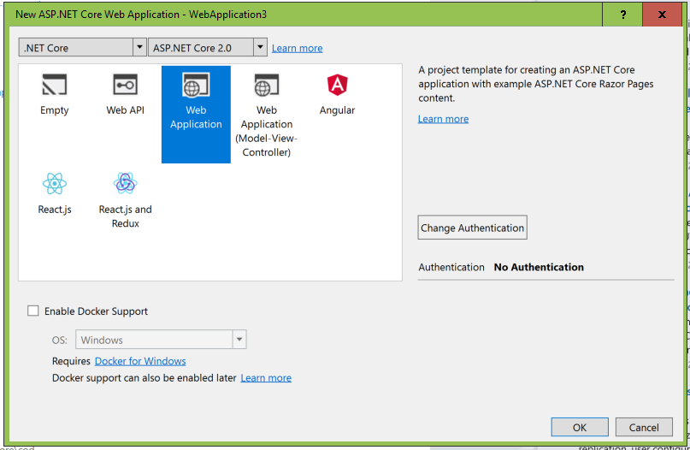
Creating a new ASP.NET Core project
Visual Studio has built-in templates
dotnet new <project type> from command line
web, mvc, razor, angular, react, reactredux, webpai
https://docs.microsoft.com/en-us/dotnet/core/tools/dotnet-new?tabs=netcore2x

Slide 5
Preparing the project
Dependencies
Nuget – Dapper for data access
Bower – bootstrap (and jquery), kendo-ui
npm – font-awesome, @types for TypeScript definitions
TypeScript and tsconfig.json
Choose locations for both ts and js files
Build setup
npm packages need to get into wwwroot
.gitignore
Don’t check in packages or build output
_Layout.cshtml
Global script and stylesheet refs

Slide 6
Front-End Review
Packages
Bootstrap: Layout, alerts, etc
Kendo UI Core: UI Controls, MVVM framework
font-awesome: spinners
Index.cshtml (view)
Index.ts → index.js (view model)

Slide 7
Back-End Review
Configuration (appsettings.json)
Services
Exception handling
Data Access
Controllers

Slide 8
Build Setup
Restores
.NET Core
npm
Bower
Build
TypeScript build
Publish .NET Core app
Publish artifacts
Continuous Integration (CI) trigger

Slide 9
Release Setup
Copy artifacts to target server
Set up IIS
No Managed Code for app pool
Deploy package into IIS
Continuous Deployment trigger

