Slide 1
Photoviewer
David Stahl

Slide 2
Agenda
Demo
Model-View-Controller
Observer Pattern
Singleton Pattern
State Pattern

Slide 3
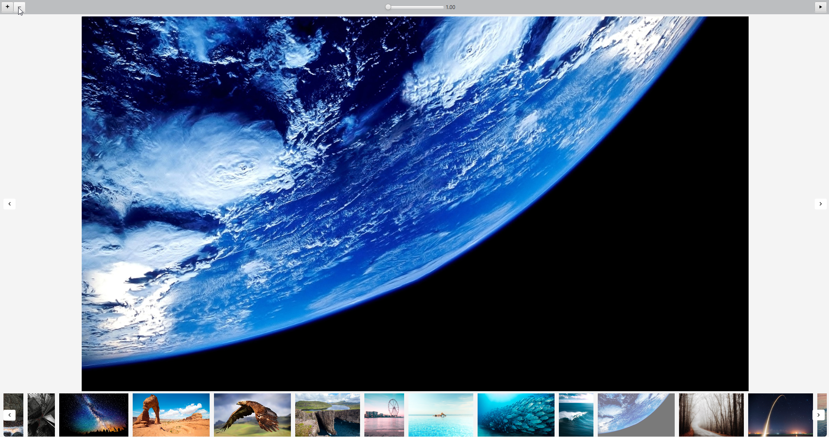
Demo

Slide 4
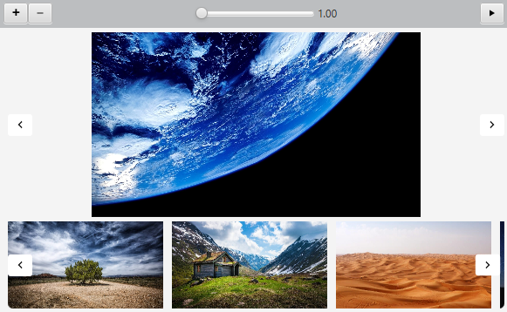
Model-View-Controller
Top Bar
Photo Viewer
Thumb List

Slide 5
Model-View-Controller
Models
PhotoList
Zooming
ThumbListController
PhotoViewController
TopBarController
Controller
ThumbList
Photo Viewer
TopBar
Views

Slide 6
Observer Pattern
Observable
PhotoList
Zooming
ThumbListController
PhotoViewController
TopBarController
Observer

Slide 7
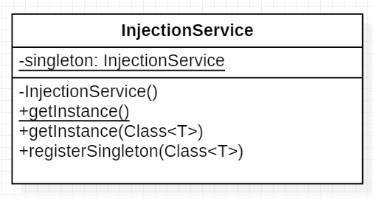
Singleton Pattern
Injektion der Observable-Instanzen mithilfe des Dependency-Injection-Patterns

Slide 8
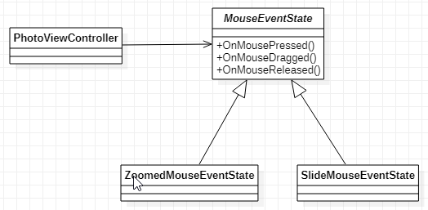
State Pattern

Slide 9
Vielen Dank

