Slide 1
Windows Scripting Host

Slide 2

Using Windows Scripting Host
David Stevenson
Senior Software Engineer, ABB Automation
drs2@frontiernet.net
www.ontotechnology.com/vduny

Slide 3
Script: VBScript or JavaScript?
ASP - Server Side Script
Internet Explorer - Client Side Script
Windows Script Host - Desktop

Slide 4
Windows Scripting Host
Easy Registry
Find Special Folders
Environment Variables
Network: Network Drives, Printers
Shortcuts
URL Shortcuts
Regular Expressions (VBScript 5.0)
Doesn’t need VB Run-time components installed

Slide 5
Why Windows Scripting Host?
System Administration
Automate common tasks
A replacement for MS-DOS .bat files
A way to test components
Object oriented access to registry, system folders, network drives, printers, etc.
Doesn’t need VB Runtime libraries or installation
“Glue Language” - Glue components together
Notes:
Full COM Support. Example: Excel.
Demo: Microsoft Examples
Double-Click: Chart.vbs
To show code: Right-click, edit Chart.vbs, close code.

Slide 6
Where to get WSH?
Windows 98 and Windows 2000
Internet Explorer 5
NT 4.0 Option Pack
msdn.microsoft.com/scripting
Will run with Windows 95

Slide 7
Development Environment
Notepad or your favorite text editor
Name the text file with .vbs extension
.js for JavaScript, .wsf for Windows Script File
Double-click .vbs, .js .wsf file to launch
Also works with VB Applications

Slide 8
Visual Basic Project References
Microsoft Windows Scripting Host Object Model - WSHOM.OCX
Windows Scripting Host - Wscript.exe
Microsoft Scripting Runtime - SCRRUN.DLL
Microsoft VBScript Regular Expressions - VBScript.dll\2

Slide 9
Wscript Properties and Methods
Arguments (Collection)
Echo
GetObject
CreateObject
Quit
Version

Slide 10
Wscript.Shell Properties and Methods
Run
Popup
CreateShortcut
SpecialFolders (Collection)
Environment (Collection)
RegDelete
RegRead
RegWrite

Slide 11
I/O Redirection
Wscript.Echo “Output text.”
Outputs to Message Box if script run by Wscript.exe
Outputs to command line (standard output) if script run by Cscript.exe
Set WshShell = CreateObject ( "Wscript.Shell" )
WshShell.Popup "This is popup text.”
WshShell.Popup always outputs to message box
Notes:
Double-click: Echo.vbs
In Command Line Window:
Cscript Echo.vbs

Slide 12
Command Line Arguments
For each objArg in Wscript.Arguments
Wscript.Echo objArg
Next
Or:
For i = 0 to Wscript.Arguments.Count - 1
Wscript.Echo Wscript.Arguments ( i )
Next
Notes:
Cscript Arguments.vbs arg1 arg2 arg3

Slide 13
WshShell.Run Syntax
Syntax
WshShell.Run (strCommand, [intWindowStype], [bWaitOnReturn])
Parameters
strCommand
Environment variables within the strCommand parameter are automatically expanded.
intWindowStyle
vbHide (0), vbNormalFocus (1), vbMinimizedFocus (2),
vbMaximizedFocus (3), vbNormalNoFocus(4), vbMinimizedNoFocus (6) (see Shell function)
bWaitOnReturn
If bWaitOnReturn is not specified or FALSE, this method immediately returns to script execution rather than waiting on the process termination.
If bWaitOnReturn is set to TRUE, the Run method returns any error code returned by the application.
If bWaitOnReturn is not specified or is FALSE, Run returns an error code of 0 (zero).
Notes:
Double-click: Calc.vbs
Select Calc.vbs, right-click, choose edit to display code.

Slide 14
Run Example 1
A script that brings up Notepad to edit itself.
Set WshShell = Wscript.CreateObject("Wscript.Shell")
WshShell.Run ( "%windir%\notepad" & Wscript.ScriptFullName )
Notes:
Double-click EditMe.vbs
Select EditMe.vbs, right-click, choose edit to display code.

Slide 15
Run Examples - Advanced 1
Bring up the default application for any extension (ex. .xls, .doc, .txt)
Set shell = CreateObject ( "WScript.Shell" )
shell.run "note.txt”
Run Windows Explorer using Run
Set shell = CreateObject ( "WScript.Shell" )
shell.run "c:"
shell.run Chr(34) & "E:\Windows Script Host" & Chr(34)

Slide 16
Run Examples - Advanced 2
Bring up Mail Window
Set shell = CreateObject ( "WScript.Shell" )
shell.run "mailto:drs2@frontiernet.net;stevenso@eng14.rochny.uspra.abb.com”
Run Internet Explorer
Set shell = CreateObject ( "WScript.Shell" )
shell.run "http://www.wrox.com"

Slide 17
Registry - Visual Basic Style
Disadvantages:
  SaveSetting, GetSetting, GetAllSettings and DeleteSetting use:
  HKEY_CURRENT_USER\Software\VB and VBA Program Settings
  Win API approach more complex.
  An object oriented approach would be better (IntelliSense).

Slide 18
Registry - Hive Abbreviations
Short Long
HKCU HKEY_CURRENT_USER
HKLM HKEY_LOCAL_MACHINE
HKCR HKEY_CLASSES_ROOT
HKEY_USERS
HKEY_CURRENT_CONFIG

Slide 19
Registry - RegWrite Syntax
WshShell.RegWrite strKey, anyValue[, strType]
where strType is one of:
  "REG_SZ"
  "REG_EXPAND_SZ"
  Example value: "%SystemRoot%\Notepad.exe"
  "REG_DWORD" - Visual Basic Type Long
  "REG_BINARY”

Slide 20
Registry - RegRead, RegDelete
RegRead supports following types: REG_SZ, REG_EXPAND_SZ, REG_DWORD, REG_BINARY, and REG_MULTI_SZ
varValue = WshShell.RegRead ( strKey )
WshShell.RegDelete strKey

Slide 21
Registry Example
Set WshShell = Wscript.CreateObject ( "Wscript.Shell" )
strRegKey = "HKCU\Software\VDUNY\RegistryWriteTest"
WshShell.RegWrite strRegKey, "Hello Registry"
strReadRegistry = WshShell.RegRead ( strRegKey )
Wscript.echo strReadRegistry
Wshell.RegDelete strRegKey
Notes:
Double-click: Registry.vbs in C:\WSH
Also in Microsoft Examples:
Registry.vbs

Slide 22
Wscript.Network Properties
ComputerName
UserDomain
UserName

Slide 23
Wscript.Network Methods
MapNetworkDrive
EnumNetworkDrives
AddPrinterConnection
RemovePrinterConnection
SetDefaultPrinter
Notes:
Microsoft Examples:
Double-click: Network.vbs
To display code: Select Network.vbs, Right-click, choose Edit.

Slide 24
Network Information
Computer Name
User Domain
User Name
Set net = CreateObject ( "Wscript.Network" )
Wscript.echo "Computer Name: " & net.ComputerName
Wscript.echo "User Domain: " & net.UserDomain
Wscript.echo "User Name: " & net.UserName

Slide 25
Create or Remove Network Drives
Set net = CreateObject ( "Wscript.Network" )
net.MapNetworkDrive ( "Z:", "\\abbntroc01\develop" )
net.RemoveNetworkDrive "Z:"

Slide 26
Enumerate Network Drives
Private Const conWindowTitle = "Enumerate Network Drives"
Dim WSHNetwork, colDrives, strMsg, i
Set WSHNetwork = WScript.CreateObject("WScript.Network")
Set colDrives = WSHNetwork.EnumNetworkDrives
If colDrives.Count = 0 Then
MsgBox "There are no network drives.", vbInformation + vbOkOnly, conWindowTitle
Else
strMsg = "Current network drive connections: " & vbCrLf
For i = 0 To colDrives.Count - 1 Step 2
strMsg = strMsg & vbCrLf & colDrives(i) & vbTab & colDrives(i + 1)
Next
MsgBox strMsg, vbInformation + vbOkOnly, conWindowTitle
End If
Notes:
Double-click: EnumNetworkDrives.vbs

Slide 27
Network Printers
Private Const conWindowTitle = "Enumerate Network Printers"
Dim WSHNetwork, colPrinters, strMsg, i
Set WSHNetwork = WScript.CreateObject ( "WScript.Network" )
Set colPrinters = WSHNetwork.EnumPrinterConnections
If colPrinters.Count = 0 Then
MsgBox "There are no network printers.", vbInformation + vbOkOnly, conWindowTitle
Else
strMsg = "Current network printers: " & vbCrLf
For i = 0 To colPrinters.Count - 1 Step 2
strMsg = strMsg & vbCrLf & colPrinters(i) & vbTab & colPrinters(i + 1)
Next
MsgBox strMsg, vbInformation + vbOkOnly, conWindowTitle
End If
Notes:
EnumPrinters.vbs works under Windows 2000, but not under Windows NT.

Slide 28
Expand Environment Strings
Set WshShell = CreateObject ( "Wscript.Shell" )
strExpanded = WshShell.ExpandEnvironmentStrings ("%SystemRoot%\System32\notepad.exe")
MsgBox strExpanded
Notes:
Double-click: ExpandEnvironmentStrings.vbs

Slide 29
Environment Variables
Set WshShell = Wscript.CreateObject ( "Wscript.Shell" )
' May select either "SYSTEM", "USER", or "VOLATILE"
For each strVarName in WshShell.Environment ( "SYSTEM" )
  Wscript.echo strVarName
Next
' Set a reference to the SYSTEM environment variables collection
Set WshSysEnv = WshShell.Environment ( "SYSTEM" )
Wscript.echo "TEMP", WshSysEnv ( "TEMP" )
Notes:
Cscript Environment.vbs
Microsoft Examples:
ShowVar.vbs

Slide 30
Special Folders
More special folders than FileSystemObject
FileSystemObject GetSpecialFolder supports:
WindowFolder, SystemFolder, TemporaryFolder
WSH supports:
AllUsersDesktop, AllUsersStartMenu, AllUsersPrograms, AllUsersStartup, Desktop, Favorites, Fonts, MyDocuments, NetHood, Programs, Recent, SendTo, StartMenu, Startup and Templates
Notes:
Cscript SpecialFolders2.vbs

Slide 31
Special Folders Example
Set WshShell = Wscript.CreateObject ( "Wscript.Shell" )
Wscript.echo "Desktop", WshShell.SpecialFolders ( "Desktop" )
For each strFolder in WshShell.SpecialFolders
Wscript.echo strFolder
Next
Notes:
Skip this example:
Cscript SpecialFolders.vbs

Slide 32
Shortcuts
Dim WSHShell, MyShortcut, MyDesktop, DesktopPath
Set WSHShell = WScript.CreateObject("WScript.Shell")
DesktopPath = WSHShell.SpecialFolders("Desktop")
' Create a shortcut object on the desktop
Set MyShortcut = WSHShell.CreateShortcut(DesktopPath & "\Shortcut to notepad.lnk")
' Set shortcut object properties and save it
MyShortcut.TargetPath = WSHShell.ExpandEnvironmentStrings("%windir%\notepad.exe")
MyShortcut.WorkingDirectory = WSHShell.ExpandEnvironmentStrings("%windir%")
MyShortcut.WindowStyle = 4
MyShortcut.IconLocation = WSHShell.ExpandEnvironmentStrings ("%windir%\notepad.exe, 0")
MyShortcut.Save
Notes:
CreateShortcut.vbs
Microsoft Examples:
Double-click: Shortcut.vbs

Slide 33
URL Shortcuts
Dim WSHShell, MyShortcut, DesktopPath
Set WSHShell = WScript.CreateObject("WScript.Shell")
DesktopPath = WSHShell.SpecialFolders("Desktop")
' Create a shortcut object on the desktop
Set MyShortcut = WSHShell.CreateShortcut(DesktopPath & "\Where do you want to go today.url")
MyShortcut.TargetPath = "http://www.microsoft.com"
MyShortcut.Save
Notes:
Double-click URLShortcut.vbs

Slide 34
VBScript Version 5.0
Regular Expressions
Const statement
DCOM Support, CreateObject supports remote objects
Classes
With statement
Eval/Execute
Script encoding
Performance enhancements in IE5 and IIS5 (Win2000)

Slide 35
Classes
All functions and subroutines in a class are Public unless they are declared Private.
Keywords: “Class YourNameHere”, “End Class”.

Slide 36
Class Example
Set MyEmp = New CEmployee
MyEmp.FirstName = InputBox ( "Enter the first name: ” )
MsgBox "Hello, " & MyEmp.FirstName
Class CEmployee
Private strFirstName
Private strID
Property Get FirstName ( )
FirstName = strFirstName
End Property
Property Let FirstName ( strNew )
strFirstName = strNew
End Property
End Class
Adapted from: Jeffrey P. McManus, “Create Classes in VBScript 5.0”, VBPJ, April, 1999.
Notes:
See folder: McManus, Create Classes in VBScript 5.0
empclass.vbs generates error because Option Explicit requires MyEmp to be declared.
Empcls2.vbs works. It’s the basic class as above.
Empcls3.vbs prompts for employee names: Johnson, Jones, Manjo,
Smith, Smythe, Terwilliger.

Slide 37
Regular Expressions
Complex Pattern Matching - Unix Style
Textual search-and-replace algorithms

Slide 38
VBScript RegExp object
Properties
  Pattern - A string that is used to define the regular expression.
  IgnoreCase
  Global - A read-only Boolean property that indicates if the regular expression should be tested against all possible matches in a string.

Slide 39
VBScript RegExp object
Methods
  Test (string) - Returns True if the regular expression can successfully be matched against the string, otherwise False is returned.
  Replace (search-string, replace-string)
  Execute (search-string) - Returns a Matches collection object, containing a Match object for each successful match. Doesn't modify the original string.

Slide 40
Pattern Matching - Position
^ Only match the beginning of a string. "^A" matches first "A" in "An A+ for Anita."
$ Only match the ending of a string. "t$" matches the last "t" in "A cat in the hat"
\b Matches any word boundary "ly\b" matches "ly" in "possibly tomorrow."
\B Matches any non-word boundary

Slide 41
Pattern Matching - Literals
[xyz] Match any one character enclosed in the character set.
[^xyz] Match any one character not enclosed in the character set.
. Match any character except \n.
\w Match any word character. Equivalent to [a-zA-Z_0-9].
\W Match any non-word character.
\d Match any digit.
\D Match any non-digit.
\s Match any space character.
\S Match any non-space character.
\n Matches a new line
\f Matches a form feed
\r Matches carriage return
\t Matches horizontal tab
\v Matches vertical tab
Repetition
{x} Match exactly x occurrences of a regular expression.
(x,} Match x or more occurrences of a regular expression.
{x,y} Matches x to y number of occurrences of a regular expression.
? Match zero or one occurrences. Equivalent to {0,1}.
* Match zero or more occurrences. Equivalent to {0,}.
+ Match one or more occurrences. Equivalent to {1,}.

Slide 42
Pattern Matching - Alternation and Grouping
( ) Grouping a clause to create a clause. May be nested. "(ab)?(c)" matches "abc" or "c".
| Alternation combines clauses into one regular expression and then matches any of the individual clauses.
"(ab)|(cd)|(ef)" matches "ab" or "cd" or "ef".
Notes:
See folder: McManus, Create Classes in VBScript 5.0
Example: empsrch.vbs
Need to figure out how to use this script.

Slide 43
RegExp Example 1 - Zip Code
Dim re As RegExp
Set re = New RegExp
re.Pattern = “^\d{5}(-\d{4})?$”
If re.test ( “12345-6789” ) then
  MsgBox “It’s a valid zip code.”
Else
  MsgBox “It’s not a valid zip code.”
End If

Slide 44
RegExp Example 2 - Phone No.
Public Function IsValidPhoneNumber ( strPhone )
Dim re ' As RegExp
Set re = New RegExp
re.Pattern = "^[01]?\s*[\(\.-]?(\d{3})[\)\.-]?\s*(\d{3})[\.-](\d{4})$"
If re.test ( strPhone ) then
IsValidPhoneNumber = True
Wscript.Echo strPhone & " is a valid phone number."
Else
IsValidPhoneNumber = False
Wscript.Echo strPhone & " is NOT a valid phone number."
End If
End Function

Slide 45
WSH 2.0
Support for Include statements
Support for multiple script engines
Support for Type Libraries (get constants)
XML syntax allows use of XML editors
Support for multiple jobs in one file

Slide 46
Windows Script Files (.WSF)
<?xml version="1.0"?>
<job>
<script language="VBScript">
Function MessageBox(strText)
MsgBox strText
End Function
</script>
<script language="JScript">
var strText1;
strText1 = "Hello, world!\nIn this example, JScript calls a VBScript Function.";
MessageBox ( strText1 ) ;
</script>
</job>

Slide 47
Include Files
IncludeTest.wsf:
<job>
<script language="VBScript" src="IncludeFile.vbs" />
<script language="VBScript">
Wscript.Echo "Calling include file subroutine."
IncludeFileSubroutine
</script>
</job>
IncludeFile.vbs:
Private Sub IncludeFileSubroutine ()
MsgBox "This is IncludeFileSubroutine"
End Sub

Slide 48
Type Library Support (Constants)
Can now get constants from COM objects
Type library information can be found in .exe, .tlb, .olb, or .dll files.
<job>
<reference object="ADODB.Connection"/>
<script language="VBScript">
MsgBox "adAddNew = " & adAddNew
</script>
</job>

Slide 49
Multiple Jobs in One .wsf File
<package>
<job id="JobOne">
<script language="VBScript">
MsgBox "Quality is Job One"
</Script>
</job>
<job id="JobTwo">
<script language="VBScript">
MsgBox "Quality is Job Two"
</Script>
</job>
</package>

Slide 50
Invoking a Job
Wscript MultipleJobs.wsf //job:"JobOne”
Wscript MultipleJobs.wsf //job:"JobTwo"

Slide 51
Creating Components With Script
Download and Install Windows Script Components
Download and Install Windows Script Component Wizard
Use the Wizard to Generate a .WSC File
Right-Click on .WSC File to Register Component or Generate Type Library

Slide 52
Parts of a WSH Component File
<?xml version="1.0"?>
<component>
<registration>
</registration>
<public>
<property name=”MyProperty">
<get/>
<put/>
</property>
<method name=”MyMethod">
</method>
<event name=”MyEvent">
<parameter name=”MyEventParam" />
</event>
</public>
<script language="VBScript">
<![CDATA[
]]>
</script>
</component>

Slide 53
Registration XML Tag
<registration progid="progID" classid="GUID" description="description"
version="version" [remotable=remoteFlag]>
<script>
(registration and unregistration script)
</script>
</registration>

Slide 54
Defining Component Properties
<property name="propertyName">
<get [internalName="getFunctionName"] />
<put [internalName="putFunctionName"] />
</property>

Slide 55
Defining Component Methods
<method name="methodName" internalName="functionName" dispid=dispID>
[<parameter name="parameterID"/>]
</method>

Slide 56
Defining Component Events
  <event name="name" dispid="dispid"/>

Slide 57
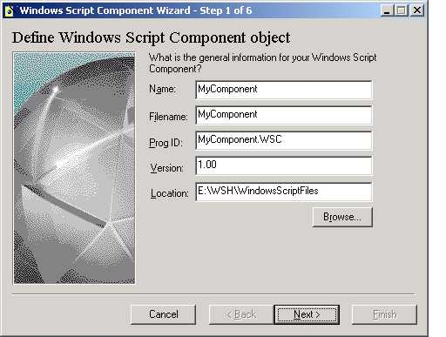
WSC Wizard Slide - Step 1

Slide 58
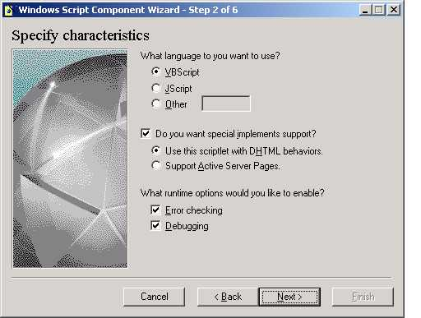
WSC Wizard Slide - Step 2

Slide 59
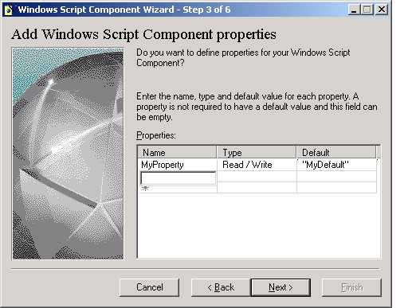
WSC Wizard Slide - Step 3

Slide 60
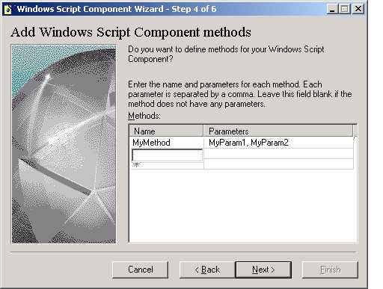
WSC Wizard Slide - Step 4

Slide 61
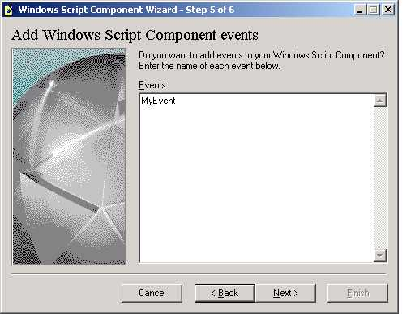
WSC Wizard Slide - Step 5

Slide 62
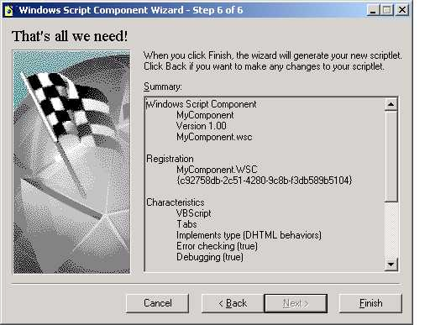
WSC Wizard Slide - Step 6

Slide 63
Resources
msdn.microsoft.com/voices/scripting.asp
msdn.microsoft.com/scripting
www.win32scripting.com
Windows Script Host Programmer's Reference, see http://www.wrox.com/Consumer/Store/Details.asp?ISBN=1861002653
Vernon W. Hui , "Microsoft Beefs up VBScript with Regular Expressions"
msdn.microsoft.com/workshop/languages/clinic/scripting051099.asp
Jeffrey McManus, "Automate With Windows Scripting Host", Visual Programming, Spring 1999
MSDN Library - January 2000
\Platform SDK\Tools And Languages\Scripting\Microsoft Windows Script Host

Slide 64
Resources 2
Jeffrey P. McManus, “Create Classes in VBScript 5.0”, VBPJ, April, 1999
Andrew Clinick, “Clinick's Clinic on Scripting: Take Five -- What's New in the Version 5.0 Script Engines”, msdn.microsoft.com/workshop/languages/clinic/clinick_ie5.asp
Newsgroup: microsoft.public.scripting.wsh
microsoft.public.scripting.vbscript
microsoft.public.scripting.jscript
http://cwashington.netreach.net/

Slide 65
Appendix

Slide 66
FileSystemObject
FileSystemObject
Folders
Drives
Folder
Files
Drive
File
SubFolders

Slide 67
FileSystemObject Reference
MSDN Library Visual Studio 6.0\
Visual Basic Documentation\
Using Visual Basic\Programmer’s Guide\
Part 2: What Can You Do With Visual Basic?\
Processing Drives, Folders, and Files

Slide 68
File System and Folder object
To create a File System Object
Dim fso
Set fso = CreateObject ( “Scripting.FileSystemObject” )
To Get A Folder object
Dim fld
Set fld = fso.GetFolder ( “C:\MyFolder” )
Test if a Folder exists
If Not fso.FolderExists ( “C:\NoFolder” ) Then Exit Sub

Slide 69
FileSystemObject
To Create a Folder
fso.CreateFolder ( “C:\NewFolder” )
To Copy a Folder
fso.CopyFolder source, destination, [, overwrite ]
source can contain wildcards, ex. “C:\Folder\*.txt”
To Move a Folder
fso.MoveFolder source, destination

Slide 70
Folder Properties
Attributes (Normal, ReadOnly, Hidden, System, Directory)
DateCreated, DateLastAccessed, DateLastModified
Name, Path, ShortName (8.3), ShortPath
Size, Type
SubFolders, Files, Drive, ParentFolder

Slide 71
Folder Methods
Copy ( Destination As String, [ OverWriteFiles As Boolean = True ] )
CreateTextFile ( FileName As String, [ Overwrite As Boolean = True ], [ Unicode As Boolean = False ] ) As TextStream
Delete ( [ Force As Boolean = False ] )
Move destination

Slide 72
File object Properties
Attributes (Normal, ReadOnly, Hidden, System, Directory)
DateCreated, DateLastAccessed, DateLastModified
Name, Path, ShortName (8.3), ShortPath(8.3)
Size, Type
Drive, ParentFolder

Slide 73
File object Methods
Copy ( Destination As String, [ OverWriteFiles As Boolean = True ] )
Delete ( [ Force As Boolean = False ] )
Move ( Destination As String )
OpenAsTextStream ( [ IOMode As IOMode = ForReading ], [Format As Tristate = TristateFalse ] ) As TextStream

Slide 74
TextStream Properties
AtEndOfLine
AtEndOfStream
Column
Line

Slide 75
TextStream Methods
Close
Read ( Characters As Long ) As String
ReadAll ( ) As String
ReadLine ( ) As String
Write ( Text As String )
WriteLine ( [ Text As String ] )

