Slide 1
Introduction to ADO
By David R. Stevenson
dsteven8@rochester.rr.com
Consulting Software Engineer
ABB Automation

Slide 2
ADO Object Model
Connection
Errors
Error
Command
Parameters
Parameter
Recordset
Fields
Field

Slide 3
ADO Object Model
Connection
Command
Recordset
Field
Properties
Property

Slide 4
VB Project References
Microsoft Active X Data Objects 2.0 (2.1) Library
Microsoft Active X Data Objects 2.0 Recordset Library
ADOX: Microsoft ADO Ext. 2.1 for DDL and Security
Microsoft ActiveX Data Objects (Multi-Dimensional) 1.0 Library

Slide 5
Connection Object
Connection to the Database
Transaction Support
Database Schema
Command Execution

Slide 6
Types of Connections
DSN-Less Connection
DSN Connection

Slide 7
Opening a Connection
Dim cn As ADODB.Connection
Set cn = New ADODB.Connection
cn.Open ConnectionString, UserId, Password, Options
‘ Note: UserId and Password override Connection String
‘ Do some ADO Work here.
cn.Close

Slide 8
Connection String?
Easy Way: Let the ADO Data Control Build one for you! (Components: Microsoft ADO Data Control 6.0 (OLEDB) )
Put Control on Form.
Right-Click and select properties.
Use Connection String Build button.
Test Connection. Copy Connection String.

Slide 9
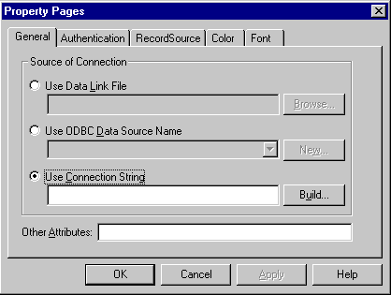
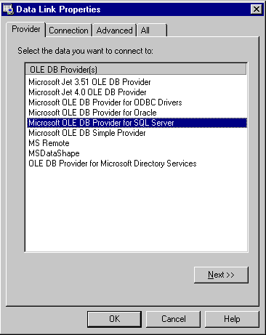
Building Connection String - 1

Slide 10
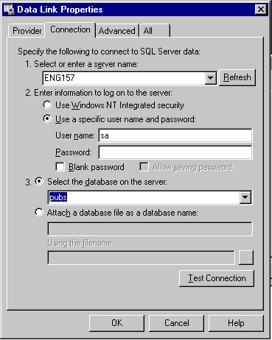
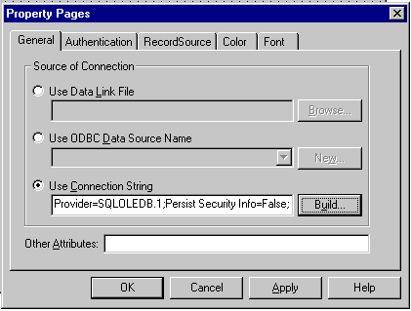
Building Connection String - 2

Slide 11
Connection String Example
SQL Server: “Provider=SQLOLEDB.1;Persist Security Info=False;User ID=sa;Initial Catalog=pubs;Data Source=ENG157”
MS Access: “Provider=Microsoft.Jet.OLEDB.3.51;Persist Security Info=False;Data Source=C:\drs\BegDB\Nwind.mdb”
Oracle example (Look Ma! No Connection String):
cn.Provider = "MSDAORA"
cn.Open , “Scott”, “Tiger”

Slide 12
Providers
MSDASQL (ODBC via System DSN)
Microsoft.Jet.OLEDB.3.51 (Access)
Microsoft.Jet.OLEDB.4.0 (Access)
SQLOLEDB (SQL Server)
MSDAORA (Oracle)
MSIDXS (Index Server)
ADSDSOObject (Active Directory Services)
MSDataShape (Hierarchical Recordsets)

Slide 13
Processing Connection Errors
Private Sub BuildErrorInformation ( cn As ADODB.Connection, ErrorNumber As Long, ErrorString As String )
Dim adoError As ADODB.Error
For Each adoError In cn.Errors
ErrorNumber = adoError.Number
' ErrorNumber = adoError.NativeError
If ErrorString <> "" Then ErrorString = ErrorString & vbCrLf
ErrorString = ErrorString & adoError.Description
Next adoError
End Sub

Slide 14
DSN Types
User - specific to the user, cannot be shared
System - All users can access it
File - Similar to System DSN, stored by default as a text file in:
\Program Files\Common Files\ODBC\Data Sources

Slide 15
Creating a DSN
Start -> Settings -> Control Panel
Double-click ODBC Data Sources
Click System DSN tab. Click Add button.
1st dialog: Select driver (SQL Server, Access, Oracle, etc.)
Enter a Name and Description for DSN.
Enter Database specific access info.
Test by selecting Test Data Source button.

Slide 16
Using a DSN Connection
Dim cn As New ADODB.Connection
cn.Open “DSN=FoodMart”

Slide 17
Transaction Support
Connection Methods
  BeginTrans
  CommitTrans
  RollbackTrans
Transactions may be nested
Not all Providers support transactions

Slide 18
Executing Commands
Execute method of Connection Object executes queries, stored procedures, or provider specific text.
Asynchronous or synchronous execution
Set Recordset = Connection.Execute ( CommandText [, RecordsAffected] [,Options] )
Returns forward-only, read-only (firehose) cursor

Slide 19
Execute Method Parameters
SQL Statement (Select, Update, Insert, Delete, DDL), Table Name, Stored Procedure Name, or provider specific text.
RecordsAffected - Variable returning Number of records that the operation affected.

Slide 20
Execute Method Option
adCmdText (SQL Statement)
adCmdTable (Table Name)
adCmdTableDirect (Table Name)
adCmdStoredProc (Stored Procedure Name)
adCmdFile (saved recordset)
adCmdUnknown (default)
adAsyncExecute (asynchronous execution)
adAsyncFetch (asynchronous fetching)
adExecuteNoRecords (non-row returning command)

Slide 21
Command Object
Execution of commands (queries, update, insert, delete, DDL, stored procedures)
Parameters (input and output) for Stored Procedures
Dim cmd As New ADODB.Command
Set cmd.ActiveConnection = cn

Slide 22
Command Object Methods
CreateParameter ( Name, Type, Direction, Size, Value )
  Direction: adParamInput, adParamOutput, adParamInputOutput, adParamReturnValue
  Type example: adInteger
Execute ( RecordsAffected, Parameters, Options)

Slide 23
Command Object Properties
ActiveConnection
CommandText: SQL, Stored Procedure Name
CommandType: adCmdText, adStoredProc
Prepared: Save a compiled version of command?
State: adStateClosed, adStateOpen, adStateExecuting, adStateFetching

Slide 24
Parameters Collection Methods
Append: append a Parameter object
Delete: delete a Parameter object
Refresh: query for parameters
Properties
  Count: number of parameters
  Item ( Index ): fetch a parameter item

Slide 25
Parameters Collection
Dim prm As ADODB.Parameter
Set prm = cmd.CreateParameter("OrderID", adInteger, adParamInput, 0, 10248)
cmd.Parameters.Append prm
Dim rs As ADODB.Recordset
cmd.CommandText = "CustOrdersDetail"
Set rs = cmd.Execute(lngRecordsAffected, , adCmdStoredProc)

Slide 26
Parameters: Return Value
' The return value is always the first parameter in the Parameters Collection.
Dim lngReturnValue As Long
Set prm = cmd.CreateParameter("RETURN_VALUE", adInteger, adParamReturnValue, 0, lngReturnValue)
cmd.Parameters.Append prm

Slide 27
Opening a Recordset
Method: Open ( Source, ActiveConnection, CursorType, LockType, Options )
  Source: Command object, SQL statement, stored procedure, or file name of persisted recordset.
  ActiveConnection: Connection string or object
  CursorType: adOpenForwardOnly, adOpenKeyset, adOpenDynamic, adOpenStatic
  LockType: adLockReadOnly, adLockPessimistic, adLockOptimistic, adLockBatchOptimistic
  Options: adCmdText, adCmdTable, adCmdStoredProcedure, adCmdUnknown, adCmdFile

Slide 28
Fields in a Recordset
Refer to by Field Number or by Field Name
  Ex.: rs.Fields(0).Value or rs.Fields(“ShipperID”).Value
Field Properties
  ActualSize: useful for variable length data.
  Name
  Type
  UnderlyingValue, Value

Slide 29
Modifying a Recordset
Recordset Methods
  AddNew ( [FieldList] [, Values] )
  Ex: rs.AddNew Array(“CompanyName”, “Phone”), Array(“Speedy Delivery”, “800-555-1212”)
  Delete ( [AffectRecords]): delete the current record or a group of records.
  Update ( [Fields], [Values] ): update records in current recordset.

Slide 30
Disconnected Recordsets
Set CursorLocation to adUseClient
After obtaining recordset, set ActiveConnection to Nothing
rs.CursorLocation = adUseClient
rs.Open “Select * from Customers”, cn, adOpenForwardOnly, adLockReadOnly, adCmdText
Set rs.ActiveConnection = Nothing
Set FunctionValueReturned = rs

Slide 31
Recordset Navigation Methods
Move ( NumRecords As Long [, Start As Bookmark ] )
MoveFirst
MoveLast
MoveNext
MovePrevious
Related Properties: BOF, EOF, Bookmark

Slide 32
Saving Recordsets To File
Save ( FileName As String
[, PersistFormat])
PersistFormat:
  adPersistADTG ( Proprietary Recordset File Format )
  adPersistXML ( XML Format, ADO 2.5 only )
May also save to ADODB.Stream and ASP Response objects (ADO 2.5)

Slide 33

Recommended Reading
ADO 2.1 Programmer’s Reference

Slide 34
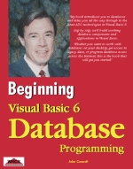
Recommended Reading
Beginning Visual Basic 6 Database Programming

Slide 35

Recommended Reading
Professional ADO 2.5 Programming

Slide 36
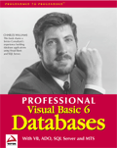
Recommended Reading
Professional Visual Basic 6 Databases

Slide 37
OpenSchema Method
Get Database Information (Meta-Data)
Set recordset = Connection.OpenSchema ( QueryType [, Criteria ] [, SchemaID] )

Slide 38
OpenSchema QueryType
adSchemaAsserts
adSchemaCatalogs
adSchemaCharacterSets
adSchemaCheckConstraints
adSchemaCollations
adSchemaColumnPrivileges
adSchemaColumns
adSchemaColumnDomainUsage
adSchemaConstraintColumnUsage
adSchemaConstraintTableUsage
adSchemaForeignKeys
adSchemaIndexes
adSchemaColumnUsage
adSchemaPrimaryKeys
adSchemaProcedureColumns
adSchemaProcedureParameters
adSchemaProcedures
adSchemaProviderSpecific
adSchemaProviderTypes
adSchemaReferentialConstraints
adSchemaSchemata
adSchemaTableConstraints
adSchemaTables
adSchemaViewColumnUsage
adSchemaViews
more...

Slide 39
OpenSchema Example
Dim rs As ADODB.Recordset
Set rs = cn.OpenSchema(adSchemaTables)
Do While Not rs.EOF
Debug.Print rs("TABLE_NAME")
Debug.Print rs("TABLE_TYPE")
rs.MoveNext
Loop

Slide 40
Properties Collection
Refresh
Count: number of properties
Item: reference by number or property name.

Slide 41
Property Object
Attributes of a single property for objects of type: Connection, Command, Recordset, Field
  Attributes: adPropNotSupported, adPropRequired, adPropOptional, adPropRead, adPropWrite
  Name
  Type: see DataTypeEnum
  Value

Slide 42
Parameter Object Properties
Attributes: adParamSigned, adParamNullable, adParamLong (binary)
Direction: adParamInput, adParamOutput, adParamInputOutput, adParamReturnValue
Name
Size: in bytes or characters
Type: example: adInteger
Value

