Slide 1
Intro to Visual Basic.NET
David Stevenson
Senior Software Engineer
Thomson – West
drs2@frontiernet.net
drstevenson58@hotmail.com
david.stevenson@westgroup.com

Slide 2
VB.NET’s Heritage
Visual
Basic.NET
Java
C++
Visual
Basic 6

Slide 3
Assembly
Assembly
Manifest
Module
Meta data
Intermediate Language
Type Defs
Methods
Properties
Fields
Type Refs
Methods
Properties
Fields
Notes:
Assembly – a collection of one or more files containing type definitions and resource files. One of the files holds the manifest. An assembly is a unit of reuse, versioning and security.
Manifest – a set of meta-data tables that contain the names of the files that are part of the assembly.
Assemblies allow the decoupling of the logical and physical aspects of types.
Reasons to use multi-file assemblies:
Allowing Internet downloads.
To add resource or data files to an assembly.
To create assemblies of types implemented in different programming languages (VB.NET, C#, etc.)

Slide 4
Compilation
Compilation
Execution
Source Code
Native
Language
Compile
Intermediate
Language
JIT
Compile

Slide 5
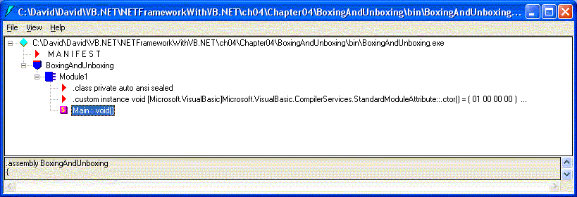
MSIL Disassembler

Slide 6
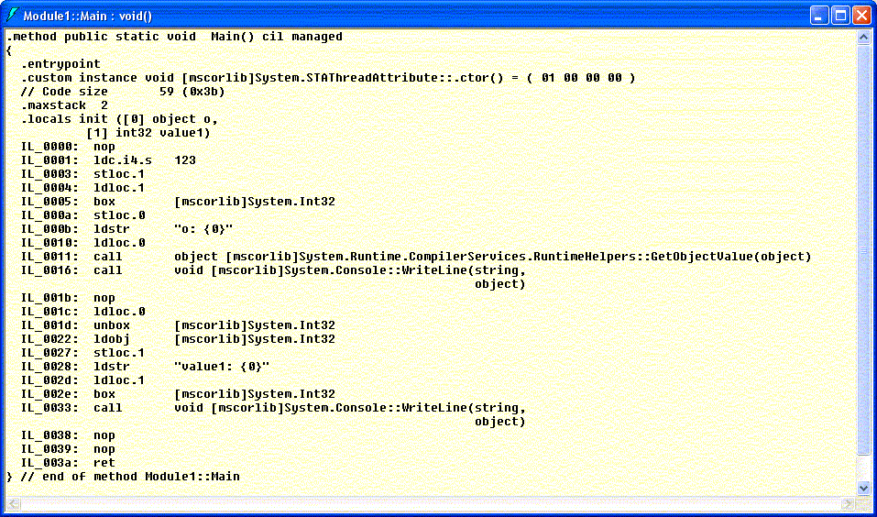
Intermediate Language

Slide 7
Types
Value Types
  Primitive Types
  Enumerations
  Structures
Reference Types
  Classes
  Interfaces
  Arrays
  Delegates
  Standard Modules

Slide 8
Value vs. Reference
‘ Point As A Structure
Dim p1 As New Point ( 10, 20 )
Dim p2 As New Point ( 30, 40 )
p1 = p2
‘ Point As A Class
Dim p1 As New Point ( 10, 20 )
Dim p2 As New Point ( 30, 40 )
p1 = p2
Thread Stack
Managed Heap
Thread Stack
p1 As Point
p1 As Point
p1
x = 10
x = 10 -> 30
y = 20
y = 20 -> 40
p2 As Point
p2 As Point
p2
x = 30
x = 30
y = 40
y = 40
Notes:
Demonstration:
PointAsStructure.vb
PointAsClass.vb
C#
PointAsStructure.cs
PointAsClass.cs

Slide 9
Value Types and
Reference Types
Value Types
Stored on the stack
Not accessed by reference
Value cannot be null
Can implement interfaces.
Reference Types
Stored on the heap
Accessed through a reference
Reference can be null
Can implement interfaces.

Slide 10
VB.NET Primitive Types
Alias | System Namespace
Byte | System.Byte
Short | System.Int16
Integer | System.Int32
Long | System.Int64
Single | System.Single
Double | System.Double
Alias | System Namespace
Decimal | System.Decimal
Boolean | System.Boolean
Date | System.DateTime
Char | System.Char
String | System.String
Notes:
Game: One of these primitive types is not like the other, one of these primitive types doesn’t belong, one of these primitive types is not like the other?
String is a reference type. All the others are value types.
Demo: PrimitiveTypes.vb
Question: What numeric types are missing?
Answer: Unsigned numeric types. (C# has them.)
From Visual Studio.NET online help:
The primitive types differ from other structure types in that they permit certain additional operations:
All primitive types permit values to be created by writing literals. For example, 123I is a literal of type Integer.
It is possible to declare constants of the primitive types.
Optional: When the operands of an expression are all primitive type constants, it is possible for the compiler to evaluate the expression at compile time. Such an expression is known as a constant expression.

Slide 11
Constants
Const <identifier> As <type> = <initial_value>
Constants must be an intrinsic (primitive) or enumerated type.

Slide 12
VB.NET: Literals
Boolean: true|false
Short: 123S, Integer: 456I, Long: 678L
Hex: &H001FE, Octal: &O377
Single: 0.123F, Double: 1.23R, 1.23E-10
Decimal: 12.34D
String: “Hello”
Character: “a”c
Date: #12/25/2002#, #12/25/2002 12:34:56 AM#
Nothing
Notes:
Demonstration:
Constants.vb
Constants.cs

Slide 13
VB.NET Enumerations
Public Enum Gender
Male
Female
End Enum
Public Enum WeekDay As Byte
Monday = 1
Tuesday = 2
Wednesday = 3
Thursday = 4
Friday = 5
End Enum

Slide 14
VB.NET
Bit Flags
Bit fields can be combined using a bitwise OR operation, whereas enumerated constants cannot.
<Flags()> Public Enum Days
Sunday = &H1
Monday = &H2
Tuesday = &H4
Wednesday = &H8
Thursday = &H16
Friday = &H32
Saturday = &H64
End Enum

Slide 15
Structures
Contain data members and function members.
Structures are value types and do not require heap allocation.
Structure variables directly contain the data of the structure
(reference type variables reference the data, or object, which exists on the managed heap).
A structure inherits from System.ValueType and may not be inherited from.

Slide 16
Structures
Thread Stack
myPoint As Point
x As Int32 = 30
y As Int32 = 40
yourPoint As Point
x As Int32 = 10
y As Int32 = 20

Slide 17
Structures
Structure Point
  Public x, y As Integer
  Public Sub New(x As Integer, y As Integer)
    Me.x = x
    Me.y = y
  End Sub
End Structure
Notes:
Replacement for the User Defined Type

Slide 18
Classes
A class is a reference type.
A class is a data structure that may contain:
data members
  constants
  variables
  events
function members
methods
  properties
  operators
  constructors
nested types
Class types support inheritance. Through inheritance, a derived class can extend and specialize a base class.
Notes:
Classes are the “blueprints” for object instances.
Object instances are objects built according to a Class “blueprint”.

Slide 19
Accessibility Modifiers
For Types, Fields and Methods
Private
Protected
Friend
Protected Friend
Public
Notes:
Demonstration: Accessibility.vb Accessibility.cs
Private The method is callable only by other methods in the same class type.
Protected The method is callable by derived types, regardless of whether they are within the same assembly.
Friend The method is callable by any code in the same assembly. (C# internal)
Protected Friend The method is callable by derived types in any assembly. (C# refers to this as internal protected).
Public The method is callable by any code in any assembly.
Demo: Accessibility.vb
Source: Richter and Balena, Applied Microsoft .NET Framework Programming In Microsoft Visual Basic .NET, p. 27
Visual Studio.NET online help for C#
public Access is not restricted.
protected Access is limited to the containing class or types derived from the containing class.
internal Access is limited to the current project.
protected internal Access is limited to the current project or types derived from the containing class.
private Access is limited to the containing type.

Slide 20
Class Modifiers
Access Modifiers
Shadows
MustInherit
NotInheritable
[ClassModifier] Class <classname>
[Inherits <baseclass>]
[Implements interface1 [,interface2] ] …
End Class
Notes:
Shadows allows the overriding non-virtual methods of a base class. This allows fixing buggy base class code for which you don’t have source code. It can be used to replace and change a base class element.
Shadowing a method replaces all implementations from higher (base classes) in the inheritance chain – regardless of method signature.
MustInherit marks the base class as an abstract class which contains methods that must be implemented by a derived class.
A NotInheritable class is a class that may not be derived from.
C# Syntax:
[ClassModifier] class <classname> [ : <baseclass>]
{
}

Slide 21
Type Members
Field | A data variable that is part of the object’s state.
Method | A function that performs an operation on the object, possibly changing the object’s state.
Property | Accessor (get) and mutator (set) methods that appear as a field to the caller.
Event | A notification mechanism between an object and other interested objects.

Slide 22
Constructors
Methods that allow a type or instance of the type to be initialized.
Run after the program begins or when an instance of a type is created.
All of the constructors in the inheritance chain are called, starting with the base class, followed by the subclasses.
Flavors:
  Default Constructors (parameterless)
  Instance
  Shared/Static (aka static constructors, class constructors, or type initializers)
  Private
Constructors (optional) must be explicitly called for Structures (otherwise Structures embedded in classes are just zeroed)
Notes:
Demo: Constructors.vb
Constructors.cs

Slide 23
Fields
A field is a member that represents a variable associated with an object or class.
A field is a data member that holds an instance of a value type or a reference to a reference type.
  Type (static) fields
  Instance (non-static) fields
Fields are stored in dynamic memory.
Fields can be:
  Read-only (written to only in a constructor)
  Read and Write.

Slide 24
Methods
All methods have a name, a signature, and a return value.
Instance methods can be overloaded, shadowed and overridden.
Shared methods can be overloaded and shadowed, but not overridden.
Notes:
Visual Studio.NET online help, Methods, Instance
Methods have a list of formal parameters (which may be empty), a return value (or no return value), and are either shared or nonshared.
Visual Studio.NET online help, Methods, Shared
Shared methods may not be Overridable, NotOverridable, or MustOverride, and they may not override methods.
Shared methods are accessed through the class. Nonshared methods, also called instance methods, are accessed through instances of the class.

Slide 25
Method Attributes
Shared
Overridable
Shadows
Overrides
MustOverride
NotOverridable
Notes:
Visual Studio.NET Online Help
Shared elements are not associated with a specific instance of a class or structure. You can access them by qualifying them either with the class or structure name, or with the variable name of a specific instance of the class or structure.
The Overridable keyword specifies that a property or method can be overridden in a derived class.
The Shadows keyword indicates that a declared programming element shadows an identically named element, or set of overloaded elements, in a base class.
The Overrides keyword specifies that a property or method overrides a member inherited from a base class.
The MustOverride keyword specifies that a property or procedure in a base class must be overridden in a derived class before it can be used.
The NotOverridable keyword specifies that a property or procedure cannot be overridden in a derived class.

Slide 26
Inheritance
Derived classes inherit, and can extend, the properties, methods, events, fields, and constants defined in the base class.
All classes are inheritable unless tagged with NotInheritable (VB.NET).
.NET allows only single implementation inheritance.
Classes may implement multiple interfaces.
Notes:
“An inheritance relationship is one in which one type (the derived type) derives from another (the base type), such that the derived type's declaration space implicitly contains all of the accessible non-constructor type members of the base type.”

Slide 27
Inheritance
[ClassModifiers] Class <derivedclass>
  Inherits <baseclass>
End Class

Slide 28
Virtual Methods
Methods that can be overridden and replaced by the derived classes.
Data type of the object determines the method to call, not the type of variable that holds the object reference.
Notes:
Demonstration: VirtualMethods.vb
VirtualMethods.cs

Slide 29
VB.NET:
Passing Parameters
ByVal: method cannot change the value of the variable passed, but mutator methods of objects can change the state of an object.
ByRef: method can change the value of variable passed, in addition to using the mutator methods to change the state of an object.
Notes:
Demonstration: SwapParameters.vb
The ByVal keyword indicates that an argument is passed in such a way that the called procedure or property cannot change the value of a variable underlying the argument in the calling code.
The ByRef keyword indicates that an argument is passed in such a way that the called procedure can change the value of a variable underlying the argument in the calling code.
C# requires that passing parameters by reference be specified in the actual arguments as well as the formal arguments. Visual Basic.NET only requires that passing parameters by reference be specified in the formal parameters. Thus, C# better documents passing parameters by reference.

Slide 30
Variable # of Parameters
Shared Function Concatenate(ByVal ParamArray strings() As String) As String
Dim result As StringBuilder = New StringBuilder()
Dim oneString As String
For Each oneString In strings
result.Append(oneString)
result.Append(" "c)
Next
Return result.ToString()
End Function
Notes:
Demonstration: VariableNumberOfParameters.vb
VariableNumberOfParameters.cs

Slide 31
Optional Parameters
Shared Sub MethodWithOptionalParameter(ByVal a As Int32, _
Optional ByVal b As Double = 1.23R)
Console.WriteLine("a: {0} b: {1}", a, b)
End Sub
Shared Sub Main()
MethodWithOptionalParameter(12, 5.67)
MethodWithOptionalParameter(12)
End Sub
Notes:
Demonstration: OptionalParameters.vb
A method can take any number of optional parameters, provided that they come after all the mandatory ones.
You should only use optional arguments only if the caller of the method class can easily anticipate the optional argument’s default value and if the default value doesn’t affect the outcome.
Shortcomings: Optional parameters don’t make your program faster.
A complete set of arguments is always passed to a method. The default value is determined at compile time using meta-data, not at run-time. Therefore, components which use methods with optional parameters must be compiled to take advantage of new default values.
Optional arguments aren’t CLS compliant.
You can only use primitive types for optional arguments.
There is no way for the method to know if the argument was omitted by the caller.
The better approach is to use overloaded methods.

Slide 32
Static Variables in a Method
Shared Sub RememberLastItem(ByVal item As String)
Static lastItem As String = ""
Console.WriteLine("item: '{0}' last item: '{1}'", item, lastItem)
lastItem = item
End Sub
Shared Sub Main()
RememberLastItem("Apple")
RememberLastItem("Orange")
RememberLastItem("Banana")
End Sub
Notes:
Demonstration:
StaticVariables.vb
StaticVariables.cs
Static variables aren’t allocated on the stack.
Static variables preserve their value between calls to the method.
Static variables are thread-safe and use thread synchronization.

Slide 33
Interfaces
Interface inheritance: a type inherits the method signatures of an interface but without any implementation.
Interfaces contain no implementation.
Interfaces define virtual methods, events, and properties.
A type contracts to implement the methods defined by an interface.
Interfaces can inherit from other interfaces.
Notes:
Interfaces express capabilities of an object.

Slide 34
Interfaces
Reference types that other types implement to guarantee that they support certain operations.
Interfaces may have methods, properties, events and member variables.
Never directly created and has no actual representation.
Other types must be converted to an interface type before interface can be used.

Slide 35
Interface Example
Public Interface IPerformable
Inherits IEnumerable ' a list of performables
Property Performable() As Boolean
ReadOnly Property NumItems() As Integer
Sub PerformQuickly()
Sub PerformSlowly(ByVal howSlow As Integer)
End Interface

Slide 36
Implementing An Interface
Property Performable() As Boolean _
Implements IPerformable.Performable
ReadOnly Property NumItems() As Integer _
Implements IPerformable.NumItems
Sub PerformQuickly() _
Implements IPerformable.PerformQuickly
Sub PerformSlowly(ByVal howSlow As Integer) _ Implements IPerformable.PerformSlowly
Overridable Function GetEnumerator() As IEnumerator _ Implements IPerformable.GetEnumerator
Notes:
The Implements keyword is used to tell the compiler which of the type’s methods contains the code that implements the interface’s method.
The signature of the type method’s implementation must exactly match the signature of the interface’s method.

Slide 37
Multiple Interfaces With the Same Signatures
Interface IRunnable
Sub Quit()
End Interface
Interface IJob
Sub Quit()
End Interface
Class JobRunner
Implements IRunnable, IJob
Sub StopRunning() Implements IRunnable.Quit
Console.WriteLine("Stop Running")
End Sub
Sub StopJob() Implements IJob.Quit
Console.WriteLine("Stop Job")
End Sub
End Class

Slide 38
Choosing Between A Class And an Interface
Is-A (specialization) versus Can-Do (capability) relationship.
Override as necessary versus must implement all.
Is consistency required?
Can be difficult to implement a complex interface 100% correctly. Having implemented methods helps greatly.
Changing interfaces require changing and compiling all classes that use them.

Slide 39
VB.NET: MyBase Keyword
MyBase refers to the immediate base class and its inherited members. It cannot be used to access Private members in the base class.
MyBase is commonly used to access base class members that are overridden or shadowed in a derived class.

Slide 40
VB.NET: Me Keyword
Me refers to the current instance of a class.
Useful in constructors when the parameter name matches the member variable.
Useful for passing a reference to the current object to another class method.

Slide 41
VB.NET: MyClass Keyword
The MyClass keyword allows you to call an Overridable method implemented in your class and make sure that implementation of the method in this class is called rather than an overridden method in a derived class.
MyClass refers to the containing class and its inherited members.
MyClass can be used as a qualifier for Shared members.

Slide 42
Overloaded Methods
Methods with the same name but differing either in parameters or return value.
Notes:
Demonstration:
Overload.vb
Overload.cs

Slide 43
Properties
Public Class Dependent
Private _FirstName As String
Private _BirthDate As Date
Public Property FirstName() As String
Get
Return _FirstName
End Get
Set(ByVal Value As String)
_FirstName = Value
End Set
End Property
End Class
Notes:
Demonstration: ParameterfulProperties.vb (Dependent.vb)
ParameterfulProperties.cs (Dependent.cs) (Uses indexers instead of parameterful properties).
Two flavors of properties: parameterless, and paramterful.
Data hiding
Data encapsulation
Encapsulation protects a type’s data from improper use and improper values, and limits avenues for access to a type’s data, which is a great assist to debugging.
Properties are smart fields. They can validate data before data is stored.
The CLR supports shared (static), instance, and virtual properties.
“backing field” private field manipulated by the Get/Set property methods.

Slide 44
Delegates
Derived from System.Delegate
Delegates: Type-safe method pointer.
Can reference both shared methods and instance methods.
Notes:
Demonstration:
SimpleDelegate.vb
SimpleDelegate.cs
Delegates are a reference type that refers to a Shared method of a type or to an instance method of an object.

Slide 45
Events and Delegates
Event
(ArrayList of Delegates)
myRefType1
Sub F ( x As Int32, y As Double )
Delegate 1
Delegate 2
anotherClass1
Sub G ( x As Int32, y As Double )
Delegate 3
anotherClass2
Shared Sub H ( x As Int32, y As Double )
Notes:
Demonstrations:
EventTest1.vb
EventTest1.cs

Slide 46
Events
Events are type members that allow for interaction. A signal that something of importance has happened.
An event member is a type that offers:
  the capability for objects to register their interest in an event.
  the capability for objects to unregister their interest in an event.
  the capability for an object to maintain a list of registered objects and to notify these objects when the event occurs.

Slide 47
Events
Declaring Events
  Event <event-id> ( formal arguments )
  Implicitly defines a delegate class named <event-id>EventHandler.
Define Event Handler(s), matching arguments.
Static: Handles <event-id> to event handler.
Dynamic: AddHandler event, delegate
Dynamic: RemoveHandler event, delegate
RaiseEvent <event-id> ( actual arguments )
Note: Code in derived classes cannot raise an instance event defined in a base class.
Notes:
Demonstrations:
Coffee.vb, CoffeeClanMember.vb, CoffeeMonitor.vb
Note: C# does not support WithEvents (adding an event handler to an event at compile time rather than run time).
Coffee.cs, CoffeeClanMember.cs, CoffeeMonitor.cs

Slide 48
Arrays
Managed Heap
5: Int32
4: Int32
3: Int32
2: Int32
1: Int32
0: Int32
myInts
Overhead

Slide 49
Arrays
Dim myInts() As Int32 ‘ Reference
Dim myInts(5) As Integer ‘ 0 to 5
All arrays derived from System.Array
CLS compliance: arrays start at index 0
Dim is used declare an array, its type, and number of dimensions.
ReDim is used to create the elements of the array, or to change the number of elements in the array. Must omit As clause.

Slide 50
Multi-dimension Arrays
Dim myMatrix ( 10, 20 ) As Int32
Dim myCube ( 5, 10, 15 ) As Int32

Slide 51
Array Initialization
Dim yourInts() As Integer = New Integer() _
{123, 456, 789, 12, 34, 56}
Dim daysInMonth(,) As Integer = New Integer(,) { _
{31, 28, 31, 30, 31, 30, 31, 31, 30, 31, 30, 31}, _
{31, 29, 31, 30, 31, 30, 31, 31, 30, 31, 30, 31} _
}

Slide 52
Passing and Returning Arrays
Arrays are passed by reference, so methods are able to modify the array.
Copying arrays: Array.Copy performs a shallow copy. Must clone elements of array.
Sub MyMethod ( ByRef a() As Int32 )
Notes:
Demonstration:
Arrays1.vb
Arrays1.cs

Slide 53
VB.NET Conversions
DirectCast (casting base types to derived types)
CType (casting value types to other value types)
CType ( expression, typename )
(CBool,CByte,CChar, CDate, CDbl, CDec, CInt, CLng, CObj, CShort, CSng, CStr)
TypeName
TypeOf <identifier> Is <ReferenceType>
System.Convert
Notes:
Demonstration:
DirectCast.vb
DirectCast2.vb
CType.vb
TypeOf.vb
Use TypeOf to determine if a class supports a specific interface.
A cast expression coerces an expression to a given type. There are specific cast keywords that coerce expressions into the primitive types; there are also two general cast keywords, CType and DirectCast, that coerce an expression into any type. DirectCast is special in that conversions from type Object to any other type are performed as a direct cast down the hierarchy — all of the special conversion behaviors from Object are ignored. When converting an expression of type Object whose run-time type is a primitive value type, DirectCast throws a System.InvalidTypeException exception if the specified type is not the same as the run-time type of the expression. If the specified type and the run-time type of the expression are the same, however, the run-time performance of DirectCast is better than that of CType.
The TypeOf…Is operator is the best choice for testing an object's type, because it is much faster than an equivalent string comparison using TypeName.
The TypeOf…Is operator returns True if an object is of a specific type, or is derived from a specific type.
The TypeName function returns a string and is the best choice when you need to store or display the class name of an object, as shown in the following code fragment:

Slide 54
Standard Modules
A reference type whose members are implicitly Shared.
Used to provide global-like variables.
Standard modules may never be instantiated.
Modules may not be nested in another type.
The members are scoped to the declaration space of the standard module's containing namespace.
Members have two names:
  one name without the standard module name (i.e. global-like naming)
  one name with the standard module name.

Slide 55
Namespaces
System
Collections
Data
OleDb
SqlClient
Text
RegularExpressions

Slide 56
Namespaces
A way of making type’s name longer, and more likely to be unique.
Import statement: a way to shorten the longer reference.
References tell compiler where to search for types.

Slide 57
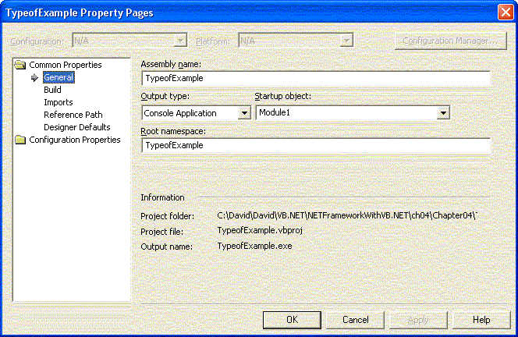
Root Namespace

Slide 58
Imports
Examples
  Imports System
  Imports System.Collections
  Imports MyCollections = System.Collections
  Dim myArray As MyCollections.ArrayList

Slide 59
Late Binding
' Point is a class (reference type) in this example
Dim o As Object = New Point(10, 20)
' If Option Strict On is enabled
' Compiler Error: Option Strict On disallows late binding
' Late Binding isn't recommended.
' Its primary use is to allow easier migration of VB6 programs.
' The following line demonstrates late binding.
Console.WriteLine("point: ({0}, {1})", o.x, o.y)
Notes:
Demonstrations:
LateBinding.vb
LateBinding2.vb
Visual Studio.NET online help:
Late binding allows Object variables to be used in a typeless way, where all resolution of members is based on the actual run-time type of the value in the variable. If strict semantics are specified by the compilation environment or by Option Strict, late binding causes a compile-time error.

Slide 60
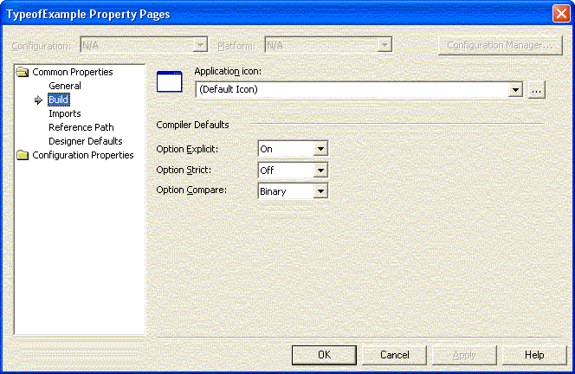
Option Strict On
Notes:
Traditionally, Visual Basic has had permissive semantics; that is, the Visual Basic language in general does not require explicit syntax to be used when performing operations that might not be optimally efficient (for example, late binding) or that might fail at run time (for example, narrowing conversions). Although permissive semantics simplifies learning the Visual Basic language, it can hamper large-scale application development by allowing coding errors to slip by undetected. Visual Basic .NET offers the option of enforcing strict semantics during compilation.
The Option Strict statement determines whether conversions and operations on Object are governed by strict or permissive type semantics and whether types are implicitly Object by default. The statement may be followed by the keywords On or Off; the default is Off. If no statement is specified in a file, the compilation environment determines which will be used.
Under strict semantics, the following are disallowed:
● Narrowing conversions without an explicit cast operator.
● Late binding.
● Operations on type Object other than =, <>, TypeOf...Is, and Is.
● Omitting the As clause in a declaration. Note Strict and Off are not reserved words

Slide 61
Boxing
Thread Stack
Managed Heap
Value Type
Convert
Reference Type
a As Integer
Convert
a As Object
p1 As Point
p1 As Object
Convert
x = 10 -> 30
x = 10 -> 30
y = 20 -> 40
y = 20 -> 40

Slide 62
Unboxing
Thread Stack
Managed Heap
Value Type
Convert
Reference Type
a As Integer
Convert
a As Object
p1 As Point
p1 As Object
Convert
x = 10 -> 30
x = 10 -> 30
y = 20 -> 40
y = 20 -> 40
Notes:
Demonstration:
BoxingAndUnboxing.vb
BoxingAndUnboxing.cs

Slide 63
Cloning: Shallow Copy
myObject1
X As Int32 = 12
Y As MyRefType
myObject2
myRefType1
X As Int32 = 12
Y As MyRefType
r As Single = 1.0
i As Double = 2.0
Notes:
MemberwiseClone method
System.Object: MemberwiseClone
Return Value
A shallow copy of the current Object.
Remarks
This method cannot be overridden; a derived class should implement the ICloneable interface if a shallow copy is not appropriate. MemberwiseClone is protected and, therefore, is accessible only through this class or a derived class.
A shallow copy creates a new instance of the same type as the original object, and then copies the non-static fields of the original object. If the field is a value type, a bit-by-bit copy of the field is performed. If the field is a reference type, the reference is copied but the referred object is not; therefore, the reference in the original object and the reference in the clone point to the same object. In contrast, a deep copy of an object duplicates everything directly or indirectly referenced by the fields in the object.
Clone can be implemented either as a deep copy or a shallow copy. In a deep copy, all objects are duplicated; whereas, in a shallow copy, only the top-level objects are duplicated and the lower levels contain references.
The resulting clone must be of the same type as or a compatible type to the original instance.

Slide 64
Cloning: Deep Copy
myObject1
myRefType1
X As Int32 = 12
r As Single = 1.0
Y As MyRefType
i As Double = 2.0
myObject2
myRefType2
X As Int32 = 12
r As Single = 1.0
Y As MyRefType
i As Double = 2.0
Notes:
Demonstration:
Cloning.vb
Cloning.cs

Slide 65
Catching Exceptions
On Error GoTo: Still there, but upgrade to exceptions
Try
‘ Perform your exception-prone code here
[ Exit Try]
Catch e1 As <ExceptionType1>
‘ Can handle different exceptions differently
Catch e2 As <ExceptionType2>
‘ handle exceptions
‘ log or report exceptions
Catch
‘ Catch any exception not caught
Finally ‘ Always executed, exception or no exception
‘ Perform clean up code here
End Try
Notes:
An exception is a violation of a programmatic interface’s implicit assumptions.

Slide 66
Creating Exceptions
Notes:
“As a general rule, hierarchies should be broad and shallow: exception types should be derived from a type close to Exception and should typically be no more than two or three levels deep. If you define an exception type that’s not going to be the base of other exception types, then mark the type as NotInheritable.”
Richter and Balena, Applied Microsoft .NET Framework Programming in Microsoft Visual Basic.NET, p. 428
System.Exception defines three constructors:
Parameterless
2) Constructor taking a string
3) Constructor taking a string and an System.Exception derived type
Exception types should always be serializable.
Don’t catch System.Exception: BE MORE SPECIFIC.
Catching System.Exception catches StackOverflowException, OutOfMemoryException.

Slide 67
Throwing Exceptions
Use Throw to re-throw the exception
Throw New <exception-constructor>

Slide 68
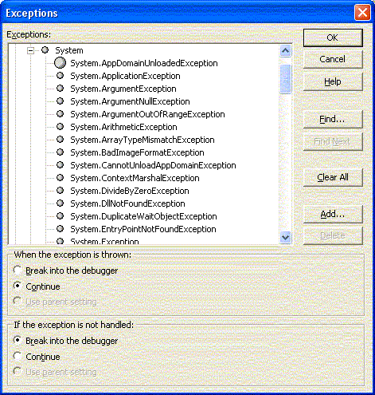
Exploring Exceptions
Debug | Exceptions…

Slide 69
Loops
Do { While | Until } condition
[ statements ]
[ Exit Do ]
[ statements ]
Loop
Do
[ statements ]
[ Exit Do ]
[ statements ]
Loop { While | Until } condition
For Each element In group
[ statements ]
[ Exit For ]
[ statements ]
Next [ element ]
For counter = start To end [ Step step ]
[ statements ]
[ Exit For ]
[ statements ]
Next [ counter ]
Notes:
While
Required unless Until is used. Keyword. Repeat the loop until condition is False.
Until
Required unless While is used. Keyword. Repeat the loop until condition is True.
condition
Optional. Boolean. Expression that evaluates to a value of True or False.
statements
Optional. One or more statements that are repeated while, or until, condition is True.
group
Required. Object variable. Must refer to an object collection or array.

Slide 70
If Then Else
If condition [ Then ]
[ statements ]
[ ElseIf elseifcondition [ Then ]
[ elseifstatements ] ]
[ Else
[ elsestatements ] ]
End If

Slide 71
Select
Select [ Case ] testexpression
[ Case expressionlist [ statements ] ]
[ Case Else [ elsestatements ] ]
End Select

Slide 72
VB.NET: Missing Features
unsigned numeric types
checked/unchecked
(use System.Convert for checking)
indexers
operator overloading
volatile keyword
C#: as (VB.NET TypeOf??)
Unsafe code

Slide 73
C#: Missing Features
Make a non-virtual call to a virtual method of the current object (functionality of VB.NET:MyClass) (VB.NET:Me is equivalent to C#:this)
Optional Parameters
Parameterful Properties (use indexing)
WithEvents
With
Standard Modules
Late Binding is more difficult – use reflection

Slide 74
References
Applied Microsoft .NET Framework Programming in Microsoft Visual Basic.NET
Professional VB.NET
Visual Studio.NET Online Help

Slide 75
Metadata
Metadata describes:
the types in your code
the definition of each type
the signatures of each type's members
the members that your code references
Eliminates need for type libraries and IDL.

Slide 76
Intermediate Language
“A CPU-independent set of instructions that can be efficiently converted to native code.”
“IL includes instructions for loading, storing, initializing, and calling methods on objects, as well as instructions for arithmetic and logical operations, control flow, direct memory access, exception handling, and other operations.”

Slide 77
Framework SDK
Install Internet Explorer 5.01 or better
Install MDAC 2.7 SP1
Install IIS
Install Framework SDK
Install Framework SP2

Slide 78
ReDim
ReDim Preserve allows change of number of elements while preserving contents of array. Can only change the right-most dimension in a multi-dimension array.

