Slide 1
GraphQL and GraphQL.NET
David stevenson

Slide 2
What is GraphQL?
GraphQL is a query language for your API, and a server-side runtime for executing queries by using a type system you define for your data. GraphQL isn't tied to any specific database or storage engine and is instead backed by your existing code and data.
https://graphql-dotnet.github.io/docs/getting-started/introduction
Consists Client Side JavaScript or JSON requests and Server Side Web API Service
Purpose: Get only the data you need. Save on execution, bandwidth and network transmission time and costs.

Slide 3
GraphQL Links
Introduction to GraphQL (JavaScript)
https://graphql.org/learn/
Introduction to GraphQL-DotNet
https://graphql-dotnet.github.io/docs/getting-started/introduction
GraphQL-DotNet Source Code
https://graphql-dotnet.github.io/
Nuget GraphQL (DotNet)
Install-Package GraphQL -Version 2.4.0

Slide 4
GraphQL – Client Side
GraphQL is a query language for your API, and a server-side runtime for executing queries by using a type system you define for your data.
A GraphQL service is created by defining types and fields on those types, then providing functions for each field on each type.
https://graphql.org/learn/
type Query {
me: User
}
type User {
id: ID
name: String
}
function Query_me(request) {
return request.auth.user;
}
function User_name(user) {
return user.getName();
}
Query: {
me {
name
}
}
JSON Result:
{
"me": {
"name": "Luke Skywalker"
}
}

Slide 5
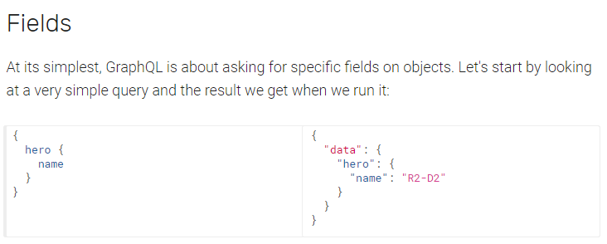
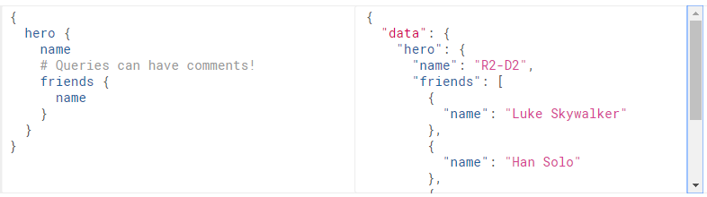
Client – Queries - Fields
Notes:
https://graphql.org/learn/queries/#fields

Slide 6
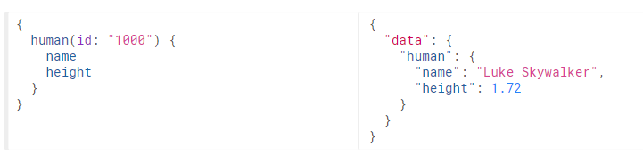
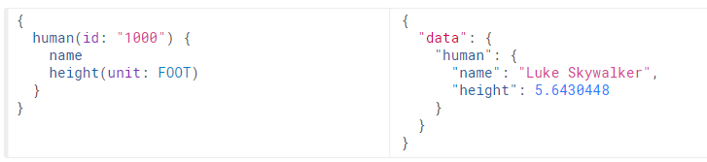
Client – Queries - Arguments
Enumerations!

Slide 7
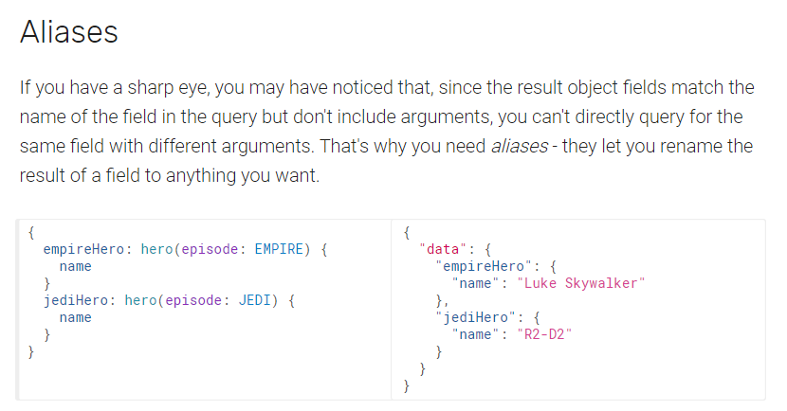
Client – Queries - Aliases

Slide 8
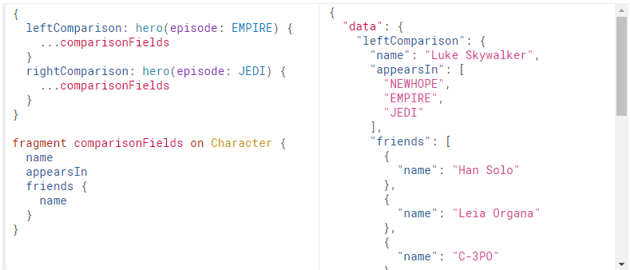
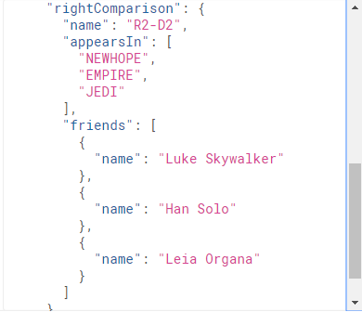
Client – Queries - Fragments
Reusable units are called fragments.

Slide 9
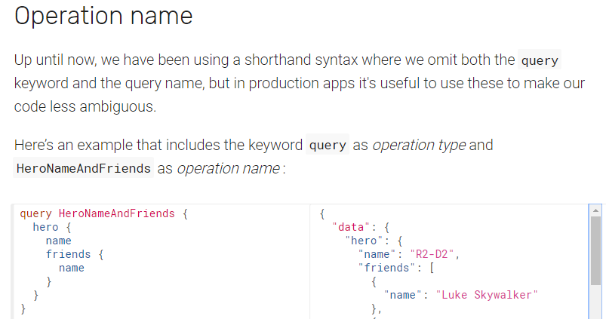
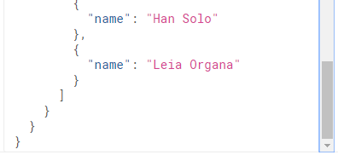
Client – Queries – Operation Name
Operation Types:
query
mutation
subscription
Operation type is required unless using query shorthand syntax.

Slide 10
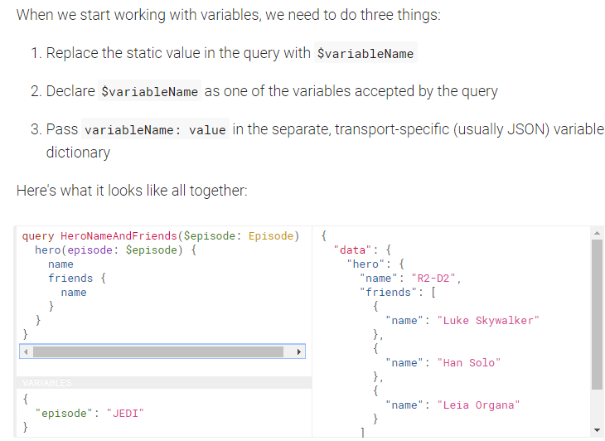

Client – Queries - Variables
All declared variables must be either scalars, enums or input object types (matches object type on server).

Slide 11
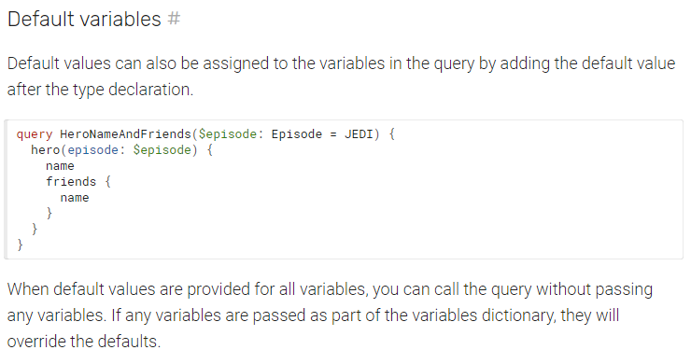
Client – Queries – Default Variables

Slide 12
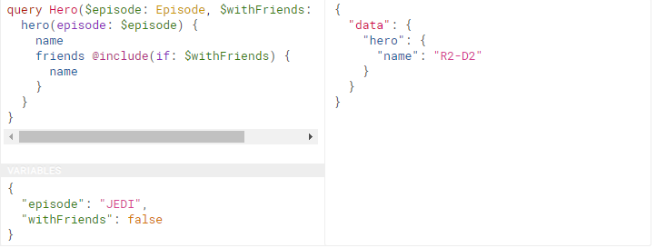
Client – Queries - Directives
The core GraphQL specification includes exactly two directives, which must be supported by any spec-compliant GraphQL server implementation:
@include(if: Boolean) Only include this field in the result if the argument is true.
@skip(if: Boolean) Skip this field if the argument is true.
Notes:
Directives can be useful to get out of situations where you otherwise would need to do string manipulation to add and remove fields in your query. Server implementations may also add experimental features by defining completely new directives.

Slide 13
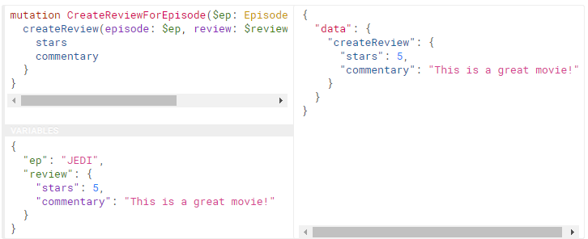
Client – Queries - Mutations
While query fields are executed in parallel, mutation fields run in series, one after the other.

Slide 14
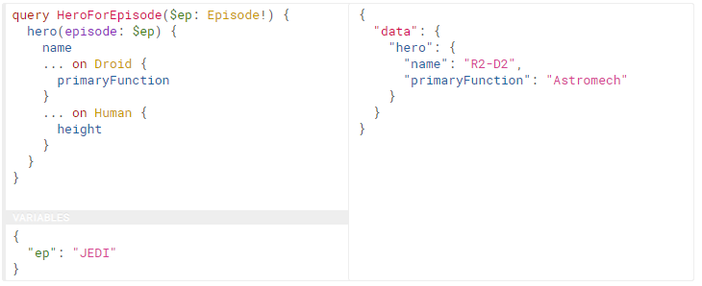
Client – Queries – Inline Fragments
GraphQL schemas include the ability to define interfaces and union types. Learn about them in the schema guide.

Slide 15
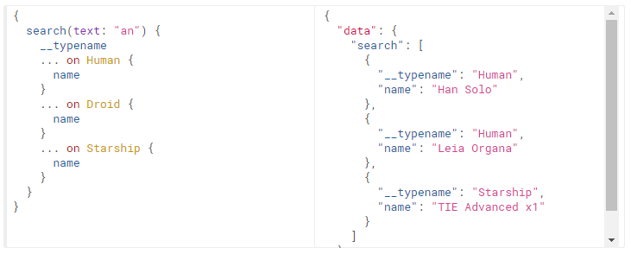
Client – Queries – Meta Fields
In the above query, search returns a union type that can be one of three options. It would be impossible to tell apart the different types from the client without the __typename field.

Slide 16
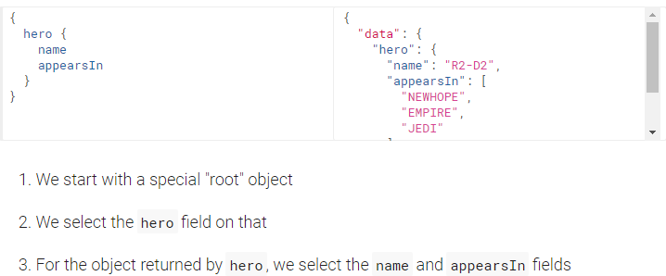

Client – Schemas and Types Type System
https://graphql.org/learn/schema/

Slide 17

Client – Schemas and Types Object types and fields
Character is a GraphQL Object Type.
name and appearsIn are fields on Character type.
String is a built-in scalar type.
Exclamation Point (!) means that a type is non-nullable.
[Episode!] is an array of Episode objects, and both the array and elements are non-nullable.

Slide 18
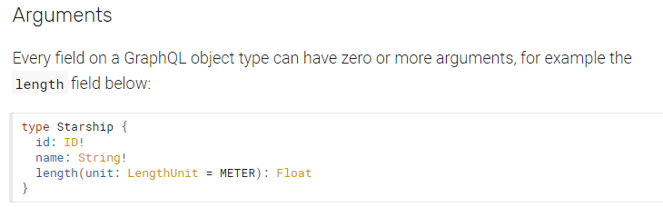
Client – Schemas and Types Arguments
All arguments are named.
Arguments can be either required or optional.
Optional arguments can define a default value.

Slide 19
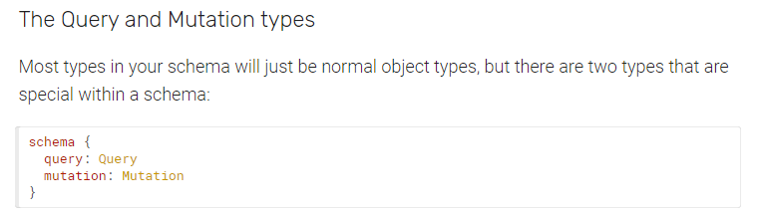
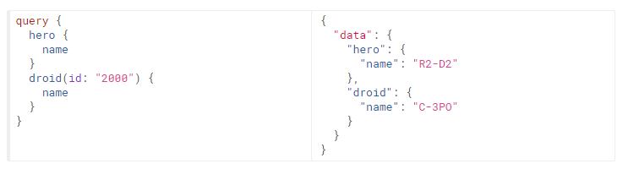

Client – Schemas and Types The Query and Mutation types
Every GraphQL service has a query type and may or may not have a mutation type.
If you have a query that looks like this, the GraphQL service needs to have a Query type with hero and droid fields:

Slide 20
Client – Schemas and Types Scalar Types
Default Scalar Types (out of the box):
Int: A signed 32-bit integer.
Float: A signed double-precision floating-point value.
String: A UTF-8 character sequence.
Boolean: true or false
ID: The ID scalar type represents a unique identifier.
Custom Scalar Types
scalar Date
The implementation must define how the type is serialized and deserialized.
Enumeration Types
Scalar type that is restricted to a particular set of allowed values.
enum Episode {
NEWHOPE
EMPIRE
JEDI
}

Slide 21

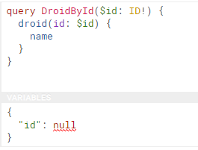
Client – Schemas and Types Lists and Non-Null
The Non-Null type modifier can also be used when defining arguments for a field, which will cause the GraphQL server to return a validation error.
{
"errors": [
{
"message": "Variable \"$id\" of required type \"ID!\" was not provided.",
"locations": [
{
"line": 1,
"column": 17
}
]
}
]
}

Slide 22
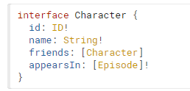
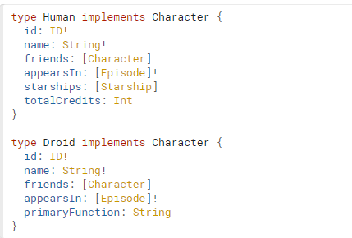
Client – Schemas and Types Interfaces
An Interface is an abstract type that includes a certain set of fields that a type must include to implement the interface.
Interfaces are useful when you want to return an object or set of objects, but those might be of several different types.

Slide 23
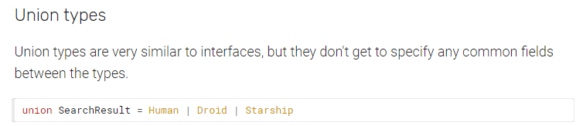
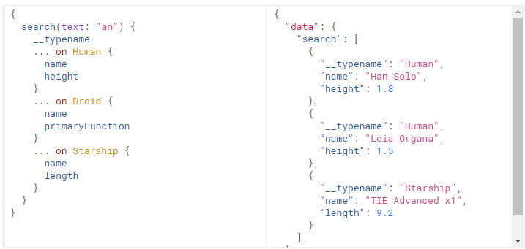
Client – Schemas and Types Union Types

Slide 24

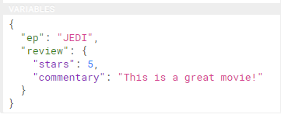
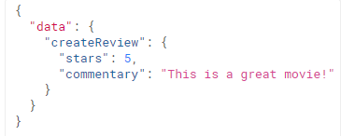
Client – Schemas and Types Input Types
Input types look exactly the same as regular object types, but with the keyword input instead of type.
mutation CreateReviewForEpisode($ep: Episode!, $review: ReviewInput!) {
createReview(episode: $ep, review: $review) {
stars
commentary
}
}

Slide 25
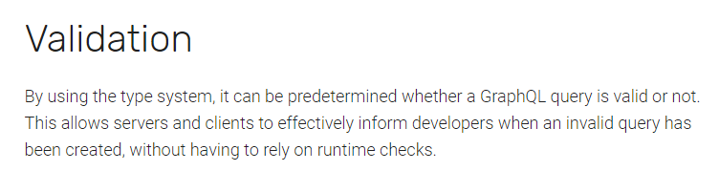
Validation

Slide 26

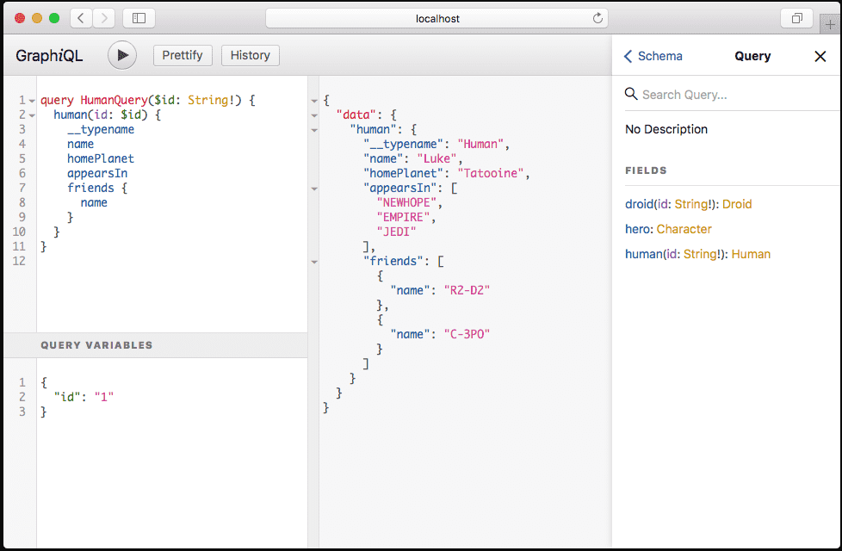
GraphiQL
https://graphql-dotnet.github.io/docs/getting-started/graphiql
GraphiQL is an interactive in-browser GraphQL IDE. This is a fantastic developer tool to help you form queries and explore your Schema.
The this ASP.NET Core sample project provides an example of hosting the GraphiQL IDE.
Try the live demo. https://graphql.org/swapi-graphql
The GraphiQL IDE is implemented in React.
Notes:
https://graphql-dotnet.github.io/docs/getting-started/graphiql # GraphiQL[GraphiQL](https://github.com/graphql/graphiql) is an interactive in-browser GraphQL IDE. This is a fantastic developer tool to help you form queries and explore your Schema. [This ASP.NET Core sample project](https://github.com/graphql-dotnet/examples/tree/master/src/AspNetCoreCustom) provides an example of hosting the GraphiQL IDE.

Slide 27
Examples – GraphQL.NET
https://github.com/graphql-dotnet/examples
GraphiQL Example: AspNetCoreCustom (Star Wars Example)

Slide 28
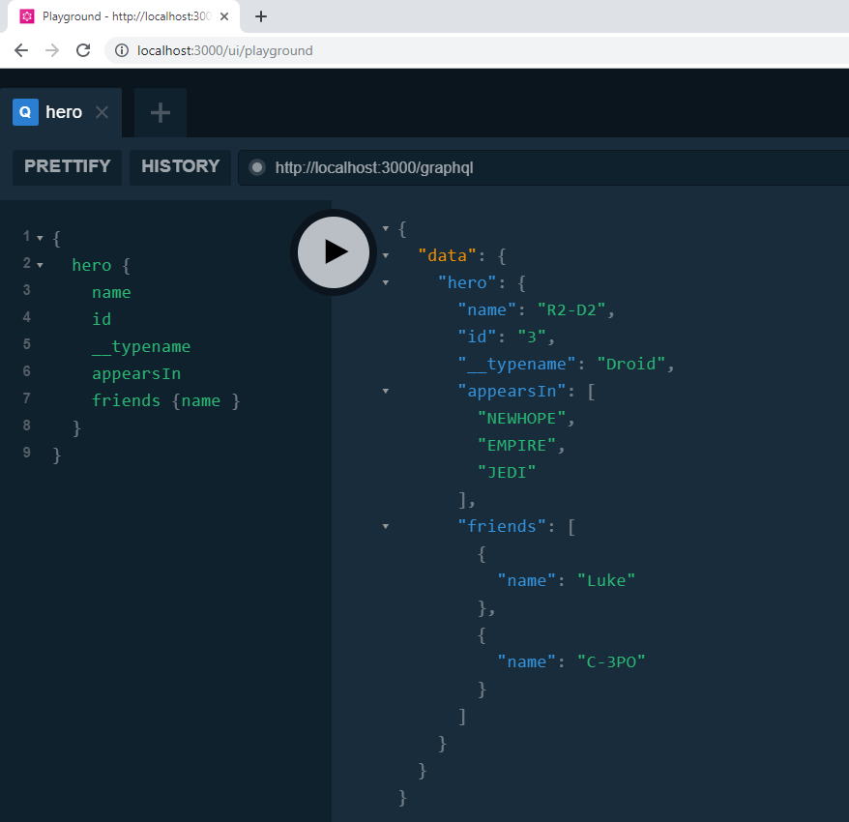
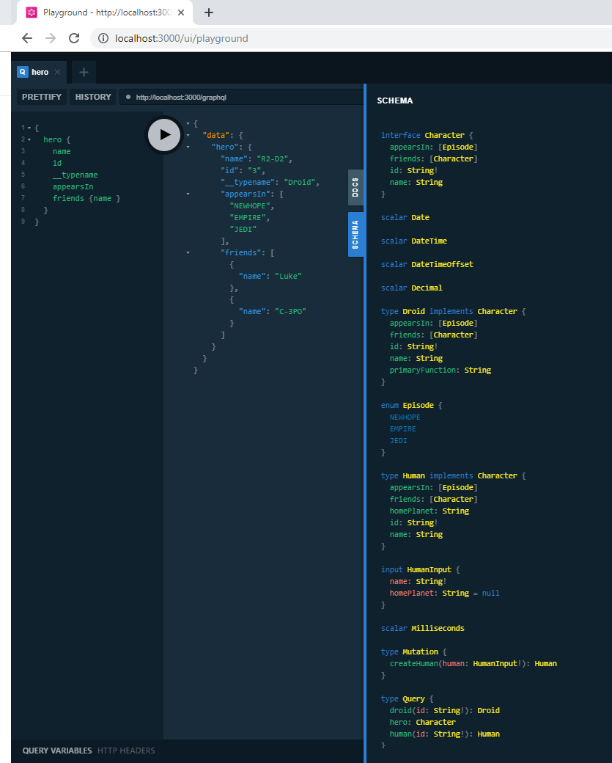

Slide 29
