Slide 1
What’s new in C#?
David Stevenson

Slide 2
What’s new in c# 6?
Read-only Auto-properties
Auto-Property Initializers
Expression-bodied function members
using static
Null - conditional operators
String Interpolation
Exception filters
nameof Expressions
await in catch and finally blocks
index initializers
Extension methods for collection initializers
Improved overload resolution

Slide 3
What’s new in c# 7.0 ?
inline out variables
Tuples
Discards
Pattern Matching
Ref locals and returns
Local Functions
More expression-bodied members
throw Expressions
Generalized async return types
Numeric literal syntax improvements

Slide 4
What do you need for c# 7 (AND TUPLES) ?
Visual Studio 2017
.NET Framework 4.7.0 or higher Or
Install-Package System.ValueTuple -Version 4.4.0

Slide 5
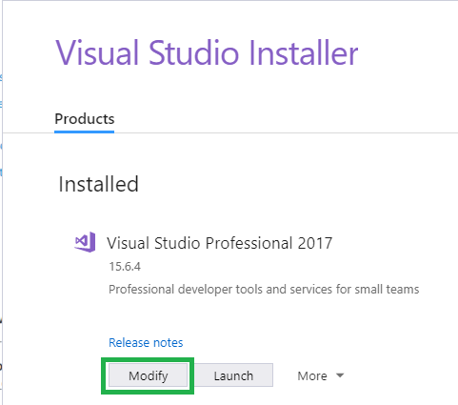
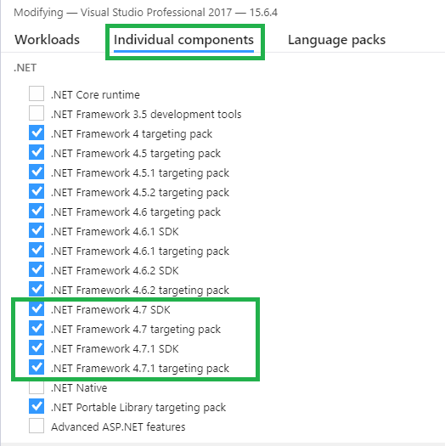
Installing .net framework 4.7.1

Slide 6
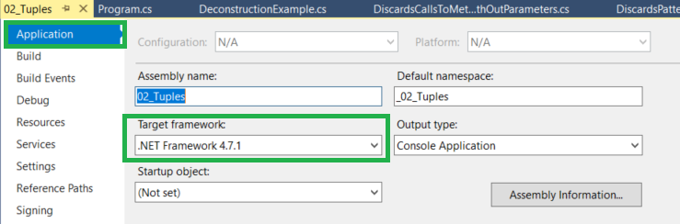
.net framework 4.7.0 or higher

Slide 7
What’s new in C# 7.1 ?
Language version selection
Async main
Default literal expressions
Inferred tuple element names
Reference assembly generation

Slide 8
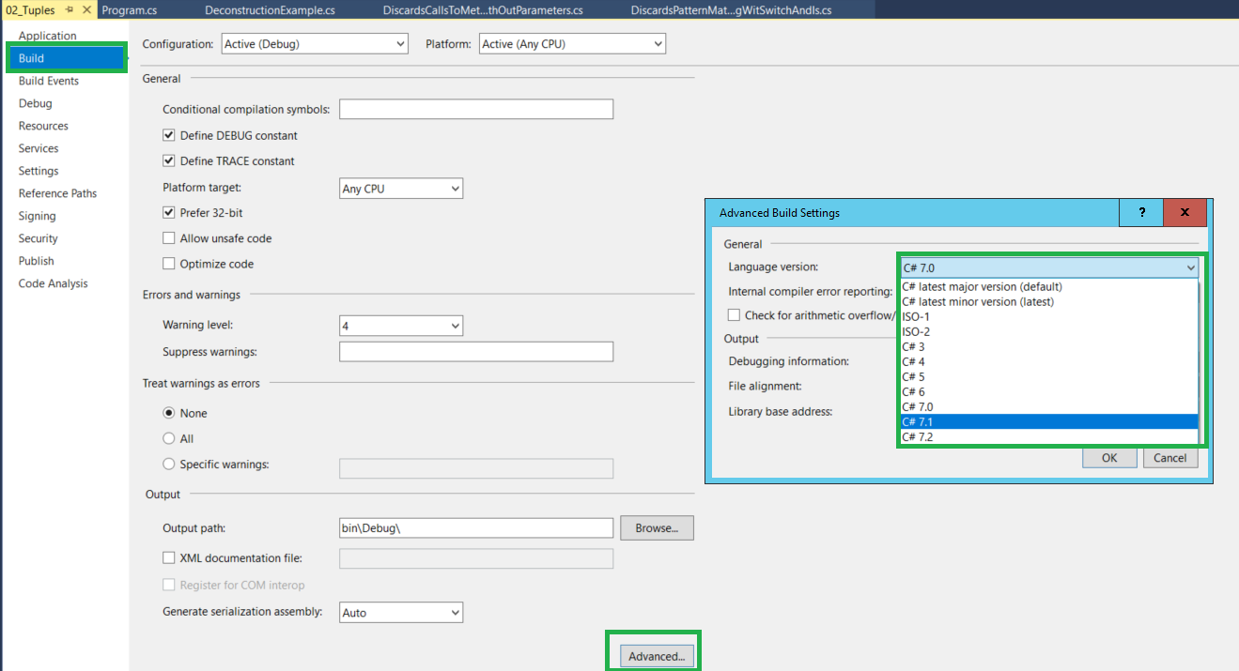

Slide 9
What’s new in C# 7.2 ?
Reference semantics with value types
Non-trailing named arguments
Leading underscores in numeric literals
private protected access modifier

Slide 10
SlideShare
https://goo.gl/Xo7oey

