Slide 1
Sales Forcasting for a Bakery Branch
Data Sciene & Machine learning – 08.01.2026
Team Goodweather
Adrian Metzgen, Thao P. Le, David Strifler, Iman Ghanad, Rakesh Kalamakuntla

Slide 2
Outline
Imputation of the values (d)
List and brief description of Self created variables (a)
Bar charts with confidence intervals for two self-created variables (a)
Linear model optimization (model equation and adjusted R2) (t)
Type of missing value imputation (d)
Neural network optimization
  Soruce code, defining the neural network
  Loss function plots for training and validation sets
  MAPE scores for overall validation set
Worst Fail and Best Improvement (d)
In github: editing the ReadMEs

Slide 3
Self created variables
Hot encoded variables
  Weekdays
  Warengruppe
  Perceived temperature: cold (>-3°C) - normal (∓3°C) - warm (>3°C), depending on monthly average
  Niederschlag (dry or wet days)
  Weathercode (10 different categories)
Rolling averages
  Temperature (7d)
  Niederschlag (7d)

Slide 4
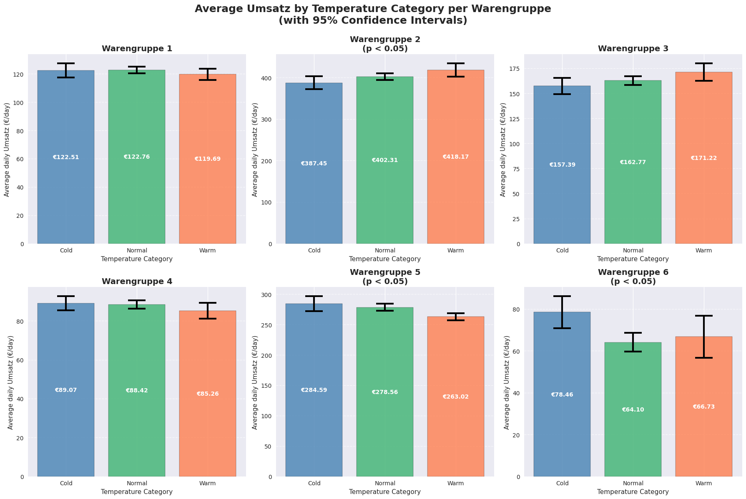
Significance of Temperature categories

Slide 5
Significance of Temperature categories
✓ Warengruppe 2: Significant influence between cold vs. warm (p=0.0166)
✓ Warengruppe 5: Significant differences between Cold vs Warm, Normal vs Warm (p=0.0115)
✓ Warengruppe 6: Significant differences between Cold vs Normal (p=0.0241)

Slide 6
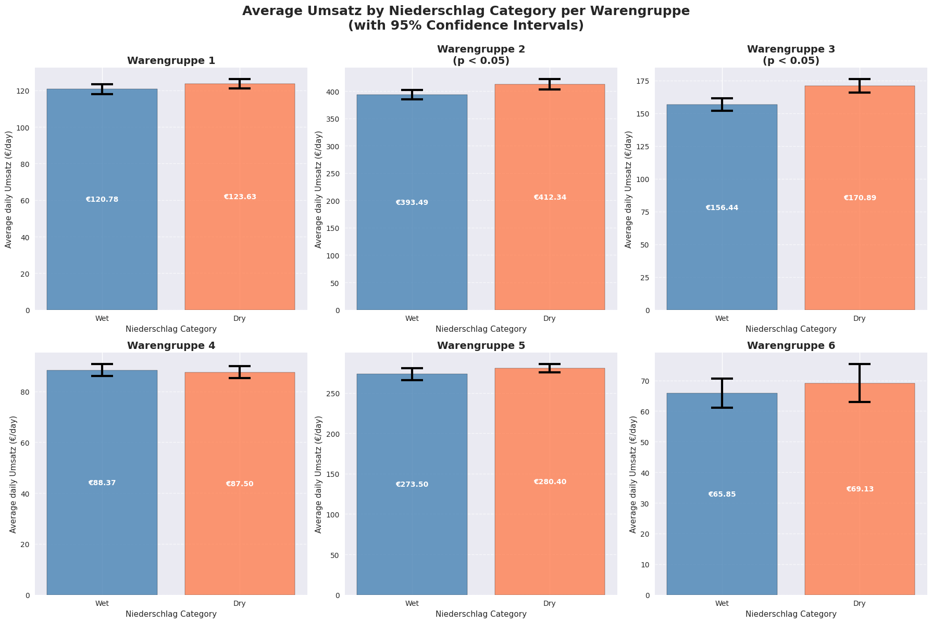
Significance of precipitation categories

Slide 7
Significance of precipitation categories
✓ Warengruppe 2: Niederschlag significantly influences Umsatz (p=0.0040)
✓ Warengruppe 3: Niederschlag significantly influences Umsatz (p=0.0000)

Slide 8
Missing value imputation
Used Method | Parameters
forward & backward filling | Bewölkung, Windgeschwindigkeit, Niederschlag, Wettercode
filling empty lines with 0 | Kieler Woche
Indicator columns were added respectively

Slide 9

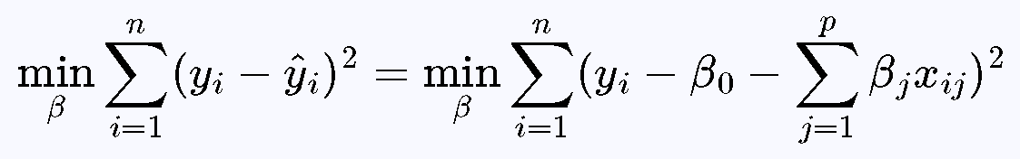
Linear Regression: Model Equation & Optimization
Linear Model Equation:
Each coefficient βi = change in target for one-unit increase in feature xi
Optimization:
Least Squares Method
✓ Use feature scaling
✓ Apply regularization (L1/L2)
✓ Validate on separate set
✓ Monitor training & validation metrics

Slide 10
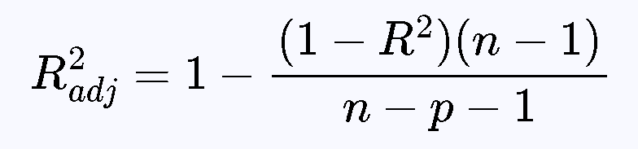
Linear Regression: Adjusted R-Squared (R²-adj)
Why Adjusted R²:
• Penalizes model complexity
• Only increases with meaningful features
• Prevents overfitting
• Fair for model comparison
R² vs R²-adj:
R²: Always increases with more features
R²-adj: Accounts for feature count
Use Adjusted R² for model selection

Slide 11
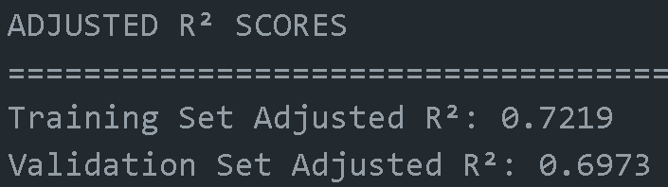
Linear Regression: R² Comparison
Before Imputation
Training R²: 0.7224
Validation R²: 0.7094
Change in Training R²:
+0.0011 (+0.15%)
Model Stability (Train-Val Gap):
Before: 0.013 (1.3%)
After Imputation
Training R²: 0.7235
Validation R²: 0.7047
Change in Validation R²:
-0.0047 (-0.66%)
After: 0.0188 (1.88%)

Slide 12
Linear Regression: Key Insights
1. Minimal Impact on Model Performance
Changes in R² are < 1%, indicating model robustness to imputation methods
2. Training Performance Improved
Training R² increased slightly (+0.15%) → Better fit on training data
3. Validation Performance Slightly Decreased
Validation R² dropped (-0.66%) → Imputation may not match original patterns perfectly
4. Model Generalization Still Strong
Train-Val gap < 2% → Model generalizes well to unseen data

Slide 13
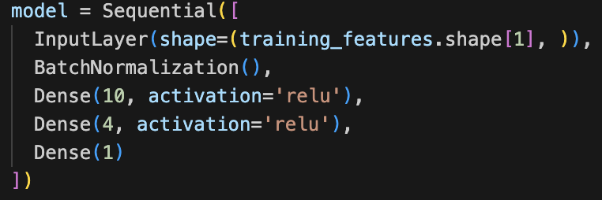
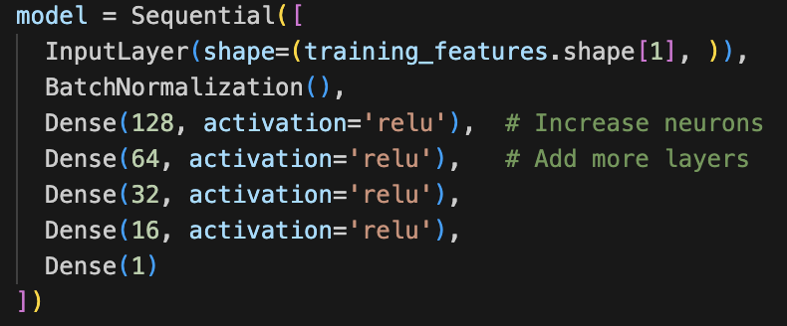
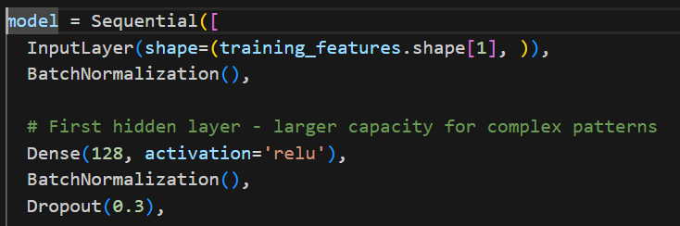
Neural Net Optimization (Tuning parameters)
Version 1
LR: 0,001; Epochs: 20
2 layers, 10 neurons on the first layer
MAPE Score:
→Train. data: 29,06 %
→Val. data: 30,05 %
Kaggle Score: 0,25227
Version 2
LR: 0,0005; Epochs: 50
4 layers, 128 neurons on the first layer
MAPE Score:
→Train. data: 21,05 %
→Val. data: 26,89 %
Kaggle Score: 0,21157
Version 3
LR: 0,001 to 0,0001; Epochs: 83
4 layers + dropout functions
MAPE Score:
→Train. data: 20,95 %
→Val. data: 22,11 %
Kaggle Score: 0,20255

Slide 14
Neural Net Optimization (Tuning parameters)
Version 1
LR: 0,001; Epochs: 20
2 layers, 10 neurons on the first layer
MAPE Score:
→Train. data: 29,06 %
→Val. data: 30,05 %
Kaggle Score: 0,25227
Version 2
LR: 0,0005; Epochs: 50
4 layers, 128 neurons on the first layer
MAPE Score:
→Train. data: 21,05 %
→Val. data: 26,89 %
Kaggle Score: 0,21157
Version 3
LR: 0,001 to 0,0001; Epochs: 83
4 layers + dropout functions
MAPE Score:
→Train. data: 20,95 %
→Val. data: 22,11 %
Kaggle Score: 0,20255

Slide 15
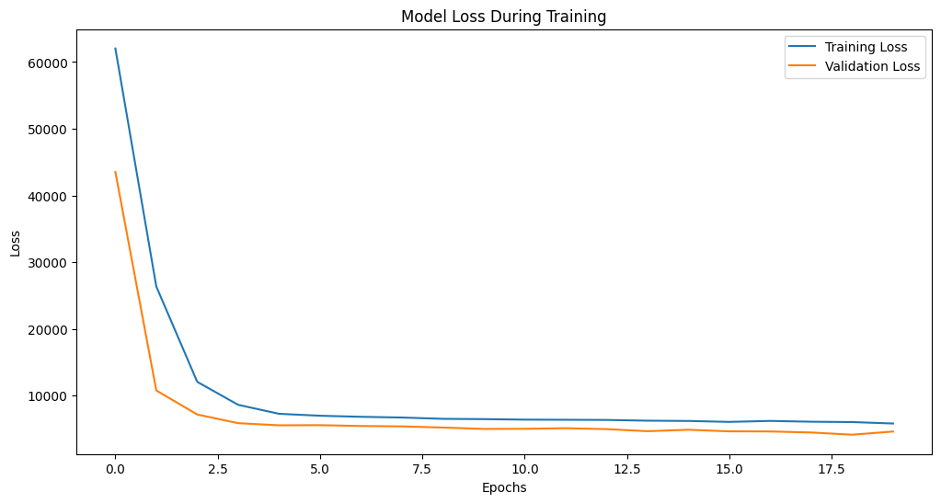
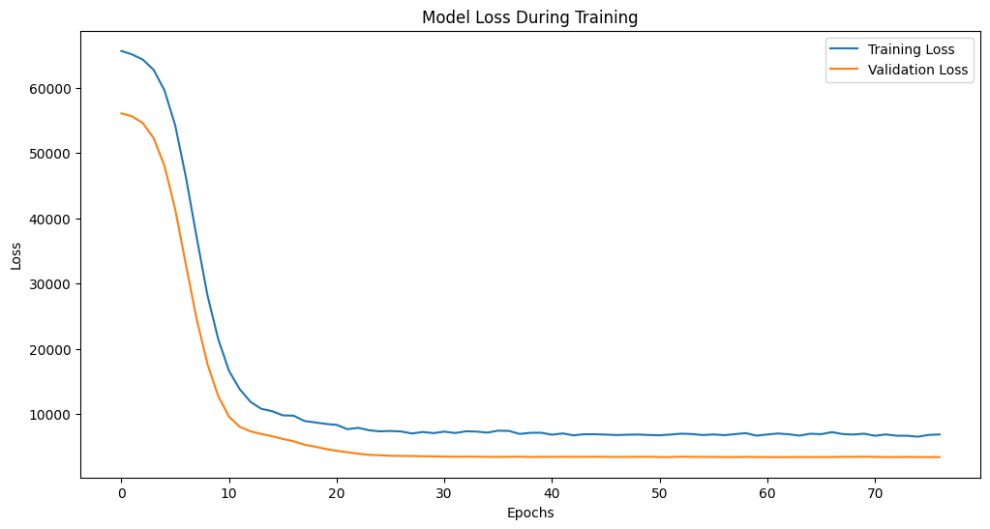
Loss Functions
Version 1
Version 3

Slide 16
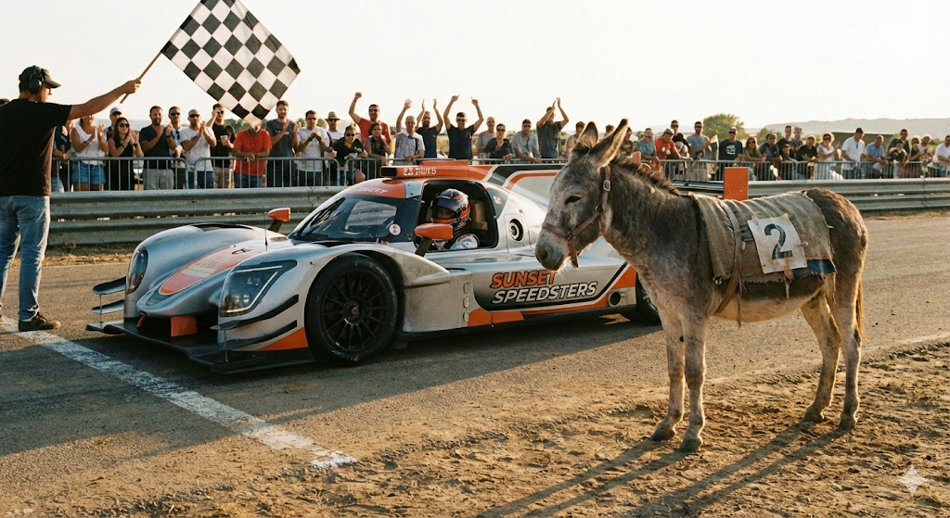
Worst fail and best improvement
We started with very different levels of knowledge
(Git, Programming, AI)
But:
step by step we all understood github and improved coordination and communication
Best improvement: Pathetic but true - working as a team :)

