Slide 1
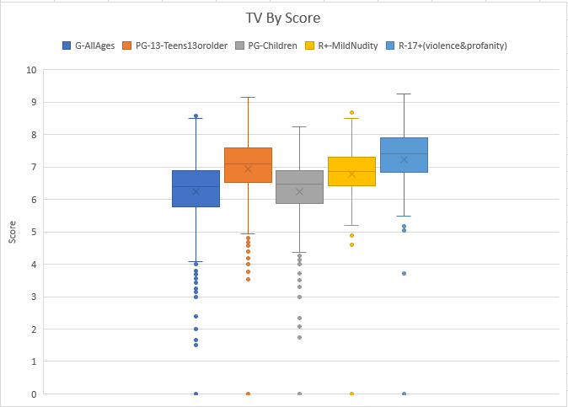
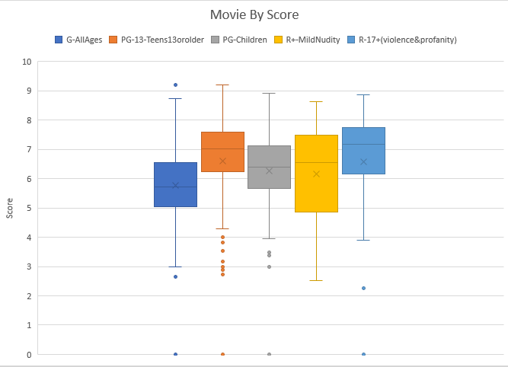
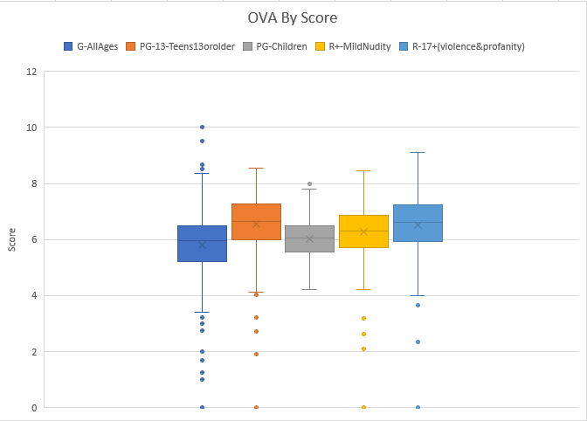
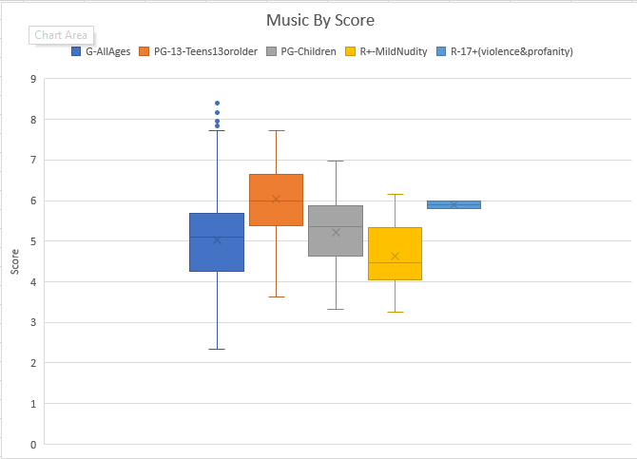
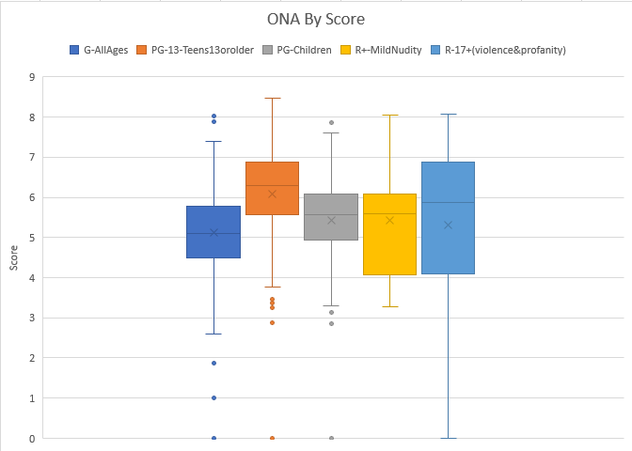
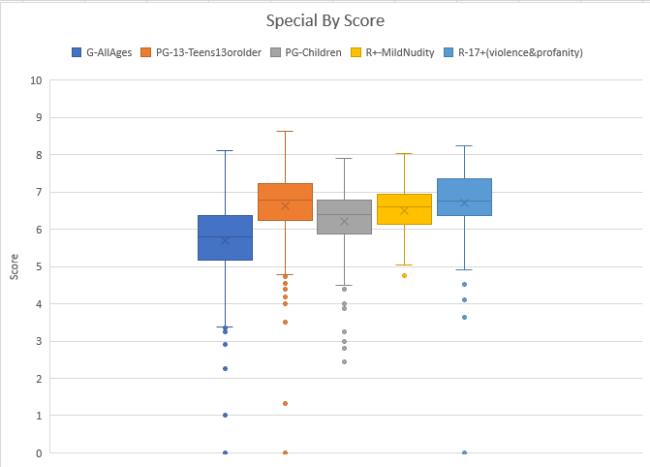
Anime Score on MAL based on Type and Rating
David Sugirdorj
NWMSU
Score
Box and Whiskers chart
Question: Does type and rating affect the score given on Anime in MAL?
Results are separated by type
Based on the Question that was asked at the beginning of the project and given the results. I am happy to say that there was a correlation between type and rating to score.
The results were compiled from a list of over 14000 data points.
The conclusion is that type and rating has a direct influence to score. Based on those two categories we can see that, score has overall similar medians in each chart.
Methods
Excel
Cleaning
Creation of charts
SAS, Weka
Data Check
Data Organization
Data Source and Reference
https://www.kaggle.com/azathoth42/myanimelist
https://support.microsoft.com/en-us/office/create-a-box-and-whisker-chart-62f4219f-db4b-4754-aca8-4743f6190f0d
https://myanimelist.net/
Dr. Eloe Nathan

