Slide 1
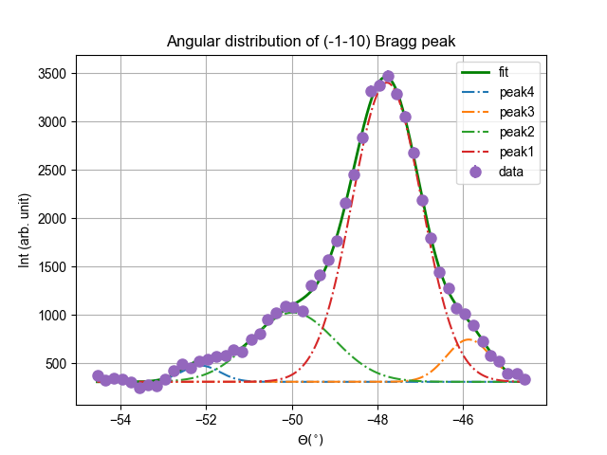
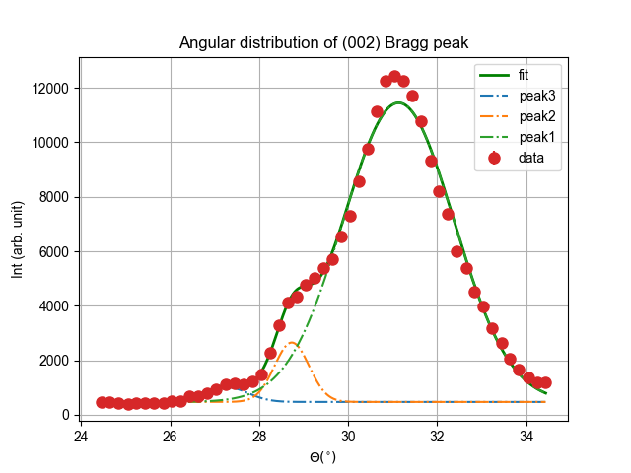
Peak | Intensity(%) | FWHM
peak1 | 71.5 | 1.91
peak2 | 19.8 | 2.2
peak3 | 6.5 | 1.2
peak4 | 2.2 | 1
Peak5 | Intensity(%) | FWHM
peak1 | 92.6 | 2.93
peak2 | 5.7 | 0.9
peak3 | 1.7 | 1.1

Slide 2
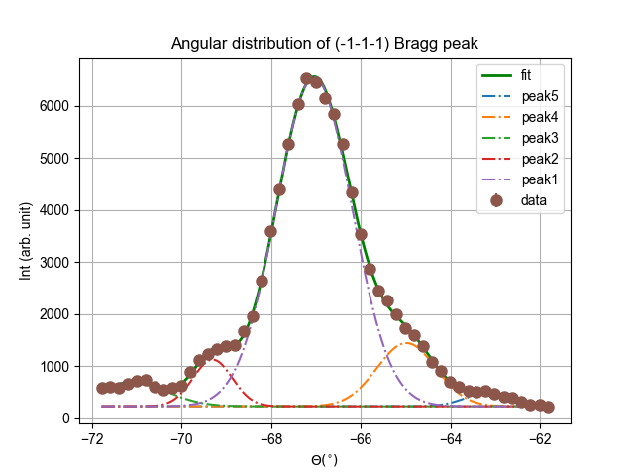
Peak | Intensity(%) | FWHM
peak1 | 76.0 | 2.0
peak2 | 5.6 | 1
peak3 | 5.2 | 1.8
peak4 | 11.4 | 1.5
peak5 | 1.8 | 1.2

