Slide 1

The Effect of Skill Granularity on Mastery Estimation in Adaptive Learning Systems
Preliminary defence
Davit Tchintcharashvili
Supervisor: Mikheil Gigauri
University of Georgia, School of IT, Engineering and Mathematics
November 2026
Notes:
Good afternoon. My name is Davit. My thesis is about learning programs, the programs where students practise mathematics. Today I will show my method and my first results.

Slide 2
The problem: when does a student know a skill?
A learning program asks questions. After each answer it must decide: does the student know this skill?
If it says “yes” too early, the student moves on and is not ready.
If it says “yes” too late, the student loses time on easy questions.
But what is one skill? Fractions can be 1 skill, or 16 small ideas.
2
Notes:
A learning program asks a student questions. After each answer it must decide: does the student know this skill now? The program can make two mistakes. It can say yes too early. Then the student moves on, but is not ready. Or it can say yes too late. Then the student loses time on easy questions. There is one more problem. What is one skill? Fractions can be one big skill. Or fractions can be sixteen small ideas. Somebody must choose. I call this choice the grain. A coarse grain means big skills. A fine grain means small skills.

Slide 3
Research question
Does the size of a skill change how well a program can decide that a student knows it?
Grain = the size of a skill: one big skill, or many small parts.
Good decision = when the program says “the student knows it”, this is true.
Stable decision = the same rule works in different situations.
3
Notes:
This is my research question. Does the size of a skill change how well the program decides? I look at two things. First, is the decision right? When the program says the student knows the skill, is it true? Second, is the decision stable? Does the same rule work in different situations?

Slide 4
What other researchers did
They compared the rules for deciding (Pelánek & Řihák, 2017).
They compared big and small skills, but only to predict the next answer (Pardos et al., 2007; Feng et al., 2009).
They made a model for questions that need several skills (Pardos et al., 2008).
Nobody checked: does the size of a skill change the decision itself? This is my work.
4
Notes:
Other researchers worked on this before me. Some compared the rules for deciding. Some compared big skills and small skills. But they only asked: can we predict the next answer? Nobody checked the decision itself, the decision that the student knows the skill. To check it, we must know the truth about the student. This is the new part of my thesis.

Slide 5
Three rules for deciding
BKT: calculates the probability that the student knows the skill. If it is 95 % or more, it says “yes”.
Moving average (EMA): looks at the last answers. New answers count more.
Streak: the student gives N right answers in a row, for example 3.
I also proved two mathematical statements about these rules.
5
Notes:
I compare three rules. The first is BKT, Bayesian Knowledge Tracing. It calculates the probability that the student knows the skill. When the probability is 95 percent or more, it says yes. The second is the moving average. It looks at the last answers, and new answers count more. The third is the streak rule. The student must give some right answers in a row, for example three. I also proved two statements. The first: the streak rule is a special case of the moving average. The second: BKT is correct when students learn exactly as BKT expects. So I must test BKT where students learn in a different way.

Slide 6
Method: computer-made students
With real students, we never know the truth. So I made 400 students in the computer.
For these students, I know exactly what they know after every answer.
I can check every decision of the program: right or wrong.
Then I change the size of the skill: too big, correct, too small.
I set the rules on one group of students and test them on a different group.
6
Notes:
How can I check a decision? With real students, we never know the truth. So I made students in the computer, four hundred of them. This is called simulation. For these students, I know exactly what they know after every answer. So I can check every decision. Then I change the size of the skill. First the skill in the program is too big. Then it is the correct size. Then it is too small. I set the rules on one group of students, and I test them on a different group. Anyone can run my code and get the same numbers.

Slide 7
Result 1: BKT is good only when students learn as it expects
How students learn | Rule | Answers needed | Right decisions
They can forget | BKT | 3.5 | 89.4 %
They can forget | Moving average | 5.5 | 96.0 %
They can forget | Streak | 4.2 | 93.5 %
Slowly, step by step | BKT | does not reach 90 % | –
Slowly, step by step | Moving average | 25.7 | 89.5 %
Slowly, step by step | Streak | 27.1 | 92.9 %
Goal: 9 of 10 decisions must be right.
When students learn slowly, BKT is too sure, too early.
7
Notes:
The first result. The goal is that nine of ten decisions are right. When students can forget, BKT is the fastest. It needs about three and a half answers. The moving average needs five and a half. But when students learn slowly, step by step, BKT does not reach the goal. It becomes very sure after a few right answers, but the student is not ready. So the number from BKT is not always a real probability. In one situation we can trust it. In another situation we cannot.

Slide 8
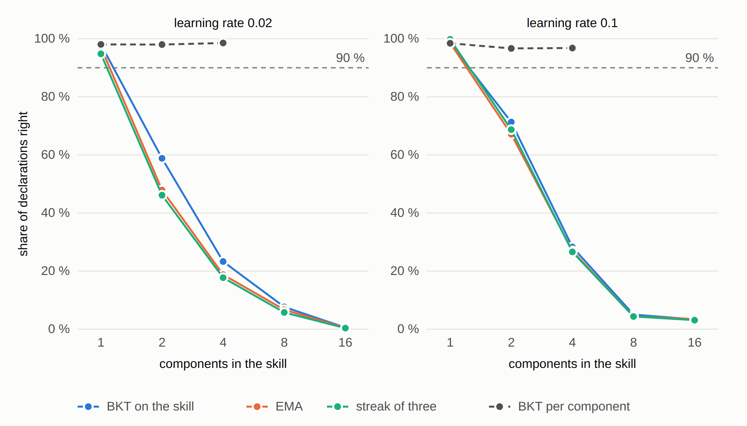
Result 2: a skill that is too big gives “yes” too early
One skill in the program, but several parts in reality. With 1 part, 98 % of decisions are right. With 4 parts, only 23 %.
All three rules fail together. BKT on each part (dashed line) stays near 98 %.
8
Notes:
The second result. Why does BKT fail? The reason is the size of the skill. Here, the real skill has several parts. The student learns each part separately. But the program sees only one big skill. Look at the picture. When the skill has one part, 98 percent of decisions are right. With two parts, 59 percent. With four parts, only 23 percent. All three rules fail together. The simple rules are not safer. The dashed line is BKT on each real part. It stays near 98 percent. But with eight or sixteen parts it stops deciding, because thirty questions are not enough for so many parts.

Slide 9
Result 3: the correct size helps, but it needs enough questions
Questions | Students who really know | Program says “yes” | Right decisions | Finds the missing idea
30 | 36.5 % | 4.1 % | 100.0 % | 56.7 %
60 | 73.0 % | 47.3 % | 85.7 % | 66.9 %
120 | 89.2 % | 85.1 % | 77.8 % | 78.8 %
Fractions as 16 small ideas, with real questions from my system, Zeno.
One fractions question needs about 6 ideas. A wrong answer does not show which idea is missing.
9
Notes:
The third result uses a real topic, fractions. I divided fractions into sixteen small ideas. The questions come from Zeno. Zeno is the practice system that I built. One fractions question needs about six ideas together. So when the answer is wrong, we do not know which idea is missing. With thirty questions, the program finds the missing idea in 57 percent of cases, and it says yes to almost nobody. With 120 questions, it finds the missing idea in 79 percent of cases. So the correct size helps. But it needs two things: questions that show the ideas separately, and enough practice.

Slide 10
Result 4: when the skill is too small, students wait too long
Pieces per real part | Answers needed | Right decisions | Program says “yes” (at 95 %)
1 (correct size) | 11.1 | 89.9 % | 94.5 %
2 | 14.5 | 94.8 % | 74.9 %
4 | 21.0 | 93.0 % | 7.1 %
The same students and the same answers. Only the program cuts the skill into smaller pieces.
Smaller is not always better.
10
Notes:
The fourth result is the opposite case. The students are the same and the answers are the same. But the program cuts each real part into smaller pieces. When I cut each part into four pieces, the program needs ten more answers. And with the usual 95 percent rule, it says yes to only 7 percent of students. Before, it was 94 percent. So smaller is not always better. Each small piece gets too few answers.

Slide 11
Limits of this work
The students are made by computer. Real students can be different.
I divided fractions into 16 ideas myself. Another person could divide them differently.
A rule that works for one group of students does not always work for a new group.
I do not say there is one best size for all skills.
I do not measure if Zeno helps a real class to learn.
11
Notes:
My work has limits. The students are made by computer, and real students can be different. I divided fractions into sixteen ideas myself, and another person could do it differently. A rule that works for one group does not always work for a new group. I repeated every experiment five times, and I keep only the results that stay the same. I do not say there is one best size for all skills. And I do not measure if Zeno helps a real class.

Slide 12
Conclusion and next steps
The size of a skill changes the decision.
Too big: the program says “yes” too early.
Too small: the program almost never says “yes”.
The skills, the questions and the rule must be chosen together.
Next, for the final thesis: the same question on answers of real students (ASSISTments data, about 4,000 students).
12
Notes:
My conclusion. The size of a skill changes the decision. When the skill is too big, the program says yes too early. When the skill is too small, the program almost never says yes. So we must choose the skills, the questions and the rule together. What is next? For the final thesis, I study the same question on answers of real students. This is a public data set called ASSISTments, with about four thousand students. Thank you. I am ready for your questions.

