Slide 1
IDE-IT (Backend)
Eric Wahlquist, John Barcellos, David Thien
Notes:
10 minutes of material

Slide 2
Motivation
IDEs are great with many features to speed up the development process, however...
Discoverability of IDE features is extremely poor
Difficult to know what features exist
Current methods don’t give you features at relevant times
Notes:
Eric
One of the best ways to discover new features is to have a friend/colleague watch you code and point out features you could be using

Slide 3
IDE-IT
Integrated Development Environment - Intelligent Tutorials
Eclipse plugin
Tracks user input and provides suggestions for using IDE features
IDE-IT Back end
Responsible for detecting user input and evaluating which IDE features the user might be interested in
Notes:
Eric
That colleague who watches you code and tells you about features? The goal of IDE-IT is to automate that process. IDE-IT is that colleague.

Slide 4
IDE-IT Vs. Previous approaches
Improving Software Developers’ Fluency by Recommending Development Environment Commands¹
Recommendations based on sequences of commands
Doesn’t work for general development process
Intellij Idea Feature Suggester
Similar idea to IDE-IT
Does not support an arbitrary frontend
Not available for Eclipse
Emerson Murphy-Hill, Rahul Jiresal, and Gail C. Murphy. 2012. Improving software developers' fluency by recommending development environment commands. In Proceedings of the ACM SIGSOFT 20th International Symposium on the Foundations of Software Engineering (FSE '12). ACM, New York, NY, USA, Article 42, 11 pages. DOI: https://doi.org/10.1145/2393596.2393645
Notes:
David
Paper gives recommendations based on sequences of commands; really useful for things like commiting to VCS or making systematic changes, but falls short on the coding part of the development process. More easily extensible
Feature Suggester works based on editor changes, but was made during a hackathon, buggy and only maintained enough to keep it running

Slide 5
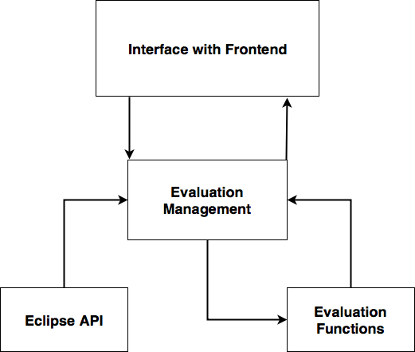
IDE-IT Backend Approach
Notes:
Eric

Slide 6
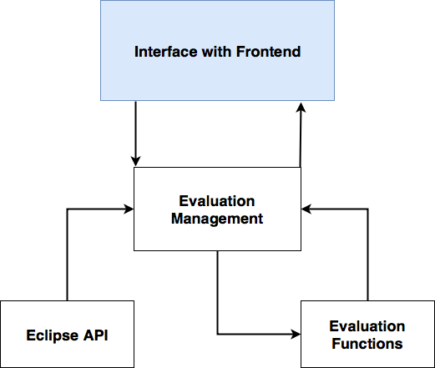
IDE-IT Backend Approach
Allows arbitrary frontend client to use backend functionality
Frontend client creates an observer, registers it with the interface
When a feature is suggested, frontend notified via the observer
Notes:
David

Slide 7
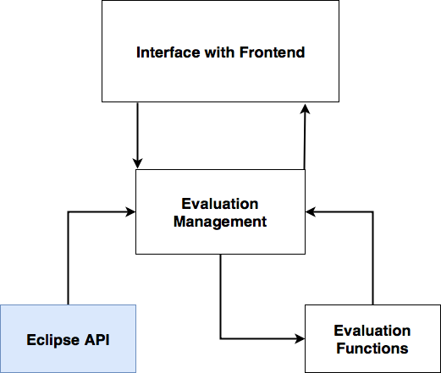
IDE-IT Backend Approach
Listens for:
New editor windows
Document changes
Annotation changes
Document saves
Sends event information to evaluation management
Notes:
Eric

Slide 8
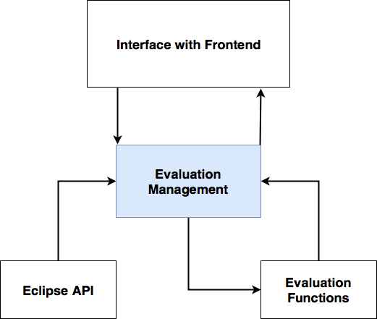
IDE-IT Backend Approach
Attaches evaluators to document editor windows
Evaluators notified of change events via the Eclipse API
Evaluators process change events through evaluation functions
Notifies frontend interface of any suggested features
Notes:
David

Slide 9
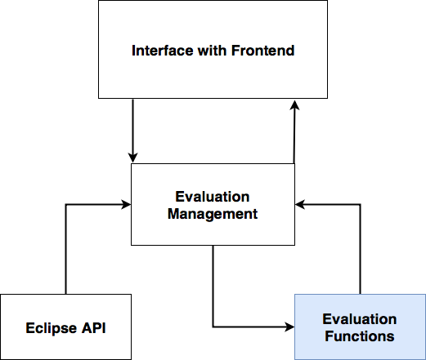
IDE-IT Backend Approach
Gets change event information from evaluation management
Determines if change event means a feature should be suggested
Notifies evaluation management if a feature should be suggested
Notes:
Eric

Slide 10
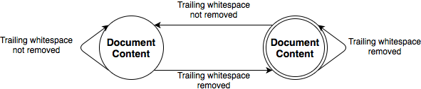
Remove trailing whitespaces on save
Notes:
David

Slide 11
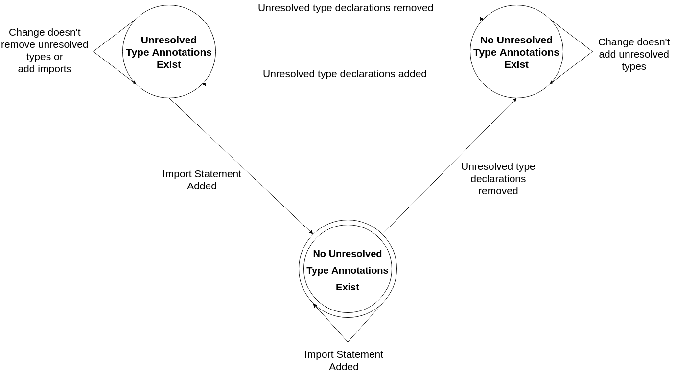
Add Imports Evaluator
Notes:
David

Slide 12
Demo
Notes:
Eric

Slide 13
Project Success Metrics
Our focus:
Maximize true positives (minimize false negatives)
Keep false positives low, but less of a concern
Evaluate against a list of possible user actions for each feature
Ask users to find all ways they can to circumvent using a feature
Compile results into a list of “cases”
Compare # of cases our evaluators cover to the total # of cases
Notes:
David
Define what we mean by false negatives and false positives
Describe the process we took to create the list of possible user actions

Slide 14
Evaluator Function Testing
Tests of true positive cases (cases where the feature evaluator should trigger)
FeatureEvaluator | Percentage Covered
AddImport Evaluator | 100%
BlockComment Evaluator | 72%
CorrectIndentation Evaluator | 94%
GetterSetter Evaluator | 66%
RemoveImport Evaluator | 100%
TrailingWhiteSpace Evaluator | 100%
Notes:
Eric

Slide 15
Conclusions
IDE-IT has proven to be a successful technique for discoverability of IDE tools
Easily extensible with high modularity
Available for download and use from github
Notes:
David

