Slide 1
Wishbone tutorial

Slide 2
Wishbone
Wishbone is an interactive tool to identify bifurcating developmental trajectories from single cell data.
It also provides data preprocessing functionality such as dimensionality reduction and gene expression visualization
If you use Wishbone, please cite
Wishbone identifies bifurcating developmental trajectories from single-cell data
Nature Biotechnology May 2016. DOI: doi:10.1038/nbt.3569

Slide 3
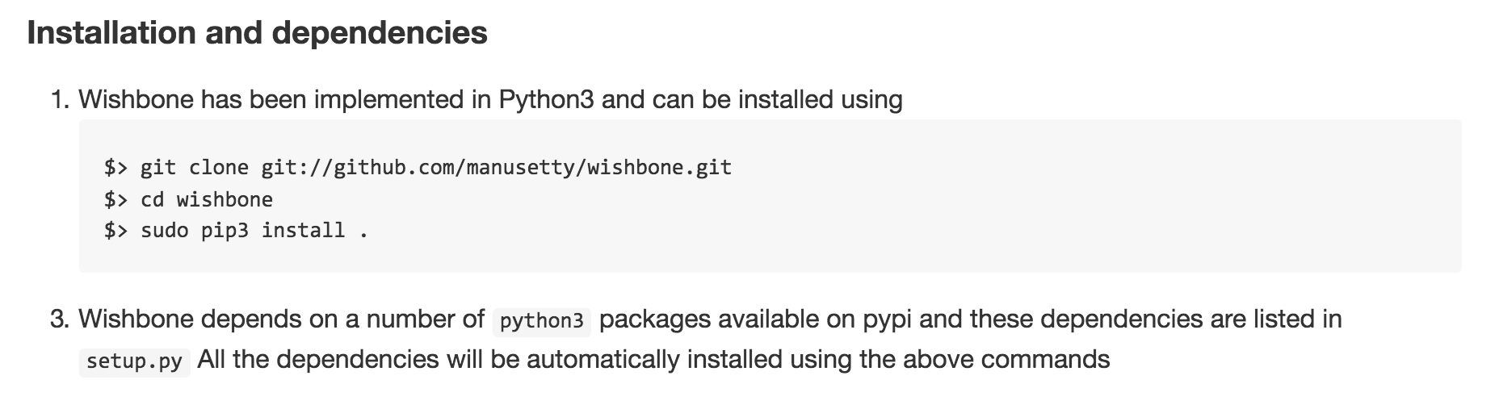
Install wishbone
Go to https://github.com/ManuSetty/wishbone
Use the following instructions to install Wishbone

Slide 4

Launch wishbone
After following the steps to install wishbone, the gui can be launched with the following command:

Slide 5
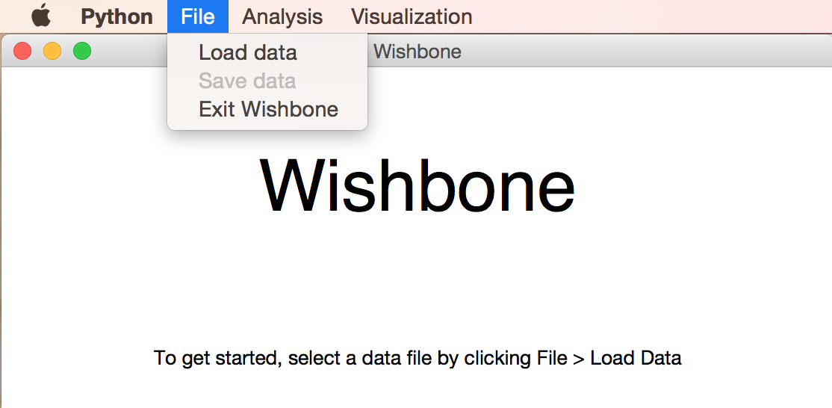
Loading data
After launching Wishbone, select File > Load Data
Select a csv file containing single cell RNA-seq data, a fcs file containing mass cytometry data, or a pickle file from a previous Wishbone session.

Slide 6
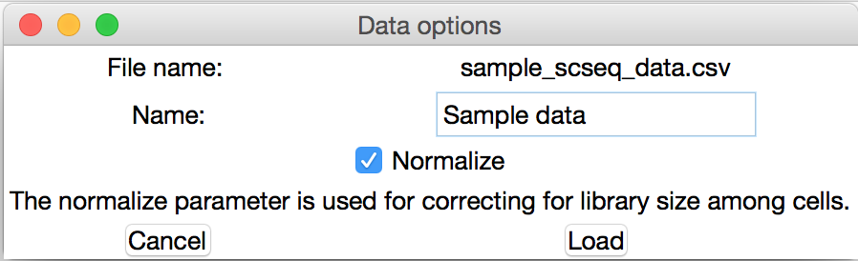
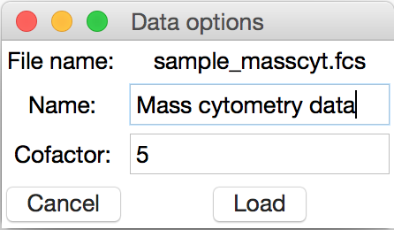
Loading data
After selecting a file, you will be prompted to enter a name for the data
If you’ve selected sc-seq data, you will also be asked to choose whether or not to correct for library size among cells.
If you’ve selected mass cytometry data, you will be prompted to enter a cofactor for normalization
sc-seq data
mass cytometry data

Slide 7
PCA
Single cell RNA-seq data suffers from high drop-out rate and as such Wishbone uses PCA to first identify “meta-genes” on which the trajectory detection and branching is based on.
Select Analysis > Principal Component Analysis to run PCA.

Slide 8
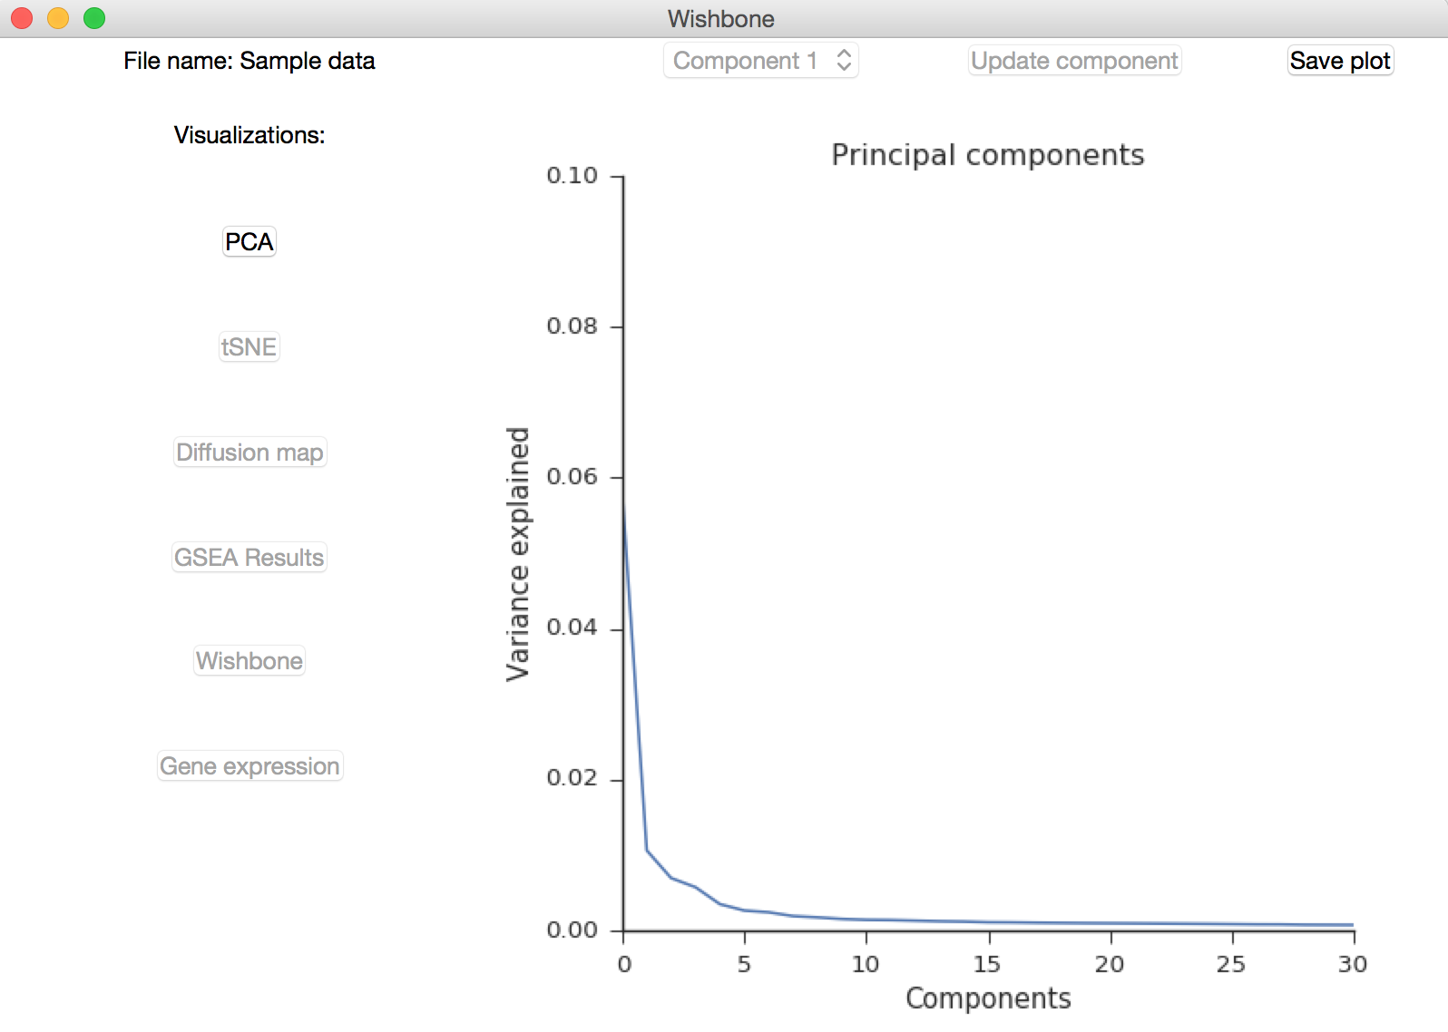
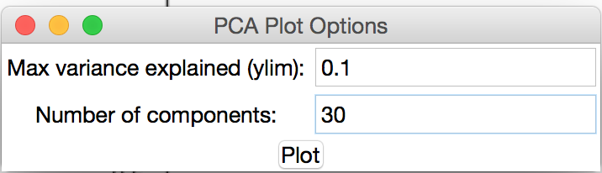
PCA Visualization
To visualize the fraction of variance explained by each component, select Principal Component Analysis from the Visualization menu.
You will be prompted to set the y-axis limits as well as the number of components you would like to visualize.

Slide 9
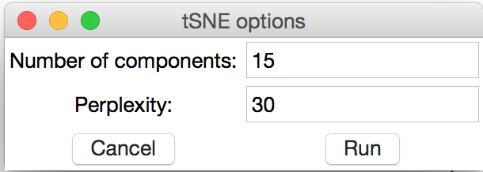
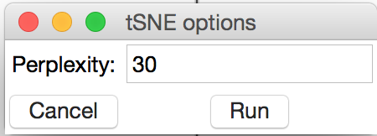
t-SNE
Wishbone uses tSNE for data visualization
Select Analysis > tSNE to run tSNE.
If analyzing sc-seq data, enter the number of components to use for tSNE.
Use the elbow method to choose the appropriate number of components
For both data types, a perplexity value is also needed to run tSNE
If the cell count is less than 100, the perplexity should be reduced
sc-seq data
mass cytometry data

Slide 10
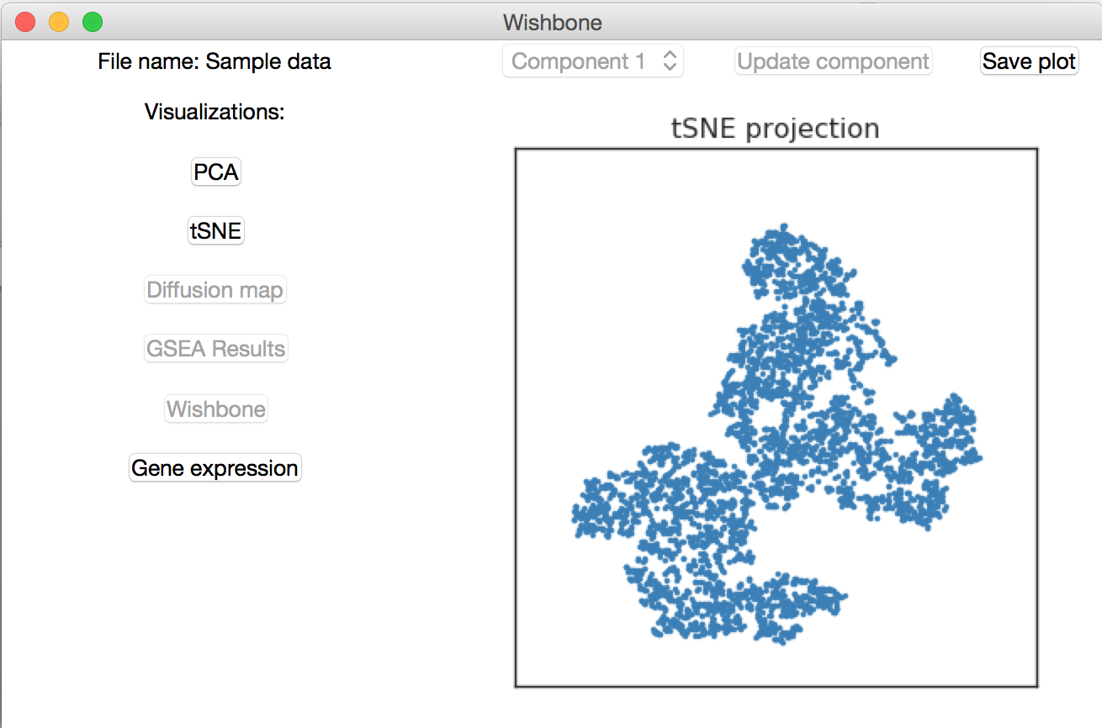
t-SNE Visualization
To see a t-SNE plot, select t-SNE from the visualization menu.

Slide 11
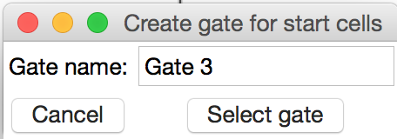
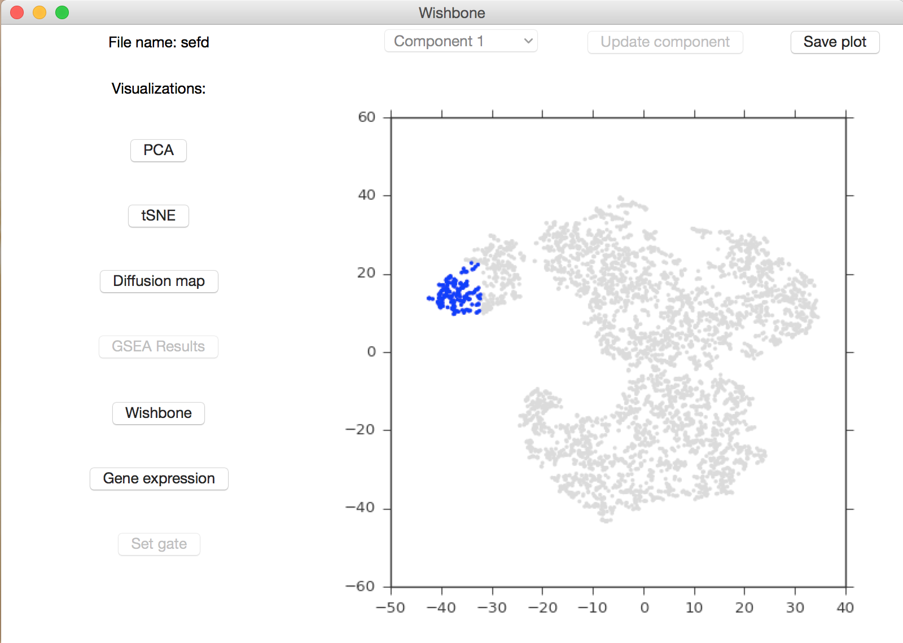
Selecting gate for start cells
A subset of cells can be selected on a t-SNE plot and saved as a gate to be used as the Wishbone starting point.
After plotting t-SNE, select ‘Set gate’ from the visualization menu
Choose a name for the gate, then drag your cursor to select a rectangular area to gate.

Slide 12
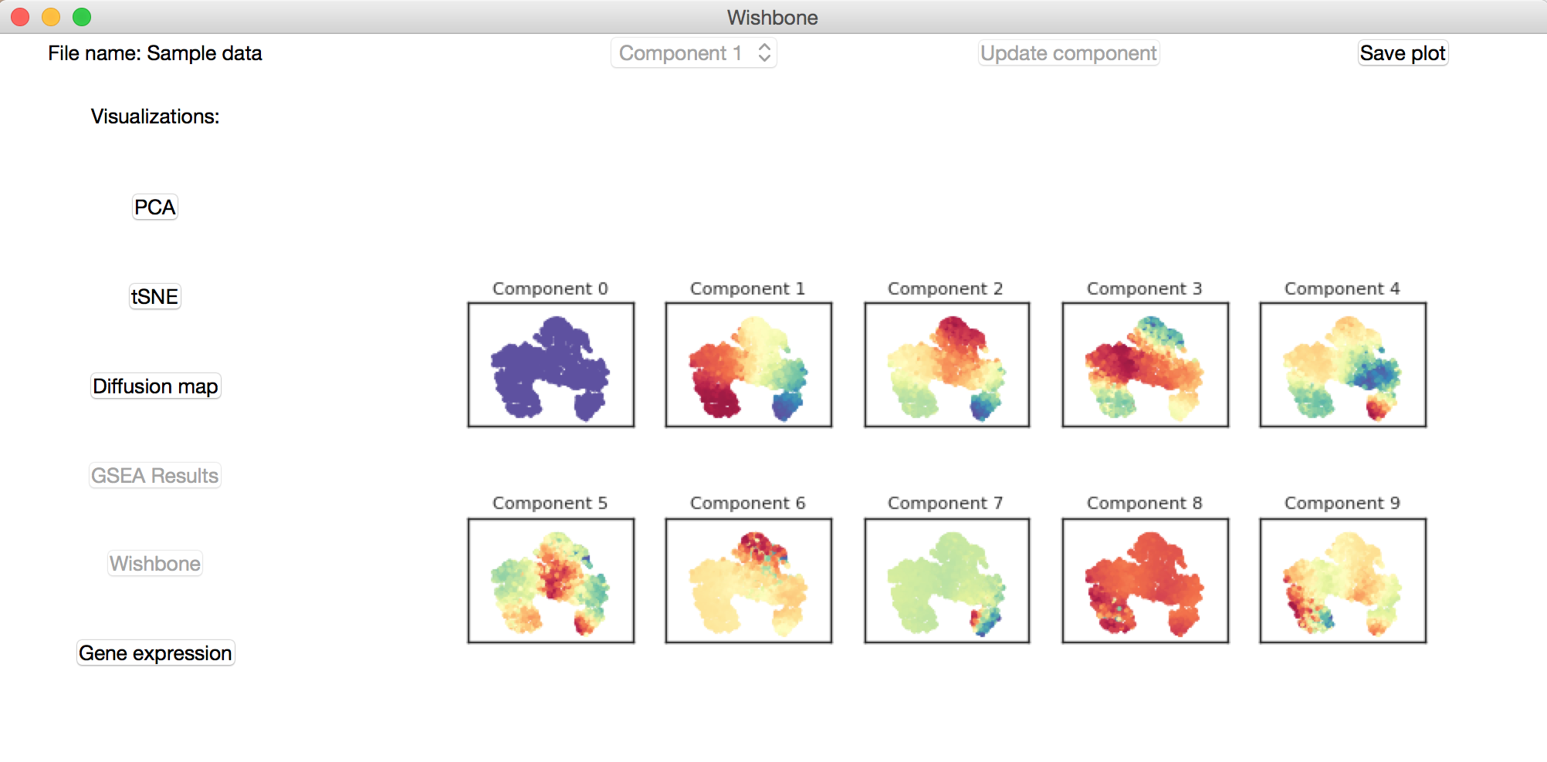
Diffusion map components
Diffusion maps are a non-linear dimensionality reduction technique to denoise data and capture the major axes of variation.
To run diffusion maps, select Analysis > Diffusion map
The top 10 diffusion components can be visualized on tSNE maps by selecting Diffusion map in the Visualization menu

Slide 13
Running GSEA
Trajectory detection in single cell RNA-seq data is confounded by non differentiation related processes such as cell cycle and metabolism
Wishbone uses GSEA along each diffusion component to identify the most relevant components
To run GSEA, Select Analysis > GSEA.
You will be prompted to select a gmt file as well as a prefix for generating GSEA reports. The supported gmt files are included with the Wishbone package.

Slide 14
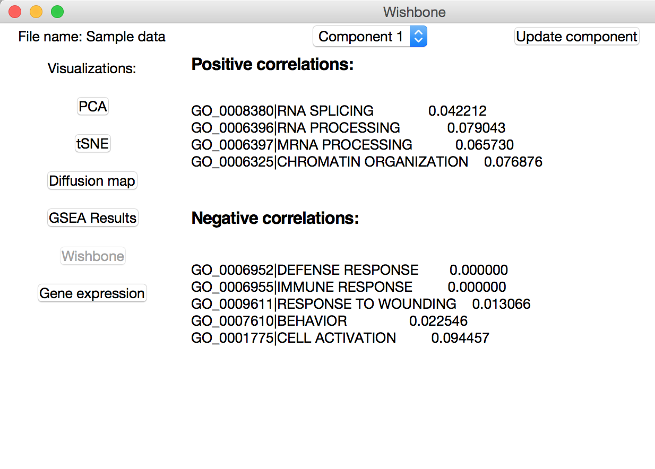
GSEA Results
Select GSEA results from the visualization menu to view the results. The positive and negative correlations for a given component will be displayed.

Slide 15
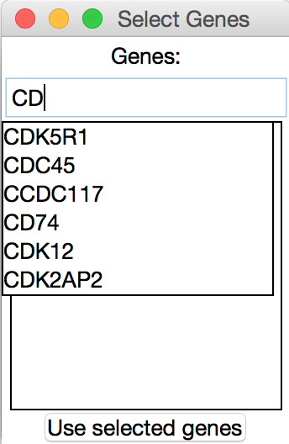
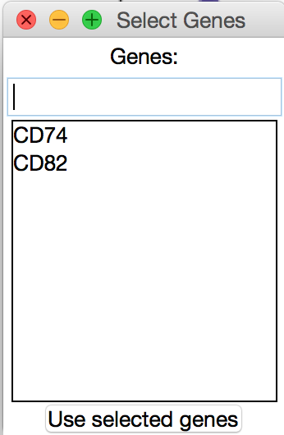
Plot gene expression
To visualize gene expression on a tSNE map, select ‘Gene expression’ from the visualization menu.
You will be prompted to select the genes you wish to visualize. Use the right arrow key to autocomplete to the first entry in the drop-down menu.

Slide 16
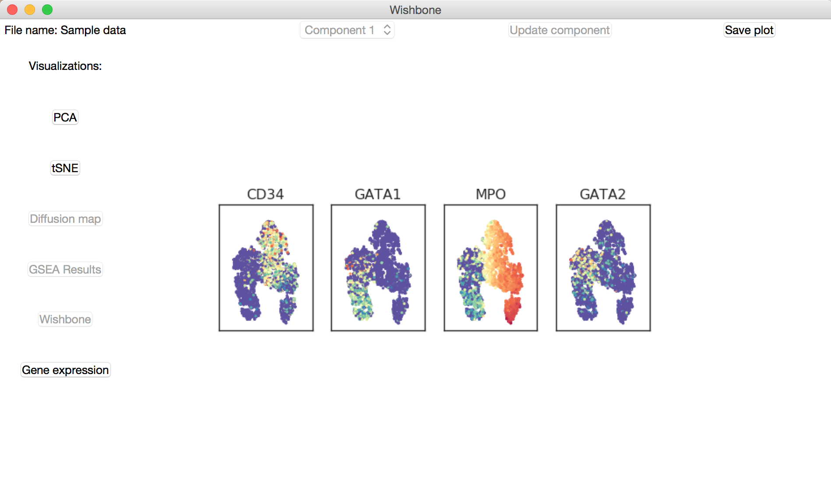
Gene expression visualization

Slide 17
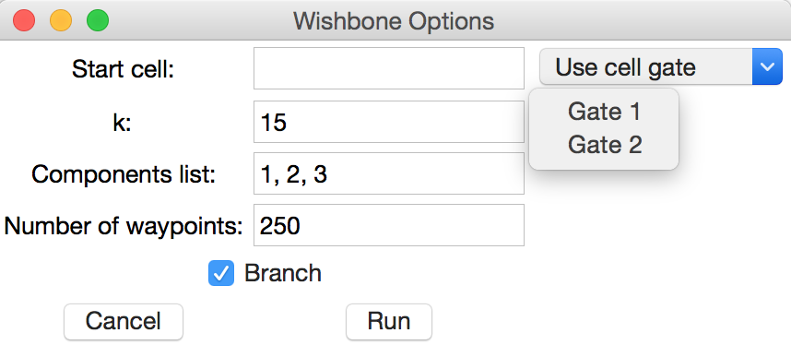
Running wishbone
To run wishbone, select Analysis > Wishbone.
You will be prompted to enter a start cell, a k value for the construction of a k-nearest neighbors graph, which diffusion components to use, the number of waypoints to use, and whether to compute branches in the trajectory.
The start cell can either be a manually selected cell or a pre-saved cell gate (a randomly selected cell within the gate will be used as the starting point).

Slide 18
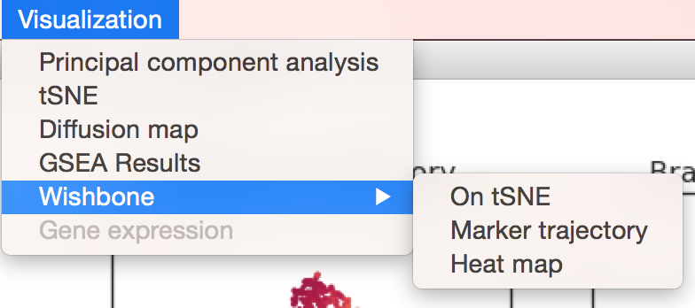
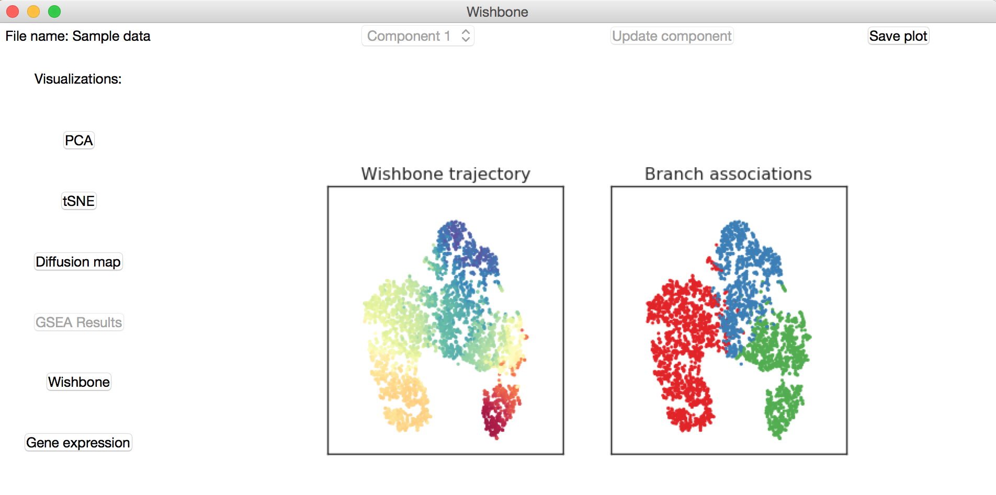
Wishbone visualizations
Wishbone trajectory and branch results can be visualized on tSNE maps by selecting Visualization > Wishbone > On tSNE.

Slide 19
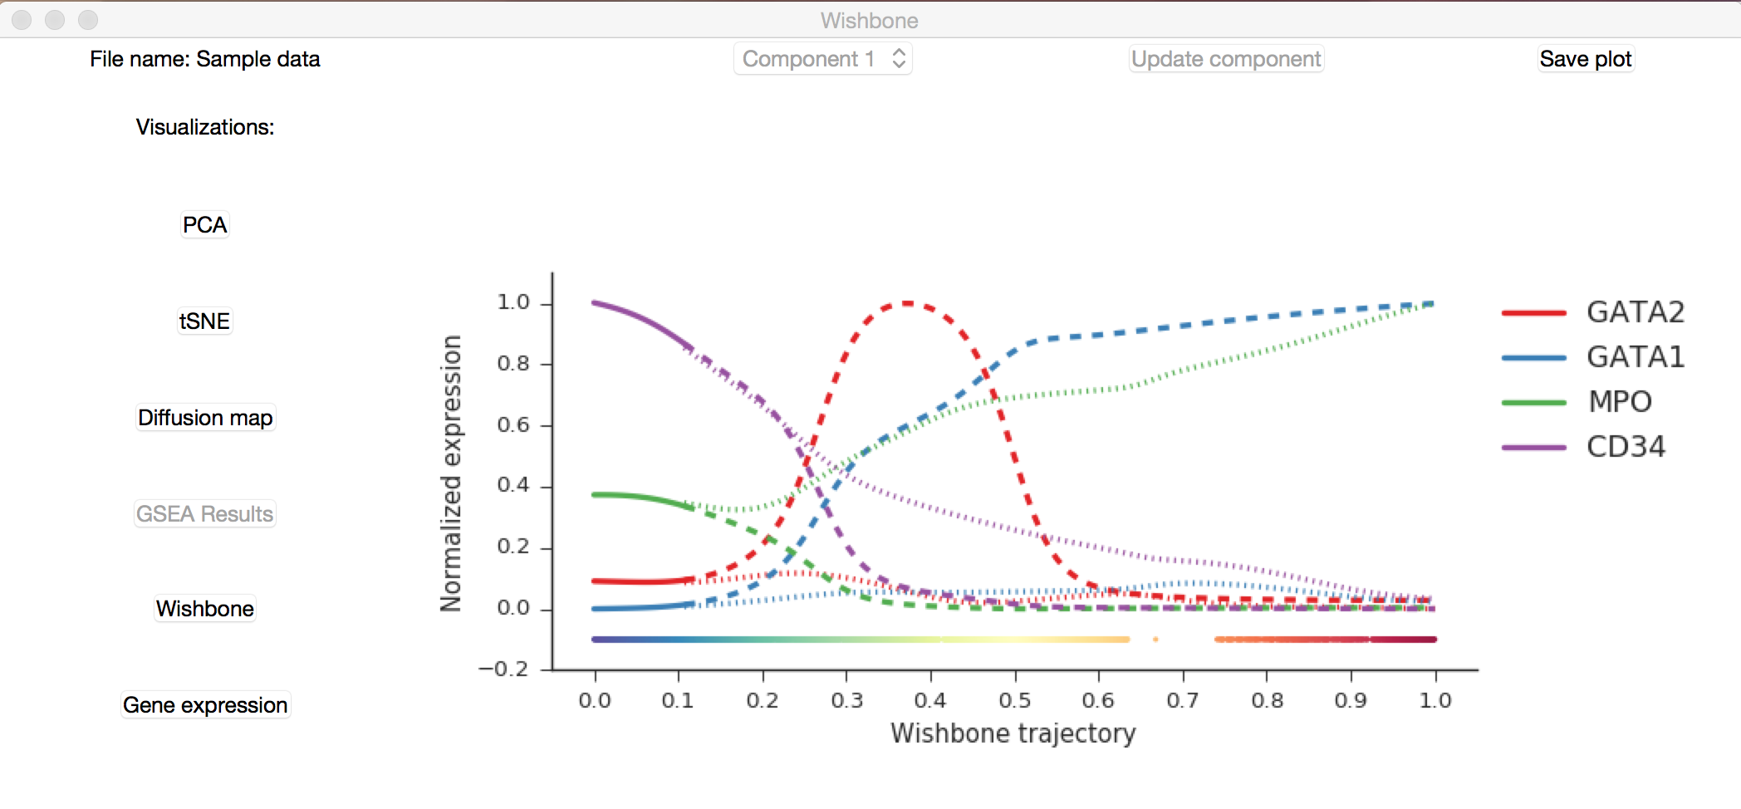
Wishbone visualizations
Gene expression trends along the trajectory can be visualized as a plot or heatmap by selection Visualization > Wishbone > Marker trajectory or Heat map

Slide 20
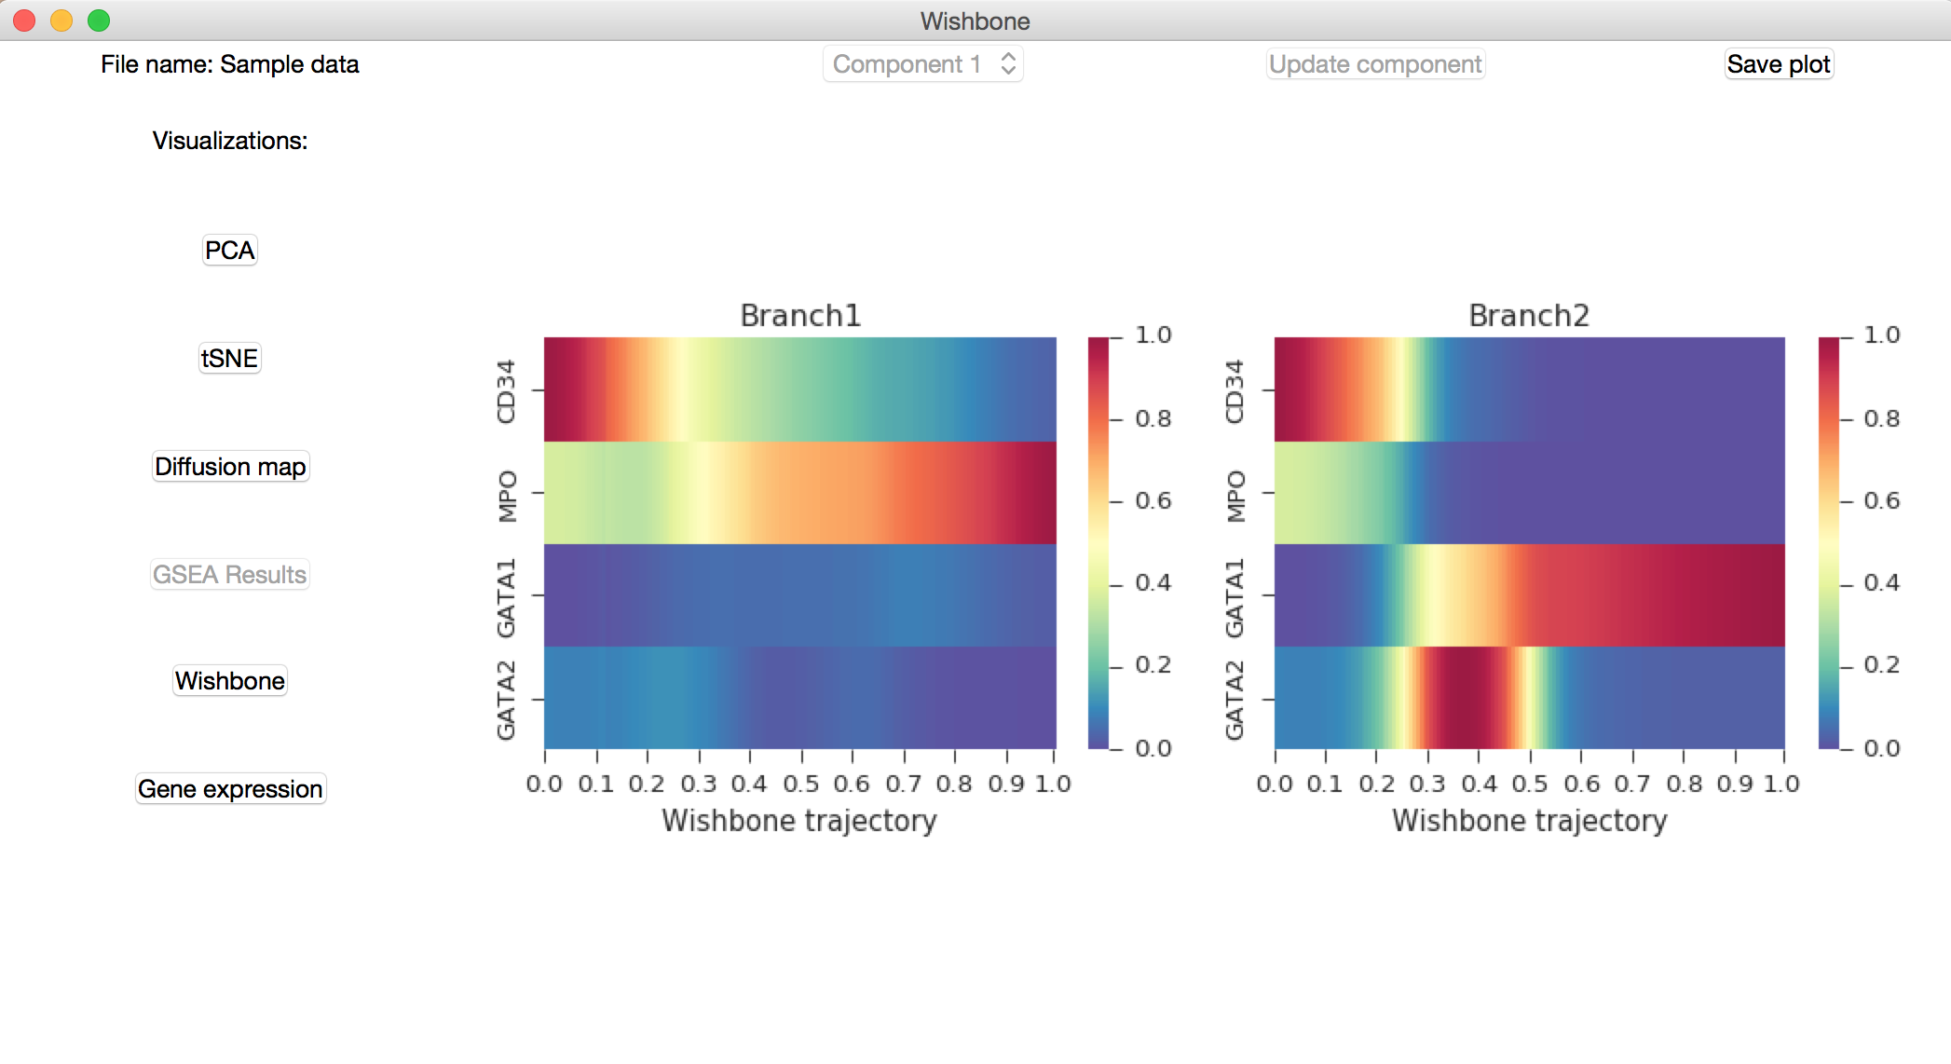
Wishbone visualizations – Heat map

Slide 21
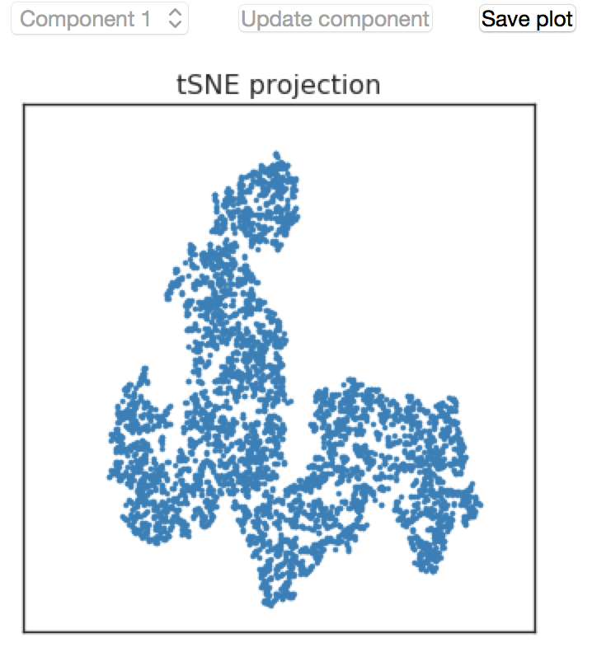
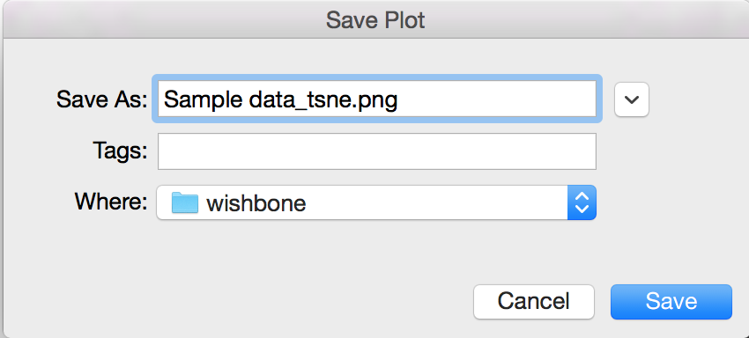
Saving plots
Each visualization can be saved using the ‘Save plot’ button in the upper right corner of the frame.

Slide 22
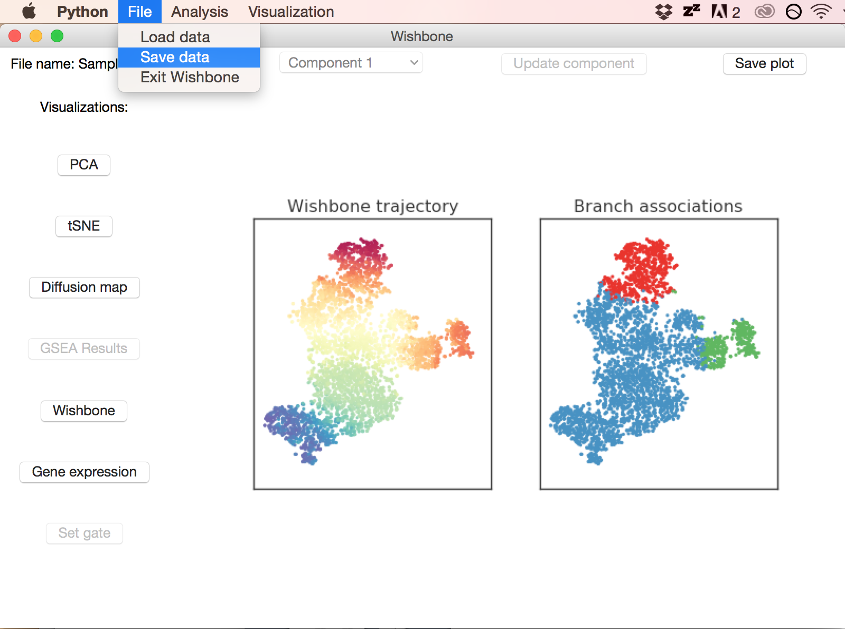
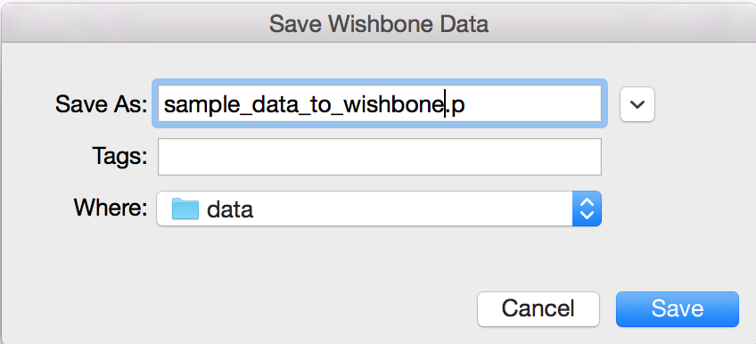
Saving data
All of your data and analysis can be saved and reloaded into Wishbone at a later time.
Select File > Save data to save your current progress as a pickle file; the data can be saved at any stage of analysis
The saved pickle file can be loaded using File > Load data

