Slide 1
MACHINE LEARNING FOR EDUCATION

Slide 2

INTRODUCTION
Notes:
A COMMON PROBLEM ALMOST EVERY ONE FACES WHEN LOOKING TO ACQUIRE NEW SKILLS IS CHOOSING A SPECIFIC COURSE IN A MARKET WITH MANY OFFERS.
THIS PROJECT’S OBJECTIVE IS THE CREATION OF MODELS BASED ON THE STUDENTS INFORMATION TO HELP COURSE PROVIDERS RECOMMEND THE ONES BEST SUITED FOR EACH STUDENT

Slide 3
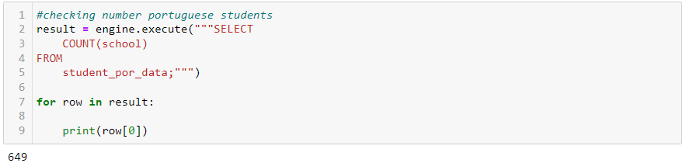
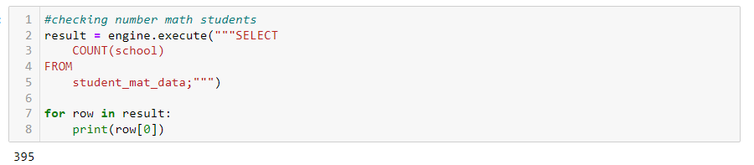
1 school - student's school (binary: "GP" - Gabriel Pereira or "MS" - Mousinho da Silveira)
2 sex - student's sex (binary: "F" - female or "M" - male)
3 age - student's age (numeric: from 15 to 22)
4 address - student's home address type (binary: "U" - urban or "R" - rural)
5 famsize - family size (binary: "LE3" - less or equal to 3 or "GT3" - greater than 3)
6 Pstatus - parent's cohabitation status (binary: "T" - living together or "A" - apart)
7 Medu - mother's education (numeric: 0 - none, 1 - primary education (4th grade), 2 – 5th to 9th grade, 3 – secondary education or 4 – higher education)
8 Fedu - father's education (numeric: 0 - none, 1 - primary education (4th grade), 2 – 5th to 9th grade, 3 – secondary education or 4 – higher education)
9 Mjob - mother's job (nominal: "teacher", "health" care related, civil "services" (e.g. administrative or police), "at_home" or "other")
10 Fjob - father's job (nominal: "teacher", "health" care related, civil "services" (e.g. administrative or police), "at_home" or "other")
11 reason - reason to choose this school (nominal: close to "home", school "reputation", "course" preference or "other")
12 guardian - student's guardian (nominal: "mother", "father" or "other")
13 traveltime - home to school travel time (numeric: 1 - <15 min., 2 - 15 to 30 min., 3 - 30 min. to 1 hour, or 4 - >1 hour)
14 studytime - weekly study time (numeric: 1 - <2 hours, 2 - 2 to 5 hours, 3 - 5 to 10 hours, or 4 - >10 hours)
15 failures - number of past class failures (numeric: n if 1<=n<3, else 4)
16 schoolsup - extra educational support (binary: yes or no)
17 famsup - family educational support (binary: yes or no)
18 paid - extra paid classes within the course subject (Math or Portuguese) (binary: yes or no)
19 activities - extra-curricular activities (binary: yes or no)
20 nursery - attended nursery school (binary: yes or no)
21 higher - wants to take higher education (binary: yes or no)
22 internet - Internet access at home (binary: yes or no)
23 romantic - with a romantic relationship (binary: yes or no)
24 famrel - quality of family relationships (numeric: from 1 - very bad to 5 - excellent)
25 freetime - free time after school (numeric: from 1 - very low to 5 - very high)
26 goout - going out with friends (numeric: from 1 - very low to 5 - very high)
27 Dalc - workday alcohol consumption (numeric: from 1 - very low to 5 - very high)
28 Walc - weekend alcohol consumption (numeric: from 1 - very low to 5 - very high)
29 health - current health status (numeric: from 1 - very bad to 5 - very good)
30 absences - number of school absences (numeric: from 0 to 93)
Notes:
FOR THIS PURPOSE I USE TWO DATA SETS REGARDING SECONDARY STUDENTS PERFORMANCE IN TWO SUBJECTS, PORTUGUESE LANGUAGE AND MATHEMATICS
The data sets contains encoded data with student grades, demographic, social and school related features for each student, like: AGE, SEX, INTERNET ACCES, HEALTH, ETC.
IT CONTAINS 649 data points for Portuguese and 395 for Mathematics

Slide 4
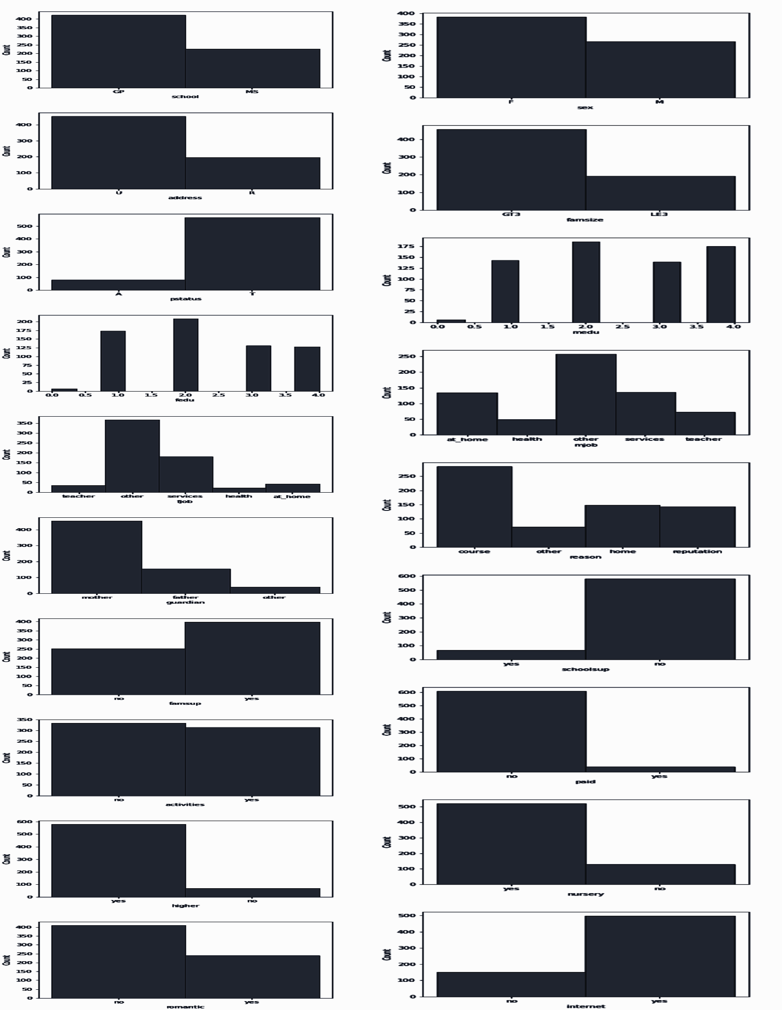
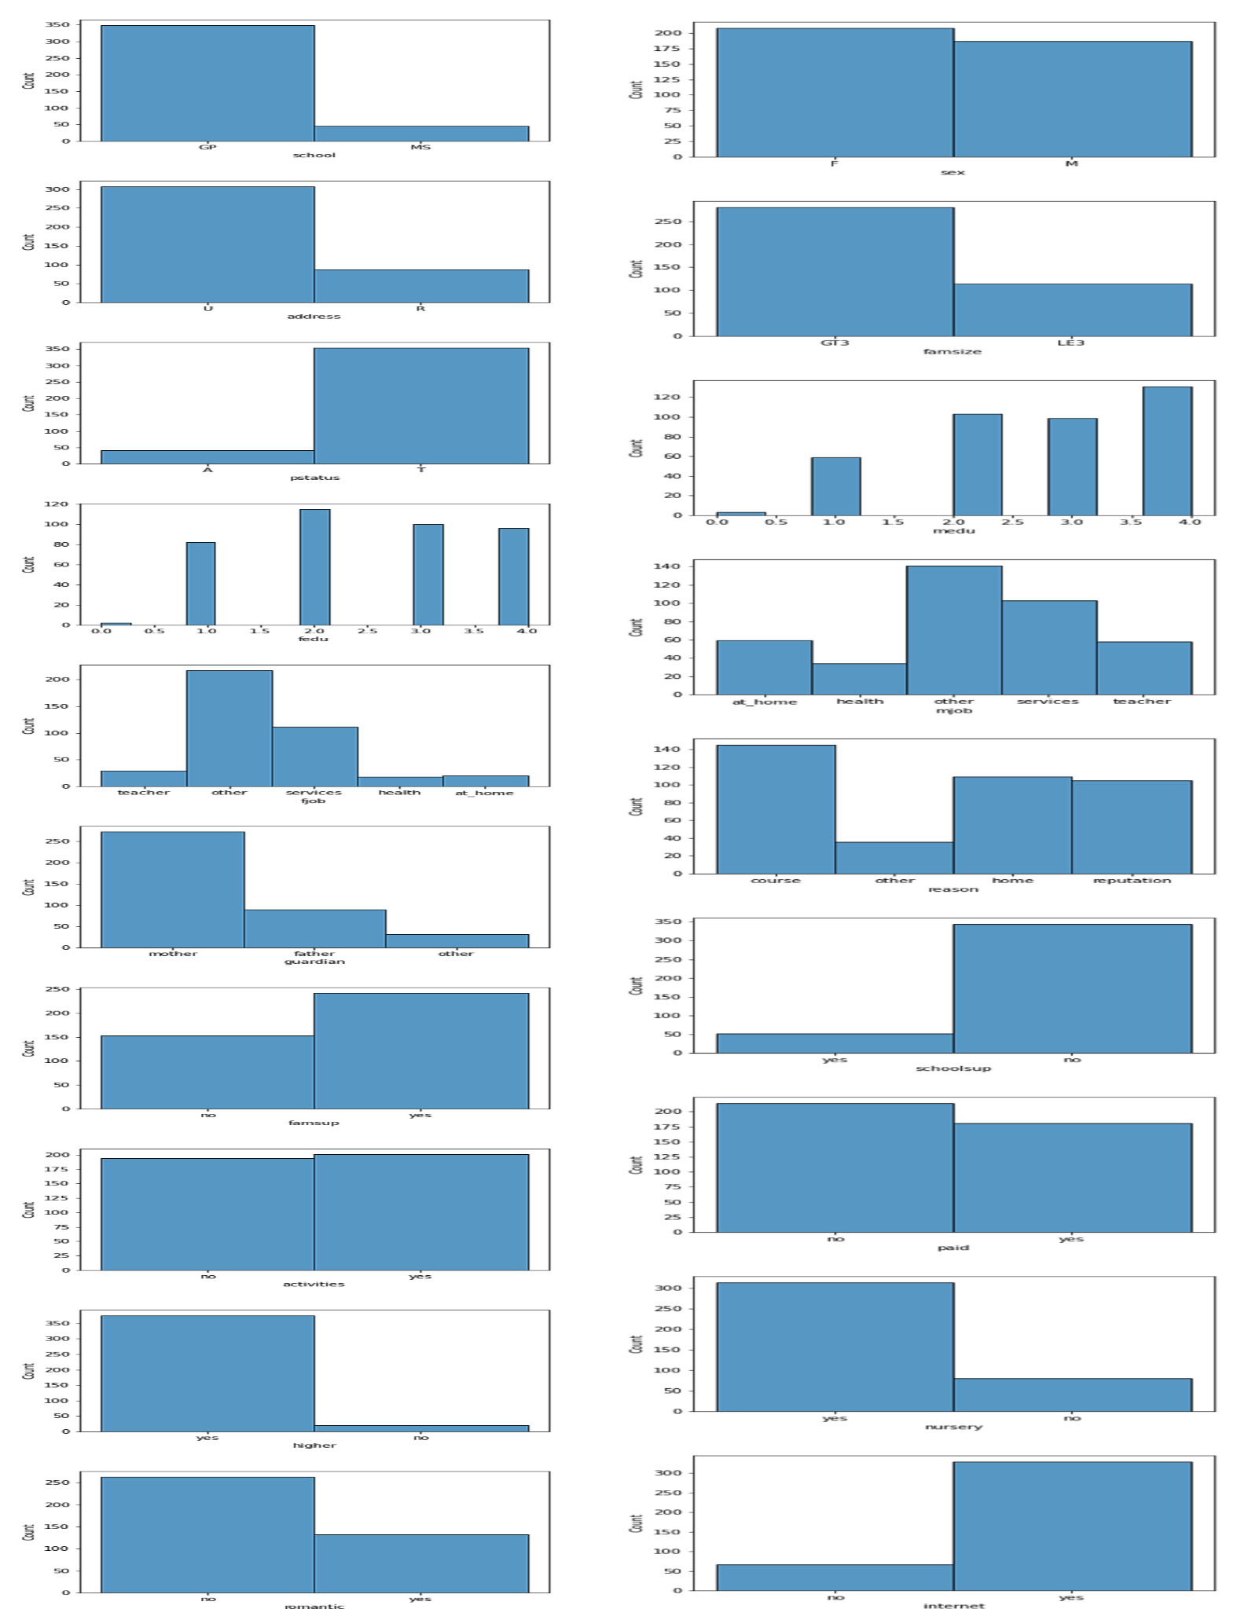
Notes:
The data exploration reveals that there distribution of the data is very similar in both data sets, mostly composed of urban students

Slide 5
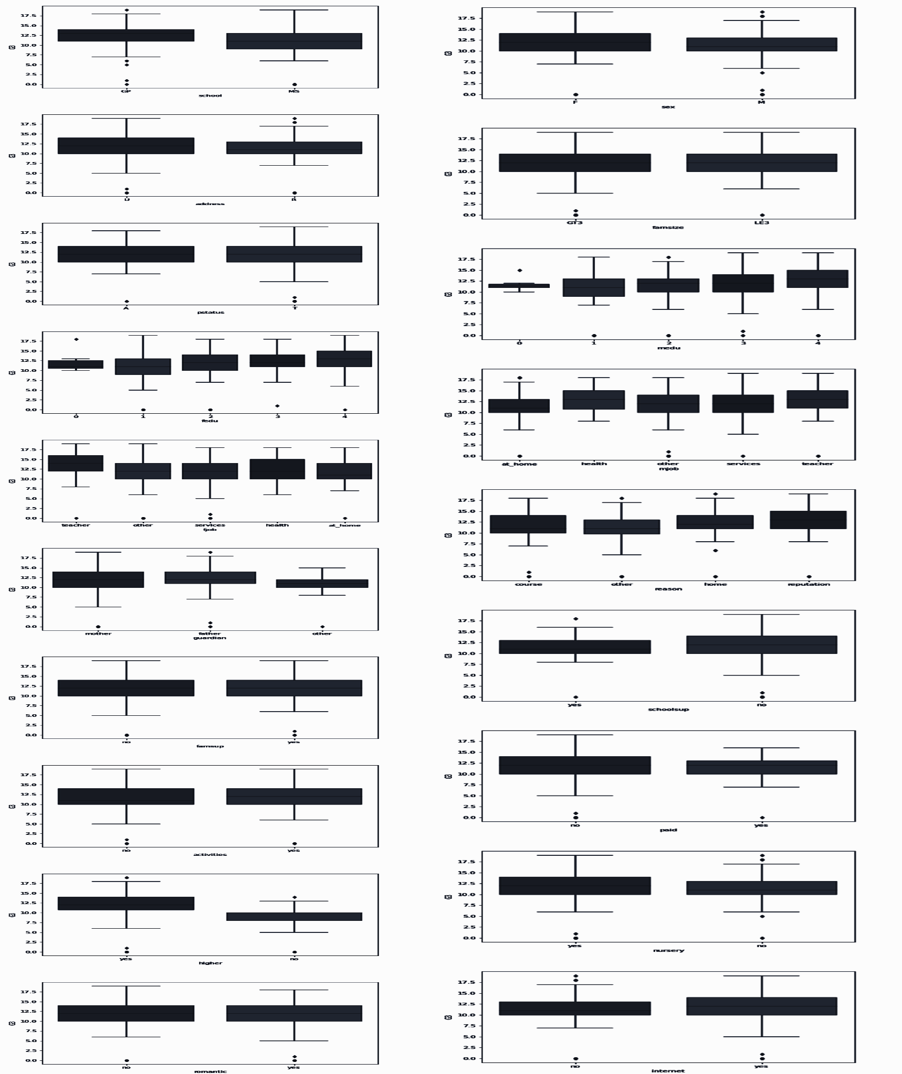
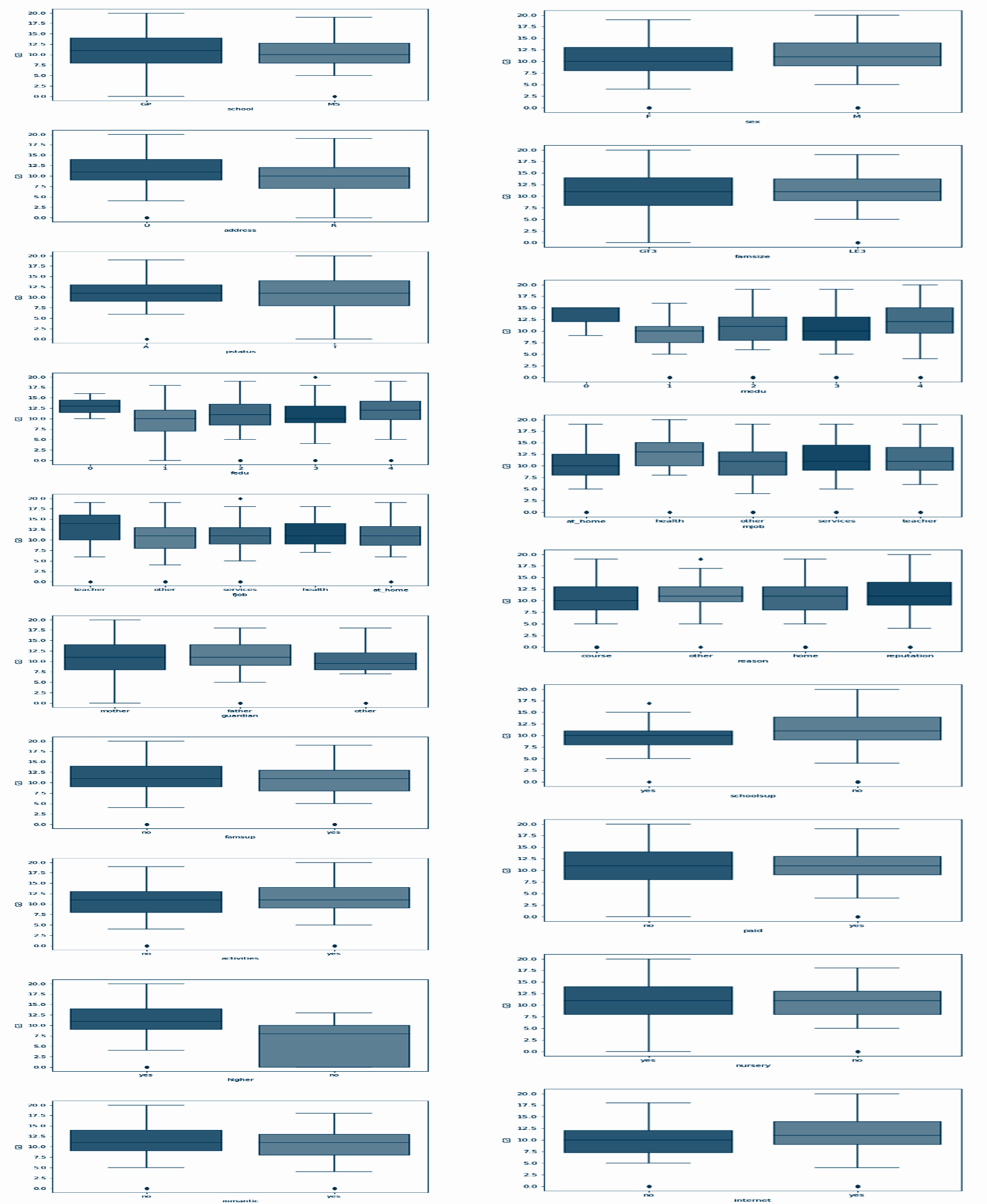
Notes:
There are few outliers.
Portuguese data is skewed toward the higher scores while the Mathematics is not

Slide 6
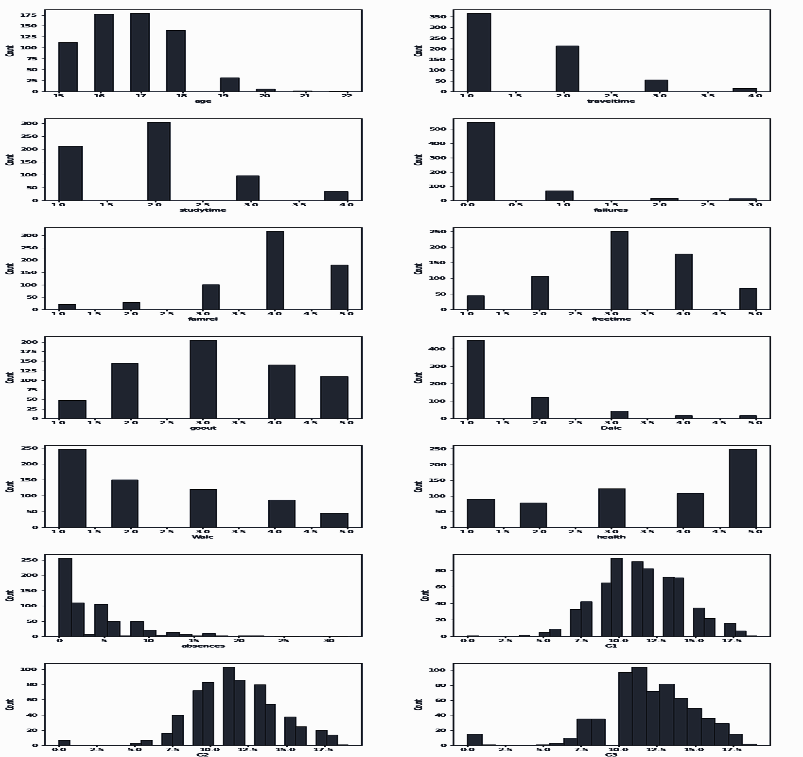
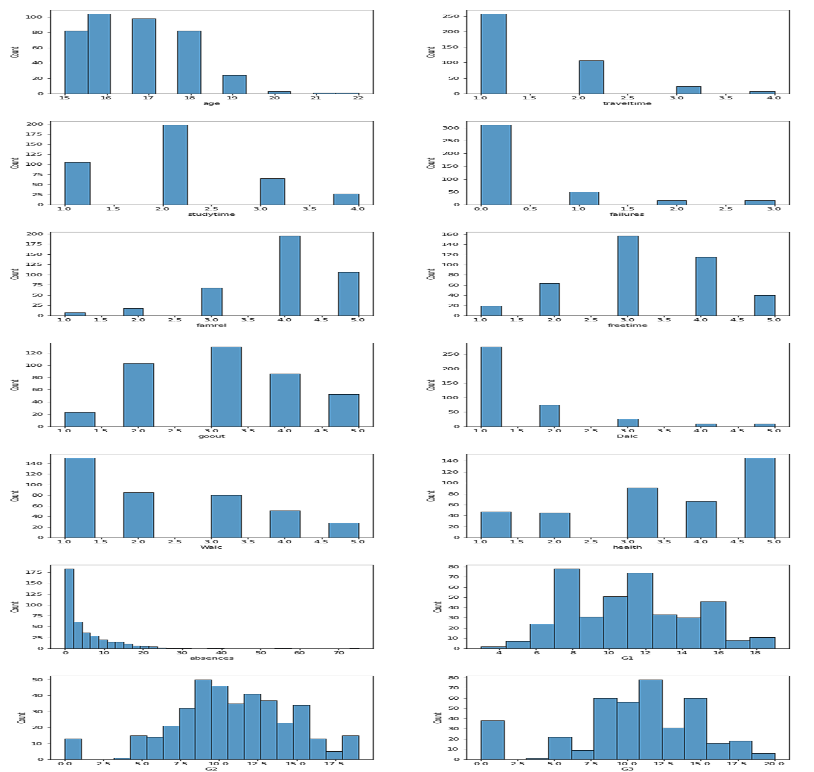
Notes:
In the numeric columns the data from both data sets is also very similar.

Slide 7
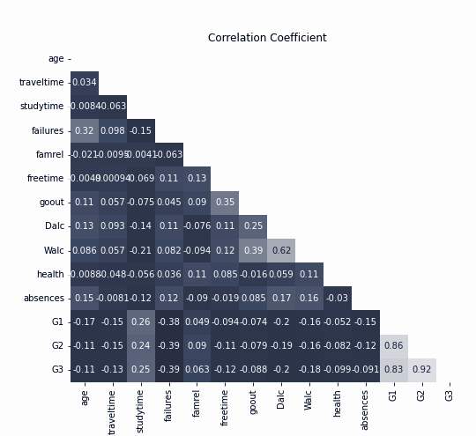
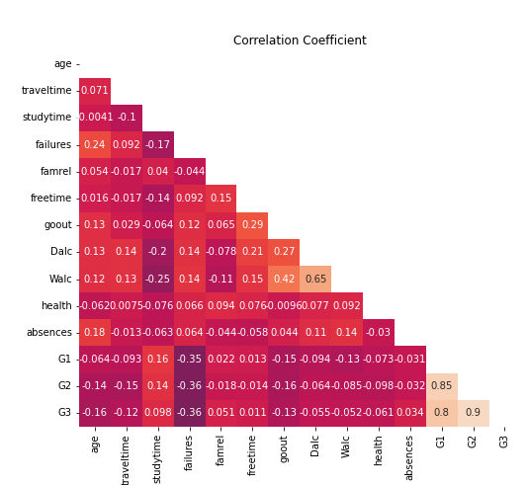
Correlation
Notes:
There is very low correlation between the features. I will use G3, the final score as the basis for my target, so I dropped the parcial scores G1 and G2.
There is a correlation between Daily alcohol consumption and Weekend alcohol consumption but is not high enough to drop any.

Slide 8
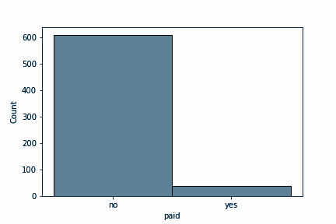
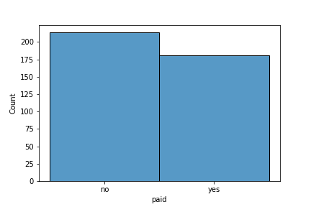
Notes:
I decided to drop all information not known in the beginning of the course like the number of absences and to keep only the students that did not attend extra paid classes.

Slide 9
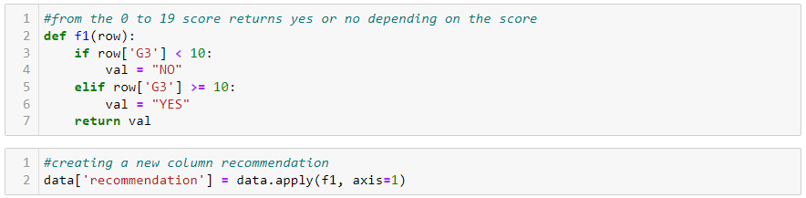
Target
Notes:
I decided to create a binary target based on the final score G3, recommending the course only to students with a score higher than 10 FOR EACH SUBJECT
After the target is created G3 IS DROPPED BECAUSE IT IS TOTALLY CORRELATED WITH THE TARGET

Slide 10
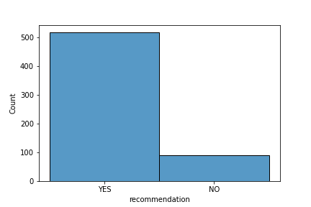
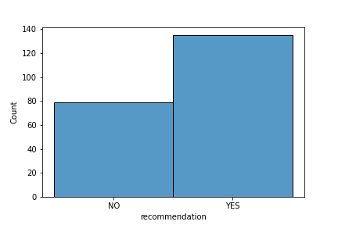
Notes:
The data skew is clear in the portuguese data set after the creation of the target

Slide 11
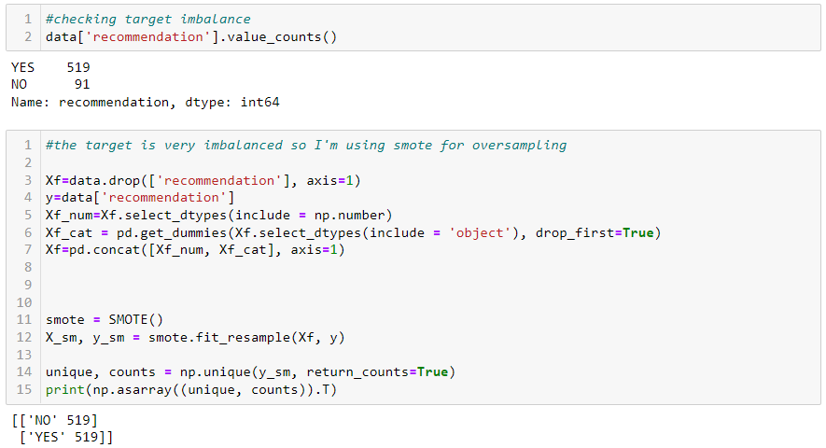
Notes:
The imbalance is so big with the portuguese data that I decided to use smote for oversampling before training the models

Slide 12
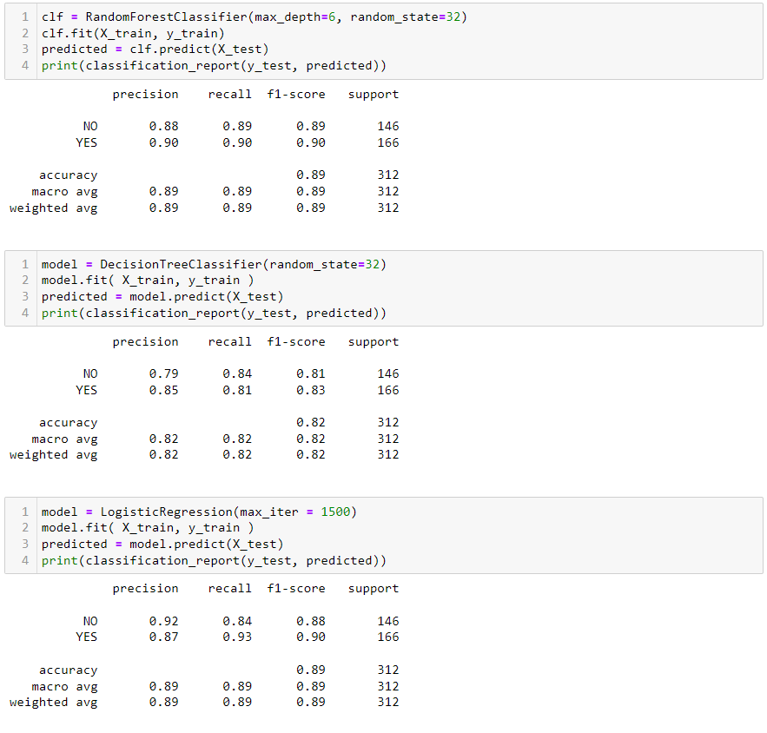
Notes:
to find the best solution I tested Random Forest, Decision Tree and Logistic regression models.
Random Forest and Logistic Regression scores are very close, with the same accuracy

Slide 13
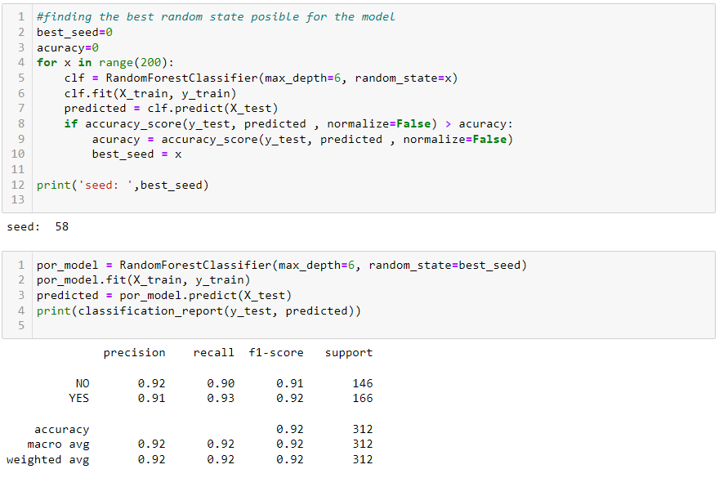
Notes:
After finding the best random state parameter based on the accuracy score for the random forest classifier, all values are better than those for linear regression.
I chose this one as the final model for the portuguese data

Slide 14
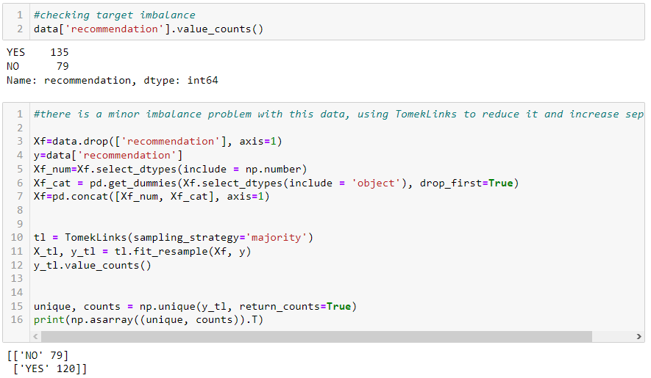
Notes:
The solve the smaller imbalance in the Mathematics data I use TomekLinks with the majority strategy, downsampling from the majority class and increasing differentiation between the two

Slide 15
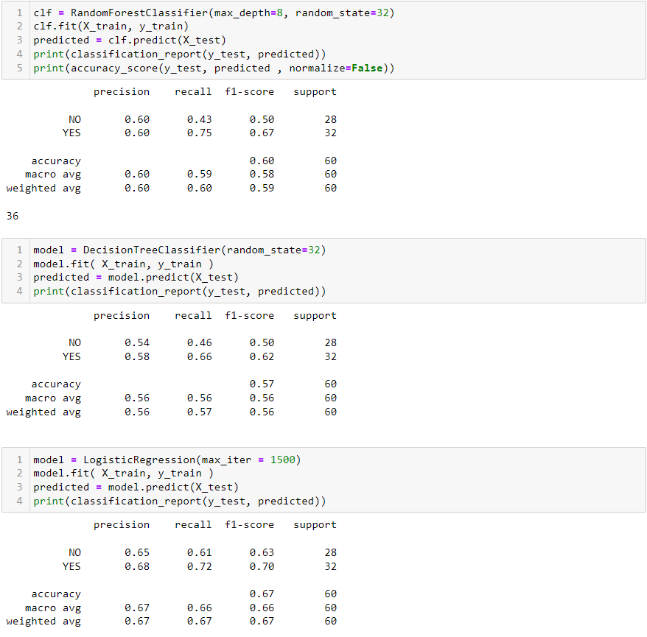
Notes:
After training and testing the same three model, Logistic Regression is the model I chose for the Mathematics data.
The model is reasonably good having only 200 data point and should be enough for this preliminary concept

Slide 16
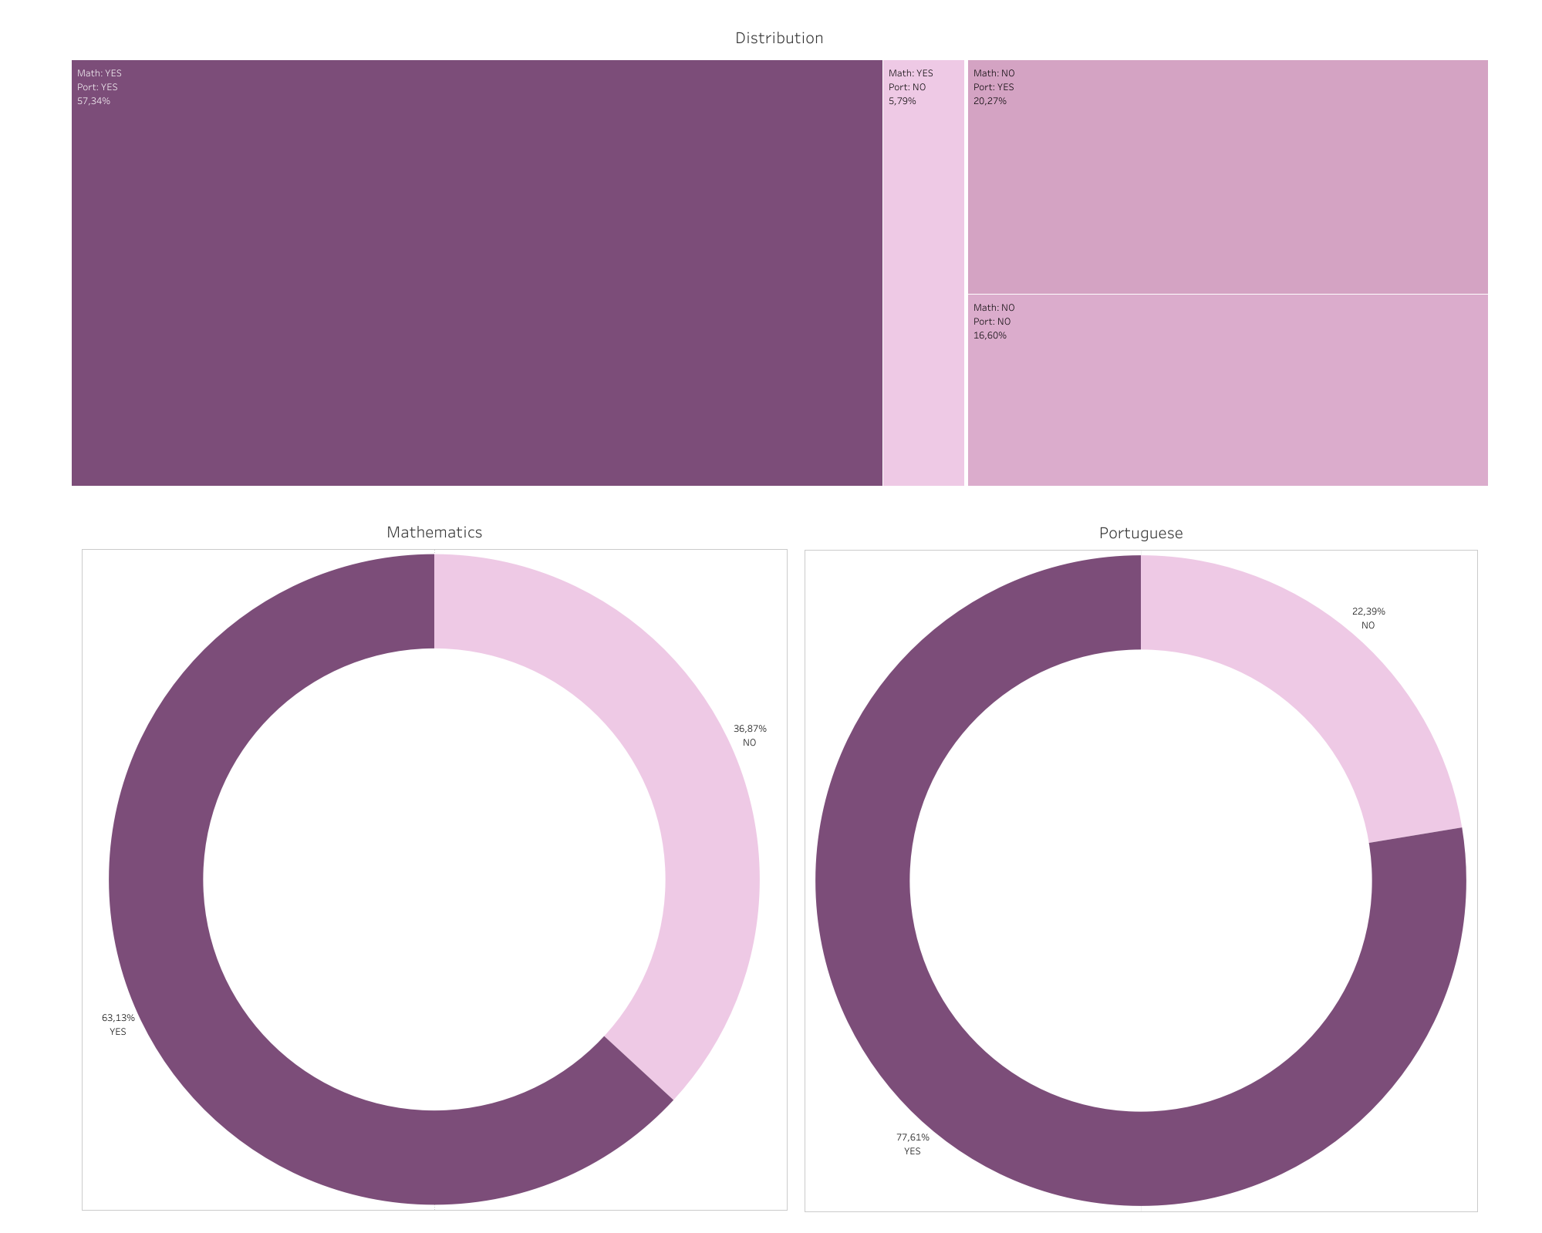
Notes:
After applying the model to all students data combined this is the end result
17% did not get any recommendation
recommending only Portuguese to 20% and only Mathematics to the 6%.
and the majority 57% getting both recommendations.

