Slide 1
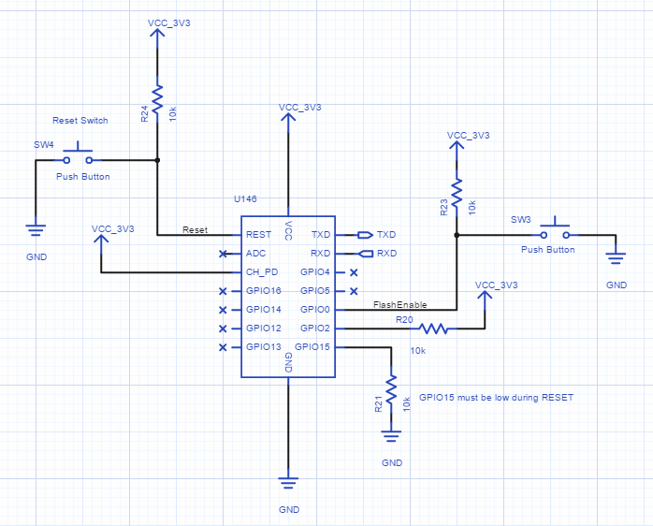
10k
4.7k

Slide 2
MCU
MCUlv1
Programmer
Gnd
TOP
Carrier
10k
R10k
Vcc
RST
TX
RX
ADC
RX
TX
10k
R10k
Vcc
CH_PD/EN
Gpio5
Gnd
RST
Gpio16
Gpio4
10k
R10k
Gpio0
Vcc
Gpio14
Gpio12
R10k
Gpio2
10k
Vcc
R4.7k
Gnd
Gpio13
Gpio15
4.7k
Vcc
Vcc
Gnd
Gnd
Install resistors through holes, leaving end to MCU loose, on bottom side of board
lay traces leaving end s to MCU loose
Install MCU, wrap mcu end traces and resistors around MCU ‘pins’, fold flat to board (to later solder to headers), solder trace/resistor-to-MCU wrapped junctions
Install header and solder MCU-to-header

Slide 3
MCU
Programmer/v1
Programmer
Carrier
Gnd
TOP
10k
Vcc
RST
TX
DTR
RX
ADC
RX
RX
TX
10k
Vcc
CH_PD/EN
Gpio5
TX
Gnd
9
RST
Gpio16
Gpio4
Vcc
10k
Gpio14
Gpio0
CTS
Vcc
Gpio12
Gpio2
Gnd
10k
Vcc
Gpio13
Gpio15
Gnd
4.7k
Vcc
Vcc
Gnd
Gnd
15

Slide 4
MCU
DHT11 Temp & Humidity Carrier/v1
Programmer
Carrier
Gnd
TOP
10k
Vcc
RST
TX
RX
DHT11
ADC
RX
TX
Vcc
10k
DHT11
Vcc
Vcc
Gpio5
Gnd
Data
CH_PD/EN
Data
---
RST
Gpio16
Gpio4
10k
---
Vcc
Gnd
Gpio14
Gpio0
Gpio12
Gnd
10k
Gpio2
Vcc
Gpio13
Gpio15
Gnd
4.7k
Vcc
Vcc
Gnd
Gnd
Gpio4
Gnd
Gpio12

Slide 5
MCU Layer
!!!Update!!!
Need to reverse layout with MCU on top, because of stacking headers!!!!
CH_PD to VCC (via 10k?)
16 to RST after resistor?
BOTTOM
Gnd
10k
RX
TX
RST
Vcc
TX
RX
R10k
ADC
Huzzah CH_PD has 10k
Gnd
Gpio5
EN/CH_PD
Vcc
Gpio4
Gpio16
RST
10k
R10k
Vcc
Gpio0
Gpio14
16 to RST for sleep mode
Need to test orientation with resistor and Gnd before/after before finalizing?
10k
R10k
Vcc
Gpio2
Gpio12
Huzzah 15 has 4.7k, not 10k
R4.7k
Gnd
Gpio15
Gpio13
4.7k
Gnd
Gnd
Vcc
Vcc
Resistors first, top-side. Don’t cut leads
Then traces, bottom side, surfacing topside for MCU connections. Bend resistor leads back and solder.
Then MCU, leads flying, connect traces
Headers and header/MCU connections
MCU
Programmer
Carrier

Slide 6
Programmer Layer
BOTTOM
Gnd
10k
RX
TX
RST
Vcc
TX
RX
ADC
Gnd
Gpio5
EN/CH_PD
Vcc
DTR
Gpio4
Gpio16
RST
10k
RX
Vcc
Gpio0
Gpio14
Vcc
10k
Gpio2
Gpio12
TX
Gnd
Gpio15
Vcc
4.7k
Gpio13
CTS
Gnd
Gnd
Vcc
Vcc
Gnd
Gnd
VCC
MCU
Programmer
Carrier
NEED POWER OPTION ON PROGAMMER
IN-CASE PROGRAMMING WITHOUT CARRIER

Slide 7
Gnd
TOP
Vcc
RST
TX
ADC
RX
Vcc
EN
Gpio5
Gnd
Gpio16
Gpio4
Gpio14
Gpio0
Vcc
Gpio12
R10k
Gpio2
Vcc
Gpio13
Gpio15
Gnd
Vcc
Gnd

Slide 8
BOTTOM
Gnd
RST
DTR
TX
Vcc
RST
TX
ADC
RX
RX
ADC
RX
EN
Gpio5
Vcc
EN
Gpio5
Gnd
TX
Gpio16
Gpio16
Gpio4
8
Vcc
Gpio4
Gpio14
CTS
Gpio14
Gpio0
Vcc
Gpio0
Gpio12
Gpio12
R10k
Gpio2
Vcc
Gnd
Gpio2
R10k
R10k
Gpio15
Gnd
Gpio13
Gpio15
Gpio13
Vcc
Gnd
Vcc
Gnd
9
Gnd
VCC
Place and connect top headers
Attach ESP
Attach row headers
Attach ESP to headers
Wire-up red connections
Cut crossed pins

Slide 9
TX
BOTTOM
TOP
RX
DTR
Gpio5
RST
TX
RST
TX
RX
Gpio4
ADC
RX
ADC
RX
TX
Gpio0
EN
Gpio5
EN
Gpio5
Vcc
Gnd
VCC
Gpio2
Gpio16
Gpio4
Gpio16
Gpio4
CTS
Gpio15
Gpio14
Gpio0
Gpio14
Gpio0
Gnd
Gnd
Gpio12
Gpio2
Gpio12
Gpio2
Gpio13
Gpio15
Gpio13
Gpio15
RST
Vcc
Gnd
Vcc
Gnd
ADC
EN
Gpio16
Gpio14
R10k
Gpio12
Gpio13
Vcc

Slide 10
Gnd
Vcc
RST
TX
ADC
RX
Vcc
EN
R10k
Gpio5
Gnd
Gpio16
Gpio4
Gpio14
Gpio0
Vcc
Gnd
Gpio12
R10k
Gpio2
Vcc
Gpio13
Gpio15
Gnd
Vcc
RST
TX
Vcc
Gnd
ADC
R10k
RX
Vcc
EN
Gpio5
Gnd
Gpio16
Gpio4
Gpio14
R10k
Gpio0
Vcc
Gpio12
R10k
Gpio2
Vcc
R10k
Gpio15
Gnd
Gpio13
Vcc
Gnd

