Slide 1
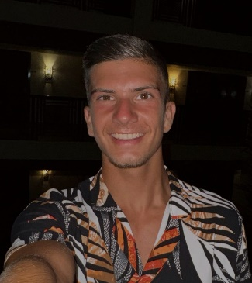
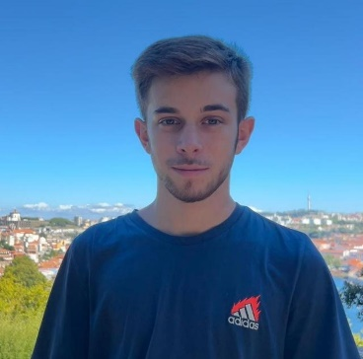
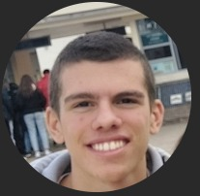
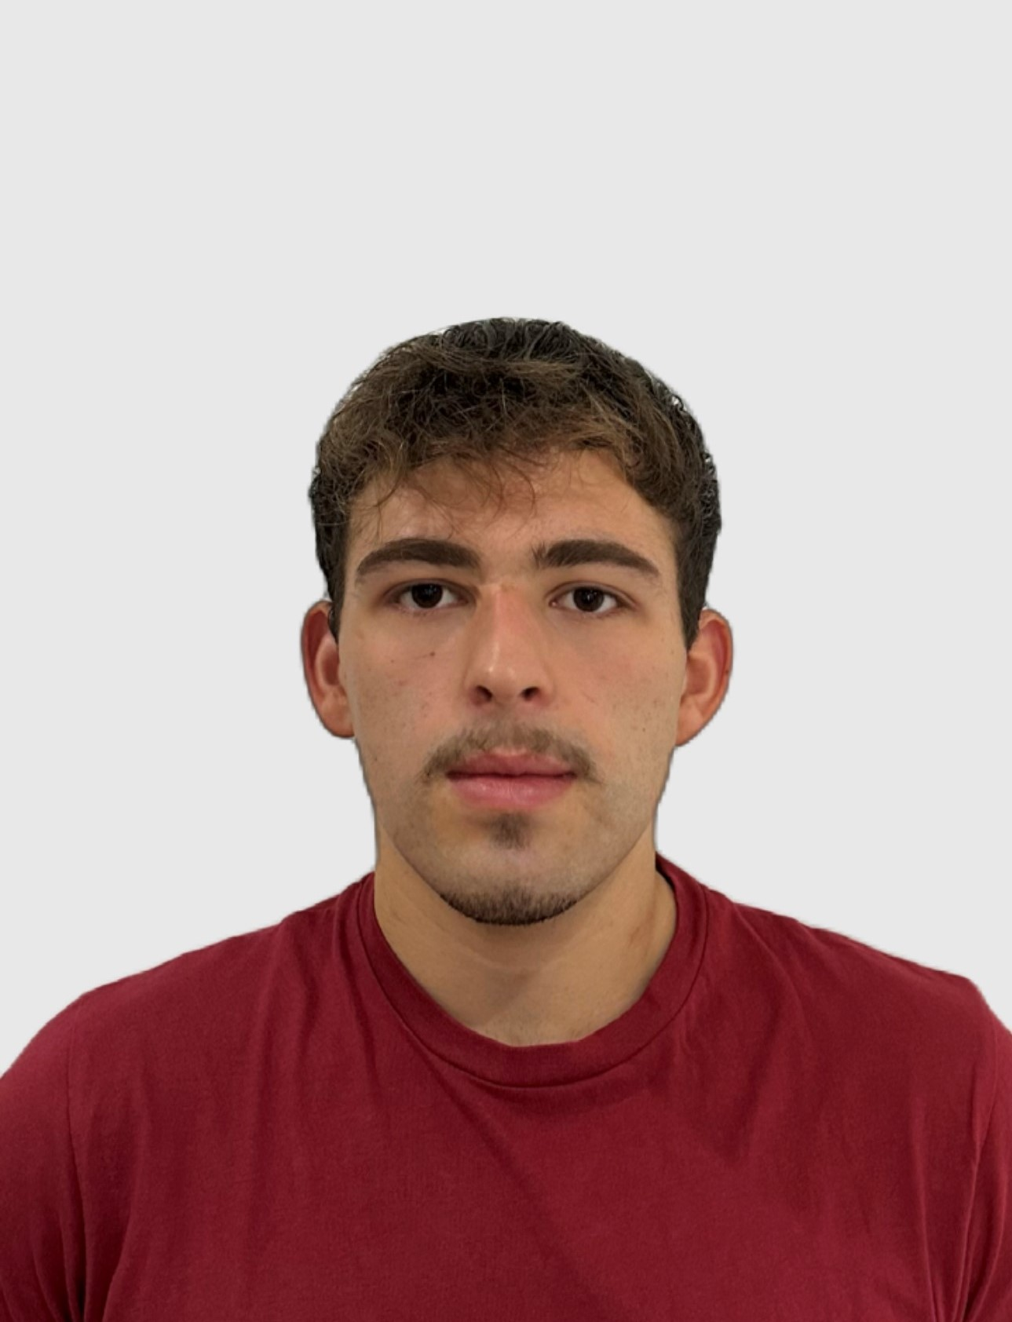
Class 2DC2DD Group 41 SPRINT 1
LAPR3 2024_2025
Group members:
Igor Coutinho (1230543) | Daniel Silva (1231046) | Rafael Barbosa (1230544) | David Vieira (1230487)

Slide 2
Sprint planning – Sprint 1
Planned Start Date: 07/10/2024 Real Start Date: 07/10/2024
Planned Finished Date: 27/10/2024 Real Finish Date: 27/10/2024
SPRINT BACKLOG
Number of stories | 18
Number of bugs | 0 (found so far)
Number of tasks | 22
Number of Management Tasks (Scrum) | 18
Number of team members | Planned: 4 Actual: 4
Total planned estimation vs execution | Planned hours: 70 Executed hours: 65

Slide 3
Sprint planning
Assignment US (as stated on project assignment) | Commited? (Yes / no according to team planning) | Todo | Doing | Testing | Done | Blocked
USBD 01 | Yes |  |  |  | x
USBD 02 | Yes |  |  |  | x
USBD 03 | Yes |  |  |  | x
USBD 04 | Yes |  |  |  | x​
USBD 05 | Yes |  |  |  | x​
USBD 06 | Yes |  |  |  | x​
USBD 07 | Yes |  |  |  | x​
USBD 08 | Yes |  |  |  | x​
USEI 01 | Yes |  |  |  | x​
USEI 02 | Yes |  |  |  | x​

Slide 4
Sprint planning
Assignment US (as stated on project assignment) | Commited? (Yes / no according to team planning) | Todo | Doing | Testing | Done | Blocked
USEI 03 | Yes |  |  |  | x​
USEI 04 | Yes |  |  |  | x
USEI 05 | Yes |  |  |  | x​
USEI 06 | Yes |  |  |  | x​
USEI 07 | Yes |  |  |  | x​
USEI 08 | Yes |  |  |  | x​
USLP 01 | Yes |  |  |  | x​
USLP 02 | Yes |  |  |  | x​
USLP 03 | No |  |  |  |  | x​

Slide 5
Work by team member

Slide 6
Work by type

Slide 7
Issues / Assumptions / unanswered questions
Description | Responsible | Date / sprint | Related issue / item in Git

Slide 8
Daily Meetings
Date | Place / duration | Daniel | David | Igor | Rafael
11/10/2024 | Class / 15 min | x | x | x | x
14/10/2024 | ISEP / 20 min | x | x | x | x
16/10/2024 | ISEP / 10 min | x | x | x | x
18/10/2024 | Class / 15 min | x | x | x | x
21/10/2024 | ISEP / 20 min | x | x | x | x
23/10/2024 | ISEP / 10 min | x | x | x | x
25/10/2024 | ISEP / 25 min | x | x | x | x

Slide 9
LLM performance assessment (chatGPT)
Source file (include file as attachment):
Input (prompt) :
Consider the development of a Sprint in a SCRUM environment with several user stories. Write a brief paragraph on each team member's performance, considering the work completed and reported in the attached file.
Then, provide an assessment of the team's overall performance in the project development, assigning a rating from 1 to 5, where 1 represents the lowest rating and 5 the highest.

Slide 10
LLM performance assessment
Output file (include file as attachment):
Output (one line per team member):
- Igor: Demonstrated steady progress, beginning with interpretation of the project statement and glossary tasks. He later shifted focus to completing user stories in BDDAD and ESINF, tackling complexity analysis. Igor showed a growing integration within the project, actively contributing to user story implementations and code reviews.
- Daniel: Focused on user stories related to the simulator and relational model. He handled simulator enhancements and took the lead on SQL code for various user stories, demonstrating solid progress. However, Daniel recognized a need to balance individual task focus with team collaboration, which he aims to improve.
- David: David contributed significantly to database model construction, progressing from conceptual to logical and physical levels. His collaboration improved over time, particularly as he moved towards handling data integration and Oracle Live SQL testing. David reported some initial difficulties but addressed them, boosting his project contributions.
- Rafael: Progressed through tasks on USBD08 and USEI04, later collaborating on SQL coding and final project reviews. Rafael adjusted to challenges with specific functionalities, showing consistent development and adaptability. He noted an upward trajectory in his contribution and is keen to enhance performance further.
Opinion about the output: We consider the output to be reasonably in line with what was developed during the sprint.

Slide 11
Sprint Retrospective
Date: 28/10/2024
What went well?
Overall, the project went well over time. We were always in dialogue with each other so that the project would move forward consistently, and any doubts would be clarified.
What went wrong?
At times, we had very different viewpoints on how to approach certain aspects of the project, which made things challenging and sometimes led to delays in completing tasks. However, by listening to each other, we were able to reach a consensus.
What we’ve learned?
We learned that, in order to carry out group work, we need to be in constant dialogue with each other.
We learned that holding daily meetings is a good way to organize and structure ideas, and to be able to follow a line of thought.
And, finally, we learned that it is better to do a little bit at a time than to let the work pile up.

Slide 12
Sprint Retrospective
Date: 27/10/2024
Action items:
Continue to communicate and respect each other's different viewpoints.

Slide 13

Overall Project perfomance:
Comments: (Provided by ChatGPT) The team collectively displayed a strong commitment to project goals and an improving collaboration trend over time. Initial challenges with understanding the project statement and certain user story requirements were efficiently addressed, with members supporting each other to clarify ambiguities. Their performance in later stages reflects increased synergy and dedication, with individuals taking on specialized roles while contributing to collective problem-solving.
- LLM evaluation: 4 (1-5 scoring)
Our evaluation
1
2
3
4
5

Slide 14


