Slide 1
"Time, clocks, and the ordering of events in a distributed system."
Communications of the ACM 21, 7 (July 1978), 558-565.
Leslie Lamport
Shivansh Chandnani (schandn2) CS 523 – Fall 2018

Slide 2
Leslie Lamport
Original developer of LaTeX
La stands for Lamport
Winner of 2013 Turing Award for his work in distributed systems
Research Scientist at Microsoft until 2014
Notes:
His work has inspired and resulted in other concepts such as Chandy Lamport algorithm which is used for taking a snapshot of a distributed system. Paxos algorithm for consensus. Byzantine failures where messages are fabricated or ill formed.
Was in MIT, SRI International and Compaq before Msft
Recent work includes temporal logic and working on TLA+, a language for reasoning about and specifying concurrent systems

Slide 3
Some overview of the paper
Winner of ACM’s Principles of Distributed Computing Influential award in 2000
Jim Gray described it as trivial yet brilliant
Started off as a note correcting mistake in another paper
What is the paper about:
Describes an algorithm for total ordering of events in a distributed system
Its corresponding application
Cited over 11000 times according to Google Scholar
Notes:
Jim gray was another Microsoft researcher in the field of database transactions
Corrected the mistake in a paper which shared the idea of using timestamps in messages in distributed systems. The algorithm violated causality.

Slide 4
What was the problem
No good way to order events
Solutions available beforehand for syncing clocks:
Ask time from another system and use that
Modify received time to account for latencies
Despite syncing clocks, could drift apart
Notes:
Talk about flight booking example. Distributed system. One system says it booked but another system booked ticket after Main issue being that in a distributed system there is no bound on messaging or processing delay
In the first case, we know that at the minimum we will have an error of latency.
In the second case, we bound it to a small number but still not good enough. For example, measure round trip time and know minimum latencies Solution was initially removing clocks altogether and using timestamps

Slide 5
Partial ordering
Define a relation → which can be described as “happens before”
Three main rules:
a → b if a and b happen in the same process and a happens before b
a → b if a is the sending of message by one process and b is the receipt of message by another process
If a → b and b → c, a → c.
Not all events can be related like this

Slide 6
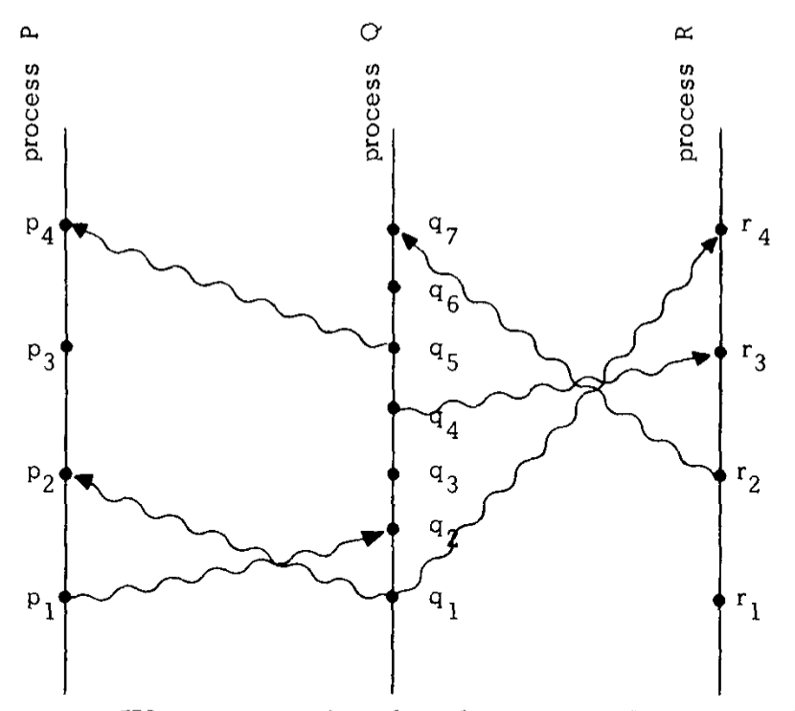
Example

Slide 7
P1 → P2
P1 → Q2
Q1 → Q2
Q2 → Q3
P1 → Q3
Cant say anything about P1 and R2
Notes:
As we go up, we go further in time. Vertical positioning isn’t enough.
P1 and R2 are called concurrent events

Slide 8
Adding logical clocks
Clock C_{i} for each Process P_{i}
Assigns a number C_{i}(a) to any event a in P_{i}
For clock function C and any event a in P_{i} , C(a) = C_{i}(a)
Condition:
For any events a and b, if a → b, C(a) < C(b)
Notes:
Ie if an event happens after another in same process, it will definitely have a higher timestamp
Similarly if a sends abd b receives then a has smaller timestamp than b
Initial value would be 0.
Increment timestamp with each event. Send timestamp. Set max to (current, incoming) + 1.

Slide 9
P1 → P2
P1 → Q2
Q1 → Q2
Q2 → Q3
C(P1) = 1
C(Q1) = 1
C(R1) = 1
C(R2) = 2
C(Q2) = 2
C(P2) = 2
C(P3) = 3
C(Q3) = 3
C(Q4) = 4
C(Q5) = 5
C(P4) = 6
Notes:
Continuing our example from previous slide
Just because higher timestamp doesn’t mean causality is implied. For example, P1 and R2.

Slide 10
Implementing total ordering
Logical clocks gave us partial ordering
We define a relation ⇒ for any arbitrary ordering of processes
If a and b are events in P_{i} and P_{j} respectively, a ⇒ b if C_{i}(a) <= C_{j}(b) and P_{i} < P_{j}
Will satisfy partial ordering since if a → b, C_{i}(a) < C_{j}(b)
Ordering is not unique
Depends on choice of clocks
Only partial ordering is not unique
Notes:
Logical was only partial ordering since some events didn’t have a relation between them
Processes could be ordered using their PIDs

Slide 11
Distributed synchronization problem
Only one system must use the resource at a time
Requests are granted in the order they are made
If all resources eventually release the resource, all requests are fulfilled
Notes:
Solved using total ordering as proposed since we can just check request’s total ordering

Slide 12
Effectiveness of solution
Removes requirement of a physical clock altogether
Use case limited to when all causalities are within the system
Notes:
Example from paper of how A can send message. Call B and then B sends message.

Slide 13
Introducing Physical clocks
Only set clocks forward, not backwards
Send a timestamp in message
Find the minimum transmission time
Update clock whenever a message is received
Minimizes skew
Notes:
Skew is difference in clock values
Set clock to max of current time, time stamp + min time
Send a message every t seconds. Bounds the time within which they will be synchronized

Slide 14
Impact and current status
Used in almost all distributed systems since then
Logical ordering allowed solving other problems and inspired other problems such as:
Consensus
Snapshotting
Vector timestamps

Slide 15
Some concerns from reviews on piazza
Does not account for failure detection
Ignores message transmission time for synchronization
Does not mention a practical implementation
Notes:
Makes assumptions that all systems are connected and work properly. Failure detection opens up a new box of problems. He did briefly mention you can have acks and timeouts and such to account for wrong behavior.
2nd point is true. Results in a single point of failure. Builds up on the first point.
Fair point. But it was 1980s and at its core, it’s a distributed algorithm which needs to be presented and proved rather than implemented. Others build upon it similarly. Though in present day, its in widespread use.

Slide 16
Future work
Minimize latencies further
Remove the requirement on physical clocks altogether
Notes:
Minimize drift

Slide 17
Works cited
Pictures taken from “"Time, clocks, and the ordering of events in a distributed system.“Communications of the ACM 21, 7 (July 1978), 558-565. Leslie Lamport

Slide 18
Thank you
Questions?

