Slide 1
Light Weight Process Context
Paper by Litton et al.
Presented by Kyo Kim

Slide 2
Outline
Problem statement
Other approaches
Method
Use cases
Evaluations
Comments

Slide 3
Problem Statement
What
Isolation/Privilege separation is done in OS level(by creating separate process) which has high overhead for context switching and IPC
Why?
Tasks/session should not be seen from one another if they are handled in the same thread (e.g. web server).
Avoid high overhead of switching between threads.

Slide 4
Other Solutions
Wedge
Isolation among sthreads but share address space.
Shreds
Isolation context within a process.
Required architectural support (e.g. ARM) and compiler support

Slide 5
Other Solutions
Trellis
privilege separation requires kernel and compiler support.
Dune
Provide virtualization support to Linux process.
Privilege separation, reference monitors, and isolation.
TLB overhead.

Slide 6
What is lwC?
It is an unit of isolation, privilege, and execution state within a process.
Virtual address space
File description bindings
Credentials
Hierarchical: Process starts with root lwC

Slide 7
Features
Light-weight context (lwCs): a method of sandboxing process execution.
A process may have several lwCs and execution states can be recovered via snapshots.
Switching lwCs between is quicker than switching between process and between kernel threads.

Slide 8
LwC API
Create
Switch
Resource management
Restrict
Overlay
Syscall

Slide 9
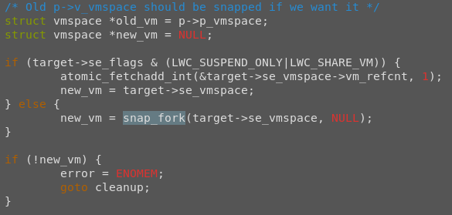
lwC
Unless specified by LWC_UNMAP
Copy all vmspace structure of the parent.
Copy all file descriptors of the parent.

Slide 10
lwC
Calling thread releases its vmspace structure and switches to the specified vmspace structure.
Attributable vs Non-Attributable Signal
Signal that can be attributed to a particular container.
SIGSEGV or SIGFPE
Signal that cannot be attributed to a particular container.
SIGKILL or SIGUSR1

Slide 11
Resource Management API
Dynamically share resources
Maps a region of memory to a specified resource.
The mapping is only granted if the caller has the privilege.
Access capabilities.

Slide 12
Isolation and Security
Assumption
lwC can perform denial of service or terminate itself using exit().
Kernel is trusted
No vulnerability in building, linking and loading apps before the main().
Trusted parent lwC

Slide 13
Use Cases
Snapshot and rollback.
Session Isolation.
Data Isolation.
Reference Monitor

Slide 14
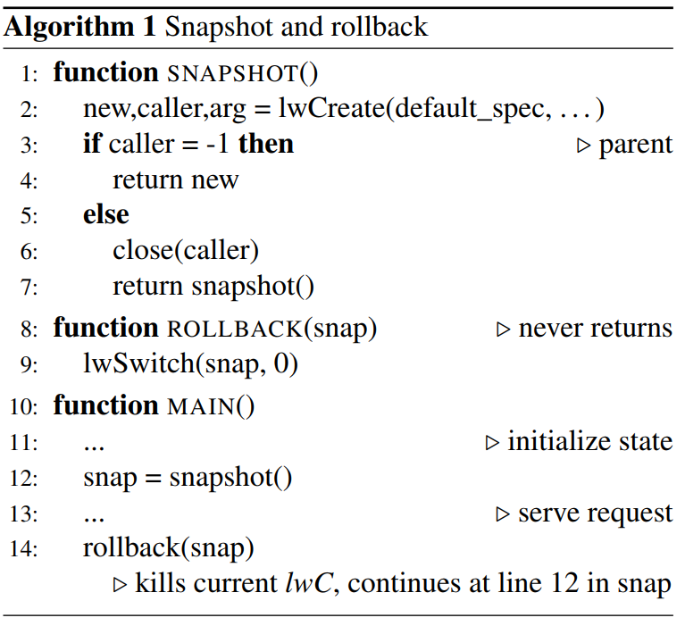
Snapshot and rollback
The duplicated container has its execution state frozen at line 2 until the rollback occurs.
Rollback switches to the duplicated container and the old container is discarded.

Slide 15
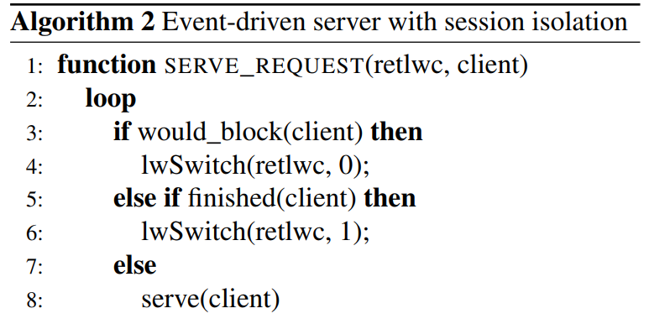
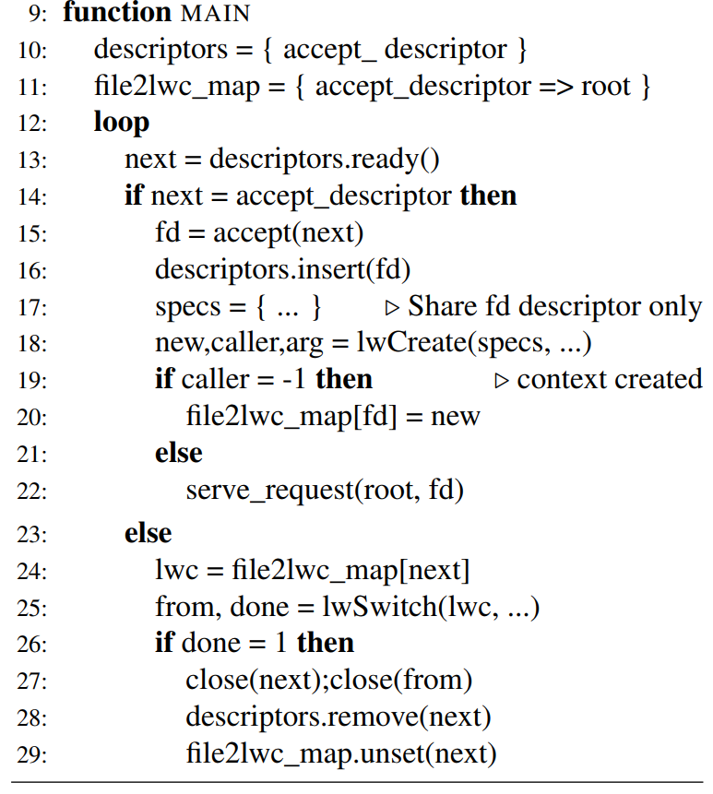
Session Isolation
The main loop is either creates new container, remove readied sockets that has its work finished, or continues to serve.

Slide 16
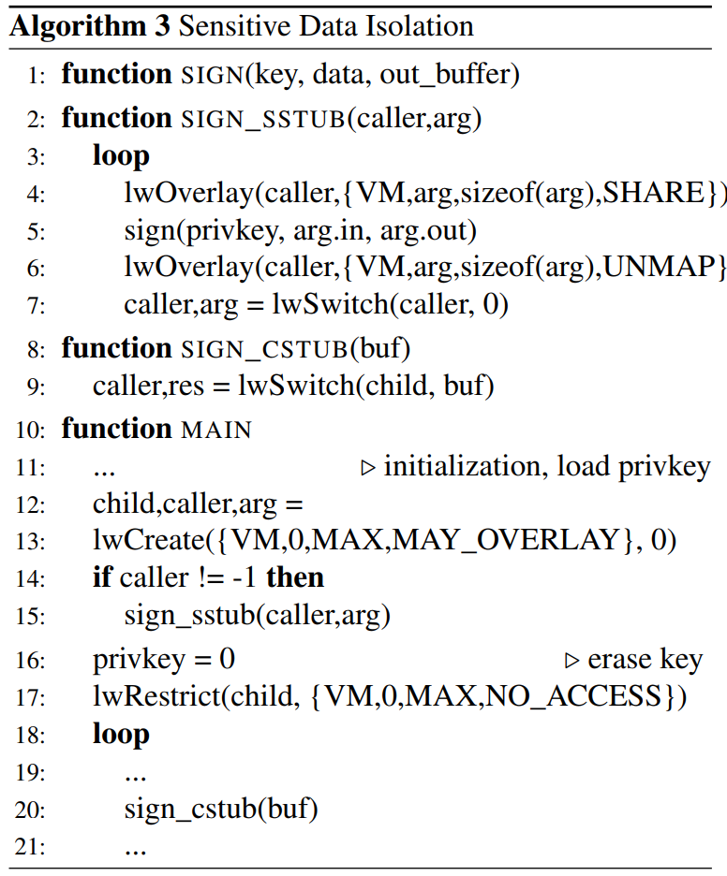
Data Isolation
Parent has no access to the private key once the key is passed to the child
If the parent wants something signed by the child, the child maps parts of the parent memory that needs to be signed.
After signing, the memory is unmapped and switches back to the parent.

Slide 17
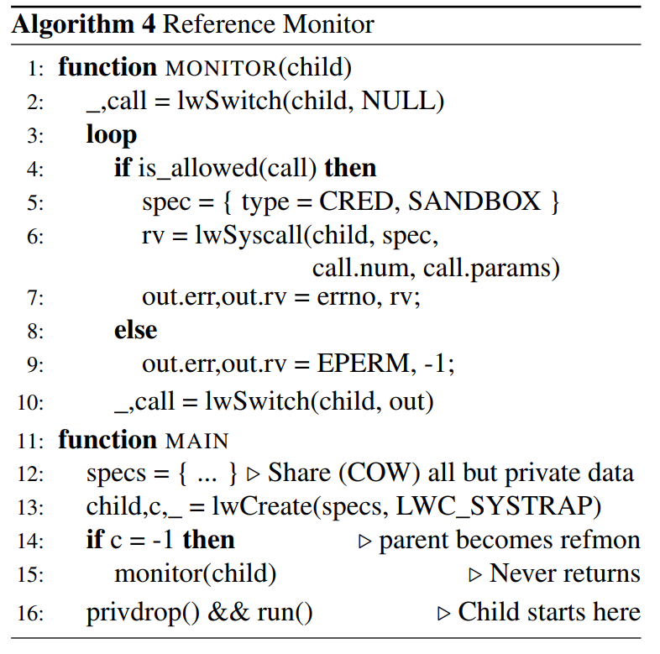
Reference Monitor
Trap any restricted system call used by the child container.

Slide 18
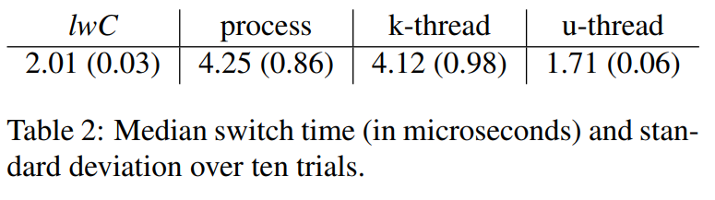
Evaluation - Switch

Slide 19
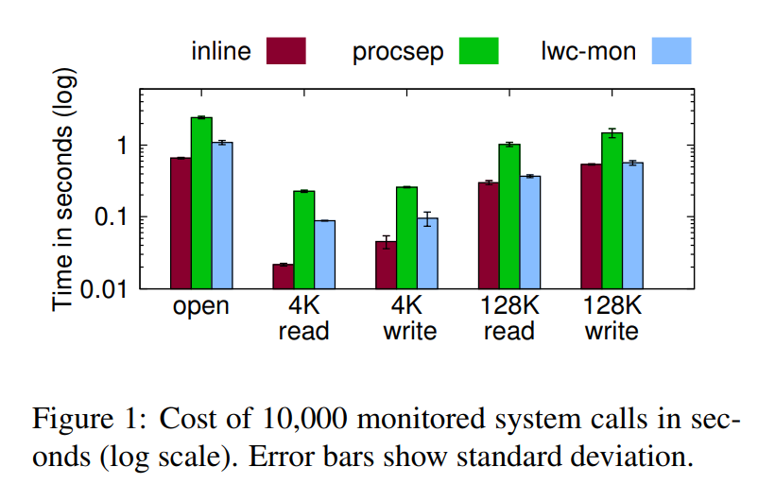
Evaluation - Monitor

Slide 20
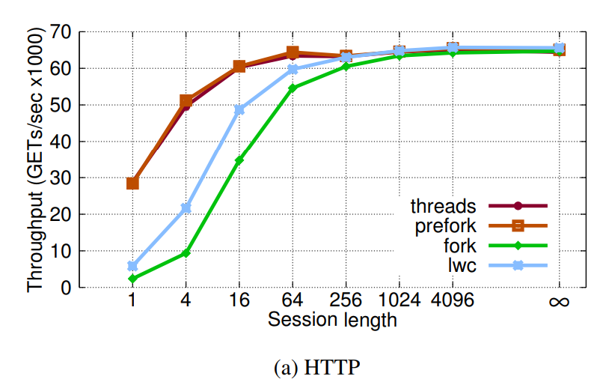
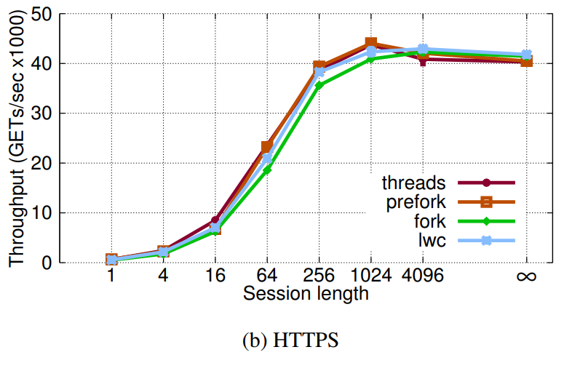
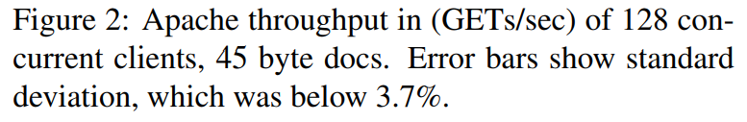
Evaluation - Apache

Slide 21
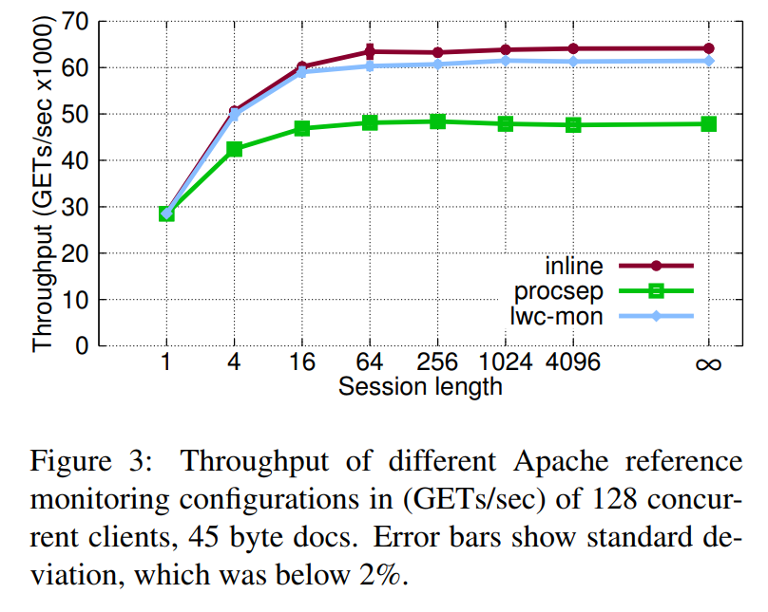
Evaluation - Apache + Monitor

Slide 22
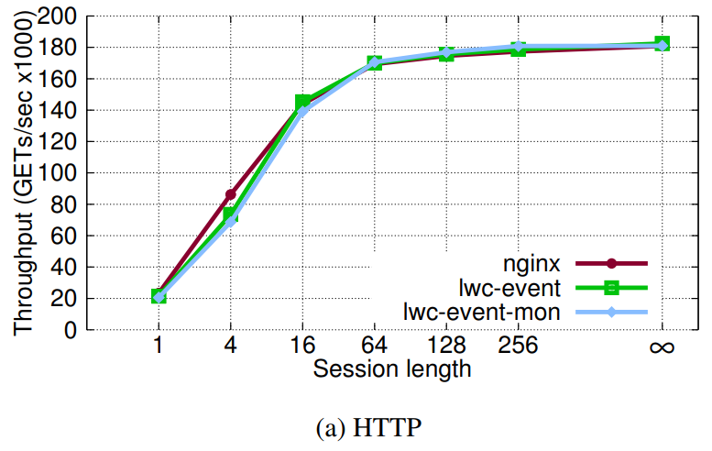
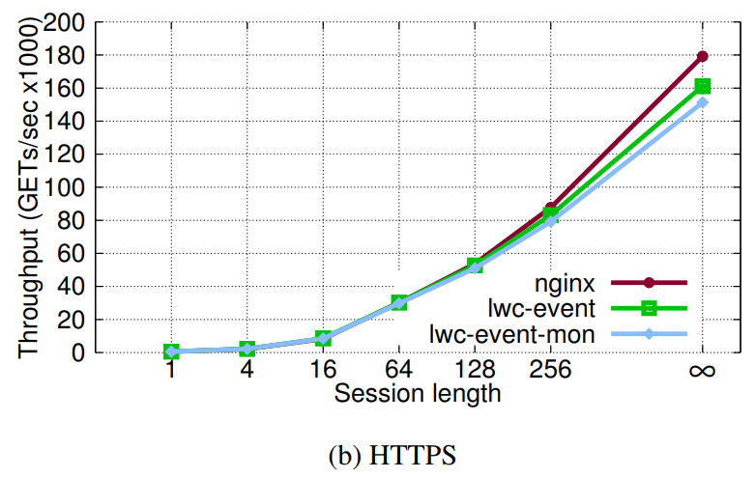
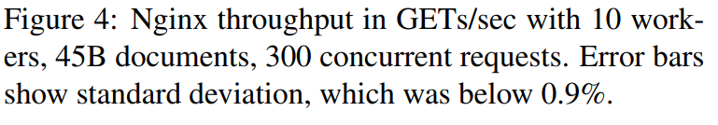
Evaluation - Nginx

Slide 23
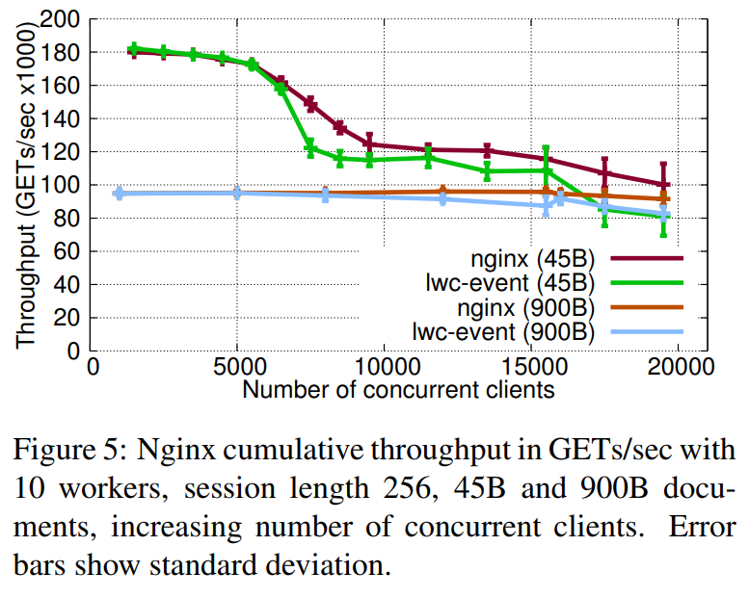
Evaluation - Nginx

Slide 24
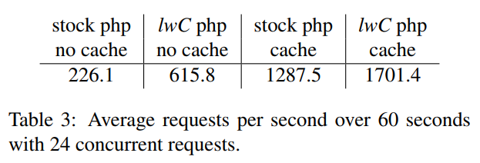
Evaluation - PHP

Slide 25
Take away
Containers that can isolate certain parts of the execution
Take snapshots of the execution state with low overhead which can be cached.
The use in Apache and Nginx shows that the overhead is small.

Slide 26
Class Comments
Making the API similar to fork() makes lwC easier to use/understand.
Contradicting feedback showed that the API was not good and thought it was similar to goto.
Potentially useful for realtime OS or embedded OS.
May not be helpful in scenarios where tasks benefit from good scheduling.
Attributable signal killing a context but not the process.
Tasks that needs to be resilient against other failing tasks may not be benefitted from this.

