Slide 1
SCONE: Secure Linux Container Environment with Intel SGX (OSDI’16)
Sergei Arnautov, Bohdan Trach, Franz Gregor, Thomas Knauth, Andre Martin, Christian Priebe, Joshua Lind, Divya Muthukumaran, Dan O’Keeffe, Mark L Stillwell, David Goltzsche, David Eyers,Rudiger Kapitza, Peter Pietzuch, and Christof Fetzer
Presenter: Jiyong Yu

Slide 2
Container-based Virtualization
Computation/Data outsourcing is popular(example: 23andMe)
Container and Virtual Machine are two popular solutions; Container normally has better performance over virtual machine; easy to deploy
Notes:
user outsource computation onto some remote cloud; the cloud will serve lots of request from different users and process all of them concurrently
since container processes are just normal processes run on the top of OS, projects like Docker create container using existing Linux kernel features to enable isolation & load balance

Slide 3
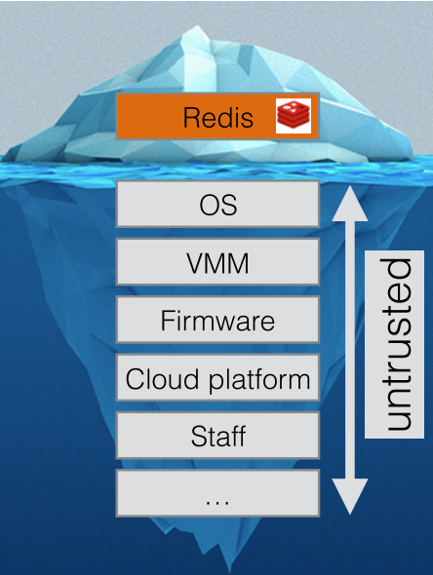
The Worries of User
The cloud provider can know all the user data/code
User has to trust the cloud provider(their HW/SW)
Users don’t trust each other
Even if cloud provider is trustworthy, their infrastructure can potentially be compromised
Notes:
Example: someone wants a remote party to analyze his health record, but don’t want they know the content of the health record
Malicious tenants exploited software/hardware bugs and then compromise hypervisor -> become the hypervisor!

Slide 4
Thread Model
Assume a privilege adversary, who controls the entire software stack (container engine, OS kernel, etc.)
The application itself is bug-free
Denial-of-service attack and side-channel attacks are out-of-scope

Slide 5
The Goal of SCONE
Run unmodified Linux applications in a container, which is running in a untrusted cloud securely and with acceptable performance
Security
Guarantee confidentiality & integrity
Minimize TCB
Performance
Low latency
High throughput
Usability
Easy to deploy
Notes:
Security: Tenants want to protect the confidentiality and integrity of their application data from accesses by unauthorized parties(other containers as well as privileged software – os kernel, hypervisor); Also minimizing the size of TCB, because there will be bugs in it that gives the attacker chance to compromise
Performance: Maintain low overhead(guarantee the low latency & high throughput)
Usability: Easy to deploy onto container platforms like Docker on a Intel SGX machine

Slide 6
Intel Software Guard eXtensions(SGX)
TCB is the processor with SGX
Isolation: Enclave’s environment is isolated from all untrusted software outside enclave
Attestation: Enclave allows the user to authenticate the software running inside an enclave
EPC size is limited.
Syscalls are not allowed
Notes:
Before SGX, without a hardware TCB, people use cryptographic schemes like HE(really large overhead)
TCB: so Intel must be trusted, offchip DRAM, Disks etc. are not trusted so off-chip data are encrypted. OS, hypervisor, BIOS are also not in TCB
Isolation: enclave shield code and data from accesses from other software & high privileged software(How? Enclave program can put code/data in EPC, which is owned by itself only. Enclave can access outside EPC carefully)
Attestation: you know your program is executed, and you know your program is running on a SGX machine
To get more EPC pages, existing EPC pages are encrypted and swapped to untrusted memory.

Slide 7
Intel Software Guard eXtensions(SGX)
Performance overhead:
Thread must exit the enclave prior to syscall; after syscall finishes thread re-enters enclave
On-chip memory and DRAM data exchange requires encryption/decryption
Application whose memory requirement exceeds EPC size will cause swapping pages between EPC and untrusted DRAM(encryption/decryption, interrupts and TLB flush)

Slide 8
Design Challenges
Minimizing the size of software level TCB while keeping the interface safe
Inside EPC vs outside EPC
Maintaining low performance overhead
Synchronous system call
Moving data into/out of on-chip memory requires encryption/decryption
More complicated page table walk
Notes:
we cannot put everything related to program execution in EPC like system libraries, because we must ensure that those libraries are bug-free; on the other hand, put everything outside TCB cannot guarantee security, since some basic operations must be done (like pass file outside should be encrypted)
Inside EPC: secure but slow. So non-important data should be outside EPC
every time we need a system call, we have to EEXIT/EENTER, which requires copying register state to EPC + flushing TLB

Slide 9
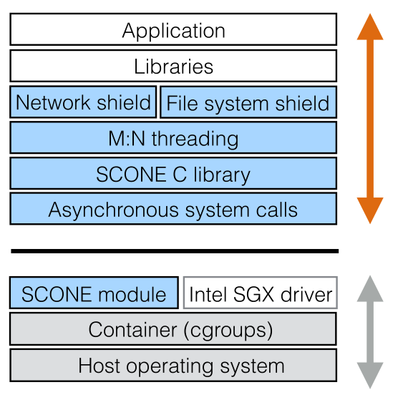
SCONE Architecture
External Interface Shielding
M:N threading (dynamic scheduling)
Asynchronous system call
Docker integration

Slide 10
Shielding
Ensuring the confidentiality and integrity of the application data passed through the OS
Filesystem shield: encrypt/authenticate files for confidentiality/integrity
Network shield: establish TLS channel between client and container
Console shield
Notes:
Filesystem shield: three prefix for a file: unprotected(OS can see), encrypted and authenticated(strictly protect from OS), authenticated(OS can see, but cannot modify). Filesystem shield will encrypt the file if is marked encrypted, and generate metadata for authentication if marked authenticated(metadata is keep inside enclave)
Network shield: attacker can control the transmit channel between enclave and remote client. So if the transmit data must be encrypted

Slide 11
Threading Model
Arbitrary number of application threads running on the machine
Each thread has a “system call thread” which resides in the kernel, used to serve the system call
A scheduler to detach the waiting thread from the processor, and attach the ready thread
FIFO request queue and response queue in non-enclave memory

Slide 12
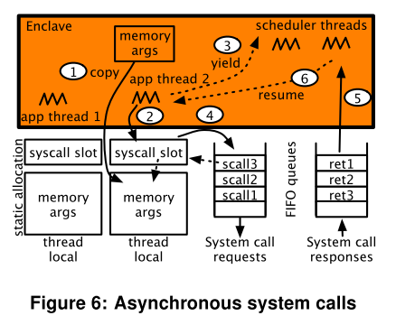
Asynchronous System Calls

Slide 13
Evaluation Result
Benchmarks: Apache, NGINX, Redis, Memcached
Variants:
glibc(use Stunnel for encryption)
SCONE-sync
SCONE-async

Slide 14
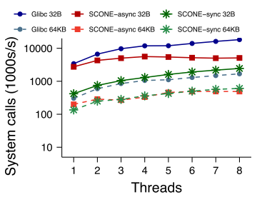
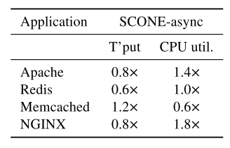
Evaluation Result
Notes:
Two details:
Throughput: async is more than glibc because glibc use Stunnel(Memcached) to encrypt communication data, which brings larger overhead
The scalability issue is caused by their FIFO queues

Slide 15
Conclusion
SCONE increases the confidentiality and integrity of containerized services using Intel SGX.
SGX-imposed enclave transition overheads are reduced effectively
The secure containers of SCONE are compatible with Docker and can run unmodified applications

Slide 16
Remarks
Overhead is too high! (that’s the cost of using SGX)
Evaluation: Thread number is fixed.
What about other CPUs?
SGX has side-channel issues!
Scalability?(modern server processors has >20 HW threads)

Slide 17
Backup slides

Slide 18
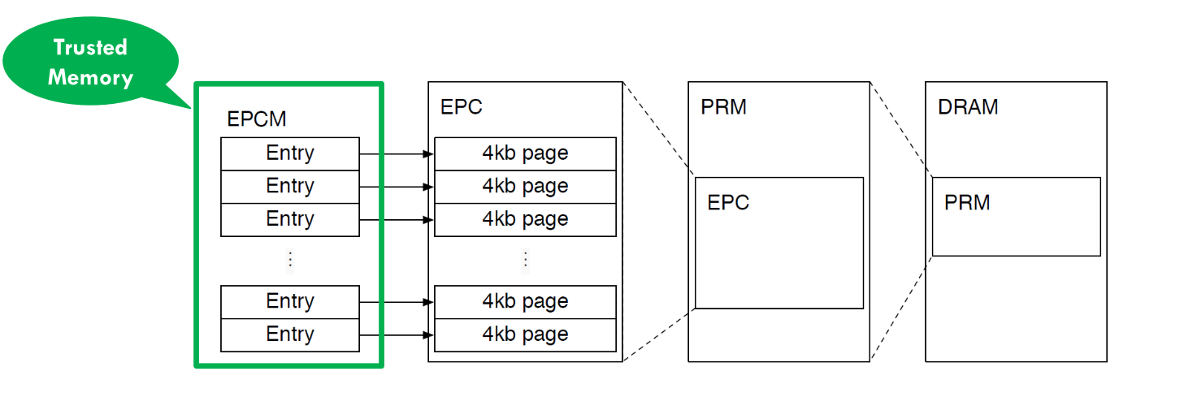
SGX Physical Memory Organization

Slide 19
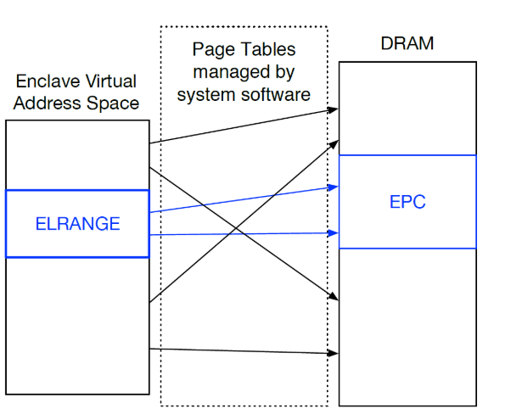
SGX Virtual Memory Organization

