Slide 1
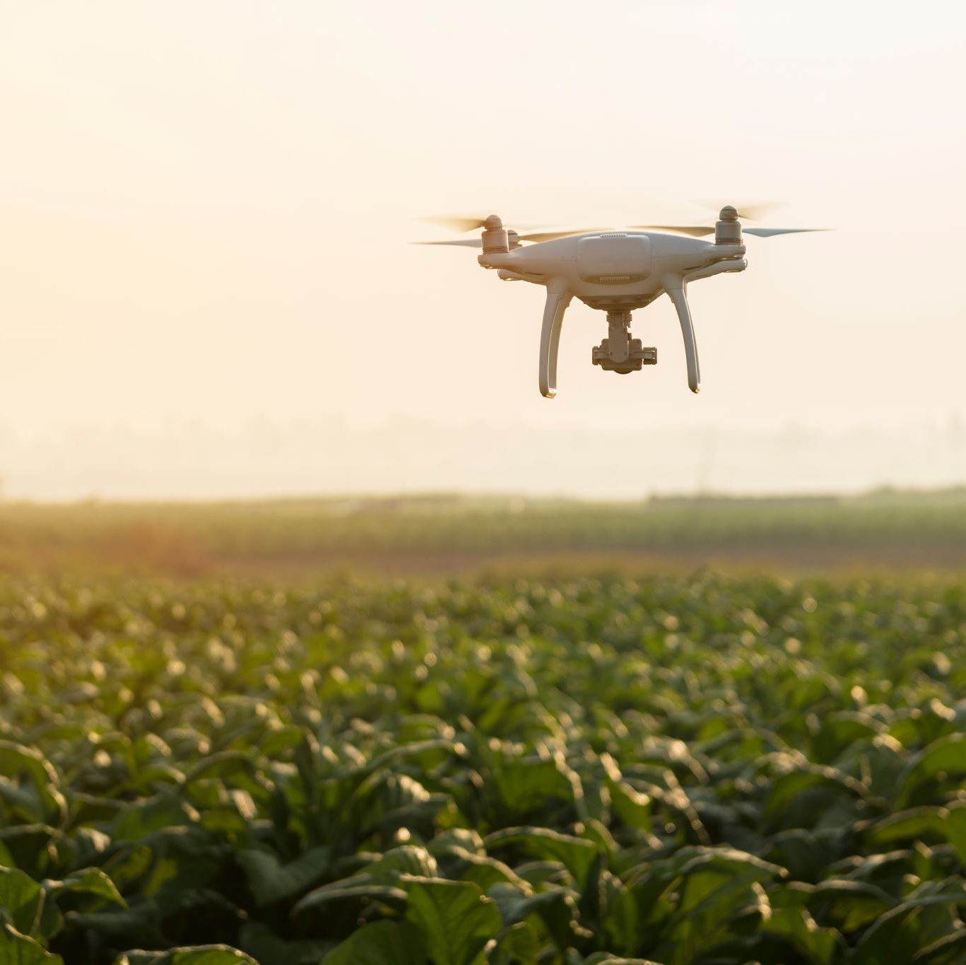
Surveillance Drone Cloud Platform
Tracking and Monitoring

Slide 2
Types of Tracking and Monitoring
Tracking Manager
Location Tracking
Image Tracking
Video Tracking
IOT data Tracking
Battery and Power Tracking
Health Monitoring
Others
Alert Monitoring
Intrusion Detection

Slide 3
Location Tracking
Location tracking is essential for monitoring the precise whereabouts of a drone.
The data parameters include:
Parameter | Description
Drone ID | ID of a particular drone.
Latitude | The drone's north-south position on the Earth's surface.
Longitude | The drone's east-west position on the Earth's surface.
Altitude | The drone's height above a reference point.
Speed | The drone's current velocity through the air.
Heading | The direction in which the drone is pointing. Eg: NW
GPS Signal Strength | The quality of the GPS signals received by the drone.

Slide 4
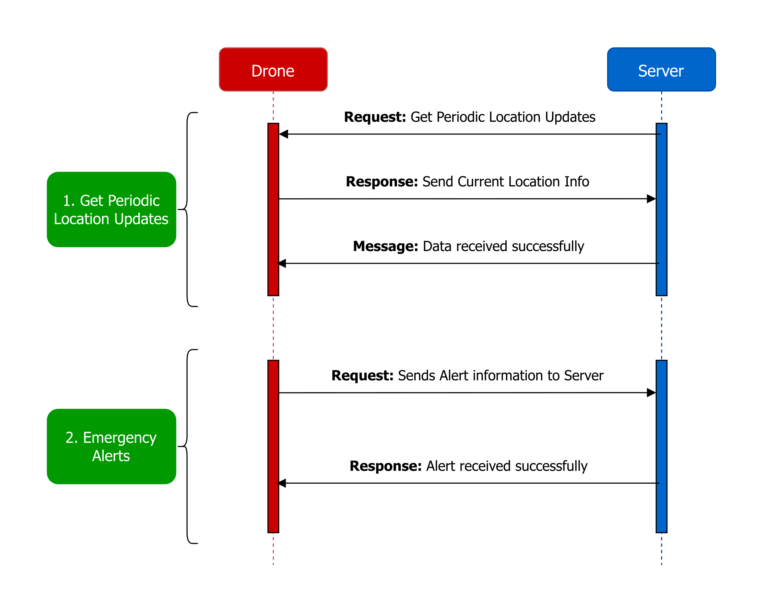
The Communication Protocol for Location tracking:

Slide 5
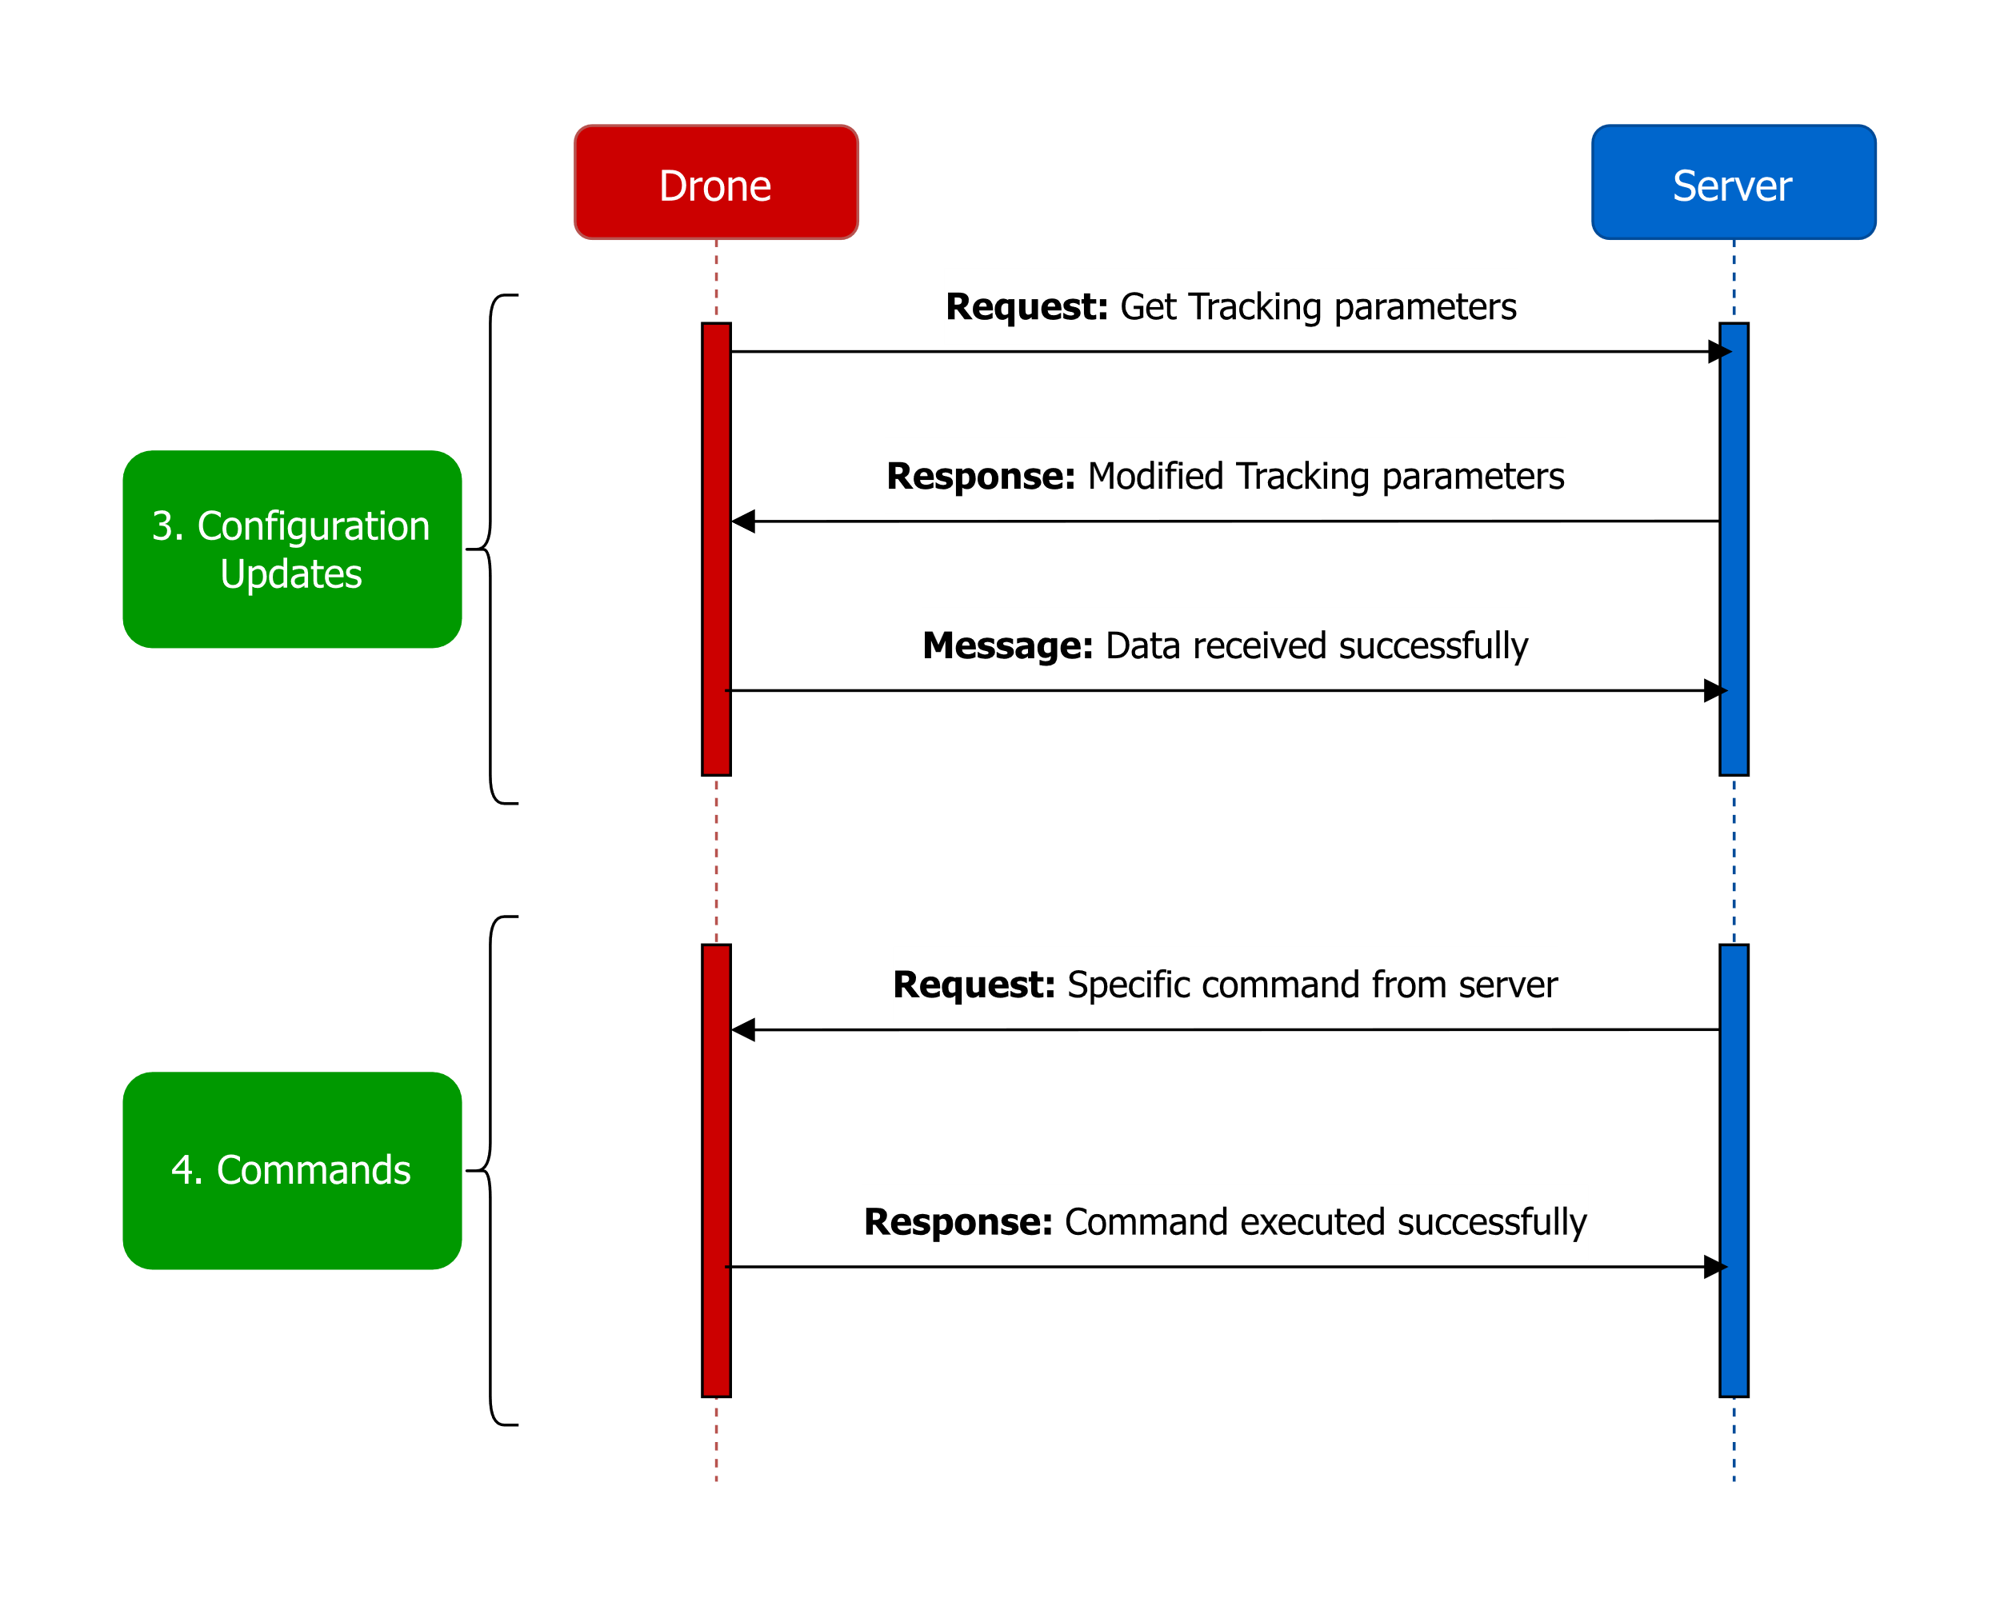
Contd…

Slide 6
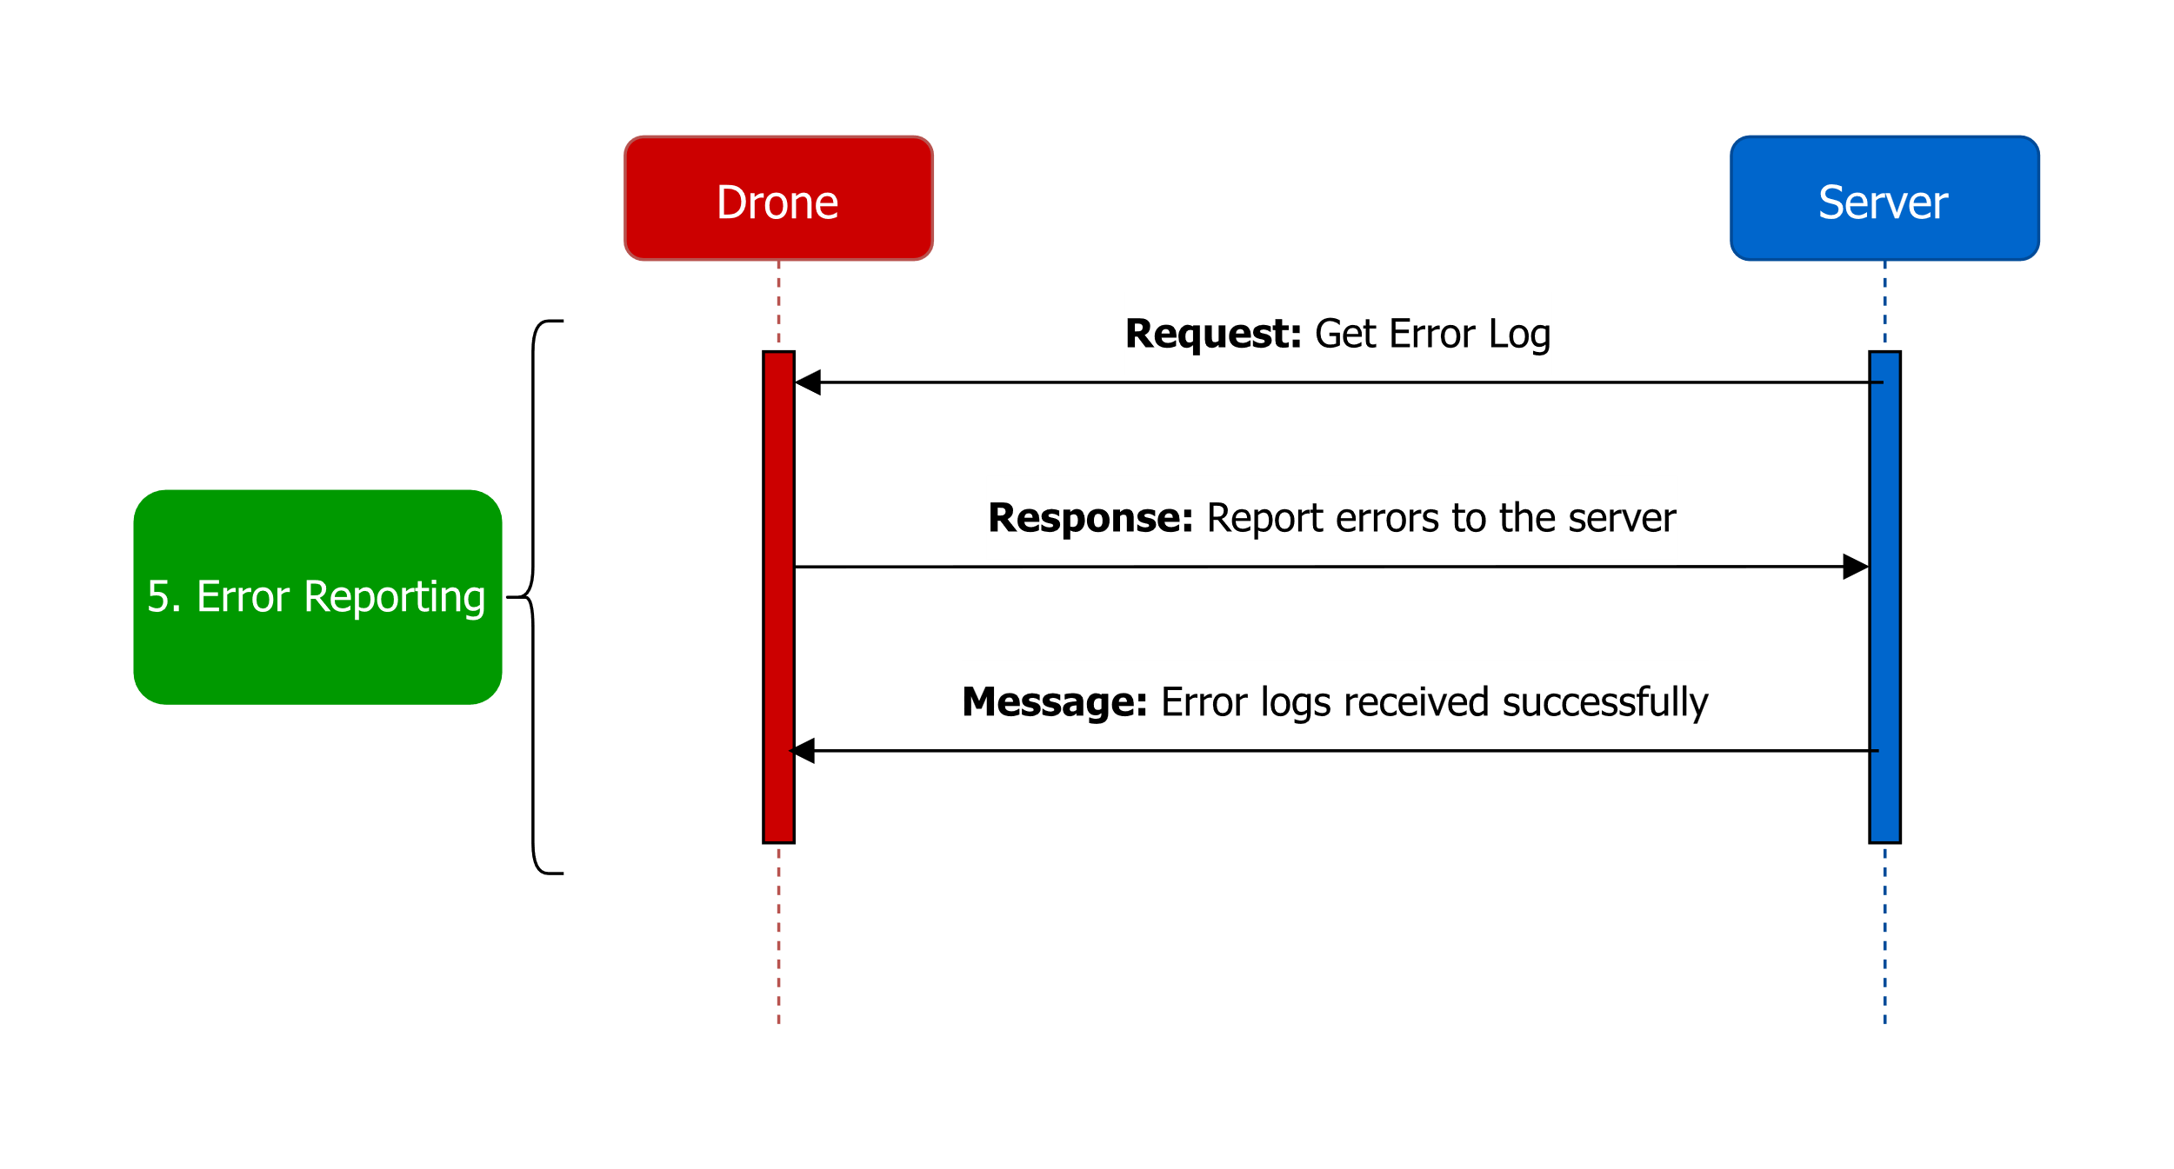
Contd…

Slide 7
Image Tracking
Image tracking involve capturing and analyzing visual data from the drone's cameras.
The data parameters include:
Parameter | Description
Drone ID | ID of a particular drone
Image Snapshot Parameters List
Timestamp | The date and time when the image was captured.
Resolution | The dimensions of the image (e.g., pixels).
File format | The format in which the image is saved (e.g., JPEG, PNG).
Geotagging | Geographic coordinates (latitude and longitude) associated with the image's capture location.

Slide 8
Image Tracking (Contd…)
Parameter | Description
Storage and Retrieval Parameters List
File paths or URLs | Locations where image and video files are stored.
Indexing and cataloging | Organizing and accessing image data efficiently.
Security and Privacy Data Parameters
Access controls | Permissions and restrictions on who can access and view the visual data.
Encryption Status | Whether image data is encrypted during storage and transmission.

Slide 9
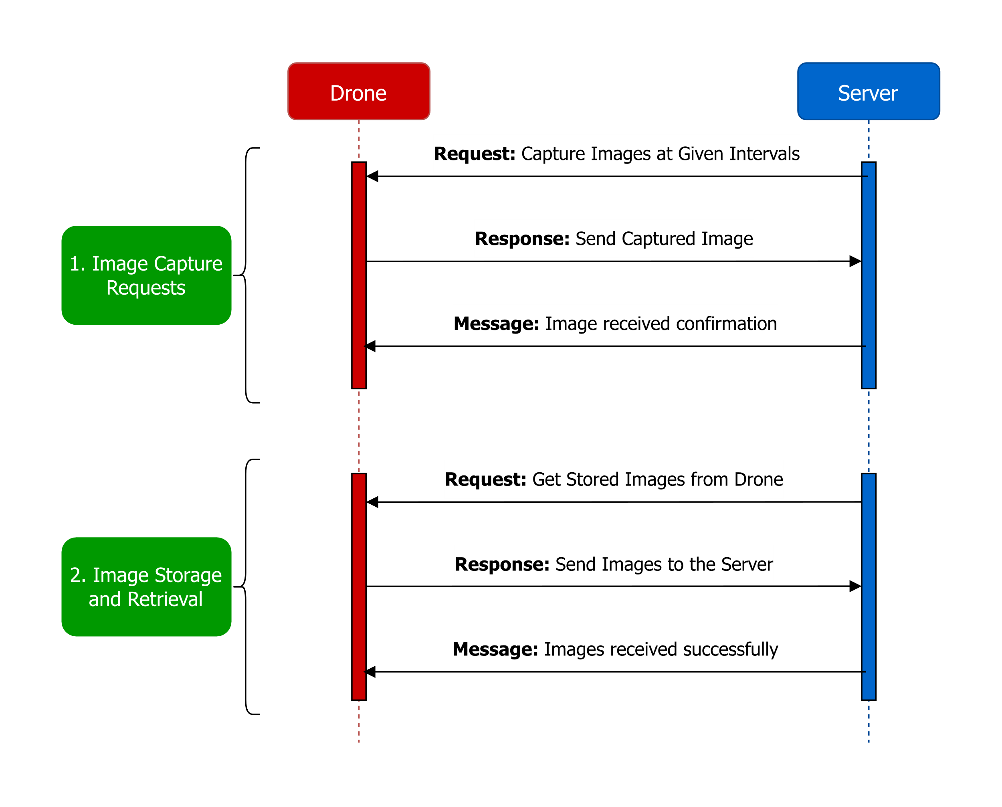
The Communication Protocol for Image tracking:

Slide 10
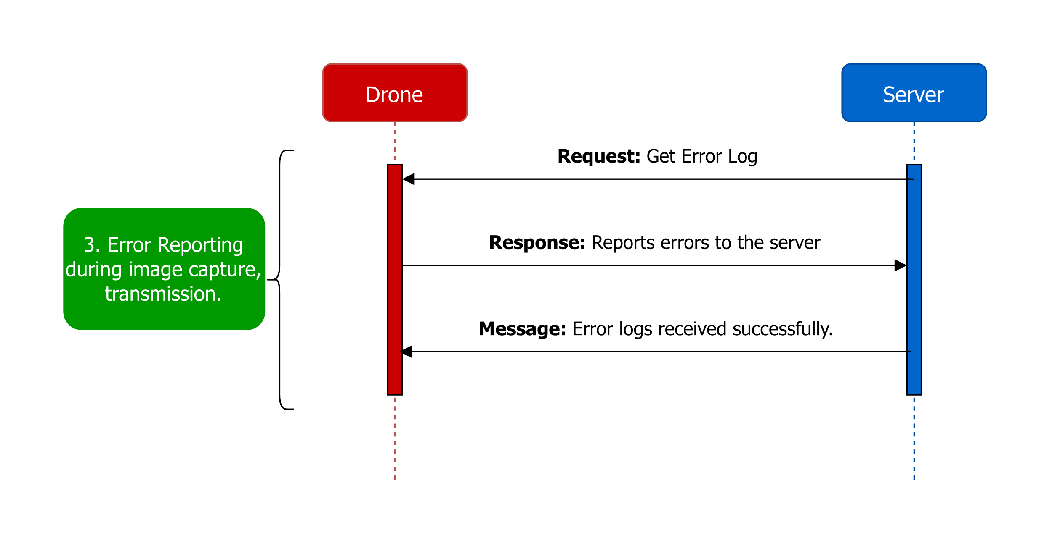
Contd…

Slide 11
Video Tracking
Video tracking involve capturing and analyzing visual data from the drone's cameras.
The data parameters include:
Parameter | Description
Drone ID | ID of a particular Drone.
Live video stream Parameters List
Frame rate | The number of frames per second in the video stream.
Resolution | The dimensions (width x height) of the video frames.
Compression level | The degree of video compression applied to reduce data size.

Slide 12
Video Tracking (Contd…)
Parameter | Description
Video Recordings Parameters List
Duration | The length of the video recording.
File format | The format in which the video is stored (e.g., MP4, AVI).
Geotagging | Geographic coordinates (latitude and longitude) associated with the video’s capture location.
Timestamp | The date and time when the video was captured.
Resolution | The dimensions of the video (e.g., pixels).

Slide 13
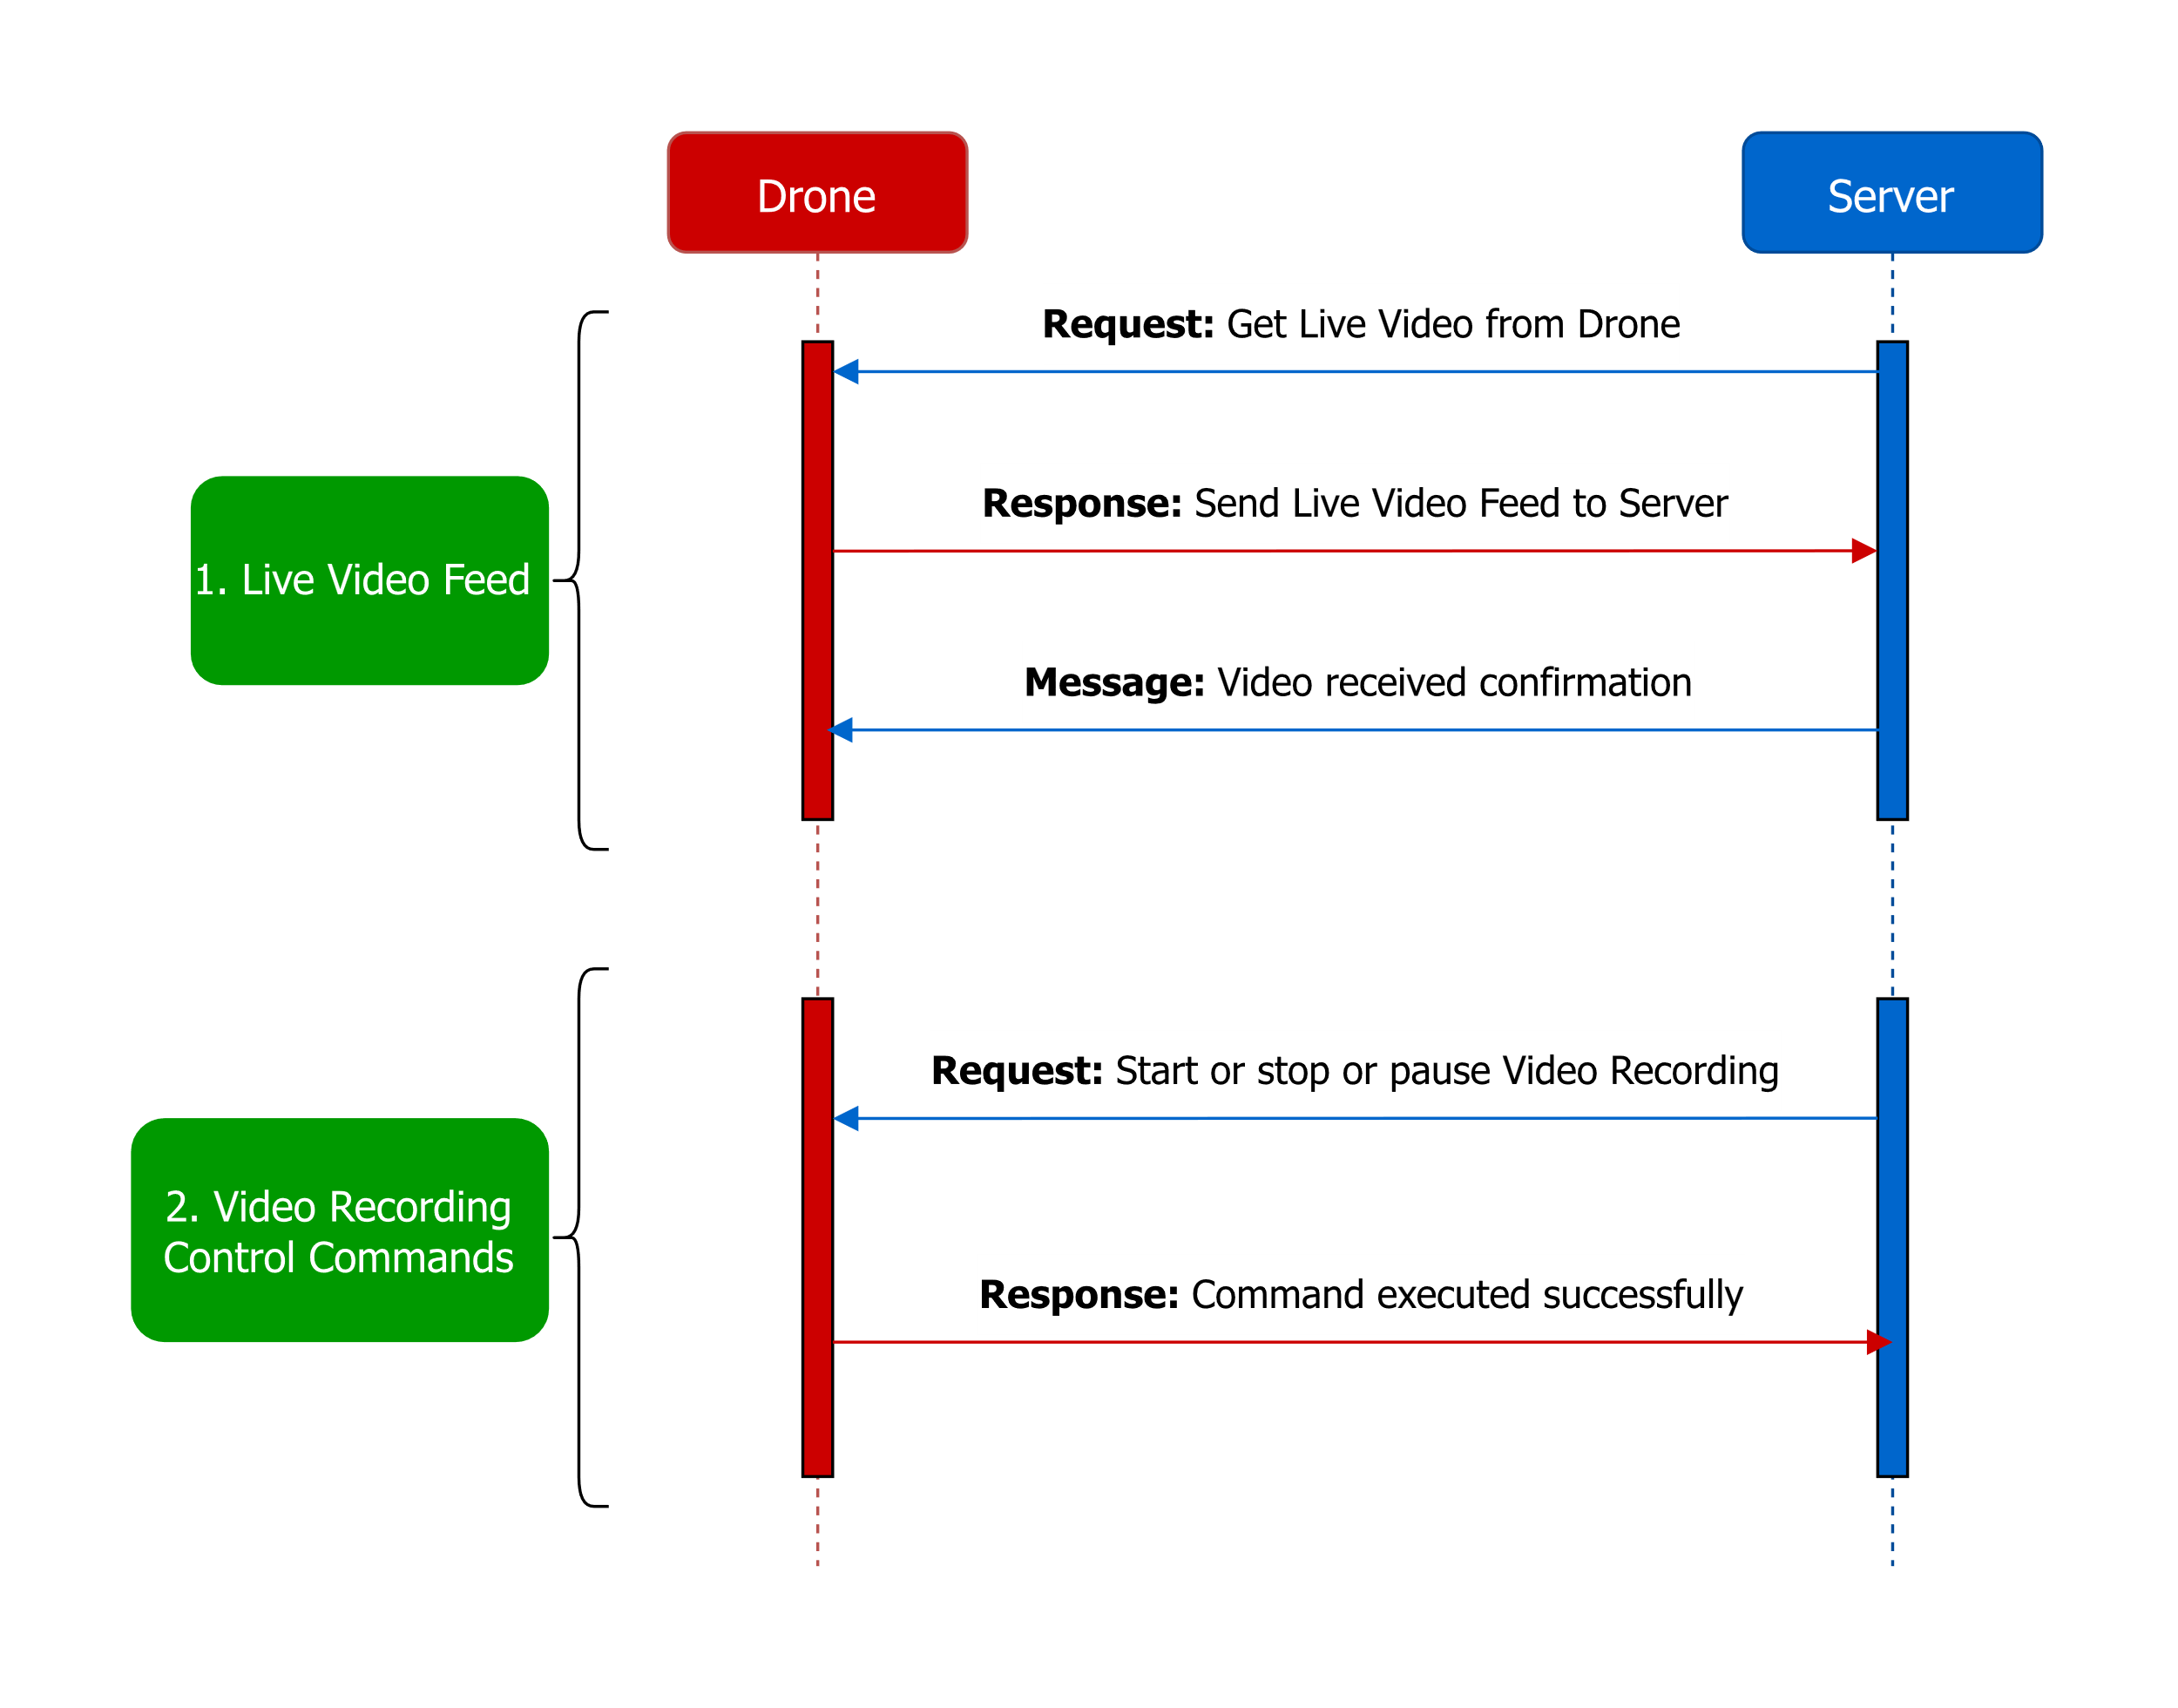
The Communication Protocol for Video tracking:

Slide 14
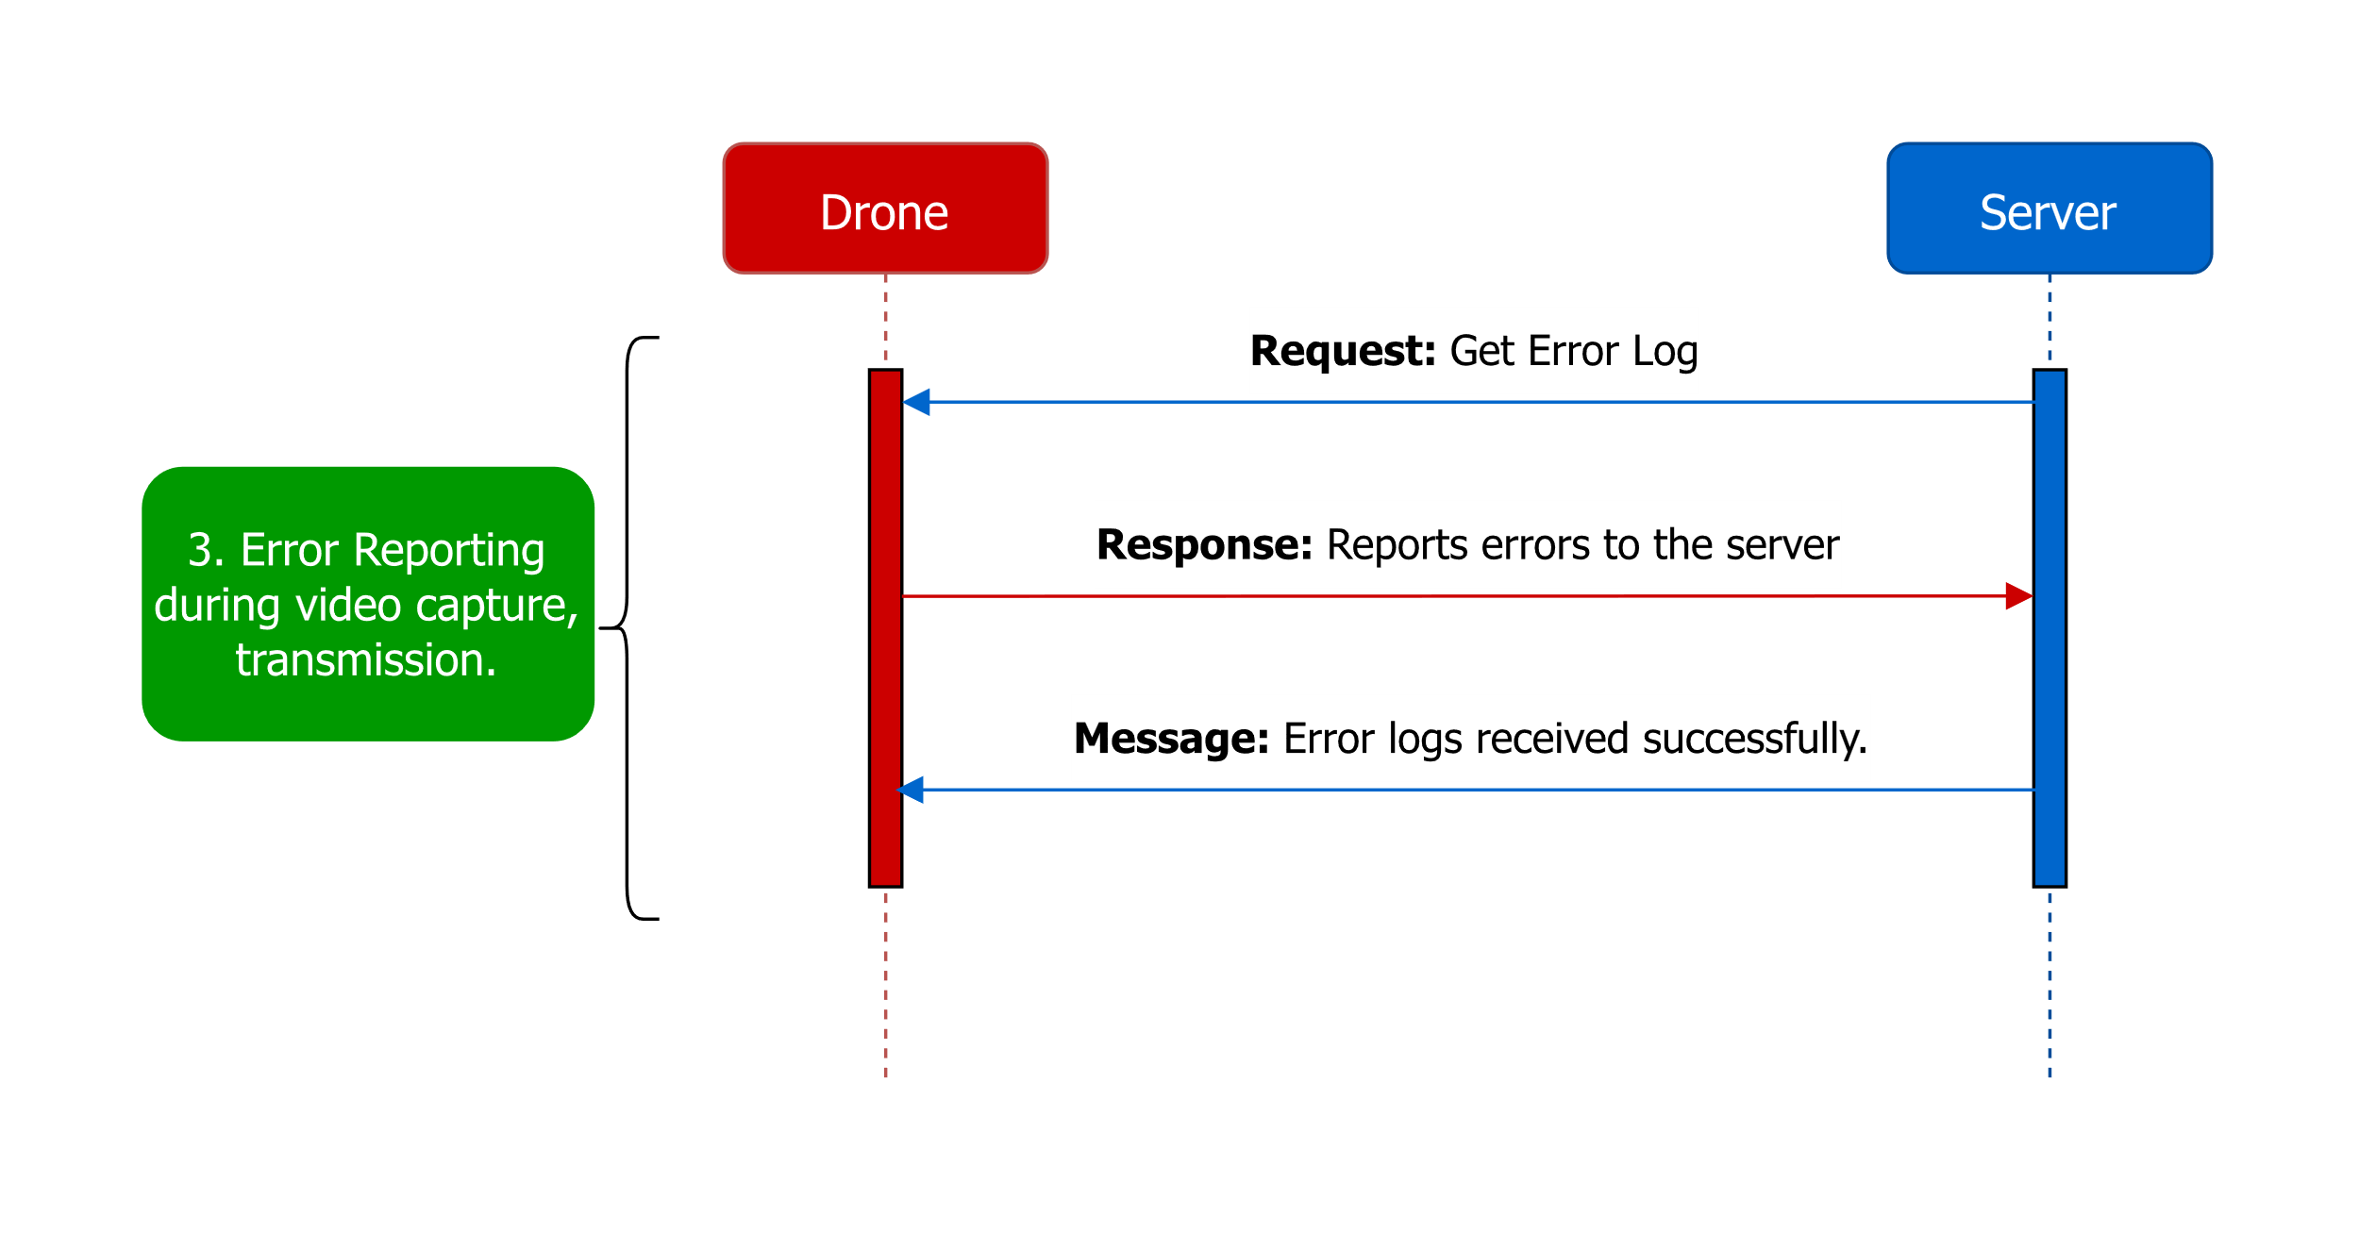
Contd…

Slide 15
IOT Data Tracking
Tracking IOT data, including sensor readings, sensor health, and operational parameters.
The data parameters include:
Parameter | Description
Drone ID | ID of a particular Drone
Device Identifier (ID) | Unique identifiers (e.g., device serial numbers or IDs) to distinguish and track individual IoT devices.
Timestamp | Date and time stamps indicating when IoT data was generated or received. (Including timezone).
Sensor Readings | Data collected from various sensors, such as temperature, humidity, pressure, light, motion, sound, or any other relevant environmental measurements.
IOT Device Status | Information about the operational state of IoT devices, including whether they are online, offline, in standby mode, or experiencing errors.

Slide 16
IOT Data Tracking (Contd…)
Parameter | Description
Data Transmission Status | Messages indicating the success or failure of data transmissions between IoT devices and the server or other devices.
Alarms and Alerts | Notifications and alerts generated by IoT devices when certain conditions or thresholds are met or exceeded. Severity levels (e.g., critical, warning) for prioritizing alerts.
Event Logs | Logs capturing events, activities, or changes in the IoT system, including device startup, shutdown, and configuration changes.

Slide 17
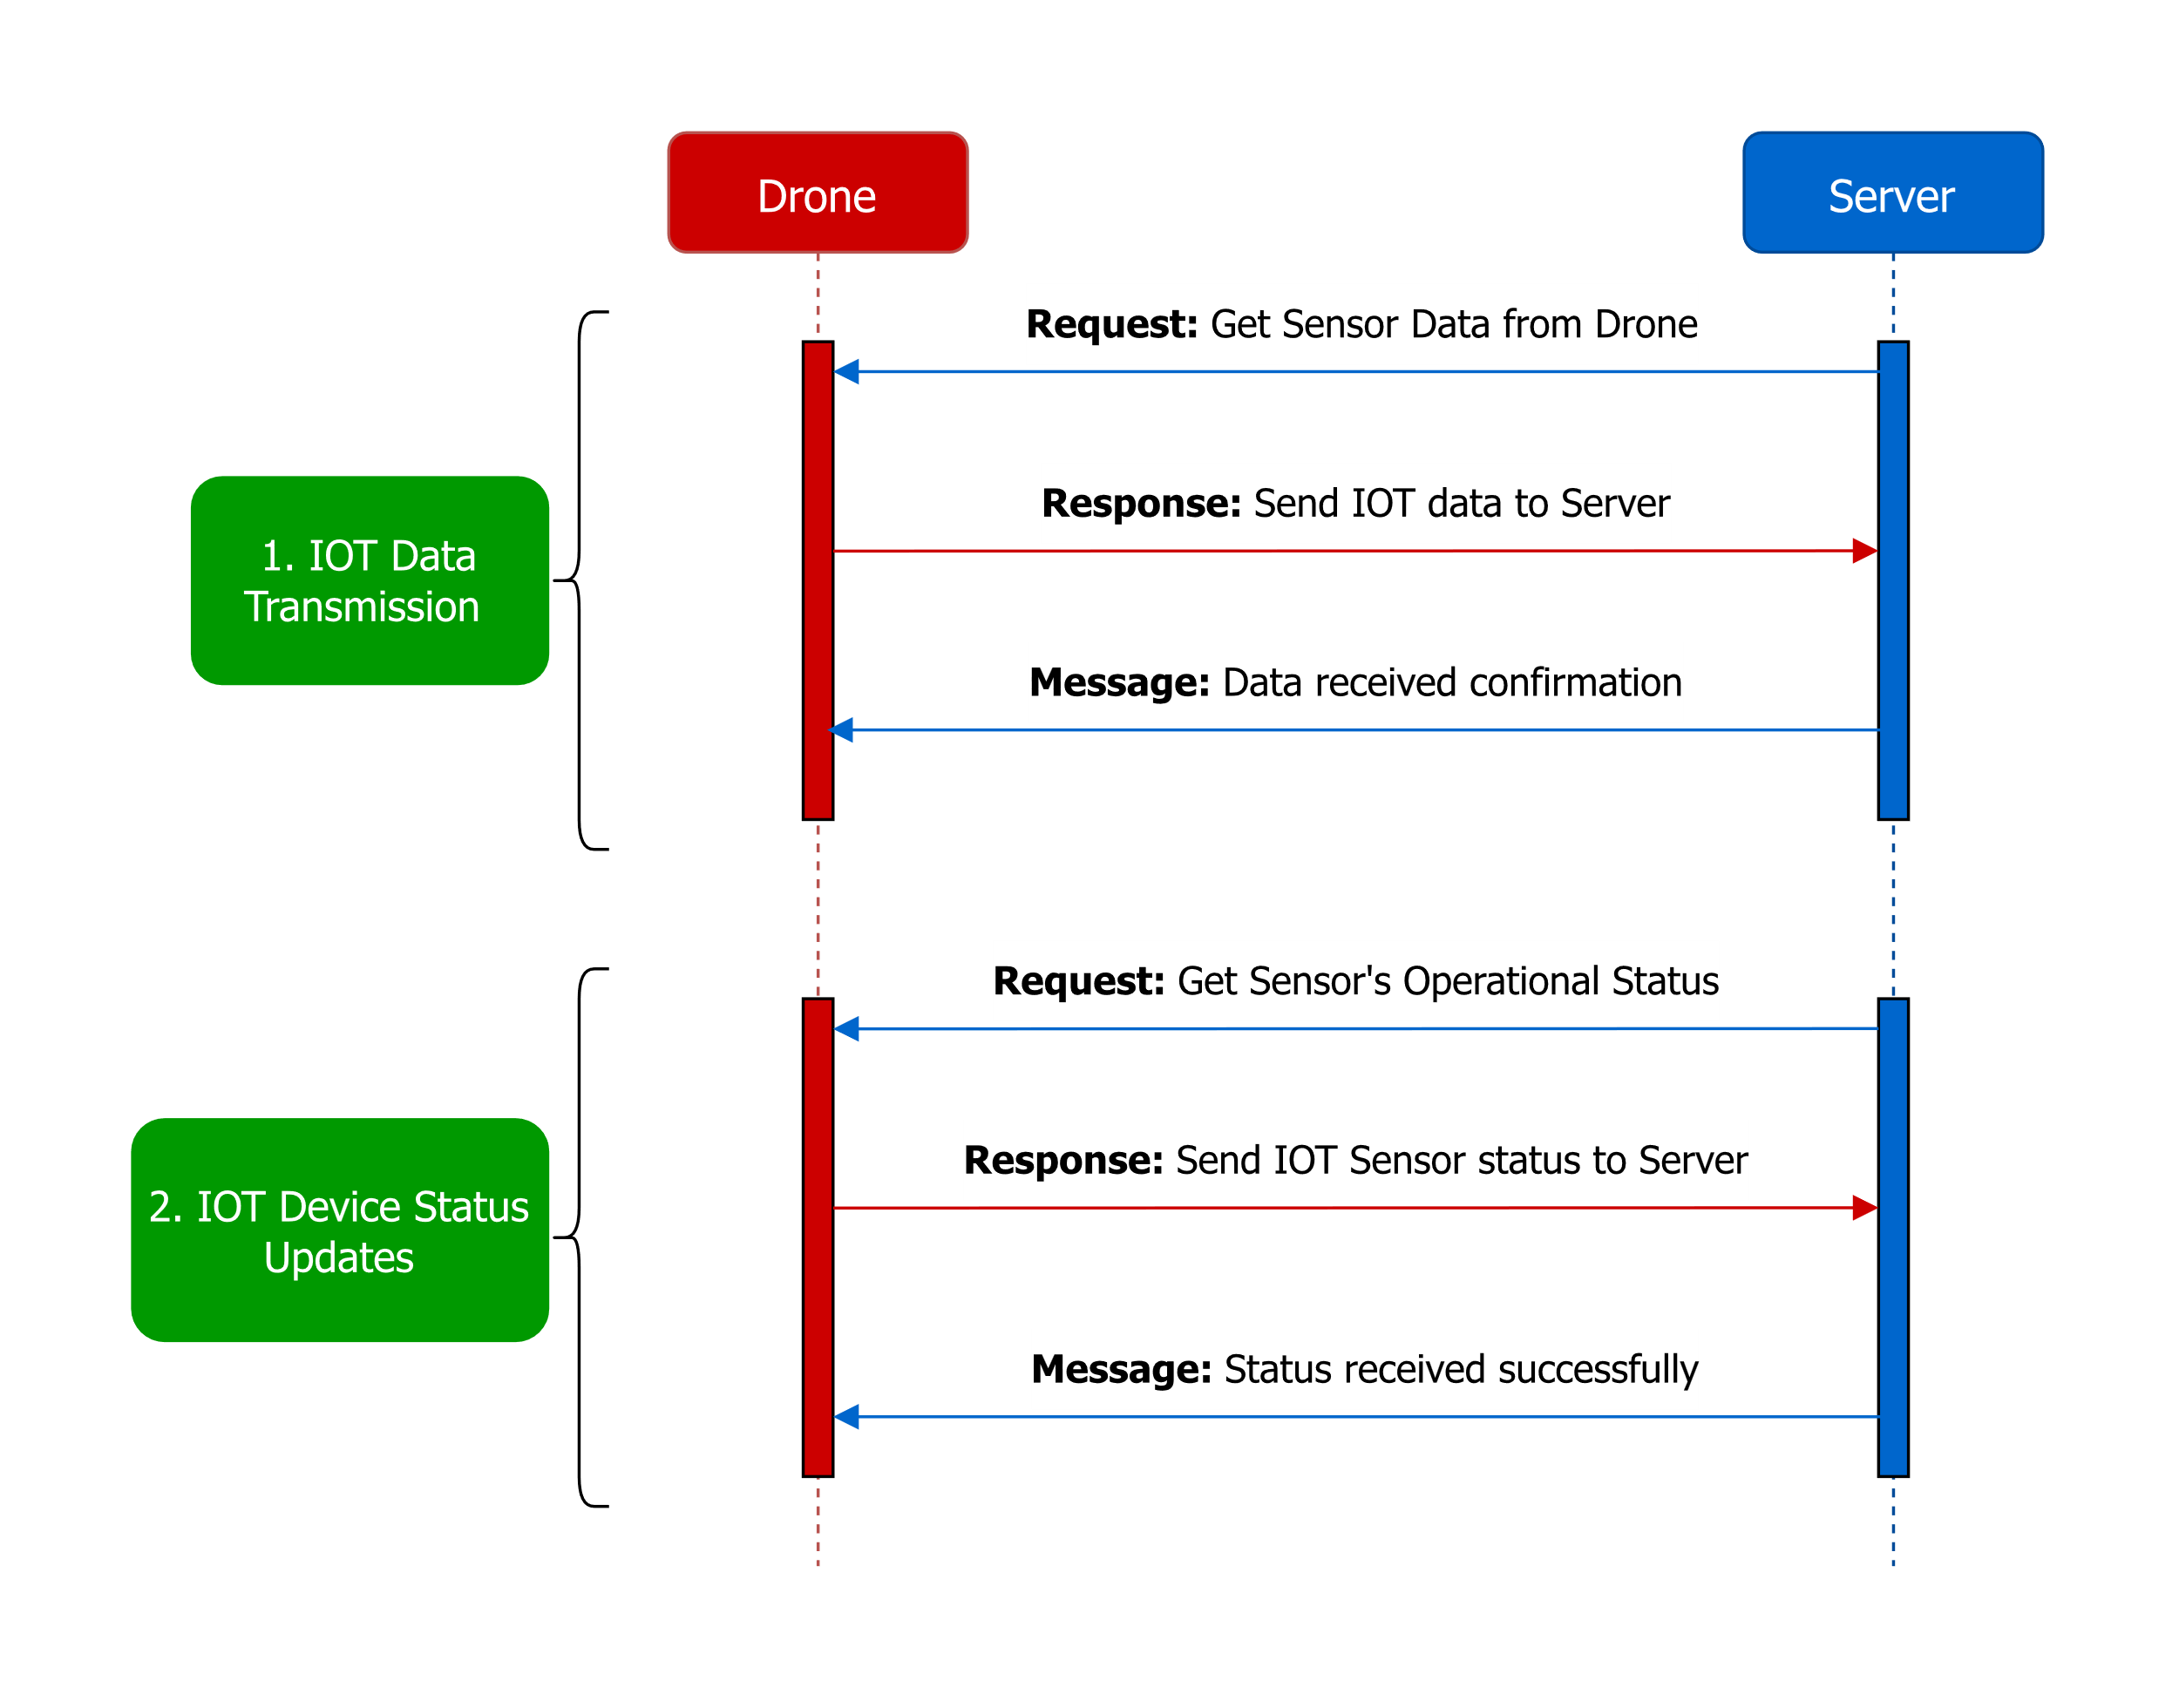
The Communication Protocol for IOT Data tracking:

Slide 18
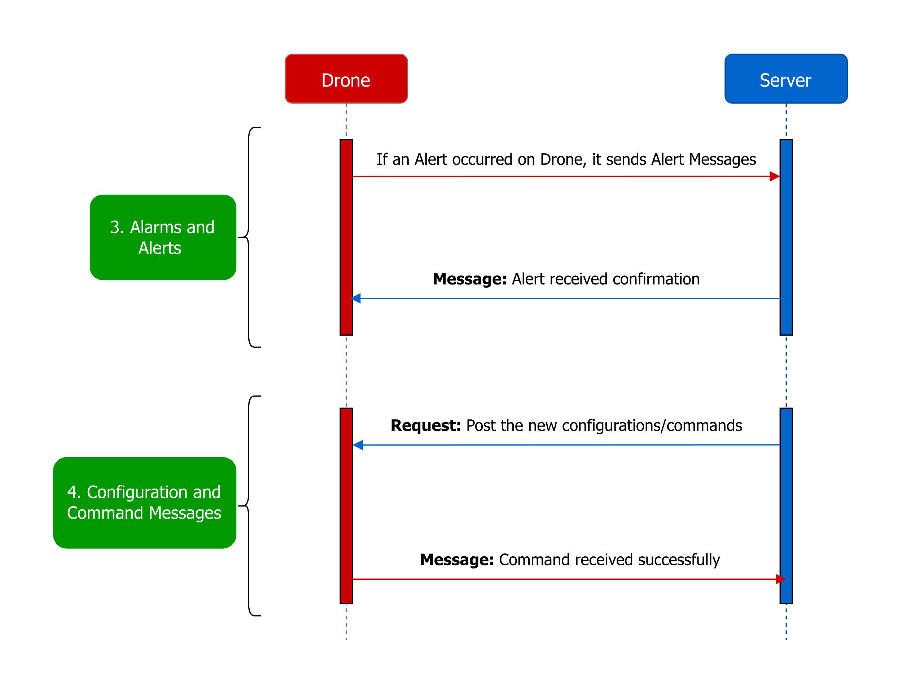
Contd…

Slide 19

Contd…

Slide 20
Battery and Power Tracking
Battery and power tracking is essential for monitoring the status and performance of a drone.
The data parameters include:
Parameter | Description
Drone ID | ID of a particular Drone
Battery Level | The remaining charge level of the drone's battery, often expressed as a percentage.
Power Status | Whether the drone's power system is currently on (powered) or off (unpowered).
Charging Status | Information about whether the battery is currently charging.
Battery Type and Capacity | Identification of the battery type (e.g., LiPo, Li-ion) and its nominal capacity in milliampere-hours (mAh) or watt-hours (Wh).

Slide 21
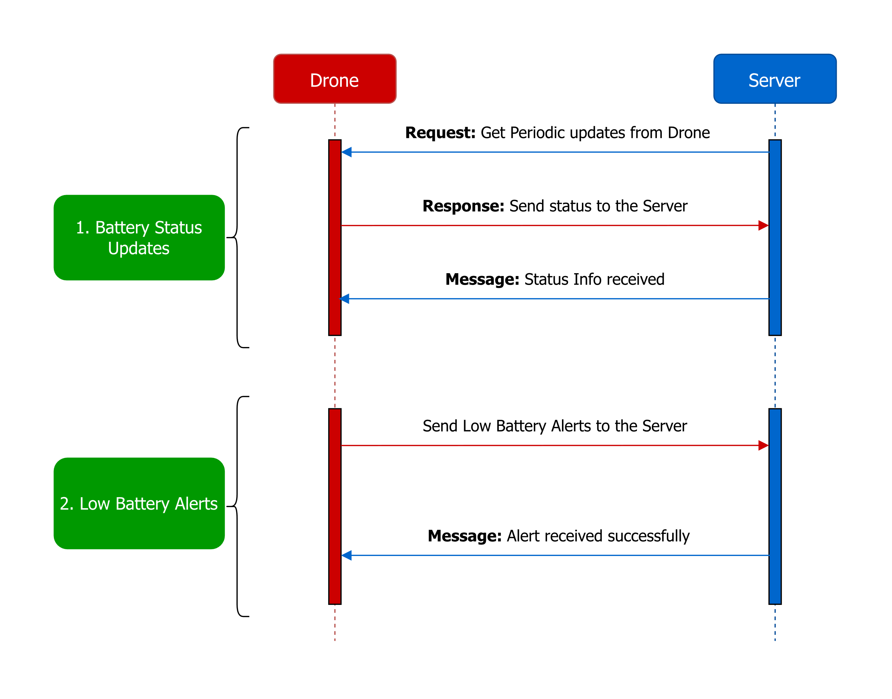
The Communication Protocol for Battery and Power tracking:

Slide 22
Performance and Health Monitoring
Health and performance monitoring for a drone involves tracking various data parameters to ensure the drone's optimal operation.
The data parameters include:
Parameter | Description
Flight Status | Information about whether the drone is currently in flight, on the ground, or in standby mode
Flight Time | The total duration of the drone's flight since takeoff.
Power Status | ON/OFF
Altitude | Altitude variations during flight.
Speed | Changes in speed, including acceleration and deceleration.

Slide 23
Performance and Health Monitoring (Contd…)
Parameter | Description
Heading | Changes in direction. E.g., N or NW
Battery Level | The remaining charge level of the drone's battery.
GPS Location | Latitude and longitude coordinates indicating the drone's precise location.
Flight Mode | The current flight mode of the drone, such as manual, autonomous, or return-to-home.
Error and Warning Messages | Notifications of system errors, warnings, or abnormal conditions.
Real-Time Video Feed | Monitoring the quality and stability of the live video feed from the drone's cameras. Frame rate, resolution, and transmission status.
Data Transmission Status | Information about the status of data transmission between the drone and the ground control station.

Slide 24
General Operational Flowchart
Tracking starts when Power-ON
User Selects a Drone
Configure tracking parameters for that drone using the tracking manager
Drone Power-ON
Initialize Tracking via Tracking Manager
Tracking stops when Power-OFF
Drone Power-OFF
Error Handling and Alerts
Monitor and Update
Start Tracking

Slide 25
THANK YOU

