Slide 1
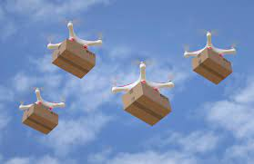
Service Oriented Mission Planner

Slide 2
Mission Planner
The mission planner is a key software component that allows users to set up and schedule drone surveillance missions.
Web application that provides an interface for admin users to create and manage missions.
Integrates with map data to allow users to visually set waypoints and define areas.
Notes:
Allows setting of all parameters for a mission - waypoints, actions, camera settings, etc.
Optimizes waypoint routes for efficiency - considers things like battery life, wind patterns, no-fly zones.
Allows setting timing and recurrence for missions - one time, recurring daily/weekly etc.
Interfaces with fleet management system to select which drone(s) will be assigned to a mission.
Sends final mission plans and waypoints to drones wirelessly.
Tracks mission status in real-time as drones execute flights.
Stores mission history data for reporting and analytics.
Allows dynamic re-tasking or pausing of in-progress missions.
APIs allow integrating with other systems like campus security software.

Slide 3
Overview
The system will consist of a fleet of drones with cameras that can fly pre-planned missions or be dynamically tasked.
The drones will stream video and telemetry data to the cloud.
Users can access and monitor the video feeds and data through a web application.
The mission planner will allow users to create and schedule surveillance missions.

Slide 4
Drone Missions
Pre-planned missions
On-demand missions
Pre-defined missions
Reactive missions

Slide 5
Pre-planned missions
Admin scheduled recurring flights over key areas
Optimized flight plans for efficiency
Provides regular oversight for proactive monitoring
Use cases
Daily flyovers of parking lots to deter break-ins
Weekly quad monitoring to track gathering sizes
Nightly scans of buildings for security breaches
Recurring perimeter sweeps for suspicious activity
Monitor pathways during peak foot traffic
Weekend housing patrols for noise complaints
Notes:
Pre-planned drone missions allow for scheduled, recurring flights over key campus areas and buildings to enable regular proactive monitoring.
The flight plans are optimized for efficiency in route and energy use. Benefits include deterring crime through consistent presence, identifying issues early before escalation, efficient use of drone resources, and building knowledge of normal activity patterns. Specific use cases could include daily monitoring of parking lots, weekly quad surveillance, and nightly building scans to maintain security.
Pre-planned missions allow flexible flight scheduling that minimizes drone energy use and expenditures.

Slide 6
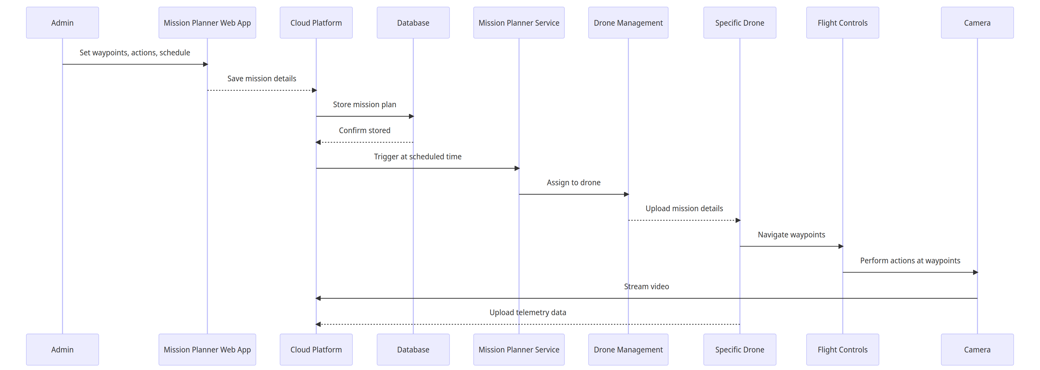
Pre - Planned Mission
Notes:
The administrator schedules a future surveillance mission in the Mission Planner web application by setting waypoints, drone actions, and timing. These details are saved to the cloud platform, which stores the mission plan in a database for later activation. At the scheduled time, the Mission Planner service triggers the plan, assigns it to a drone through the management system, and uploads the mission specifications. The drone then autonomously follows the planned waypoints using its flight controller, performs surveillance actions with its cameras, streams video feeds, and uploads telemetry data to the cloud. After completion, the drone returns safely to base and the cloud archives the mission data for potential future analysis.

Slide 7
On-demand missions
Users can dynamically task drones via web app
Specify area on map to surveil
Mission planner generates waypoints
Set camera settings and actions
Use cases:
View large student gatherings
Inspect reported vandalism
Check buildings during breaks
Survey campus prior to events
Monitor protests or demonstrations
Respond to restricted access reports
Search for missing persons
Notes:
On-demand missions allow users to dynamically task drones to investigate situations as they arise. Users specify an area of interest on a map in the web application and the mission planner generates optimal waypoints for drone routing. Camera settings and other actions can also be configured by the user prior to launch. These customizable, adaptable missions enable rapid response surveillance of developing events, specific targets of opportunity, or other ad hoc concerns that require focused drone oversight. Example use cases include monitoring protests, surveying event venues, inspecting vandalism, and searching for missing persons on campus.

Slide 8
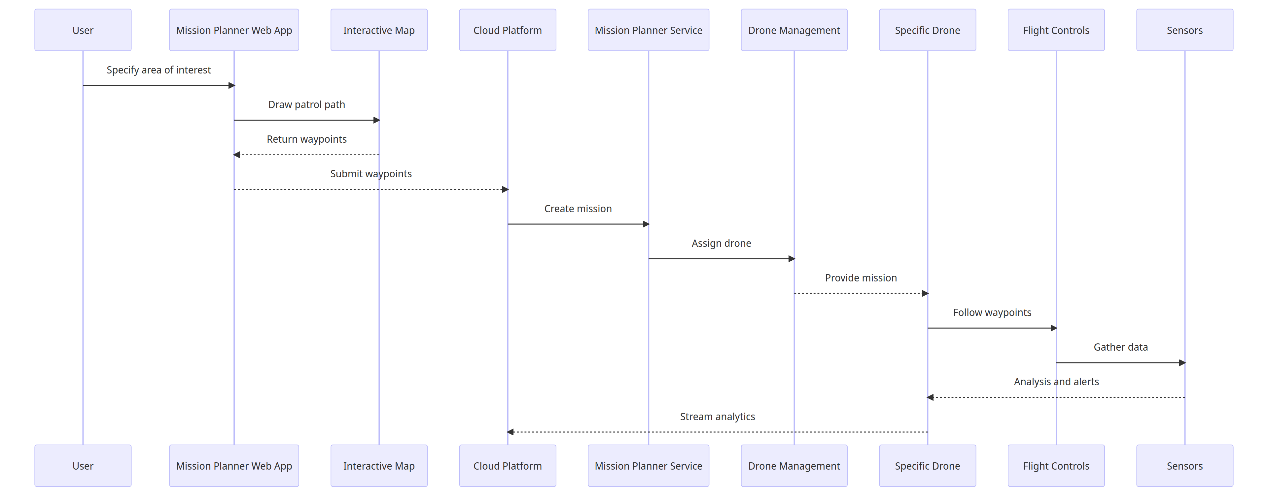
On Demand Missions
Notes:
The user specifies an area of interest for surveillance in the Mission Planner web application, which interacts with a map interface to generate an optimal drone patrol path and waypoints. These customized waypoints are submitted to the cloud platform, which creates a mission and assigns it to a drone through the management system. The specific drone receives the on-demand mission details, then autonomously follows the generated waypoints using its flight controller and leverages sensors to gather aerial data. Analysis of the streaming sensor feeds produces alerts for any anomalies detected during the flight. Once complete, the drone sends the full analytics package from the mission back to the cloud platform for storage and potential future review.

Slide 9
Pre-defined Missions
Patrols with randomized waypoints
Vary flight paths, avoid repetitive routes
Parameters set for area, duration, speed
Mission planner optimizes route and settings
Use Cases:
Irregular surveillance of recreational spaces
Randomized parking area oversight
Varying quad and open space flights
Frequent dorm patrols at irregular times
Notes:
Random patrol missions generate unpredictable drone routes by varying waypoints and flight paths to avoid repetitive routines. The mission planner optimizes randomized route parameters like area, duration and speed for efficient surveillance. The unpredictable coverage identifies incidents pattern analysis may miss and cost-effectively monitors large areas over time. Example use cases include irregular oversight of recreational spaces, parking lots, quads and unpredictable dorm patrols.

Slide 10
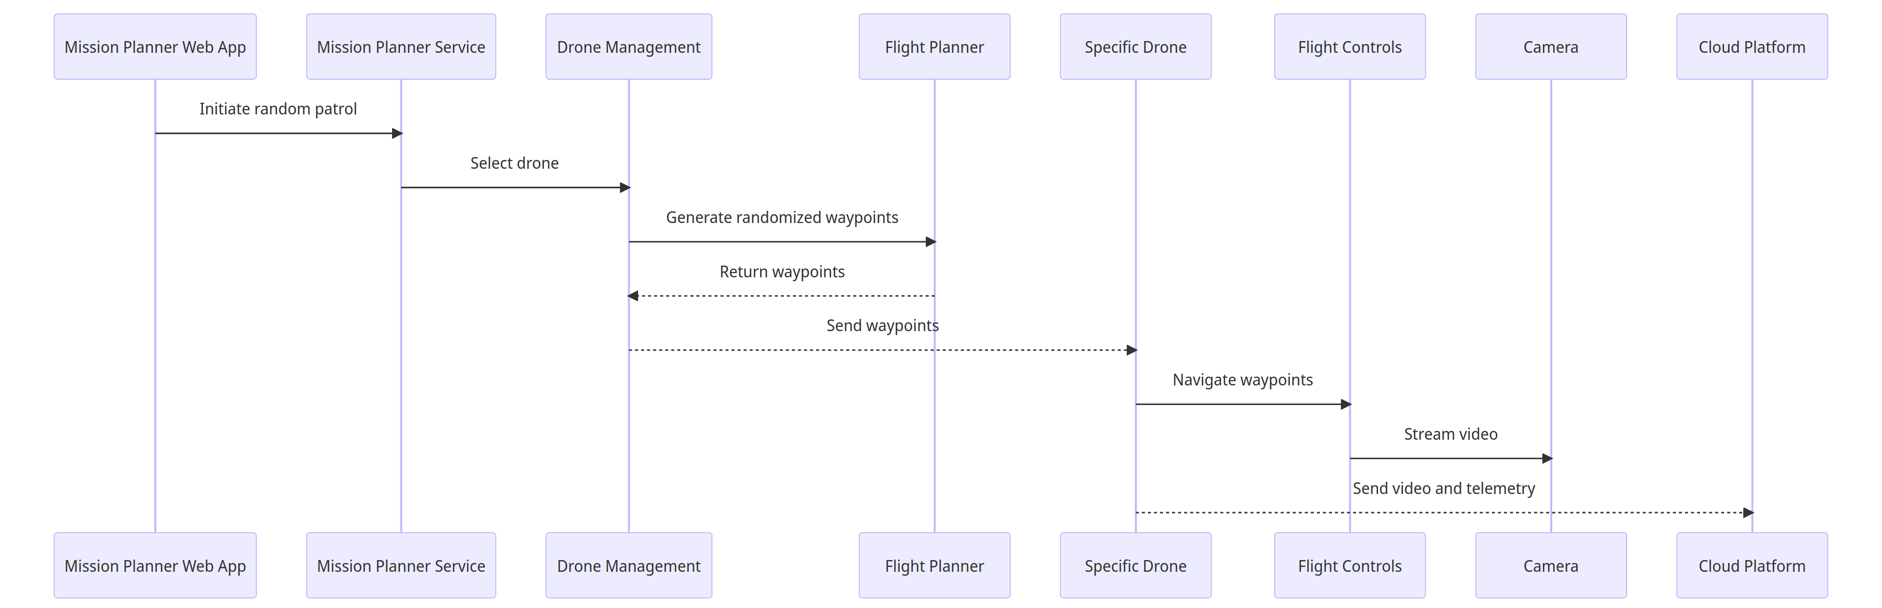
Random Patrols
Notes:
The Mission Planner web application initiates a random surveillance patrol by signaling the Mission Planner service, which selects an appropriate drone through the management system. The flight planner generates randomized waypoints for this drone to follow, returning them to the management system to be sent to the specific drone. The drone receives the waypoints and uses its flight controller to navigate the randomized path, streaming live video through its cameras back to the cloud platform. Telemetry data containing analytics for the unpredictable flight are also sent to the cloud after completing the patrol for archival and analysis of the randomized coverage. The variable nature of random patrols enables broad monitoring that complements scheduled flights.

Slide 11
Reactive missions
Continuous monitoring of drones and sensors
Leverage sensor data like motion detection
Drone retasked if sensor threshold exceeded
New waypoints based on sensor location
Drone interrupts current mission
Use Cases:
Rapid dispatch to investigate sensor alerts like gunshots
Dynamically adapt to unfolding situations by responding to shouts
Flexible rerouting from ongoing missions to crashes
Real-time surveillance by retasking drones based on alerts
Generate new waypoints to efficiently investigate emerging incidents
Notes:
Reactive missions involve continuously monitoring drone sensors to leverage data like motion detection and retask drones if a threshold is exceeded, interrupting ongoing flights. New waypoints are generated based on the sensor location triggering the alert to redirect the drone and rapidly investigate incidents like gunshots, shouts, or crashes through efficient routing. Use cases demonstrate real-time adaptive surveillance by dynamically rerouting drones mid-flight to emerging events detected by the system, enabling automated responses that flexibly adapt missions as situations unfold for rapid eyes on developing incidents.

Slide 12
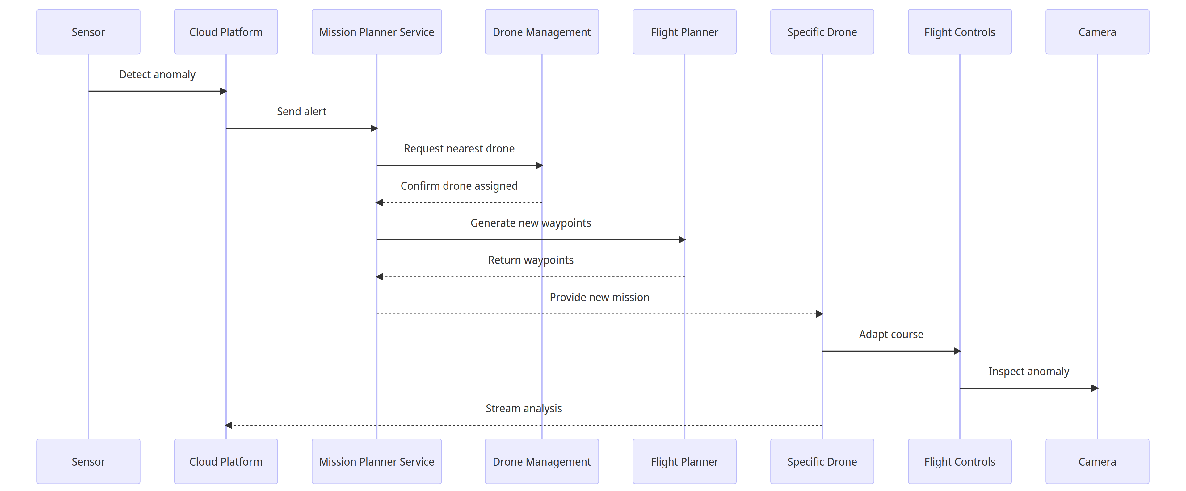
Reactive Missions
Notes:
When a sensor detects an anomaly, it sends an alert to the cloud platform, which forwards it to the Mission Planner service to initiate a reactive response. The Mission Planner requests the nearest available drone from the management system for the mission. Once a drone is assigned, the flight planner generates new waypoints based on the sensor location to route the drone to inspect the alert. These waypoints are returned to the Mission Planner and sent to the drone, which then adapts its course to fly the new route and examine the anomaly onsite. Reactive missions allow the drone fleet to dynamically respond to real-time sensor triggers by interrupting planned flights and autonomously investigating events as they unfold.

Slide 13
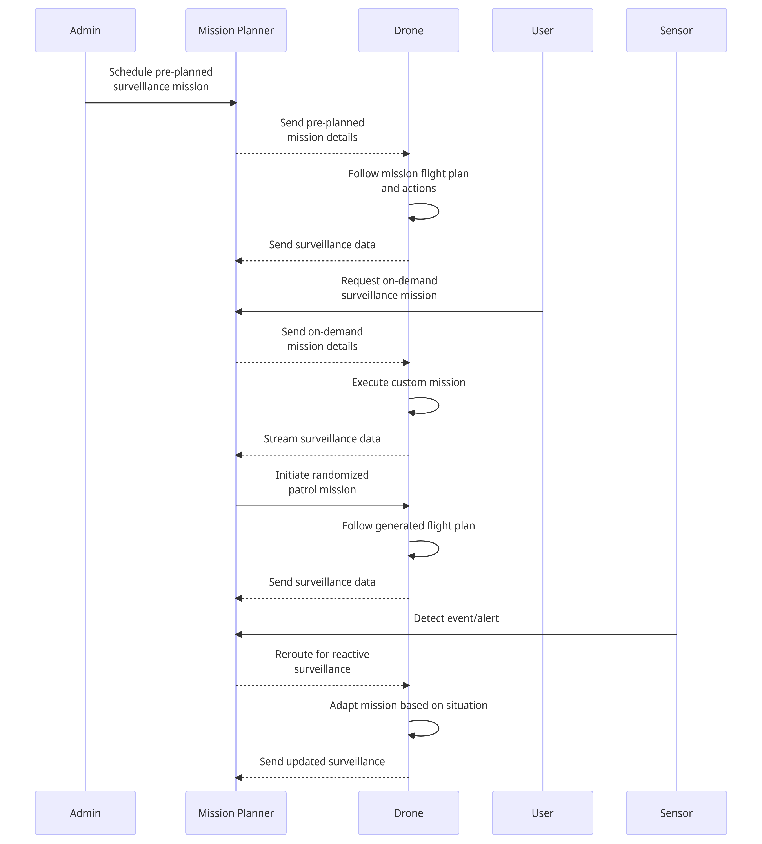
Combined Missions
Notes:
Key steps:
Admins schedule pre-planned missions
Mission planner sends details to drone
Drone executes mission and sends data
Users request on-demand missions
Mission planner generates and assigns mission
Drone executes and streams data
For random patrols, mission planner initiates
Drone follows generated plan
Sensors trigger reactive rerouting
Mission planner adapts mission
Drone adjusts and sends updates

Slide 14
Way Point Actions
Navigation Actions
Camera Actions
Hover
Orbit
Change Altitude
Change Speed
Pause
Rotate
Return to Launch
Loiter
Take Photo
Start/Stop Video
Switch Camera
Aim Camera
Scan Area
Notes:
Hover - Drone holds position at set altitude over waypoint for configured duration
Orbit - Drone circles around waypoint at specified radius and speed
Change Altitude - Drone ascends/descends to predefined altitude upon reaching waypoint
Change Speed - Adjust cruise speed to new preset at waypoint
Pause - Drone pauses at waypoint for set time before proceeding
Rotate - Drone rotates or changes heading by specified degree amount
Return to Launch - Abort mission and return to takeoff point
Loiter - Drone lingers within set radius of waypoint until directed
Take Photo - Drone snaps still image using camera at waypoint
Start/Stop Video - Initiate or conclude video recording at waypoint
Switch Camera - Change between forward, downward, IR cameras at waypoint
Aim Camera - Point camera in specified direction relative to waypoint
Scan Area - Drone scans designated area with cameras at waypoint

Slide 15
Way Point Actions
Payload Actions
Mission Control Actions
Toggle Light
Drop Object
Speak Message
Engage/Disengage Payload
Abort/Resume Mission
Proceed to Next Waypoint
Hold at Waypoint
End Mission

Slide 16
Navigation Actions
Hover - Drone holds position at set altitude over waypoint for configured duration
Orbit - Drone circles around waypoint at specified radius and speed
Change Altitude - Drone ascends/descends to predefined altitude upon reaching waypoint
Change Speed - Adjust cruise speed to new preset at waypoint
Pause - Drone pauses at waypoint for set time before proceeding
Rotate - Drone rotates or changes heading by specified degree amount
Return to Launch - Abort mission and return to takeoff point
Loiter - Drone lingers within set radius of waypoint until directed

Slide 17
Camera Actions
Take Photo - Drone snaps still image using camera at waypoint
Start/Stop Video - Initiate or conclude video recording at waypoint
Switch Camera - Change between forward, downward, IR cameras at waypoint
Aim Camera - Point camera in specified direction relative to waypoint
Scan Area - Drone scans designated area with cameras at waypoint

Slide 18
Payload Actions
Toggle Light - Turn on/off spotlight, indicator lights on drone
Drop Object - Release small carried object at designated waypoint
Speak Message - Drone broadcasts pre-recorded audio message
Engage/Disengage Payload - Activate or deactivate additional sensors

Slide 19
Mission Control Actions
Abort/Resume Mission - Stop and pause the mission immediately or continue a paused mission.
Proceed to Next Waypoint - Skip the current waypoint and move on to the next one in the flight plan.
Hold at Waypoint - Maintain the drone's position at the current waypoint indefinitely until further instruction.
End Mission - Terminate the mission and have the drone return directly to the takeoff point and land.

Slide 20
Some other ideas:
Waypoints for recharging drone batteries between missions
Alternate landing sites if the drone charging station is blocked
Contingency waypoints in case of emergencies

Slide 21
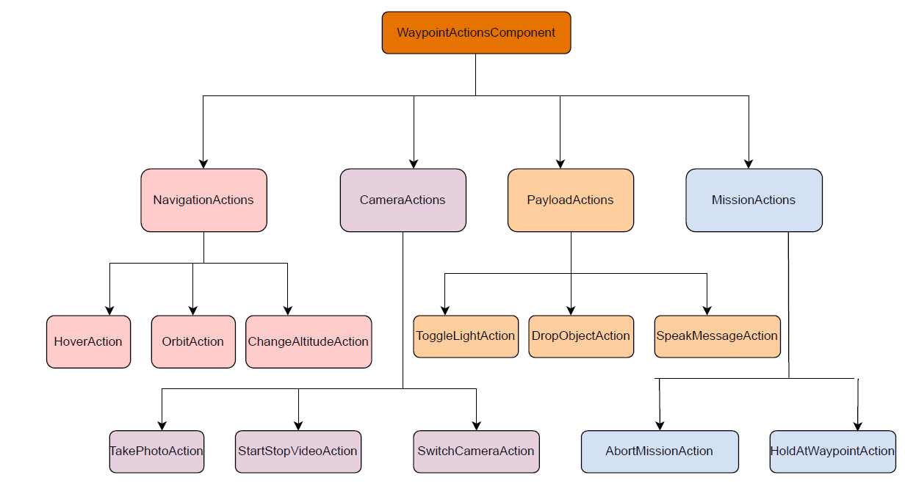
Modular Structure
Notes:
Main WaypointActionsComponent contains all action subcomponents
Each action is its own React component with internal state and methods
Navigation, Camera, Payload, Mission subgroups for organization

Slide 22
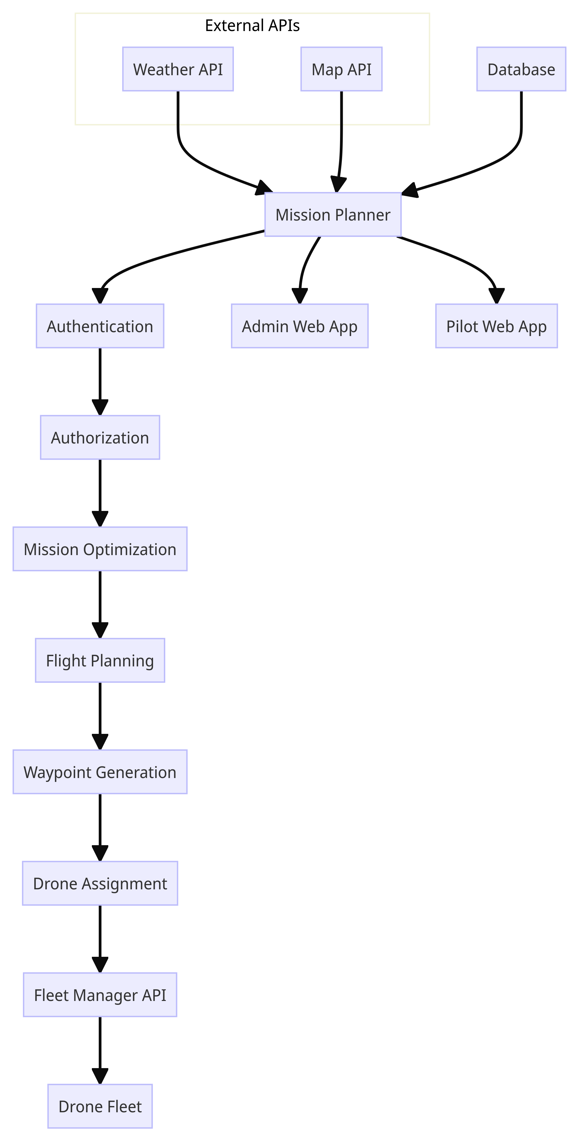
Mission Planner
Notes:
Key aspects:
Integration with external APIs for weather, maps
Authentication and authorization
Mission optimization algorithms
Automated flight planning
Waypoint generation
Integration with fleet management
Database for mission data
Interfaces for admin and pilot apps
The drone Mission Planner integrates with weather and map APIs to ingest environmental data for optimizing operations. It handles user authentication and authorization before allowing mission planning activities. Optimization algorithms generate efficient flight plans, which are converted into detailed waypoint routes for specific drone assignment. The waypoints are sent to the actual drones via integration with the fleet management system API. The Mission Planner also provides web interfaces for administrators to schedule missions and pilots to request them, persisting mission data in a connected database.

Slide 23
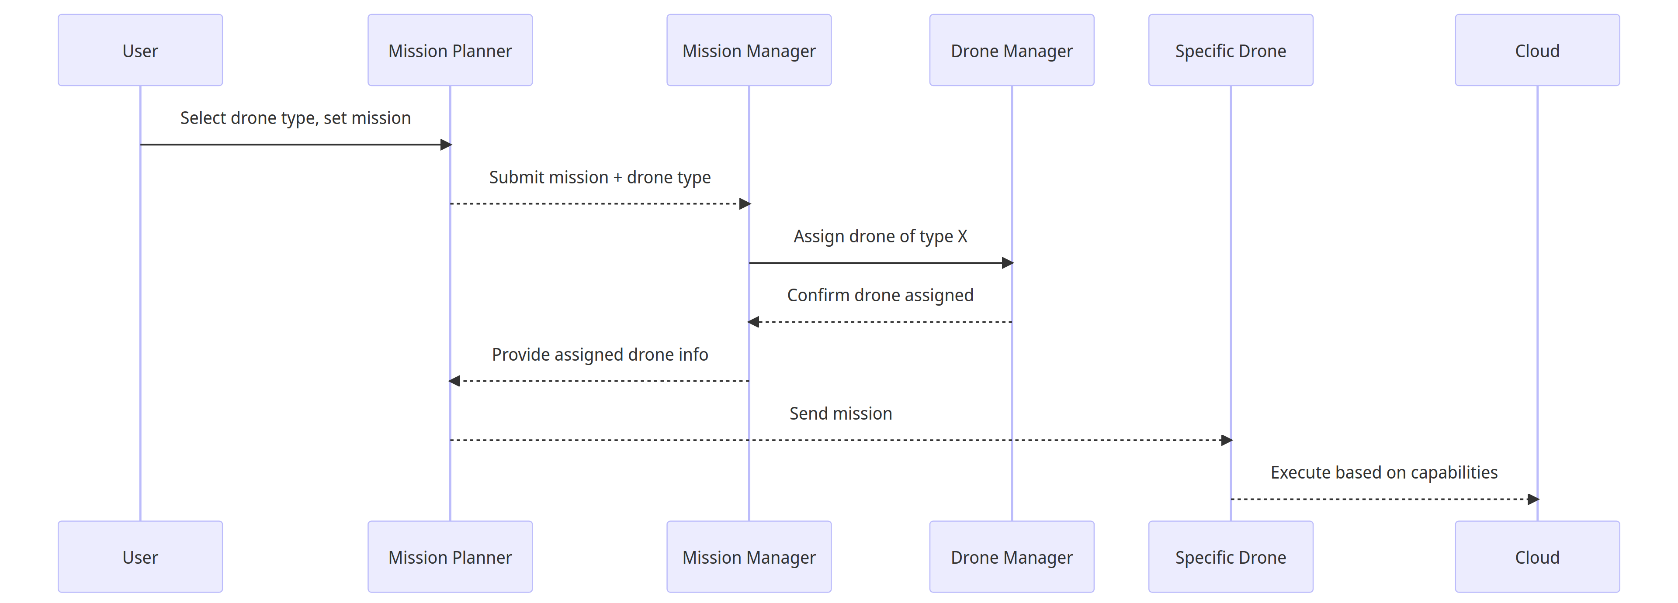
Workflow Diagram

Slide 24
Drone Types
Surveillance Drone
Mapping Drone
Agriculture Drone
Inspection Drone
Cargo Drone
Security Drone
Racing Drone
Research Drone
Photography Drone
Water Spreading Drone
Environment Monitor Drone
Traffic Monitor Drone
Emergency Response Drone
Underwater Drone
Heavy Lift Drone
Radio Tower Inspection Drone
Solar Panel Inspection Drone
Pipeline Inspection Drone
Public Safety Drone

Slide 25
Drone Type | Description | Configurations | Actions | Capabilities
Surveillance Drone | Quadcopter with cameras and object tracking | Quadcopter frame with 4 high torque motors; 1080p HD and thermal cameras; onboard chip for image processing; GPS module; obstacle avoidance sensors | Real-time video streaming; object detection and tracking; autonomous navigation and patrolling; swarming with other drones | Persistent wide area surveillance; tracking suspects/vehicles; data recording and transmission; operate in all lighting conditions
Mapping Drone | Fixed-wing for aerial mapping | Fixed wing airframe optimized for stability and endurance; 50MP RGB and LiDAR cameras; RTK GPS module; onboard data storage; autopilot | Autonomous grid flight patterns; high resolution aerial photogrammetry; 3D terrain mapping; generation of orthomosaic maps/3D models | Survey and map large areas rapidly; highly precise surveying and measurement; can map remote or difficult to access areas
Inspection Drone | Foldable hexacopter for close inspection | Foldable hexacopter frame for portability; 4K camera on 3-axis gimbal; robotic manipulator arm; onboard processor and storage | Close visual inspection of infrastructure; accessing confined spaces; surface sample collection; precision manipulation tasks | Detailed inspection of bridges, towers, flares; detect faults and anomalies; improves inspection quality and safety

Slide 26
Drone Type | Description | Configurations | Actions | Capabilities
Agriculture Drone | Rugged fixed-wing with sprayer | Fixed wing airframe; multispectral and NDVI cameras; liquid sprayer tank and nozzles; autopilot for waypoint navigation | Autonomous field survey flights; vegetation index measurement; targeted spraying of fertilizers/pesticides | Monitor crop health over large areas; early detection of irrigation needs and diseases; reduce farming costs and chemical usage
Cargo Drone | Heavy lift multicopter with cargo delivery | Multicopter with 8 or more rotors; sturdy frame and landing gear; cargo attachment system (hooks, clamps, drop system); large batteries | Vertical takeoff and landing; precision hovering and maneuvering; lowering and raising cargo with winch; autonomous cargo delivery | Lift and deliver packages up to 10kg; transport urgently needed supplies; access areas unreachable by ground
Security Drone | RTF quadcopter with siren and lights | Quadcopter frame; HD camera; spotlight and siren; colorful flashing LED lights; loudspeaker; autonomous patrolling abilities | Day/night surveillance; deter unauthorized access; broadcast verbal warnings; provide emergency illumination; alert security forces | Enhance perimeter security; prevent break-ins; disperse unruly crowds; aid search-and-rescue operations

Slide 27
Drone Type | Description | Configurations | Actions | Capabilities
Racing Drone | Agile FPV quadcopter | Lightweight quadcopter frame; high-RPM motors; FPV camera and goggles; manual and programmable autopilot | High speed maneuvering through obstacles; inverted flight and flips; autonomous laps and tricks | Test piloting skills; practice racing techniques; develop and tune agile control algorithms
Research Drone | Customizable drone platform | Custom airframe; developer SDK and APIs; swappable payload bay; onboard compute; safety features and overrides | Test experimental sensors and robotics; develop and evaluate autonomy algorithms; model drone swarm behaviors | Rapid prototyping of drone systems; test advanced drone capabilities; experiment with payload integration
Photography Drone | Foldable drone optimized for camera stability | Foldable frame for portability; 3-axis gimbal; 1-inch CMOS camera; active vibration damping; automatic subject tracking | Steady hover filming; dynamic cinematic movements; tracking moving subjects; HDR and panoramic image capture | Film Hollywood-quality aerial footage; immersive perspectives for sports/events; inspections not possible traditionally

Slide 28
Drone Type | Description | Configurations | Actions | Capabilities
Water Spreading Drone | Fixed wing VTOL drone with water tank and sprayers | Fixed wing VTOL airframe; large water tank; spray nozzles; water level sensors; autopilot | Precision water dispersal over fires; even distribution for irrigation | Carry and spray hundreds of liters of water; access rough terrain; quick firefighting response
Environmental Monitor Drone | Rugged quadcopter with air quality sensors | Rugged waterproof frame; air quality sensors; water sampling equipment; data transmission | Autonomous air sampling routines; remote water sampling; data logging | Monitor pollution levels across cities; analyze microclimates;
Traffic Monitor Drone | Quadcopter with cameras for traffic analysis | Quadcopter frame; HD cameras; computer vision processors; traffic analysis software | Persistent monitoring of traffic intersections; vehicle detection and tracking | Monitor congestion and incidents; analyze vehicle/pedestrian patterns; traffic enforcement

Slide 29
Drone Type | Description | Configurations | Actions | Capabilities
Emergency Response Drone | VTOL drone for search and rescue operations | VTOL hybrid airframe for vertical takeoff; IR camera; loudspeaker; drop bays for supplies; 45min flight time | Aerial search and detection of survivors; two-way vocal communication; emergency package delivery | Find lost or injured people; provide instructions and aid; reach areas ground vehicles cannot access
Underwater Drone | ROV designed for underwater inspections and mapping | Waterproof hull; underwater motors and thrusters; HD cameras and lights; depth sensor; obstacle avoidance sonar | Autonomous navigation and mapping; visual inspection of subsea structures | Safely inspect dams, piers, offshore platforms; create 3D reconstructions of underwater areas
Heavy Lift Drone | Large octocopter capable of lifting heavy objects | Reinforced rigid frame with 8 rotors; 150kg lift capacity; cargo hooks and nets; dual operator control | Vertical heavy load transport and placement; construction material delivery; disaster debris removal | Lift objects and vehicles up to 150kg; access congested or restricted sites

Slide 30
Drone Type | Description | Configurations | Actions | Capabilities
Radio Tower Inspection Drone | VTOL drone optimized for inspecting radio/cell towers | VTOL hybrid; high zoom camera; LIDAR; extended range; 35min flight; rugged frame | Autonomous inspection of towers; minimize tower climbs; HD photo/video; mapping | Improve safety over manual inspection; frequent and thorough surveys; remote sites
Solar Panel Inspection Drone | Lightweight drone for inspecting solar farms | Lightweight frame; high-res camera; thermal imaging; 35min flight time | Autonomous panel inspection; identify faults, debris, wear | Thoroughly cover large solar installations; improve panels' output
Pipeline Inspection Drone | Fixed wing VTOL drone optimized for long-range pipeline inspection | VTOL hybrid airframe, high-zoom visual camera, LiDAR, 35min flight time, GPS waypoint navigation | Autonomous pipeline inspection flights, anomaly detection, mapping | Cover hundreds of miles of pipelines, identify leaks/damage, improve inspection efficiency; Oil, gas, and water pipeline inspection, reducing risk and improving coverage over manual methods
Public Safety Drone | Rugged weatherproof quadcopter equipped with policing features | Durable airframe, FPV camera, spotlight, loudspeaker, tear gas/pepper spray payload | Pursue suspects, conduct patrols, broadcast announcements, deploy non-lethal deterrents | Tracking fleeing suspects, crowd control, search operations, hostage situations, Supporting law enforcement in dangerous situations, improving incident response

Slide 31
Drone -Products
DJI Zenmuse XT2: A thermal imaging camera integrated with a DJI drone for enhanced aerial thermal inspections.
FLIR Vue Pro R: A rugged, high-performance thermal imaging camera commonly used in professional drone applications.
Parrot Anafi USA: A versatile and compact drone designed for surveillance and reconnaissance missions.
Skydio 2: Known for its advanced autonomous flight capabilities, it excels in obstacle avoidance and tracking.
DJI Mavic 2 Enterprise: Equipped with accessories like lights and speakers, it's tailored for commercial and industrial applications.
Yuneec Typhoon H Pro: A hexacopter with a focus on stability and professional-grade aerial photography.
Autel Evo II: A foldable drone with impressive flight time and camera options, suitable for various industries.
DJI Matrice 300 RTK: Designed for heavy-duty tasks, it supports multiple payloads and has advanced flight control features.
Wingtra One: A fixed-wing VTOL drone optimized for mapping and surveying applications.
Alrobotics Optimus: Known for its robust build and adaptability to various payload configurations.
DJI Phantom 4 RTK: Integrates real-time kinematic (RTK) technology for precise mapping and surveying.

Slide 32
Key Observations:
The DJI Matrice 300 RTK has the most comprehensive capabilities, covering almost all sub-services except orthomosaic mapping. It is the most versatile for cross-functional use.
The Wingtra One specializes in mapping capabilities like 3D modeling, orthomosaic, and photogrammetry. Lacks most other sub-services.
The DJI Zenmuse XT2, Parrot Anafi USA, Skydio 2, and Yuneec Typhoon H Pro are mid-range models balancing surveillance and inspection capabilities.
The Autel Evo II adds agriculture services like crop assessment and spraying to the mid-range feature set.
The FLIR Vue Pro R and Alrobotics Optimus specialize more in environmental monitoring services.
The DJI Phantom 4 RTK aligns mostly with agriculture use cases.
For public safety, the Matrice 300, Skydio 2, and Autel Evo II likely have the most relevant capabilities.

Slide 33
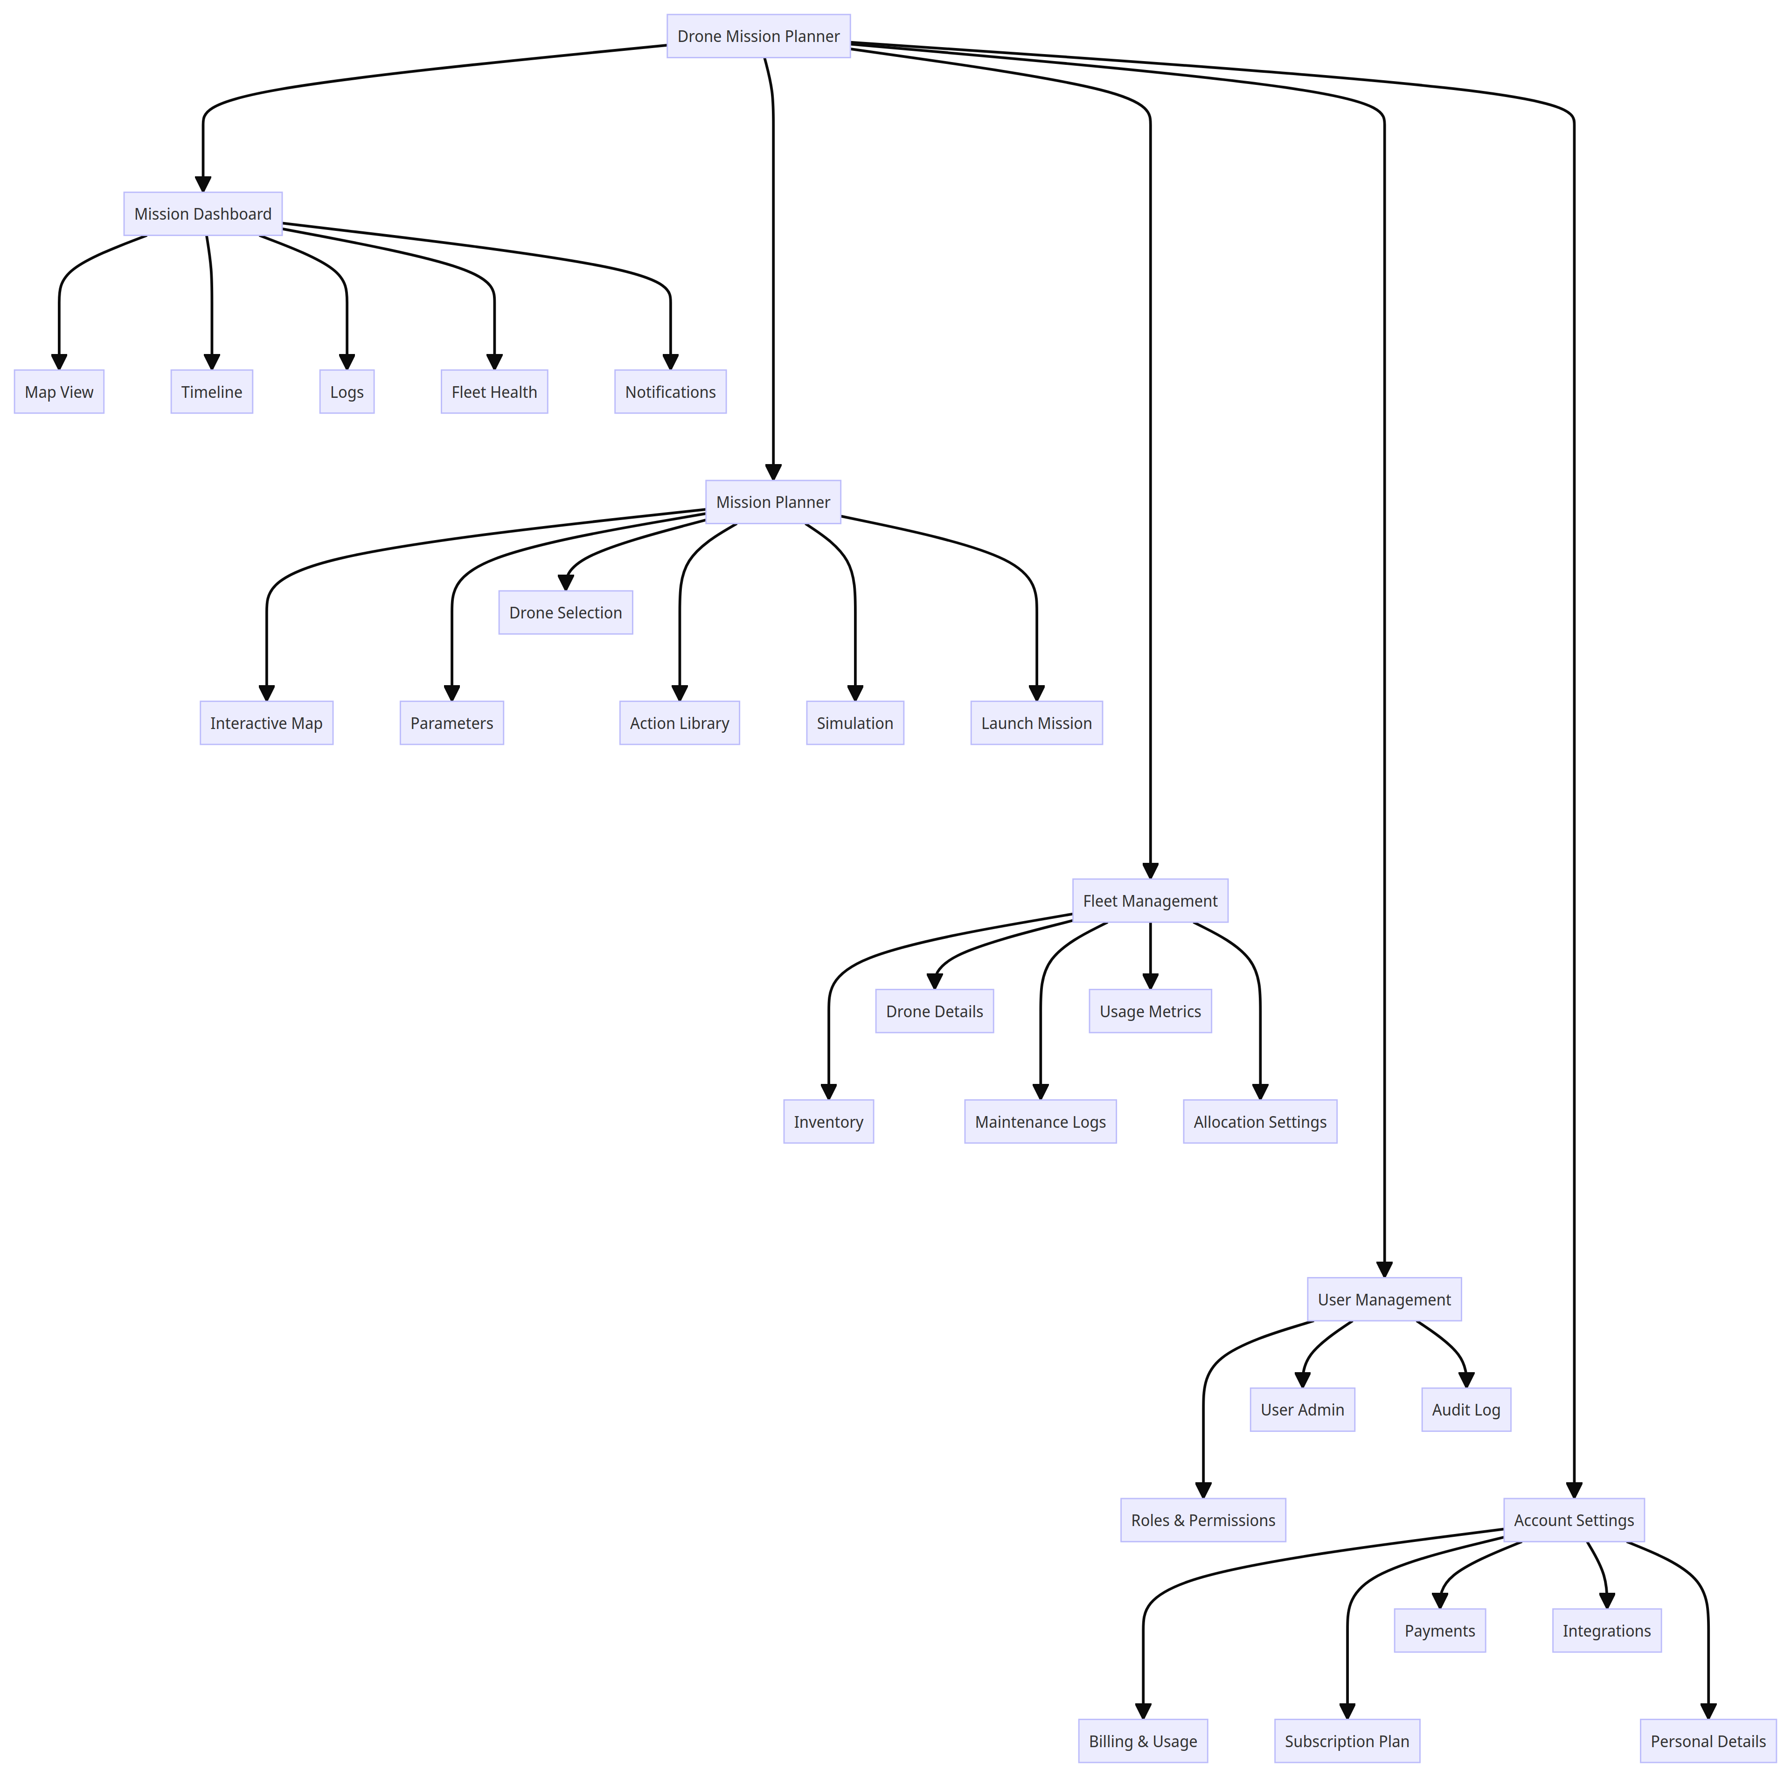
High Level UI Design

Slide 34
