Slide 1
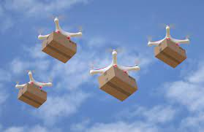
Service Oriented Mission Planner

Slide 2
Mission Planner
The mission planner is a key software component that allows users to set up and schedule drone surveillance missions.
Web application that provides an interface for admin users to create and manage missions.
Integrates with map data to allow users to visually set waypoints and define areas.
Notes:
Allows setting of all parameters for a mission - waypoints, actions, camera settings, etc.
Optimizes waypoint routes for efficiency - considers things like battery life, wind patterns, no-fly zones.
Allows setting timing and recurrence for missions - one time, recurring daily/weekly etc.
Interfaces with fleet management system to select which drone(s) will be assigned to a mission.
Sends final mission plans and waypoints to drones wirelessly.
Tracks mission status in real-time as drones execute flights.
Stores mission history data for reporting and analytics.
Allows dynamic re-tasking or pausing of in-progress missions.
APIs allow integrating with other systems like campus security software.

Slide 3
Overview
The system will consist of a fleet of drones with cameras that can fly pre-planned missions or be dynamically tasked.
The drones will stream video and telemetry data to the cloud.
Users can access and monitor the video feeds and data through a web application.
The mission planner will allow users to create and schedule surveillance missions.

Slide 4
Drone Missions
Pre-planned missions
On-demand missions
Pre-defined missions
Reactive missions

Slide 5
Pre-planned missions
Admin scheduled recurring flights over key areas
Optimized flight plans for efficiency
Provides regular oversight for proactive monitoring
Use cases
Daily flyovers of parking lots to deter break-ins
Weekly quad monitoring to track gathering sizes
Nightly scans of buildings for security breaches
Recurring perimeter sweeps for suspicious activity
Monitor pathways during peak foot traffic
Weekend housing patrols for noise complaints
Notes:
Pre-planned drone missions allow for scheduled, recurring flights over key campus areas and buildings to enable regular proactive monitoring.
The flight plans are optimized for efficiency in route and energy use. Benefits include deterring crime through consistent presence, identifying issues early before escalation, efficient use of drone resources, and building knowledge of normal activity patterns. Specific use cases could include daily monitoring of parking lots, weekly quad surveillance, and nightly building scans to maintain security.
Pre-planned missions allow flexible flight scheduling that minimizes drone energy use and expenditures.

Slide 6
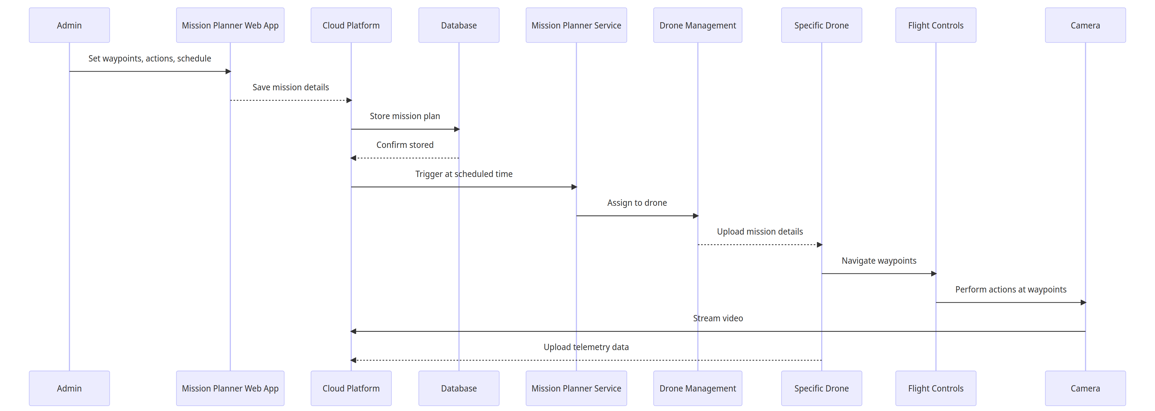
Pre - Planned Mission
Notes:
The administrator schedules a future surveillance mission in the Mission Planner web application by setting waypoints, drone actions, and timing. These details are saved to the cloud platform, which stores the mission plan in a database for later activation. At the scheduled time, the Mission Planner service triggers the plan, assigns it to a drone through the management system, and uploads the mission specifications. The drone then autonomously follows the planned waypoints using its flight controller, performs surveillance actions with its cameras, streams video feeds, and uploads telemetry data to the cloud. After completion, the drone returns safely to base and the cloud archives the mission data for potential future analysis.

Slide 7
On-demand missions
Users can dynamically task drones via web app
Specify area on map to surveil
Mission planner generates waypoints
Set camera settings and actions
Use cases:
View large student gatherings
Inspect reported vandalism
Check buildings during breaks
Survey campus prior to events
Monitor protests or demonstrations
Respond to restricted access reports
Search for missing persons
Notes:
On-demand missions allow users to dynamically task drones to investigate situations as they arise. Users specify an area of interest on a map in the web application and the mission planner generates optimal waypoints for drone routing. Camera settings and other actions can also be configured by the user prior to launch. These customizable, adaptable missions enable rapid response surveillance of developing events, specific targets of opportunity, or other ad hoc concerns that require focused drone oversight. Example use cases include monitoring protests, surveying event venues, inspecting vandalism, and searching for missing persons on campus.

Slide 8
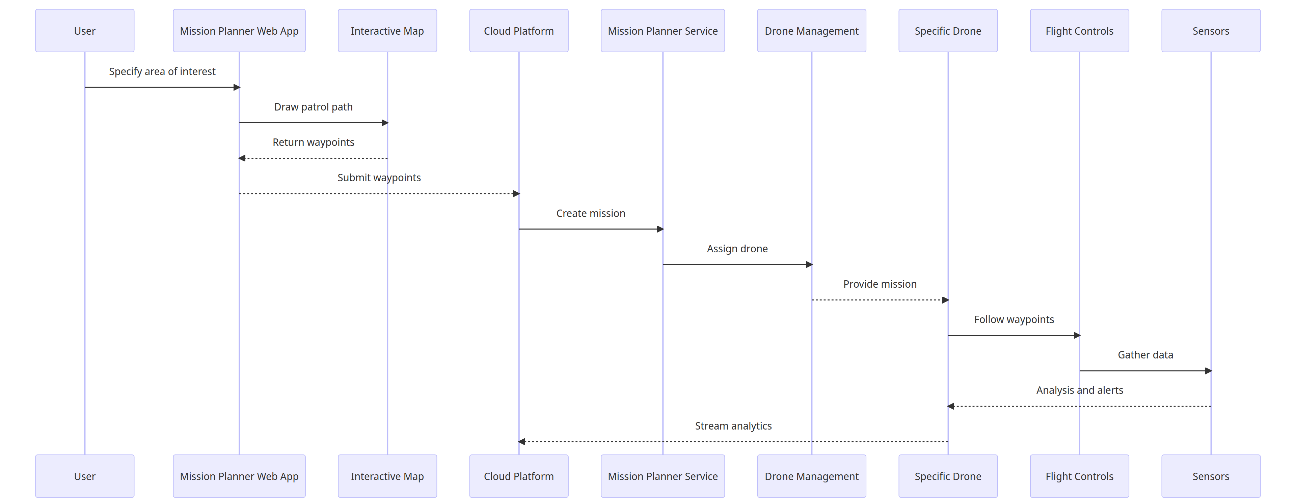
On Demand Missions
Notes:
The user specifies an area of interest for surveillance in the Mission Planner web application, which interacts with a map interface to generate an optimal drone patrol path and waypoints. These customized waypoints are submitted to the cloud platform, which creates a mission and assigns it to a drone through the management system. The specific drone receives the on-demand mission details, then autonomously follows the generated waypoints using its flight controller and leverages sensors to gather aerial data. Analysis of the streaming sensor feeds produces alerts for any anomalies detected during the flight. Once complete, the drone sends the full analytics package from the mission back to the cloud platform for storage and potential future review.

Slide 9
Pre-defined Missions
Patrols with randomized waypoints
Vary flight paths, avoid repetitive routes
Parameters set for area, duration, speed
Mission planner optimizes route and settings
Use Cases:
Irregular surveillance of recreational spaces
Randomized parking area oversight
Varying quad and open space flights
Frequent dorm patrols at irregular times
Notes:
Random patrol missions generate unpredictable drone routes by varying waypoints and flight paths to avoid repetitive routines. The mission planner optimizes randomized route parameters like area, duration and speed for efficient surveillance. The unpredictable coverage identifies incidents pattern analysis may miss and cost-effectively monitors large areas over time. Example use cases include irregular oversight of recreational spaces, parking lots, quads and unpredictable dorm patrols.

Slide 10
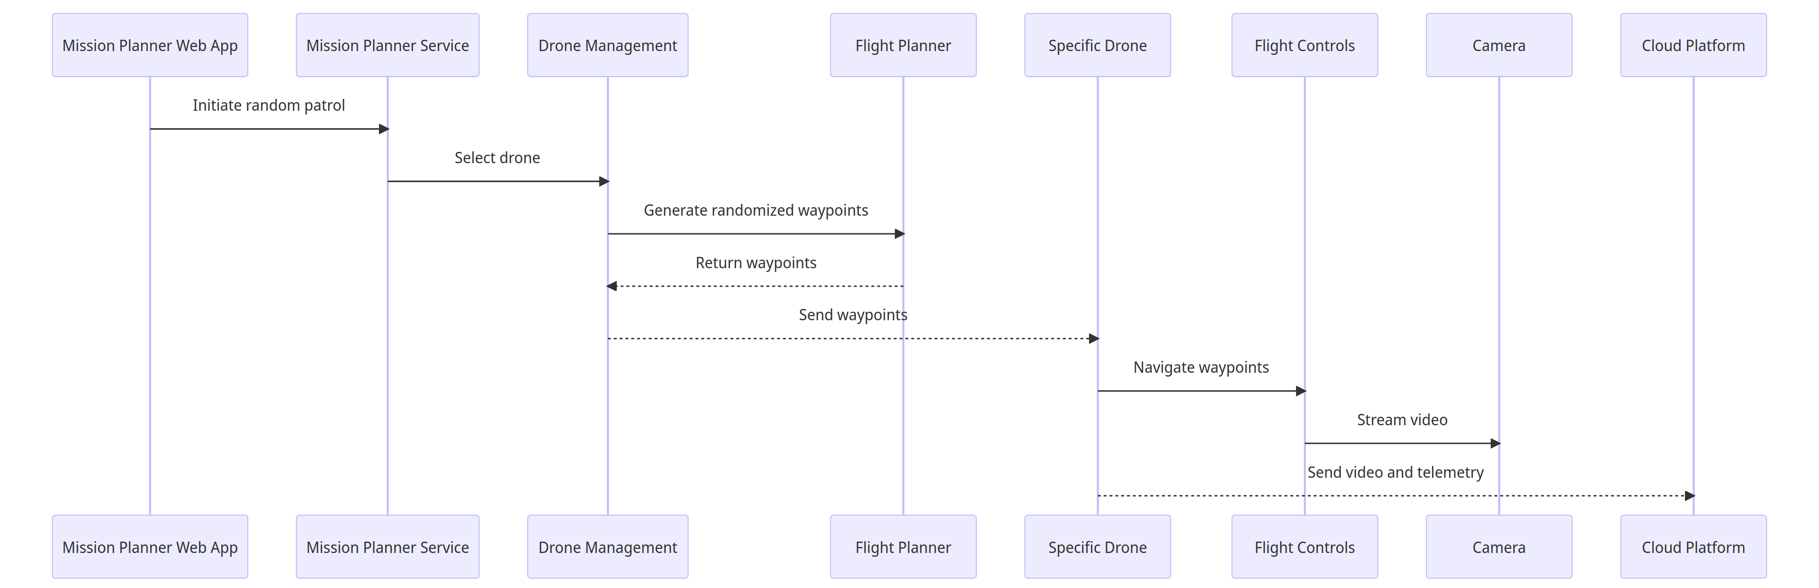
Random Patrols
Notes:
The Mission Planner web application initiates a random surveillance patrol by signaling the Mission Planner service, which selects an appropriate drone through the management system. The flight planner generates randomized waypoints for this drone to follow, returning them to the management system to be sent to the specific drone. The drone receives the waypoints and uses its flight controller to navigate the randomized path, streaming live video through its cameras back to the cloud platform. Telemetry data containing analytics for the unpredictable flight are also sent to the cloud after completing the patrol for archival and analysis of the randomized coverage. The variable nature of random patrols enables broad monitoring that complements scheduled flights.

Slide 11
Reactive missions
Continuous monitoring of drones and sensors
Leverage sensor data like motion detection
Drone retasked if sensor threshold exceeded
New waypoints based on sensor location
Drone interrupts current mission
Use Cases:
Rapid dispatch to investigate sensor alerts like gunshots
Dynamically adapt to unfolding situations by responding to shouts
Flexible rerouting from ongoing missions to crashes
Real-time surveillance by retasking drones based on alerts
Generate new waypoints to efficiently investigate emerging incidents
Notes:
Reactive missions involve continuously monitoring drone sensors to leverage data like motion detection and retask drones if a threshold is exceeded, interrupting ongoing flights. New waypoints are generated based on the sensor location triggering the alert to redirect the drone and rapidly investigate incidents like gunshots, shouts, or crashes through efficient routing. Use cases demonstrate real-time adaptive surveillance by dynamically rerouting drones mid-flight to emerging events detected by the system, enabling automated responses that flexibly adapt missions as situations unfold for rapid eyes on developing incidents.

Slide 12
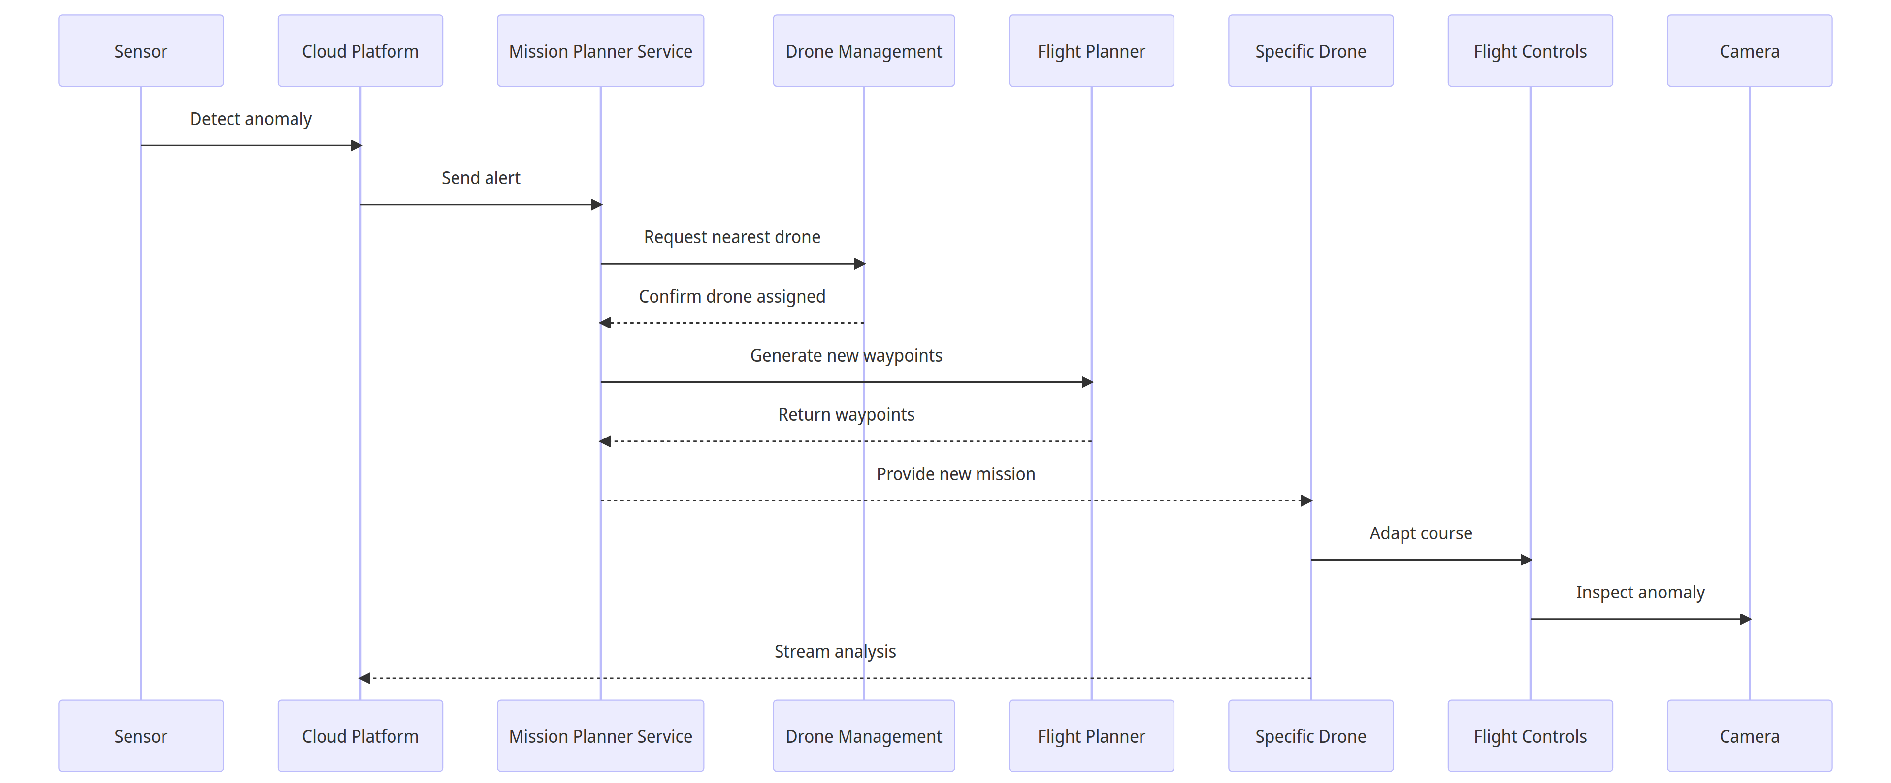
Reactive Missions
Notes:
When a sensor detects an anomaly, it sends an alert to the cloud platform, which forwards it to the Mission Planner service to initiate a reactive response. The Mission Planner requests the nearest available drone from the management system for the mission. Once a drone is assigned, the flight planner generates new waypoints based on the sensor location to route the drone to inspect the alert. These waypoints are returned to the Mission Planner and sent to the drone, which then adapts its course to fly the new route and examine the anomaly onsite. Reactive missions allow the drone fleet to dynamically respond to real-time sensor triggers by interrupting planned flights and autonomously investigating events as they unfold.

Slide 13
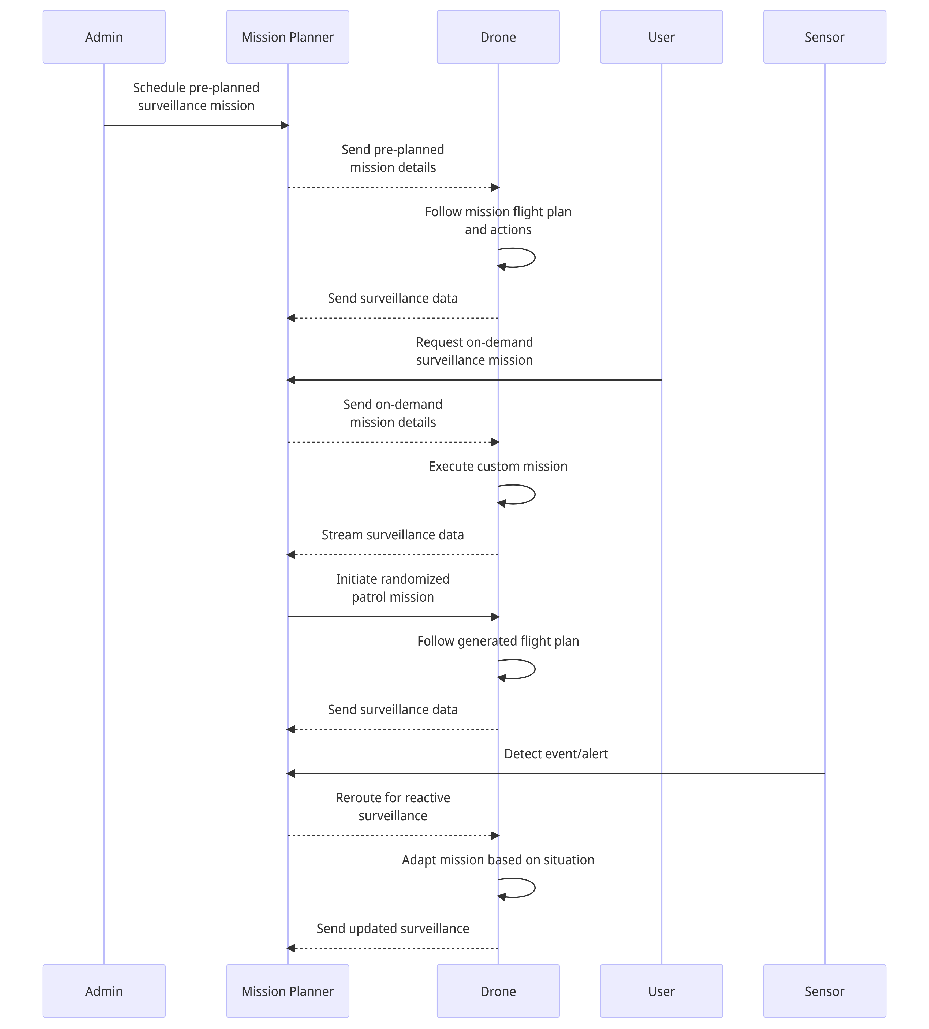
Combined Missions
Notes:
Key steps:
Admins schedule pre-planned missions
Mission planner sends details to drone
Drone executes mission and sends data
Users request on-demand missions
Mission planner generates and assigns mission
Drone executes and streams data
For random patrols, mission planner initiates
Drone follows generated plan
Sensors trigger reactive rerouting
Mission planner adapts mission
Drone adjusts and sends updates

Slide 14
Way Point Actions
Navigation Actions
Camera Actions
Hover
Orbit
Change Altitude
Change Speed
Pause
Rotate
Return to Launch
Loiter
Take Photo
Start/Stop Video
Switch Camera
Aim Camera
Scan Area
Notes:
Hover - Drone holds position at set altitude over waypoint for configured duration
Orbit - Drone circles around waypoint at specified radius and speed
Change Altitude - Drone ascends/descends to predefined altitude upon reaching waypoint
Change Speed - Adjust cruise speed to new preset at waypoint
Pause - Drone pauses at waypoint for set time before proceeding
Rotate - Drone rotates or changes heading by specified degree amount
Return to Launch - Abort mission and return to takeoff point
Loiter - Drone lingers within set radius of waypoint until directed
Take Photo - Drone snaps still image using camera at waypoint
Start/Stop Video - Initiate or conclude video recording at waypoint
Switch Camera - Change between forward, downward, IR cameras at waypoint
Aim Camera - Point camera in specified direction relative to waypoint
Scan Area - Drone scans designated area with cameras at waypoint

Slide 15
Way Point Actions
Payload Actions
Mission Control Actions
Toggle Light
Drop Object
Speak Message
Engage/Disengage Payload
Abort/Resume Mission
Proceed to Next Waypoint
Hold at Waypoint
End Mission

Slide 16
Navigation Actions
Hover - Drone holds position at set altitude over waypoint for configured duration
Orbit - Drone circles around waypoint at specified radius and speed
Change Altitude - Drone ascends/descends to predefined altitude upon reaching waypoint
Change Speed - Adjust cruise speed to new preset at waypoint
Pause - Drone pauses at waypoint for set time before proceeding
Rotate - Drone rotates or changes heading by specified degree amount
Return to Launch - Abort mission and return to takeoff point
Loiter - Drone lingers within set radius of waypoint until directed

Slide 17
Camera Actions
Take Photo - Drone snaps still image using camera at waypoint
Start/Stop Video - Initiate or conclude video recording at waypoint
Switch Camera - Change between forward, downward, IR cameras at waypoint
Aim Camera - Point camera in specified direction relative to waypoint
Scan Area - Drone scans designated area with cameras at waypoint

Slide 18
Payload Actions
Toggle Light - Turn on/off spotlight, indicator lights on drone
Drop Object - Release small carried object at designated waypoint
Speak Message - Drone broadcasts pre-recorded audio message
Engage/Disengage Payload - Activate or deactivate additional sensors

Slide 19
Mission Control Actions
Abort/Resume Mission - Stop and pause the mission immediately or continue a paused mission.
Proceed to Next Waypoint - Skip the current waypoint and move on to the next one in the flight plan.
Hold at Waypoint - Maintain the drone's position at the current waypoint indefinitely until further instruction.
End Mission - Terminate the mission and have the drone return directly to the takeoff point and land.

Slide 20
Some other ideas:
Waypoints for recharging drone batteries between missions
Alternate landing sites if the drone charging station is blocked
Contingency waypoints in case of emergencies

Slide 21
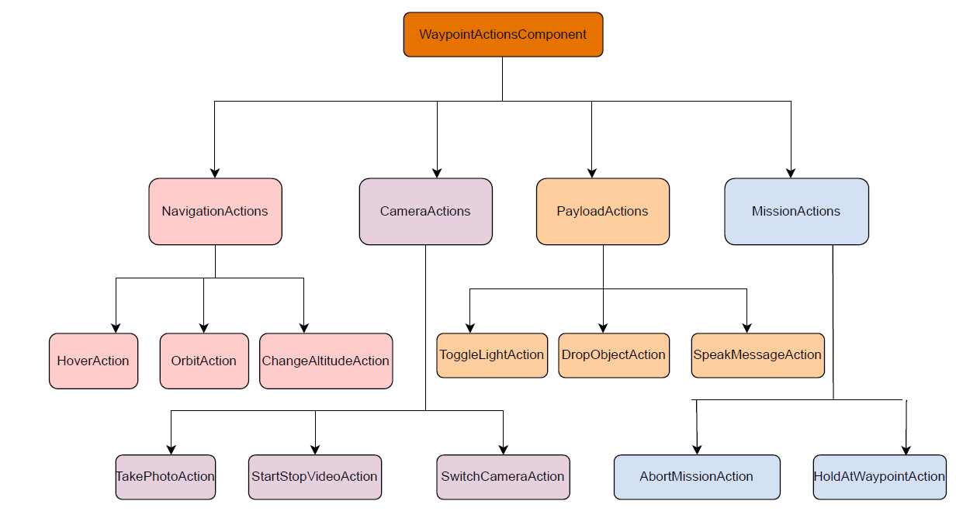
Modular Structure
Notes:
Main WaypointActionsComponent contains all action subcomponents
Each action is its own React component with internal state and methods
Navigation, Camera, Payload, Mission subgroups for organization

Slide 22
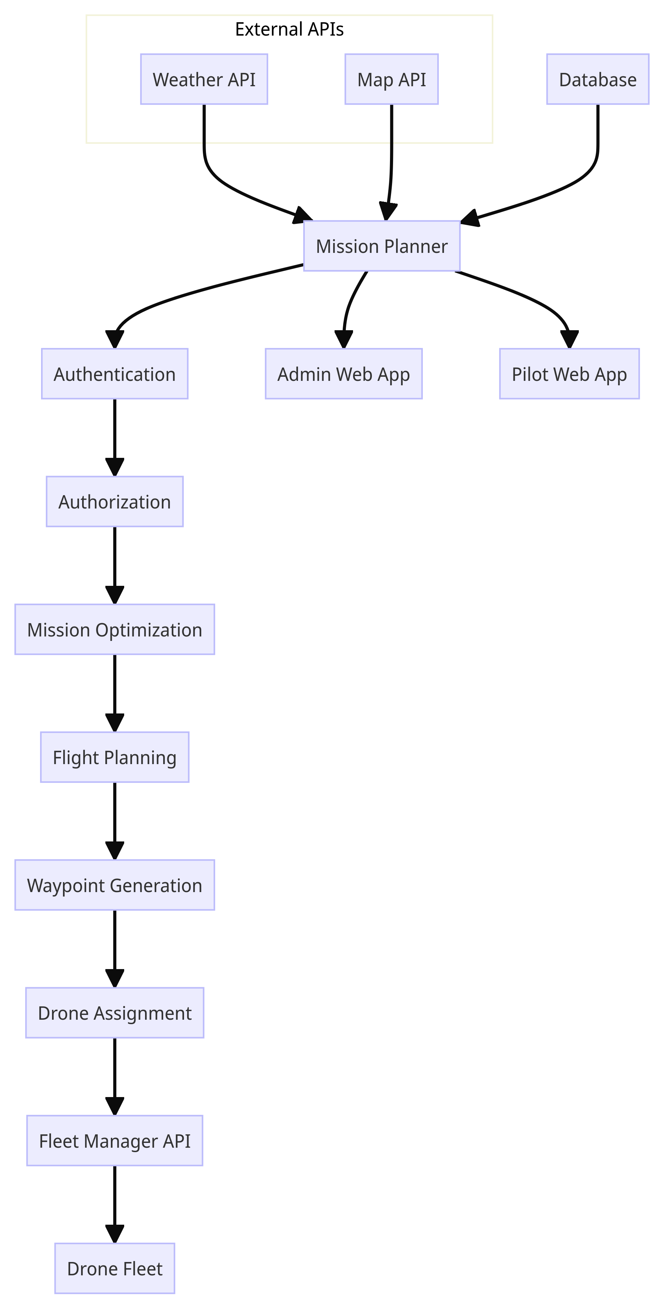
Mission Planner
Notes:
Key aspects:
Integration with external APIs for weather, maps
Authentication and authorization
Mission optimization algorithms
Automated flight planning
Waypoint generation
Integration with fleet management
Database for mission data
Interfaces for admin and pilot apps
The drone Mission Planner integrates with weather and map APIs to ingest environmental data for optimizing operations. It handles user authentication and authorization before allowing mission planning activities. Optimization algorithms generate efficient flight plans, which are converted into detailed waypoint routes for specific drone assignment. The waypoints are sent to the actual drones via integration with the fleet management system API. The Mission Planner also provides web interfaces for administrators to schedule missions and pilots to request them, persisting mission data in a connected database.

Slide 23
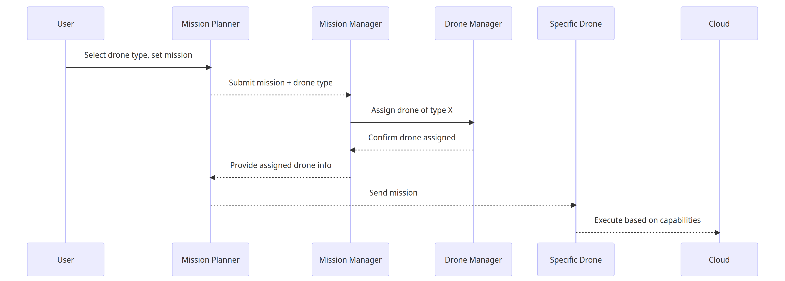
Workflow Diagram

Slide 24
Drone Types
Surveillance Drone
Mapping Drone
Agriculture Drone
Inspection Drone
Cargo Drone
Security Drone
Racing Drone
Research Drone
Photography Drone
Water Spreading Drone
Environment Monitor Drone
Traffic Monitor Drone
Emergency Response Drone
Underwater Drone
Heavy Lift Drone
Radio Tower Inspection Drone
Solar Panel Inspection Drone
Pipeline Inspection Drone
Public Safety Drone

Slide 25
Drone Type | Description | Configurations | Actions | Capabilities
Surveillance Drone | Quadcopter with cameras and object tracking | Quadcopter frame with 4 high torque motors; 1080p HD and thermal cameras; onboard chip for image processing; GPS module; obstacle avoidance sensors | Real-time video streaming; object detection and tracking; autonomous navigation and patrolling; swarming with other drones | Persistent wide area surveillance; tracking suspects/vehicles; data recording and transmission; operate in all lighting conditions
Mapping Drone | Fixed-wing for aerial mapping | Fixed wing airframe optimized for stability and endurance; 50MP RGB and LiDAR cameras; RTK GPS module; onboard data storage; autopilot | Autonomous grid flight patterns; high resolution aerial photogrammetry; 3D terrain mapping; generation of orthomosaic maps/3D models | Survey and map large areas rapidly; highly precise surveying and measurement; can map remote or difficult to access areas
Inspection Drone | Foldable hexacopter for close inspection | Foldable hexacopter frame for portability; 4K camera on 3-axis gimbal; robotic manipulator arm; onboard processor and storage | Close visual inspection of infrastructure; accessing confined spaces; surface sample collection; precision manipulation tasks | Detailed inspection of bridges, towers, flares; detect faults and anomalies; improves inspection quality and safety

Slide 26
Drone Type | Description | Configurations | Actions | Capabilities
Agriculture Drone | Rugged fixed-wing with sprayer | Fixed wing airframe; multispectral and NDVI cameras; liquid sprayer tank and nozzles; autopilot for waypoint navigation | Autonomous field survey flights; vegetation index measurement; targeted spraying of fertilizers/pesticides | Monitor crop health over large areas; early detection of irrigation needs and diseases; reduce farming costs and chemical usage
Cargo Drone | Heavy lift multicopter with cargo delivery | Multicopter with 8 or more rotors; sturdy frame and landing gear; cargo attachment system (hooks, clamps, drop system); large batteries | Vertical takeoff and landing; precision hovering and maneuvering; lowering and raising cargo with winch; autonomous cargo delivery | Lift and deliver packages up to 10kg; transport urgently needed supplies; access areas unreachable by ground
Security Drone | RTF quadcopter with siren and lights | Quadcopter frame; HD camera; spotlight and siren; colorful flashing LED lights; loudspeaker; autonomous patrolling abilities | Day/night surveillance; deter unauthorized access; broadcast verbal warnings; provide emergency illumination; alert security forces | Enhance perimeter security; prevent break-ins; disperse unruly crowds; aid search-and-rescue operations

Slide 27
Drone Type | Description | Configurations | Actions | Capabilities
Racing Drone | Agile FPV quadcopter | Lightweight quadcopter frame; high-RPM motors; FPV camera and goggles; manual and programmable autopilot | High speed maneuvering through obstacles; inverted flight and flips; autonomous laps and tricks | Test piloting skills; practice racing techniques; develop and tune agile control algorithms
Research Drone | Customizable drone platform | Custom airframe; developer SDK and APIs; swappable payload bay; onboard compute; safety features and overrides | Test experimental sensors and robotics; develop and evaluate autonomy algorithms; model drone swarm behaviors | Rapid prototyping of drone systems; test advanced drone capabilities; experiment with payload integration
Photography Drone | Foldable drone optimized for camera stability | Foldable frame for portability; 3-axis gimbal; 1-inch CMOS camera; active vibration damping; automatic subject tracking | Steady hover filming; dynamic cinematic movements; tracking moving subjects; HDR and panoramic image capture | Film Hollywood-quality aerial footage; immersive perspectives for sports/events; inspections not possible traditionally

Slide 28
Drone Type | Description | Configurations | Actions | Capabilities
Water Spreading Drone | Fixed wing VTOL drone with water tank and sprayers | Fixed wing VTOL airframe; large water tank; spray nozzles; water level sensors; autopilot | Precision water dispersal over fires; even distribution for irrigation | Carry and spray hundreds of liters of water; access rough terrain; quick firefighting response
Environmental Monitor Drone | Rugged quadcopter with air quality sensors | Rugged waterproof frame; air quality sensors; water sampling equipment; data transmission | Autonomous air sampling routines; remote water sampling; data logging | Monitor pollution levels across cities; analyze microclimates;
Traffic Monitor Drone | Quadcopter with cameras for traffic analysis | Quadcopter frame; HD cameras; computer vision processors; traffic analysis software | Persistent monitoring of traffic intersections; vehicle detection and tracking | Monitor congestion and incidents; analyze vehicle/pedestrian patterns; traffic enforcement

Slide 29
Drone Type | Description | Configurations | Actions | Capabilities
Emergency Response Drone | VTOL drone for search and rescue operations | VTOL hybrid airframe for vertical takeoff; IR camera; loudspeaker; drop bays for supplies; 45min flight time | Aerial search and detection of survivors; two-way vocal communication; emergency package delivery | Find lost or injured people; provide instructions and aid; reach areas ground vehicles cannot access
Underwater Drone | ROV designed for underwater inspections and mapping | Waterproof hull; underwater motors and thrusters; HD cameras and lights; depth sensor; obstacle avoidance sonar | Autonomous navigation and mapping; visual inspection of subsea structures | Safely inspect dams, piers, offshore platforms; create 3D reconstructions of underwater areas
Heavy Lift Drone | Large octocopter capable of lifting heavy objects | Reinforced rigid frame with 8 rotors; 150kg lift capacity; cargo hooks and nets; dual operator control | Vertical heavy load transport and placement; construction material delivery; disaster debris removal | Lift objects and vehicles up to 150kg; access congested or restricted sites

Slide 30
Drone Type | Description | Configurations | Actions | Capabilities
Radio Tower Inspection Drone | VTOL drone optimized for inspecting radio/cell towers | VTOL hybrid; high zoom camera; LIDAR; extended range; 35min flight; rugged frame | Autonomous inspection of towers; minimize tower climbs; HD photo/video; mapping | Improve safety over manual inspection; frequent and thorough surveys; remote sites
Solar Panel Inspection Drone | Lightweight drone for inspecting solar farms | Lightweight frame; high-res camera; thermal imaging; 35min flight time | Autonomous panel inspection; identify faults, debris, wear | Thoroughly cover large solar installations; improve panels' output
Pipeline Inspection Drone | Fixed wing VTOL drone optimized for long-range pipeline inspection | VTOL hybrid airframe, high-zoom visual camera, LiDAR, 35min flight time, GPS waypoint navigation | Autonomous pipeline inspection flights, anomaly detection, mapping | Cover hundreds of miles of pipelines, identify leaks/damage, improve inspection efficiency; Oil, gas, and water pipeline inspection, reducing risk and improving coverage over manual methods
Public Safety Drone | Rugged weatherproof quadcopter equipped with policing features | Durable airframe, FPV camera, spotlight, loudspeaker, tear gas/pepper spray payload | Pursue suspects, conduct patrols, broadcast announcements, deploy non-lethal deterrents | Tracking fleeing suspects, crowd control, search operations, hostage situations, Supporting law enforcement in dangerous situations, improving incident response

Slide 31
Drone -Products
DJI Zenmuse XT2: A thermal imaging camera integrated with a DJI drone for enhanced aerial thermal inspections.
FLIR Vue Pro R: A rugged, high-performance thermal imaging camera commonly used in professional drone applications.
Parrot Anafi USA: A versatile and compact drone designed for surveillance and reconnaissance missions.
Skydio 2: Known for its advanced autonomous flight capabilities, it excels in obstacle avoidance and tracking.
DJI Mavic 2 Enterprise: Equipped with accessories like lights and speakers, it's tailored for commercial and industrial applications.
Yuneec Typhoon H Pro: A hexacopter with a focus on stability and professional-grade aerial photography.
Autel Evo II: A foldable drone with impressive flight time and camera options, suitable for various industries.
DJI Matrice 300 RTK: Designed for heavy-duty tasks, it supports multiple payloads and has advanced flight control features.
Wingtra One: A fixed-wing VTOL drone optimized for mapping and surveying applications.
Alrobotics Optimus: Known for its robust build and adaptability to various payload configurations.
DJI Phantom 4 RTK: Integrates real-time kinematic (RTK) technology for precise mapping and surveying.

Slide 32
Key Observations:
The DJI Matrice 300 RTK has the most comprehensive capabilities, covering almost all sub-services except orthomosaic mapping. It is the most versatile for cross-functional use.
The Wingtra One specializes in mapping capabilities like 3D modeling, orthomosaic, and photogrammetry. Lacks most other sub-services.
The DJI Zenmuse XT2, Parrot Anafi USA, Skydio 2, and Yuneec Typhoon H Pro are mid-range models balancing surveillance and inspection capabilities.
The Autel Evo II adds agriculture services like crop assessment and spraying to the mid-range feature set.
The FLIR Vue Pro R and Alrobotics Optimus specialize more in environmental monitoring services.
The DJI Phantom 4 RTK aligns mostly with agriculture use cases.
For public safety, the Matrice 300, Skydio 2, and Autel Evo II likely have the most relevant capabilities.

Slide 33
Key Components - UI Sections
Mission Dashboard
Fleet Management
Mission Planner
User Management
Account Settings

Slide 34
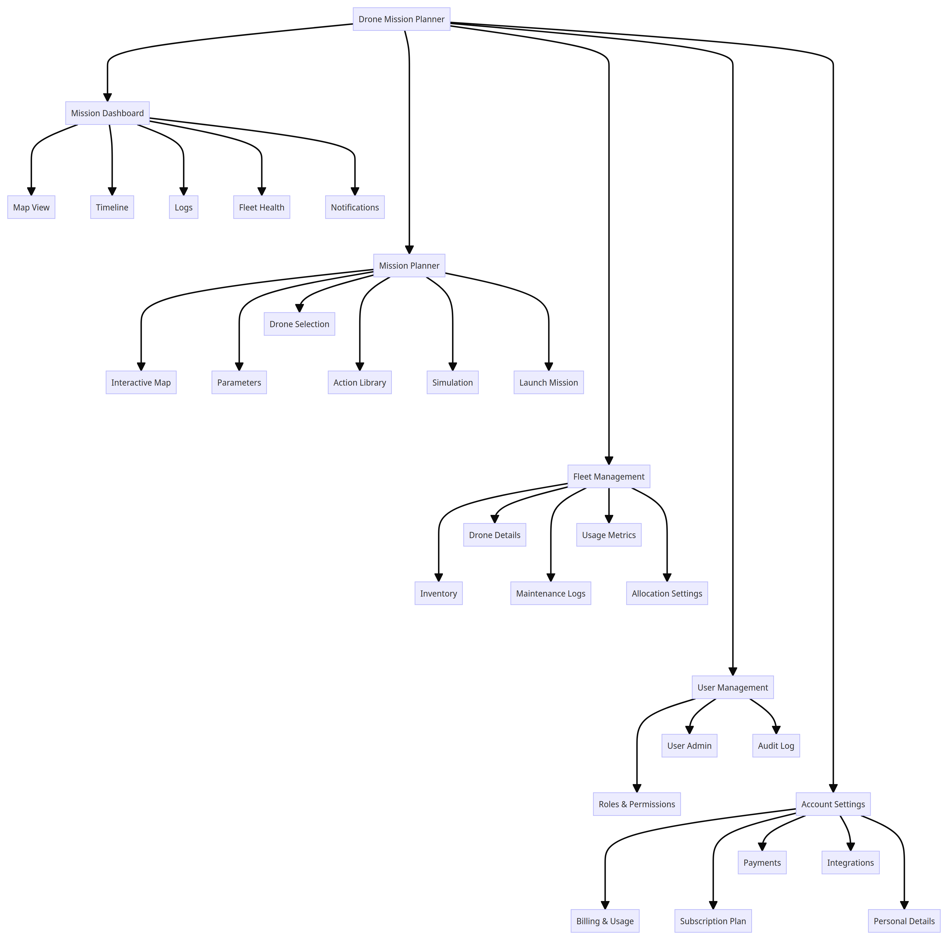
High Level UI Design

Slide 35
Mission Dashboard
Map View
Mission Timeline
Logs Table
Fleet Health
Notifications

Slide 36
Mission Dashboard - Components
1. Map View:
Definition: The map view is an interactive component that provides a visual representation of the current state of active drones and geofenced areas.
Purpose: To allow users to monitor and manage drone operations in real-time and to visualize geofenced areas for mission planning and safety.
Components:
Icons representing active drones on the map.
Shaded zones to indicate geofenced areas.
Info popups when clicking on drones or geofenced zones.
Real-time drone location updates.
Display of historic flight paths as lines on the map.
Map layer toggles for different map styles (maps, satellite, terrain)

Slide 37
Mission Dashboard - Components
2. Mission Timeline:
Definition: The mission timeline provides a Gantt chart view of upcoming, active, and past missions, along with status indicators.
Purpose: To give users an overview of mission schedules, statuses, and the ability to drill down for more details.
Components:
Gantt chart showing missions with indicators for completed, in progress, or failed status.
Clicking on a mission provides detailed information.
Filters for sorting missions by drone, user, or time period.

Slide 38
Mission Dashboard - Components
3. Logs Table:
Definition: The logs table displays historical mission records and their details in tabular format.
Purpose: To help users track and analyze past missions for reference and analysis.
Components:
Table columns: Mission name, assigned drone, date, and status.
Filter and sort options for easy data retrieval.
Pagination for navigating through mission records.
Clicking on a row provides a mission summary.

Slide 39
Mission Dashboard - Components
4. Fleet Health:
Definition: Fleet health charts offer an overview of the overall status of the drone fleet, including key metrics like battery levels, operating hours, and availability.
Purpose: To provide insights into the condition and performance of the drone fleet, facilitating proactive maintenance and decision-making.
Components:
Charts displaying fleet metrics (battery levels, operating hours, availability).
Ability to drill down for more detailed information on individual drones.
Configuration options for setting alert thresholds.

Slide 40
Mission Dashboard - Components
5. Notifications:
Definition: The notifications feed presents system events such as mission completions, errors, warnings, and information messages.
Purpose: To keep users informed about critical events and system status changes.
Components:
Feed of system events with timestamps.
Filter options by message type (error, warning, info).
Clicking on an event provides detailed information.
Custom notification settings to tailor alerts to user preferences.

Slide 41
Mission Planner - Components
Interactive Map to Set Waypoints
Mission Parameters Form
Drone Selection Filters
Library of Pre-Built Actions
Mission Creation and Management

Slide 42
Mission Planner - Components
Interactive Map to Set Waypoints:
Definition: The Interactive Map is a central feature of the Mission Planner, providing users with an intuitive interface to define and visualize mission waypoints.
Purpose: It allows users to plan and design flight paths by placing waypoints on the map, facilitating precise mission planning.
Components:
An interactive map interface where users can click to create, move, and delete waypoints.
Tools for adjusting altitude, heading, and other waypoint attributes.
Visual feedback, such as line segments connecting waypoints, to show the planned flight path.
Real-time updates as waypoints are added or modified.

Slide 43
Mission Planner - Components
2. Mission Parameters Form:
Definition: The Mission Parameters Form is a data entry interface that enables users to specify mission details, such as mission name, date, and specific requirements.
Purpose: It ensures that each mission is well-defined and includes all necessary information for successful execution.
Components:
Form fields for entering mission name, date, location, and any special instructions.
Dropdown menus, checkboxes, or radio buttons for selecting mission-specific parameters, such as flight mode or camera settings.
Validation checks to ensure that all required information is provided.

Slide 44
Mission Planner - Components
3. Drone Selection Filters:
Definition: Drone Selection Filters are tools that simplify the process of selecting drones for specific services or mission types, automatically allocating the most suitable drone based on the chosen service.
Purpose: They streamline the drone selection process, ensuring that users can quickly allocate drones without needing extensive knowledge of drone specifications.
Components:
Service Selection: Users choose a specific service or mission type from a predefined list (e.g., "Aerial Photography," "Search and Rescue," "Mapping").
Automatic Allocation: Upon selecting a service, the system automatically allocates an available drone that is optimized for the chosen service. This allocation is based on drone capabilities, sensors, and historical performance data.
Confirmation: Users receive a confirmation message indicating the allocated drone for the selected service. They can proceed with mission planning, knowing that a suitable drone has been assigned.

Slide 45
Mission Planner - Components
4. Library of Pre-Built Actions:
Definition: The Library of Pre-Built Actions is a repository of predefined actions or mission components that users can easily incorporate into their mission plans.
Purpose: It streamlines mission planning by providing a library of common actions and sequences.
Components:
A categorized library of pre-built actions, such as "Takeoff," "Hover," "Capture Image," or "Return to Base."
Drag-and-drop functionality to add actions to the mission plan.
Customization options for adjusting action parameters, duration, or sequencing.

Slide 46
Mission Planner - Components
5. Mission Creation and Management:
Definition: Mission Creation and Management features allow users to create new missions, save mission templates, and manage existing missions.
Purpose: These components streamline mission planning by enabling users to create, organize, and access mission plans efficiently.
Components:
Create New Mission: A button or option that initiates the process of creating a new mission. This can include setting a mission name, date, location, and initial parameters.
Mission List: A dashboard or panel displaying a list of all saved missions. Users can view, edit, duplicate, or delete missions from this list.
Mission Templates: A library of reusable mission templates that users can save and apply to new missions with predefined settings and waypoints.
Mission Export: An option to export mission plans in various formats (e.g., JSON, KML) for sharing or archival purposes.
Mission Import: The ability to import mission plans created elsewhere into the Mission Planner for further customization.

Slide 47
User Management
User roles and permissions
Add/remove/edit users
Activity audit log
Role management
Permission settings

Slide 48
User Management - Components
User Roles and Permissions:
Definition: User Roles and Permissions refer to the system's capability to assign different roles to users, each with its set of permissions and access levels.
Purpose: It allows administrators to control user access and actions within the system, ensuring security and data integrity.
Components:
Predefined user roles (e.g., Admin, Operator, Viewer) with associated permissions.
Custom role creation for specific access requirements.
Permission assignment at a granular level (e.g., read-only access to certain features, ability to edit mission plans).
Role-based access control (RBAC) for efficient management of user privileges.

Slide 49
User Management - Components
2. Add/Remove/Edit Users:
Definition: The ability to Add, Remove, and Edit Users involves user account management, including creating new accounts, deactivating or deleting accounts, and modifying user details.
Purpose: Administrators can maintain an updated and organized user base, ensuring that only authorized individuals have access.
Components:
User registration or creation form with required fields.
Deactivation or removal options for user accounts.
User profile editing capabilities for administrators.
User status indicators (active, inactive) for easy identification.

Slide 50
User Management - Components
3. Activity Audit Log:
Definition: The Activity Audit Log records and maintains a comprehensive log of user activities, including login/logout events, actions performed, and system changes.
Purpose: It serves as a critical tool for auditing, monitoring user actions, and troubleshooting issues.
Components:
A log that captures timestamps, user actions, and descriptions of activities.
Search and filter options for querying specific user actions or date ranges.
Export capabilities for generating audit reports.
Security measures to protect the integrity of the audit log.

Slide 51
User Management - Components
4. Role Management:
Definition: Role Management involves the creation, modification, and assignment of user roles, defining the access levels and permissions for each role.
Purpose: Administrators can adapt user roles to evolving organizational needs and ensure that roles align with user responsibilities.
Components:
Role creation and editing interface with options to specify role name, description, and associated permissions.
Role assignment to users, allowing administrators to assign or update roles for individual users.
A visual representation of role hierarchies or relationships, if applicable.
Role-based access control (RBAC) settings to fine-tune permissions.

Slide 52
User Management - Components
5. Permission Settings:
Definition: Permission Settings provide administrators with the ability to configure and customize permissions and access controls for specific roles or users.
Purpose: It allows for fine-grained control over user access and ensures that permissions align with specific operational requirements.
Components:
Permission configuration interface with checkboxes, toggle switches, or other controls for each permission.
Role-specific permission assignment for adjusting permissions based on roles.
Permission templates or presets to simplify permission assignment for common roles.
Auditing and tracking changes to permission settings.

Slide 53
Account Settings
Usage and billing overview
Adjust subscription plan
Payment settings
Integration preferences
Personal details

Slide 54
Account Settings - Components
1. Usage and Billing Overview:
Definition: The Usage and Billing Overview section provides users with a summary of their account's usage, including resource consumption and billing information.
Purpose: It allows users to monitor their resource usage and understand billing details for their subscription.
Components:
Visual representation of resource consumption (e.g., storage, data transfer, mission credits).
Billing summary, including current charges, payment history, and billing cycle information.
Usage analytics, such as graphs or charts showing historical usage trends.
Notifications for upcoming payments or subscription renewals.

Slide 55
Account Settings - Components
2. Adjust Subscription Plan:
Definition: The Adjust Subscription Plan feature enables users to modify their subscription level or tier to better align with their needs.
Purpose: It provides flexibility in scaling subscription plans up or down based on changing requirements.
Components:
Subscription plan options with clear descriptions and pricing details.
Upgrade and downgrade buttons for users to switch between plans.
Proration calculations for seamless plan changes mid-billing cycle.
Subscription plan comparison table for users to evaluate options.

Slide 56
Account Settings - Components
3. Payment Settings:
Definition: Payment Settings allow users to manage their payment methods, update billing information, and configure payment preferences.
Purpose: It ensures that users can keep their payment details up to date and manage payment-related preferences.
Components:
Payment method management for adding, editing, or removing credit cards, bank accounts, or other payment sources.
Billing address and contact information updates.
Auto-renewal settings to enable or disable automatic subscription renewals.
Payment history and receipts for reference.

Slide 57
Account Settings - Components
4. Integration Preferences:
Definition: Integration Preferences enable users to configure integrations with third-party services or tools, such as data storage, analytics, or external applications.
Purpose: It facilitates seamless integration with external services to enhance workflow and data management.
Components:
Configuration options for connecting to external services or APIs.
Integration status indicators to confirm successful connections.
Data synchronization settings, including frequency and data transfer options.
Integration documentation or guides for assistance.

Slide 58
Account Settings - Components
5. Personal Details:
Definition: Personal Details refer to the user's profile information, including contact details, notifications, and preferences.
Purpose: It allows users to customize their account settings to reflect their personal preferences and contact information.
Components:
User profile information (name, email address, profile picture).
Contact preferences for notifications, updates, and newsletters.
Language and regional settings for personalization.
Two-factor authentication (2FA) settings for enhanced security.

Slide 59
Fleet Management
Drone inventory table
Drone details - status, model, sensors
Maintenance logs and schedules
Utilization metrics and history
Automated allocation settings

Slide 60
Fleet Management - Components
Drone Inventory Table:
Definition: The Drone Inventory Table presents a structured list of all drones in the fleet, including essential details.
Purpose: It serves as a centralized inventory management tool for tracking and accessing information about all drones in the fleet.
Components:
Table columns for drone ID or serial number, model, current status (e.g., operational, in maintenance), and availability.
Filters for sorting drones based on various criteria such as status, model, or availability.
Options for bulk actions, such as assigning drones to missions or scheduling maintenance.

Slide 61
Fleet Management - Components
2. Drone Details:
Definition: The Drone Details component offers a detailed overview of individual drones, encompassing their current status, model specifications, and sensor configurations.
Purpose: It provides comprehensive insights into each drone's technical specifications and operational status, facilitating effective fleet management.
Components:
Display of drone status (e.g., operational, in maintenance, in use) with clear visual indicators.
Information about the drone model, including specifications, payload capacity, and range.
Sensor configuration details, highlighting the sensors and equipment onboard.
Access to historical maintenance and utilization data for the selected drone.

Slide 62
Fleet Management - Components
3. Maintenance Logs and Schedules:
Definition: The Maintenance Logs and Schedules component tracks all maintenance activities, schedules, and maintenance history for each drone in the fleet.
Purpose: It ensures proactive maintenance planning, records all maintenance actions, and helps maintain the fleet's overall health.
Components:
A log of past maintenance actions, including dates, tasks performed, and responsible personnel.
Scheduling tools for setting up routine maintenance tasks, inspections, and repairs.
Alerts and notifications to remind users of upcoming maintenance tasks.
Detailed maintenance history for each drone, accessible via drill-down.

Slide 63
Fleet Management - Components
4. Utilization Metrics and History:
Definition: Utilization Metrics and History provides data and insights into how drones are used over time, including flight hours, missions completed, and operational patterns.
Purpose: It helps optimize drone deployment, allocate resources efficiently, and track the overall performance of the fleet.
Components:
Metrics such as total flight hours, missions completed, and average flight duration for each drone.
Historical data on drone utilization, allowing users to analyze trends and patterns.
Visualizations, such as utilization charts or graphs, for at-a-glance insights.
Tools for generating utilization reports and exporting data for further analysis.

Slide 64
Fleet Management - Components
5. Automated Allocation Settings:
Definition: The Automated Allocation Settings component allows users to configure rules and preferences for automated drone allocation to missions or tasks.
Purpose: It streamlines the process of assigning drones to missions and ensures efficient resource allocation.
Components:
Configuration options for defining allocation rules, such as prioritizing certain drones for specific mission types or locations.
Preferences for automated allocation, including criteria like proximity, availability, and mission complexity.
Logs or history of automated allocation decisions for auditing and analysis.
The ability to fine-tune allocation settings based on real-world performance and outcomes.

Slide 65
