Slide 1

Service Oriented Mission Planner

Slide 2
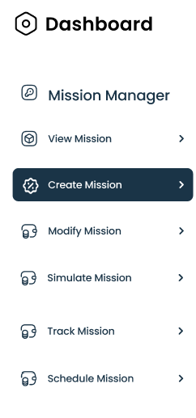
Updated Mission Planner –Components
View Mission
Create Mission
Modify Mission
Simulate Mission
Track Mission
Schedule Mission
Notes:
Allows setting of all parameters for a mission - waypoints, actions, camera settings, etc.
Optimizes waypoint routes for efficiency - considers things like battery life, wind patterns, no-fly zones.
Allows setting timing and recurrence for missions - one time, recurring daily/weekly etc.
Interfaces with fleet management system to select which drone(s) will be assigned to a mission.
Sends final mission plans and waypoints to drones wirelessly.
Tracks mission status in real-time as drones execute flights.
Stores mission history data for reporting and analytics.
Allows dynamic re-tasking or pausing of in-progress missions.
APIs allow integrating with other systems like campus security software.

Slide 3
View Missions
Query the Database and Display a List of Created Missions
Utilize a search function to query the mission database.
Display a list of missions along with their key information.
Mission Summary Fields Include:
Drone ID
Drone Type
Service Address
Longitude and Latitude
Waypoints (WPs)
Duration
Distance
Status
Offer user-friendly navigation to access mission details.

Slide 4
Create Mission
Effortless Mission Creation Process
Select the Service Type:
Choose the specific service type for the mission (e.g., surveillance, delivery).
Available Drones for the Selected Service Type:
Display a list of drones compatible with the chosen service type.
Creating a New Mission:
Select a drone from the list of available drones.
Specify the service type.
Click "Create" to enter the mission planner.
Saving the Mission:
When satisfied with mission planning, click "Save."
A new mission, e.g., "Mission xxx with N WPs," will be created in the database.

Slide 5
Modify Mission
Flexible Mission Editing
Select an "idle" mission from the mission list.
Click "Modify" to access the mission planner with mission header records and associated waypoints.
Edit mission details, waypoints, and parameters as needed.
Save modifications to update the mission in the database.

Slide 6
Simulate Mission
Realistic Mission Simulation
Select any mission from the list.
Click "Simulate" to enter the mission planner with mission header records and waypoints.
Simulation Interface:
Cesium map displays the mission's flight path.
Timeline allows control over the simulation's progress.
Simulation Controls:
"Pause": Temporarily pause the simulation.
"Resume": Continue the simulation.
"Fast Forward": Speed up the simulation.
"Fast Backward": Rewind the simulation for review or adjustments.

Slide 7
Track Mission
Real-time Monitoring of Active Missions
Select an "in-service" mission.
Retrieve information from the NoSQL database to monitor the mission's progress.
Key Tracked Information:
Live camera view from the drone.
Real-time tracking parameters (e.g., altitude, speed, battery status).
Provide a user-friendly interface to visualize and interact with mission data.

Slide 8
Schedule Mission
Efficient Mission Planning
Access the mission scheduler to plan future missions.
User-Friendly Scheduling Interface:
Specify mission details (service type, drones, waypoints, etc.).
Set a date and time for the mission.
Seamless Integration:
Scheduled missions seamlessly transition to the mission list when their start time approaches.
Ensures efficient mission management and execution.

Slide 9


