Slide 1
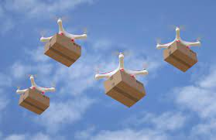
Service Oriented Mission Planner

Slide 2
Mission Planner
The mission planner is a key software component that allows users to set up and schedule drone surveillance missions.
Web application that provides an interface for admin users to create and manage missions.
Integrates with map data to allow users to visually set waypoints and define areas.
Notes:
Allows setting of all parameters for a mission - waypoints, actions, camera settings, etc.
Optimizes waypoint routes for efficiency - considers things like battery life, wind patterns, no-fly zones.
Allows setting timing and recurrence for missions - one time, recurring daily/weekly etc.
Interfaces with fleet management system to select which drone(s) will be assigned to a mission.
Sends final mission plans and waypoints to drones wirelessly.
Tracks mission status in real-time as drones execute flights.
Stores mission history data for reporting and analytics.
Allows dynamic re-tasking or pausing of in-progress missions.
APIs allow integrating with other systems like campus security software.

Slide 3
Overview
The system will consist of a fleet of drones with cameras that can fly pre-planned missions or be dynamically tasked.
The drones will stream video and telemetry data to the cloud.
Users can access and monitor the video feeds and data through a web application.
The mission planner will allow users to create and schedule surveillance missions.

Slide 4
Drone Missions
Pre-planned missions
On-demand missions
Random patrols
Reactive missions

Slide 5
Pre-planned missions
Admin scheduled recurring flights over key areas
Optimized flight plans for efficiency
Provides regular oversight for proactive monitoring
Use cases
Daily flyovers of parking lots to deter break-ins
Weekly quad monitoring to track gathering sizes
Nightly scans of buildings for security breaches
Recurring perimeter sweeps for suspicious activity
Monitor pathways during peak foot traffic
Weekend housing patrols for noise complaints
Notes:
Pre-planned drone missions allow for scheduled, recurring flights over key campus areas and buildings to enable regular proactive monitoring.
The flight plans are optimized for efficiency in route and energy use. Benefits include deterring crime through consistent presence, identifying issues early before escalation, efficient use of drone resources, and building knowledge of normal activity patterns. Specific use cases could include daily monitoring of parking lots, weekly quad surveillance, and nightly building scans to maintain security.
Pre-planned missions allow flexible flight scheduling that minimizes drone energy use and expenditures.

Slide 6
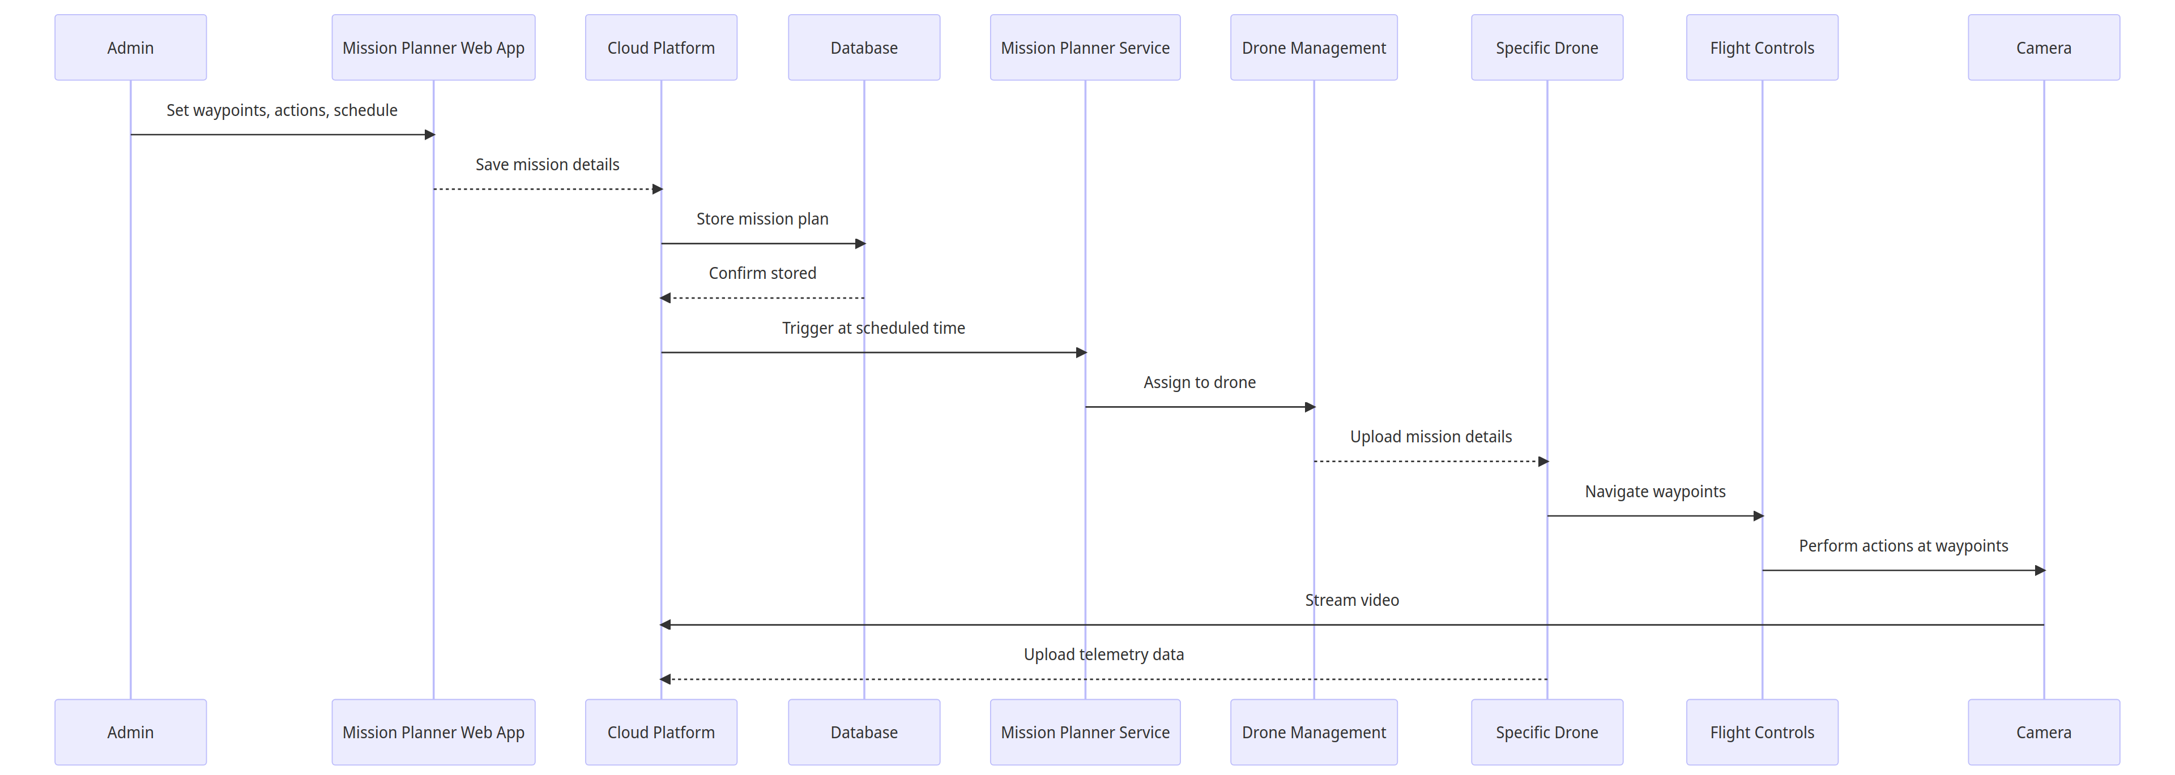
Pre - Planned Mission
Notes:
The administrator schedules a future surveillance mission in the Mission Planner web application by setting waypoints, drone actions, and timing. These details are saved to the cloud platform, which stores the mission plan in a database for later activation. At the scheduled time, the Mission Planner service triggers the plan, assigns it to a drone through the management system, and uploads the mission specifications. The drone then autonomously follows the planned waypoints using its flight controller, performs surveillance actions with its cameras, streams video feeds, and uploads telemetry data to the cloud. After completion, the drone returns safely to base and the cloud archives the mission data for potential future analysis.

Slide 7
On-demand missions
Users can dynamically task drones via web app
Specify area on map to surveil
Mission planner generates waypoints
Set camera settings and actions
Use cases:
View large student gatherings
Inspect reported vandalism
Check buildings during breaks
Survey campus prior to events
Monitor protests or demonstrations
Respond to restricted access reports
Search for missing persons
Notes:
On-demand missions allow users to dynamically task drones to investigate situations as they arise. Users specify an area of interest on a map in the web application and the mission planner generates optimal waypoints for drone routing. Camera settings and other actions can also be configured by the user prior to launch. These customizable, adaptable missions enable rapid response surveillance of developing events, specific targets of opportunity, or other ad hoc concerns that require focused drone oversight. Example use cases include monitoring protests, surveying event venues, inspecting vandalism, and searching for missing persons on campus.

Slide 8
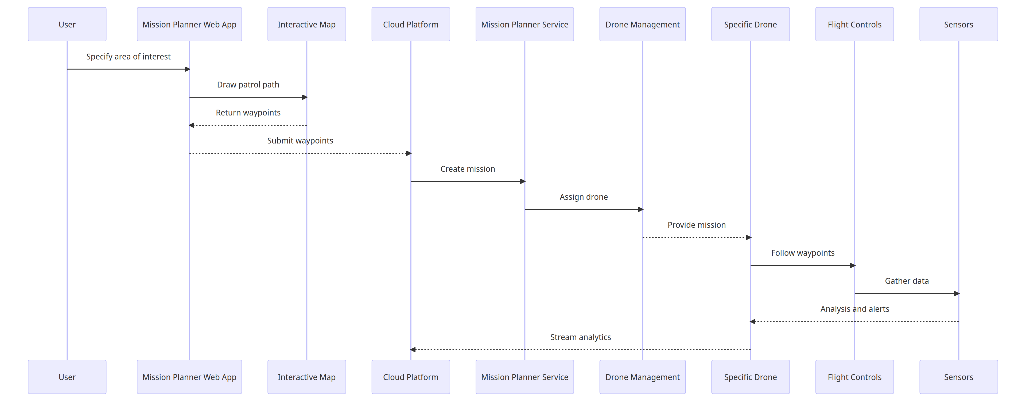
On Demand Missions
Notes:
The user specifies an area of interest for surveillance in the Mission Planner web application, which interacts with a map interface to generate an optimal drone patrol path and waypoints. These customized waypoints are submitted to the cloud platform, which creates a mission and assigns it to a drone through the management system. The specific drone receives the on-demand mission details, then autonomously follows the generated waypoints using its flight controller and leverages sensors to gather aerial data. Analysis of the streaming sensor feeds produces alerts for any anomalies detected during the flight. Once complete, the drone sends the full analytics package from the mission back to the cloud platform for storage and potential future review.

Slide 9
Random patrols
Patrols with randomized waypoints
Vary flight paths, avoid repetitive routes
Parameters set for area, duration, speed
Mission planner optimizes route and settings
Use Cases:
Irregular surveillance of recreational spaces
Randomized parking area oversight
Varying quad and open space flights
Frequent dorm patrols at irregular times
Notes:
Random patrol missions generate unpredictable drone routes by varying waypoints and flight paths to avoid repetitive routines. The mission planner optimizes randomized route parameters like area, duration and speed for efficient surveillance. The unpredictable coverage identifies incidents pattern analysis may miss and cost-effectively monitors large areas over time. Example use cases include irregular oversight of recreational spaces, parking lots, quads and unpredictable dorm patrols.

Slide 10
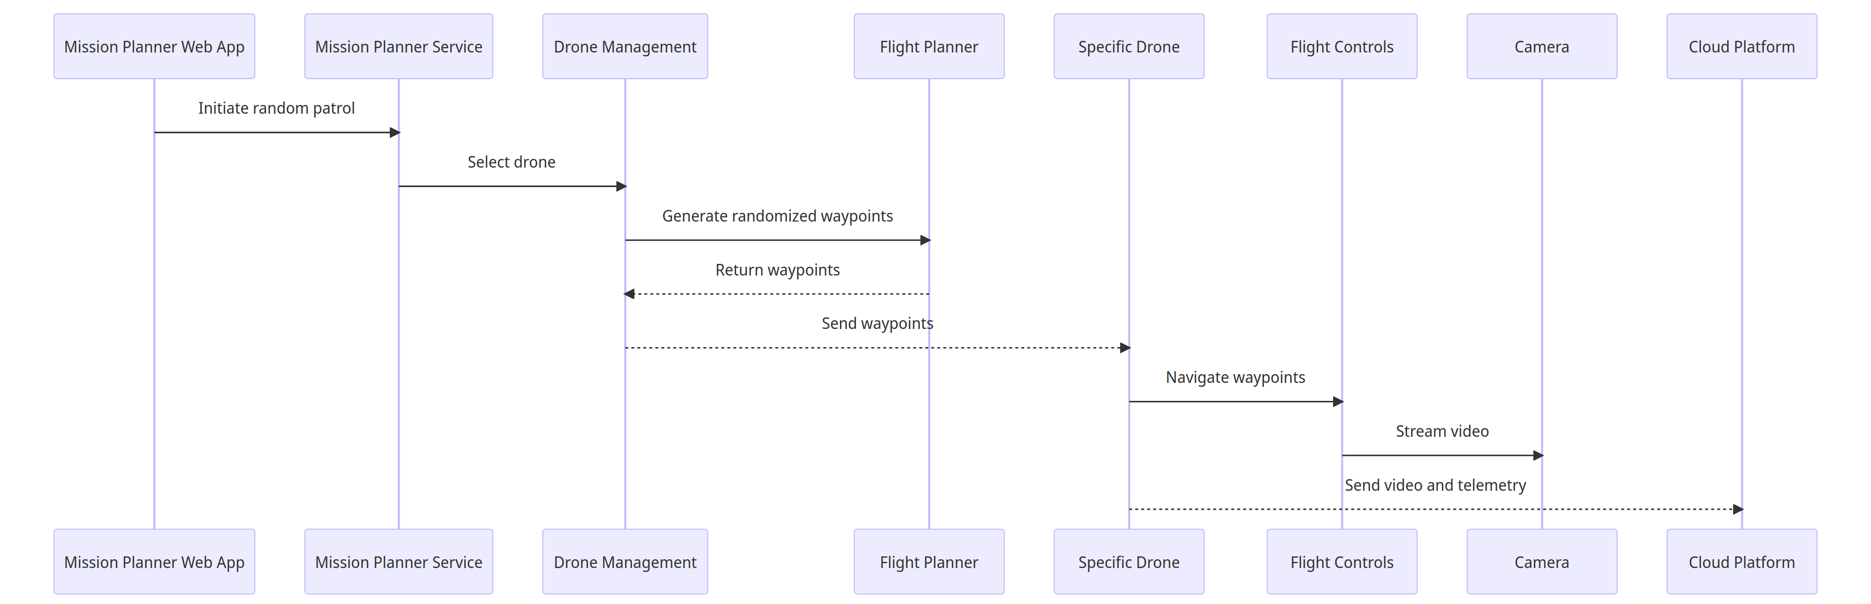
Random Patrols
Notes:
The Mission Planner web application initiates a random surveillance patrol by signaling the Mission Planner service, which selects an appropriate drone through the management system. The flight planner generates randomized waypoints for this drone to follow, returning them to the management system to be sent to the specific drone. The drone receives the waypoints and uses its flight controller to navigate the randomized path, streaming live video through its cameras back to the cloud platform. Telemetry data containing analytics for the unpredictable flight are also sent to the cloud after completing the patrol for archival and analysis of the randomized coverage. The variable nature of random patrols enables broad monitoring that complements scheduled flights.

Slide 11
Reactive missions
Continuous monitoring of drones and sensors
Leverage sensor data like motion detection
Drone retasked if sensor threshold exceeded
New waypoints based on sensor location
Drone interrupts current mission
Use Cases:
Rapid dispatch to investigate sensor alerts like gunshots
Dynamically adapt to unfolding situations by responding to shouts
Flexible rerouting from ongoing missions to crashes
Real-time surveillance by retasking drones based on alerts
Generate new waypoints to efficiently investigate emerging incidents
Notes:
Reactive missions involve continuously monitoring drone sensors to leverage data like motion detection and retask drones if a threshold is exceeded, interrupting ongoing flights. New waypoints are generated based on the sensor location triggering the alert to redirect the drone and rapidly investigate incidents like gunshots, shouts, or crashes through efficient routing. Use cases demonstrate real-time adaptive surveillance by dynamically rerouting drones mid-flight to emerging events detected by the system, enabling automated responses that flexibly adapt missions as situations unfold for rapid eyes on developing incidents.

Slide 12
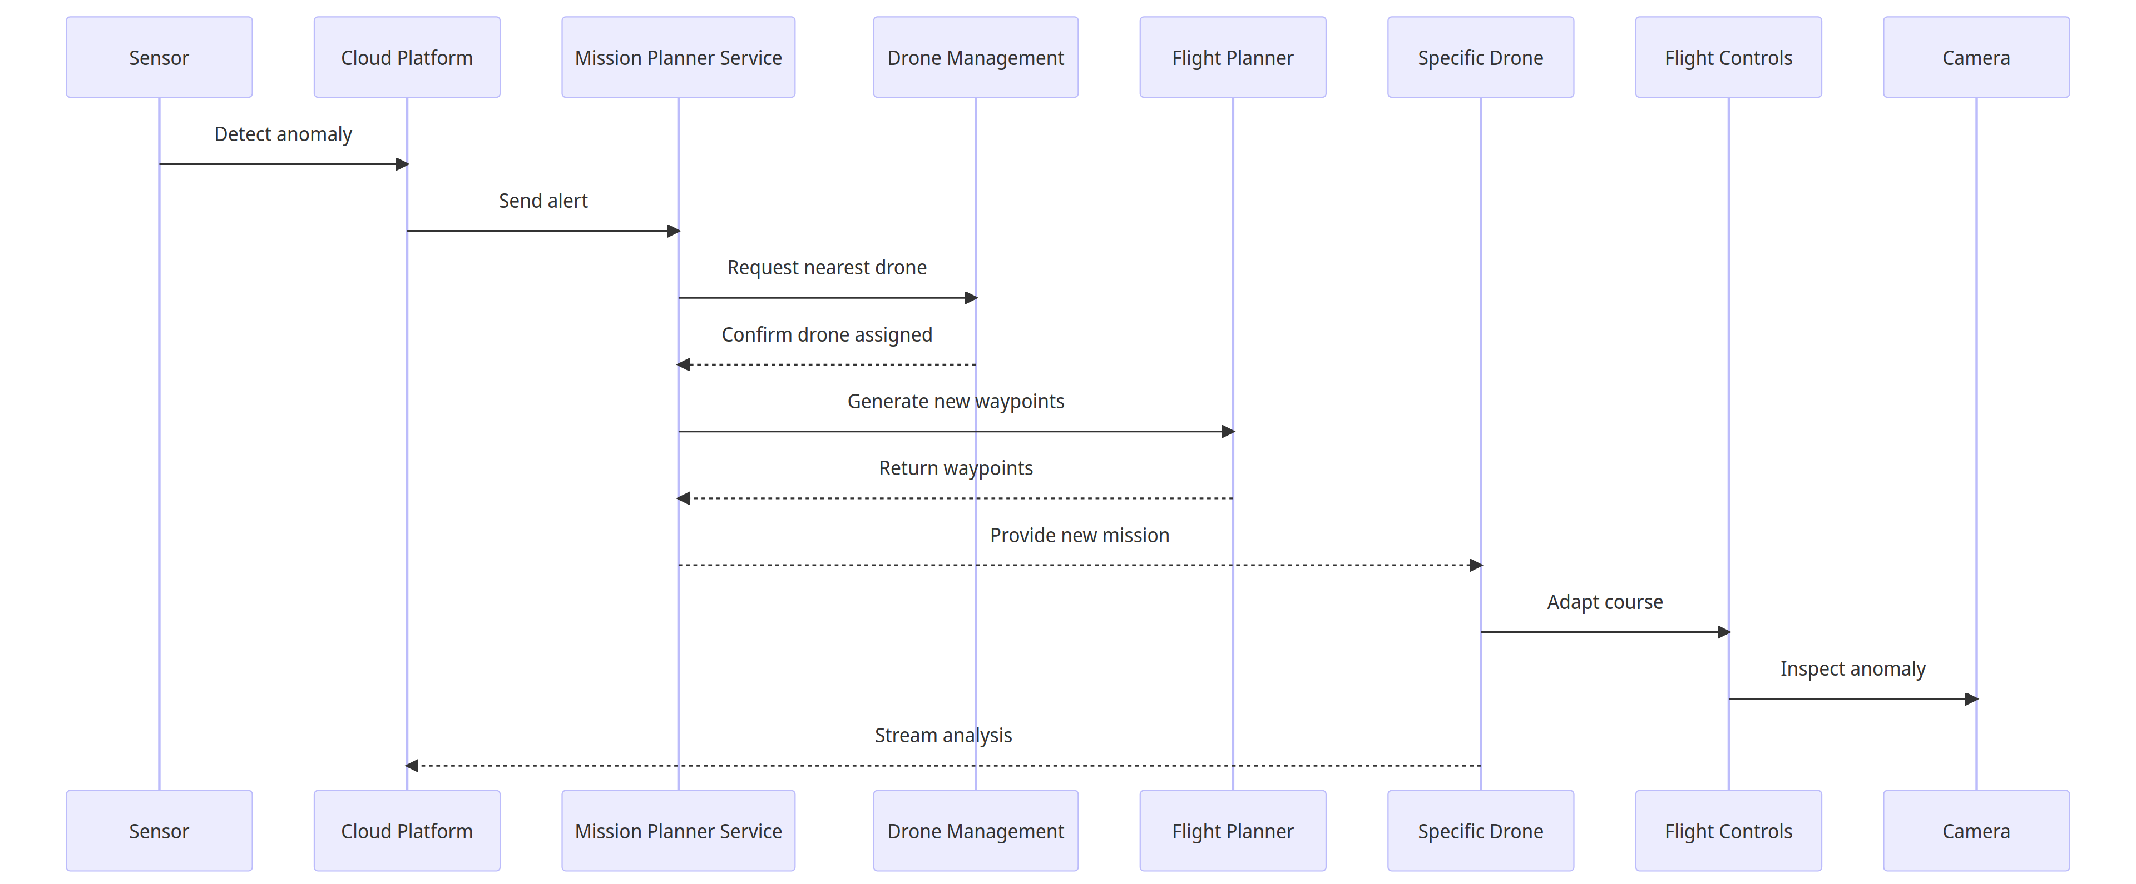
Reactive Missions
Notes:
When a sensor detects an anomaly, it sends an alert to the cloud platform, which forwards it to the Mission Planner service to initiate a reactive response. The Mission Planner requests the nearest available drone from the management system for the mission. Once a drone is assigned, the flight planner generates new waypoints based on the sensor location to route the drone to inspect the alert. These waypoints are returned to the Mission Planner and sent to the drone, which then adapts its course to fly the new route and examine the anomaly onsite. Reactive missions allow the drone fleet to dynamically respond to real-time sensor triggers by interrupting planned flights and autonomously investigating events as they unfold.

Slide 13
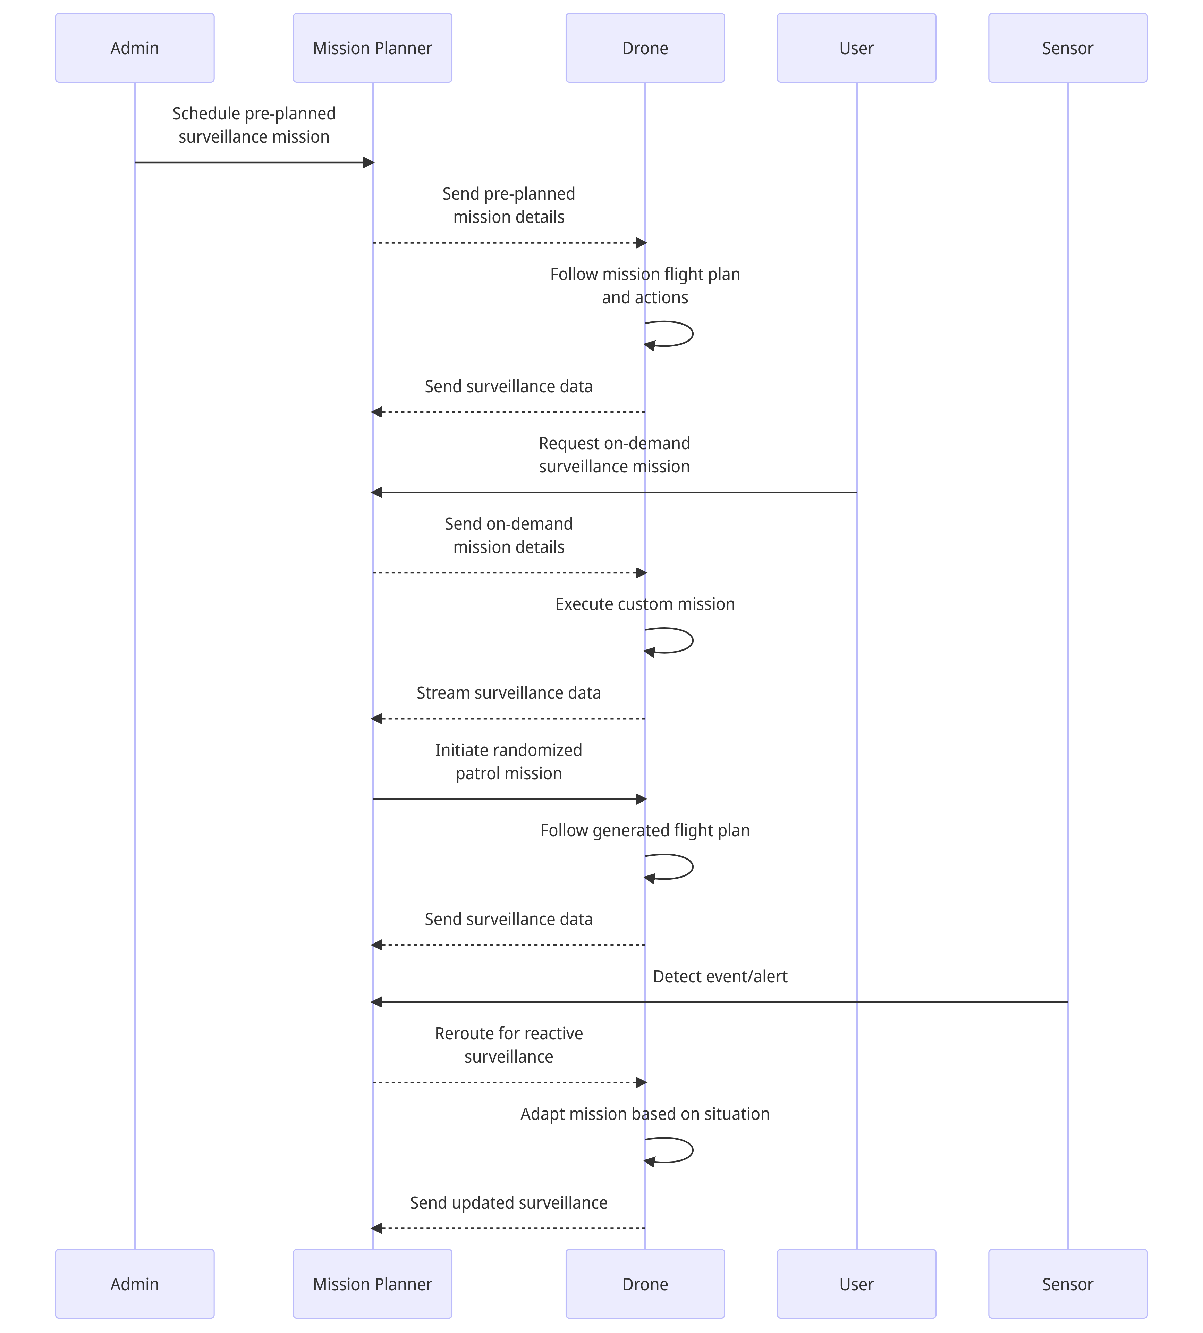
Combined Missions
Notes:
Key steps:
Admins schedule pre-planned missions
Mission planner sends details to drone
Drone executes mission and sends data
Users request on-demand missions
Mission planner generates and assigns mission
Drone executes and streams data
For random patrols, mission planner initiates
Drone follows generated plan
Sensors trigger reactive rerouting
Mission planner adapts mission
Drone adjusts and sends updates

Slide 14
Way Point Actions
Navigation Actions
Camera Actions
Hover
Orbit
Change Altitude
Change Speed
Pause
Rotate
Return to Launch
Loiter
Take Photo
Start/Stop Video
Switch Camera
Aim Camera
Scan Area
Notes:
Hover - Drone holds position at set altitude over waypoint for configured duration
Orbit - Drone circles around waypoint at specified radius and speed
Change Altitude - Drone ascends/descends to predefined altitude upon reaching waypoint
Change Speed - Adjust cruise speed to new preset at waypoint
Pause - Drone pauses at waypoint for set time before proceeding
Rotate - Drone rotates or changes heading by specified degree amount
Return to Launch - Abort mission and return to takeoff point
Loiter - Drone lingers within set radius of waypoint until directed
Take Photo - Drone snaps still image using camera at waypoint
Start/Stop Video - Initiate or conclude video recording at waypoint
Switch Camera - Change between forward, downward, IR cameras at waypoint
Aim Camera - Point camera in specified direction relative to waypoint
Scan Area - Drone scans designated area with cameras at waypoint

Slide 15
Way Point Actions
Payload Actions
Mission Control Actions
Toggle Light
Drop Object
Speak Message
Engage/Disengage Payload
Abort/Resume Mission
Proceed to Next Waypoint
Hold at Waypoint
End Mission

Slide 16
Navigation Actions
Hover - Drone holds position at set altitude over waypoint for configured duration
Orbit - Drone circles around waypoint at specified radius and speed
Change Altitude - Drone ascends/descends to predefined altitude upon reaching waypoint
Change Speed - Adjust cruise speed to new preset at waypoint
Pause - Drone pauses at waypoint for set time before proceeding
Rotate - Drone rotates or changes heading by specified degree amount
Return to Launch - Abort mission and return to takeoff point
Loiter - Drone lingers within set radius of waypoint until directed

Slide 17
Camera Actions
Take Photo - Drone snaps still image using camera at waypoint
Start/Stop Video - Initiate or conclude video recording at waypoint
Switch Camera - Change between forward, downward, IR cameras at waypoint
Aim Camera - Point camera in specified direction relative to waypoint
Scan Area - Drone scans designated area with cameras at waypoint

Slide 18
Payload Actions
Toggle Light - Turn on/off spotlight, indicator lights on drone
Drop Object - Release small carried object at designated waypoint
Speak Message - Drone broadcasts pre-recorded audio message
Engage/Disengage Payload - Activate or deactivate additional sensors

Slide 19
Mission Control Actions
Abort/Resume Mission - Stop and pause the mission immediately or continue a paused mission.
Proceed to Next Waypoint - Skip the current waypoint and move on to the next one in the flight plan.
Hold at Waypoint - Maintain the drone's position at the current waypoint indefinitely until further instruction.
End Mission - Terminate the mission and have the drone return directly to the takeoff point and land.

Slide 20
Key Differences
Pause
Hold
Hover
Temporarily stops drone movement and propellers
Brief duration - few seconds or minutes
Conserves battery
Maintains position and altitude
Propellers active to keep drone in place
Indefinite duration until commanded otherwise
Holds precise 3D coordinates
Propellers actively keep drone stationary
Duration can be set or indefinite
Notes:
In short:
Pause: Quick power saving stop
Hold: Stay put for extended time
Hover: Remain fixed at exact spot

Slide 21
Some other ideas:
Waypoints for recharging drone batteries between missions
Alternate landing sites if the drone charging station is blocked
Contingency waypoints in case of emergencies

Slide 22
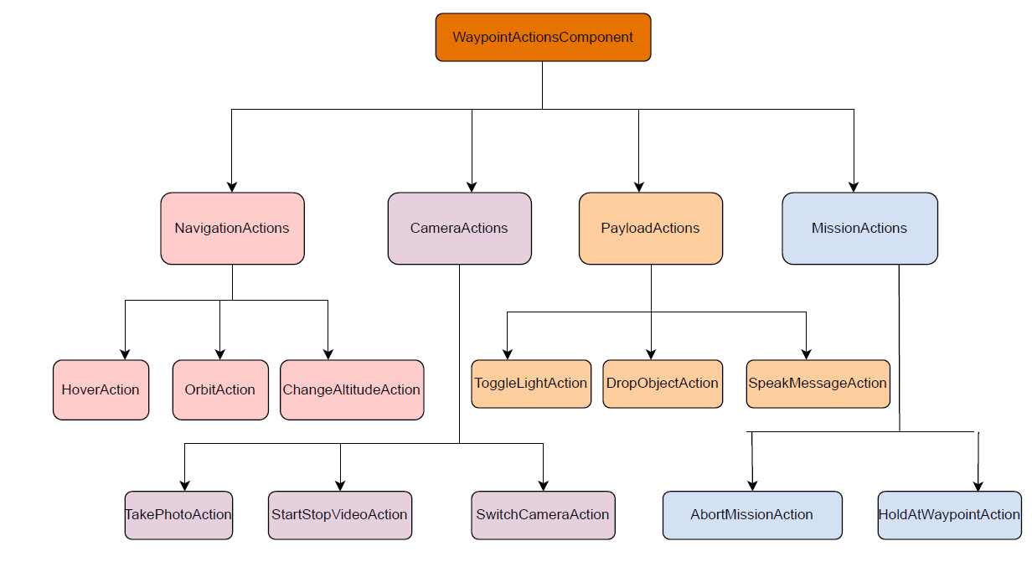
Modular Structure
Notes:
Main WaypointActionsComponent contains all action subcomponents
Each action is its own React component with internal state and methods
Navigation, Camera, Payload, Mission subgroups for organization

Slide 23
Workflow Diagrams

Slide 24
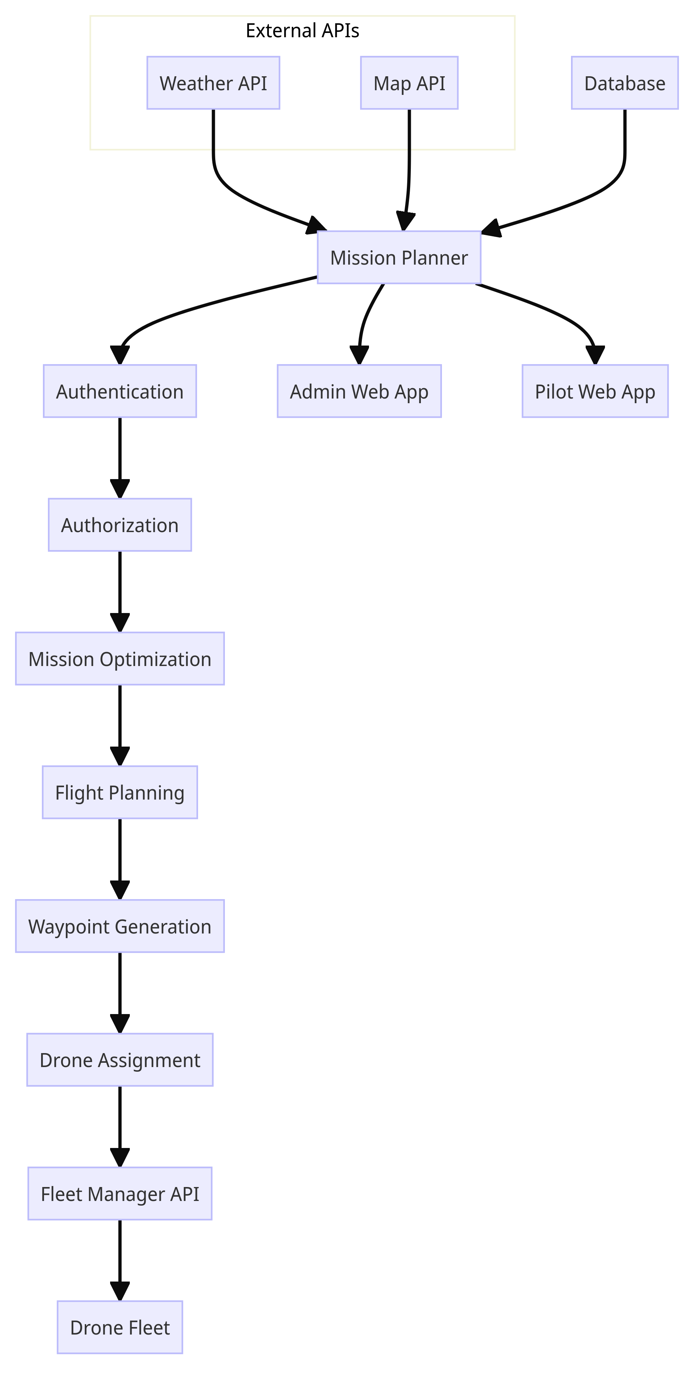
Mission Planner
Notes:
Key aspects:
Integration with external APIs for weather, maps
Authentication and authorization
Mission optimization algorithms
Automated flight planning
Waypoint generation
Integration with fleet management
Database for mission data
Interfaces for admin and pilot apps
The drone Mission Planner integrates with weather and map APIs to ingest environmental data for optimizing operations. It handles user authentication and authorization before allowing mission planning activities. Optimization algorithms generate efficient flight plans, which are converted into detailed waypoint routes for specific drone assignment. The waypoints are sent to the actual drones via integration with the fleet management system API. The Mission Planner also provides web interfaces for administrators to schedule missions and pilots to request them, persisting mission data in a connected database.

Slide 25
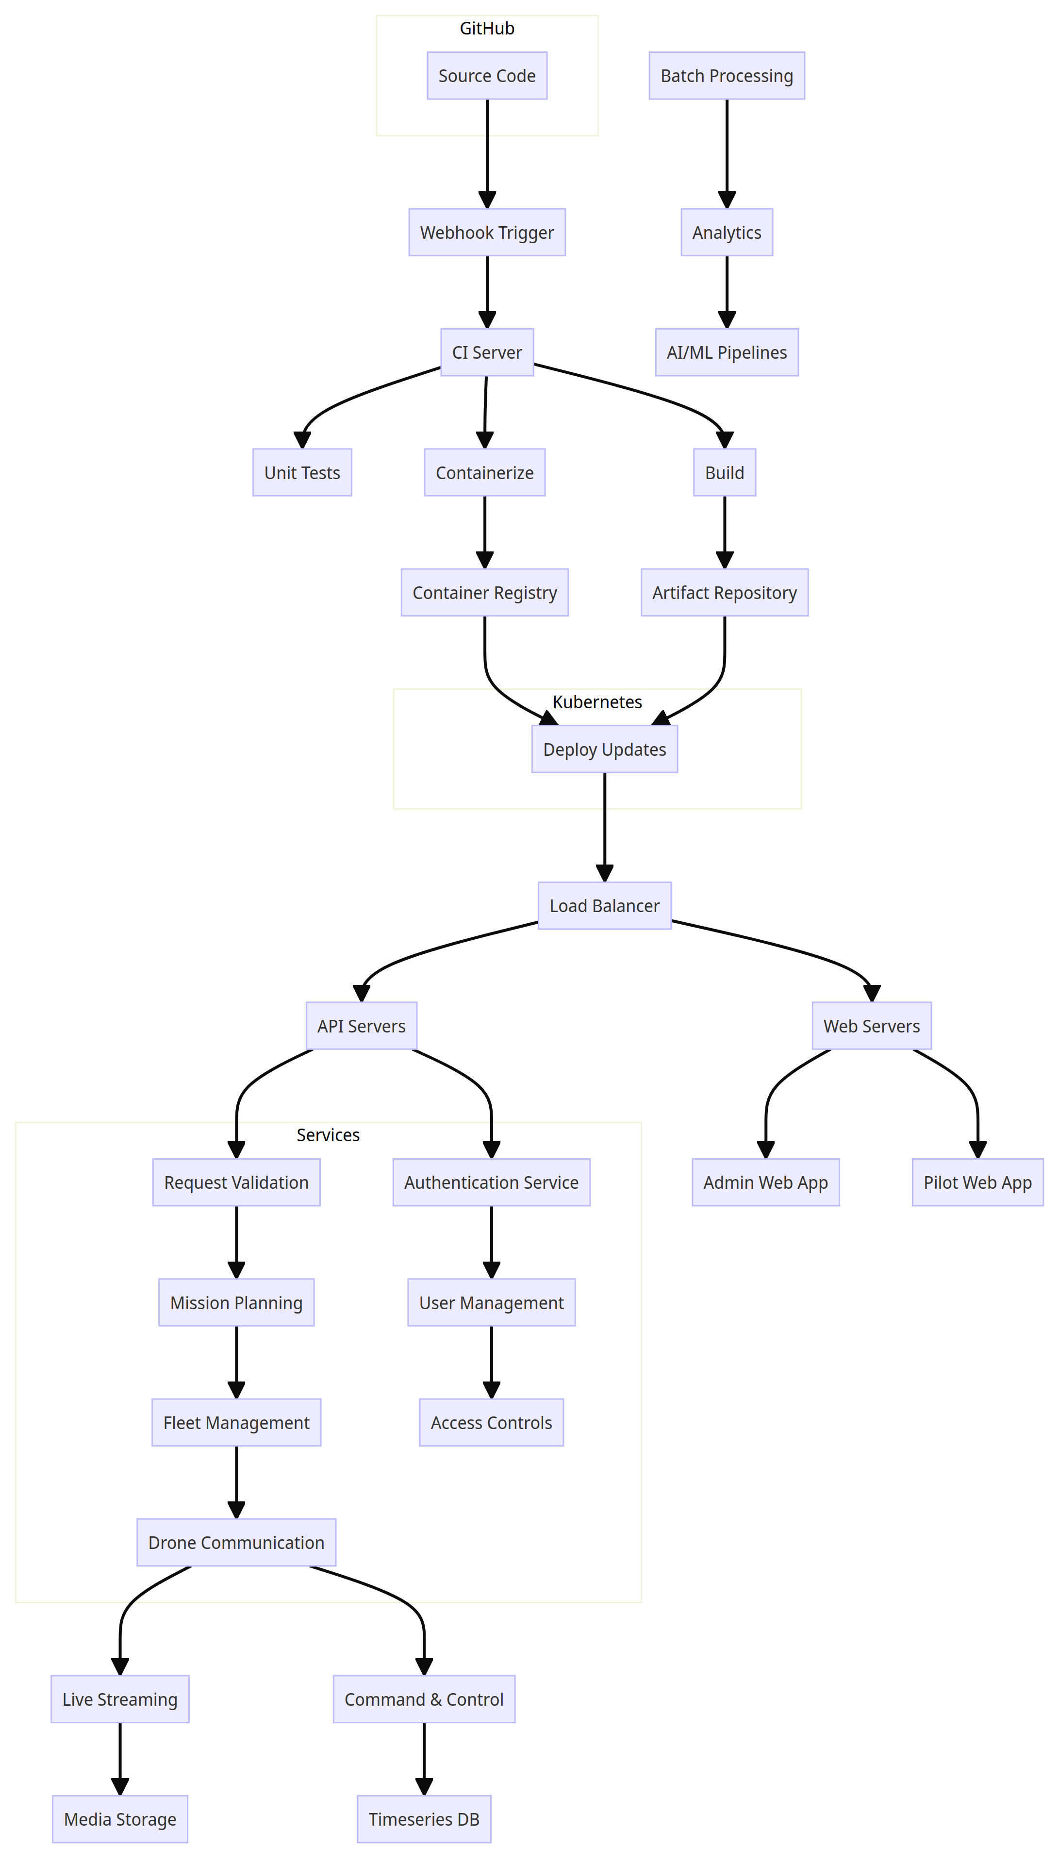
High Level Architecture
Notes:
On-Premises
Drone charging stations
Security systems (cameras, alarms, access control)
Networking infrastructure (WiFi, cellular, satellite)
Server racks, backup power
Cloud Platform
Load balancers distribute requests
Web servers host admin/pilot apps
API servers implement REST APIs
Caching layers improve performance
Services
Authentication (OAuth, JWT, etc)
User management and access control
Mission planning and optimization
Drone fleet management
Flight control and telemetry processing
Streaming and storage services
Data Pipeline
Stream ingestion with buffers
Timeseries DB for telemetry
Object storage for media
Data lake for analytics
Batch processing with Spark or Hadoop
BI tools and dashboards
Analytics
Machine learning models for video and data
Anomaly detection algorithms
Predictive analytics on telemetry
Natural language processing on audio
Data visualization and reporting
Security
Encryption, TLS certificates, VPCs
Regular security audits
DDoS mitigation
Role based access control
CI/CD pipeline checks
The drone system code is managed in GitHub, with webhooks set up to trigger CI pipelines that run tests, builds, and containerization on every commit. These containers are pushed to a registry while build artifacts go to a repository, before being deployed to Kubernetes from which they are load balanced across web and API servers. The servers handle user apps, authentication, and expose APIs to internal services like mission planning, fleet management, and drone communication. These services ingest and process data streams, storing media and telemetry, and passing batches to analytics and machine learning pipelines. This automated architecture allows rapid development while maintaining availability through cloud-native technologies like containers and orchestration.

Slide 26
