Slide 1

Service Oriented Mission Planner

Slide 2
Deck Station
Definition: A deck station, in drone terminology, is a ground-based control center designed to manage and monitor drone operations effectively.
Purpose: The primary goal of a deck station is to offer a centralized hub for drone operators, enabling them to control and supervise different facets of drone missions.
Applications: Deck stations find widespread use in diverse scenarios, including drone inspections, surveillance operations, mapping missions, and various other applications.
Centralized Control: By providing a centralized location, deck stations streamline drone operations, enhancing efficiency and control for operators involved in managing complex missions.
Notes:
Allows setting of all parameters for a mission - waypoints, actions, camera settings, etc.
Optimizes waypoint routes for efficiency - considers things like battery life, wind patterns, no-fly zones.
Allows setting timing and recurrence for missions - one time, recurring daily/weekly etc.
Interfaces with fleet management system to select which drone(s) will be assigned to a mission.
Sends final mission plans and waypoints to drones wirelessly.
Tracks mission status in real-time as drones execute flights.
Stores mission history data for reporting and analytics.
Allows dynamic re-tasking or pausing of in-progress missions.
APIs allow integrating with other systems like campus security software.

Slide 3
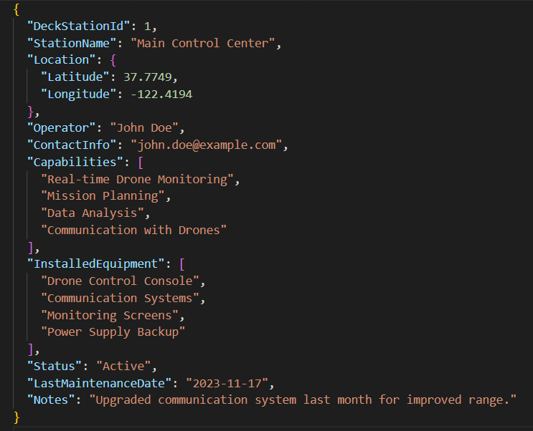
Sample Record for a Deck Station Record

Slide 4
Key Fields
DeckStationId: A unique identifier for the deck station.
StationName: Name or designation of the deck station.
Location: Geographic coordinates of the deck station.
Operator: Person responsible for operating the deck station.
ContactInfo: Contact information of the responsible operator.
Capabilities: List of capabilities or functions the deck station supports.
InstalledEquipment: List of equipment installed at the deck station.
Status: Current status of the deck station (e.g., "Active," "Under Maintenance," etc.).
LastMaintenanceDate: Date when the deck station was last serviced or maintained.
Notes: Any additional notes or comments about the deck station.

Slide 5
Deck Station ID
If we want to associate a deck station with the starting point (waypoint 0) of a mission, we can modify our mission data structure to include information about the associated deck station.
{
"MissionId": 1,
"DeckStationId": 1, // New attribute for deck station association
"Waypoints": [
{
"WaypointId": 0,
"Latitude": 37.7749,
"Longitude": -122.4194,
"Altitude": 100
},
// ... Other waypoints
],
// ... Other mission attributes
}

Slide 6
Top 4 fields of a Deck Station
DeckStationId: A unique identifier for the deck station, crucial for tracking and referencing.
Location: Geographic coordinates of the deck station, essential for spatial awareness and mission planning.
Status: Current status of the deck station (e.g., "Active," "Under Maintenance," etc.), indicating operational readiness.
Capabilities: List of capabilities or functions the deck station supports, defining its operational scope.

Slide 7
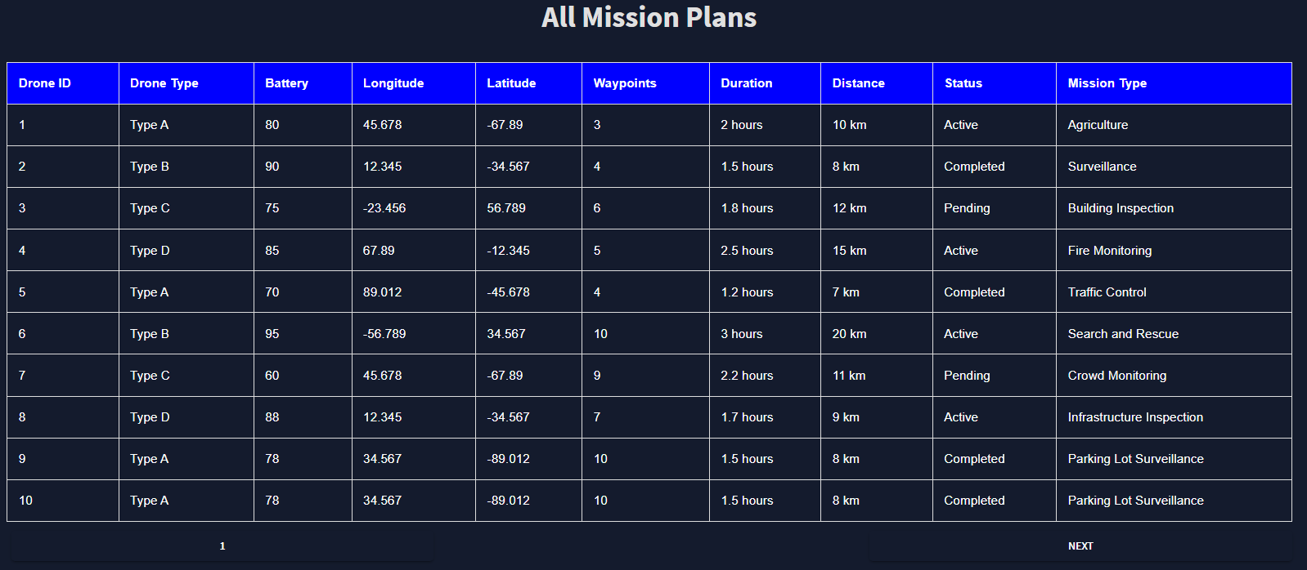
View Missions

Slide 8
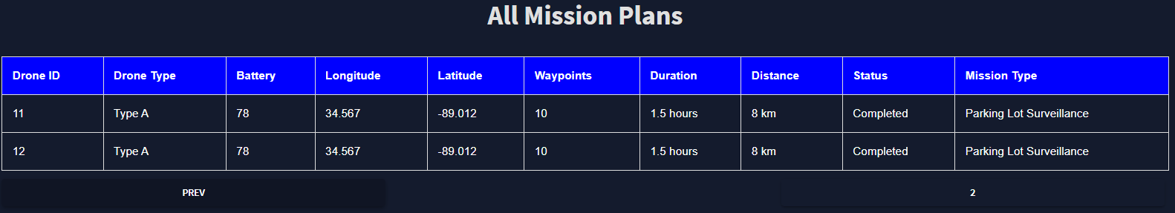
View Missions
I

Slide 9


