Slide 1
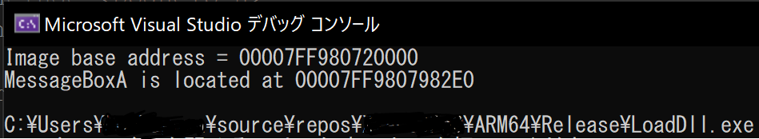

Slide 2
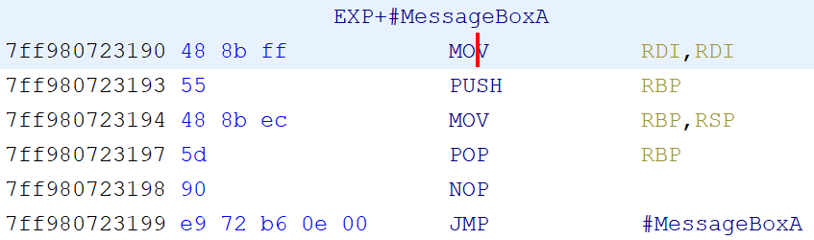
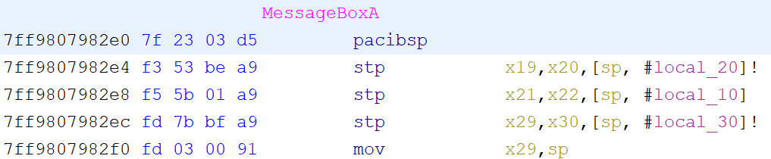
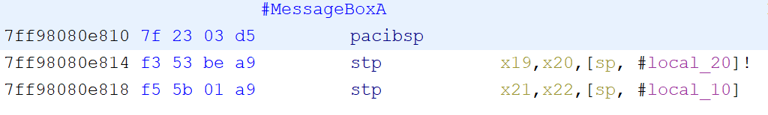
x64
Arm64

Slide 3
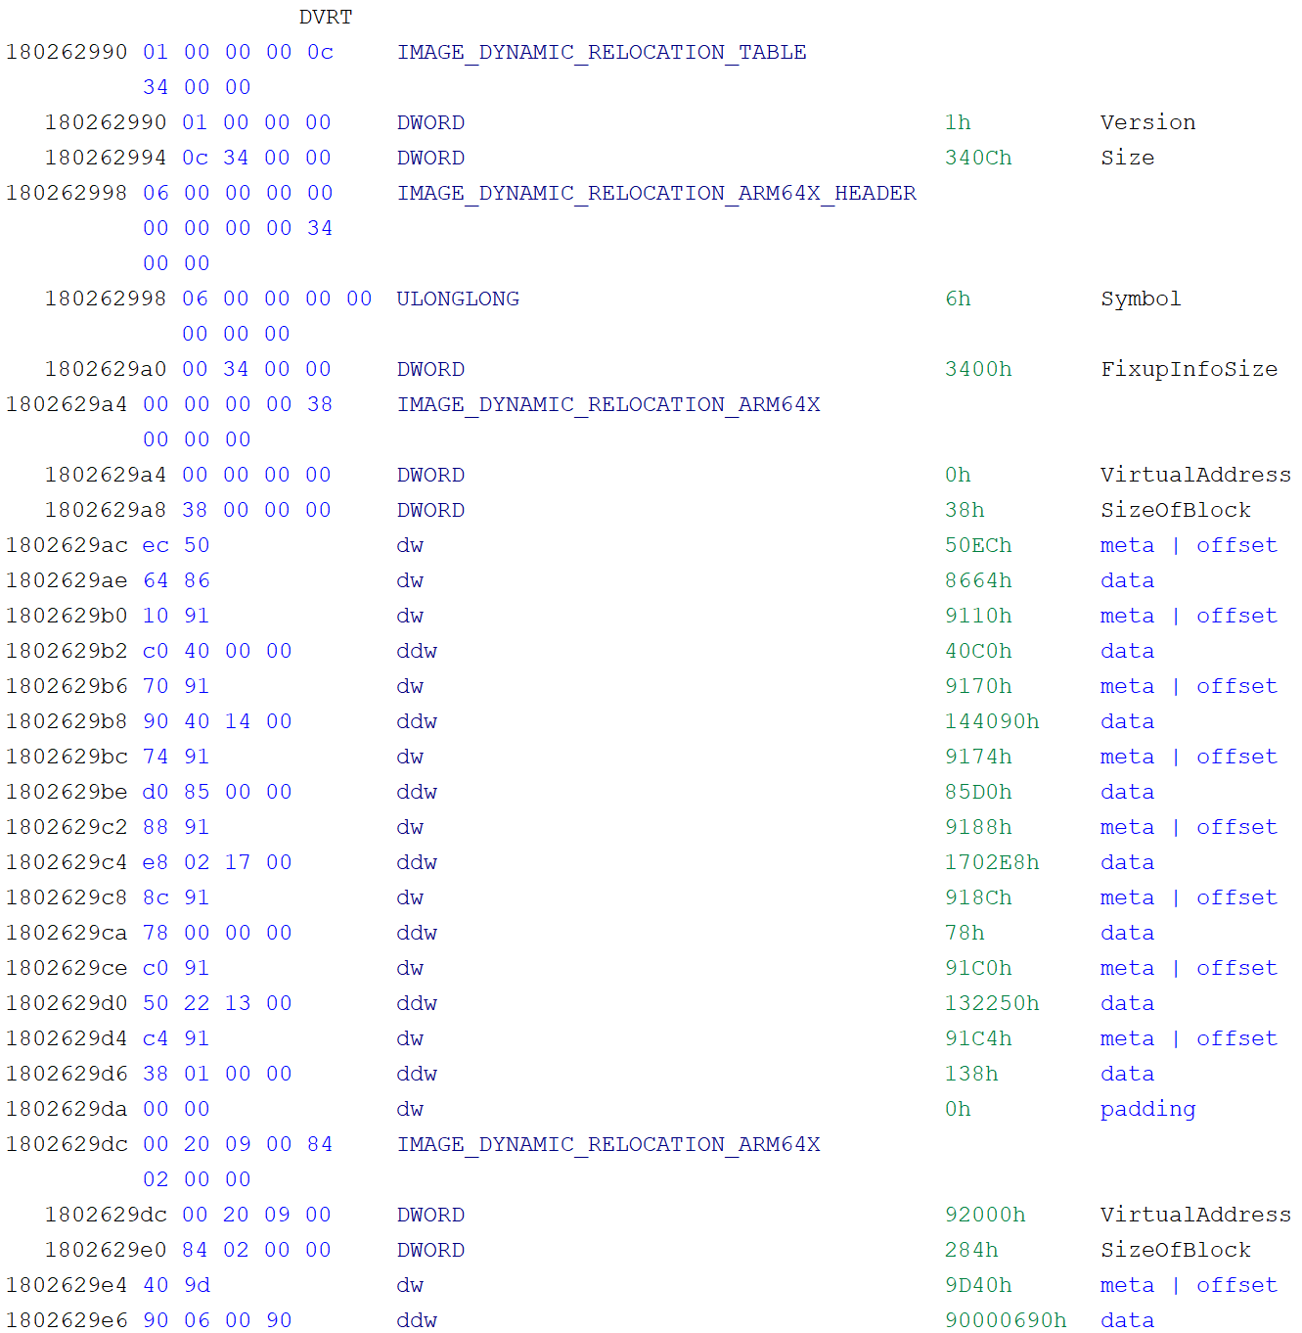
VirtualAddress == 0
#0
#1

Slide 4
DVRT Header
Relative virtual address
DVRT ARM64X Header
Size of block
Block #1
type | offset
data to be written
…
…
Block #n
type | offset
data to be written

Slide 5
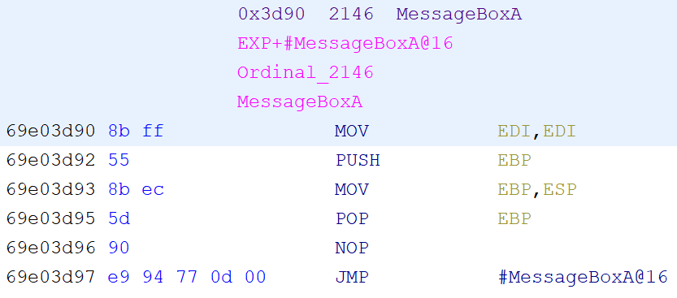
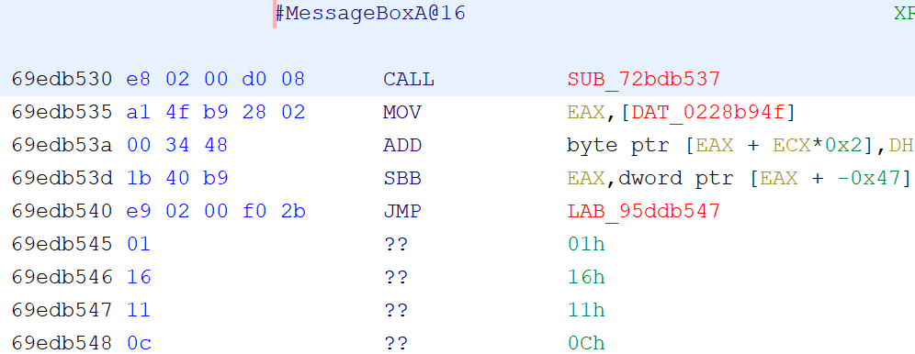
x86
x86? (seems junk)

