Slide 2
SDNFV Lab 6
Network Functions
助教：蔣汶儒
sdnta@win.cs.nycu.edu.tw
Deadline: 2025/11/25

Slide 3
OUTLINE
Router Specification
ONOS App and Services in Use
Docker Introduction & Usage
In Used App Configurations
Virtual Router Workflow
Project Information and Installation
Supplement
Scoring Criteria
Reference

Slide 4
OUTLINE
Router Specification
ONOS App and Services in Use
Docker Introduction & Usage
In Used App Configurations
Router Workflow
Lab Information and Installation
Supplement
Scoring Criteria
Reference

Slide 5
Goal
Intra-domain host communication
  Handled by Bridge APP
Inter-domain host communication
  SDN domain <-> Other domain
Transit host communication
  Other domain <-> SDN domain <-> Other domain

Slide 6
vRouter Specification
Intra AS packet forwarding and packet-in request
  Lab3
Arp Reply for devices in AS
  Lab3
Automatic IP Allocation
  Lab4
IPv6 Capability
  Lab5
Routing table maintenance
  Lab6

Slide 7
OUTLINE
Router Specification
ONOS App and Services in Use
Docker Introduction & Usage
In Used App Configurations
Router Workflow
Lab Information and Installation
Supplement
Scoring Criteria
Reference

Slide 8
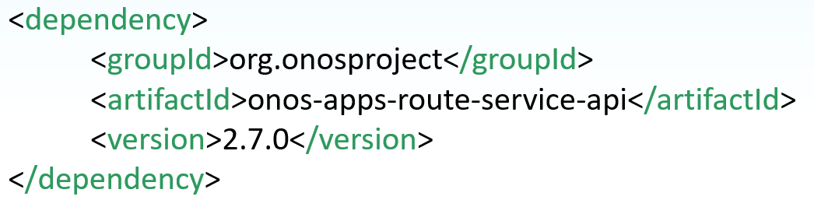
ONOS Route Service Usage
Update dependencies in pom.xml file.
Import methods.

Slide 9
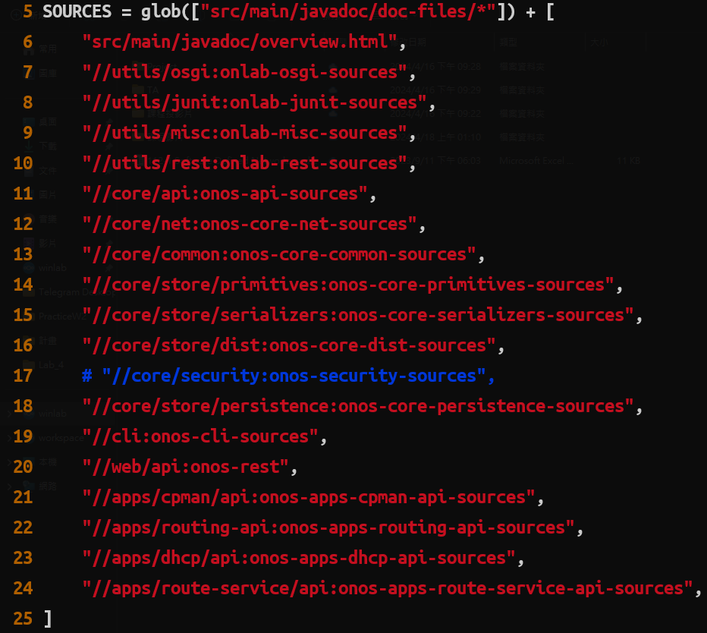
How to Read The Friendly Manual
Steps to build and view onos docs
  Goto ONOS_HOME (often ~/onos)
  Open docs/BUILD
  Modify SOURCES add `//apps/route-service/api:onos-apps-route-service-api-sources`

Slide 10
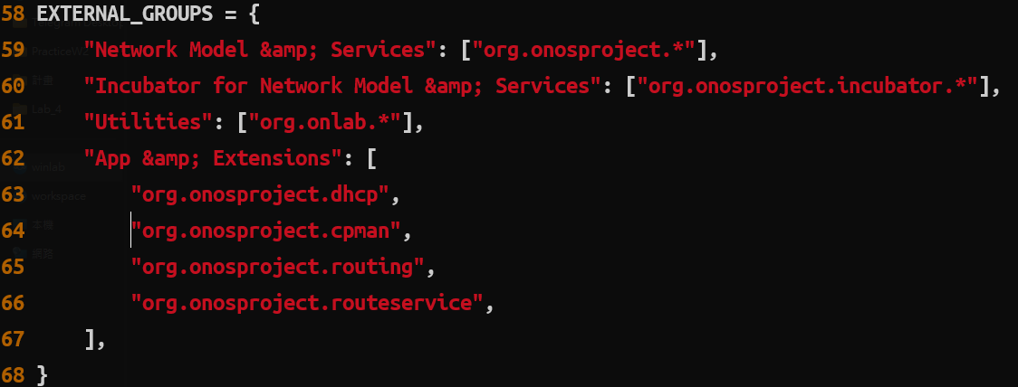
How to Read The Friendly Manual
Steps to build and view onos docs
  Goto ONOS_HOME (often ~/onos)
  Open docs/BUILD
  Modify SOURCES, add `//apps/route-service/api:onos-apps-route-service-api-sources`
  Modify EXTERNAL_GROUPS, add `org.onosproject.routeservice`

Slide 11
How to Read The Friendly Manual
Steps to build and view onos docs
  Goto ONOS_HOME (often ~/onos)
  Open docs/BUILD
  Modify SOURCES, add `//apps/route-service/api:onos-apps-route-service-api-sources`
  Modify EXTERNAL_GROUPS, add `org.onosproject.routeservice`
  Run `bazel build //docs:external`
  Run `unzip bazel-bin/docs/external.jar`
    You shall find `apidocs` directory been generated
  Goto `apidocs` and run `python3 -m http.server`
  You will find the documentation been serve at localhost:8000

Slide 12
OUTLINE
Router Specification
ONOS App and Services in Use
Docker Introduction & Usage
In Used App Configurations
Router Workflow
Lab Information and Installation
Supplement
Scoring Criteria
Reference

Slide 13
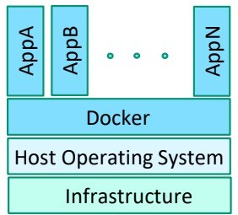
Introduction to Docker
Docker is a software platform that allows you to build, test, and deploy applications quickly in packages called containers
Typical steps for creating Docker containers:
  Build Docker images of the desired OS distribution and applications
  Store the images in a Docker Registry
    Public (Docker Hub)
    Private
  Run Docker to build containers of images

Slide 14
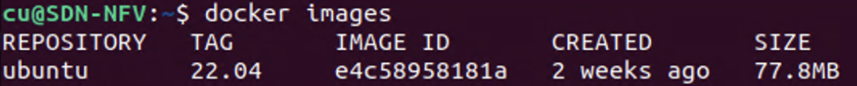
Pull Image
Usage
E.g., Pull ubuntu:22.04 image from Docker hub registry
List images
$ docker pull <name>:<tag>
$ docker pull ubuntu:22.04
$ docker images

Slide 15


Docker run (1/2)
Run a command in a new container
‒ Create and run a container
‒ Execute a command in the container
Usage
E.g., Create and Run a container “test”
  -d: Detached (like a daemon in background)
  -it: Interactive processes (like a shell)
  --name: Assign a name to the container
$ docker run <options> <image>:<tag> <command> <arg..>
Create and Run a container
Execute a command in the container
$ docker run -d -it --name test ubuntu:22.04

Slide 16
Docker run (2/2)
List containers
  “--all”, “-a”: Show all containers
Container is connected to docker0 bridge by default
Default IP for docker0 bridge is 172.17.0.1/16
Docker will assign an IP for the container
$ docker ps -a
docker0
Host
172.17.0.1
172.17.X.X
eth0
test
Container

Slide 17
Docker exec
Execute a command in a running container
Usage
E.g., Exec bash command in a running container “test”
$ docker exec <options> <container> <command>
$ docker exec -it test bash

Slide 18
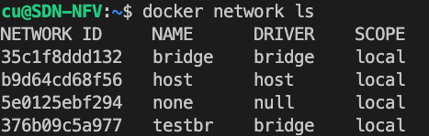
Docker network - Create
Create a bridge network
Usage
E.g., Create a network bridge “testbr”
List networks
$ docker network create <bridge>
$ docker network create testbr
Host
$ docker network ls
docker0
testbr
eth0
test
Container
Notes:
host (no isolation between host and containers on this network, to the outside world they are on the same network)
none (attached containers run on container-specific network stack)

Slide 19
Network Environment after testbr Creation
Internet
eth0
docker0
testbr
eth0
test
Container
Host

Slide 20
Docker network - Connect
Connect to a bridge network
Usage
E.g., Connect container “test” to bridge “testbr”
‒ Docker will add an interface on the container and assign an IP
$ docker network connect <network> <container>
$ docker network connect testbr test
Host
docker0
testbr
eth0
eth1
test
Container

Slide 21


Steps to Setup Example Scenario
Prepare Docker images
Create containers
Setup container networks
  Setup network for domains
  Connect domains
Configure host gateways
  Gateway of h1 = R1
  Gateway of h2 = R2
Setup routers
Check routes
Virtual Machine
Docker
Domain 1
Domain 2
h1
R1
R2
h2

Slide 22
Step 1 – Prepare Docker images (1/3)
Prepare docker image “host”
Write Dockerfile
‒ Create configuration file host.Dockerfile
$ vi host.Dockerfile
FROM ubuntu:22.04
RUN apt-get update -y \
&& apt-get install -y traceroute \
&& apt-get install -y net-tools \
&& apt-get install -y iproute2 \
&& apt-get install -y iputils-ping
CMD ["sleep","infinity"]

Slide 23
Step 1 – Prepare Docker images (2/3)
Build docker image with Dockerfile
  -t: Name and optionally a tag in the “name:tag” format
  -f: Name of the Dockerfile (Default is 'PATH/Dockerfile')
List image
$ docker build -t host -f host.Dockerfile .
$ docker images

Slide 24
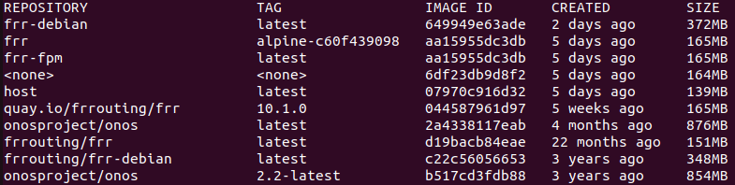
Step 1 – Prepare Docker images (3/3)
Prepare Docker image frrouting
Pull image frrouting/frr-debian from docker hub
List image
$ docker pull frrouting/frr-debian
$ docker images
Note: Do not use frrouting/frr image as it doesn’t have the necessary component built for this lab.

Slide 25
Step 2 – Create Containers (1/2)
Create a container with prepared image
--privileged: Give extended privileges to this container
--cap-add: Add Linux capabilities
  NET_ADMIN: Enable network administration operations
  NET_BROADCAST: Make socket able to broadcasts, and listen to multicasts
$ docker run --privileged --cap-add NET_ADMIN \
--cap-add NET_BROADCAST -d -it \
--name <container name> <image>

Slide 26
Step 2 – Create Containers (2/2)
Create container for a host h1 (h2)
Create container for a virtual router R1 (R2)
$ docker run --privileged --cap-add NET_ADMIN \
--cap-add NET_BROADCAST -d -it \
--name h1 host
$ docker run --privileged --cap-add NET_ADMIN \
--cap-add NET_BROADCAST -d -it \
--name R1 frrouting/frr-debian
Docker
h1
R1
R2
h2

Slide 27
Step 3 – Setup Container Networks (1/3)
Setup network for domains
Create a bridge network R1h1br
‒ R1h1br: Bridge name
Connect containers h1 and R1 to bridge R1h1br
‒ Docker will assign IP to interfaces automatically
$ docker network create R1h1br
$ docker network connect R1h1br R1
$ docker network connect R1h1br h1
Docker bridge
h1
R1
R1h1br
172.18.0.3
172.18.0.2
Notes:
create network for domain

Slide 28
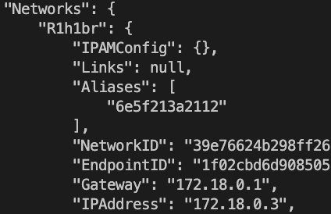

Step 3 – Setup Container Networks (2/3)
Docker bridge
Check the IP addresses of network interfaces
Repeat network setup procedure for another domain
  Create bridge network R2h2br
  Connect containers R2 and h2
$ docker inspect h1 (R1)
h1
R1
172.18.0.3
R1h1br
172.18.0.2
Inspected result for h1
Inspected result for R1
Notes:
screenshot

Slide 29
Step 3 – Setup Container Networks (3/3)
Connect two domains
Create inter domain bridge
Connect containers R1 and R2 to bridge R1R2br
$ docker network create R1R2br
$ docker network connect R1R2br R1
$ docker network connect R1R2br R2
h1
R1
R2
h2
R1h1br
R2h2br
R1R2br
Domain 1
Domain 2

Slide 30
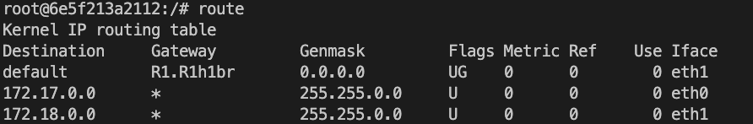
Step 4 – Configure Host Gateways (1/1)
Run bash on h1 (h2)
Set R1 (R2) as default gateway of h1 (h2)
Check route on h1 (h2)
Exit h1 bash via CTRL+D
172.18.0.2
$ docker exec -it h1 bash
h1
R1h1br
R1
h1/# ip route del default
h1/# ip route add default via 172.18.0.2
Gateway = 172.18.0.2 (R1)
h1/# route
h1’s bash prompt

Slide 31
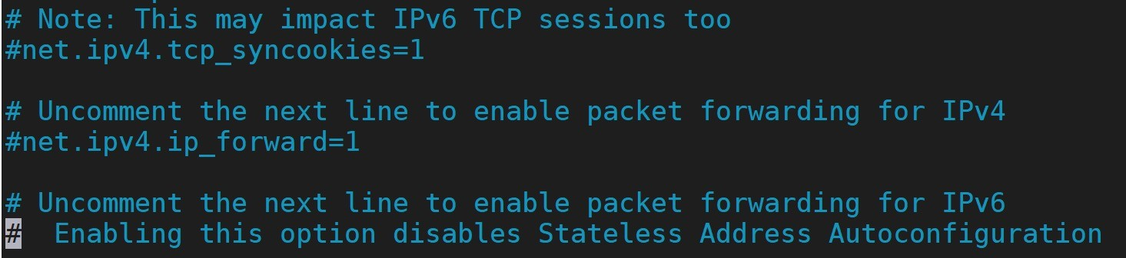
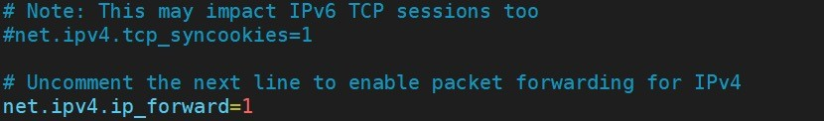
Step 5 – Setup Routers (1/4)
Run bash on R1 (R2)
Enable IP forwarding on R1 (R2)
‒ Uncomment
“net.ipv4.ip_forward=1”
Run sysctl to
load configuration
$ docker exec -it R1 bash
R1/# vi /etc/sysctl.conf
R1/# sysctl -p

Slide 32
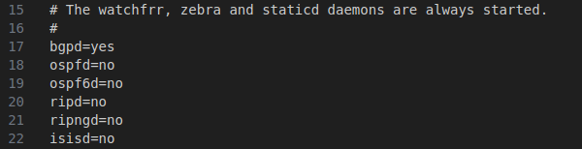
Step 5 – Setup Routers (2/4)
FRR daemons config file R1(R2)
‒ Edit FRR daemon configuration file on R1 (R2)
‒ Edit bgpd=yes to turn on bgp routing daemon
R1/# vi /etc/frr/daemons

Slide 33
Step 5 – Setup Routers (3/4)
ASN 65000
Set BGP configuration for routers
‒ Edit configuration file frr.conf on R1
172.18.0.0/16
R1/# vi /etc/frr/frr.conf
R1
h1
! FRR configuration for R1
!
frr defaults datacenter
!
router bgp 65000
bgp router-id 172.20.0.2
timers bgp 3 9
neighbor 172.20.0.3 remote-as 65001
neighbor 172.20.0.3 ebgp-multihop
neighbor 172.20.0.3 timers connect 5
neighbor 172.20.0.3 advertisement-interval 5
network 172.18.0.0/16
!
log stdout
line vty
172.20.0.2
172.20.0.3
R2
h2
172.19.0.0/16
ASN 65001
ASN 65000
ASN 65001
Notes:
router bgp [ASN] : Enable BGP daemon and set autonomous system number (ASN); this is supplied by your ISP.
bgp router-id [A.B.C.D] : Configure the router ID.
network [A.B.C.D/M] : Announce BGP on network: A.B.C.D/M, identifies the subnet to advertise.
neighbor [A.B.C.D|A:B:C:D:E:F:G:H] remote-as [ASN] : Set neighbor as a member of remote ASN.
neighbor [A.B.C.D|A:B:C:D:E:F:G:H] ebgp-multihop : Set neighbor on another network using EBGP multi-hop.
neighbor [A.B.C.D|A:B:C:D:E:F:G:H] timers connect [time] : Set the BGP connection timer, in seconds.

Slide 34
Step 5 – Setup Routers (4/4)
ASN 65000
Set BGP configuration for routers
‒ Edit configuration file frr.conf on R2
172.18.0.0/16
R2/# vi /etc/frr/frr.conf
R1
h1
! FRR configuration for R2
!
frr defaults datacenter
!
router bgp 65001
bgp router-id 172.20.0.3
timers bgp 3 9
neighbor 172.20.0.2 remote-as 65000
neighbor 172.20.0.2 ebgp-multihop
neighbor 172.20.0.2 timers connect 5
neighbor 172.20.0.2 advertisement-interval 5
network 172.19.0.0/16
!
log stdout
line vty
172.20.0.2
172.20.0.3
R2
h2
172.19.0.0/16
ASN 65001
ASN 65000
ASN 65001
Notes:
router bgp [ASN] : Enable BGP daemon and set autonomous system number (ASN); this is supplied by your ISP.
bgp router-id [A.B.C.D] : Configure the router ID.
network [A.B.C.D/M] : Announce BGP on network: A.B.C.D/M, identifies the subnet to advertise.
neighbor [A.B.C.D|A:B:C:D:E:F:G:H] remote-as [ASN] : Set neighbor as a member of remote ASN.
neighbor [A.B.C.D|A:B:C:D:E:F:G:H] ebgp-multihop : Set neighbor on another network using EBGP multi-hop.
neighbor [A.B.C.D|A:B:C:D:E:F:G:H] timers connect [time] : Set the BGP connection timer, in seconds.

Slide 35
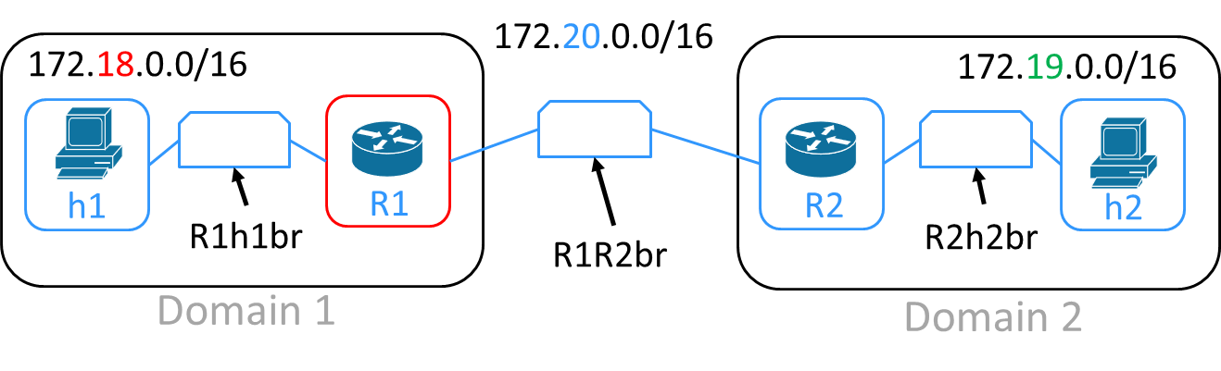
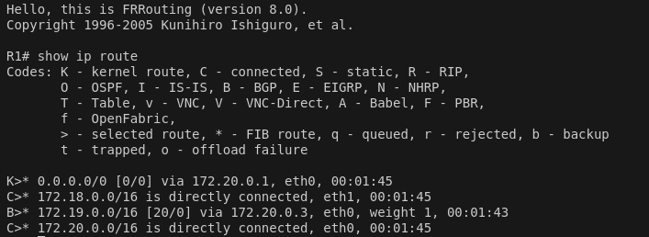
Step 6 – Check Routes (1/2)
Restart R1 (R2)
Interact with FRR daemons
Show routes on R1 (R2)
$ docker restart R1
R1/# vtysh
R1FRR> show ip route

Slide 36
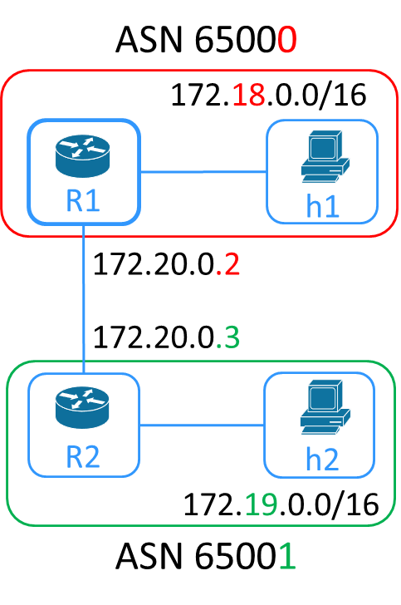
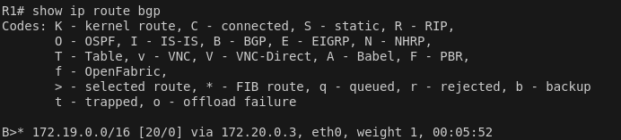
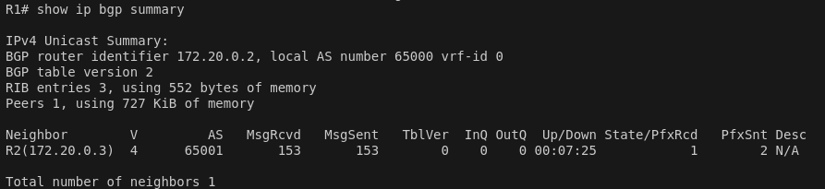
Step 6 – Check Routes (2/2)
Show bgp route in R1 FRR (in vtysh)
Show bgp summary in R1 FRR (in vtysh)
R1FRR> show ip route bgp
R1FRR> show ip bgp summary

Slide 37
OUTLINE
Router Specification
ONOS App and Services in Use
Docker Introduction & Usage
In Used App Configurations
Router Workflow
Lab Information and Installation
Supplement
Scoring Criteria
Reference

Slide 38
Installation of Docker
Update apt (confirm to install the latest package)
Install curl for data transfer
Retrieve Docker installation script and install Docker
Manage Docker as a non-root user
Other Methods: https://docs.docker.com/engine/install/ubuntu/
$ sudo apt-get update
$ sudo apt-get install -y curl
$ sudo curl -ssl https://get.docker.com | sh
$ sudo groupadd docker
$ sudo usermod -aG docker $USER
$ newgrp docker

Slide 39
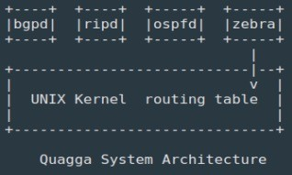
Introduction to FRRouting
FRRouting is an open-source software that provides routing services
‒ Supports common routing protocols: BGP, OSPF, RIP, and IS-IS
‒ Consists of a core daemon Zebra and separate routing protocol daemons
Routing Protocols (daemons) communicate their best routes to Zebra
Zebra computes best routes and modifies kernel routing table through netlink
User
Kernel
Netlink

Slide 40

Introduction to FIB Pushing
Zebra supports a FIB Push Interface (FPI)
‒ FPI allows an external component to learn the forwarding information
Forwarding Plane Manager (FPM):
‒ Receives FIB
‒ Decode FIB into routes
‒ Programs forwarding plane
FIB Pushing:
‒ FPM establishes a TCP
connection with zebra
‒ Zebra pushes FIB to FPM
ospfd
bgpd
ripd
FIB Push Interface
zebra
FPM
User
Control Plane
Kernel
Forwarding Plane
Routing Table/
Forwarding Table
10

Slide 41
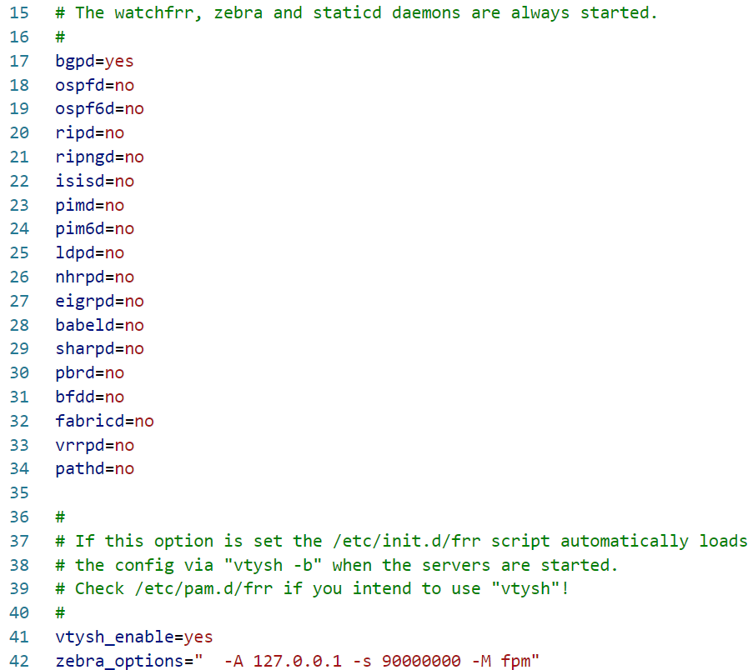
Enabling FPM Module
To enable FPM, you have to set –M fpm in zebra_options at /etc/frr/daemons

Slide 42
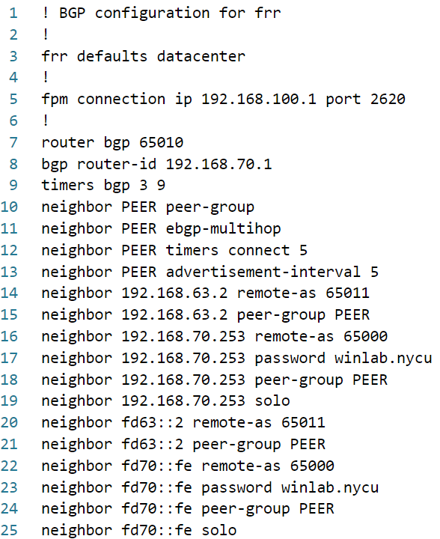
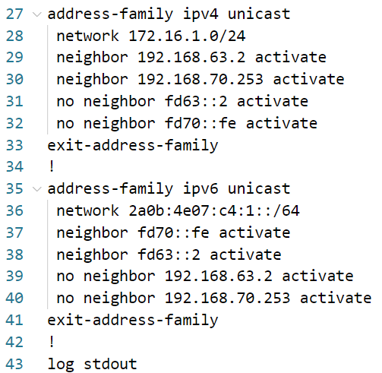
FRRouting Configuration
Configurations in /etc/frr/frr.conf
FPM connection
Announce IPv4 prefix on IPv4 Interface
Peer Group (template) for neighbors
Use the template
BGP Passwords
Don’t advertise the prefix that you received
Same as IPv6 Interface
NOTE* Older versions of FRRouting might not work, this is just an example

Slide 43
OUTLINE
Router Specification
ONOS App and Services in Use
Docker Introduction & Usage
In Used App Configurations
Router Workflow
Lab Information and Installation
Supplement
Scoring Criteria
Reference

Slide 44

Gateway Traffic Handling Example
Any packets within the domain only knows about the gateway’s MAC.
After analyzing the information (IP), it will change the according MAC and sends the packet out.
DOMAIN A
DOMAIN B
src
dst
src
dst
src
dst
IP
A
B
A
B
A
B
MAC
A
R1
R1’
R2’
R2
B
Host A
Host B
R1
R2

Slide 45
Transit Traffics
Transit traffics are in fact two interdomain traffics.
dst
src
DOMAIN B
C
B
Host B
R2
R1
DOMAIN A
R1
R2
DOMAIN C
dst
src
C
B
Host C
R4
R2’
R4

Slide 46
OUTLINE
Router Specification
ONOS App and Services in Use
Docker Introduction & Usage
In Used App Configurations
Router Workflow
Lab Information and Installation
Supplement
Scoring Criteria
Reference

Slide 47
Linux Network Brief Introduction
Network Namespaces
  Provide a way to create isolated network environments within a Linux system.
  Allow processes to have their own network stack, including interfaces, routing tables, and firewall rules.
Each Container have it’s own Network Namespace.
A network Bridge is a kernel created logical L2 switch
Veth devices, short for virtual Ethernet devices
Use veth pairs to connect Network Namespaces or Bridges together.

Slide 48
Linux Network Brief Introduction (cont.)
Mapping to physical instruments.
Namespace = node (computer/server)
Veth pair = 2 network interface cards (NIC) that connects to each other
Bridge = switch
If you want to connect your computer to a switch
  Create a veth pair (Create 2 NIC that connects to each other)
  Connect one NIC to your namespace
  Connect the other one to your bridge
Bridge
Namespace
Veth
Veth

Slide 49
Linux Network Brief Introduction (cont.)
Mapping to physical instruments.
Namespace = node (computer/server)
Veth pair = 2 network interface cards (NIC) that connects to each other
Bridge = switch
How to find a container’s namespace (ns)?
  Locate docker pid
  It is at file `/proc/$pid/ns/net`
Similarly you can connect two namespaces (containers) with the same mechanism.
Container
Container
Veth
Veth

Slide 50
Ubuntu IP Command Introduction
Normally, we can use `ip netns exec` command to execute commands inside a namespace; however, it will only search ns for directories in `/var/run/netns`
Two ways to run `ip netns exec` in container namespace
  Create a soft link `ln -sfT /proc/$pid/ns/net /var/run/netns/$pid`
  Use nsenter command `nsenter -t $pid -n <command>`
Useful ip commands
  `ip link add <name> type <type>`: Create a NIC by the type.
  `ip link set <name> up`: Bring up (enable) the NIC.
  `ip address add <ip> dev <name>`: Add an ip address to the NIC.
  `ip route show`: Show current routes.
  `ip route add {<ip> | default} via {ip}: Add a route.

Slide 51
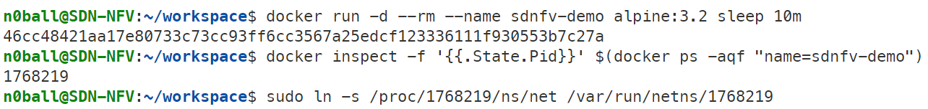
Docker Network Namespace Introduction
Create a container named sdnfv-demo
Find the pid of the container
Make soft link so that ip netns can find container ns
Show interface information of ns
Create a dummy NIC using netns command
Show interface information of the container
NIC is created inside the container

Slide 52
Tunnel and VXLAN
A Tunnel send data over a network by encapsulating packets within other packets.
  Commonly used to connect different networks, provide secure communication, bypass firewalls.
  Applications
    Virtual Private Networks (VPN)
    Generic Routing Encapsulation (GRE)
    Virtual Extensible LAN (VXLAN)
  Types
    Layer 2: Transmit data that is higher or equal to Layer 2
    Layer 3: Transmit data that is higher or equal to Layer 3
VXLAN (L2 Tunnel)
  Designed to help build large, scalable L2 networks over existing L3 networks

Slide 53
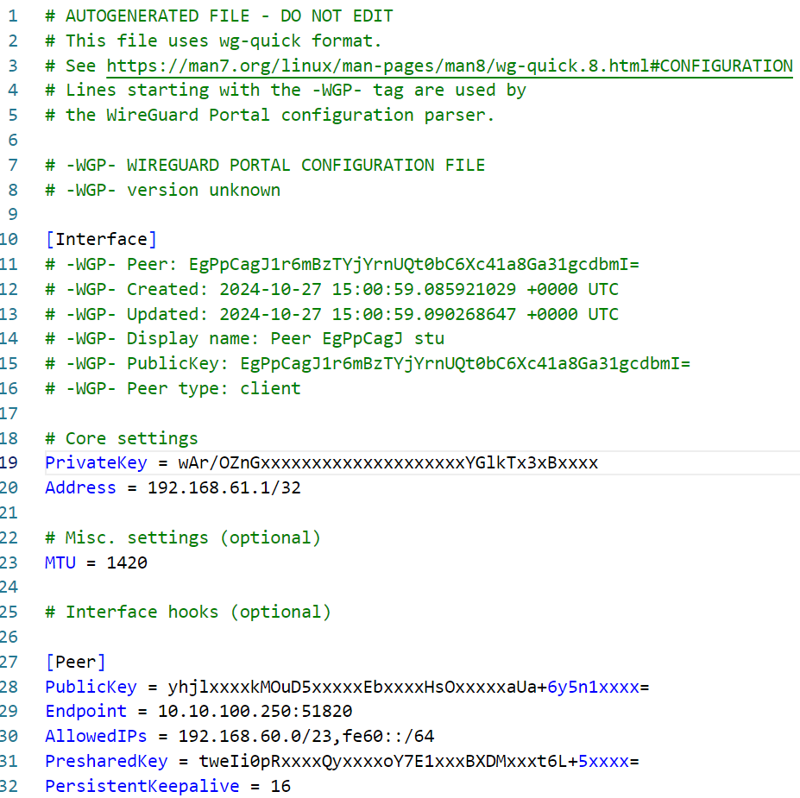
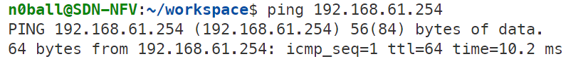
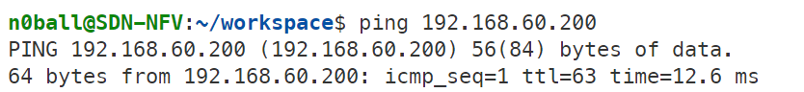
Wireguard
TA will provide a Wireguard configuration file
  Remember, the last number of your IP is your ID (x)
Run the follow command to install wireguard
Copy the configuration file to wg0
Bring up the Wireguard interface
Check if Wireguard is good
  Wireguard gateway
  VXLAN Target
This is your ID (x)
This is Wireguard gateway
Some wireguard version requires port
This is your x

Slide 54
Maximum Transmission Unit (MTU)
The largest size (in bytes) of a network packet that can be transmitted over a particular interface or network medium without fragmentation.
Default to 1500 Bytes.
What Happens if Packet Size Exceeds the MTU?
  Fragmentation
  Drop (Especially IPv6)
Suggested subtraction of MTU due to encapsulation
  VXLAN: 50 Bytes
  Wireguard: 80 Bytes

Slide 55

Autonomous System (AS)
AS Types
Stub
Multi Homed
Transit
Internet Exchange Point

Slide 56
ISP Characteristic
Internet Service Provider (ISP)
  A company or organization that provides individuals, enterprises, and other entities access to the internet.
Key Concepts
  Internet Access
  Internet Service
  IP Addresses
If you have been assigned an IP from NYCU
  How does the Internet world routes packets to your IP’s location?
  How does others know the way to find you in the Internet world?
Goal: A vrouter in a small ISP and that manages internet resources.

Slide 57
ISP Service Requirements
Service requirements for customers.
  Routers to exchange other AS’s route.
  Layer 2 modification
  Packet handling
Service requirements for other ISPs.
  Packet handling
  Quality of Service (QoS)

Slide 58
Configuration Requirements
You are running an AS65xx0 and announcing prefixes
  172.16.x.0/24.
  2a0b:4e07:c4:xx::/64
You help to transit prefixes announced by AS65xx1
  172.17.x.0/24.
  2a0b:4e07:c4:1xx::/64
IXP is AS65000 at 192.168.70.253/24 and fd70::fe/64
  You have to announce the prefixes you know to the IXP
  You can connect the IXP via
    192.168.70.x/24
    fd70::x/64
  BGP Password is winlab.nycu

Slide 59
OVS and VXLAN
You can consider OVS as a bridge.
  You can create veth pairs and connect your container
  You can create VXLAN Tunnel
Let’s see if we can create a tunnel using `ovs-vsctl` and `ip` commands.
192.168.100.1/24
Dummy NIC
OvS
Veth
Veth

Slide 60
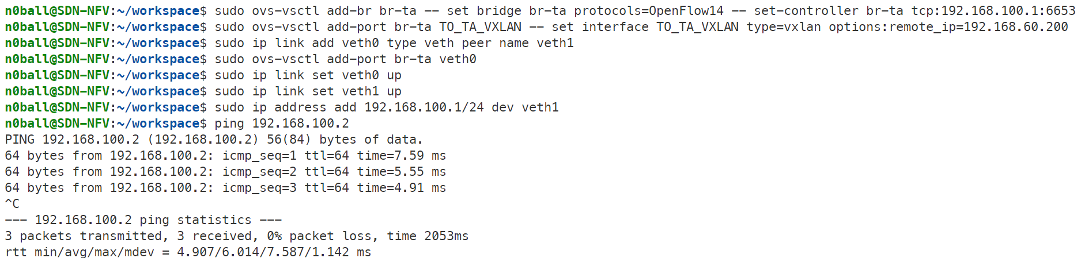
OVS and VXLAN (cont.)
Create a ovs switch named br-ta
Set ovs protocol
Set ovs controller
Set VXLAN connected to IP
Create a VXLAN port name TO_TA_VXLAN on ovs swtich br-ta

Slide 61
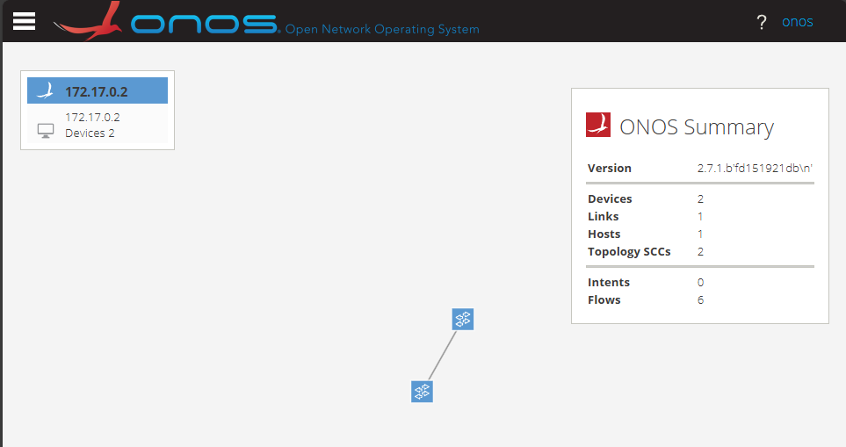
OVS and VXLAN (cont.)
You can use docker to create an onos controller
If you have finish lest step, you shall see two switches connected

Slide 62
Topology Template
192.168.63.1/24
192.168.70.xx/24
172.16.xx.1/24
192.168.100.3/24
fd63::1/64
fd70::xx/64
2a0b:4e07:c4:xx::1/64
AS65030
172.16.xx.3/24
2a0b:4e07:c4:xx::3/64
172.17.xx.1/24
2a0b:4e07:c4:1xx::1/64
192.168.100.2/24
Host 2
FRRouting
ONOS
AS65031
Host 3
OVS1
172.17.xx.2/24
2a0b:4e07:c4:1xx::2/64
192.168.63.2/24
fd63::2/64
Host 1
OVS2
172.16.xx.2/24
2a0b:4e07:c4:xx::2/64
VXLAN

Slide 63
Sample Topology (x=3)
192.168.63.1/24
192.168.70.3/24
172.16.3.1/24
192.168.100.3/24
fd63::1/64
fd70::3/64
2a0b:4e07:c4:3::1/64
AS65030
172.16.3.3/24
2a0b:4e07:c4:3::3/64
172.17.3.1/24
2a0b:4e07:c4:103::1/64
192.168.100.2/24
Host 2
FRRouting
ONOS
AS65031
Host 3
OVS1
172.17.3.2/24
2a0b:4e07:c4:103::2/64
192.168.63.2/24
fd63::2/64
Host 1
OVS2
172.16.3.2/24
2a0b:4e07:c4:3::2/64
VXLAN

Slide 64
Sample Topology (x=25)
To avoid misconfiguration, don’t use a-f as IP in your settings.
  Use 25, instead
AS65250
192.168.63.1/24
192.168.70.25/24
172.16.25.1/24
192.168.100.3/24
fd63::1/64
fd70::25/64
2a0b:4e07:c4:25::1/64
172.16.25.3/24
2a0b:4e07:c4:25::3/64
172.17.25.1/24
2a0b:4e07:c4:103::1/64
Host 2
FRRouting
ONOS
192.168.100.2/24
AS65251
Host 3
OVS1
172.17.25.2/24
2a0b:4e07:c4:125::2/64
192.168.63.2/24
fd63::2/64
Host 1
OVS2
172.16.25.2/24
2a0b:4e07:c4:25::2/64
VXLAN

Slide 65
Topology for 3 Students
AS65xx0
VXLAN
VXLAN
AS65yy0
AS65zz0
VXLAN

Slide 66
OUTLINE
Router Specification
ONOS App and Services in Use
Docker Introduction & Usage
In Used App Configurations
Router Workflow
Lab Information and Installation
Supplement
Scoring Criteria
Reference

Slide 67
Helper Scripts
Hints
  Remember to use your old project codes
  ONOS might have bugs due to it has not been updated for 2 years
    Use wireshark to make sure that the packet is exactly what you expected
    Print debug is your best friend
    Read the docs
  You use reactive forward to test your topologies

Slide 68
TA Contacts
If you have any problem
  Mail to me
  Register demo time for help
Lab 6
  Team Register (should be done before 11/23, update at everyday noon)
https://docs.google.com/spreadsheets/d/18jBtdl7BgK_GIqJtgEI210icpPq_Et1tVk8eLnFe6Kk/edit?usp=sharing
    Deadline: 11/26

Slide 69
OUTLINE
Router Specification
ONOS App and Services in Use
Docker Introduction & Usage
In Used App Configurations
Router Workflow
Lab Information and Installation
Supplement
Scoring Criteria
Reference

Slide 70

Supplements
A sample of frr config
You can mount
  ./config/daemons to /etc/frr/daemons
  ./config/R1/frr.conf to /etc/frr/frr.conf
Docker images
  For FRR-Routers use frrouting/frr-debian
    Or build from souce (More recommended frr/docker at master · FRRouting/frr)
  For ONOS, the image is onosproject/onos:2.7-latest
  For host containers, you can use nicolaka/netshoot:latest

Slide 71
OUTLINE
Router Specification
ONOS App and Services in Use
Docker Introduction & Usage
In Used App Configurations
Router Workflow
Lab Information and Installation
Supplement
Scoring Criteria
Reference

Slide 72
Deployment Requirements
DO NOT TRY TO ATTACK EITHER OTHER STUDENTS OR TA SERVERS
You are required to create a Makefile so that you are able to
  Clear the entire project via make clean command
  Deploy the project via make deploy command
If not, you will be scored 0

Slide 73
Scores
Intra-domain traffic (from both AS)
  IPv4 (16 points)
  IPv6 (4 points)
Inter-domain traffic (from both AS)
  IPv4 (28 points)
  IPv6 (12 points)
Transit traffic
  IPv4 (28 points)
  IPv6 (12 points)

Slide 74
OUTLINE
Router Specification
ONOS App and Services in Use
Docker Introduction & Usage
In Used App Configurations
Router Workflow
Lab Information and Installation
Supplement
Scoring Criteria
Reference

Slide 75
Reference
ovs-vsctl(8) - Linux manual page (https://man7.org/linux/man-pages/man8/ovs-vsctl.8.html)
ip(8) - Linux man page (https://linux.die.net/man/8/ip)

