Slide 1
BANK CHURN · A BUSINESS PERSPECTIVE
Why Are Our Customers Leaving?
A churn & retention analysis of 10,000 retail-banking customers
20.4% churn · €186M deposits at risk · 2,037 customers lost
Data Analyst Program, Hebrew University of Jerusalem | Noy Levy, David Zeff, Danielle Ab, Sagi Gutin, Shira Meriash | June 2026

Slide 2
PROJECT
Team & Mentor
Presenters
Noy Levy, David Zeff, Danielle Ab, Sagi Gutin, Shira Meriash
Mentor
Tal Mizrachi
Dataset
Bank Churn — 10,000 retail-banking customers
Tools
Python (pandas) · cleaning & analysis | Plotly · interactive dashboard | PowerPoint
Bank Churn · Data Analyst Program, Hebrew University of Jerusalem
2

Slide 3
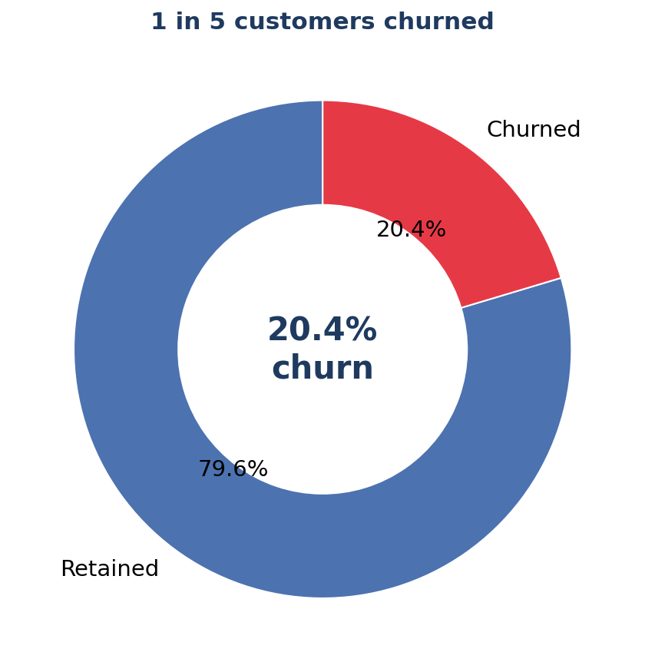
INTRODUCTION
The Domain — Retail Banking Churn
▸ Churn = a customer leaves the bank (closes their relationship). Our flag: Exited = 1.
▸ Why it matters: acquiring a new customer costs far more than keeping one — and a churned customer takes their deposits and fee income with them.
▸ The base: 10,000 customers across France, Germany and Spain, with demographics, account balances, products held and activity.
▸ Our questions: How many leave? WHO leaves, and WHY? And WHERE should the bank intervene first?
Bank Churn · Data Analyst Program, Hebrew University of Jerusalem
3

Slide 4
WHAT WE MEASURE
KPIs & Success Metrics
SUCCESS METRICS — CURRENT vs TARGET
20.4%
79.6%
52%
49%
CHURN RATE
RETENTION RATE
ACTIVE MEMBERS
CROSS-SELL (2+ PRODUCTS)
target ≤ 15%
target ≥ 85%
target ≥ 60%
target ≥ 60%
DEPOSITS, VALUE & REVENUE
€765M
€76K
€186M
≈€4.6M
DEPOSITS UNDER MGMT
AVG BALANCE / CUSTOMER
DEPOSITS AT RISK
REVENUE AT RISK / YR
total deposit book
per customer
24% of the book
~2.5% NIM (illustrative)
Why these: churn is the north-star; balance- and revenue-at-risk put it in euros; engagement and cross-sell are the levers we can pull. Success = churn ≤ 15% and retention ≥ 85% within a year.
Revenue figures assume a 2.5% net-interest margin on deposits — illustrative, as the dataset has no revenue field.
Bank Churn · Data Analyst Program, Hebrew University of Jerusalem
4

Slide 5
FROM MESSY TO TRUSTED
Data Preparation & Assumptions
▸ Source: one Excel workbook, two sheets (Customer_Info + Account_Info), joined on CustomerId.
▸ Standardised geography — France was split across 'France/French/FRA' → unified.
▸ Fixed types — stripped '€' from Balance & EstimatedSalary (text→number); Yes/No → 1/0.
▸ Removed duplicates, imputed 3 missing ages (median), reconciled a duplicated Tenure column.
▸ Filters/assumptions: snapshot data (no time dimension); full customer base analysed, no sampling.
Data-quality catch
'HasCrCard' was identical to 'IsActiveMember' for every row — a corrupted column. Detected and restored to authentic values.
Validation vs. published reference
Rows
10,000 ✓
Missing values
0 ✓
Churn rate
20.37% ✓
Geography mix
match ✓
Total balance
€0.77bn ✓
Bank Churn · Data Analyst Program, Hebrew University of Jerusalem
5

Slide 6
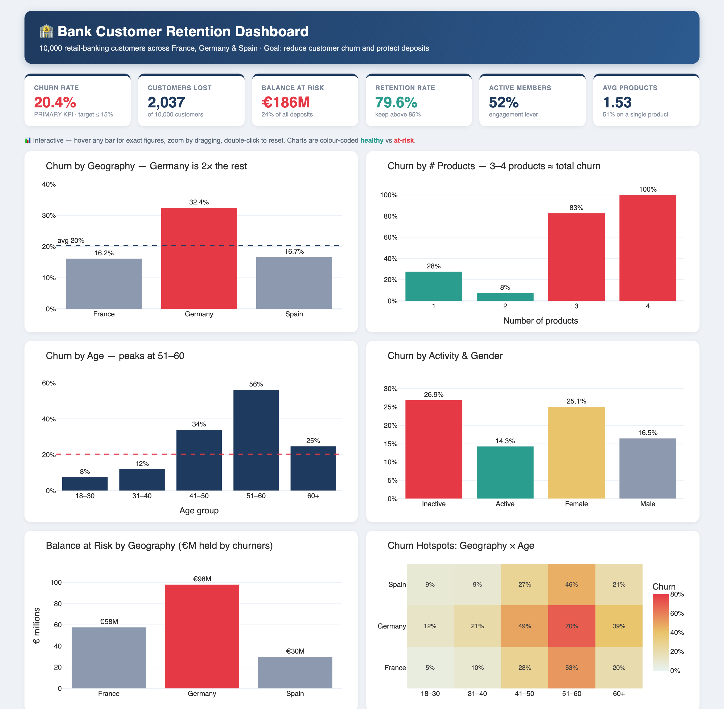
BI TOOL: PLOTLY
The Dashboard — One Page, Six Lenses
Bank Churn · Data Analyst Program, Hebrew University of Jerusalem
6

Slide 7
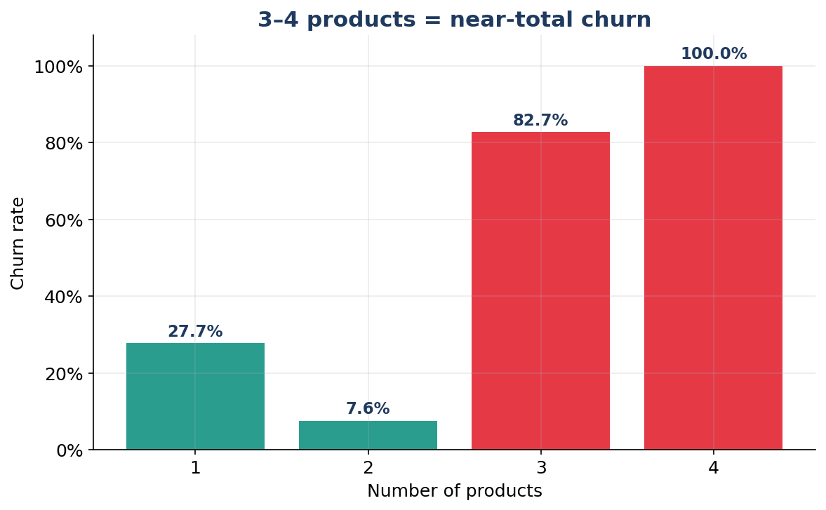
DEEP DIVE
Insight 1 — The Product Paradox
▸ 2 products is the sweet spot — just 7.6% churn. These customers are engaged and sticky.
▸ 3–4 products = near-certain exit — 83% and 100% churn. The 326 customers here are almost all gone.
▸ Half the base (51%) holds a single product and churns at 27.7%.
▸ Read: piling products onto unhappy customers backfires; the goal is the right second product, not more products.
1 → 2 products
moving single-product customers to two is the biggest retention prize.
Bank Churn · Data Analyst Program, Hebrew University of Jerusalem
7

Slide 8
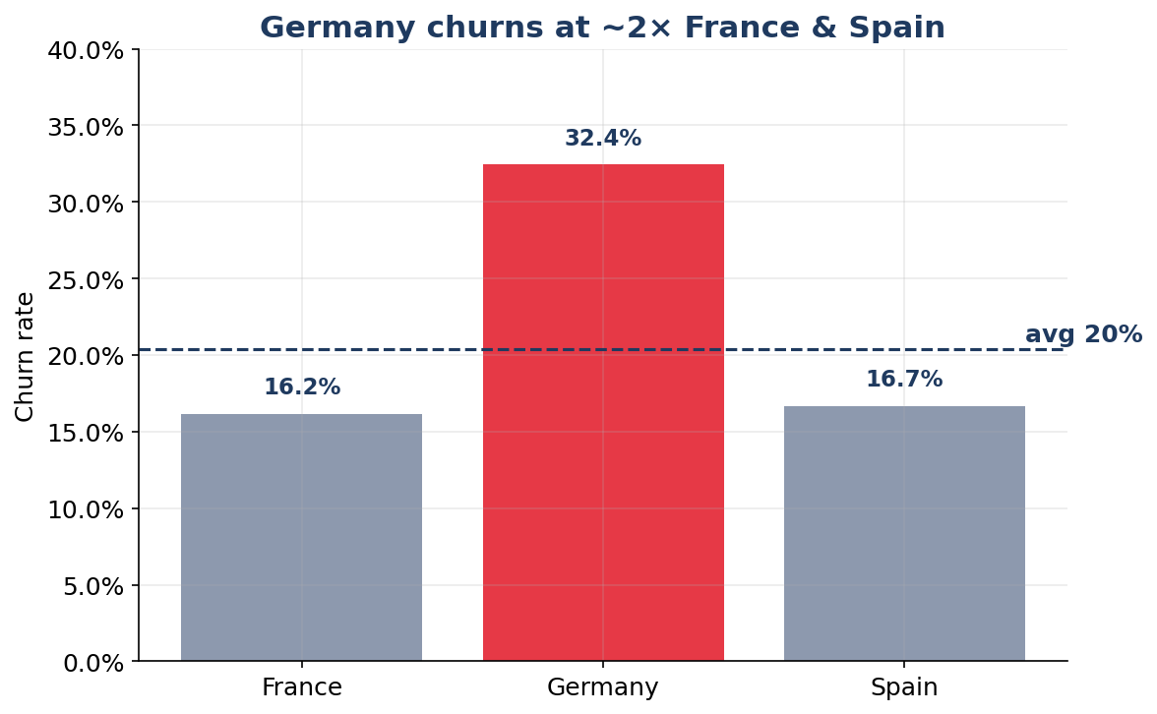
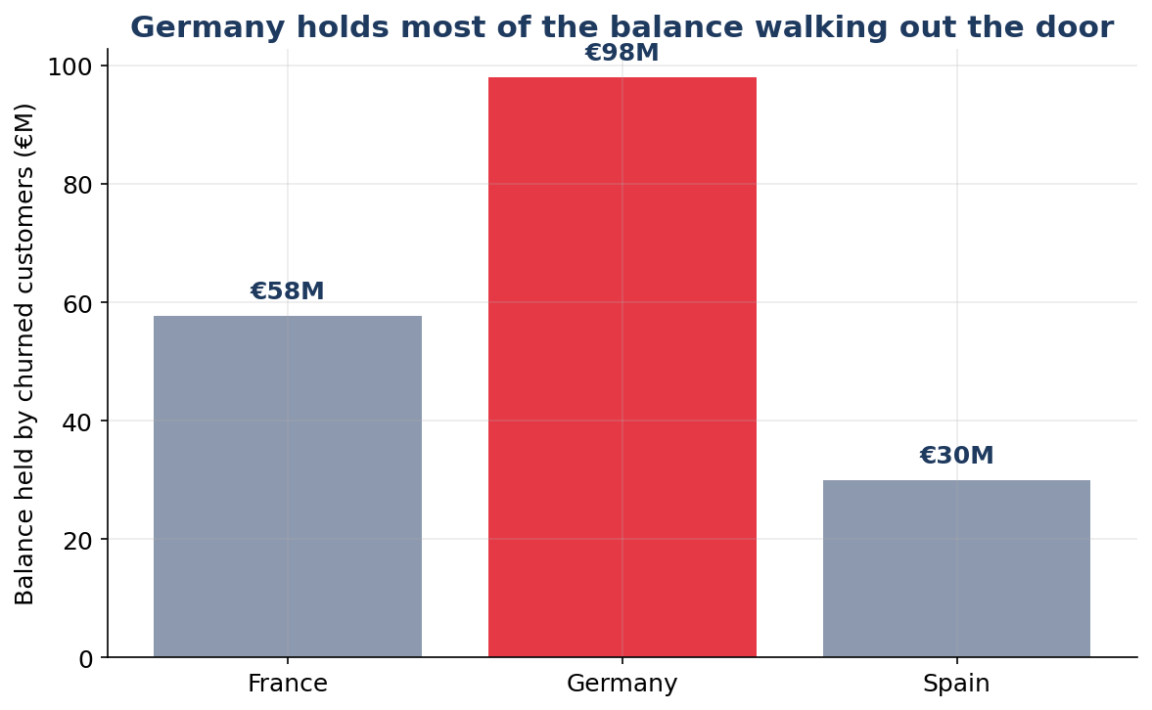
DEEP DIVE
Insight 2 — Germany & the Deposit Drain
Germany: 32% churn · €120k avg balance · €98M walking out the door
Germany churns at twice the rate of France & Spain, yet holds ~2× the average balance — so it is both our biggest leak and our most valuable one. Priority market #1.
Bank Churn · Data Analyst Program, Hebrew University of Jerusalem
8

Slide 9
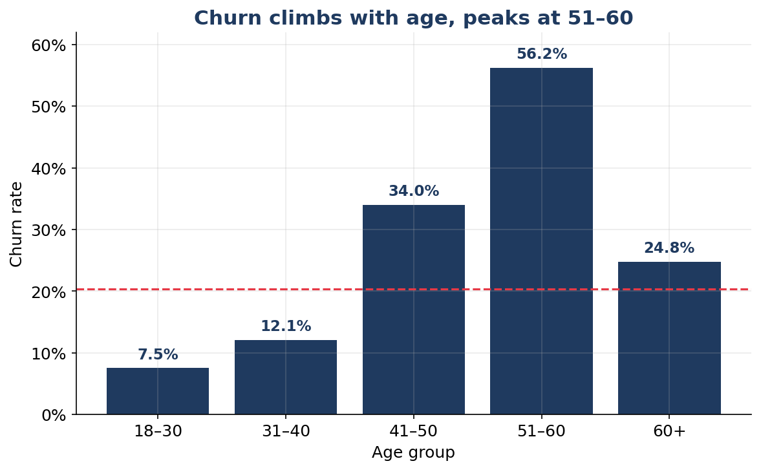
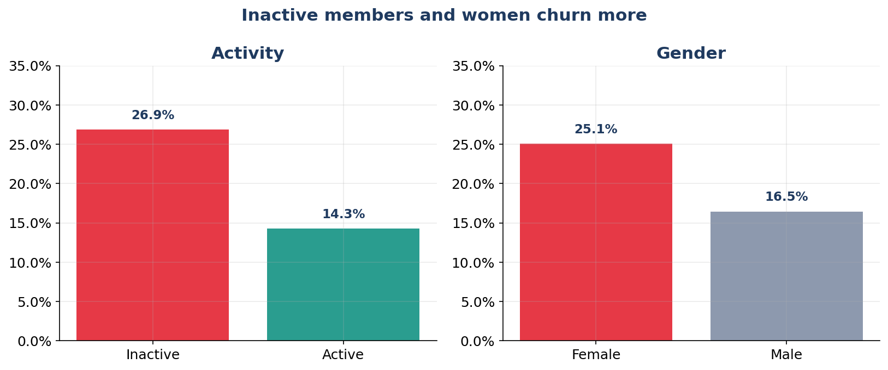
DEEP DIVE
Insight 3 — Age & Engagement
2,521 customers are BOTH inactive and single-product — and 37% of them churn
Age 51–60 churns at 56%; inactive members at 27% (vs 14% active); women at 25% (vs 17%). The inactive + single-product overlap is the single most actionable at-risk segment.
Bank Churn · Data Analyst Program, Hebrew University of Jerusalem
9

Slide 10
DEEP DIVE
Equally Useful — What Does NOT Drive Churn
Three things the bank might expect to matter — but the data says don't:
Tenure
Credit score
Has credit card
≈ 19–21% churn at every tenure
22% (poor) vs 19% (good)
20.8% vs 20.2%
Loyalty length is flat — long-tenured customers leave just as often.
Only a faint signal — not a useful targeting variable.
No effect. (This is also where we caught the corrupted column.)
Focus the retention budget where it counts
products, geography, age and engagement — not tenure, credit score or card ownership.
Bank Churn · Data Analyst Program, Hebrew University of Jerusalem
10

Slide 11
FROM INSIGHT TO ACTION
Recommendations
1
Launch a Germany retention task force
32% churn + high balances → review pricing, product fit and local service. Biggest single opportunity.
2
Fix the multi-product problem
Audit why 3–4-product customers leave (fees? mis-selling?) before any further cross-sell to them.
3
Move single-product customers to two
Targeted, value-led second product — 2 products is the 7.6%-churn sweet spot. Largest reachable group.
4
Re-activate the inactive
Engagement campaign for the 2,521 inactive single-product customers churning at 37%.
5
Protect the 45–60 segment
Proactive relationship outreach for older, higher-churn, higher-balance customers (and women).
Bank Churn · Data Analyst Program, Hebrew University of Jerusalem
11

Slide 12
CONCLUSION
1 in 5 customers leave — but the churn is concentrated and addressable.
▸ Churn is driven by product fit, geography, age and engagement — not by tenure or credit history.
▸ Germany, multi-product and inactive single-product customers are the clear priority segments.
▸ Cutting churn from 20.4% to 15% would retain ~537 more customers each cycle and protect tens of €M in deposits.
Target: churn ≤ 15% · retention ≥ 85%

Slide 13
Questions?
Thank you · Bank Churn — A Business Perspective
Noy Levy, David Zeff, Danielle Ab, Sagi Gutin, Shira Meriash · Data Analyst Program, Hebrew University of Jerusalem

