Slide 1
MACHINE LEARNING · CLASSIFICATION
Consumer Ad
Click Prediction
CTR
Predicting click-through on the Criteo 1M dataset
CLICK · NO-CLICK
PRESENTED BY
Fathema Othman · Lotam Ben Yakove · David Zeff

Slide 2
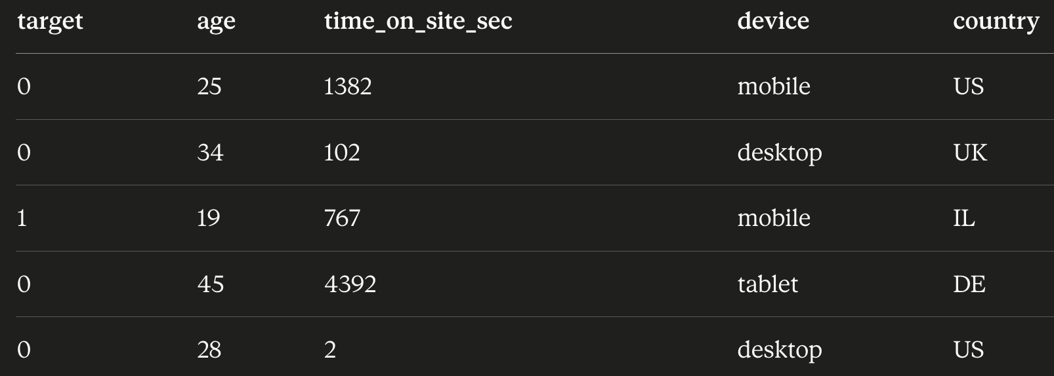
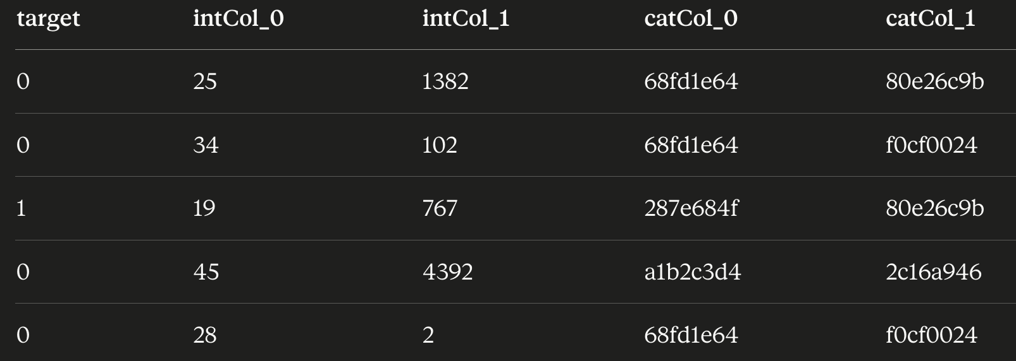
OVERVIEW
The Data
■ 1 million rows of user impressions, labeled clicked or not clicked.
■ Data is encrypted to maintain user privacy.
■ Example: a column 'age' becomes int_col_1 with no semantics.
■ This removes intuition — we rely on experimentation.
ORIGINAL (illustrative)
AFTER ENCRYPTION
Consumer Ad Click Prediction · Criteo CTR
02 / 28

Slide 3
GOAL
The Problem
■ We want to predict if a user clicked on an ad or not.
“Should I click
or not?”
1M
~25%
39
rows in dataset
positive (click) rate
features (13 num + 26 cat)
👤
Consumer Ad Click Prediction · Criteo CTR
03 / 28

Slide 4

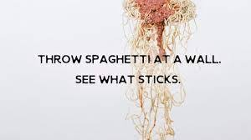
APPROACH
Guiding Philosophy
■ Columns are hashed — we can't reason about meaning.
■ So: test multiple alternatives at every decision point.
■ Let the validation set decide.
DECISIONS TESTED
model
imbalance fix
threshold
encoder
scaler
imputer
outlier handling
Consumer Ad Click Prediction · Criteo CTR
04 / 28

Slide 5
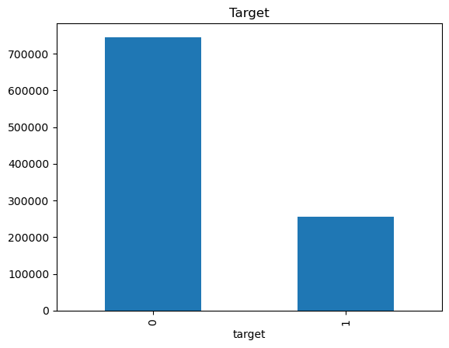
EDA FINDINGS · 1/5
~25% Positive — Imbalanced
■ Target ~25% positive — imbalanced classes.
■ Keep this in mind for cutoff threshold and resampling decisions.
Consumer Ad Click Prediction · Criteo CTR
05 / 28

Slide 6
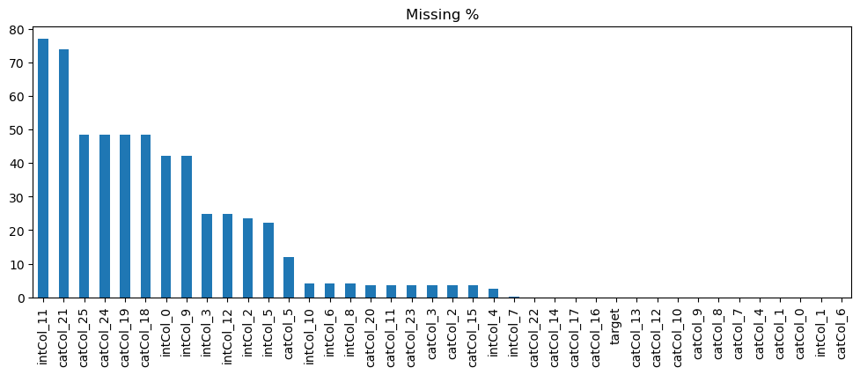
EDA FINDINGS · 2/5
Heavy Missingness
■ Heavy missingness in several numeric columns.
■ Affects how we deal with missing data downstream.
Consumer Ad Click Prediction · Criteo CTR
06 / 28

Slide 7
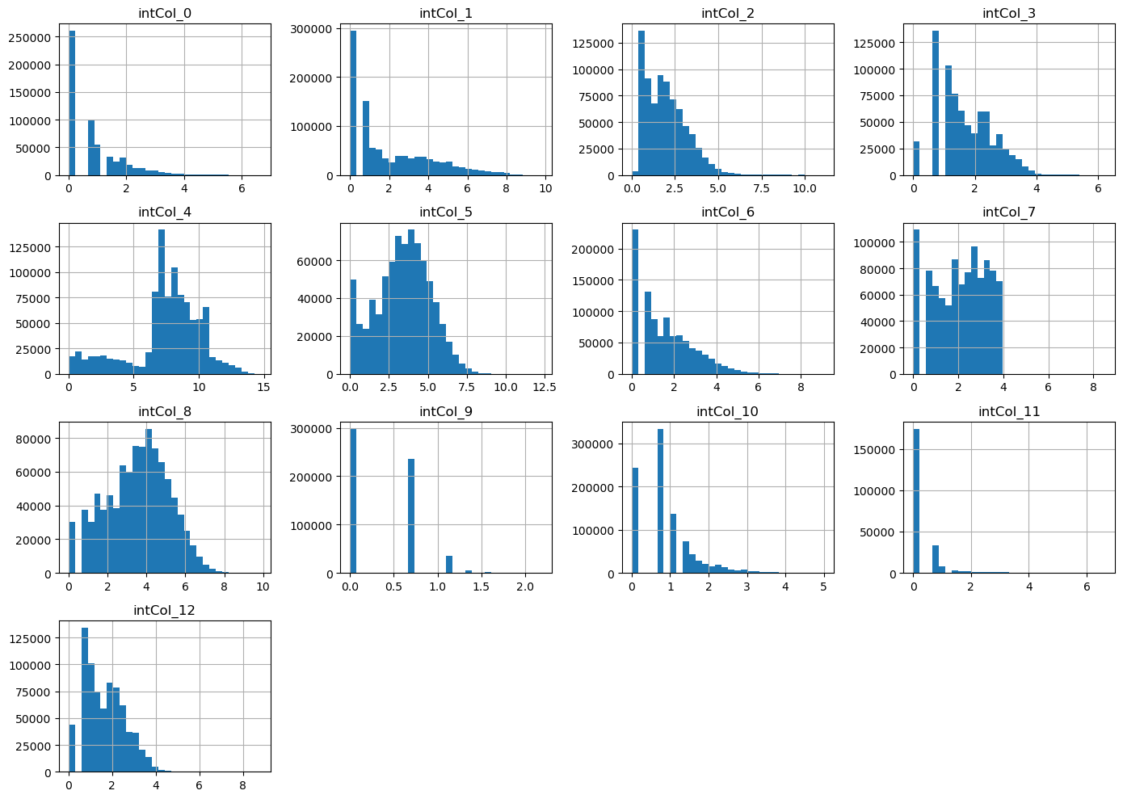
EDA FINDINGS · 3/5
Skewed Numerics
■ Some numerics span 0 → millions (heavy skew).
■ Important for models that assume specific distributions.
Consumer Ad Click Prediction · Criteo CTR
07 / 28

Slide 8
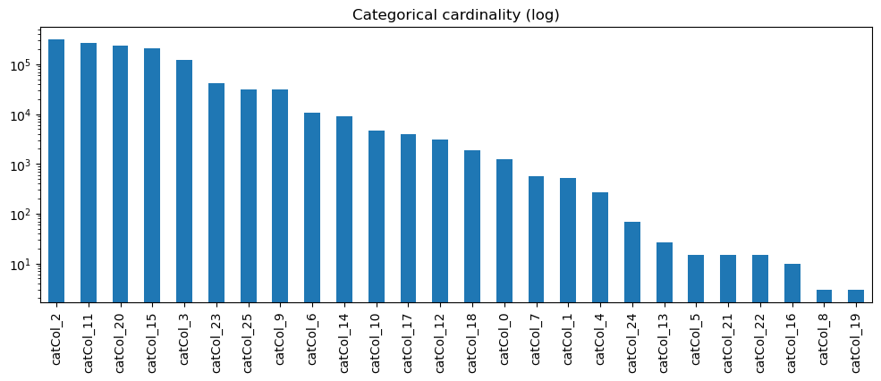
EDA FINDINGS · 4/5
High Categorical Cardinality
■ Categorical cardinality ranges from ~10 to >100,000 unique values.
■ Drives the encoding choice: one-hot is infeasible for high-cardinality columns;
■ ordinal or target encoding is more practical.
Consumer Ad Click Prediction · Criteo CTR
08 / 28

Slide 9
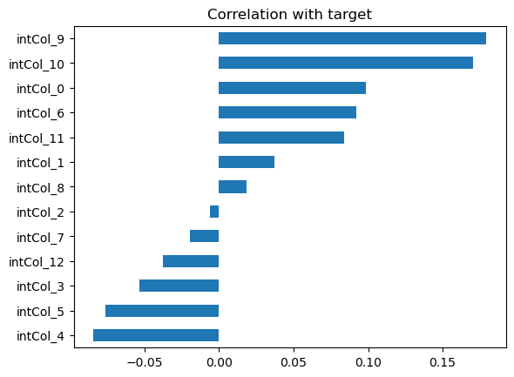
EDA FINDINGS · 5/5
No Single Giveaway Feature
■ No feature that "gives away" the target (no 100% correlation).
■ No single feature with high correlation to the target.
■ Signal will need to come from the combination of features.
Consumer Ad Click Prediction · Criteo CTR
09 / 28

Slide 10
SECTION 2 · OVERVIEW
Preprocessing Pipeline
■ EDA gave us hints — but for the baseline, we keep preprocessing simple.
■ We don't fully apply EDA insights yet — we want a clean baseline first.
■ Later iterations can be more precise and surgical.
PIPELINE STAGES
Outlier cap
Impute
Encode
Scale
ColumnTransformer
Consumer Ad Click Prediction · Criteo CTR
10 / 28

Slide 11
PREPROCESSING PIPELINE · STEP 1 OF 5
Outlier Capping
■ Clip numerics at the 1st and 99th percentile.
■ Drop the extremes to normalize early models.
■ Simple, robust starting point.
STEP
1
1 / 5
Consumer Ad Click Prediction · Criteo CTR
11 / 28

Slide 12
PREPROCESSING PIPELINE · STEP 2 OF 5
Numeric Imputation: Median
■ Replace nulls in numeric columns with the column median.
■ Just a baseline.
■ Other strategies (mean, KNN, constants) come later in the shootout.
STEP
2
2 / 5
Consumer Ad Click Prediction · Criteo CTR
12 / 28

Slide 13
PREPROCESSING PIPELINE · STEP 3 OF 5
Categorical Imputation: 'missing'
■ Replace nulls in categorical columns with the literal text 'missing'.
■ Again, a baseline.
■ Mode imputation is a natural alternative to try next.
STEP
3
3 / 5
Consumer Ad Click Prediction · Criteo CTR
13 / 28

Slide 14
PREPROCESSING PIPELINE · STEP 4 OF 5
Categorical Encoding: Ordinal
■ OrdinalEncoder for high-cardinality categoricals.
■ One-hot is too costly given many categorical columns have huge cardinalities.
■ Target encoding is a strong follow-up to try.
STEP
4
4 / 5
Consumer Ad Click Prediction · Criteo CTR
14 / 28

Slide 15
PREPROCESSING PIPELINE · STEP 5 OF 5
Scaling: StandardScaler
■ StandardScaler on numeric features.
■ Required for KNN and other distance-based models.
■ Tree-based models are unaffected.
STEP
5
5 / 5
Consumer Ad Click Prediction · Criteo CTR
15 / 28

Slide 16
SECTION 2 · WRAP-UP
One Pipeline, No Leakage
COLUMNTRANSFORMER
All wrapped in one ColumnTransformer.
No leakage. Proper sequence of events. Issues minimized — fit on train only,
transform on val/test using parameters learned from training.
✓ no leakage
✓ reproducible
✓ swappable steps
Consumer Ad Click Prediction · Criteo CTR
16 / 28

Slide 17
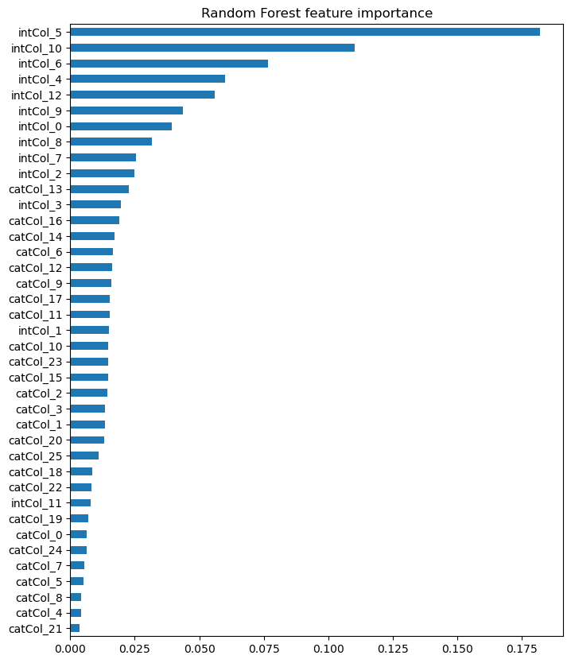
SECTION 3
Feature Importance
■ Quick Random Forest on a 100k sample.
■ Confirms the model isn't relying on one weird column.
■ Signal is spread across multiple features — healthy.
Consumer Ad Click Prediction · Criteo CTR
17 / 28

Slide 18
SECTION 4
Train / Val / Test Split
■ Stratified split: 60% / 20% / 20%.
■ Train (600k): fit models.
■ Val (200k): compare models, tune choices.
■ Test (200k): touched exactly once at the end.
■ Stratify preserves the ~25% positive rate everywhere.
TRAIN 60%
VAL 20%
TEST 20%
600k rows
200k
200k
STRATIFIED ON y · ~25% positives in each split
Consumer Ad Click Prediction · Criteo CTR
18 / 28

Slide 19
SECTION 5
Model Comparison on Val
NB
KNN
GBM
Naïve Bayes
K-Nearest Neighbors
HistGradient
Boosting
Fast probabilistic baseline.
Distance-based.
Fit on a 50k sample.
Gradient-boosted trees.
Strong tabular baseline.
METRICS: accuracy · precision · recall · F1 · ROC-AUC · confusion matrix
Consumer Ad Click Prediction · Criteo CTR
19 / 28

Slide 20
SECTION 5 · VAL METRICS
Results
Model | Accuracy | Precision | Recall | F1 | ROC-AUC
GBM | 0.6962 | 0.4382 | 0.6802 | 0.5330 | 0.7594
NB | 0.6977 | 0.4151 | 0.4536 | 0.4335 | 0.6727
KNN | 0.5158 | 0.2912 | 0.6272 | 0.3978 | 0.5790
GBM is the winner on ROC-AUC and F1 — highlighted in coral.
Consumer Ad Click Prediction · Criteo CTR
20 / 28

Slide 21
SECTION 5 · DISCUSSION 1/3
Which Metric Matters?
FOCUS METRIC
■ ROC-AUC measures how well the model orders clickers above non-clickers
■ across all thresholds — it is threshold-independent.
■ Means you don't penalize a model for the default 0.5 cutoff.
■ GBM wins on ROC-AUC (0.7594).
ROC-AUC
Consumer Ad Click Prediction · Criteo CTR
21 / 28

Slide 22
SECTION 5 · DISCUSSION 2/3
Which Metric Matters?
FOCUS METRIC
■ Accuracy is misleading on imbalanced data.
■ With ~75% non-clickers, "always predict no-click" scores 75% accuracy — useless.
■ NB has the highest accuracy (0.6977) but the worst AUC among the top two.
Accuracy
Consumer Ad Click Prediction · Criteo CTR
22 / 28

Slide 23
SECTION 5 · DISCUSSION 3/3
Which Metric Matters?
FOCUS METRIC
■ Pricey impressions → precision matters more (false positives cost us).
■ Cheap impressions, expensive misses → recall matters more.
■ If costs balance out → F1 captures both.
■ GBM also wins on F1 (0.5330).
Precision
vs Recall
Consumer Ad Click Prediction · Criteo CTR
23 / 28

Slide 24
SECTION 6
Final Evaluation on Test
■ Refit GBM on train + val combined.
■ Predict once on the held-out test set.
■ Recall is low — model misses ~3 of every 4 clicks.
■ Two ways to fix: resampling, or threshold tuning.
ACCURACY
PRECISION
RECALL
0.78
0.66
0.24
F1
ROC-AUC
0.35
0.76
⚠ LOW RECALL
At a 0.5 cutoff, the model misses ~76% of real clicks.
Consumer Ad Click Prediction · Criteo CTR
24 / 28

Slide 25
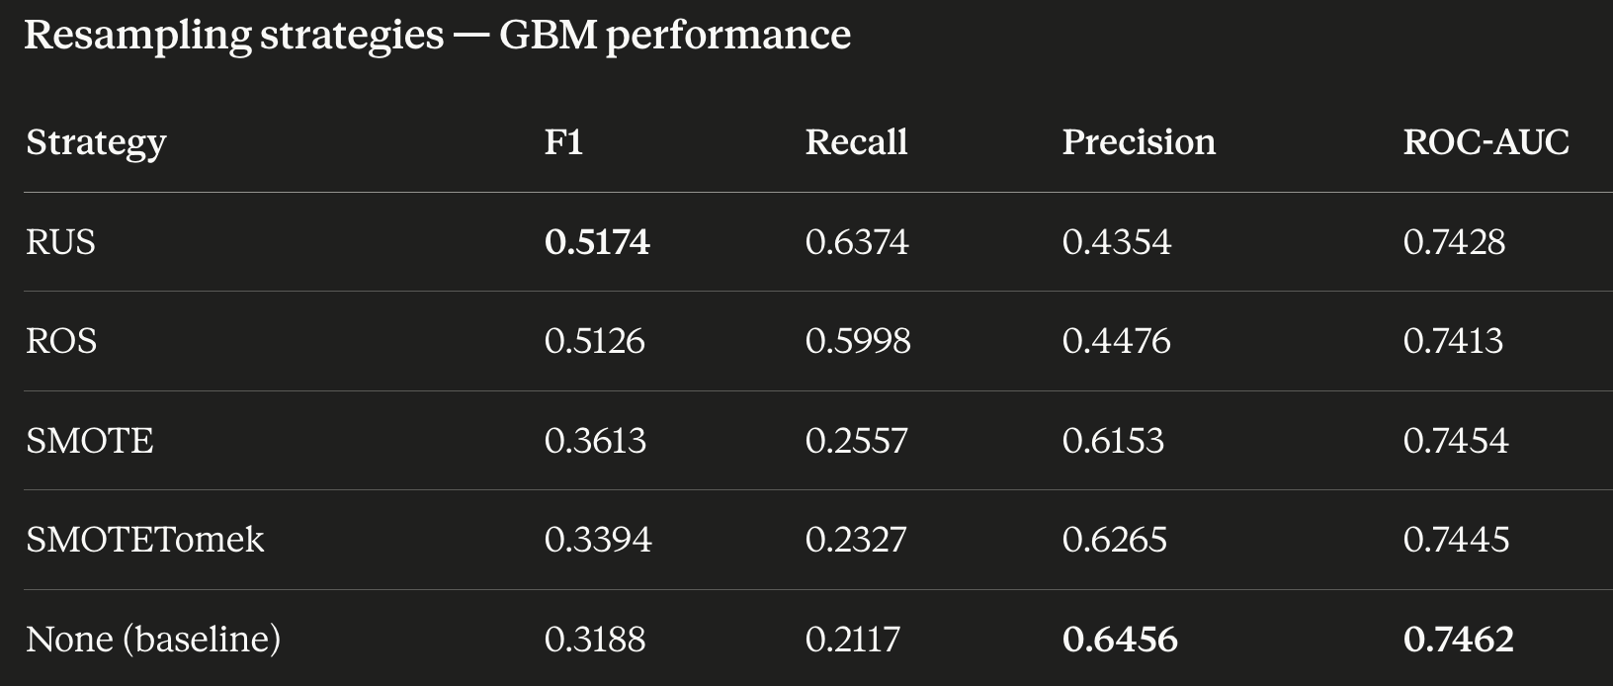
SECTION 7
Class Imbalance — Resampling
■ Tried: None, ROS, RUS, SMOTE, SMOTETomek.
■ Resampling fires only during fit — val/test stay real.
■ Best on F1: RUS (~0.52) and ROS (~0.51).
■ Trade-off: higher recall, lower precision.
■ AUC barely moves — same ranking, different cutoff behavior.
Consumer Ad Click Prediction · Criteo CTR
25 / 28

Slide 26
ROADMAP · 1 OF 2
Future Improvements
TECHNIQUE
K-Fold Cross-Validation
Right now, decisions ride on a single validation split — which is
noisy when comparing close-performing options. K-fold CV averages
across multiple folds, giving more stable estimates and better
judgement on which model / preprocessing path really wins.
Consumer Ad Click Prediction · Criteo CTR
26 / 28

Slide 27
ROADMAP · 2 OF 2
Future Improvements
Imputation (num)
median · mean · const 0 · const -1 · KNN
Imputation (cat)
'missing' constant · mode
Cat encoder
Target · Frequency / Count
Scaling
None · Standard · Robust
Model
LR (L1 / L2 / Elastic) · LightGBM · XGBoost · CatBoost · RandomForest
Hyperparameters
sweep over the winning family
Consumer Ad Click Prediction · Criteo CTR
27 / 28

Slide 28
THANK YOU
Questions?
PROJECT REPOSITORY
github.com/DavidZeff1/proj_click_ad
Fathema Othmn · Lotam Ben Yakove · David Zeff

