Slide 1
Consumer Ad Click Prediction
By Fathema Othmn
Lotam Ben Yakove
David Zeff

Slide 2
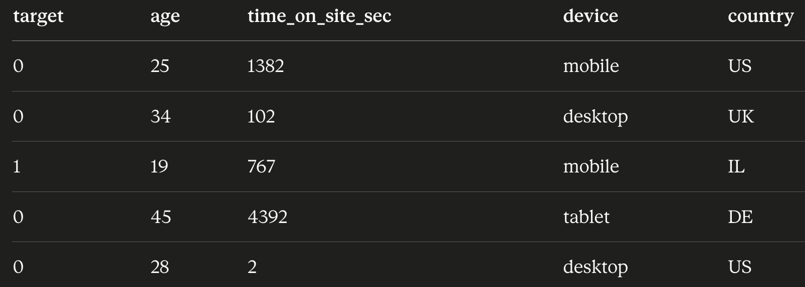
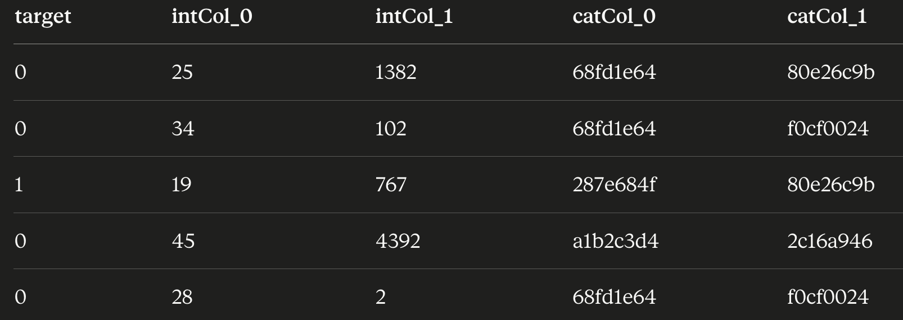
The Data
Original(example)
1 million rows of user info with a target value of clicked or not clicked
Data is encrypted to maintain real user privacy
For example, the column ‘age’ is transformed to int_col_1, and the column name is changed to cat_col_1
This throws away any intuition, and we will have to do lots of experimentation
After encrytion

Slide 3


The Problem
We want to predict if a user clicked on a ad or not
Should I Click or not ?

Slide 4

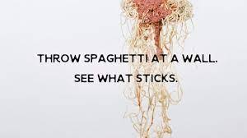
Guiding Philosophy
Columns are hashed — we can't reason about meaning
So: test multiple alternatives at every decision point
Let the validation set decide
Decisions tested: model, imbalance fix, threshold, encoder,
scaler, imputer, outlier handling

Slide 5
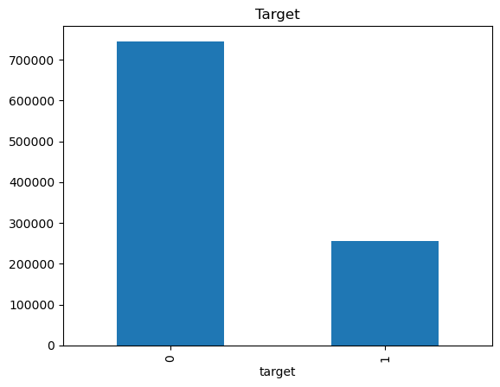
1.1 EDA Findings
Target ~25% positive — imbalanced
We will have to keep this in mind when we decide on the cutoff thresh hold and resampling

Slide 6
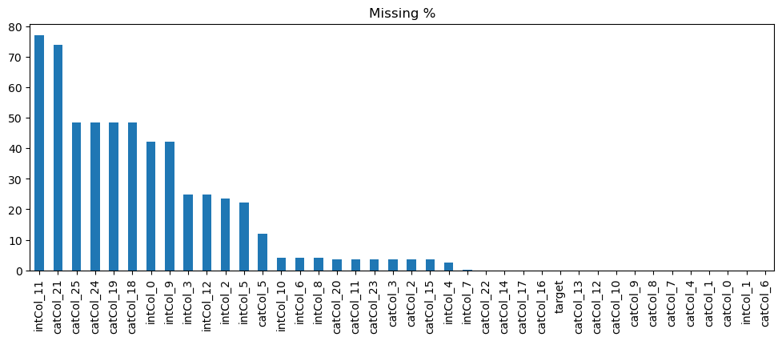
1.2 EDA Findings
Heavy missingness in several numeric columns
This will affect how we decide to deal with missing data

Slide 7
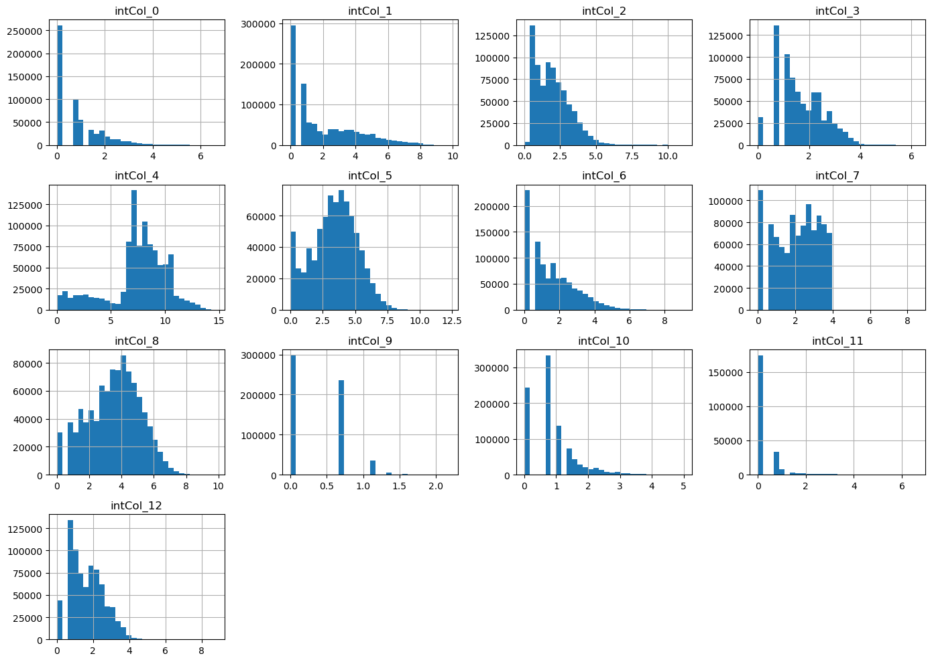
1.3 EDA Findings
Some numerics span 0 → millions (heavy skew)
We will need to keep this in mind when trying models that assume a certain kind of distribution

Slide 8
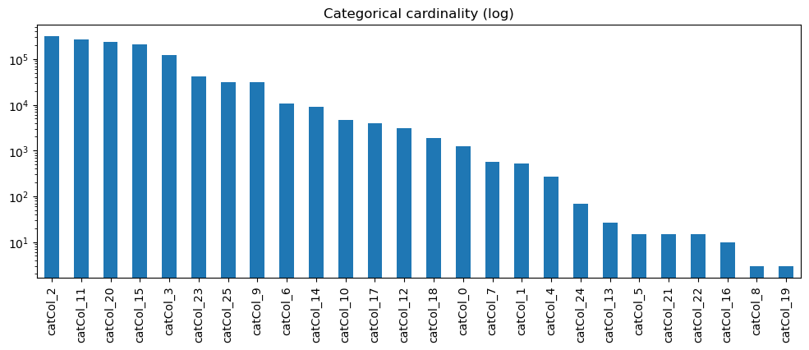
1.4 EDA Findings
Categorical cardinality ranges from ~10 to >100,000
Amount of unique values will help us decide how to encode our categorical data (for low cardinality we can use one hot while high cardinality we can use either ordinal/target encoding)

Slide 9
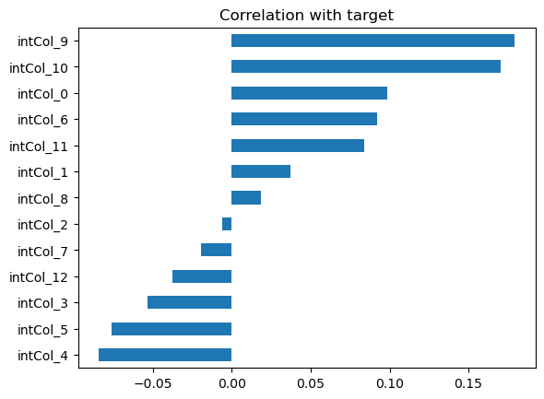
1.5 EDA Findings
No feature that ”gives away” the target(100% correlation)
No feature that has high correlation with target

Slide 10

2.0 Preprocessing Pipeline
Note: in our eda we learned information that can help us make better pre processing decisions
We don’t neccessarirly put this eda info into practice in our preprocessing for now, because we want to keep it simple for a baseline and later on we will be more precise and surgical

Slide 11
2.1 Preprocessing Pipeline
Outlier cap: clip numerics at 1st / 99th percentile
All outliers beneath the 1st and above the 99th percentile get rid of just to make the initial models more normalized

Slide 12
2.2 Preprocessing Pipeline
Numeric impute: median
Replace nulls in numeric cols with the median
Just as a baseline
We will use different methods later on see which ones have better results

Slide 13
2.3 Preprocessing Pipeline
Categorical impute: constant 'missing’
All nulls in categorical columns will be replaced with the text ‘missing’
Again, just a baseline

Slide 14
2.3 Preprocessing Pipeline
Categorical encode: OrdinalEncoder (high cardinality)
We saw many cat columns had many different values this is why we will prefer not to use one hot since it will be too costly, alter on we can experiment with target encoding

Slide 15
2.4 Preprocessing Pipeline
Numeric scale: StandardScaler (needed for KNN)
Some distance-based models require scaling in order to work properly

Slide 16
2.5 Preprocessing Pipeline
All wrapped in one ColumnTransformer → no leakage and proper sequence of events minimize issues

Slide 17
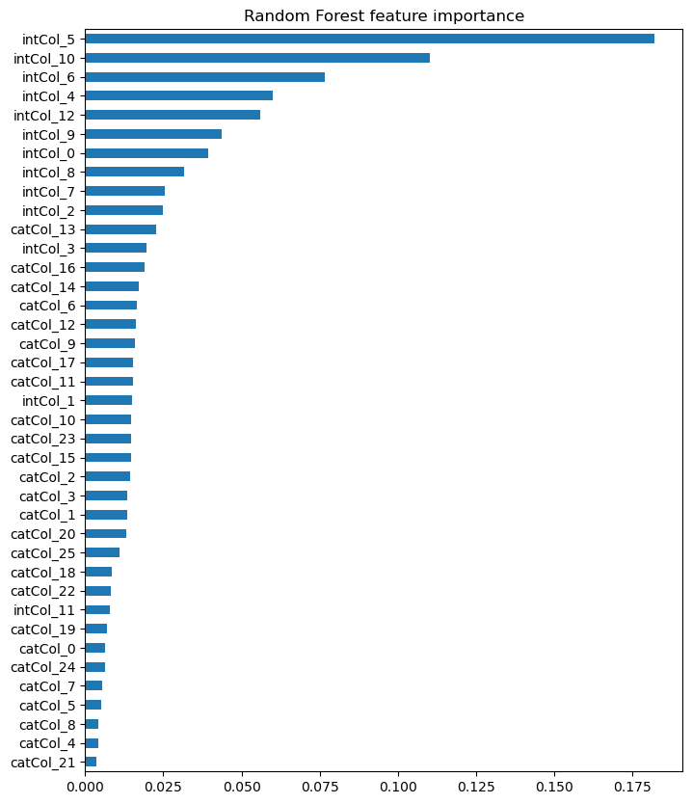
3. Feature Importance
Quick Random Forest on 100k sample
Confirms model isn't relying on one weird column

Slide 18
4. Train / Val / Test Split
Stratified split: 60% / 20% / 20%
Train (600k): fit models
Val (200k): compare models, tune choices
Test (200k): touched exactly once at the end
Stratify preserves ~25% positive rate everywhere

Slide 19
5. Model Comparison on Val
NB(Naïve Bayes) — fast probabilistic baseline
KNN(K nearest Neighbors) — distance-based (fit on 50k sample)
GBM — HistGradientBoosting
Metrics: accuracy, precision, recall, F1, ROC-AUC, confusion matrix

Slide 20
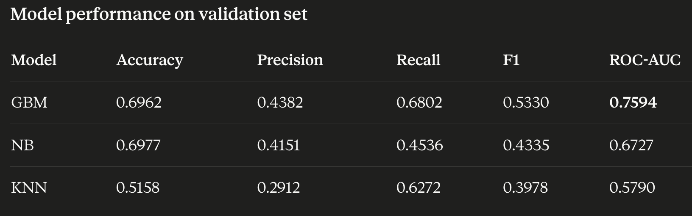
Results

Slide 21
Which performance metric do we care about 1.1
ROC-AUC. It measures how well the model orders clickers above non-clickers across all thresholds, and it's threshold-independent — so you're not penalizing a model just because a default 0.5 threshhold.
GBM wins when it comes to ROC-AUC.

Slide 22
Which performance metric do we care about 1.2
Accuracy: With ~75% non-clickers, a model that predicts "no click" for everyone scores 75% accuracy while being useless. Notice NB has the highest accuracy (0.6977) but the worst AUC among the top two.

Slide 23
Which performance metric do we care about 1.3
Precision vs Recall depends:
If we are paying money for each show, precision matters more — every false positive costs us.
If it is cheap to show ad, expensive to miss a buyer, recall matters more.
If costs are roughly balanced, F1 captures both. GBM wins on F1 too (0.5330).

Slide 24
6. Final Evaluation on Test
Refit GBM on train + val combined
Predict once on the held-out test set
Accuracy 0.78 / Precision 0.66 / Recall 0.24 / F1 0.35 / AUC 0.76
Recall is low — model misses ~3 of every 4 clicks
Two ways to fix: resampling, or threshold tuning

Slide 25
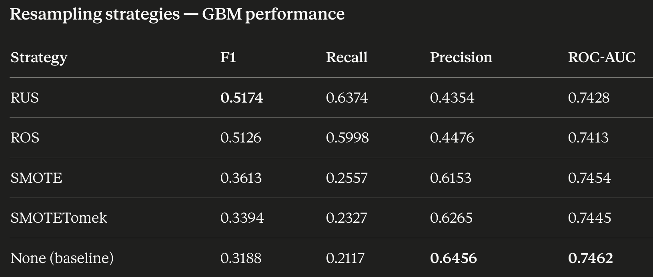
7. Class Imbalance — Resampling
Tried: None, ROS, RUS, SMOTE, SMOTETomek
Resampling fires only during fit — val/test stay real
Best on F1: RUS (~0.52) and ROS (~0.51)
Trade-off: higher recall, lower precision
AUC barely moves — same ranking, different cutoff behavior

Slide 26
Future improvements
K-fold cross-validation
Right now decisions ride on a single val split — noisy when comparing close-performing options.

Slide 27
Future improvements
Imputation (num): median, mean, const 0, const -1, KNN
Imputation (cat): 'missing' constant, mode
Cat encoder: Target, Frequency/Count
Scaling: None, Standard, Robust
Model: LR (L1/L2/Elastic), (LightGBM/XGBoost/CatBoost), RandomForest
Hyper params

Slide 28
Thank You!
Repo: https://github.com/DavidZeff1/proj_click_ad

