Slide 1
Exploring influence weights
There are different weighting options.
i.e. divide citation counts by the number of [citing authors, cited authors, citing references]
0: [True, True, True]
1: [True, True, False]
2: [True, False, True]
3: [True, False, False]
4: [False, True, True]
5: [False, True, False]
6: [False, False, True]
7: [False, False, False]
0: all
1: #auciting+cited
2: #auciting+ref
3: #auciting
4: #cited+ref
5: #aucited
6: #refs
7: noweights

Slide 2
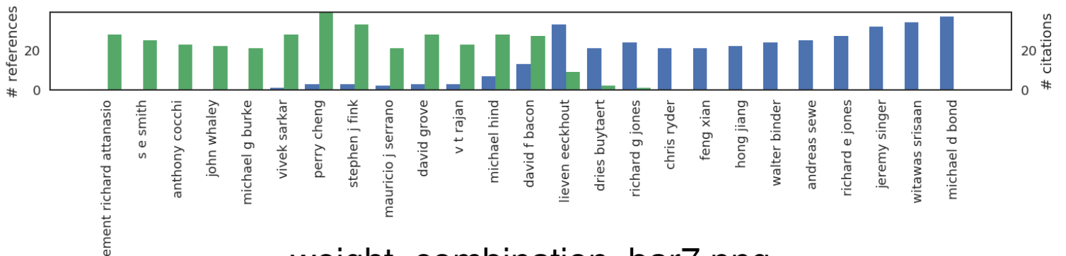
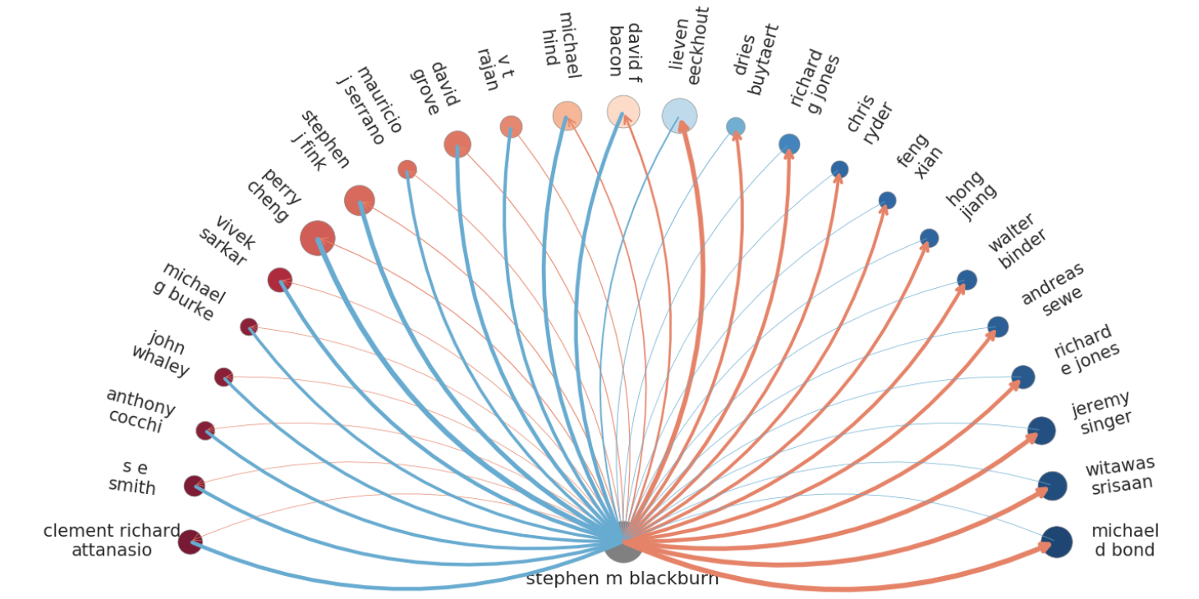
7: noweights
Questions to think about:
What do you see?
Do all names makes sense?
Who are people on the right and on the left?
Are the height of the bars sensible? Why or why not

Slide 3
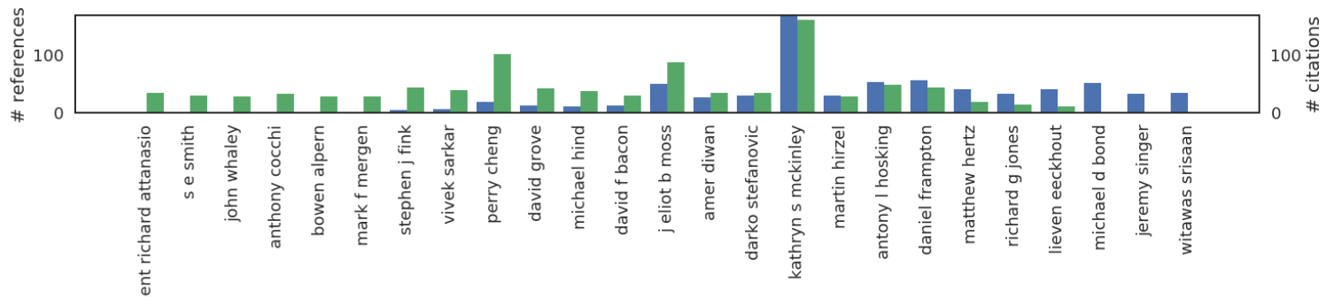
7: noweights
Including self-cites 7: noweights
Who are on the right-hand side now?
Who are on the left?

Slide 4
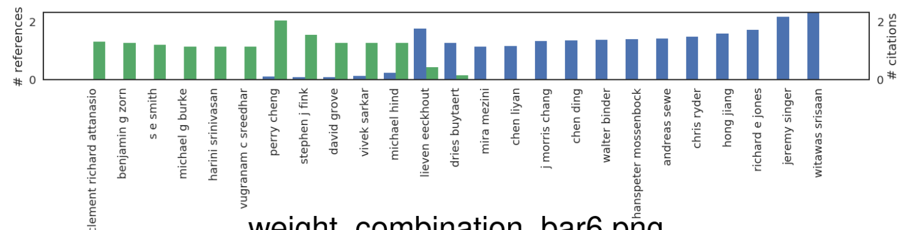
7: noweights
6: #refs

Slide 5
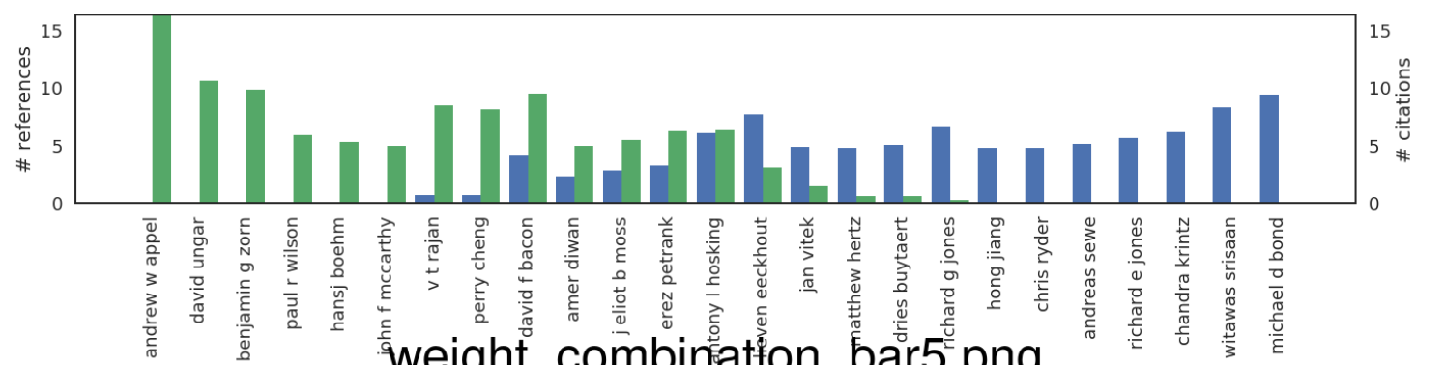
7: noweights
5: #au-cited

Slide 6
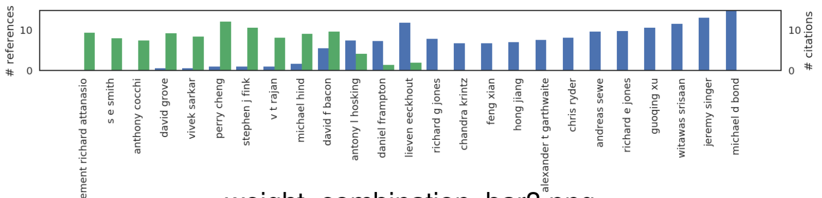
7: noweights
3: #au-citing

Slide 7
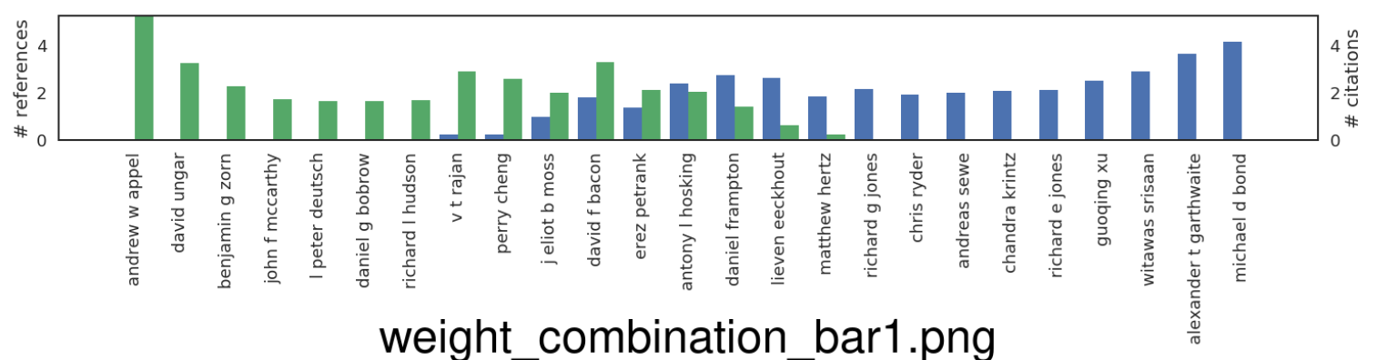
7: noweights
1: #auciting+cited

Slide 8
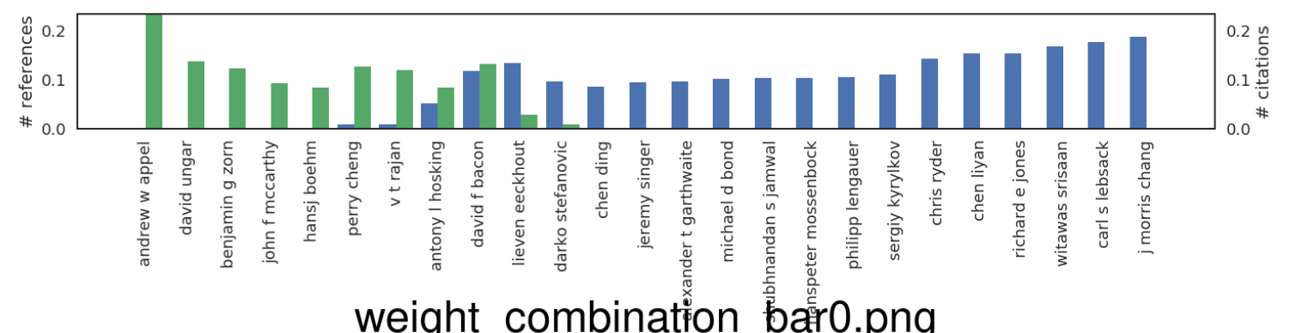
7: noweights
0: ALL

