Slide 1
Exploring citation weights
[citing authors, cited authors, citing references]
0: [True, True, True]
1: [True, True, False]
2: [True, False, True]
3: [True, False, False]
4: [False, True, True]
5: [False, True, False]
6: [False, False, True]
7: [False, False, False]
0: all
1: #auciting+cited
2: #auciting+ref
3: #auciting
4: #cited+ref
5: #aucited
6: #refs
7: noweights

Slide 2
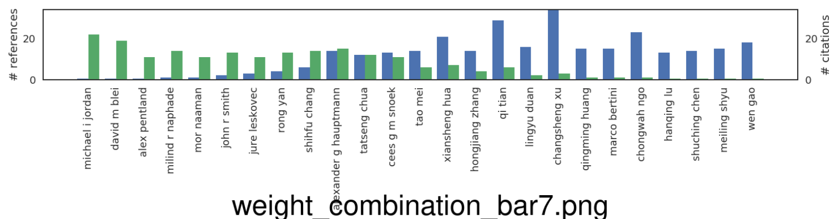
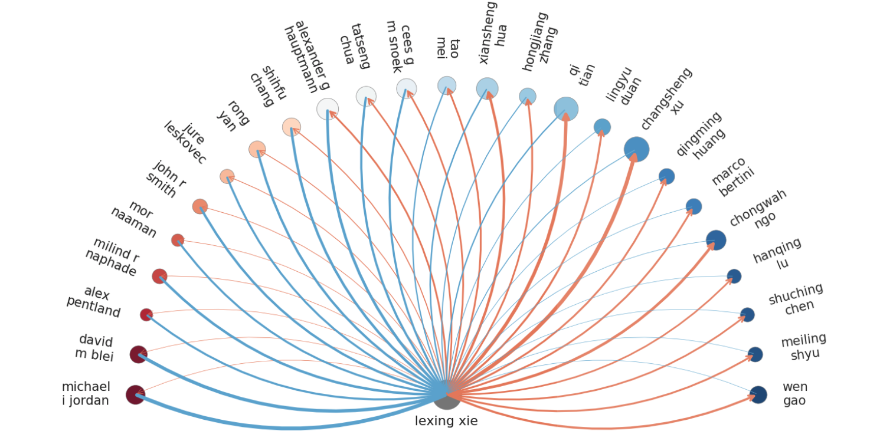
7: noweights
Take-away:
All names makes sense.
People on the right are senior productive authors in my field.
People on the left are senior authors in my field or in fields that influenced me.
The height of the bars are sensible – max. 20 cites in either direction. (I may have written a small multiple of 20 papers)

Slide 3
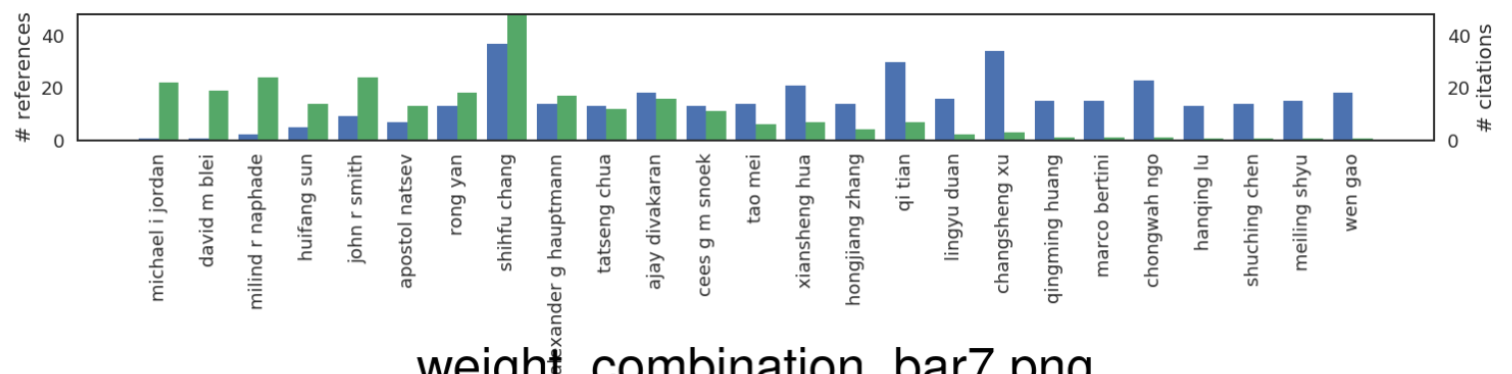
7: noweights
Including self-cites 7: noweights
Right-hand side unchanged
Left-hand side included much more co-authors

Slide 4
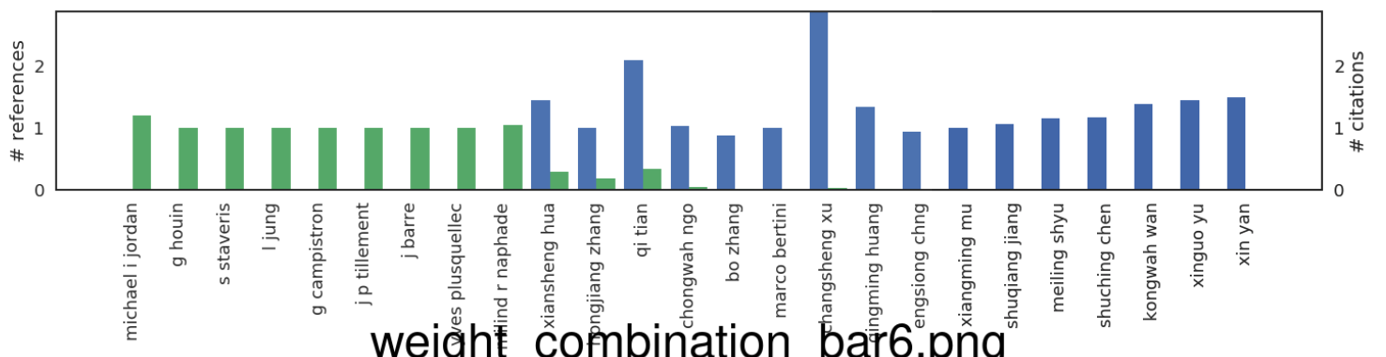
7: noweights
I have no idea who the circled names are.
Y-axis not interpretable anymore.
What’s the intuition of this: people who cite me a lot and use a shorter ref list (in my field it may mean a short paper / less competitive venue)?
6: #refs

Slide 5
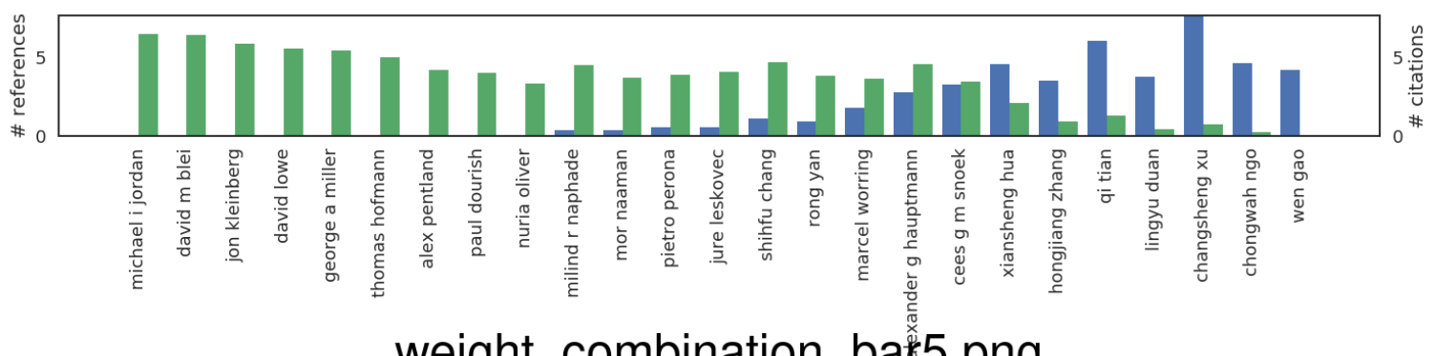
7: noweights
I still recognize almost all names.
The break-even point moved right significantly, the drop in green bars gradual (why??)
Y-axis (compared to the above), says there’s 3-4 authors per paper “on average” (for both my paper and others citing me)?
blue: papers I wrote with less co-authors carry more weight (??)
green: papers I cite, and wrote with less co-authors carry more weight (??)
5: #au-cited

Slide 6
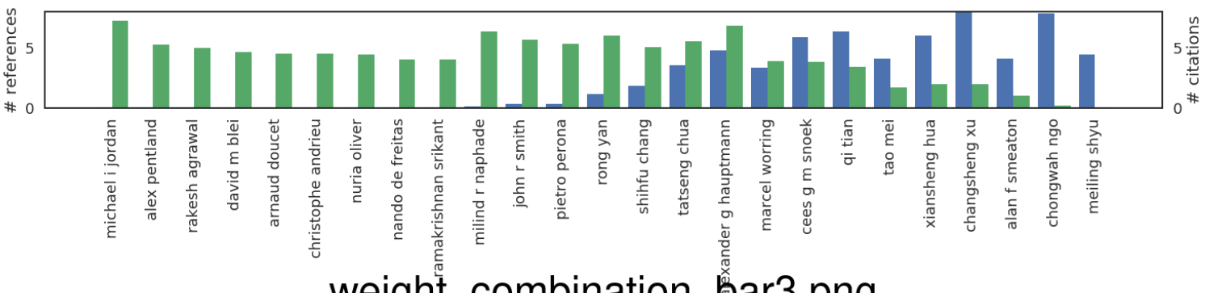
7: noweights
I still recognize almost all names. Circled ones -- minor influence or no memory at all !
The break-even point moved right significantly, the drop in green bars gradual (why?)
Y-axis (compared to the above), says there’s 3-4 authors per paper “on average”
blue: papers others wrote with less co-authors gives more citation credit (??)
green: papers I wrote with less co-authors gives out more citation credit (??)
3: #au-citing

Slide 7
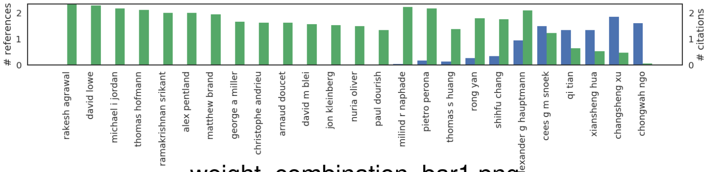
7: noweights
I recognize most names. Circled ones -- minor influence or no memory at all !
The break-even point moved right even further (why?)
Y-axis (compared to the above), says there’s 3-4 authors per paper “on average”
Papers with less co-authors give+recieve more citation credit (??)
1: #auciting+cited

Slide 8
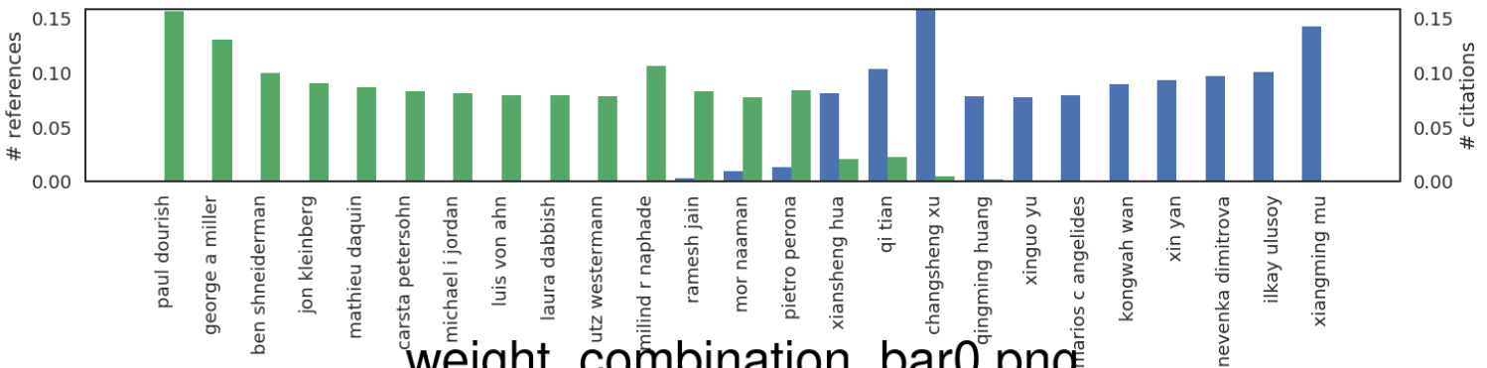
7: noweights
Blue circled – no idea who they are, or minor influence on me
Red Circle – she’s stopped publishing a long while ago
Y-axis is not interpretable at all
…
0: ALL

