Slide 1
避障軌跡規劃

Slide 2
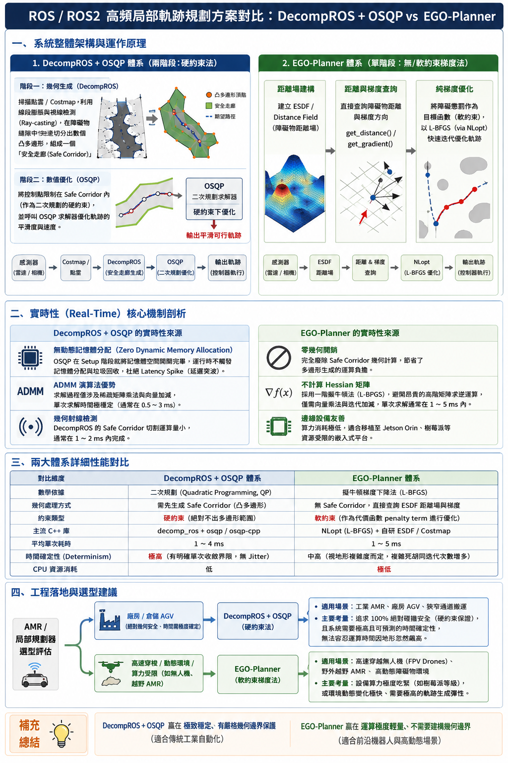
DecompROS + QSQP vs. ESDF + L-BFGS (EGO-Planner)

Slide 3
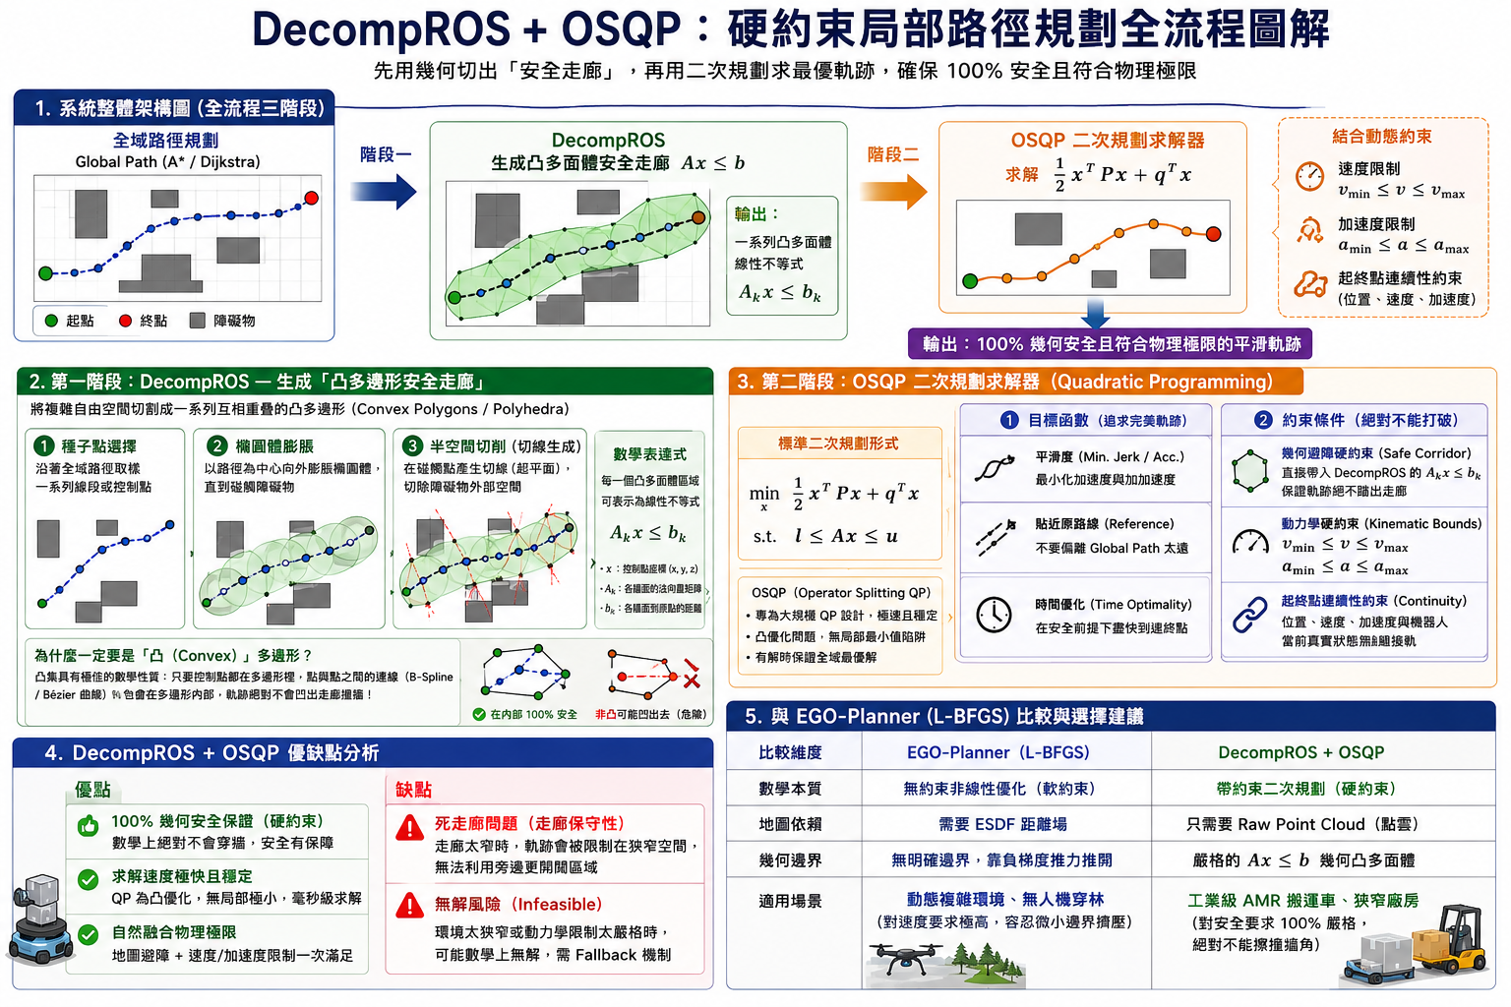
DecompROS + QSQP 概念流程說明

Slide 4
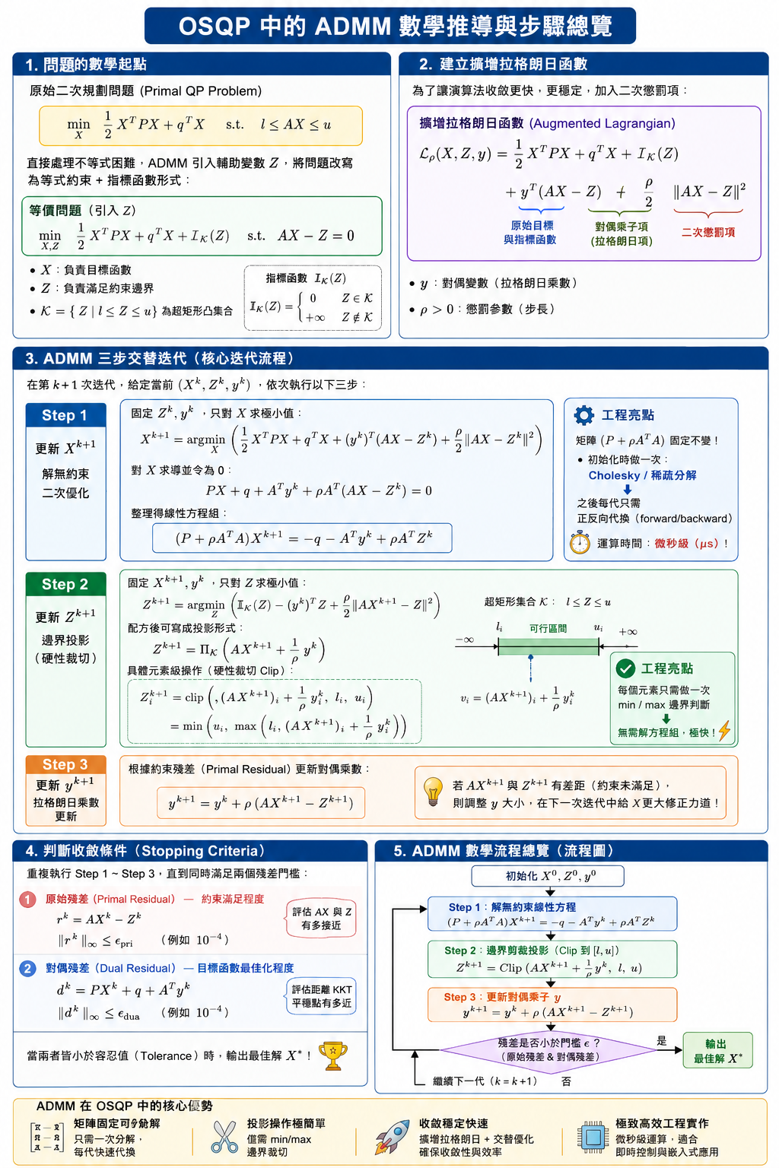
ADMM（Alternating Direction Method of Multipliers，交替方向乘子法）

Slide 5
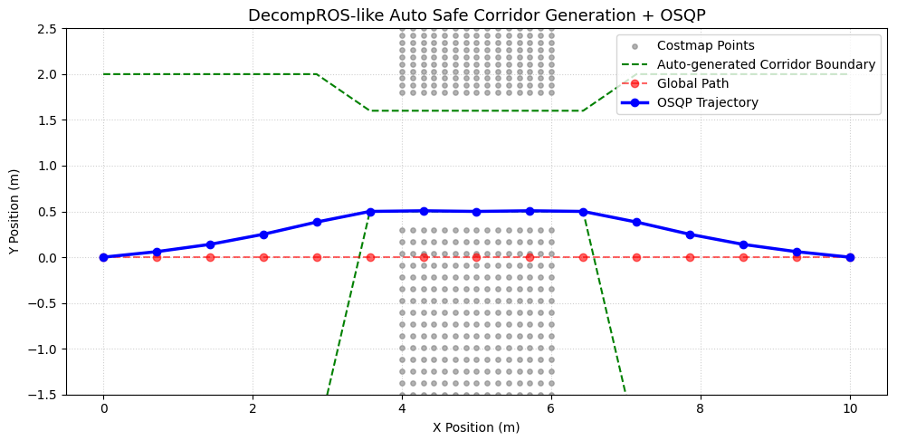
DecompROS + QSQP 演算法測試結果 (1)
y_min, y_max = -2.0, 2.0
y_max = np.min(top_obs[:, 1]) - 0.2
y_min = np.max(bottom_obs[:, 1]) + 0.2
N = 15
w_smooth, w_ref = 15.0, 1.0

Slide 6
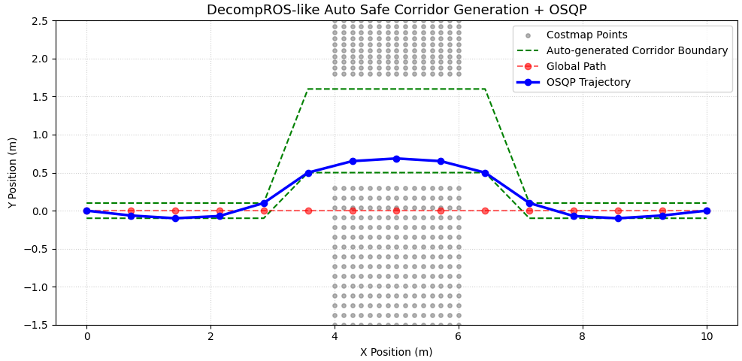
DecompROS + QSQP 演算法測試結果 (2)
y_min, y_max = -0.1, 0.1
y_max = np.min(top_obs[:, 1]) - 0.2
y_min = np.max(bottom_obs[:, 1]) + 0.2
N = 15
w_smooth, w_ref = 15.0, 1.0

Slide 7
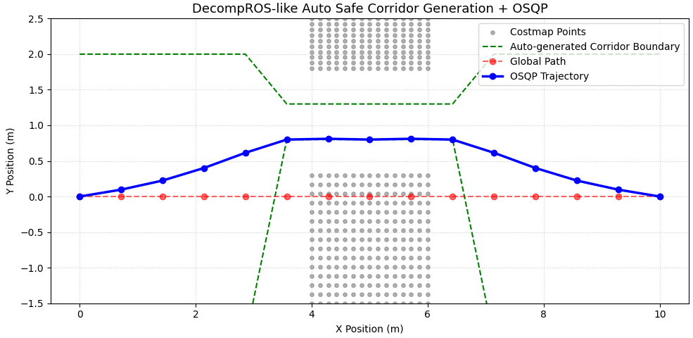
DecompROS + QSQP 演算法測試結果 (3)
y_min, y_max = -2.0, 2.0
y_max = np.min(top_obs[:, 1]) - 0.5
y_min = np.max(bottom_obs[:, 1]) + 0.5
N = 15
w_smooth, w_ref = 15.0, 1.0

Slide 8
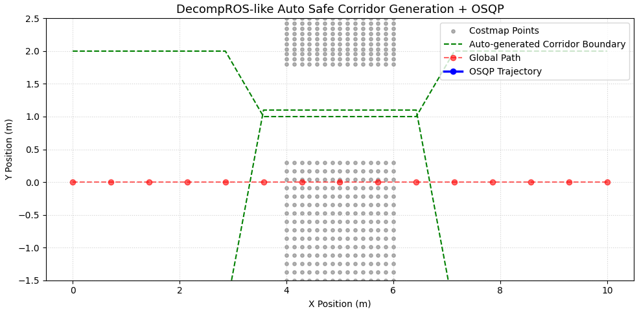
DecompROS + QSQP 演算法測試結果 (4)
y_min, y_max = -2.0, 2.0
y_max = np.min(top_obs[:, 1]) - 0.8
y_min = np.max(bottom_obs[:, 1]) + 0.8
N = 15
w_smooth, w_ref = 15.0, 1.0

Slide 9
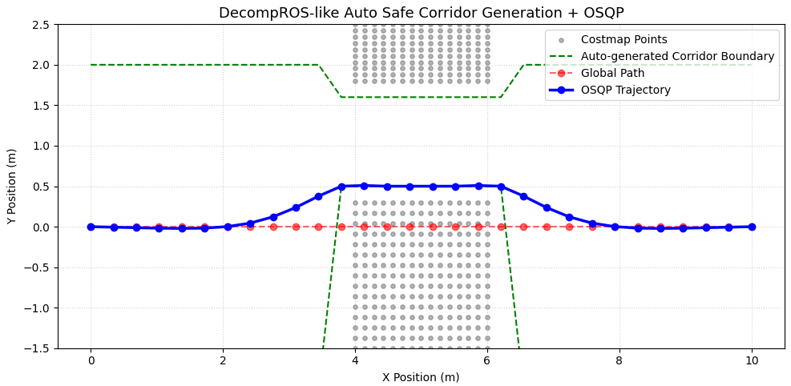
DecompROS + QSQP 演算法測試結果 (5)
y_min, y_max = -2.0, 2.0
y_max = np.min(top_obs[:, 1]) - 0.2
y_min = np.max(bottom_obs[:, 1]) + 0.2
N = 30
w_smooth, w_ref = 15.0, 1.0

Slide 10
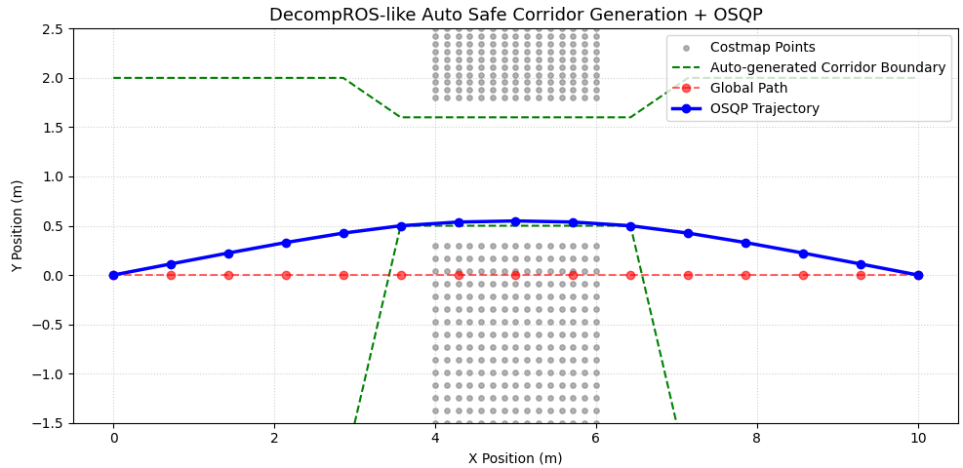
DecompROS + QSQP 演算法測試結果 (6)
y_min, y_max = -2.0, 2.0
y_max = np.min(top_obs[:, 1]) - 0.2
y_min = np.max(bottom_obs[:, 1]) + 0.2
N = 15
w_smooth, w_ref = 150.0, 1.0

Slide 11
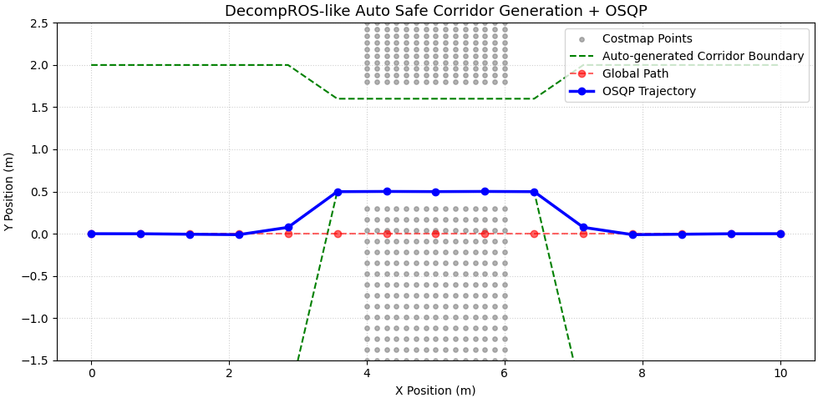
DecompROS + QSQP 演算法測試結果 (7)
y_min, y_max = -2.0, 2.0
y_max = np.min(top_obs[:, 1]) - 0.2
y_min = np.max(bottom_obs[:, 1]) + 0.2
N = 15
w_smooth, w_ref = 15.0, 100.0

Slide 12
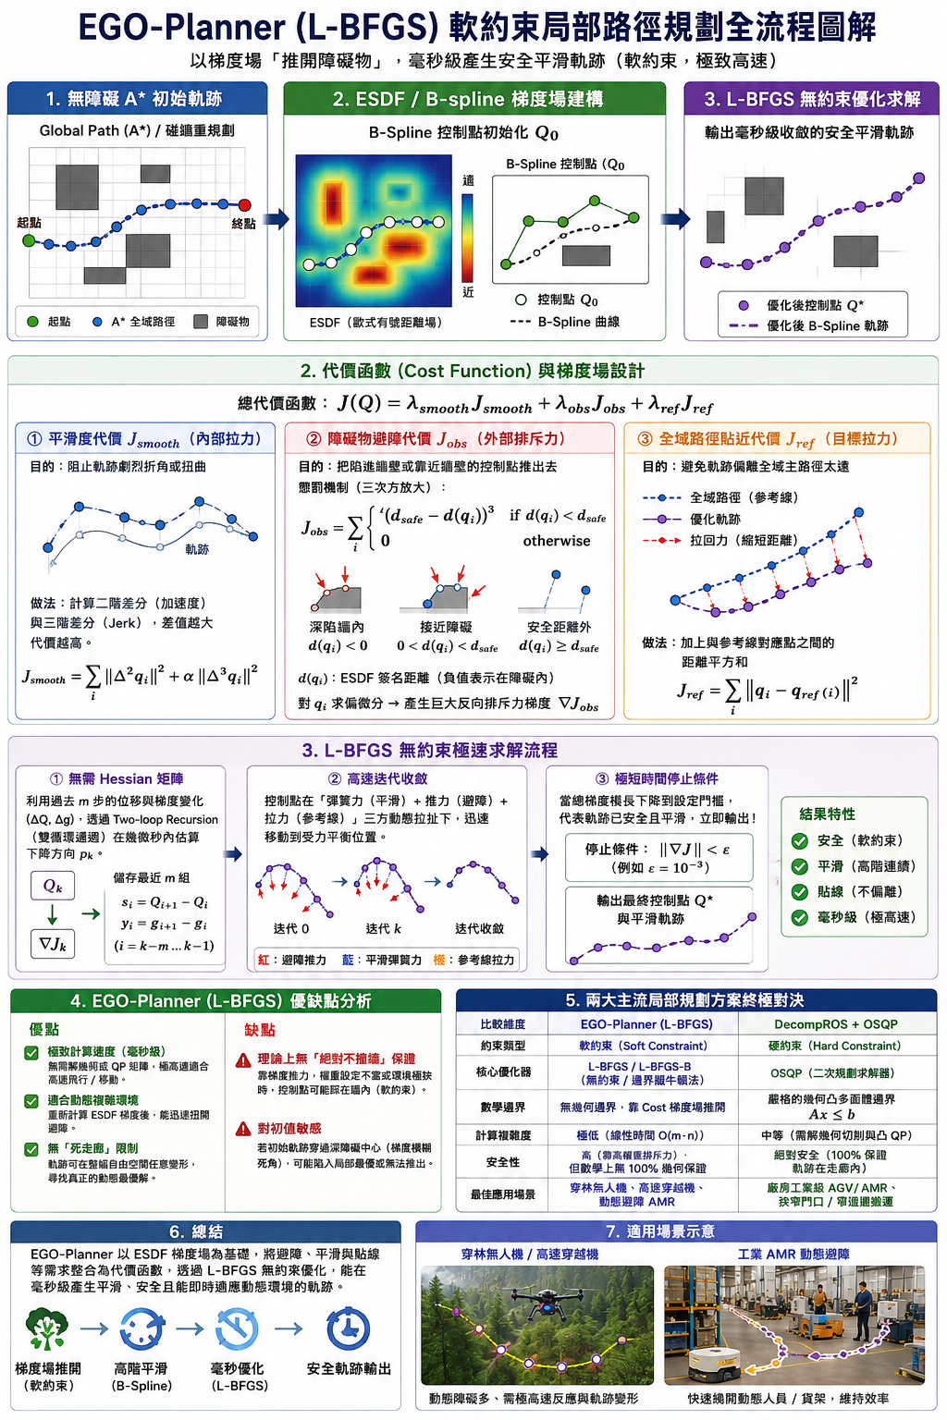
ESDF + L-BFGS 概念流程說明

Slide 13
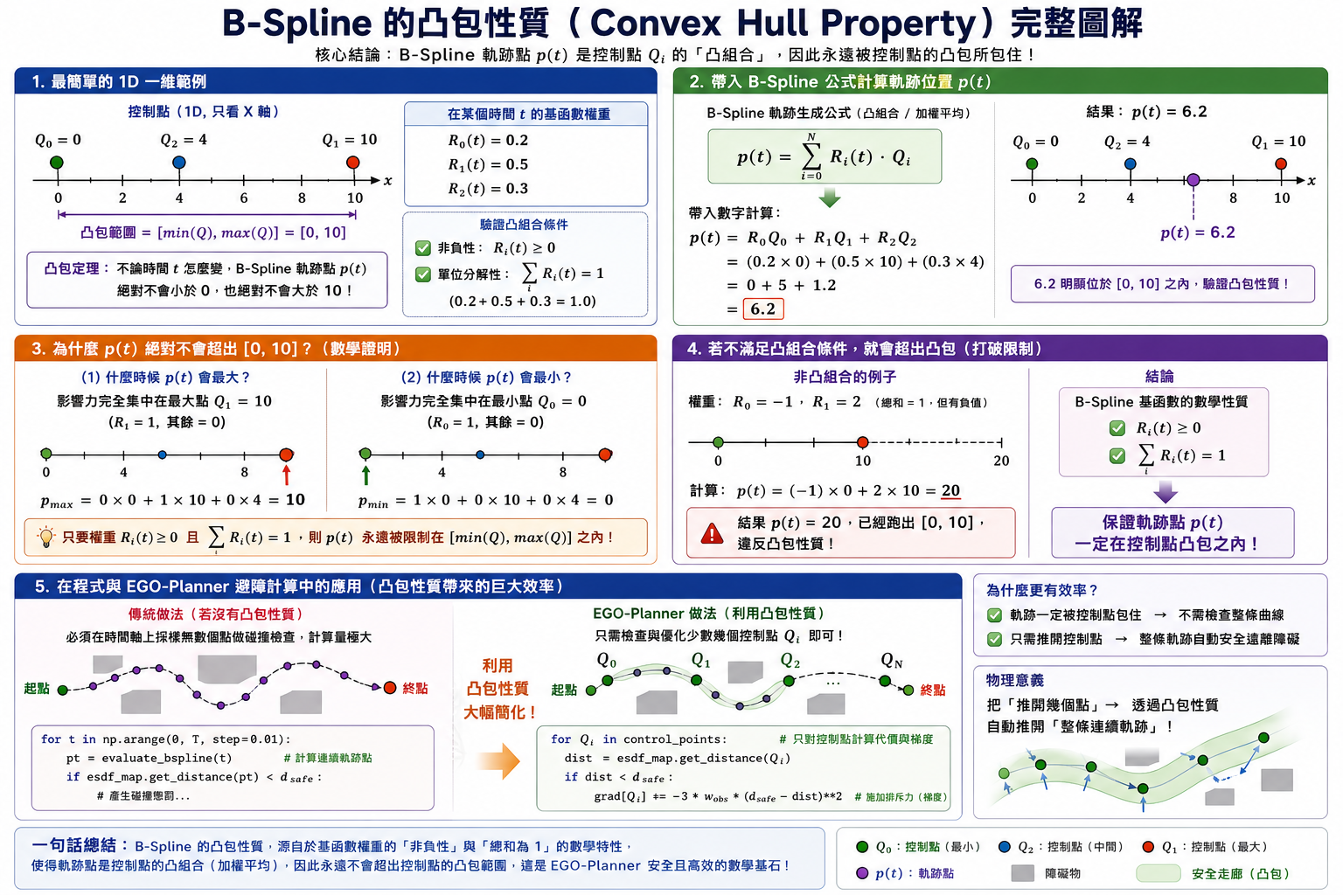
B-Spline 的凸包特性 (Convex hull property)

Slide 14
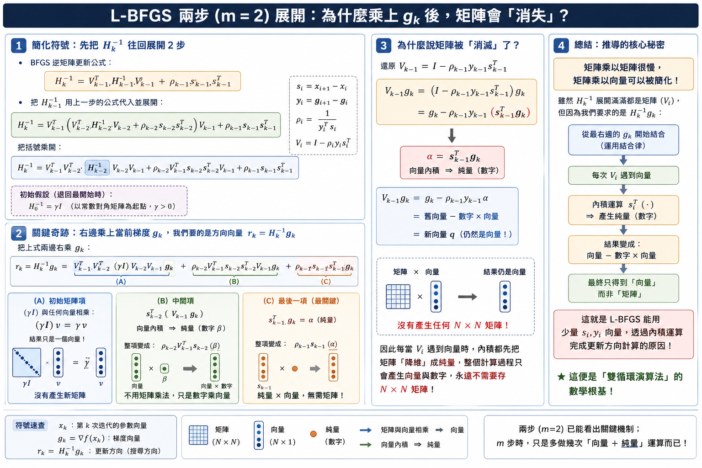
L-BFGS 推導證明為何可以避免 Hessian 巨大矩陣的計算

Slide 15
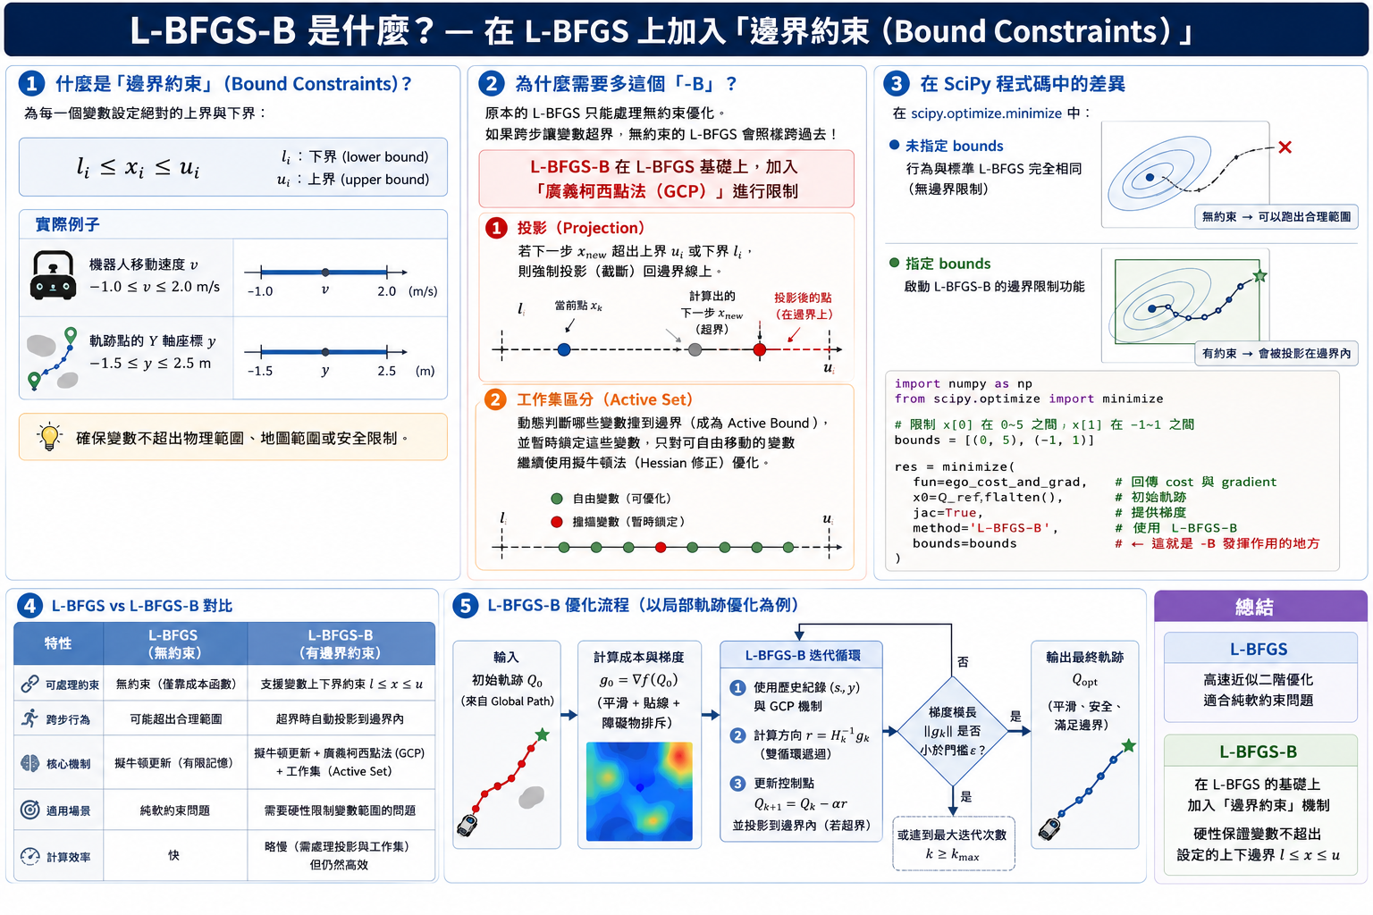
何謂 L-BFGS-B

Slide 16
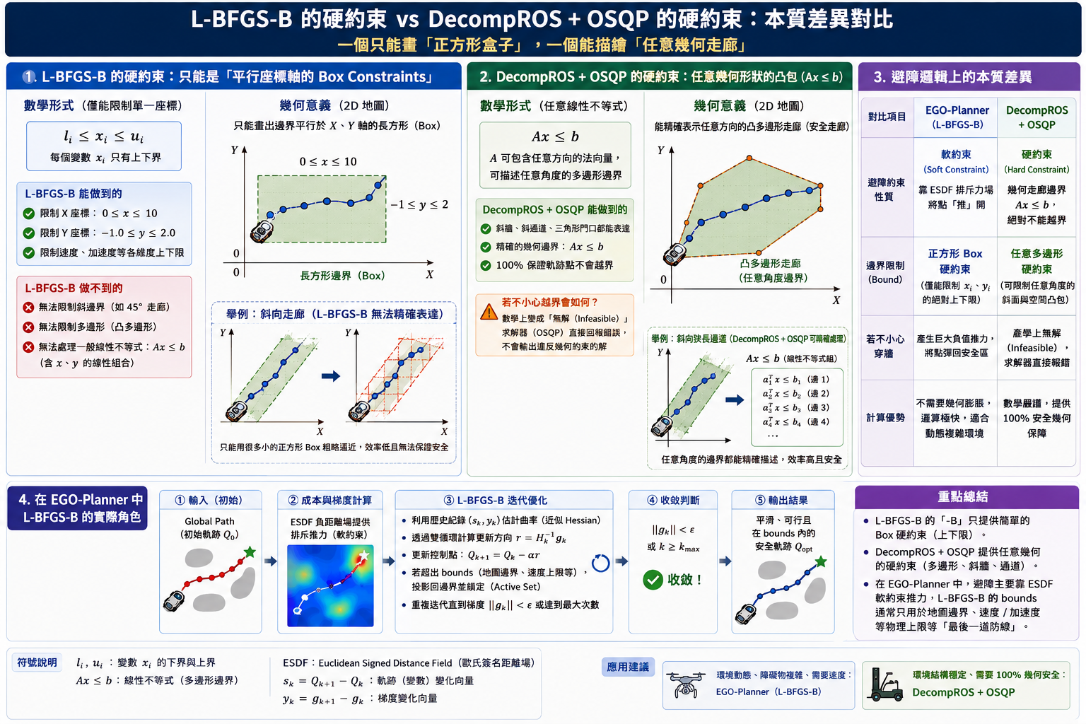
L-BFGS-B vs. DecompROS + QSQP 約束條件差異

Slide 17
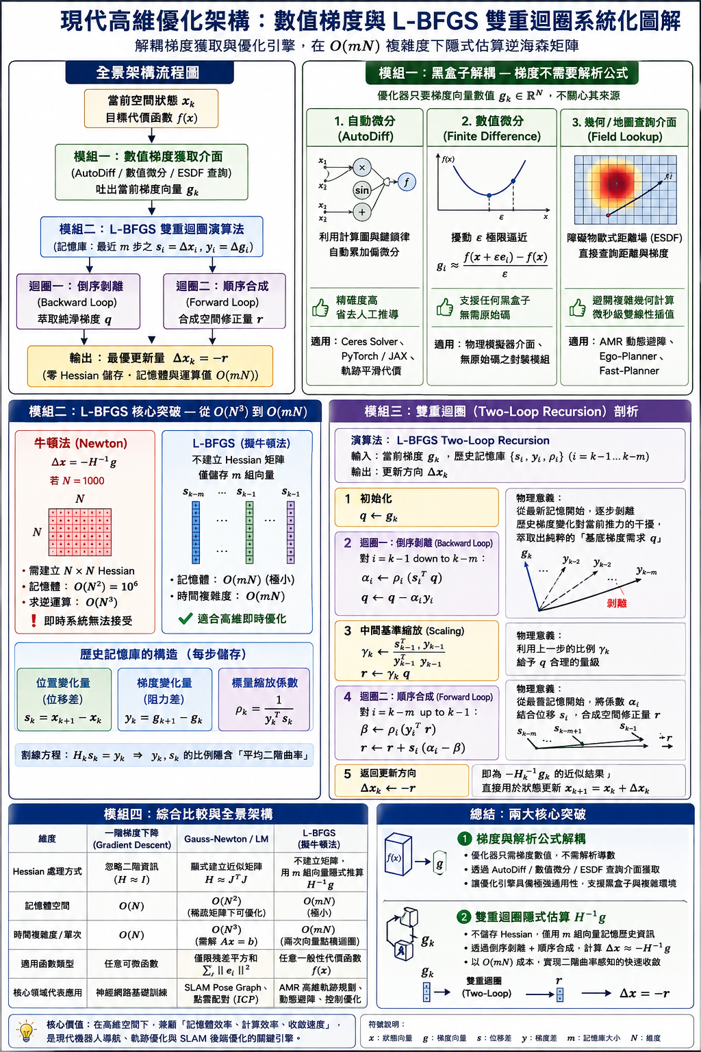
雙迴圈隱士計算逆海森矩陣

Slide 18
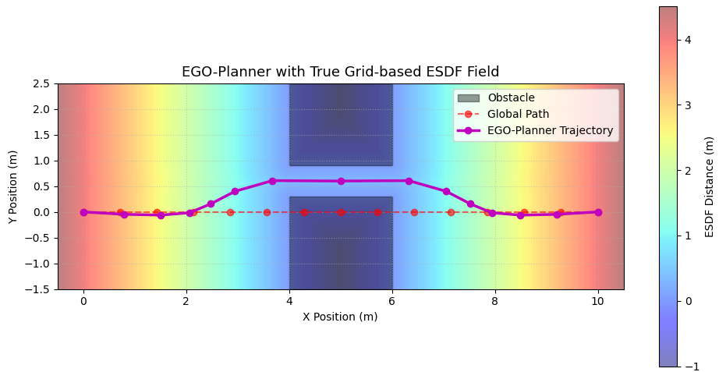
ESDF + L-BFGS 演算法測試結果 (1)
N = 15
d_safe = 0.6
w_smooth = 5.0
w_obs = 200.0
w_ref = 0.5

Slide 19

ESDF + L-BFGS 演算法測試結果 (2)
N = 30
d_safe = 0.6
w_smooth = 5.0
w_obs = 200.0
w_ref = 0.5

Slide 20
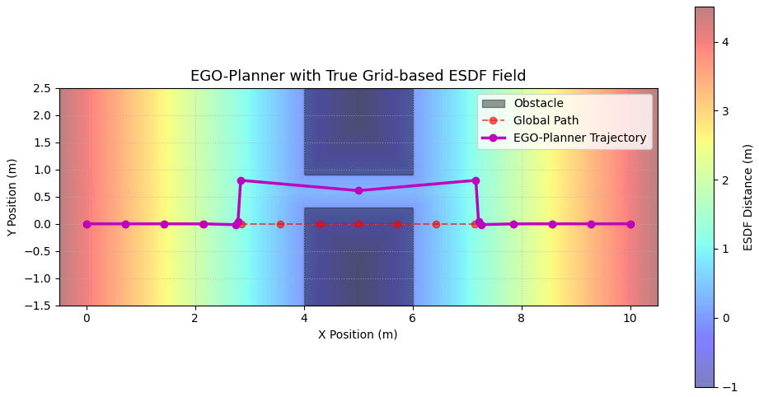
ESDF + L-BFGS 演算法測試結果 (3)
N = 15
d_safe = 1.5
w_smooth = 5.0
w_obs = 200.0
w_ref = 0.5

Slide 21
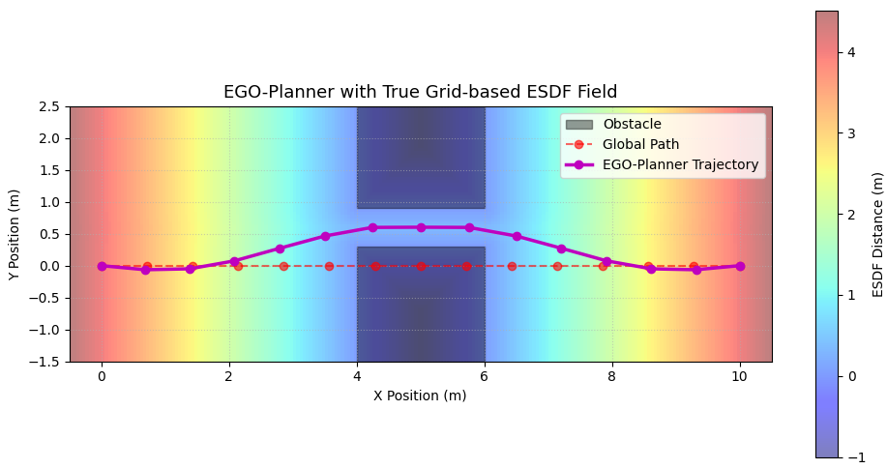
ESDF + L-BFGS 演算法測試結果 (4)
N = 15
d_safe = 0.6
w_smooth = 50.0
w_obs = 200.0
w_ref = 0.5

Slide 22

ESDF + L-BFGS 演算法測試結果 (5)
N = 15
d_safe = 0.6
w_smooth = 5.0
w_obs = 2000.0
w_ref = 0.5

Slide 23

ESDF + L-BFGS 演算法測試結果 (6)
N = 15
d_safe = 0.6
w_smooth = 5.0
w_obs = 200.0
w_ref = 100.0

Slide 24
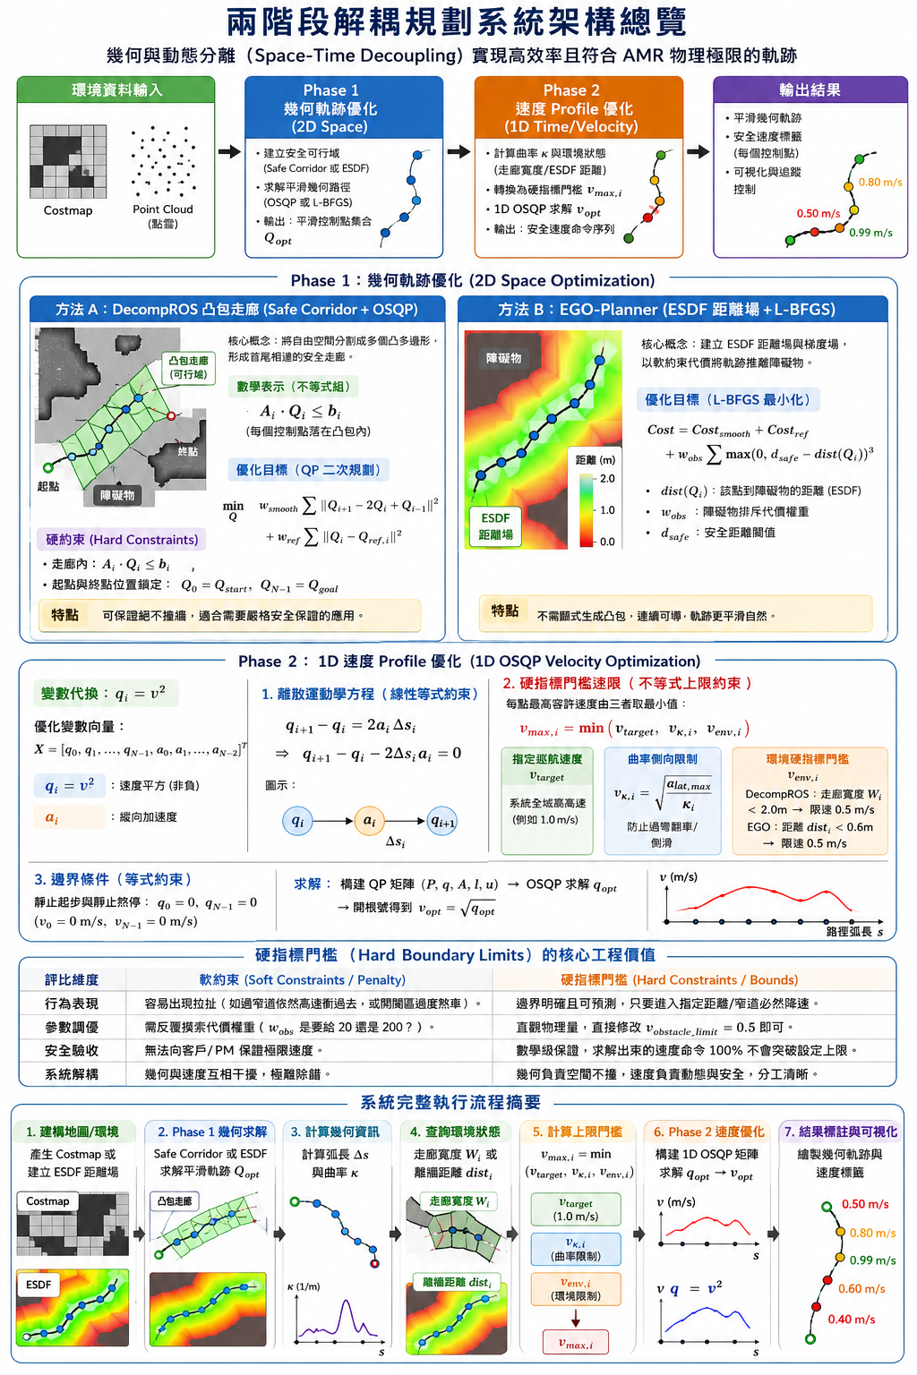
兩階段解耦合最佳化參考輸入架構

Slide 25
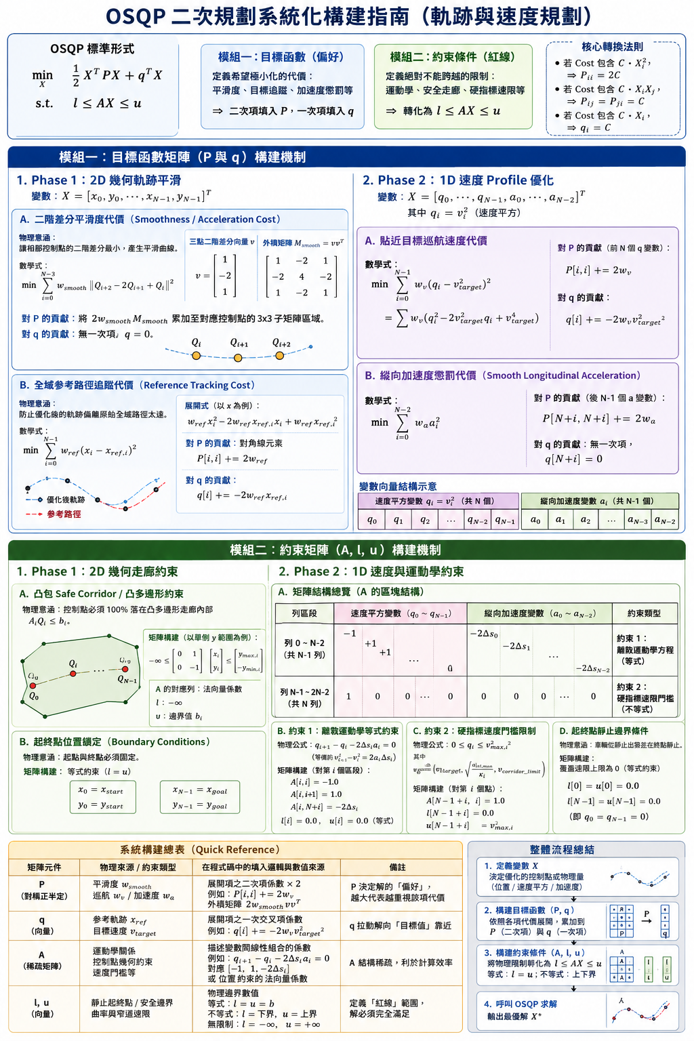
QSQP 軌跡規劃與速度規劃細節

Slide 26
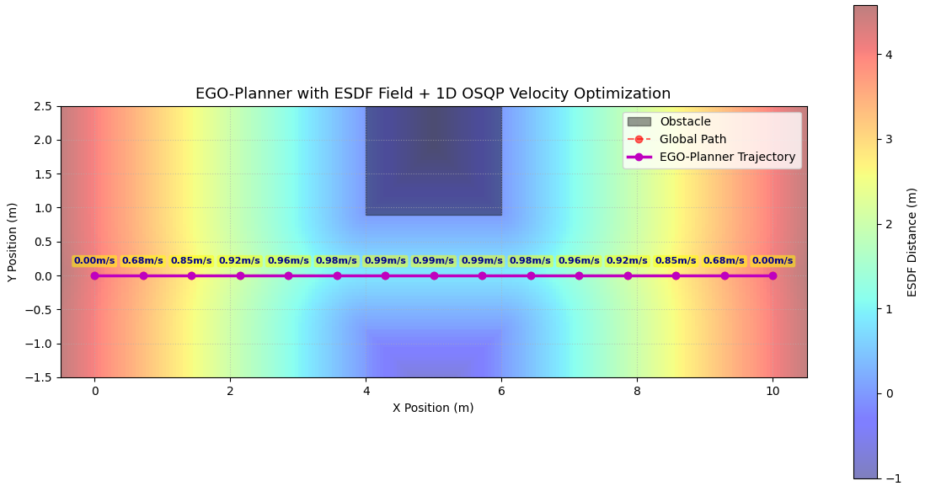
ESDF Field + L-GFBS + 1-D QSQP Opt. (1)
v_opt = optimize_velocity_profile(
Q_opt,
esdf_map,
v_target=1.0,
a_max=0.5,
a_lat_max=0.5,
d_safety_margin=0.6,
v_obstacle_limit=0.5
)
w_v = 1.0 # 貼近指定速度的權重
w_a = 5.0 # 懲罰縱向加速度的權重
def _add_wall_obstacles(self):
"""填入 Costmap 障礙物區域"""
x_indices = np.linspace(self.x_min, self.x_max, self.nx)
y_indices = np.linspace(self.y_min, self.y_max, self.ny)
for ix, x in enumerate(x_indices):
for iy, y in enumerate(y_indices):
if 4.0 <= x <= 6.0:
# 避開中間通道 y in [-0.8, 0.9]
if not (-0.8 < y < 0.9):
self.costmap[iy, ix] = True
# 利用 ESDF 距離場判斷與障礙物距離
dist, _ = esdf_map.get_esdf_and_grad(Q_opt[i, 0], Q_opt[i, 1])
if dist < d_safety_margin:
v_max_obs = v_obstacle_limit # 靠近障礙物時限速 (例如 0.5 m/s)
else:
v_max_obs = v_target

Slide 27
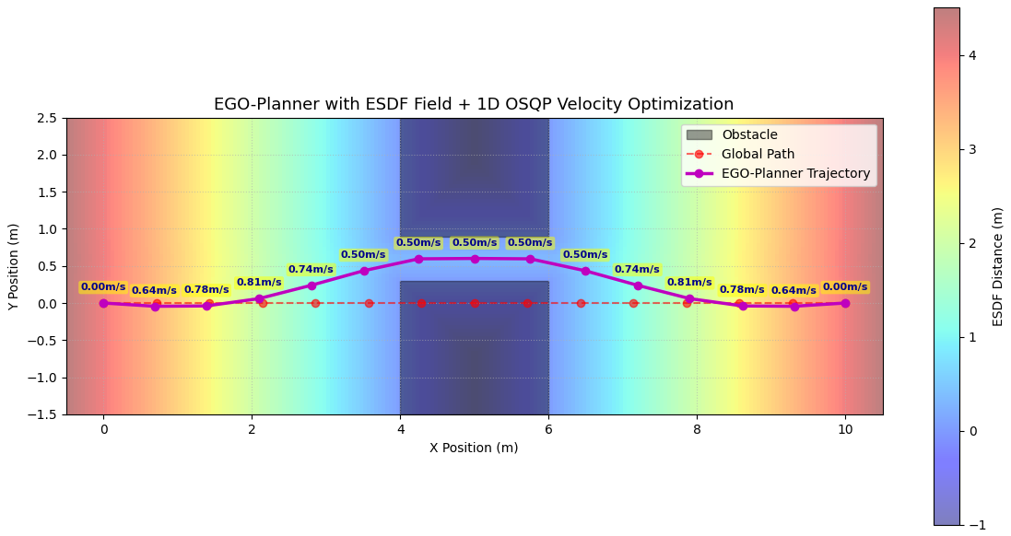
ESDF Field + L-GFBS + 1-D QSQP Opt. (2)
v_opt = optimize_velocity_profile(
Q_opt,
esdf_map,
v_target=1.0,
a_max=0.5,
a_lat_max=0.5,
d_safety_margin=0.6,
v_obstacle_limit=0.5
)
w_v = 1.0 # 貼近指定速度的權重
w_a = 5.0 # 懲罰縱向加速度的權重
def _add_wall_obstacles(self):
"""填入 Costmap 障礙物區域"""
x_indices = np.linspace(self.x_min, self.x_max, self.nx)
y_indices = np.linspace(self.y_min, self.y_max, self.ny)
for ix, x in enumerate(x_indices):
for iy, y in enumerate(y_indices):
if 4.0 <= x <= 6.0:
# 避開中間通道 y in [0.3, 0.9]
if not (0.3 < y < 0.9):
self.costmap[iy, ix] = True
# 利用 ESDF 距離場判斷與障礙物距離
dist, _ = esdf_map.get_esdf_and_grad(Q_opt[i, 0], Q_opt[i, 1])
if dist < d_safety_margin:
v_max_obs = v_obstacle_limit # 靠近障礙物時限速 (例如 0.5 m/s)
else:
v_max_obs = v_target

Slide 28
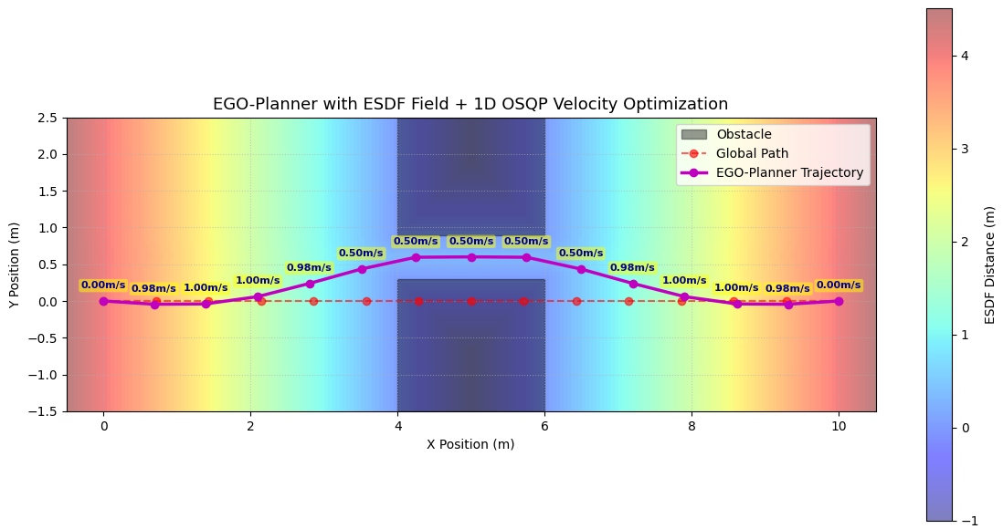
ESDF Field + L-GFBS + 1-D QSQP Opt. (3)
v_opt = optimize_velocity_profile(
Q_opt,
esdf_map,
v_target=1.0,
a_max=0.5,
a_lat_max=0.5,
d_safety_margin=0.6,
v_obstacle_limit=0.5
)
w_v = 1.0 # 貼近指定速度的權重
w_a = 0.1 # 懲罰縱向加速度的權重
def _add_wall_obstacles(self):
"""填入 Costmap 障礙物區域"""
x_indices = np.linspace(self.x_min, self.x_max, self.nx)
y_indices = np.linspace(self.y_min, self.y_max, self.ny)
for ix, x in enumerate(x_indices):
for iy, y in enumerate(y_indices):
if 4.0 <= x <= 6.0:
# 避開中間通道 y in [0.3, 0.9]
if not (0.3 < y < 0.9):
self.costmap[iy, ix] = True
# 利用 ESDF 距離場判斷與障礙物距離
dist, _ = esdf_map.get_esdf_and_grad(Q_opt[i, 0], Q_opt[i, 1])
if dist < d_safety_margin:
v_max_obs = v_obstacle_limit # 靠近障礙物時限速 (例如 0.5 m/s)
else:
v_max_obs = v_target

Slide 29
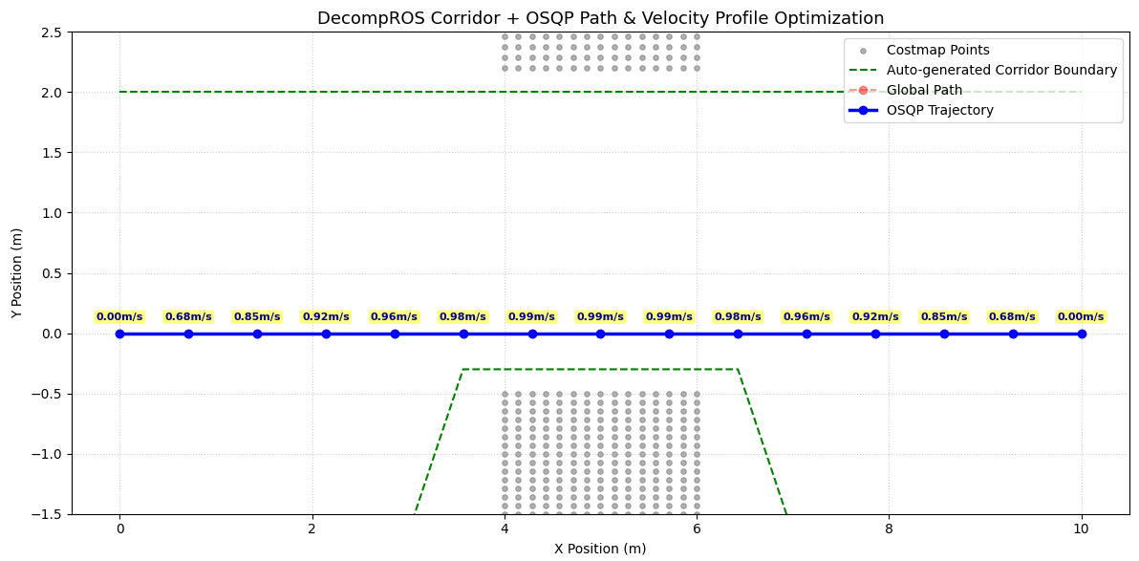
DecompROS + Traj. QSQP Opt. + Speed/Accel. QSQP Opt. (1)
v_opt = optimize_velocity_profile(
Q_opt,
corridor_boxes,
v_target=1.0,
a_max=0.5,
a_lat_max=0.5,
v_corridor_limit=0.5
)
w_v = 1.0 # 貼近指定速度的權重
w_a = 5.0 # 懲罰縱向加速度的權重
# 下半部牆壁
for x in np.linspace(4.0, 6.0, 15):
for y in np.linspace(-1.5, -0.5, 15):
obs_points.append([x, y])
# 上半部牆壁
for x in np.linspace(4.0, 6.0, 15):
for y in np.linspace(2.2, 3.0, 10):
obs_points.append([x, y])
return np.array(obs_points)
# 約束 2: 每個點的速度上限 q_i <= min(v_target^2, a_lat_max / kappa_i, v_corridor_limit^2)
for i in range(num_q):
A_osqp[row_idx, i] = 1.0
l_osqp[row_idx] = 0.0 # v^2 >= 0
# 1. 幾何曲率限制側向加速度：v^2 * kappa <= a_lat_max
if kappa[i] > 1e-3:
v_max_kappa = np.sqrt(a_lat_max / kappa[i])
else:
v_max_kappa = v_target
# 2. 走廊寬度限速（若 Corridor 寬度 < 2.0m，強制限制最高速度）
corridor_width = corridor_boxes[i][2] - corridor_boxes[i][1]
if corridor_width < 2.0:
v_max_corridor = v_corridor_limit # 窄道安全限速
else:
v_max_corridor = v_target
# 最終速限取三者的最小值
v_max_i = min(v_target, v_max_kappa, v_max_corridor)
u_osqp[row_idx] = v_max_i ** 2
row_idx += 1

Slide 30
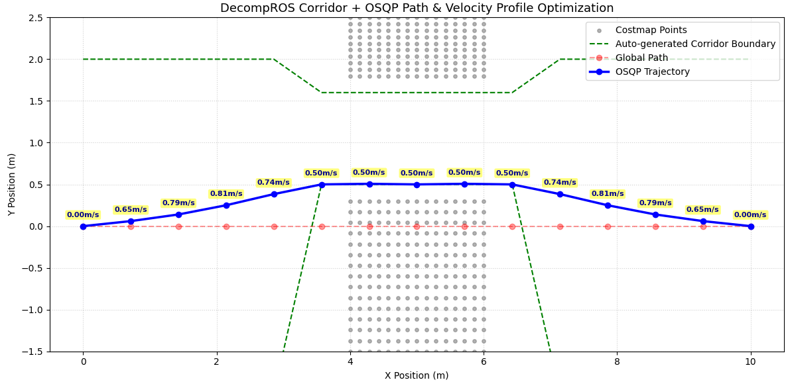
DecompROS + Traj. QSQP Opt. + Speed/Accel. QSQP Opt. (2)
v_opt = optimize_velocity_profile(
Q_opt,
corridor_boxes,
v_target=1.0,
a_max=0.5,
a_lat_max=0.5,
v_corridor_limit=0.5
)
w_v = 1.0 # 貼近指定速度的權重
w_a = 5.0 # 懲罰縱向加速度的權重
# 下半部牆壁
for x in np.linspace(4.0, 6.0, 15):
for y in np.linspace(-1.5, 0.3, 15):
obs_points.append([x, y])
# 上半部牆壁
for x in np.linspace(4.0, 6.0, 15):
for y in np.linspace(1.8, 2.5, 10):
obs_points.append([x, y])
return np.array(obs_points)
# 約束 2: 每個點的速度上限 q_i <= min(v_target^2, a_lat_max / kappa_i, v_corridor_limit^2)
for i in range(num_q):
A_osqp[row_idx, i] = 1.0
l_osqp[row_idx] = 0.0 # v^2 >= 0
# 1. 幾何曲率限制側向加速度：v^2 * kappa <= a_lat_max
if kappa[i] > 1e-3:
v_max_kappa = np.sqrt(a_lat_max / kappa[i])
else:
v_max_kappa = v_target
# 2. 走廊寬度限速（若 Corridor 寬度 < 2.0m，強制限制最高速度）
corridor_width = corridor_boxes[i][2] - corridor_boxes[i][1]
if corridor_width < 2.0:
v_max_corridor = v_corridor_limit # 窄道安全限速
else:
v_max_corridor = v_target
# 最終速限取三者的最小值
v_max_i = min(v_target, v_max_kappa, v_max_corridor)
u_osqp[row_idx] = v_max_i ** 2
row_idx += 1

Slide 31
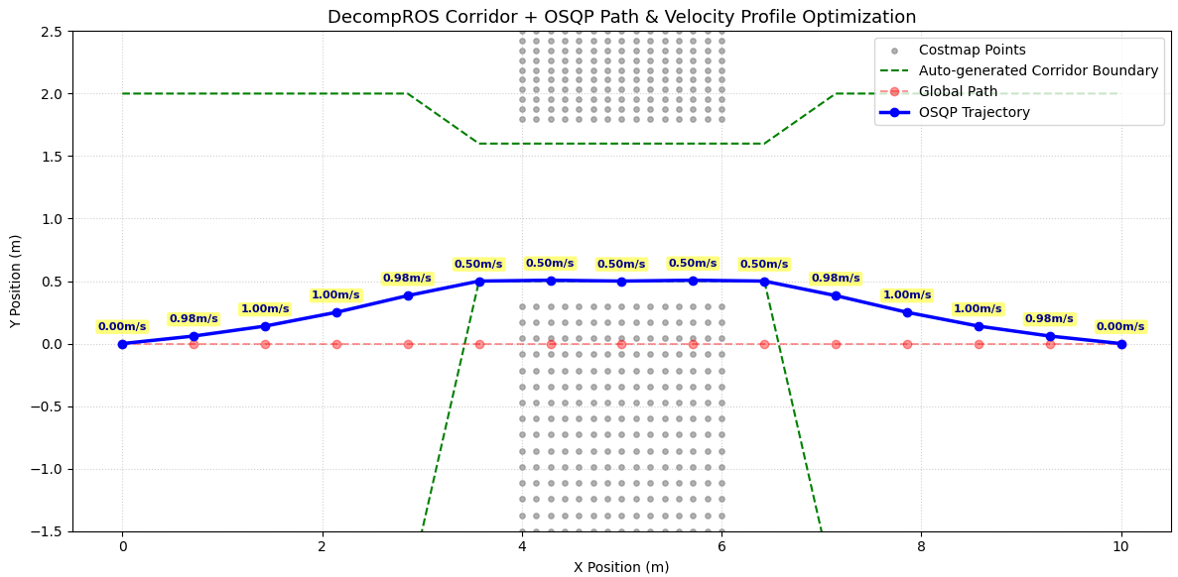
DecompROS + Traj. QSQP Opt. + Speed/Accel. QSQP Opt. (3)
v_opt = optimize_velocity_profile(
Q_opt,
corridor_boxes,
v_target=1.0,
a_max=0.5,
a_lat_max=0.5,
v_corridor_limit=0.5
)
w_v = 1.0 # 貼近指定速度的權重
w_a = 0.1 # 懲罰縱向加速度的權重
# 下半部牆壁
for x in np.linspace(4.0, 6.0, 15):
for y in np.linspace(-1.5, 0.3, 15):
obs_points.append([x, y])
# 上半部牆壁
for x in np.linspace(4.0, 6.0, 15):
for y in np.linspace(1.8, 2.5, 10):
obs_points.append([x, y])
return np.array(obs_points)
# 約束 2: 每個點的速度上限 q_i <= min(v_target^2, a_lat_max / kappa_i, v_corridor_limit^2)
for i in range(num_q):
A_osqp[row_idx, i] = 1.0
l_osqp[row_idx] = 0.0 # v^2 >= 0
# 1. 幾何曲率限制側向加速度：v^2 * kappa <= a_lat_max
if kappa[i] > 1e-3:
v_max_kappa = np.sqrt(a_lat_max / kappa[i])
else:
v_max_kappa = v_target
# 2. 走廊寬度限速（若 Corridor 寬度 < 2.0m，強制限制最高速度）
corridor_width = corridor_boxes[i][2] - corridor_boxes[i][1]
if corridor_width < 2.0:
v_max_corridor = v_corridor_limit # 窄道安全限速
else:
v_max_corridor = v_target
# 最終速限取三者的最小值
v_max_i = min(v_target, v_max_kappa, v_max_corridor)
u_osqp[row_idx] = v_max_i ** 2
row_idx += 1

