Slide 1
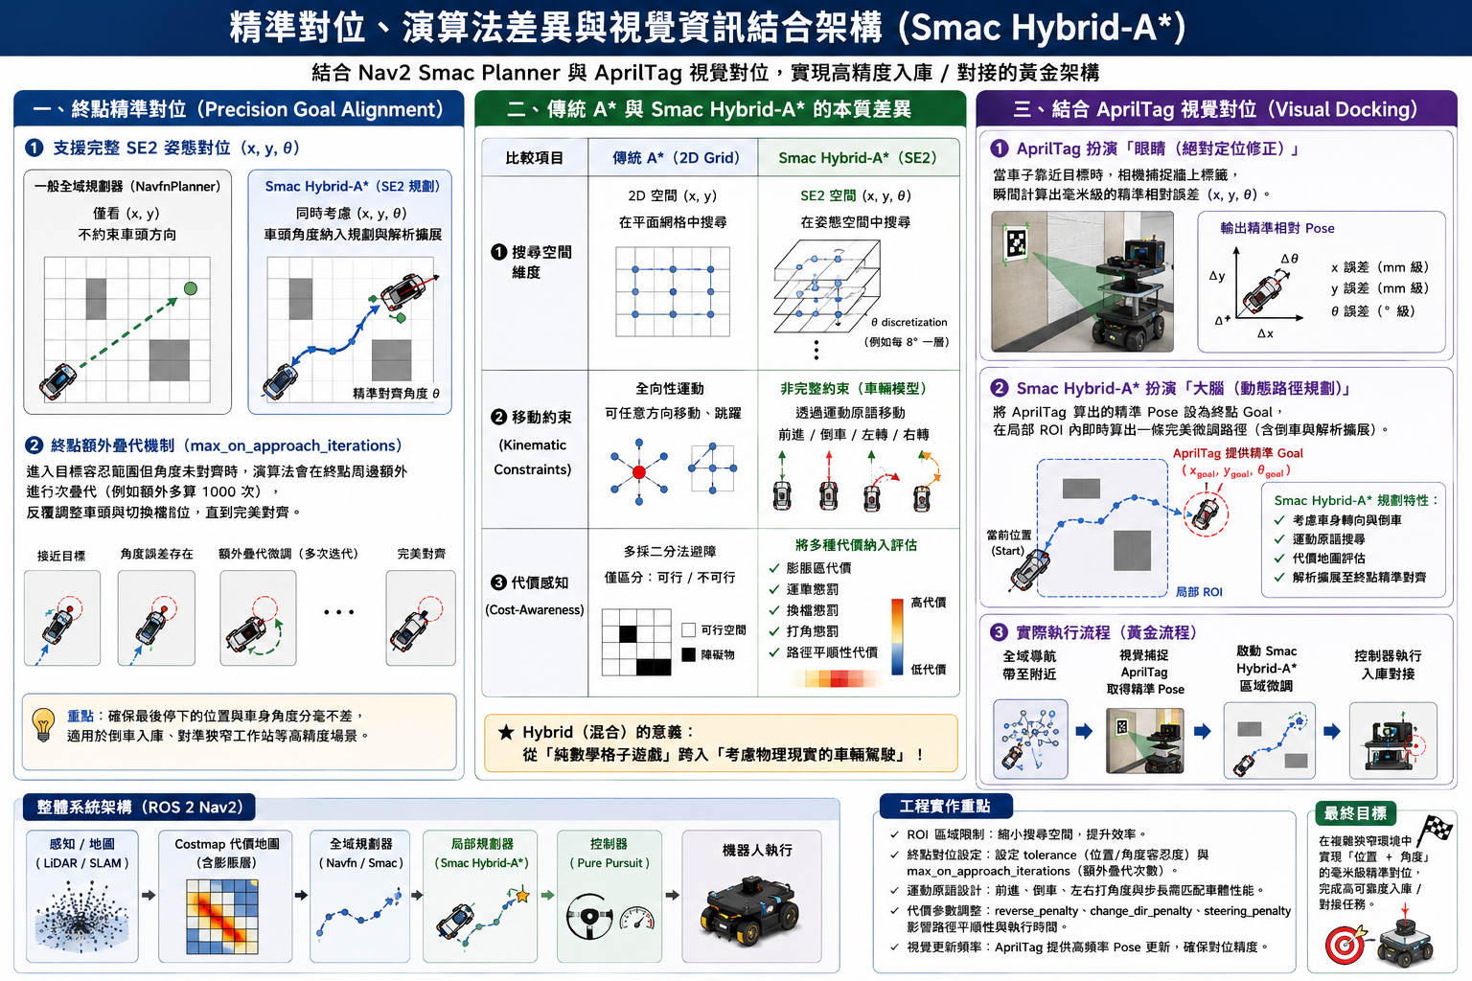
SMAC Planner 概念說明

Slide 2
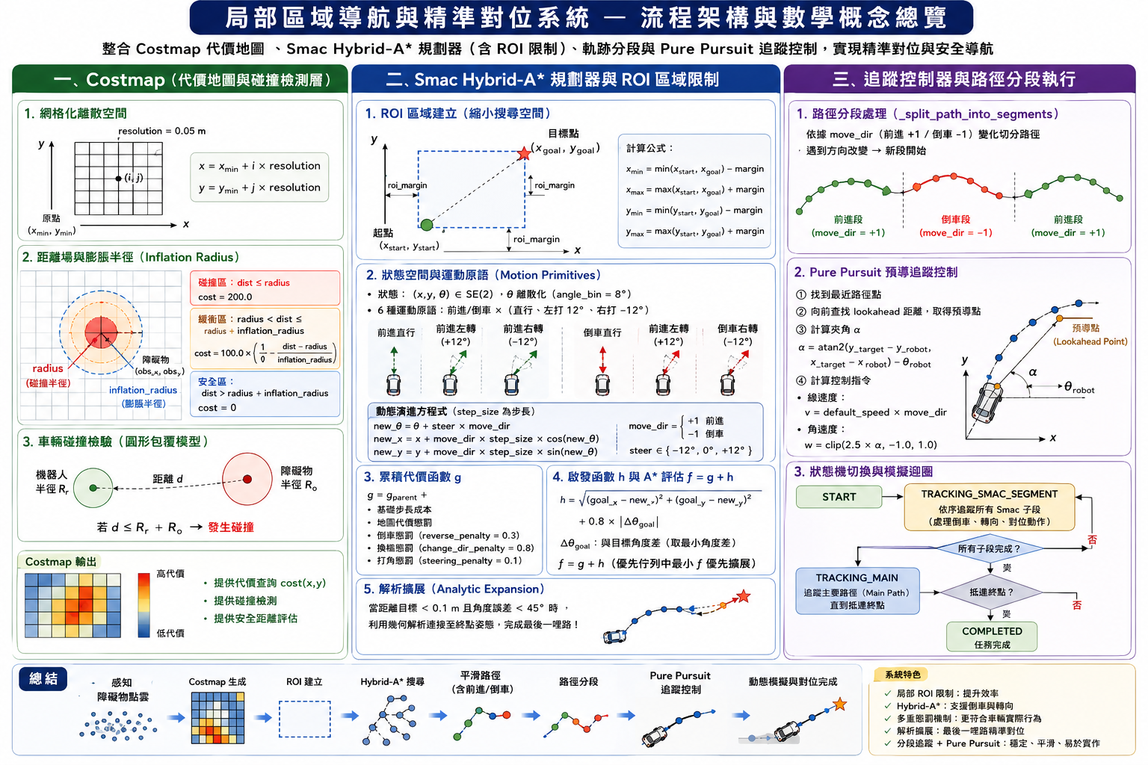
SMAC Planner 範例代碼測試

Slide 3
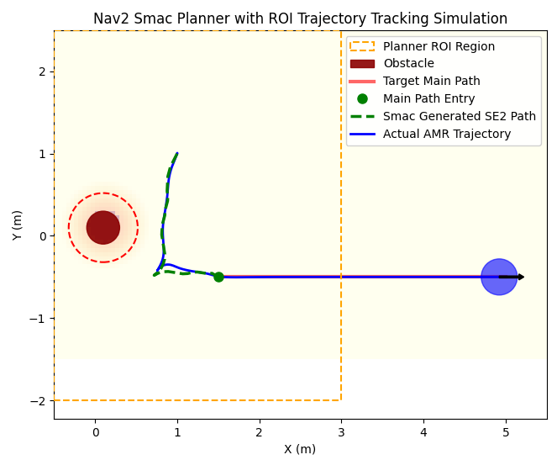
Hybrid A* 演算法測試 (1)
self.step_size = 0.06
self.reverse_penalty = 0.3
self.change_dir_penalty = 0.8
self.steering_penalty = 0.1
dist < 0.1 and angle_diff < np.radians(45) and goal_angle_diff < np.radians(45)
self.costmap.add_obstacle(x=0.1, y=0.1, radius=0.2, inflation_radius=0.35)

Slide 4
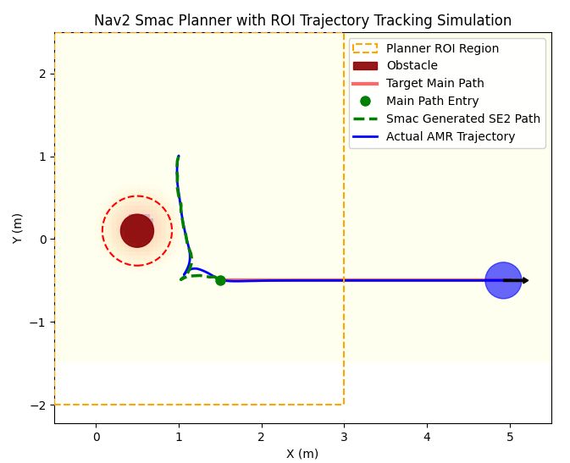
Hybrid A* 演算法測試 (2)
self.step_size = 0.06
self.reverse_penalty = 0.3
self.change_dir_penalty = 0.8
self.steering_penalty = 0.1
dist < 0.1 and angle_diff < np.radians(45) and goal_angle_diff < np.radians(45)
self.costmap.add_obstacle(x=0.5, y=0.1, radius=0.2, inflation_radius=0.35)

Slide 5
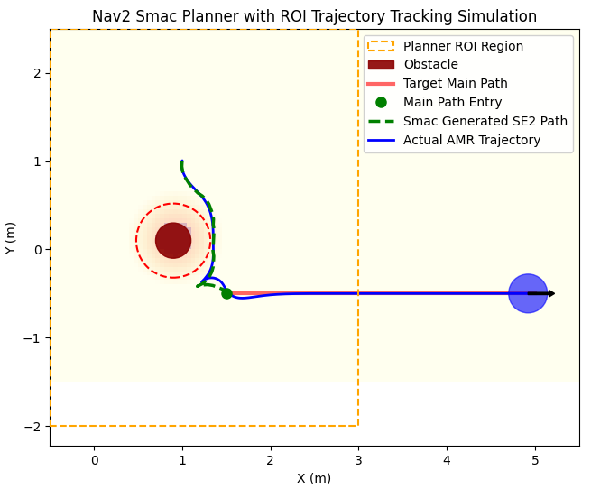
Hybrid A* 演算法測試 (3)
self.step_size = 0.06
self.reverse_penalty = 0.3
self.change_dir_penalty = 0.8
self.steering_penalty = 0.1
dist < 0.1 and angle_diff < np.radians(45) and goal_angle_diff < np.radians(45)
self.costmap.add_obstacle(x=0.9, y=0.1, radius=0.2, inflation_radius=0.35)

Slide 6
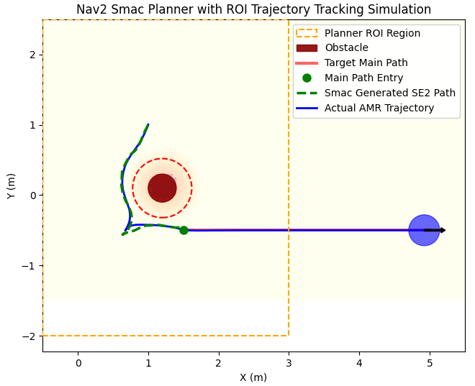
Hybrid A* 演算法測試 (4)
self.step_size = 0.06
self.reverse_penalty = 0.3
self.change_dir_penalty = 0.8
self.steering_penalty = 0.1
dist < 0.1 and angle_diff < np.radians(45) and goal_angle_diff < np.radians(45)
self.costmap.add_obstacle(x=1.2, y=0.1, radius=0.2, inflation_radius=0.35)

Slide 7
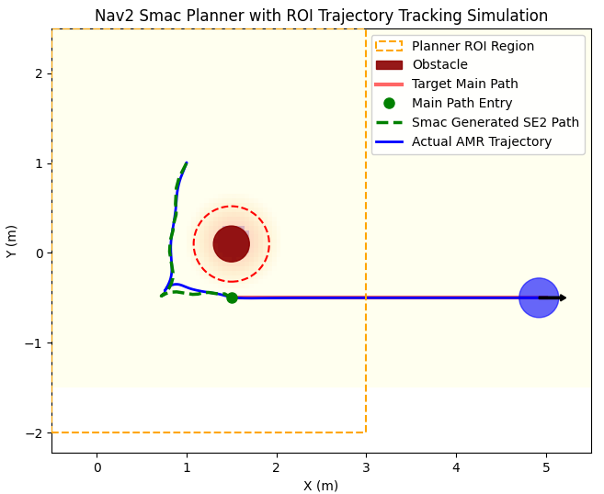
Hybrid A* 演算法測試 (5)
self.step_size = 0.06
self.reverse_penalty = 0.3
self.change_dir_penalty = 0.8
self.steering_penalty = 0.1
dist < 0.1 and angle_diff < np.radians(45) and goal_angle_diff < np.radians(45)
self.costmap.add_obstacle(x=1.5, y=0.1, radius=0.2, inflation_radius=0.35)

Slide 8
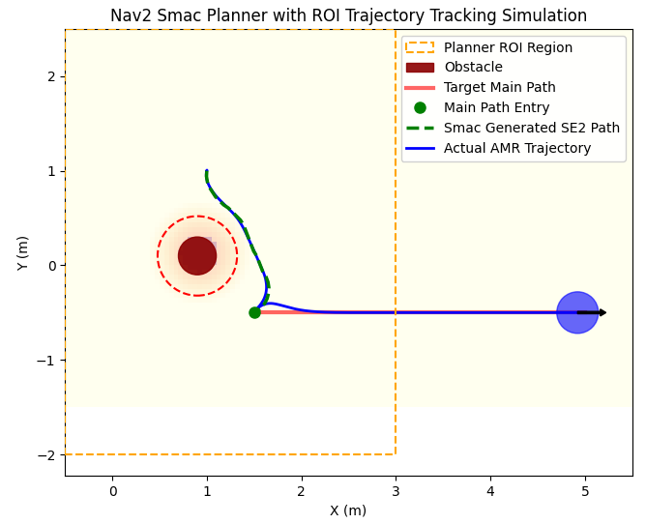
Hybrid A* 演算法測試 (6)
self.step_size = 0.06
self.reverse_penalty = 0.3
self.change_dir_penalty = 0.8
self.steering_penalty = 0.8
dist < 0.1 and angle_diff < np.radians(45) and goal_angle_diff < np.radians(45)
self.costmap.add_obstacle(x=0.9, y=0.1, radius=0.2, inflation_radius=0.35)

Slide 9
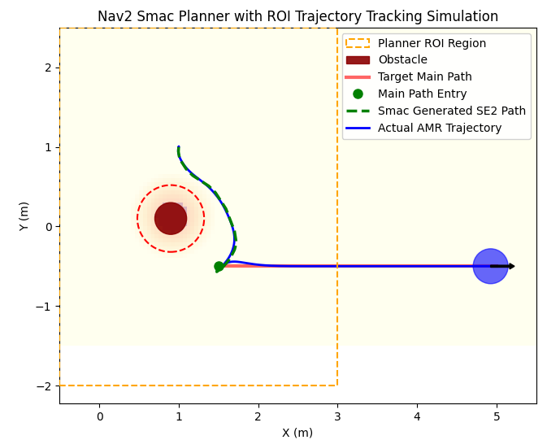
Hybrid A* 演算法測試 (7)
self.step_size = 0.06
self.reverse_penalty = 0.3
self.change_dir_penalty = 0.8
self.steering_penalty = 2.0
dist < 0.1 and angle_diff < np.radians(45) and goal_angle_diff < np.radians(45)
self.costmap.add_obstacle(x=0.9, y=0.1, radius=0.2, inflation_radius=0.35)

Slide 10
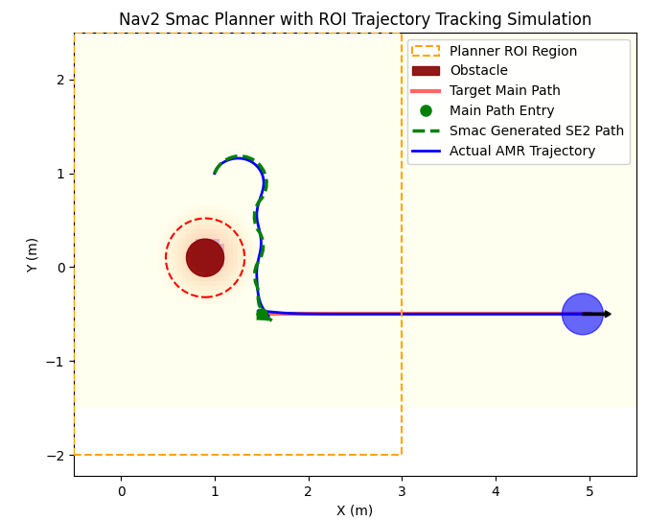
Hybrid A* 演算法測試 (8)
self.step_size = 0.06
self.reverse_penalty = 2.0
self.change_dir_penalty = 0.8
self.steering_penalty = 0.1
dist < 0.1 and angle_diff < np.radians(45) and goal_angle_diff < np.radians(45)
self.costmap.add_obstacle(x=0.9, y=0.1, radius=0.2, inflation_radius=0.35)

Slide 11
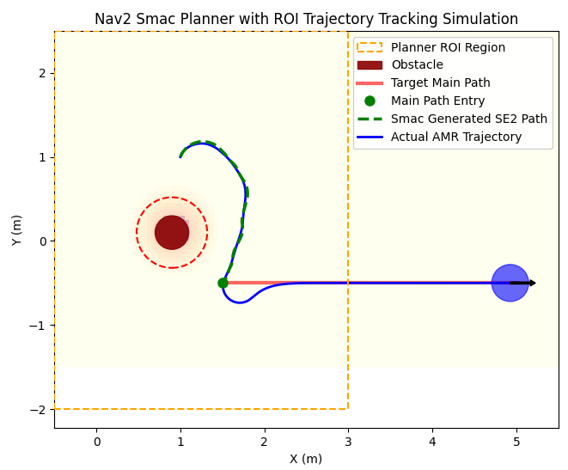
Hybrid A* 演算法測試 (9)
self.step_size = 0.06
self.reverse_penalty = 10.0
self.change_dir_penalty = 0.8
self.steering_penalty = 0.1
dist < 0.1 and angle_diff < np.radians(45) and goal_angle_diff < np.radians(45)
self.costmap.add_obstacle(x=0.9, y=0.1, radius=0.2, inflation_radius=0.35)

Slide 12
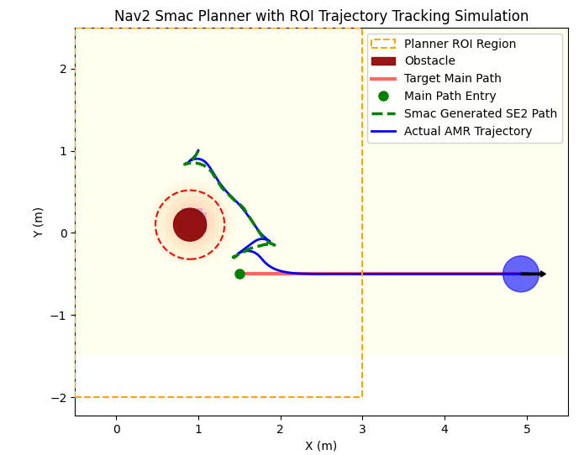
Hybrid A* 演算法測試 (10)
self.step_size = 0.06
self.reverse_penalty = 0.3
self.change_dir_penalty = 0.1
self.steering_penalty = 0.1
dist < 0.1 and angle_diff < np.radians(45) and goal_angle_diff < np.radians(45)
self.costmap.add_obstacle(x=0.9, y=0.1, radius=0.2, inflation_radius=0.35)

Slide 13
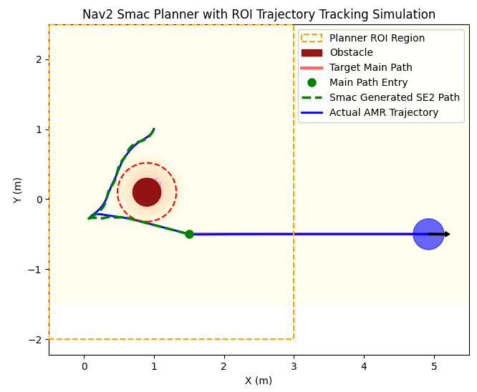
Hybrid A* 演算法測試 (11)
self.step_size = 0.06
self.reverse_penalty = 0.3
self.change_dir_penalty = 0.1
self.steering_penalty = 0.1
dist < 1.0 and angle_diff < np.radians(45) and goal_angle_diff < np.radians(45)
self.costmap.add_obstacle(x=0.9, y=0.1, radius=0.2, inflation_radius=0.35)

