Slide 1

Investing in Movies:
A Data-Driven Analysis
David Zvi Samuel Alter

Slide 2
Objective
To recommend two movie investment strategies based on different risk profiles:
Conservative Strategy – Lower risk with more moderate return potential
Aggressive Strategy – Higher risk with greater return potential
Data: IMDb movie dataset covering 1920–2015
Supporting research:
“Breaking Down the Box Office: An Analysis of Film Profitability Factors” - Link

Slide 3
Data Clearing
Movies Relevance
Analysis focuses on movies released from 2005 onward, where most of the dataset is concentrated, and providing a more representative view of modern market trends

Slide 4
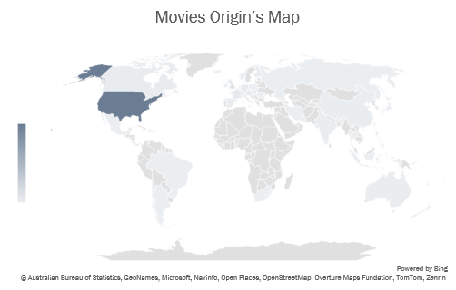
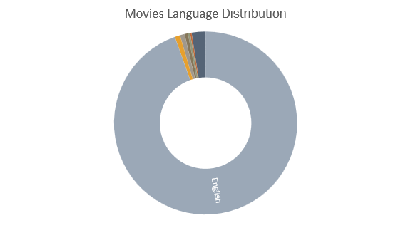
Data Clearing
Geographic & Language Focus
The analysis focuses on English-language movies from the U.S., as they represent most of the dataset and provide the most consistent basis for comparison
More Movies
fewer Movies
94.5%

Slide 5
Data Clearing
Selected Genres for Analysis
Genres with a sample size above 100 movies were included to improve the reliability of the analysis

Slide 6
Base Analysis based on genres
Two investment strategies were selected based on risk tolerance:
Comedy – a more conservative option with lower volatility
Drama – a higher-return opportunity, but with significantly greater risk

Slide 7

Conservative Strategy: Comedy Films
Stronger risk-adjusted investment potential

Slide 8
Conservative Strategy
Star power in Comedy films
Steve Carell offers the stronger risk-adjusted investment. While Joseph Gordon-Levitt delivers a slightly higher average ROI, his returns are more volatile. Overall, Steve Carell provides the better balance between return and risk
*For Actor how acted in three or more comedy movies

Slide 9
Conservative Strategy
Directors in Comedy films
Seth Gordon is the strongest choice, offering the best balance between average ROI and investment risk among the directors analyzed
*For directors how directed in three or more comedy movies

Slide 10
Conservative Strategy
Optimal Budget & Runtime for Comedy Films
Recommended profile: Medium-budget comedy films ($10M–$40M), supported by a preferred runtime of 111–140 minutes
Medium Budget ($10M–$40M): best balance between ROI and risk
Preferred runtime: 111–140 min — highest ROI (105%), but high variability limits its predictive power
Budget Class | Budget Range
Low Budget | < $10M
Medium Budget | $10M–$40M
High Budget | $40M–$100M
Blockbuster | > $100M

Slide 11
Conservative Strategy
Movie Rating Category
Recommended profile: PG rated movie

Slide 12
Conservative Strategy
Optimal Release Month
March offers the best risk-adjusted return, while October is recommended for investors seeking higher potential returns and willing to accept greater volatility

Slide 13
Conservative Strategy bottom line
Base features
Movie from the U.S.A
Movie in English
Analysis
Comedy Movie genre
Movie starred by – ‘Steve Carrel’
Movie directed by – ‘Seth Gordon’
Added advantage
Medium-budget comedy films ($10M–$40M)
Preferred runtime - 111–140 minutes
Movie release window – March or October
PG rated movie

Slide 14

Aggressive Strategy: Drama Films
higher-return opportunity, but with significantly greater risk

Slide 15
Aggressive Strategy
Star power in Drama films
Ryan Gosling offers a strong combination of high average ROI and relatively low volatility, making him an attractive risk-adjusted choice
*For Actor how acted in three or more comedy movies

Slide 16
Aggressive Strategy
Directors in Drama films
Alex Kendrick combines exceptionally high return potential with a strong ROI-over-risk ratio, making him an attractive choice for investors willing to accept high volatility
Row Labels | Average of ROI | StdDev of ROI | ROI OVER RISK
Alex Kendrick | 6097.02 | 4245.82 | 1.44
Darren Aronofsky | 329.65 | 396.93 | 0.83
Richard Linklater | 203.07 | 315.88 | 0.64
Lasse HallstrÃ¶m | 101.11 | 153.04 | 0.66
Woody Allen | 63.09 | 19.59 | 3.22
Clint Eastwood | 55.98 | 195.77 | 0.29
Steven Spielberg | 23.16 | 56.57 | 0.41
Shana Feste | -15.44 | 72.12 | -0.21
*For directors how directed in three or more comedy movies

Slide 17
Aggressive Strategy
Optimal Budget & Runtime for Drama Films
Recommended profile: Medium-budget Drama films ($10M–$40M), supported by a preferred runtime of <90 minutes
Medium-budget films offer the strongest balance, while low-budget films provide high-return potential at extremely unreasonably high risk
Preferred runtime: <90 minutes - highest return potential, but extreme volatility makes it a high-risk option, and high variability limits its predictive power
Budget Class | Budget Range
Low Budget | < $10M
Medium Budget | $10M–$40M
High Budget | $40M–$100M
Blockbuster | > $100M

Slide 18
Aggressive Strategy
Movie Rating Category
Recommended profile: PG-13 rated movie

Slide 19
Aggressive Strategy
Optimal Release Month
May offers the highest return potential, while August provides a more balanced alternative with lower volatility and still-strong ROI

Slide 20
Aggressive Strategy bottom line
Base features
Movie from the U.S.A
Movie in English
Analysis
Drama Movie genre
Movie starred by – ‘Ryan Gosling’
Movie directed by – ‘Alex Kendrick’
Added advantage
Medium-budget Drama films
Preferred runtime - <90 minutes
Movie release window – May or August
($10M–$40M)
PG-13 rated movie

Slide 21

Final statements and summary

Slide 22
Supporting research
Added Benefit
Using the research article by – ‘Zachary Wisnefsky’
‘Breaking Down the Box Office: An Analysis of Film Profitability Factors’ - Link
“I find that sequel and prequel films are much more likely to earn a profit and generate significantly higher return on investment and profit margin.”
And add to my both Recommendations is to instead of invest in an original new IP, You should invest in sequel or prequel of an existing established movies franchise

Slide 23
Investment Recommendations Summary
Base features
Strategy
Analysis
Movie from the U.S.A
Movie in English
sequel or prequel Movie
Aggressive
Conservative
Medium-budget Drama films
Preferred runtime - 111–140 minutes
Movie release window – March or October
PG-13 rated movie
Comedy Movie genre
Movie starred by – ‘Steve Carrel’
Movie directed by – ‘Seth Gordon’
Drama Movie genre
Movie starred by – ‘Ryan Gosling’
Movie directed by – ‘Alex Kendrick’
Medium-budget comedy films
Preferred runtime - <90 minutes Movie release window – May or August
PG rated movie

