Slide 1
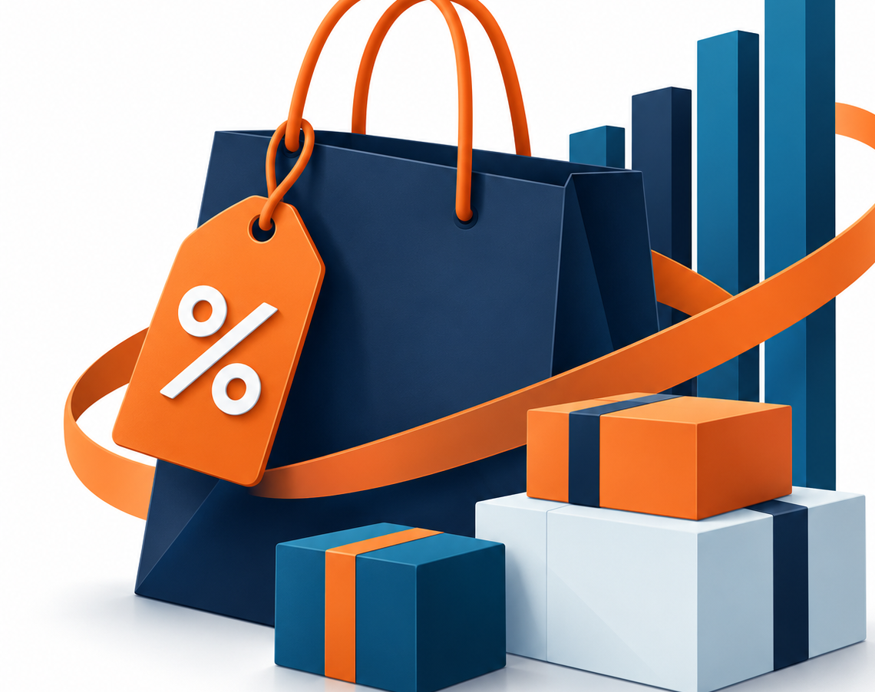
Customer Shopping Behavior and Promotion Effectiveness
SQL and Excel Mini Project
Shilat Ben Shimol Biton
David Zvi Samuel Alter
Hagit Turjeman

Slide 2
Our Chosen Topics & Why They Matter
Best-Selling Products & Consumer Preferences
Help us understand which products customers prefer, identify top-performing categories, and support better inventory and product decisions.
Effectiveness of Discounts & Promotions
Help us examine how promotions relate to customer purchasing behavior and evaluate whether they are associated with increased spending.
About the Dataset
Our analysis is based on a synthetic dataset of 3,900 customer shopping records, including 20 variables covering customer demographics, purchasing behavior, product categories, seasonal trends, and promotions.

Slide 3
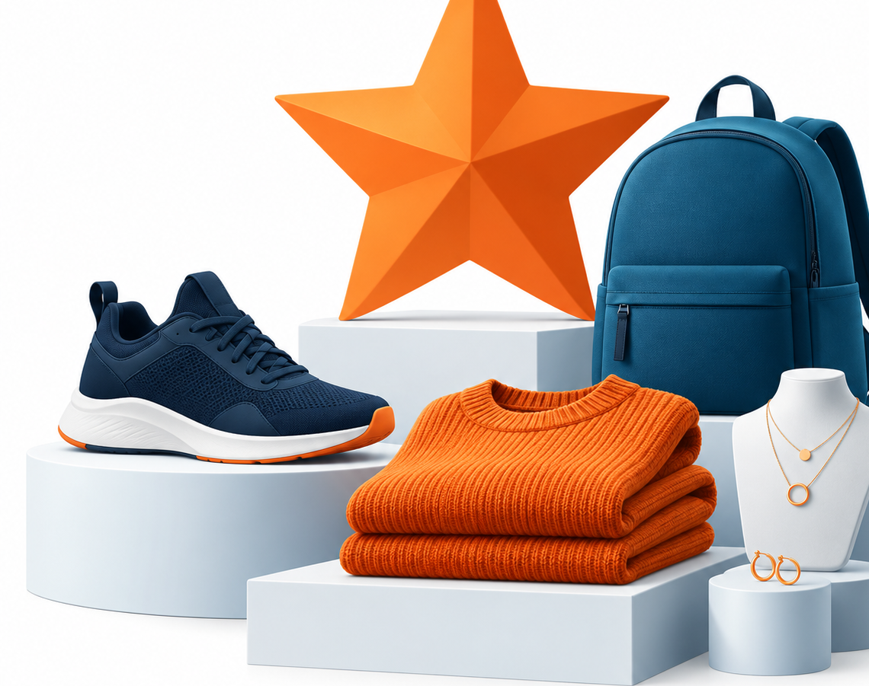
Best-Selling Products and Consumer Preferences

Slide 4
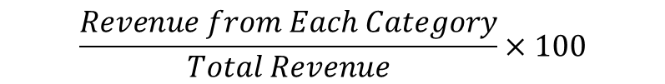
Methodology & Key Performance Indicators (KPIs)
1. Product popularity index
Purpose: Identify the most popular products by combining sales volume and customer ratings.
Calculation:
3. Impact of rating on sales
Purpose: Examine whether products with higher customer ratings tend to sell more units.
Calculation:
Pearson Correlation between
Average Review and Total units Sold
$$Total Units Sold×Average Review Rating$$
2. Revenue contribution by category
Purpose: Measure how much each product category contributes to total revenue.
Calculation:
$$\frac{Revenue from Each Category}{Total Revenue}×100$$

Slide 5
Product Popularity
Total Unit Sold X Average Review Rating = Product Popularity index
Product Popularity Index
RANKING SNAPSHOT
TOP 3
1
Jewelry
642
2
Pants
636
3
Blouse
630
BOTTOM 3
1
Jeans
452
2
Backpack
537
3
Gloves
541
Most products have similar popularity levels, but Jeans is the clear outlier with 85 points below the next-lowest product

Slide 6
Product Popularity by Category
Within most categories, product popularity is relatively balanced.
The main exceptions are Jeans, which significantly lower in Clothing, and Sandals, which clearly lead in Footwear

Slide 7
Category Popularity Index
Popularity Index & Per-item View
Footwear has the highest average sales per item, while Accessories has the lowest. This shows that a category’s total popularity does not necessarily mean stronger product-level performance.

Slide 8
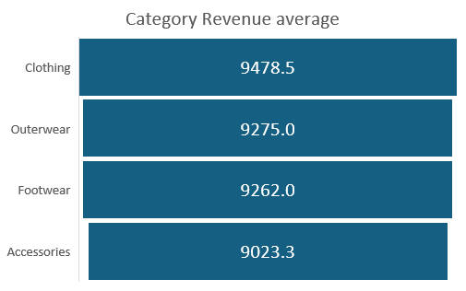
Revenue share varies far more than average revenue
Average Revenue
Total Revenue Share
Average revenue is tightly clustered: Clothing leads with $9478, only about 5% above Accessories with $9023.
Revenue is concentrated: Clothing and Accessories generate 76.6% of the total, while Outerwear contributes only 8.0%.
Revenue share is driven mainly by category size (number of products) and purchase volume and not by major differences in average revenue

Slide 9
Impact of Ratings on Sales
Correlation
r = -0.15
Very weak negative relationship
Customer ratings are not a strong predictor of how many items are purchased

Slide 10
Key Insights and Recommendations for Product Preferences
Customer demand is broadly balanced, with a few clear product winners and underperformers
Outcome Summary
Recommendations for Business Owners
1
Jewelry, Pants, and Blouse are the most popular products; Jeans is the clear underperformer.
1
Keep the most popular products visible and well stocked, especially Jewelry, Pants, Blouse, and Sandals.
Sandals lead Footwear, and Footwear has the highest average sales per product.
Review Jeans pricing, design, placement, and customer feedback to understand why its demand is lower.
2
2
3
Clothing and Accessories generate 76.6% of revenue mainly because they include more products; sales per product are similar across categories.
3
Test a small expansion of Footwear and Outerwear, as they show strong sales and revenue per product despite having fewer items.
4
Customer ratings have little connection to the number of items purchased.
4
Plan inventory and marketing around actual purchase patterns instead of relying mainly on ratings.
Prioritize proven product demand, strengthen Footwear winners, and take focused action to improve or replace weak products such as Jeans.

Slide 11
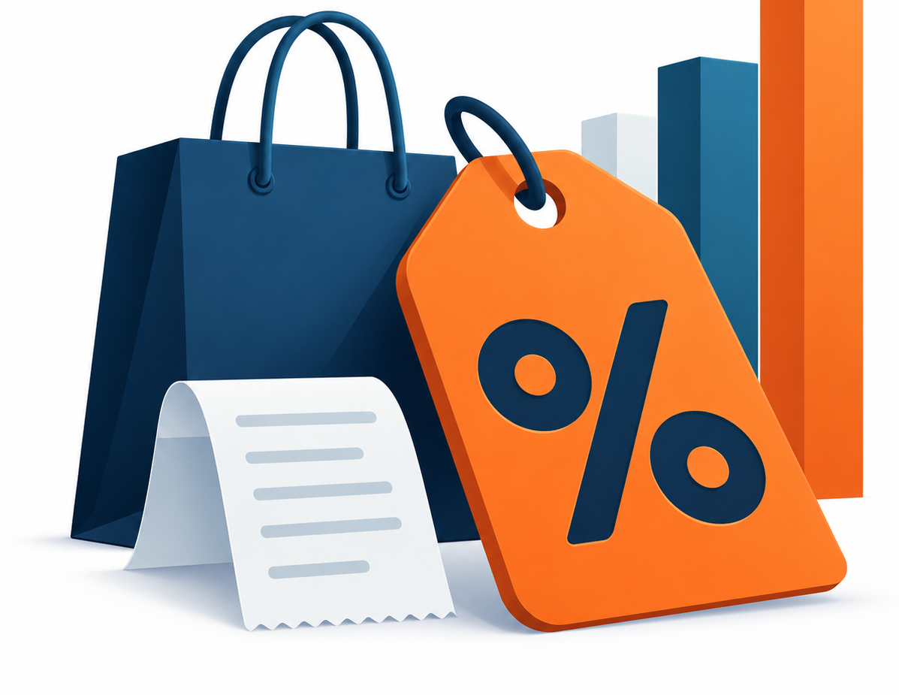
Effectiveness of Discounts and Promotions

Slide 12


Methodology & Key Performance Indicators (KPIs)
1. Promotion effectiveness rate
Purpose: To compare sales with and without promotions and evaluate their effectiveness.
Calculation:
3. Promo code usage rate
Purpose: To measure the percentage of transactions involving promo codes.
Calculation:
$$\frac{\left(Sales with Promotion−Sales without Promtion\right)}{Sales without Promtion}×100$$
$$\frac{Number of Transaction Promo Code}{Total Transaction}×100$$
2. Average discount impact on purchase amount
Purpose:To examine whether discounted purchases have a higher average value than non-discounted purchases.
Calculation:
$$Average Purchase Amount with Discount −Average Purchase Amount without Discount$$

Slide 13
Promo Codes and Discounts Move Together
Purchase without Discount | Purchase with Discount
0 | 1,677 (100%) | Purchase with Promo Code
2,223 (100%) | 0 | Purchase without Promo Code
Key Finding:
Every transaction with a promo code also includes a discount, and vice versa. The two variables represent the same group of transactions in the dataset.
* The following slides use one combined indicator: Promotion Exposure (promo code and/or discount). Results describe association with this combined indicator and cannot isolate the effect of promo codes from discounts.

Slide 14
Promotion Exposure Rate
Combined Promotion Exposure effectiveness rate
Average Purchase Value by Promotion Exposure
Combined promotion exposure rate: 43%
The measure includes promo codes and discounts
Promotion-exposed transactions have a slightly lower average purchase value than non-exposed transactions

Slide 15
Who Is Exposed to Promo code/Discount? A Demographic View
Promotion Exposure Rate by Age Group
Promotion Exposure Rate by Gender
Young Adults generate the highest total revenue, but promotion exposure is nearly identical across age groups. The revenue gap mainly reflects differences in group size within the dataset.
Male customers show 63.24% combined exposure, while female customers show none.
36.14%

Slide 16
Promotion Exposure by Subscription Status
Subscription status is strongly associated with the combined indicator: 78% of subscribers used promo code/discount, compared with 0% of non-subscribers. Promo-code use and discounts can not be isolated.

Slide 17
When Are Customers More Exposed to Promotions? A Seasonal View
KEY FINDING
Fall has the highest average purchase value despite the lowest combined promotion exposure, suggesting stronger seasonal demand may reduce reliance on promotional incentives.

Slide 18
Which Product Categories Have Higher Promotion Exposure?
The pattern differs by product category. In Footwear, promotion-exposed purchases have a higher average value. In Accessories and Outerwear, they have a lower average value.

Slide 19
How Does Promotion Exposure Vary by Product Category and Season?
Winter | Fall | Summer | Spring | Category
43.6 | 42.6 | 42.6 | 46.5 | Accessories
42.6 | 35.6 | 45.1 | 44.9 | Clothing
40 | 49.3 | 45.6 | 38.7 | Footwear
47.5 | 45.5 | 44 | 40.7 | Outwear
Exposure to a promo code and/or discount varies by category and season:
Highest combined exposure: Footwear in Fall (49.3%) & Outerwear in Winter (47.5%)
Lowest combined exposure: Clothing in Fall (35.6%)
Promotional activity should be targeted rather than distributed uniformly

Slide 20
Key Insights and Recommendations for Promotion Strategy
Promotions Are Widely Used, but Their Incremental Value Is Unclear
Outcome Summery
Recommendations For Business Owners
1
Promo codes and discounts always appear together, so their individual effects cannot be separated.
1
Check why promo codes and discounts always appear together and confirm whether this reflects the business process or a data-quality issue.
2
43% of transactions are exposed to promo code/discount, but average purchase value is slightly lower ($59.28 vs. $60.13).
Check why only some customer groups receive promotions (males & Subscribers), and make sure the data is correct.
2
3
Promo code/discount is concentrated among subscribers and male customers, suggesting targeting or data-rule effects.
Focus promotion tests on the categories and seasons where they work best, especially Footwear.
3
4
Results vary by category and season; only Footwear shows a clear positive purchase-value difference.
4
Test promotions on a small group first, then compare sales and profit with customers who did not receive the promotion (A/B Test).
Promotions do not increase average purchase value overall
test targeted offers by category and season, starting with Footwear.

