Slide 1
Restaurant management system

Slide 2
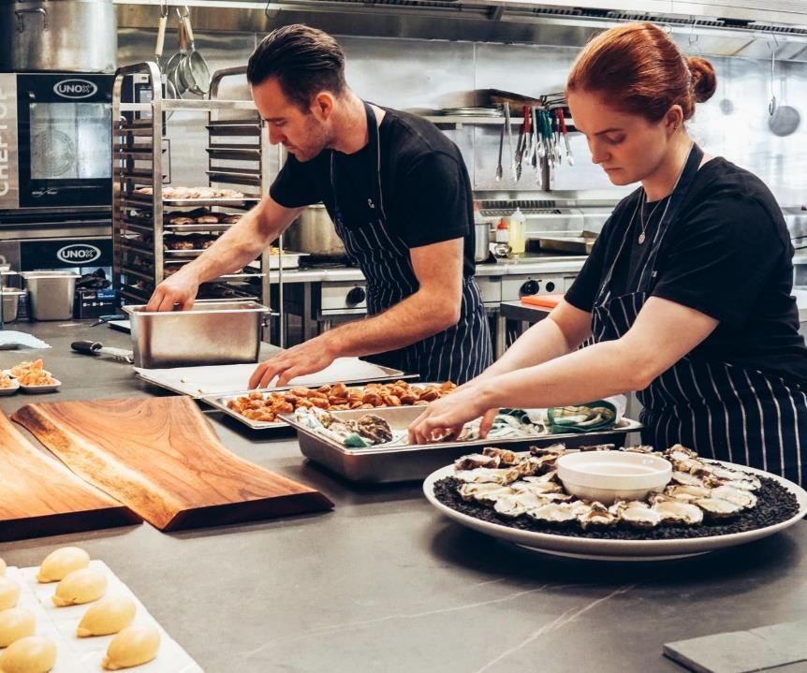

About Us
We are from Group 10!
Members:
Dao Hai Long BA9-041
Doan Van Chuong BA9-008
Dang Thai Son BA9-053
Nguyen Minh Hieu BA9-020
Do Cong Hoa BA9-022

Slide 3
Let’s preview some concepts
INTRODUCTION ABOUT
OUR PROJECT
03
DEMO OF SOME FEATURES
01
STRUCTURE OF THE
PROJECT
02
04
CONCLUSION

Slide 4
INTRO
01
What ?
Why ?
How ?

Slide 5
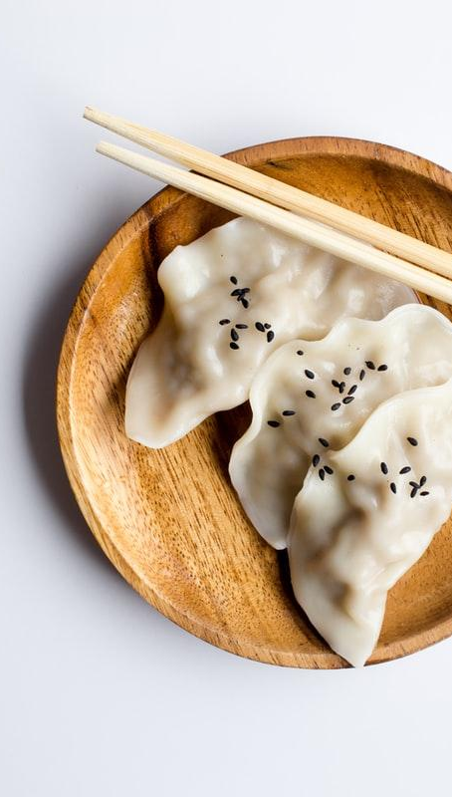
WHAT?
Management tool for restaurant business.
Fundamental and primitive kind of python application.

Slide 6
WHY?
For a big and crowded restaurant, it’s hard to handle all the things by hand.
Help the manager to make their work more efficient.

Slide 7
HOW?
CUSTOMER
Manage customer: arrive time, number,..
DISHES
Manage menu: price, information…
ORDER
Order management: quantity, total price…

Slide 8
Structure
02
Database
Interface
Modules

Slide 9

Database
Contains data set that can be applied for the interface

Slide 10
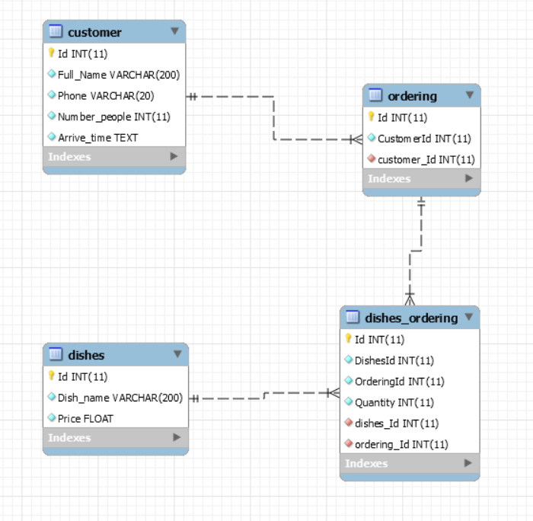
Database diagram

Slide 11
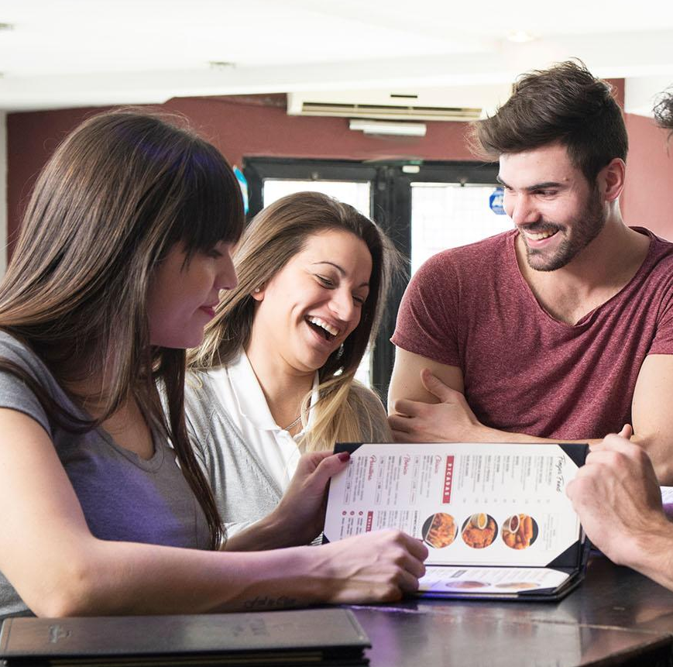
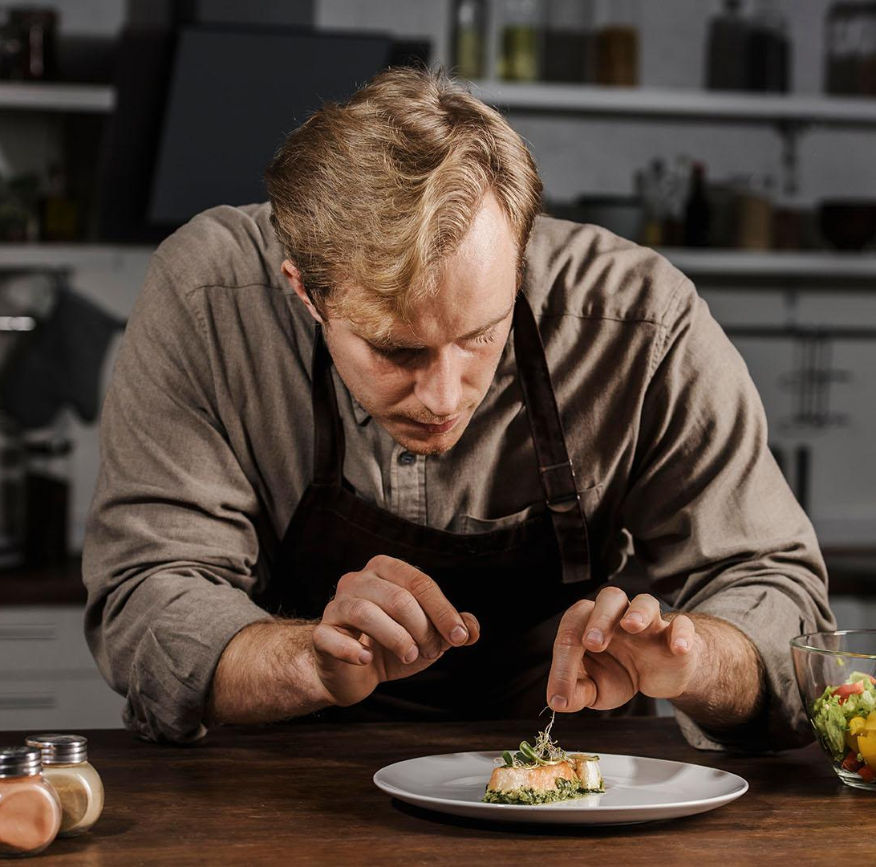
Relationship
Customer- Ordering
Dishes- Ordering
One to many: one customer can have many orders.
Many to many: one dish can belong to many orders and vice versa

Slide 12

Tables’ functions
Customer
Key information of a customer.
Dishes
Information of all dishes in the menu.
Ordering
Contains customers’ ID implementing which order belongs to which customer.
Dishes-ordering
Intermediary table between dishes and ordering table.

Slide 13
Interface
Friendly for users.

Slide 14
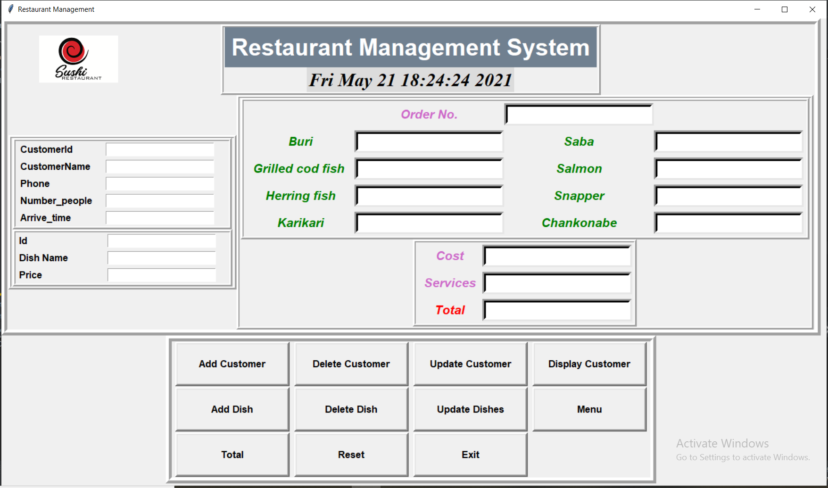
UI design

Slide 15
Three main parts of UI
Adding
Add information of customers and dishes and store it into database
Receipt calculating
Calculate cost of each dish then sum it up to provide customers with receipts
Feature buttons
Provide some others tasks to improve the efficency

Slide 16
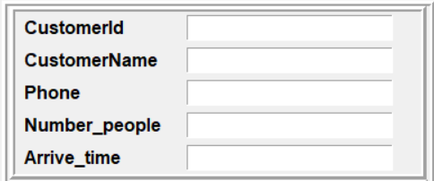
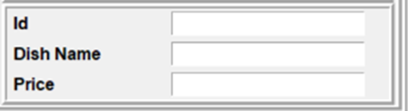
Adding function

Slide 17
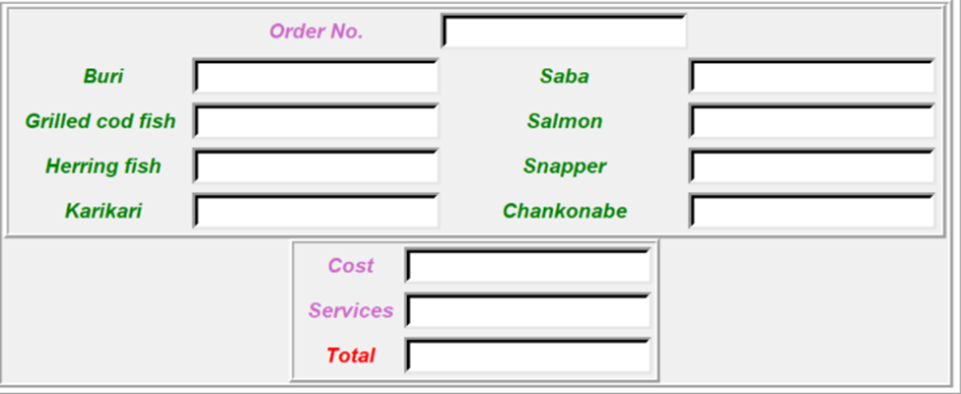
Receipt calculating

Slide 18
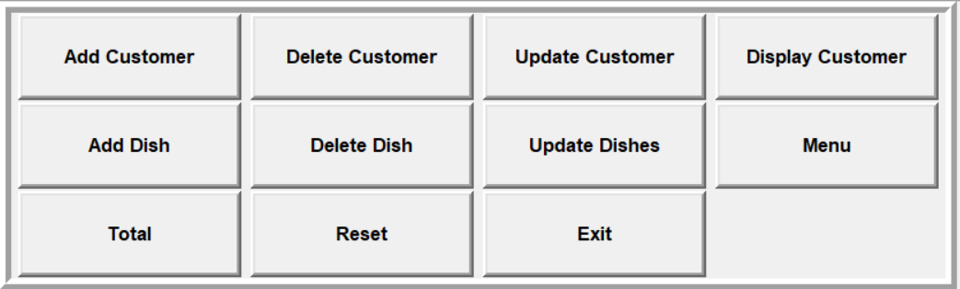
Feature buttons

Slide 19
MODULES
Divides the project into small parts

Slide 20
Modules and Packages
Project
Domains
Images
Interfaces
Main
Database
Methods

Slide 21
Demo
03
Menu
Customer displaying
Receipt calculating

Slide 22
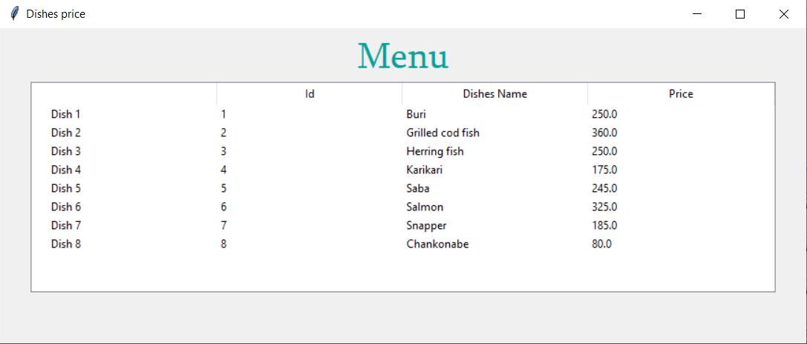
Menu Displaying

Slide 23
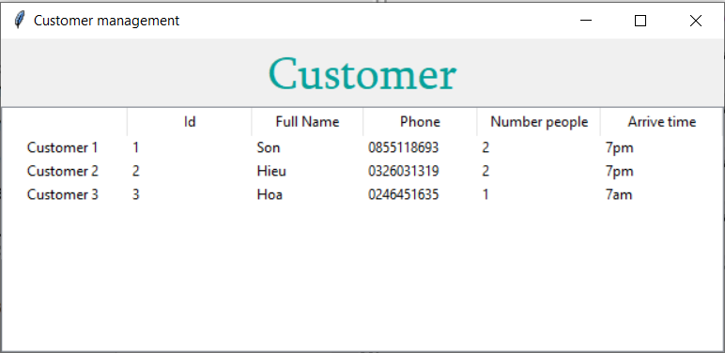
Customer displaying

Slide 24
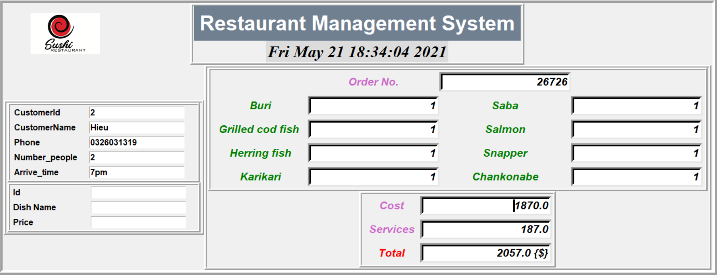
Receipt calculation

Slide 25
Conclusion
04
Done
Not done

Slide 26
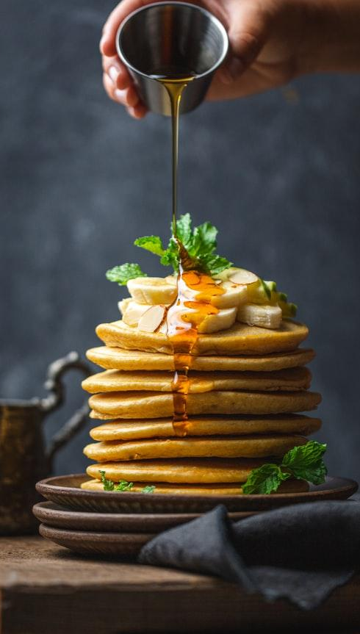
DONE
CRUD of Dishes, Customer table.
Calculate total price.

Slide 27
NOT DONE
Only can add or delete 1 customer or dish at a time.
For receipt calculating feature, we cannot set default every dishes to 0 in the interface
The calculating receipt feature can deal with only a given number of dishes

Slide 28

Thanks!
Any questions?

