Slide 1
Project for the laboratory of advanced programming
TravelMania

Slide 2
The Team
Alessandro Appolloni
Davide Renzetti
Stefano Servillo

Slide 3
Project Description
TravelMania is a web application for tracking expenses during a travel. This application is been designed for people who travel a lot and are focused on saving. The user can create an account, add travels to his account and keep a record of the expenses; then, he can see charts representing them, and he can compare two different travels

Slide 4
SCRUM
The SCRUM method has been used: we divided the development process in 5 sprint:
Design
Front-End development
Back-End development
Charts development
Testing and presentation

Slide 5
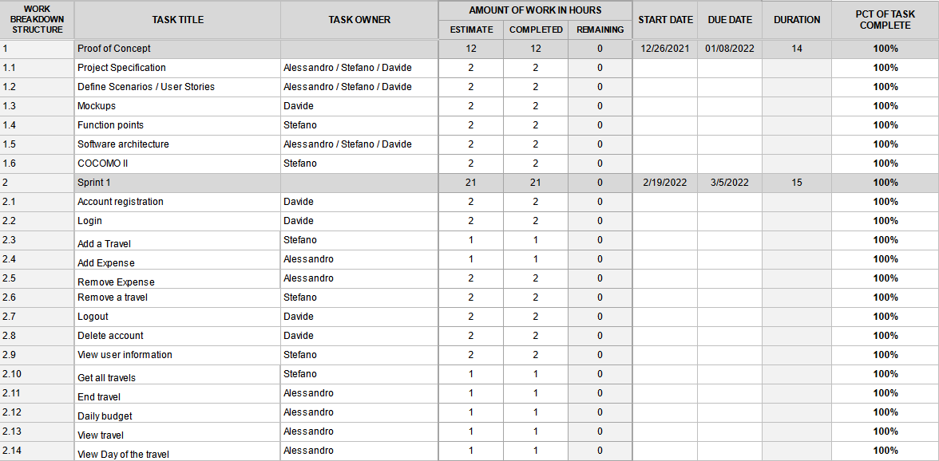
SCRUM

Slide 6
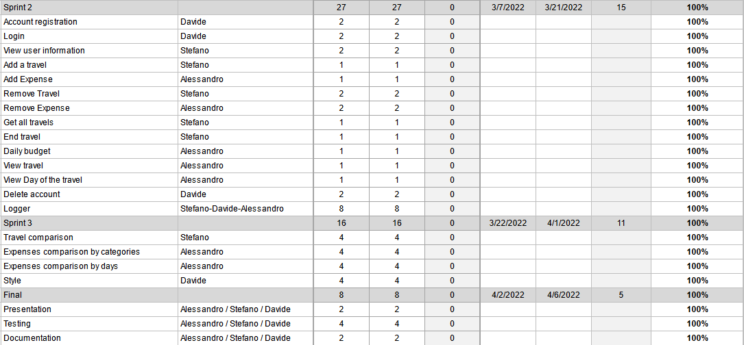
SCRUM

Slide 7
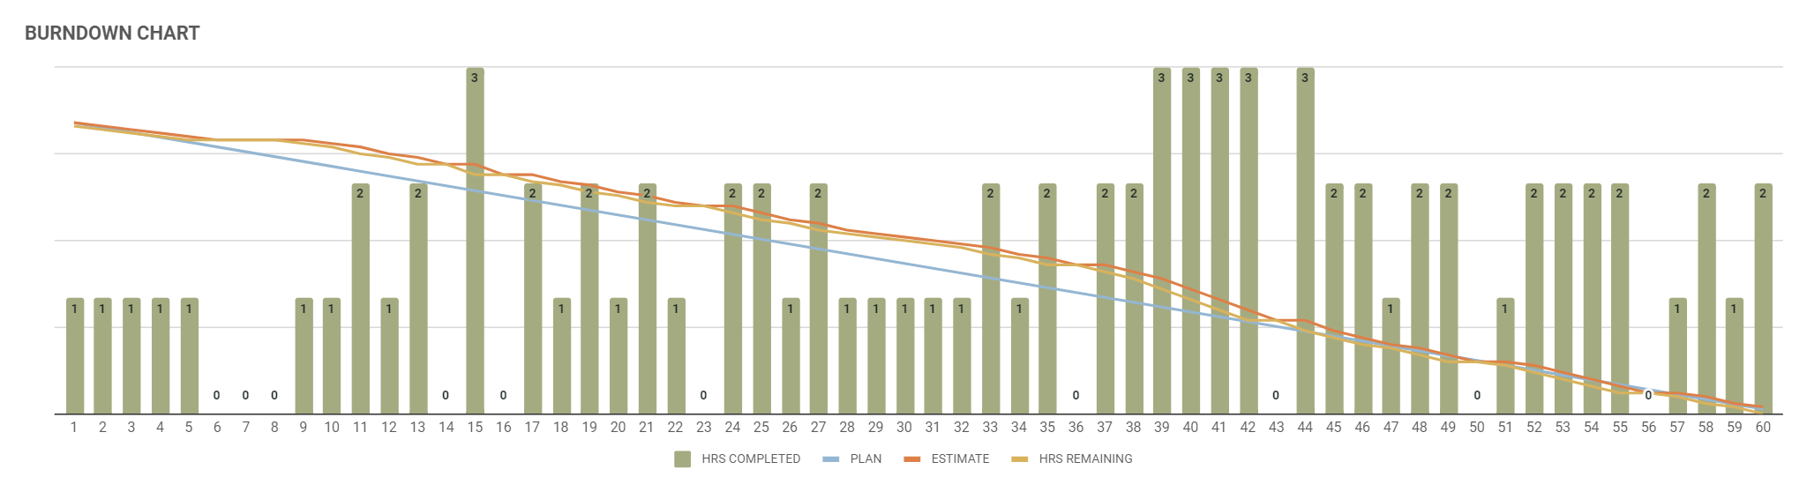
Burndown chart
 |  | ESTIMATE | COMPLETED | REMAINING | EST/DAYS
BURNDOWN DATA | TOTAL HOURS | 84 | 84 | 0 | 1.4

Slide 8
Project Design
For estimating the effort necessary to develop the project, function points and COCOMO II have been used. First, we created a mockup, with Balsamiq, and we used it to calculate the function points; then we used the function points for COCOMO II.
Also, we made an UML diagram and an ER diagram.

Slide 9
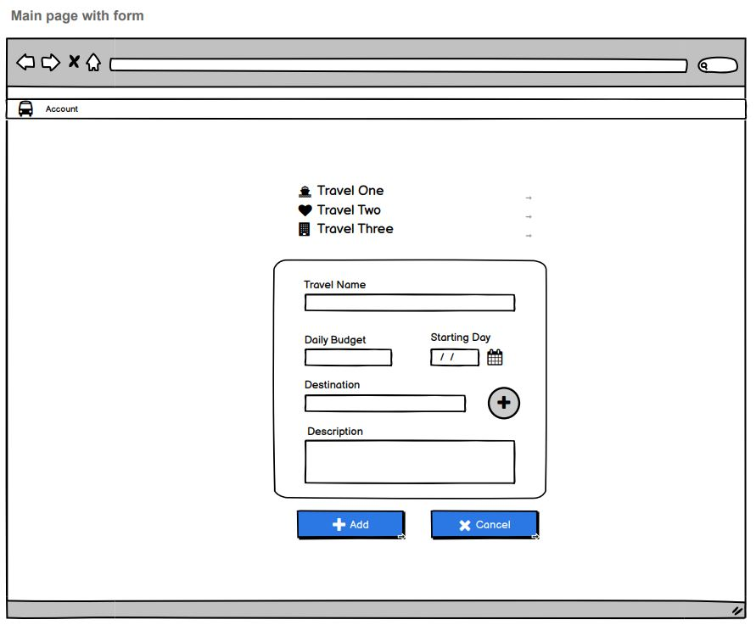
Mockup

Slide 10
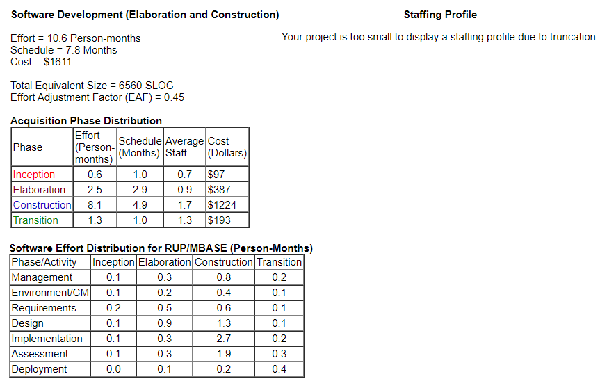
COCOMO II

Slide 11
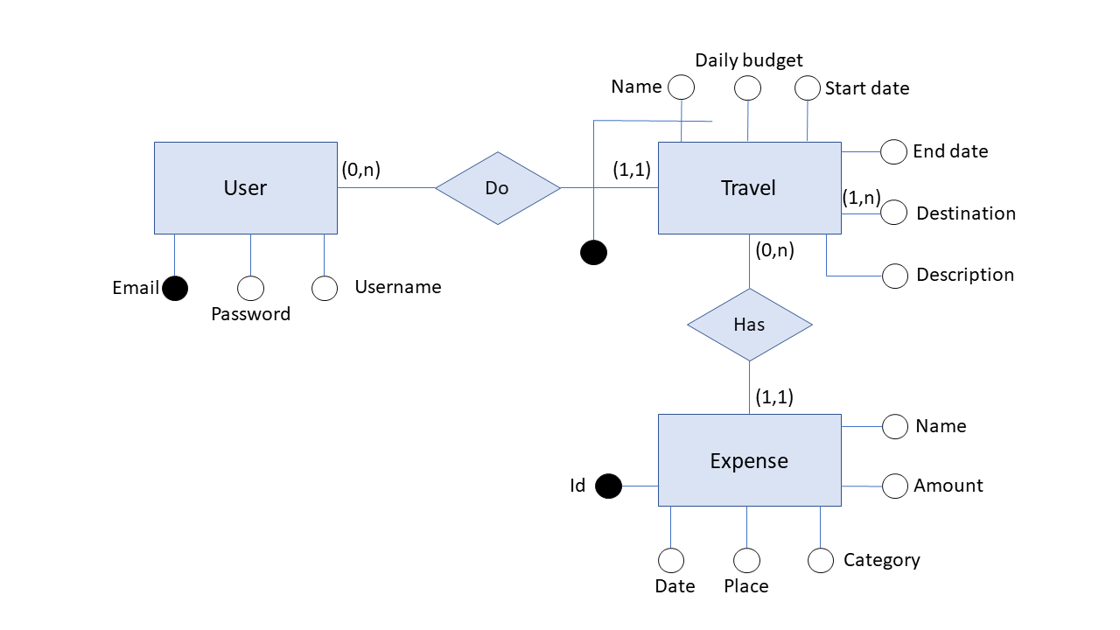
Entity-relationship diagram

Slide 12
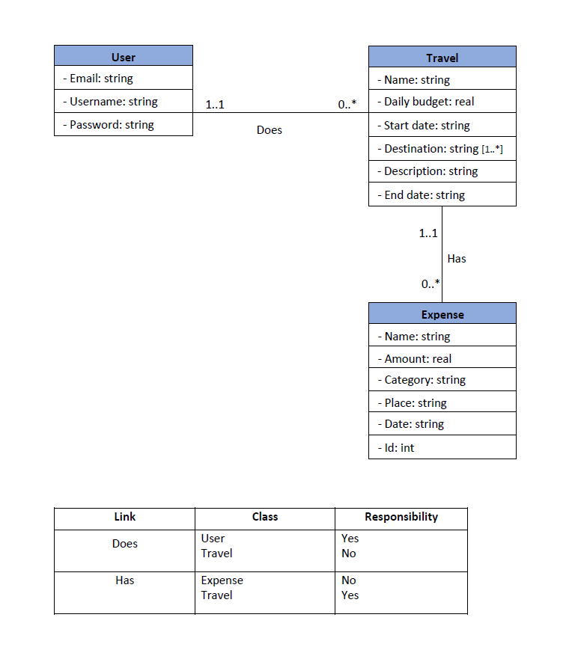
UML diagram

Slide 13
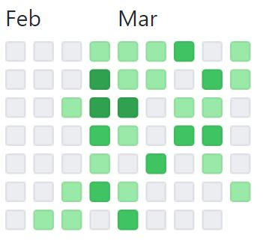
Github
During all the development process we used Github. In total, we made 244 commits

Slide 14
Technologies
Web server: Nginx
Front-End: Angular & Bootstrap
Back-End: Node.js
Database: PostgreSQL
Logging system: RabbitMQ
Containerization: Docker

Slide 15
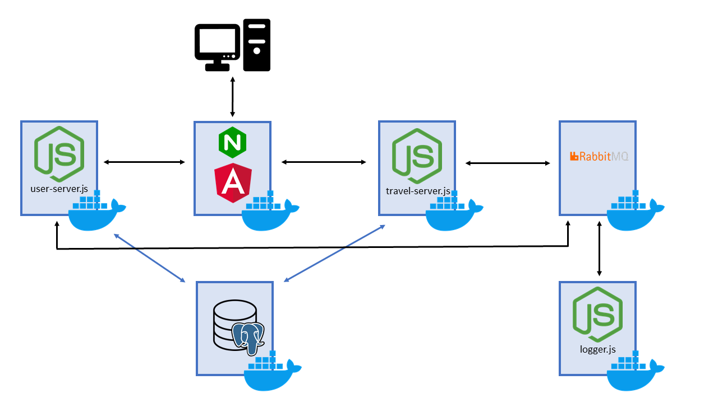
Schema

Slide 16
Services
TravelMania have 3 principal microservices:
-The users service
-The travels service
-The logger service

Slide 17
Users Service
This service is responsible for all the procedures related to the users.
Creating an account
Login
Changing the password
Retrieving the user information
Deleting an account

Slide 18
Travels Service
This service is responsible for all the procedures related to the travels.
Creating a travel
Completing a travel
Retrieving all the information of a travel
Adding an expense
Deleting an expense
Retrieving all the information of an expense
Deleting a travel

Slide 19
Logger Service
The logger service tracks all the requests done by the users and all the errors of the servers.
Both the travels service and the users service communicate with it, using rabbitmq as broker.

Slide 20
Thanks for your attention!
Visit the Github page of the project

