Slide 1










Moodies
Server.js
App.js
Logger.js

Slide 2
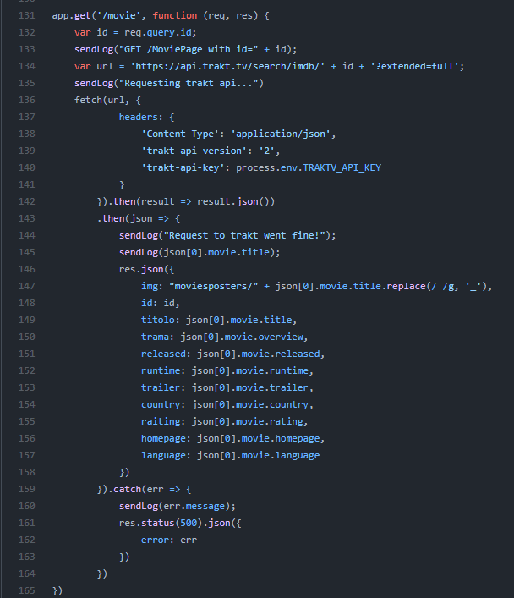
Trakt api call
c
GET https://api.trakt.tv/search/imdb/...
Process.env.TRAKT_API_KEY
JSON{}
Info sul film generato dal server salvate in res.json.

Slide 3
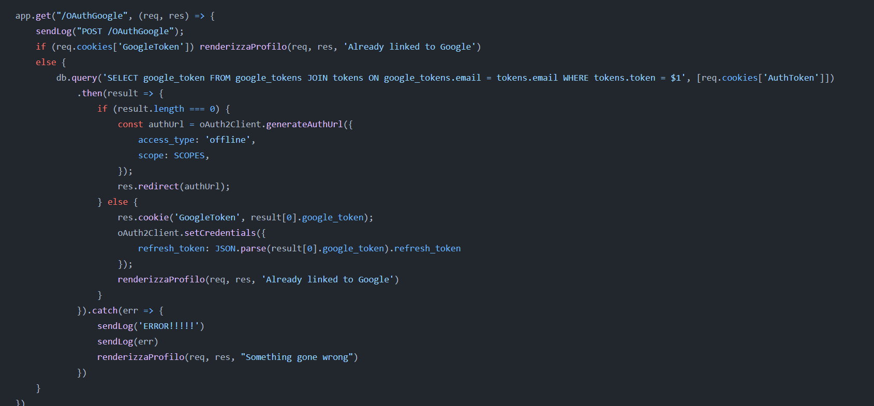
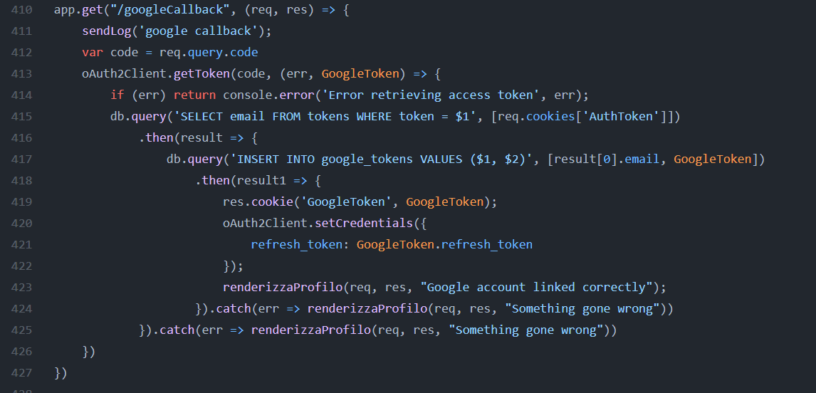
Google calendar OAuth
c

