Slide 1
Progress Meeting

Slide 2
Overview
Work Done
Refactoring, Results, QMIX/VDN
CybORG implementation
Results
Current results
Input on the results?
Future work
Reformat result section
Continue CybORG implementations

Slide 3
QMIX and VDN
Refactoring of the codebase and training of the different methods
QMIX
Not working in MPE
VDN
Simpler variant of QMIX
No mixing network – Q-Values are summed linearly
Performs as expected in MPE

Slide 4
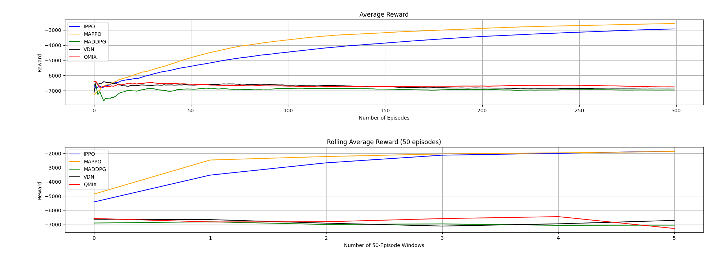
Methods - Results

Slide 5
Results – General Discussion
Implementation matters
Network implementation
Hyperparameters
Different method specific implementations
Tips and trick implemented from the state-of-the-art
Some can be model-dependent

Slide 6
PPO vs Everyone
On-Policy
Data collected from current policy
New data used at every training – Can adapt better to change in the environment
Off-Policy
Replay Buffer
Higher Sample Efficiency
(Outdated) Data from the older-policies can be used
In dynamic environments we might not capture new dynamics

Slide 7
PPO vs Everyone
On-Policy
Exploration: Stochastic Policy
Exploration of the space is inherited in such methods
Off-Policy
Exploration: eps-greedy, Gumbel-Softmax
Deterministic methods with elements of Stochasticity during exploration (eps-greedy, Gumbel-Softmax etc.)
Can be hindered by the partial observability of the environment
Can suffer (more) from state-aliasing

Slide 8
PPO vs Everyone
On-Policy
Exploration: Stochastic Policy
Overall:
Specific PPO characteristic might help in POMDP environments with large action and observation space
Off-Policy
Exploration: eps-greedy, Gumbel-Softmax

Slide 9
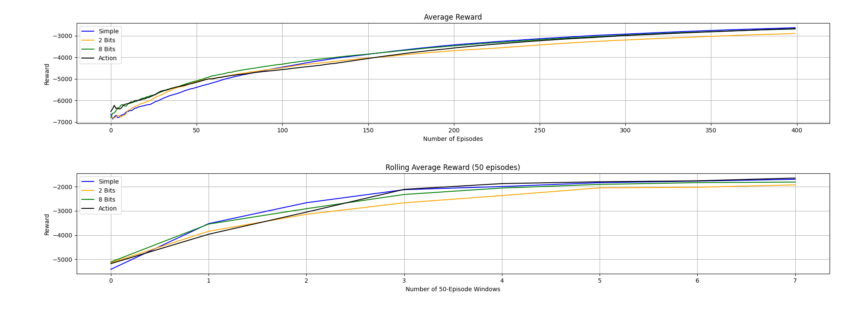
Messages – Results (IPPO)

Slide 10
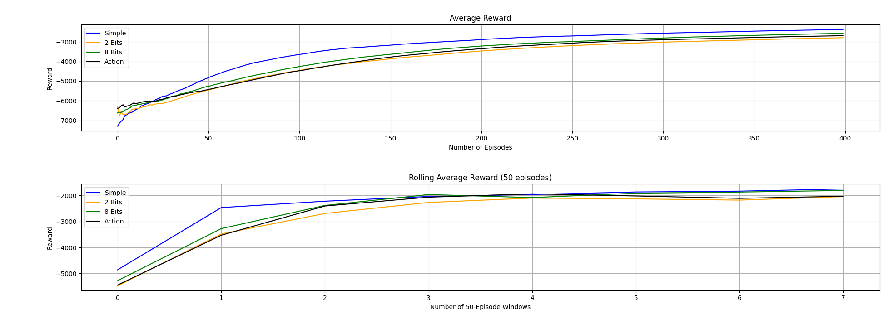
Messages – Results (MAPPO)

Slide 11
Messages - Discussion
8 Bits and Action Messages perform better than 2 Bits – Why?
More data is better
If it conveys useful information
Better results in the initial stages of training

Slide 12
Messages - Discussion
8 Bits and Action Messages perform better than 2 Bits – Why?
Messages do not improve the results of the methods – Why?
Are the message useful (in theory)?
Yes, share data on actions and on state
Independent agents may learn enough by themselves (Schroeder de Witt et al.)
Agents achieved a local-maxima
PPOs implementation employs ‘tricks’ to encourage exploration

Slide 13
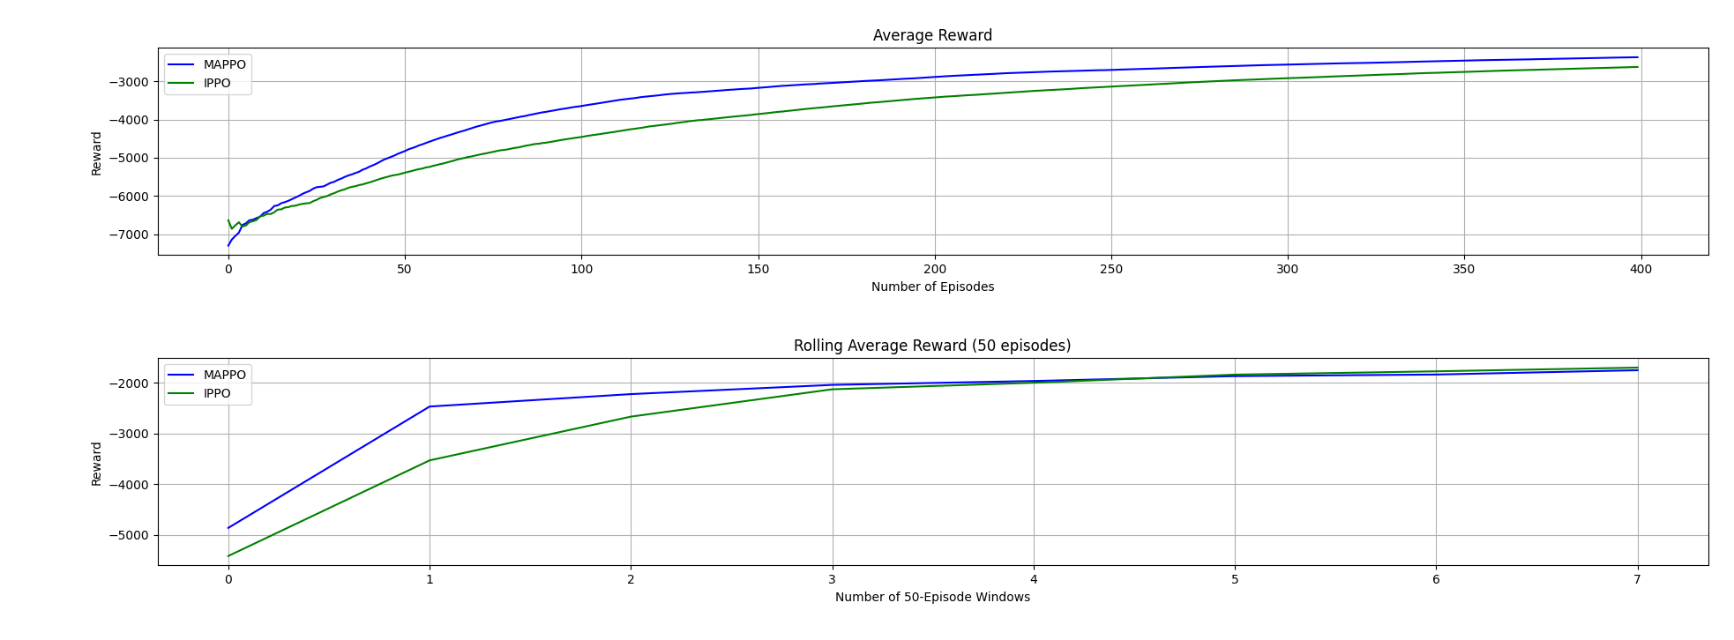
MAPPO vs IPPO - Results

Slide 14
MAPPO vs IPPO - Discussion
MAPPO: Better results in the early stages of training
Centralized learning can enhance the initial collaboration
IPPO: Similar (or better) final results (Schroeder de Witt et al, Yu et al.) – Why?
Increase in complexity of the state space
Local-maxima reached

Slide 15
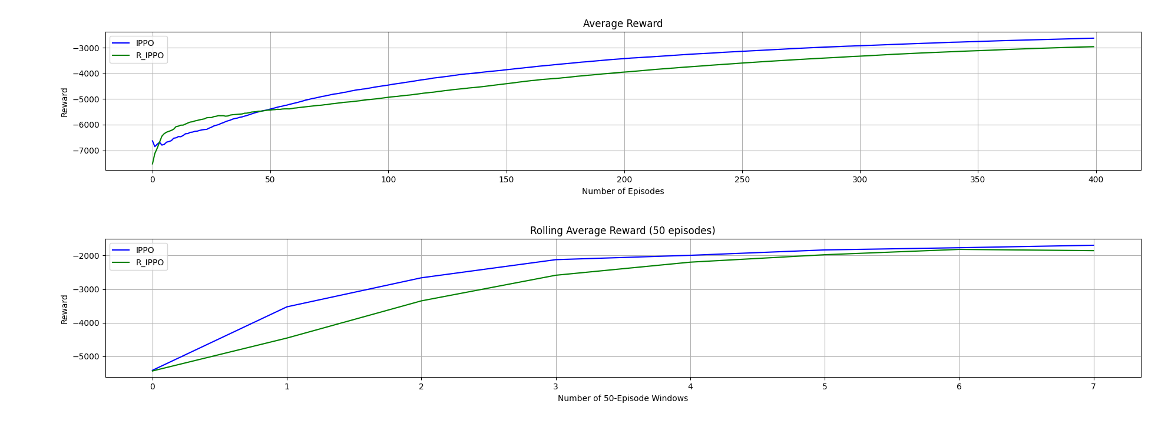
Recurrency – Results (IPPO)

Slide 16
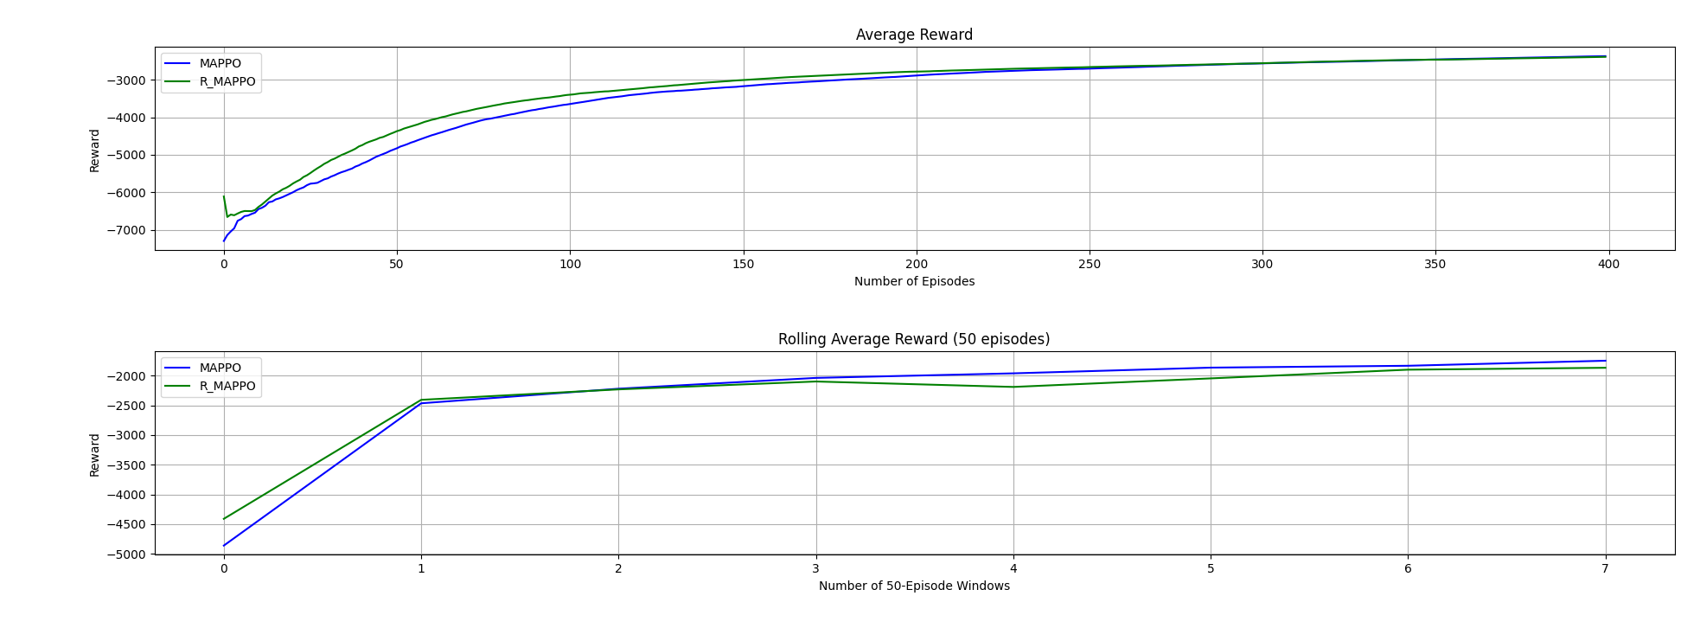
Recurrency – Results (MAPPO)

Slide 17
Recurrency - Discussion
Why Recurrent Policies do not work as well?
Ni et al. Study:
Highlights many studies that have reported poor results from recurrent policies
Gives a guideline of some implementation details that can help recurrency (most of them is implemented)
Overall: Very problem (model and method) specific
Current architecture does not work well in the problem

Slide 18
PPO – Local-Maxima
What can be done if PPO is stuck on a local-maxima?
Entropy-Regularization: Added to the loss function to improve exploration
Already implemented: Further test
Learning rate annealing: decrease the learning rate with time
Already implemented: Test with Reward-based-Annealing
Intrinsic exploration motivations
Not implemented: usually suggested with Sparse rewards
If there are a lot of space/action we risk of producing only noise

Slide 19
Results – Agent Policy
IPPO – Agent 0-3 | %
Sleep | 29-34
Analyse (2) | 13-15
Deploy Decoy (2) | 13-15
Remove (3) | 12-14
Allow Traffic Zone (1) | 12-14
Restore (5) | 9-10
Monitor (1) | 1-2
Block Traffic Zone (1) | 1-2

Slide 20
Results – Agent Policy
IPPO – Agent 4 | %
Sleep | 29-35
Analyse (2) | 14-26
Remove (3) | 10-17
Deploy Decoy (2) | 10-23
Allow Traffic Zone (1) | 9-15
Restore (5) | 5-9
Block Traffic Zone (1) | 0-2
Monitor (1) | 0-1

Slide 21
CybORG - Changes
Start with changes that can have comparable results to the baseline:
Individual rewards
Action timestep

Slide 22
CybORG – Next Changes
Start with changes that can have comparable results to the baseline:
Individual rewards
Action timestep
Add (2) agents to HQ network

Slide 23
Future Work
Finish write-up of first section of results
Extra testing on some configurations
Test first few changes to CybORG architecture
Implement Agent Changes to CybORG architecture

