Slide 1
Progress Meeting

Slide 2
Overview
Past Week
QMIX – Almost
R-MAPPO
Test: MADDPG
Future work
Finish/Test QMIX
Test Messages implementation
Code cleaning

Slide 3
QMIX
Implementation finished
Each agent has their own Network (not recurrent yet)
Mixing network:
Input: Agent Q_Values + Central State
Output: Central Q_Value
Strange results in MPE
Further testing required – Already tested with the most popular library on GitHub
Test on CybORG

Slide 4
MADDPG
Tested again with different hyperparameters
Adapted another implementation for the testing
Results:
No improvement

Slide 5
R-MAPPO
Recurrent Version of MAPPO (Centralized PPO)
Same network structure as IPPO
1 LSTM Layer + 3 Linear layers
To be tested on CybORG

Slide 6
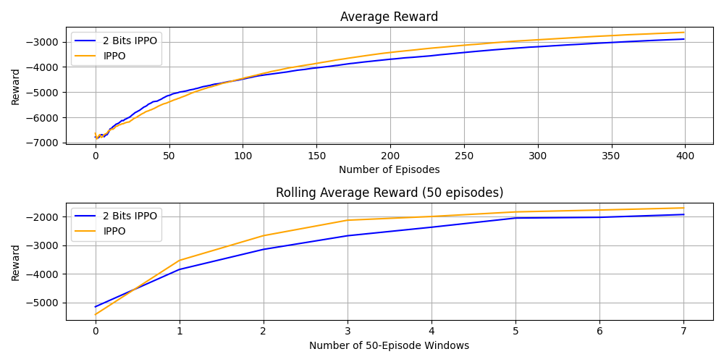
Messages

Slide 7
Next Week
Test QMIX implementation
Fix bugs if found
Test 8 Bits Messages and Action Messages
Code cleaning and refactoring

