Slide 1
Mid-Term Progress Meeting

Slide 2
Overview
What I did in the past weeks
Recurrent PPO
QMIX
The results (so far)
IPPO vs MAPPO vs R-PPO vs MADDPG
Next Few Weeks
Finish QMIX
Implement R-QMIX
Review implemented methods
Future works
Changes to CybORG and timeline discussion

Slide 3
Recurrent PPO
Rationale:
Use an LSTM layer in the Actor and Critic architecture
Initialize hidden and cell state of LSTM with 0s (Reset that at each episode)
Collect trajectories and current hidden states (use current hidden states to choose actions and critic values)
Reconstruct LSTM state during training
Positive findings:
Can help in POMDP environments
Can help in environments where actions have a temporal dependency
My Implementation:
1 LSTM Layer
3 Linear Layers

Slide 4
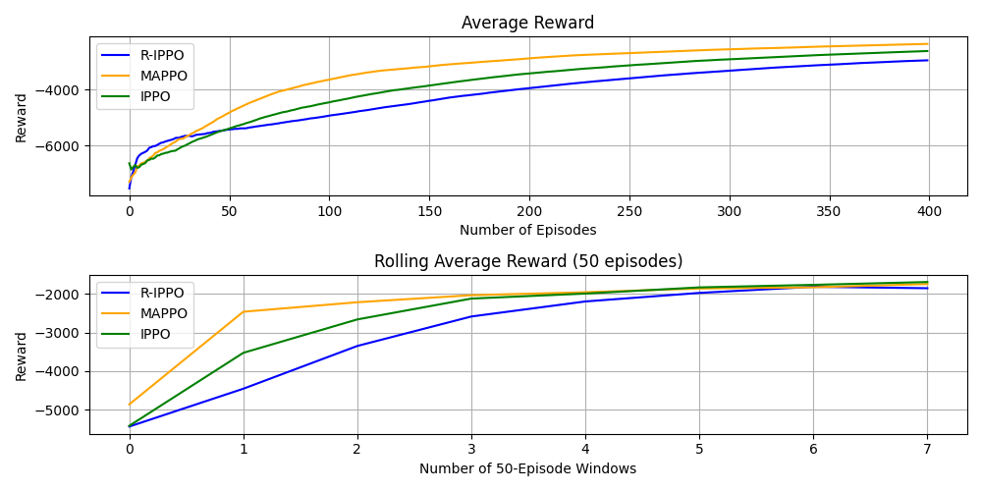
Results

Slide 5
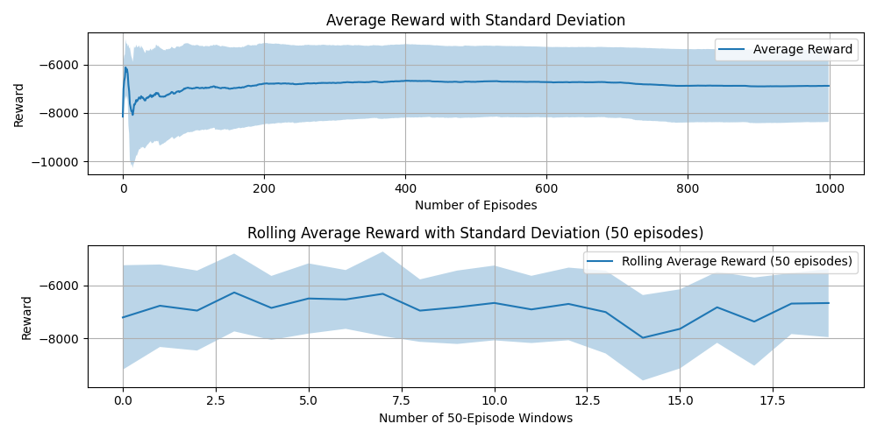
MADDPG - Results

Slide 6
Methods Implemented so Far
IPPO
R-IPPO
MAPPO
R-MAPPO
MADDPG
QMIX
R-QMIX
Best Results
1550 – 1700
Submission: IPPO

Slide 7
QMIX
Method designed specifically for Cooperative Tasks
Centralized Training with Decentralized execution
Agent Network for each agent
Mixing Network: takes individual Q_Values and state to output a centralized Q_Value
Hypernetwork: produces the weight (positive) for the network
Scalable w.r.t increase number of agents
Should promote coordination in cooperative environments
State of the Work:
Implemented – Not tested yet

Slide 8
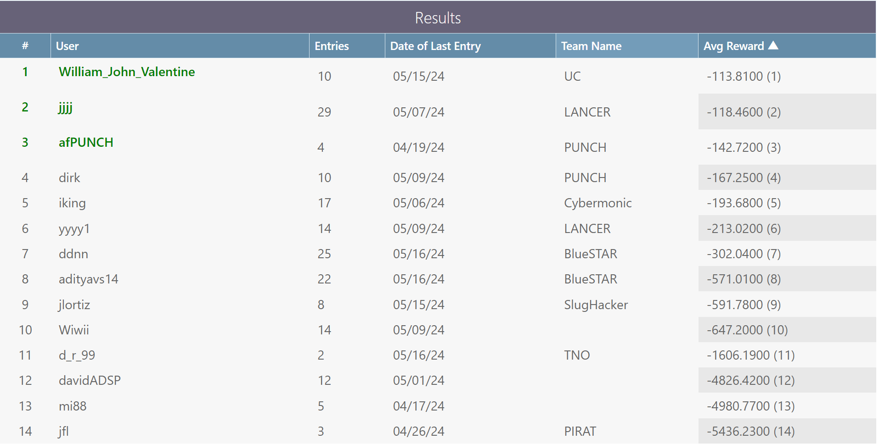
CAGE 4

Slide 9
Messages
2 Bits Messages - Initial results not positive
Continue with the testing with all the different methods
8 Bits Messages -To test
Action related messages – To test
Agents send each other their selected action
Help with non-stationarity of environment
Each action has a specific number associated to it.
E.g: Action [6] -> [0,0,0,0,0,1,1,0]

Slide 10
Immediate future work
Finish Implementation of QMIX
Implement R-QMIX
Implement Action Related Messages
What to test:
QMIX + R-QMIX
R-MAPPO
Methods + Messages

Slide 11
Future work – Part 2
Changes to CybORG
Change connectivity of the network
Reshape the reward, state and action calculation accordingly.
Implement RL based attackers
The number of attackers is variable: Would this work?
Test different agents organizations:
Multiple agents in subnetwork (HQ Network) – How can they coordinate?
Would the rewards improve or not?

Slide 12
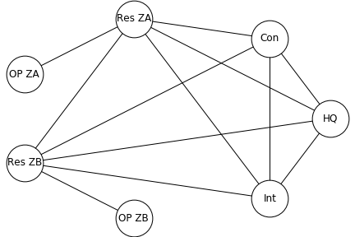
Works on the environment
Current Network Topology (when no connection is blocked)
Similar to a ‘Mesh Topology’ (each device connected to each others)
What if we change this to a ‘Star Topology’?

Slide 13
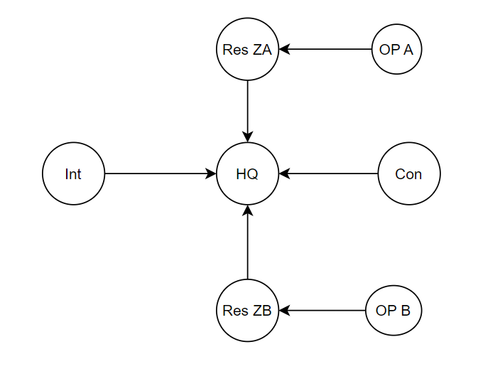
Works on the environment
Current Network Topology (when no connection is blocked)
Similar to a ‘Mesh Topology’ (each device connected to each others)
What if we change this to a ‘Star Topology’?
Puts pressure on the HQ network
Reshape reward accordingly
How do the agents action change
Combined with testing different agents organizations

Slide 14
Agents Organization
1st Change: Add more defenders in the HQ network (old and new topology)
2nd Change: Implement specialized agents per subnetwork
Now: agent is responsible for all possible actions to take in a network
After: each agent will be responsible for different actions
E.g: (Agent 1 – Monitor), (Agent 2 – Analyse), (Agent 3 – DeployDecoy) etc.

Slide 15
Research Questions
RQ1 → Related to RL Environments
RQ2 → How can collaborative RL contribute to defending the environment for the use case of Intrusion Prevention?
RQ3 → Which of the different RL methods proves the most effective for the aforementioned use case?
Environment changes
Can the same agents still defend a network with different topology?
How does the network topology influences the agents coordination and results?
Agents organization
Which methods get better/worse with a different organization?
Does the increase in number of agents improve or worsen the results?

Slide 16
Timeline
3rd June – 16th June | Finish 2nd batch RL methods
17th June – 2nd July | Write paper sections
Part 1 Finished
3rd July – 7th August | Prepare environment/agents changes
2nd Sept – 22nd Sept | Testing and report
23rd Sept – 6th Oct | Presentation and Report
7th Oct – 13th Oct | Thesis Wrap-Up
14th Oct – 30th Oct | Buffer weeks (Implement RL Attacker)

